Slide 1

Movie reviews based on IMDB Ratings
SaI TEJA aVADHOOTHA, Sushanthik reddy poreddy, Swapan Gupta chollati

Slide 2

Abstract
Most of us follow these reviews to watch movies. How accurate is IMDb to provide the reviews?
We have implemented Neural Networks using Word2Vec and Deep Learning Models. We have also run various regression models and also generated classification reports to check the accuracy.
Internet Movie Database(IMDb) is a database which accepts the inputs(reviews) from users and display them to the viewers.

Slide 3
Dataset
The dataset is taken from IEEE-dataport and that contains various reviews collected from the viewers for more than 1000 movies across different genres. It contains two files where one file deals with the genre of the film and the other deal with the reviews from the users.
https://ieee-dataport.org/open-access/imdb-movie-reviews-dataset#files
https://ieee-dataport.org/open-access/imdb-users-ratings-dataset

Slide 4
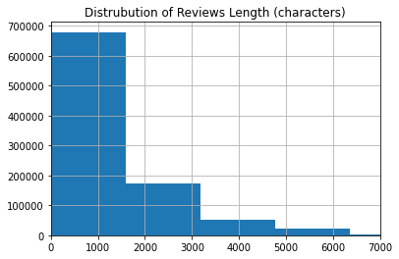
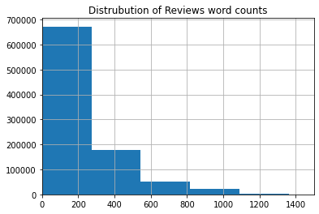
Data Visualization
The length of reviews varies in a large range - from 1 character to more than 7k characters.
We can observe that most reviews are having under 300-400 words.

Slide 5
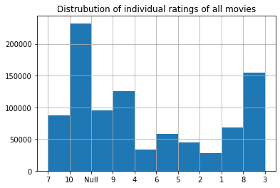
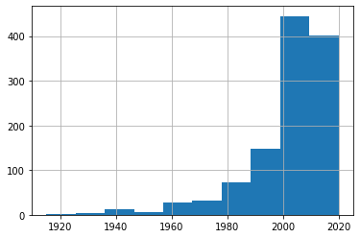
Data Visualization
Reviews with 10 star are comparatively very high. Also, reviews with less than 5 star are significantly low in number.
We can observe that the overall rating for the movies are greater than 5 which indicates the movies were received well.
Majority of the movies are released after the year 2000.
Distribution of release year of all Movies

Slide 6
Extracting and Analyzing Emojis
IMDb Dataset contains of a lot of reviews which include emojis which the reviewers use to express their feeling by a pictorial representation of action.
But for further pre-processing of the data it will not be possible for us to use these emojis so we have converted the emojis to text by installing emoji wheel.
We have also imported NLTK Tokenizer Package to find the punctuations and to remove the stopwords.
The below slide shows us a visualization of the emojis which where used more frequently.

Slide 7
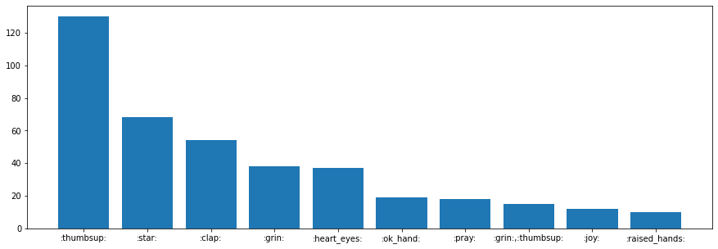
Visualization of Decoded Emojis

Slide 8
N-Gram Analysis
N-grams are used for generating sequence of words in any sentence.
A "unigram" is an n-gram of size 1, a "bigram" is a size 2 n-gram, and a "trigram" is a size 3 n-gram.
For effective approximation matching, n-grams can be employed.
A series of items can be embedded in a vector space by converting it to a collection of n-grams.

Slide 9
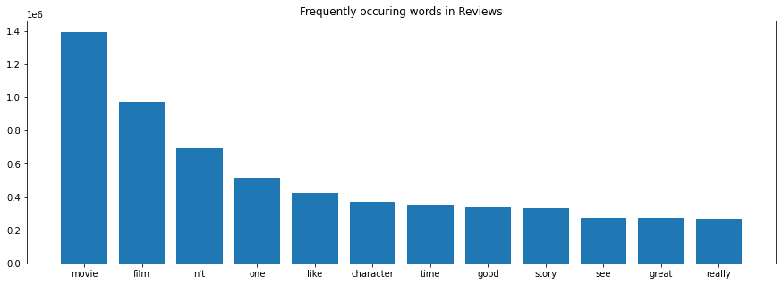
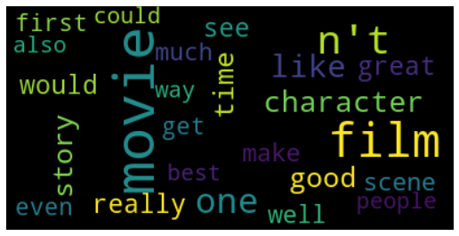
Frequently occurring words in Reviews

Slide 10
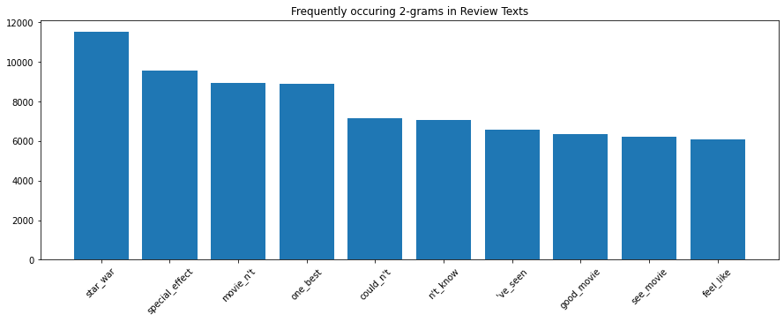
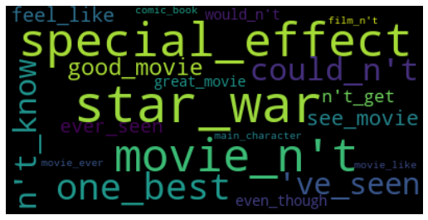
Frequently Occurring 2-grams in Reviews

Slide 11
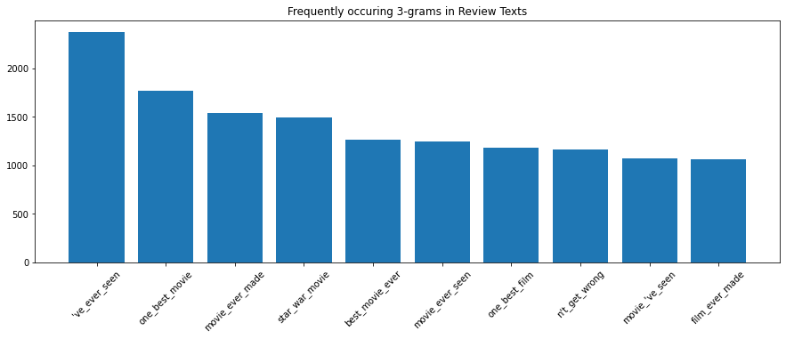
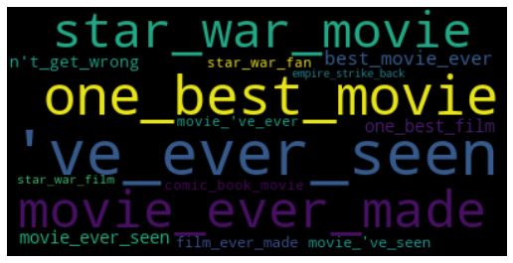
Frequently Occurring 3-grams in Reviews

Slide 12
Word Embedding using Word2Vec
Word embedding is a language modeling approach that converts words into real-number vectors.
Word2Vec is a collection of word embedding models which has one input layer, one output layer and one hidden layer making up two-layer neural network.
It has two Architectures:
1.CBOW(Continuous Bag of Words)
2.Skip Gram

Slide 13
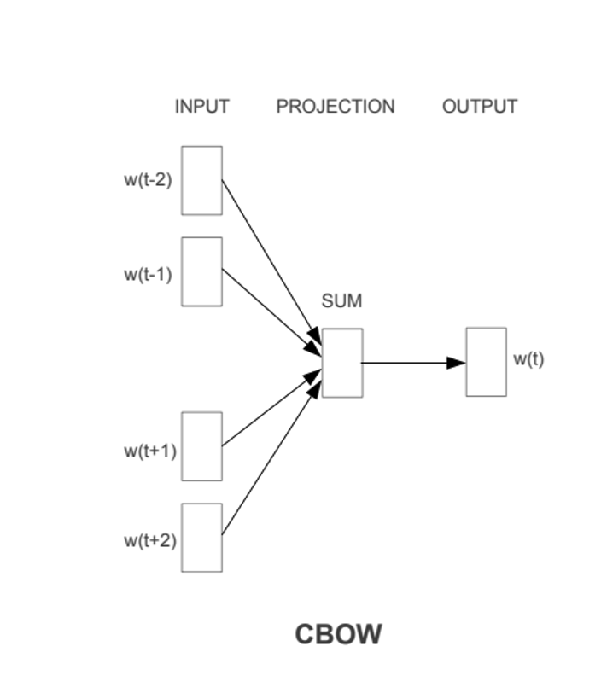
CBOW(Continuous Bag of Words)
The CBOW model attempts to analyze the context of the words and uses that data as input.
This model then tries to generate contextually correct terms.
For a given sentence of words this model converts the sentence into pairs of words based on the window size.
The model uses these word pairings to try to predict the target word based on the context words.

Slide 14
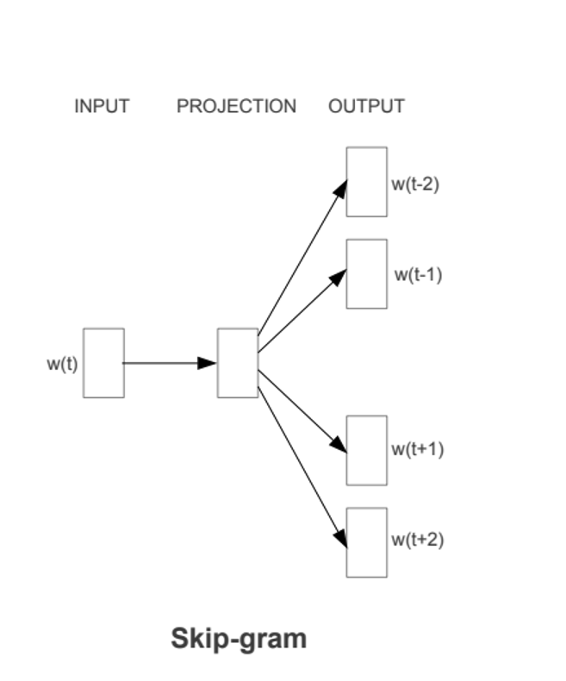
Skip Gram
Skip Gram is the reverse of the CBOW Algorithm, where Target is the input and the context words are the output.
To obtain word embedding for target and context words, input is transmitted to a separate embedding layer.
Then these two layers are passed to a dense layer which predicts if a combination of words is contextually relevant by predicting 1 or 0.

Slide 15
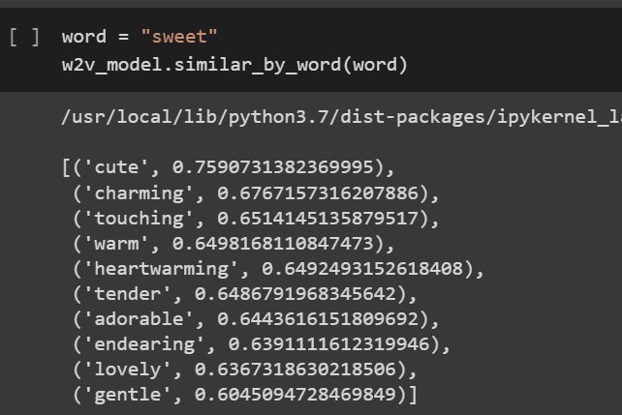
Predicted Outputs using Word2Vec
We can observe that based on the given input of word “sweet”, the model has predicted a sequence of contextual words.

Slide 16
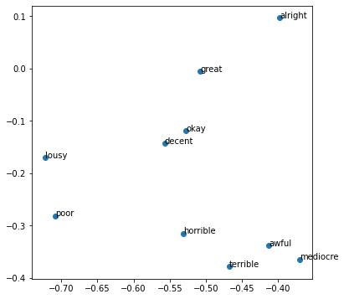
Plotting the similar word vectors
For a given input of the words “good” and “bad” from the data set the model has predicted the relative outcomes.
We can observe that the positive sentiments are lying in the greater half of the graph where the negative sentiments are lying in the lower.

Slide 17
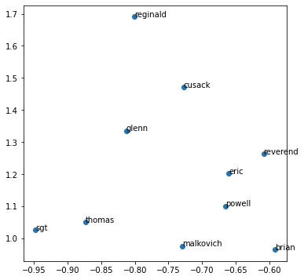
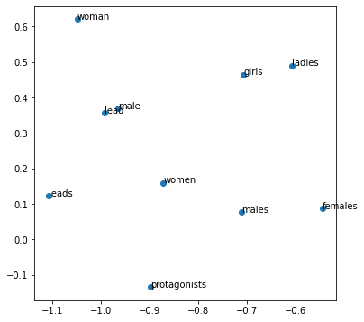
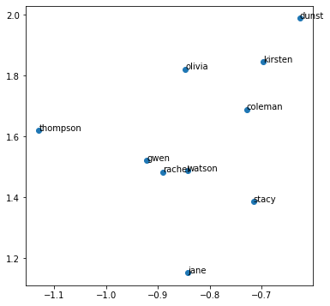
Few More Examples of Similar Word Vectors
For the Inputs ‘john’,’william’
For the Inputs ‘men’,’female’
For the Inputs ‘mary’,’emma’

Slide 18
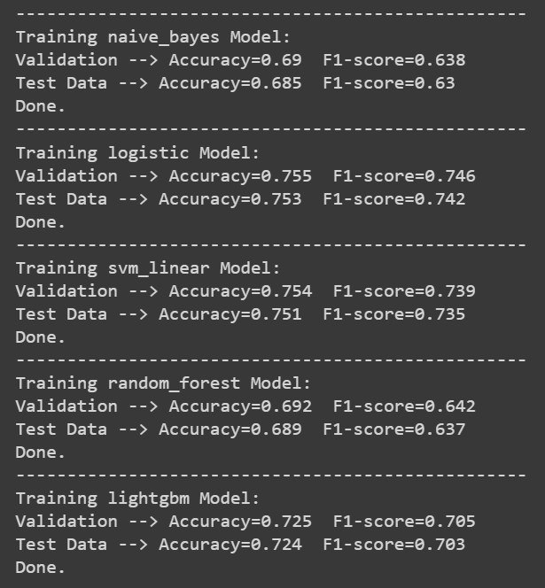
Classification Models
We have performed different classification models like Naive Bayes, Logistic Regression, SVM Linear, Random Forest Classifier, Boosting Classifier.
The results obtained after performing those models are as follows:
We can observe that logistic model is the best model with an accuracy of 0.755 and F1-score of 0.746.

Slide 19
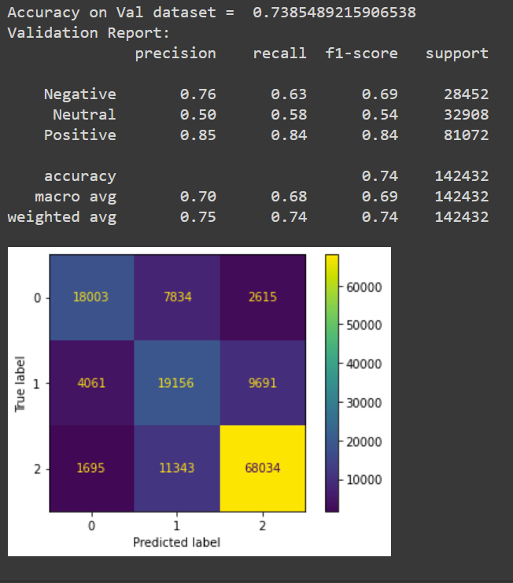
Results: Validation Report and Confusion Matrix

Slide 20
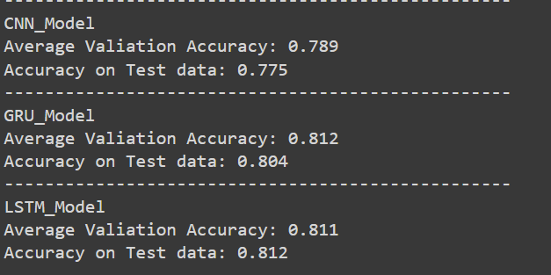
Deep Learning Neural Networks
We have trained the model using different Deep Learning Neural Networks and obtained the results as follows
We can consider LSTM as the best model with an accuracy of 81%

Slide 21
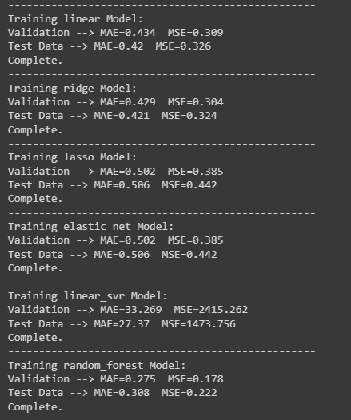
Regressions
We have performed different regressions like KNN, Linear Regression, Ridge, Lasso, Elastic Net, Linear SVR, Random Forest, Gradient Boosting .
The results obtained after performing these regressions is as follows:
We can observe that Random Forest Regressor is the model with best MAE
We have achieved a K-fold R2 Score of 0.49.

Slide 22
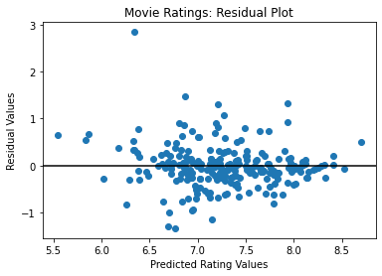
Residual Plot

Slide 23
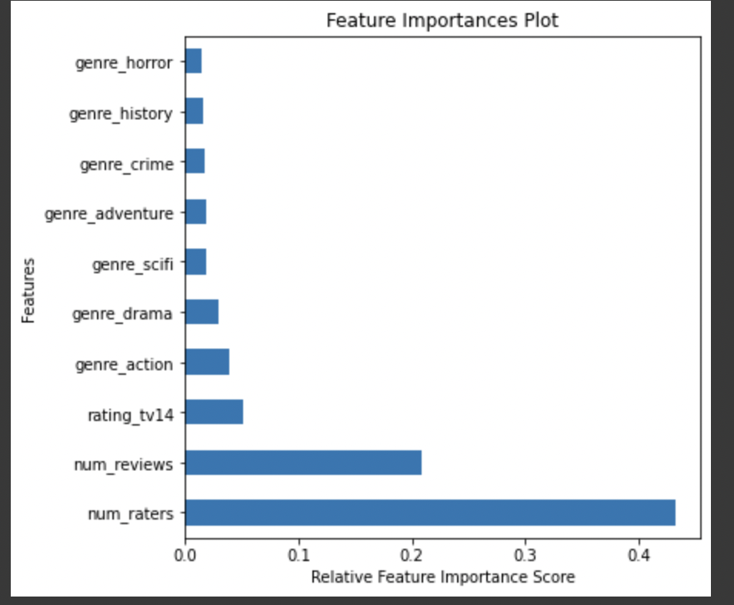
Most Important Feature

Slide 24
Future Scope
Need to identify Fake Reviewers who will score a movie at a highest rating to achieve better accuracy.
If possible, we will try treating the outliers.
Detecting the outliers and treating those to improve the accuracy of the model.

