Slide 1

COMPANY NAME
VulSen Analytics Report
Prepared for HP • July 08, 2026 • 4 item(s) included

Slide 2
Contents
01 Vulnerability 2026-07-08 07:17
02 Secondary Modifier 2026-07-08 07:17
03 Vulnerability 2026-07-08 07:25
04 Secondary Modifier 2026-07-08 07:25
VulSen Analytics · 2

Slide 3

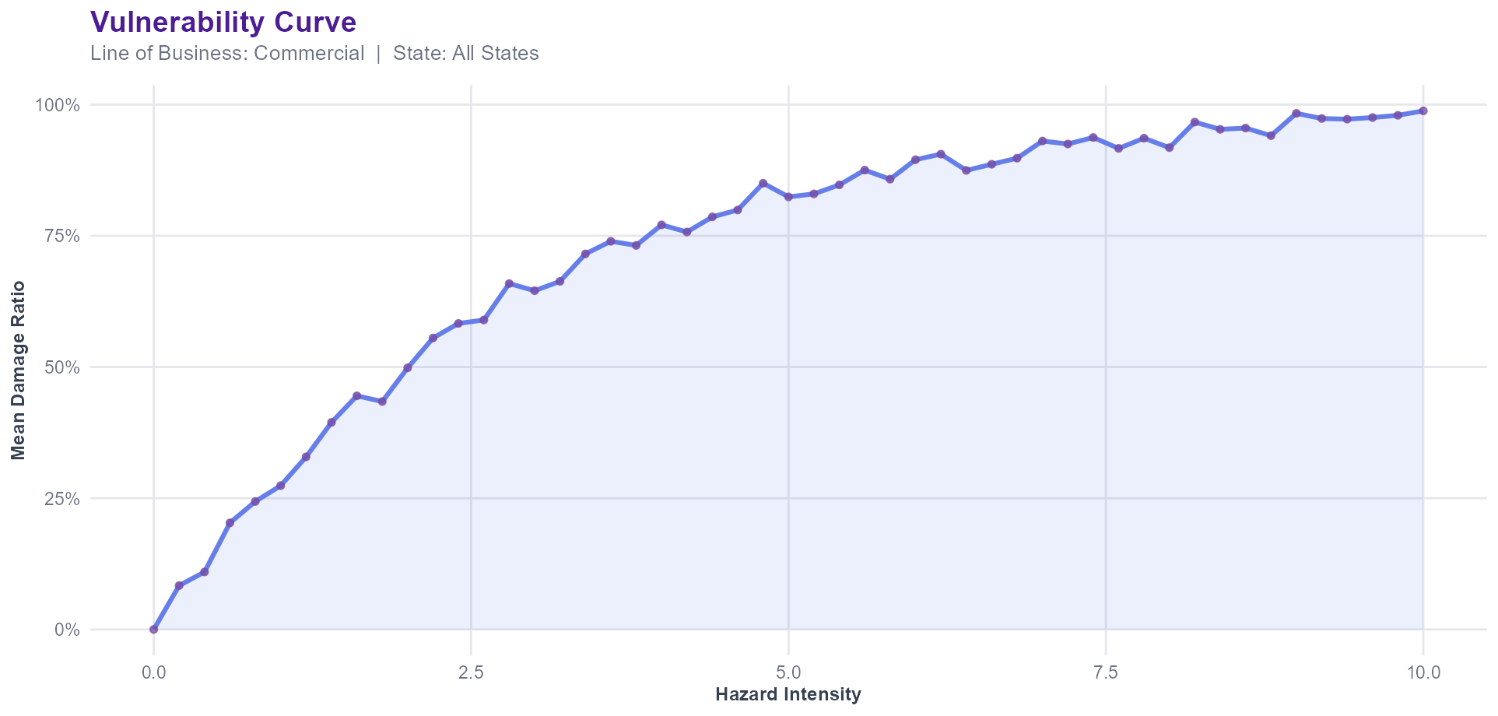
Vulnerability — Visualization ❘ 01/04
VulSen Analytics · 3

Slide 4
Vulnerability — Commentary ❘ 01/04
▸ The vulnerability curve rises steeply through low-to-moderate hazard intensities and levels off near 98.8% damage ratio at the highest intensities modelled. The fastest rate of damage accumulation occurs around an intensity of 0.4, which marks the critical threshold for this scope (Line of Business: Commercial, State: All States). Exposure concentrated near or beyond this threshold is most sensitive to further increases in hazard severity, and may warrant closer review of mitigation credits or deductible structure.
VulSen Analytics · 4

Slide 5
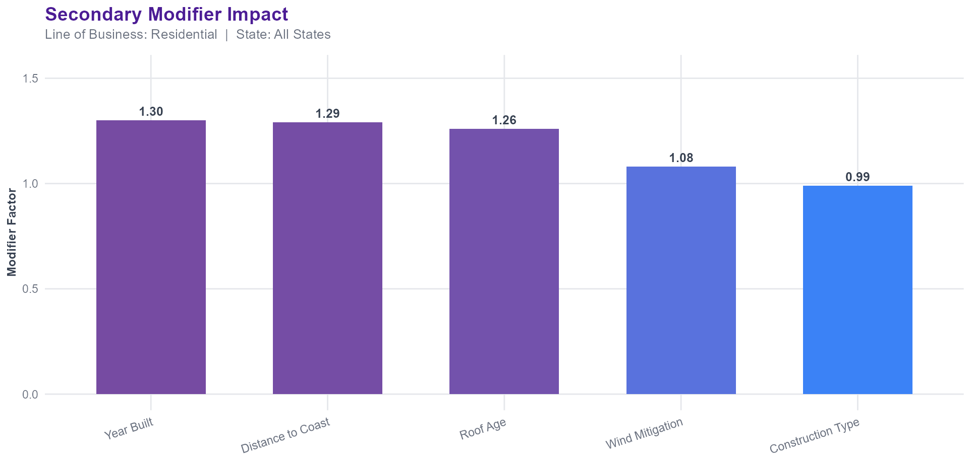
Secondary Modifier — Visualization ❘ 02/04
VulSen Analytics · 5

Slide 6
Secondary Modifier — Commentary ❘ 02/04
▸ Among the secondary modifiers reviewed, 'Year Built' applies the largest adjustment at a factor of 1.30, while 'Construction Type' contributes the smallest at 0.99. This spread (Line of Business: Residential, State: All States) suggests underwriting and rating decisions are most sensitive to 'Year Built', and refinements to that characteristic's capture or validation are likely to have the greatest impact on rate accuracy.
VulSen Analytics · 6

Slide 7

Vulnerability — Visualization ❘ 03/04
VulSen Analytics · 7

Slide 8
Vulnerability — Commentary ❘ 03/04
▸ The vulnerability curve rises steeply through low-to-moderate hazard intensities and levels off near 100% damage ratio at the highest intensities modelled. The fastest rate of damage accumulation occurs around an intensity of 0.2, which marks the critical threshold for this scope (Line of Business: Residential, State: All States). Exposure concentrated near or beyond this threshold is most sensitive to further increases in hazard severity, and may warrant closer review of mitigation credits or deductible structure.
VulSen Analytics · 8

Slide 9
Secondary Modifier — Visualization ❘ 04/04
VulSen Analytics · 9

Slide 10
Secondary Modifier — Commentary ❘ 04/04
▸ Among the secondary modifiers reviewed, 'Year Built' applies the largest adjustment at a factor of 1.30, while 'Construction Type' contributes the smallest at 0.99. This spread (Line of Business: Residential, State: All States) suggests underwriting and rating decisions are most sensitive to 'Year Built', and refinements to that characteristic's capture or validation are likely to have the greatest impact on rate accuracy.
VulSen Analytics · 10

