Slide 1
AWS

Slide 2
Table of Contents
Getting Star ted with AWS
AWS Identity & Access Management (AWS IAM)
Amazon EC2 – Basics
High Availability & Scalability
RDS, Aurora & ElastiCache
Amazon Route 53
Classic Solutions Architecture
Amazon S3

Slide 3
What’s AWS?
AWS (Amazon Web Services) is a Cloud Provider
They provide you with servers and services that you can use on demand and scale easily
AWS has revolutionized IT over time
AWS powers some of the biggest websites in the world
Amazon.com
Netflix

Slide 4




AWS Cloud History
2002:
Internally launched
2004:
Launched publicly with SQS
2007:
Launched in Europe
2003:
Amazon infrastructure is one of their core strength.
Idea to market
2006:
Re-launched
publicly with SQS, S3 & EC2

Slide 5



AWS Cloud Use Cases
AWS enables you to build sophisticated, scalable applications
Applicable to a diverse set of industries
Use cases include
Enterprise IT, Backup & Storage, Big Data analytics
Website hosting, Mobile & Social Apps
Gaming

Slide 6
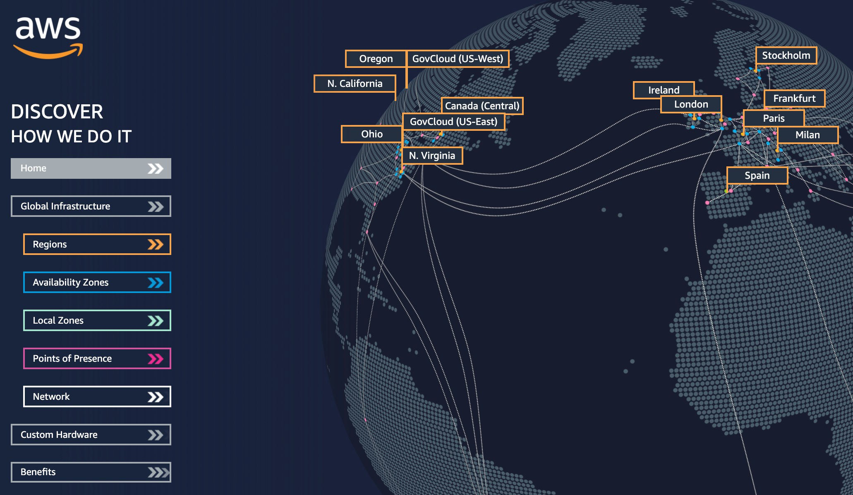
AWS Global Infrastructure
AWS Regions
AWS Availability Zones
AWS Data Centers
AWS Edge Locations / Points of Presence
https://infrastructure.aws/

Slide 7
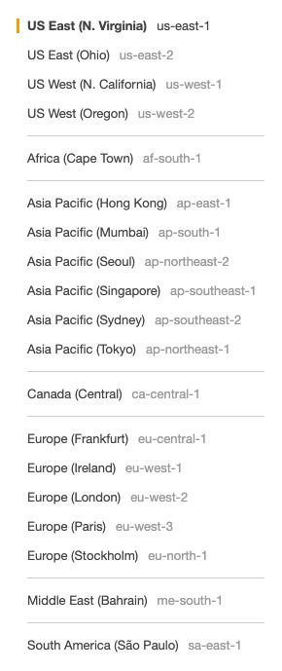
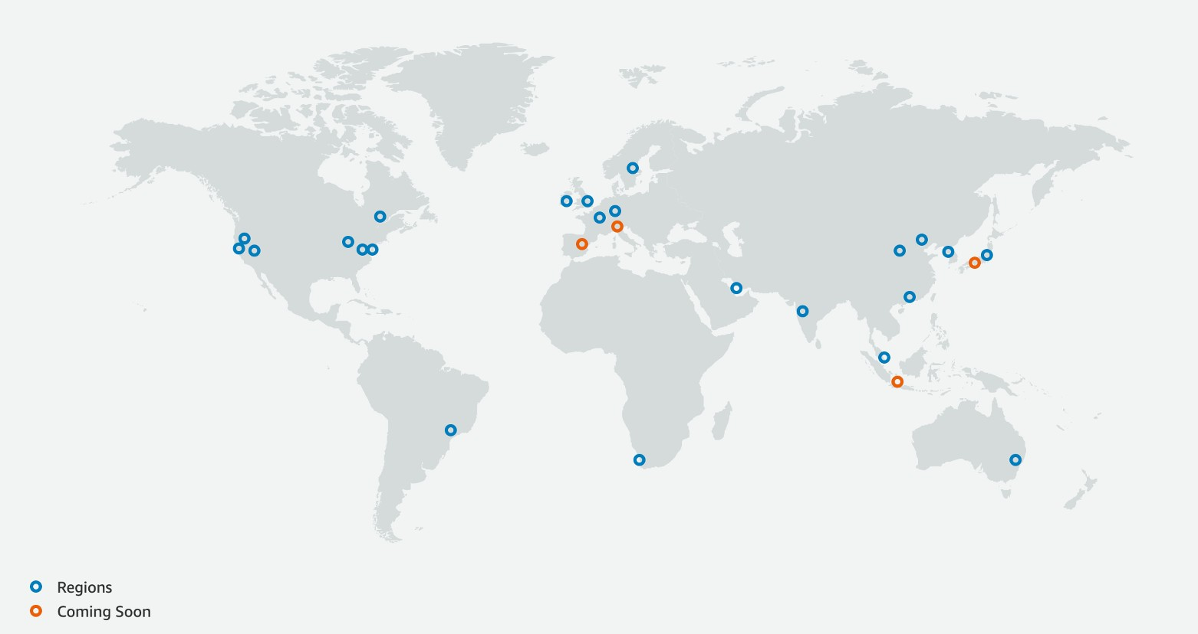
AWS Regions
AWS has Regions all around the world
Names can be us-east-1, eu-west-3…
A region is a cluster of data centers
Most AWS services are region-scoped
https://aws.amazon.com/about-aws/global-infrastructure/

Slide 8
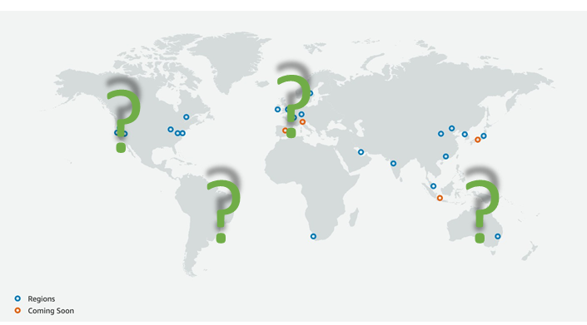
How to choose an AWS Region?
Compliance with data governance and legal requirements: data never leaves a region without your explicit permission
Proximity to customers: reduced latency
Available services within a Region: new services and new features aren’t available in every Region
Pricing: pricing varies region to region and is transparent in the service pricing page
If you need to launch a new application, where should you do it?

Slide 9
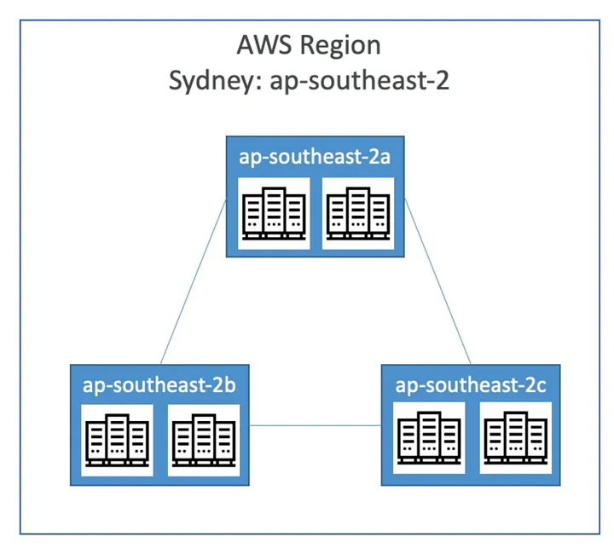
AWS Availability Zones
Each region has many availability zones (usually 3, min is 3, max is 6). Example:
ap-southeast-2a
ap-southeast-2b
ap-southeast-2c
Each availability zone (AZ) is one or more discrete data centers with redundant power, networking, and connectivity
They’re separate from each other, so that they’re isolated from disasters
They’re connected with high bandwidth, ultra-low latency networking

Slide 10
AWS Identity and Access Management (AWS IAM)

Slide 11







IAM: Users & Groups
IAM = Identity and Access Management, Global service
Root account created by default, shouldn’t be used or shared
Users are people within your organization, and can be grouped
Groups only contain users, not other groups
Users don’t have to belong to a group, and user can belong to multiple groups
Group: Developers
Group: Operations
Group Audit Team
Alice
Bob
Charles
David
Edward
Fred

Slide 12
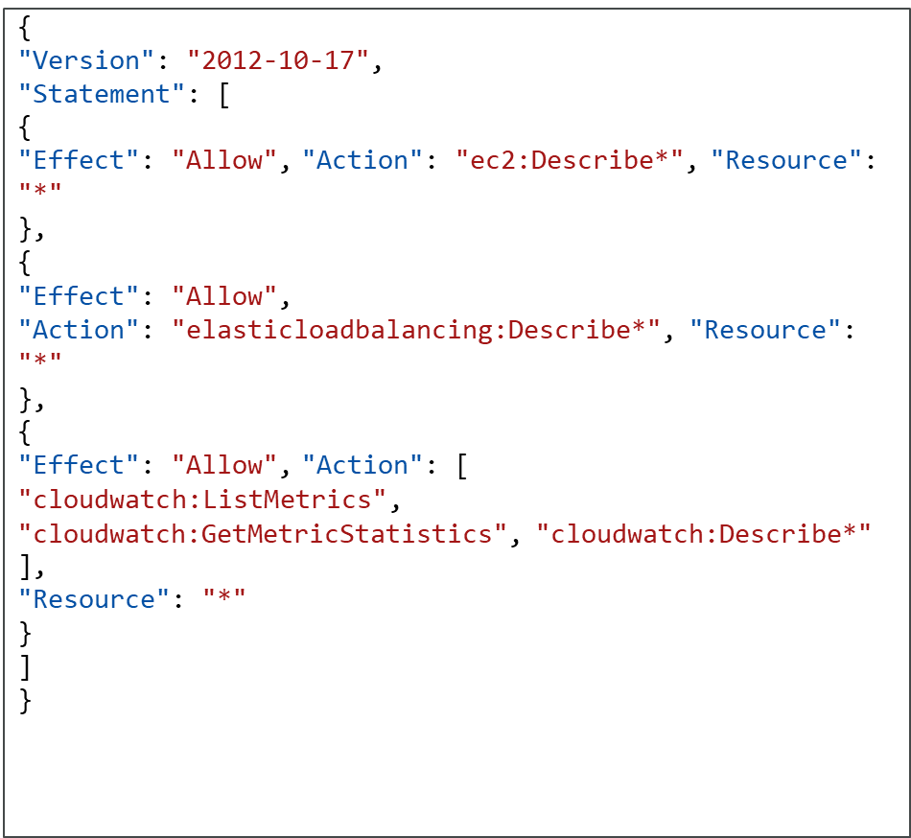
IAM: Permissions
Users or Groups can be assigned JSON documents called policies
These policies define the
permissions of the users
In AWS you apply the least privilege principle: don’t give more permissions than a user needs

Slide 13
IAM – Password Policy
Strong passwords = higher security for your account
In AWS, you can setup a password policy:
Set a minimum password length
Require specific character types:
including uppercase letters
lowercase letters
numbers
non-alphanumeric characters
Allow all IAM users to change their own passwords
Require users to change their password after some time (password expiration)
Prevent password re-use

Slide 14

Multi Factor Authentication - MFA
Users have access to your account and can possibly change configurations or delete resources in your AWS account
You want to protect your Root Accounts and IAM users
MFA = password you know + security device you own
Main benefit of MFA:
if a password is stolen or hacked, the account is not compromised
alice

Slide 15
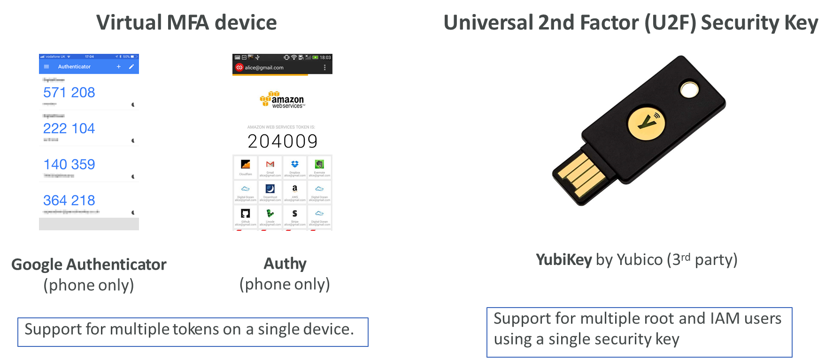
MFA devices options in AWS

Slide 16


MFA devices options in AWS
NOT FOR DISTRIBUTION © Stephane Maarek www.datacumulus.com
Hardware Key Fob MFA Device
Hardware Key Fob MFA Device for AWS GovCloud (US)
Provided by Gemalto (3rd party)
Provided by SurePassID (3rd party)
© Stephane Maarek

Slide 17

How can users access AWS ?
To access AWS, you have three options:
AWS Management Console (protected by password + MFA)
AWS Command Line Interface (CLI): protected by access keys
AWS Software Developer Kit (SDK) - for code: protected by access keys
Access Keys are generated through the AWS Console
Users manage their own access keys
Access Keys are secret, just like a password. Don’t share them
Access Key ID ~= username
Secret Access Key ~= password

Slide 18
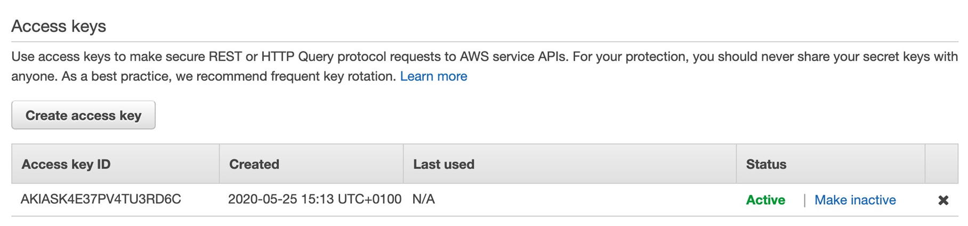
Example (Fake) Access Keys
Access key ID: AKIASK4E37PV4983d6C
Secret Access Key: AZPN3zojWozWCndIjhB0Unh8239a1bzbzO5fqqkZq
Remember : don’t share your access keys

Slide 19
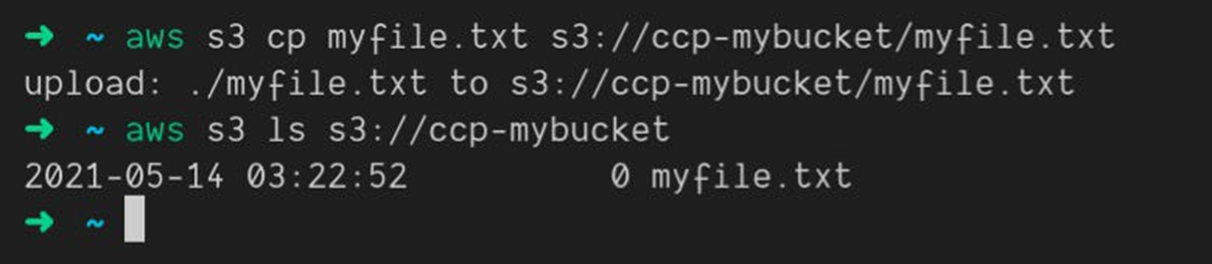
What’s the AWS CLI?
A tool that enables you to interact with AWS services using commands in your command-line shell
Direct access to the public APIs of AWS services
You can develop scripts to manage your resources
It’s open-source https://github.com/aws/aws-cli
Alternative to using AWS Management Console

Slide 20



What’s the AWS SDK?
AWS Software Development Kit (AWS SDK)
Language-specific APIs (set of libraries)
Enables you to access and manage AWS services programmatically
Embedded within your application
Supports
SDKs (JavaScript, Python, PHP, .NET, Ruby, Java, Go, Node.js, C++)
Mobile SDKs (Android, iOS, …)
IoT Device SDKs (Embedded C, Arduino, …)
Example: AWS CLI is built on AWS SDK for Python
AWS SDK
Your Application

Slide 21



IAM Roles for Services
IAM Role
EC2 Instance (virtual server)
Some AWS service will need to perform actions on your behalf
To do so, we will assign permissions to AWS services with IAM Roles
Common roles:
EC2 Instance Roles
Lambda Function Roles
Roles for CloudFormation
Access AWS

Slide 22
IAM Security Tools
IAM Credentials Report (account-level)
a report that lists all your account's users and the status of their various credentials
IAM Access Advisor (user-level)
Access advisor shows the service permissions granted to a user and when those services were last accessed.
You can use this information to revise your policies.

Slide 23
IAM Guidelines & Best Practices
Don’t use the root account except for AWS account setup
One physical user = One AWS user
Assign users to groups and assign permissions to groups
Create a strong password policy
Use and enforce the use of Multi Factor Authentication (MFA)
Create and use Roles for giving permissions to AWS services
Use Access Keys for Programmatic Access (CLI / SDK)
Audit permissions of your account using IAM Credentials Report & IAM Access Advisor
Never share IAM user s & Access Keys

Slide 24
Amazon EC2 – Basics

Slide 25

Amazon EC2
EC2 is one of the most popular of AWS’ offering
EC2 = Elastic Compute Cloud = Infrastructure as a Service
It mainly consists in the capability of :
Renting virtual machines (EC2)
Storing data on virtual drives (EBS)
Distributing load across machines (ELB)
Scaling the services using an auto-scaling group (ASG)
Knowing EC2 is fundamental to understand how the Cloud works

Slide 26
EC2 sizing & configuration options
Operating System (OS): Linux, Windows or Mac OS
How much compute power & cores (CPU)
How much random-access memory (RAM)
How much storage space:
Network-attached (EBS & EFS)
hardware (EC2 Instance Store)
Network card: speed of the card, Public IP address
Firewall rules: security group
Bootstrap script (configure at first launch): EC2 User Data

Slide 27
EC2 User Data
It is possible to bootstrap our instances using an EC2 User data script.
bootstrapping means launching commands when a machine starts
That script is only run once at the instance first start
EC2 user data is used to automate boot tasks such as:
Installing updates
Installing software
Downloading common files from the internet
Anything you can think of
The EC2 User Data Script runs with the root user

Slide 28
Hands-On: Launching an EC2 Instance running Linux
We’ll be launching our first virtual server using the AWS Console
We’ll get a first high-level approach to the various parameters
We’ll see that our web server is launched using EC2 user data
We’ll learn how to start / stop / terminate our instance.

Slide 29
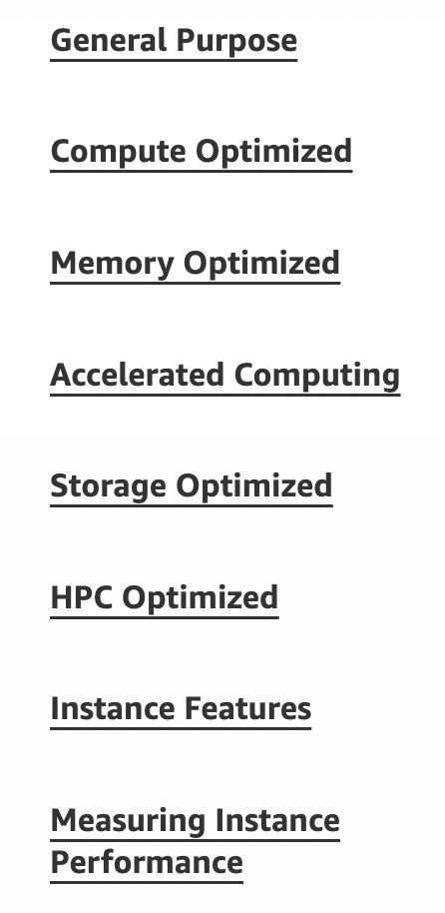
EC2 Instance Types - Overview
You can use different types of EC2 instances that are optimised for different use cases (https://aws.amazon.com/ec2/instance-types/)
AWS has the following naming convention:
m5.2xlarge
m: instance class
5: generation (AWS improves them over time)
2xlarge: size within the instance class

Slide 30
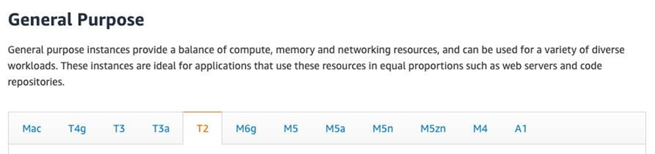
EC2 Instance Types – General Purpose
Great for a diversity of workloads such as web servers or code repositories
Balance between:
Compute
Memory
Networking
In the course, we will be using the t2.micro which is a General Purpose EC2 instance

Slide 31
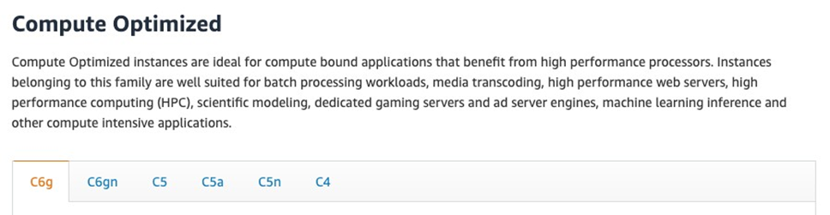
EC2 Instance Types – Compute Optimized
Great for compute-intensive tasks that require high performance processors:
Batch processing workloads
Media transcoding
High performance web servers
High performance computing (HPC)
Scientific modeling & machine learning
Dedicated gaming servers

Slide 32
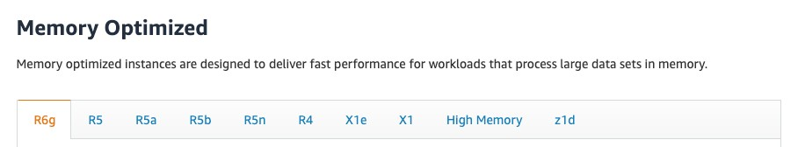
EC2 Instance Types – Memory Optimized
Fast performance for workloads that process large data sets in memory
Use cases:
High performance, relational/non-relational databases
Distributed web scale cache stores
In-memory databases optimized for BI (business intelligence)
Applications performing real-time processing of big unstructured data

Slide 33
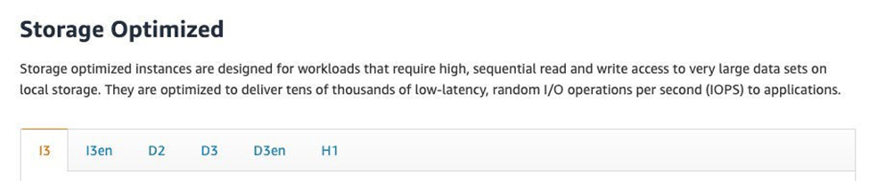
EC2 Instance Types – Storage Optimized
Great for storage-intensive tasks that require high, sequential read and write access to large data sets on local storage
Use cases:
High frequency online transaction processing (OLTP) systems
Relational & NoSQL databases
Cache for in-memory databases (for example, Redis)
Data warehousing applications
Distributed file systems

Slide 34
EC2 Instance Types: example

Slide 35

Introduction to Security Groups
Security Groups are the fundamental of network security in AWS
They control how traffic is allowed into or out of our EC2 Instances.
Security groups only contain rules
Security groups rules can reference by IP or by security group
Inbound traffic Outbound traffic
Security Group
WWW
EC2 Instance

Slide 36
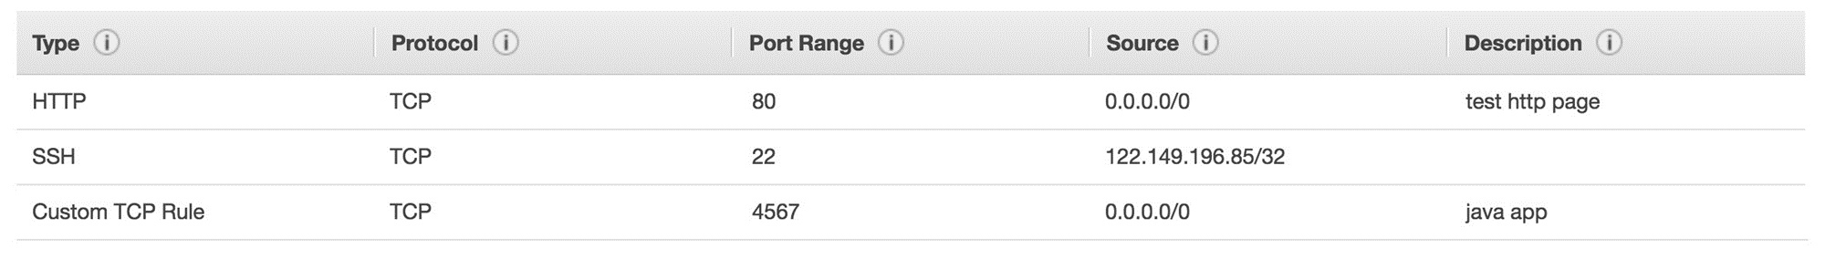
Security Groups Deep Dive
Security groups are acting as a “firewall” on EC2 instances
They regulate:
Access to Ports
Authorised IP ranges – IPv4 and IPv6
Control of inbound network (from other to the instance)
Control of outbound network (from the instance to other)

Slide 37
Security Groups Diagram
Your Computer - IP XX.XX.XX.XX (authorised port 22)
Security Group 1 Inbound
Filter IP / Port with Rules
Port 22
Port 22
Other computer (not authorised port 22)
EC2 Instance IP XX.XX.XX.XX
Security Group 1 Outbound
Filter IP / Port with Rules
WWW
Any IP – Any Port
Any Port

Slide 38
Security Groups Good to know
Can be attached to multiple instances
Locked down to a region / VPC combination
Does live “outside” the EC2 – if traffic is blocked the EC2 instance won’t see it
It’s good to maintain one separate security group for SSH access
If your application is not accessible (time out), then it’s a security group issue
If your application gives a “connection refused“ error, then it’s an application error or it’s not launched
All inbound traffic is blocked by default
All outbound traffic is authorised by default

Slide 39
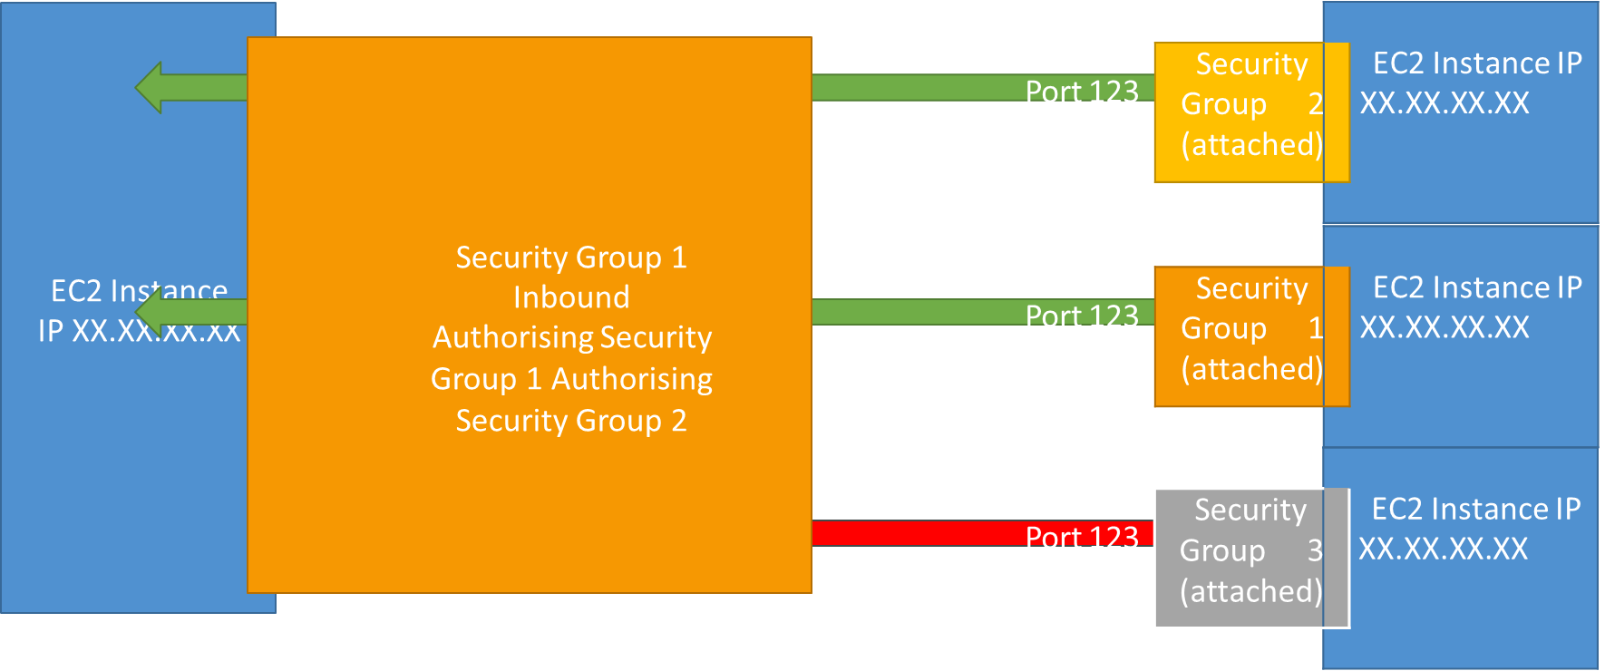
Referencing other security groups Diagram

Slide 40
Classic Ports to know
22 = SSH (Secure Shell) - log into a Linux instance
21 = FTP (File Transfer Protocol) – upload files into a file share
22 = SFTP (Secure File Transfer Protocol) – upload files using SSH
80 = HTTP – access unsecured websites
443 = HTTPS – access secured websites
3389 = RDP (Remote Desktop Protocol) – log into a Windows instance

Slide 41
High Availability & Scalability

Slide 42
Scalability & High Availability
Scalability means that an application / system can handle greater loads by adapting.
There are two kinds of scalability:
Vertical Scalability
Horizontal Scalability (= elasticity)
Scalability is linked but different to High Availability
Let’s deep dive into the distinction, using a call center as an example

Slide 43

Vertical Scalability
Vertically scalability means increasing the size of the instance
For example, your application runs on a t2.micro
Scaling that application vertically means running it on a t2.large
Vertical scalability is very common for non distributed systems, such as a database.
RDS, ElastiCache are services that can scale vertically.
There’s usually a limit to how much you can vertically scale (hardware limit)

Slide 44

Horizontal Scalability
operator
operator
operator
Horizontal Scalability means increasing the number of instances / systems for your application
Horizontal scaling implies distributed systems.
This is very common for web applications / modern applications
It’s easy to horizontally scale thanks the cloud offerings such as Amazon EC2
operator
operator
operator

Slide 45
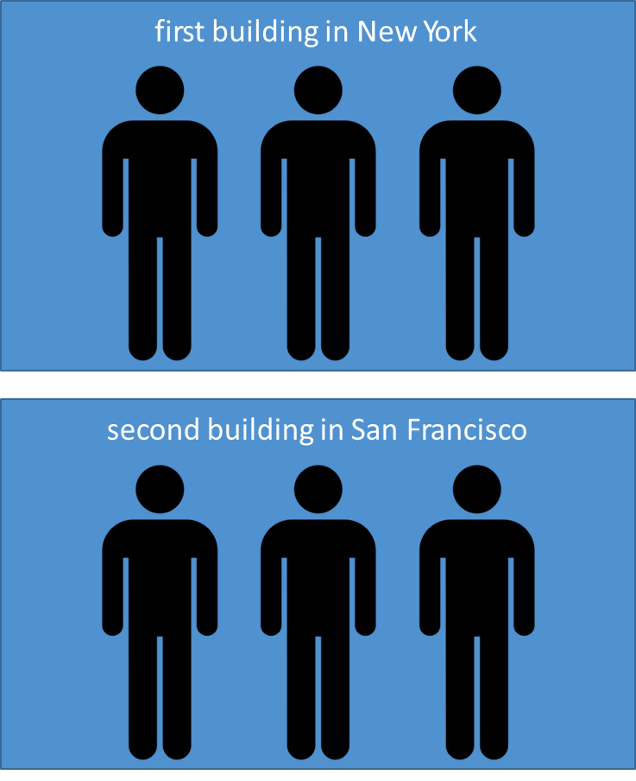
High Availability
High Availability usually goes hand in hand with horizontal scaling
High availability means running your application / system in at least 2 data centers (== Availability Zones)
The goal of high availability is to survive a data center loss
The high availability can be passive (for RDS Multi AZ for example)
The high availability can be active (for horizontal scaling)

Slide 46
High Availability & Scalability For EC2
Vertical Scaling: Increase instance size (= scale up / down)
From: t2.nano - 0.5G of RAM, 1 vCPU
To: u-12tb1.metal – 12.3 TB of RAM, 448 vCPUs
Horizontal Scaling: Increase number of instances (= scale out / in)
Auto Scaling Group
Load Balancer
High Availability: Run instances for the same application across multi AZ
Auto Scaling Group multi AZ
Load Balancer multi AZ

Slide 47





What is load balancing?
Load Balances are servers that forward traffic to multiple servers (e.g., EC2 instances) downstream
Elastic Load Balancer
EC2 Instance
EC2 Instance
EC2 Instance

Slide 48
Why use a load balancer?
Spread load across multiple downstream instances
Expose a single point of access (DNS) to your application
Seamlessly handle failures of downstream instances
Do regular health checks to your instances
Provide SSL termination (HTTPS) for your websites
Enforce stickiness with cookies
High availability across zones
Separate public traffic from private traffic

Slide 49
Why use an Elastic Load Balancer?
An Elastic Load Balancer is a managed load balancer
AWS guarantees that it will be working
AWS takes care of upgrades, maintenance, high availability
AWS provides only a few configuration knobs
It costs less to setup your own load balancer but it will be a lot more effort on your end
It is integrated with many AWS offerings / services
EC2, EC2 Auto Scaling Groups, Amazon ECS
AWS Certificate Manager (ACM), CloudWatch
Route 53, AWS WAF, AWS Global Accelerator

Slide 50
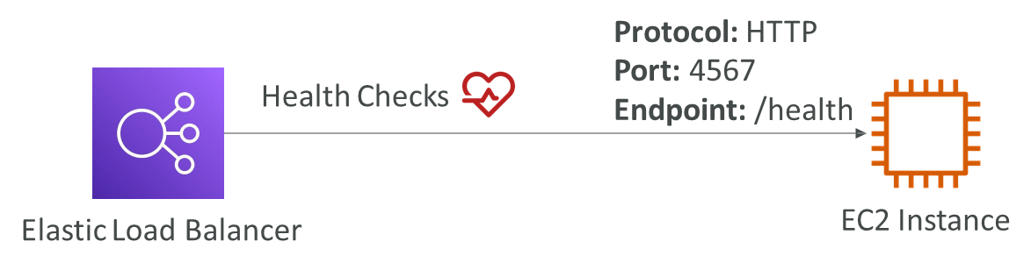
Health Checks
Health Checks are crucial for Load Balancers
They enable the load balancer to know if instances it forwards traffic to are available to reply to requests
The health check is done on a port and a route (/health is common)
If the response is not 200 (OK), then the instance is unhealthy

Slide 51
Types of load balancer on AWS
AWS has 4 kinds of managed Load Balancers
Classic Load Balancer (v1 - old generation) – 2009 – CLB
HTTP, HTTPS,TCP, SSL (secure TCP)
Application Load Balancer (v2 - new generation) – 2016 – ALB
HTTP, HTTPS, WebSocket
Network Load Balancer (v2 - new generation) – 2017 – NLB
TCP, TLS (secure TCP), UDP
Gateway Load Balancer – 2020 – GWLB
Operates at layer 3 (Network layer) – IP Protocol
Overall, it is recommended to use the newer generation load balancers as they provide more features
Some load balancers can be setup as internal (private) or external (public) ELBs

Slide 52


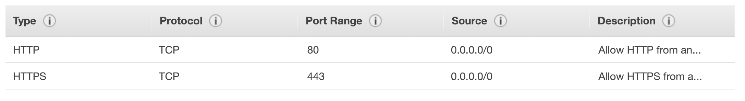
Load Balancer Security Groups
HTTPS / HTTP
From anywhere
Users
Load Balancer Security Group:
HTTP Restricted to Load balancer
EC2
Application Security Group: Allow traffic only from Load Balancer

Slide 53
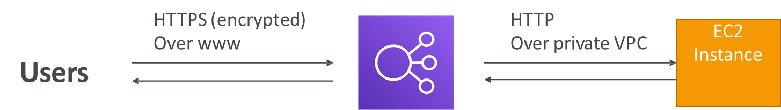
Load Balancer - SSL Certificates
The load balancer uses an X.509 certificate (SSL/TLS server certificate)
You can manage certificates using ACM (AWS Certificate Manager)
You can create upload your own certificates alternatively
HTTPS listener:
You must specify a default certificate
You can add an optional list of certs to support multiple domains
Clients can use SNI (Server Name Indication) to specify the hostname they reach
Ability to specify a security policy to support older versions of SSL / TLS (legacy clients)

Slide 54

What’s an Auto Scaling Group?
In real-life, the load on your websites and application can change
In the cloud, you can create and get rid of servers very quickly
The goal of an Auto Scaling Group (ASG) is to:
Scale out (add EC2 instances) to match an increased load
Scale in (remove EC2 instances) to match a decreased load
Ensure we have a minimum and a maximum number of EC2 instances running
Automatically register new instances to a load balancer
Re-create an EC2 instance in case a previous one is terminated (ex: if unhealthy)
ASG are free (you only pay for the underlying EC2 instances)

Slide 55
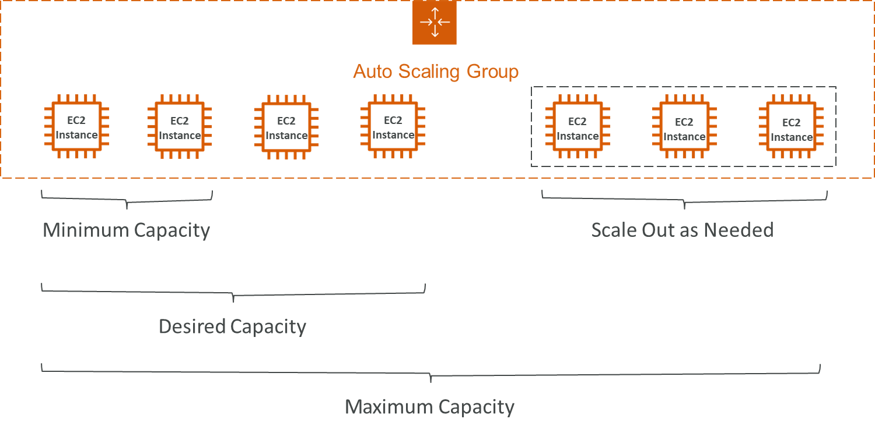
Auto Scaling Group in AWS

Slide 56



Auto Scaling Group in AWS With Load Balancer
Users
Elastic Load Balancer
ELB can check the health of your EC2 instances!
Auto Scaling Group
EC2
Instance
EC2
Instance
EC2
Instance
EC2
Instance
EC2
Instance
EC2
Instance
EC2
Instance

Slide 57
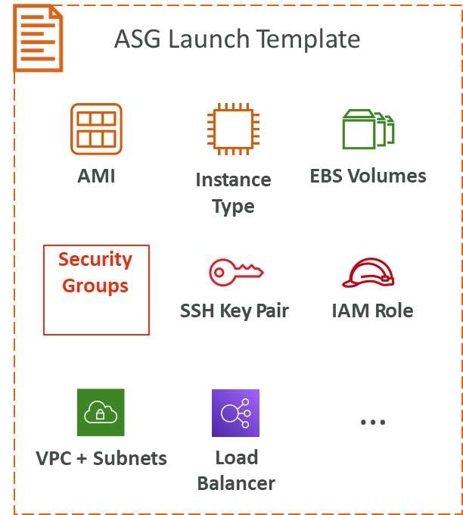
Auto Scaling Group Attributes
A Launch Template (older “Launch Configurations” are deprecated)
AMI + Instance Type
EC2 User Data
EBS Volumes
Security Groups
SSH Key Pair
IAM Roles for your EC2 Instances
Network + Subnets Information
Load Balancer Information
Min Size / Max Size / Initial Capacity
Scaling Policies

