Slide 1
EbAY Website
Under Guidance of Mrs. Vaishali Sonawane Mam.
By ANKIREDDY MARY SWAPNA

Slide 2
Introduction :
eBay, founded in 1995 by Pierre Omidyar.
link:https://www.ebay.com/
EBAY is a global e-commerce wEBSITE, where individuals and businesses can buy or sell nearly anything via auction-style listings or fixed-price “Buy It Now” options .
Used page object model(pom),testng framework for automation.

Slide 3
Overview
What is EBAY?
EBAY is an ecommerce platform that allows users to SHOP EASILY.
IT DISPLAYS VARIOUS CATEGORIES LIKE ANTIQUES, ART, BAbY, BOOKS ETC.
it has ebay lives which enables users to watch based on various categories.

Slide 4
Responsibities
Creating TEST PLANS FOR MODULES
CREATING TEST CASES
MANUAL TESTING AND AUTOMATION
IDENTIFYING & CREATING DEFECT REPORT
CREATING TEST CASES ANALYSIS
CREATING EPICS,STORY,TASK AND BUG IN JIRA.

Slide 5
Modules
Module 1 : Sign in page
Checked all the functionalities on Sign in page which included personal info as email
& password.
Module 2 : Search & Navigation
Checked all the functionalities TO Validate user product discovery flow like Search, filter by categories.
Module 3 : EBAY LIVE
Checked all the functionalities on EBAY LIVE BASED ON CATEGORIES.
Notes:
Module 1: Signn in page
Checked all the functionalities on Sign in page which included personal info as email
address, password
Module 2: Women page
Checked all the functionalities on Women page which included item details, Quantity, Filters,compare button,Add to cart button,product info,grid,list button
Module 3: Tshirt page
Checked all the functionalities on T-Shirt page which included item details, Quantity, Filters,compare button,Add to cart button,product info,grid,list button
Module 4: All Buttons and Drop Down Arrow :
team checked if all the buttons and drop down arrows of different fields are functioning properly or not

Slide 6
Module 4 : All Buttons and Drop Down Arrow
checked if all the buttons and drop down arrows of different fields are functioning properly or not.
Module 5 : all categories
Checked show products listed in the all categories module.
Module 6 : saved
Checked saved items are visible in this module.
Module 7 : Header And footer
Show all valid details on header and footer like ,logo of EBAY, HELP & contact , sign in, add to cart, all info about site(about EBAY)

Slide 7
Defects
While running a testcase at certain point some fields are not working as it is expected which is nothing but a defect, so I have created a Defect report on those defects.

Slide 8
Defect identifier :- B_001
Defect summary :- WHOLE SALE LOTS UNDER BABY MODULE DOES NOT SHOW ANY RESULTS EVEN IT IS A NAVIGABLE LINK.
Ø Test Id :- DF_001
Ø Test case name :- DF_NOT_NAVIGABLE_LINK
Ø Module name :- ALL CATEGORIES
Ø Reproducible :- 1. Login to ebay
2.click on all categories
3.select baby
4.Under Baby ,click on Wholesale Lots
Ø Severity :- MEDIUM
Ø Priority :- MEDIUM
Ø Raised by :- SWAPNA
Ø Assigned to :- VAISHALI SONANIS MAM
Ø Date of assignment :-19-08-2005
Ø Status :- pending
Ø Snap shots :-
Ø Fixed by :-
Ø Date of fixing :-

Slide 9
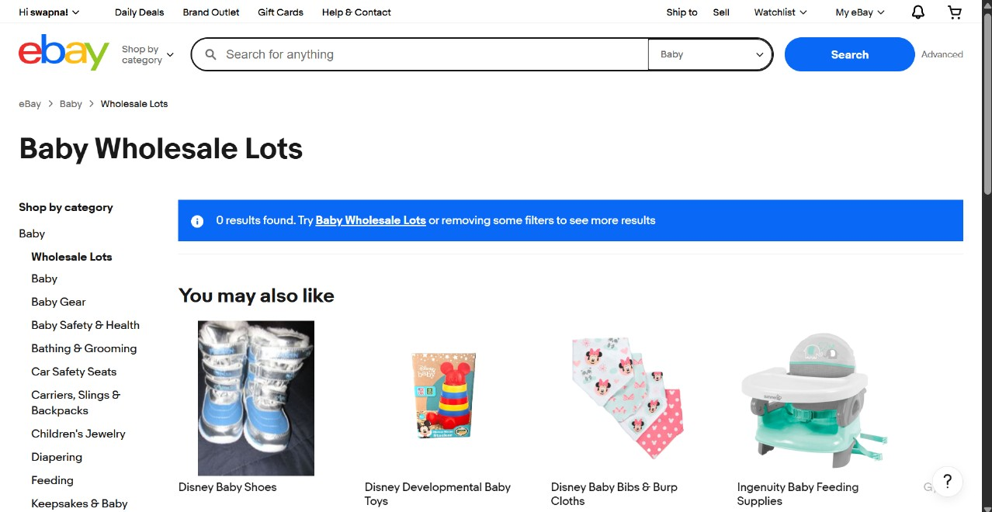

Slide 10
Challenges
While testing big website which contains huge data we faced some challenges about:
it takes lots of time to perform manual testing on all modules in different browsers. .

Slide 11
Experience
Because of lot of communication And discussion with members it’s helps everyone to write taste case in easy way.
Helps to find out bugs.
Manual testing needs strong observation and in that testers needs to apply all possibilities in test cases.

Slide 12
Thank You!!!
Vaishali Mam For Guiding me through out the Project.

