Slide 1

Data Science Internship
British Airlines – Web Scraping – TASK1
Swapna Kattoju

Slide 2

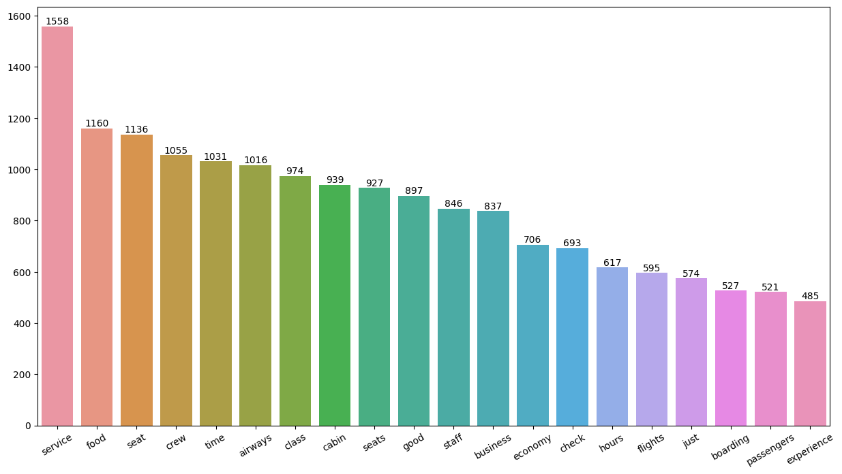
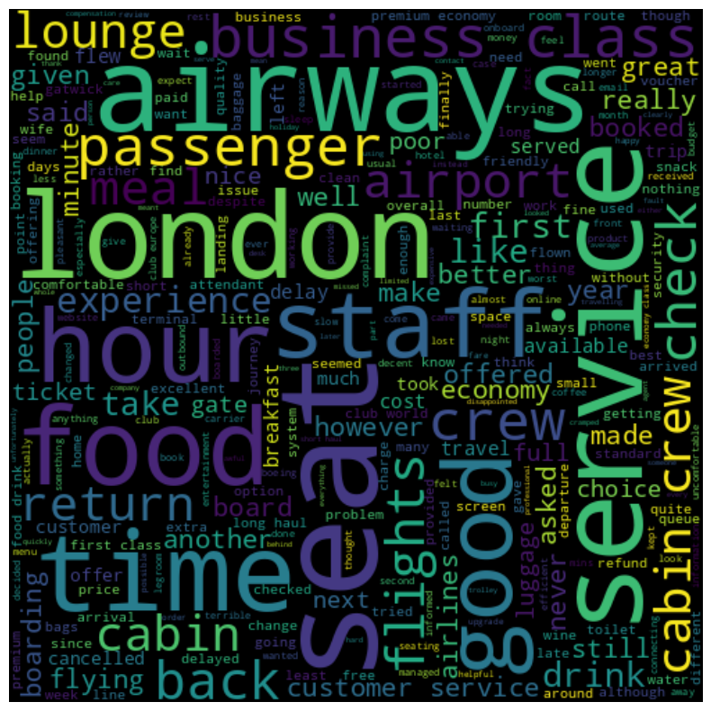
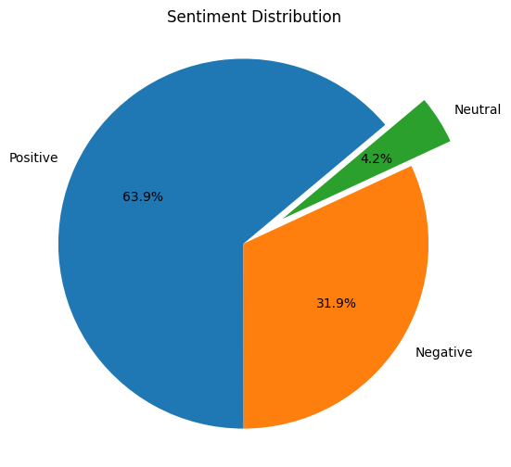
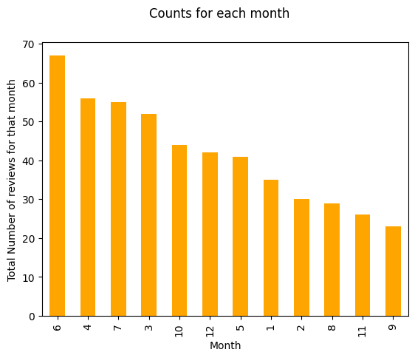
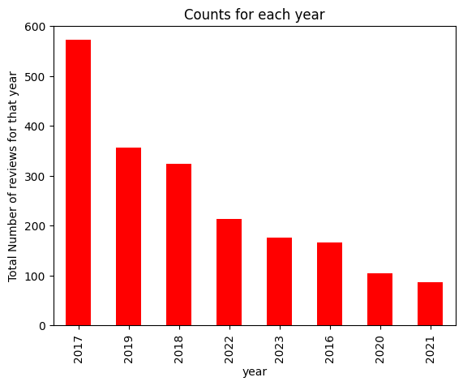
Data Scraping – Task 1
Data Scraping
Total Records Scraped 2000
Maximum reviews provided in year and the busiest months people travelling during | 2017 April - July
Passesngers always reminded of the following --> from wordCloud | Service,food,seat,crew, economy cabin ,crew
Out of 2000 reviews - positive Negative and neutral resp.. | 63.9% 31.9%, 4.2%

