Slide 1
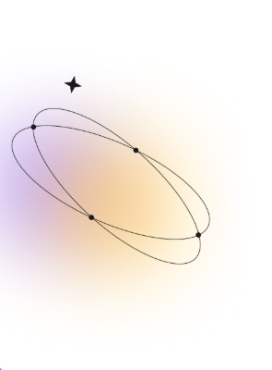
Mini_Compiler_Project
Course Code: CSE 430
Course Title: Compiler Design Lab
Submitted To:
Md. Shafayetul Haque
Lecturer,
Department of CSE,UAP
Submitted By: Swapna Khanam
Reg No:21201082
Sec:B2

Slide 2

Table of Contents
Abstract
Introduction
System Design
Project Structure
Tasks Overview (1–7)
Implementation Commands
Results
Conclusion & Future Work
1

Slide 3
Abstract
This project demonstrates the complete compilation process for a simplified programming language.
It includes all major compiler phases: Lexical Analysis, Syntax Analysis, AST generation, Intermedite Code Generation, Optimization, and Assembly Code Generation.
Tools used: Flex, Bison, GCC, and Python.
2

Slide 4
Introduction
Objective: Design and implement a small compiler to translate source code into optimized intermediate and assembly representations.
Each phase developed modularly using C, Lex, Yacc, and Python.
Focused on language analysis, translation, and optimization.
3

Slide 5
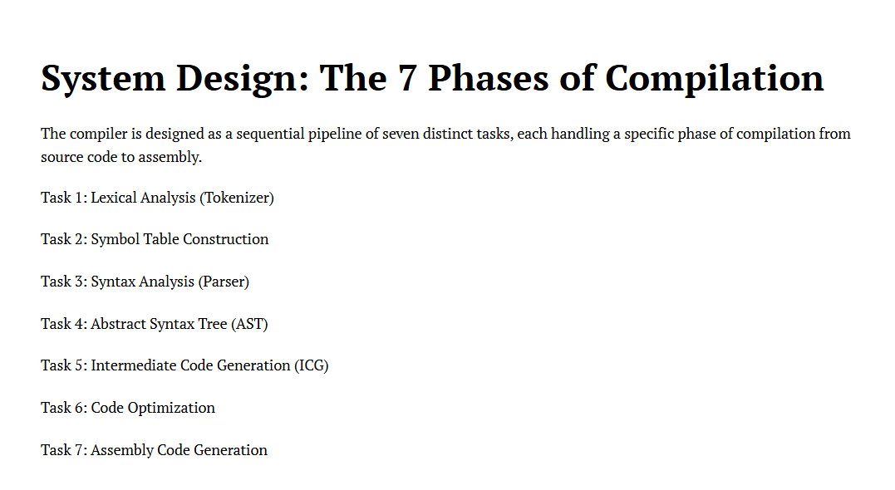
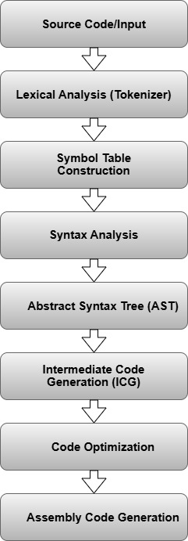
System Design
4

Slide 6
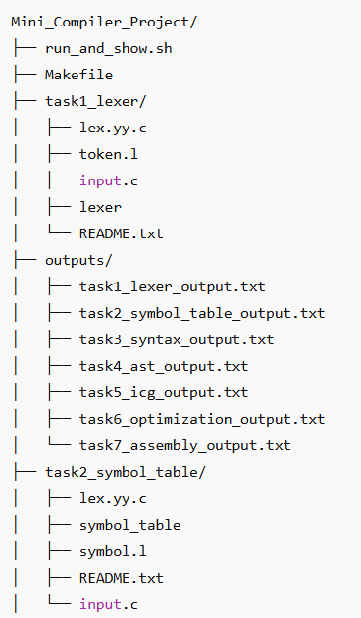
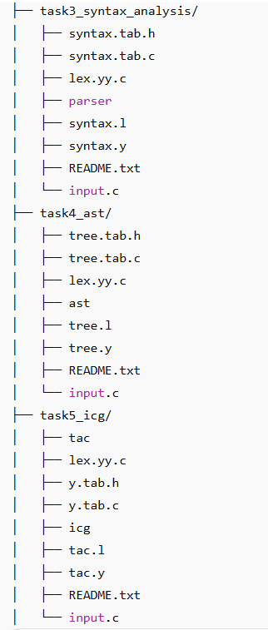
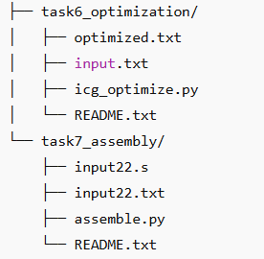
Project Structure
The project contains multiple task folders and output files.
Each folder includes its respective code (lex/yacc files, Python scripts, input/output files).
Outputs are stored in the 'outputs/' directory.
5

Slide 7
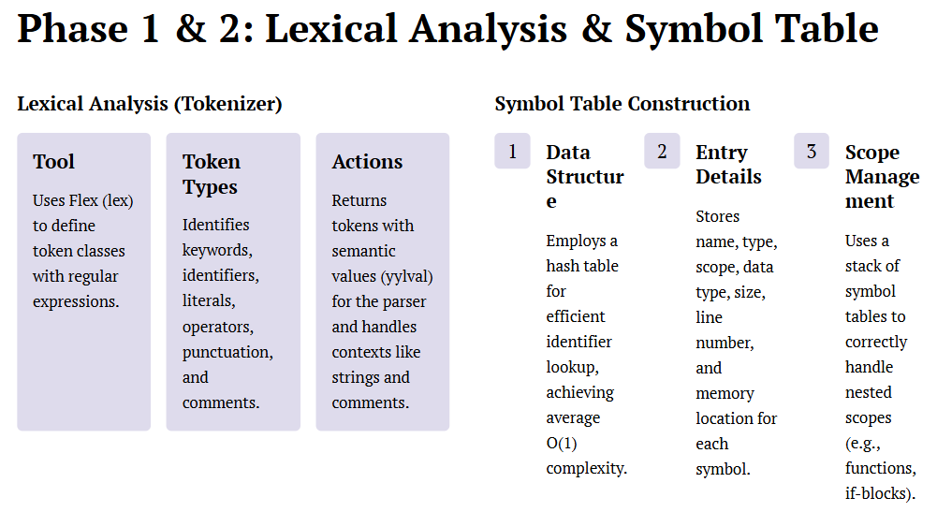
Tasks Overview
6

Slide 8
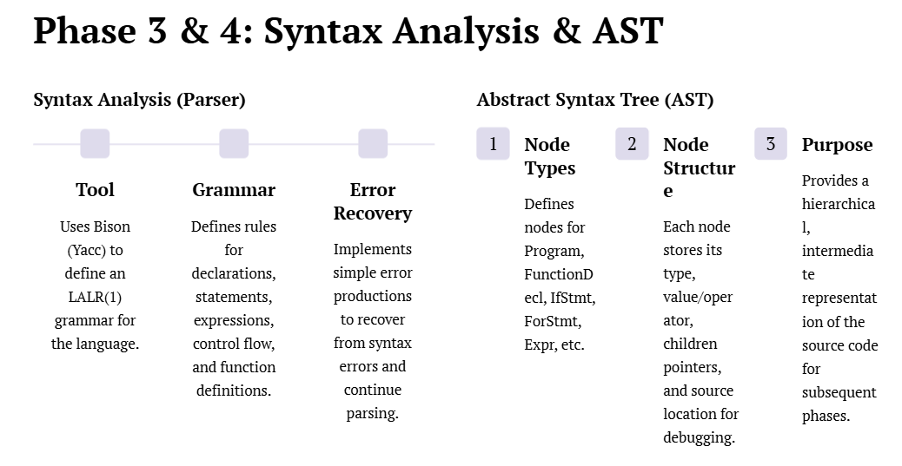
7

Slide 9
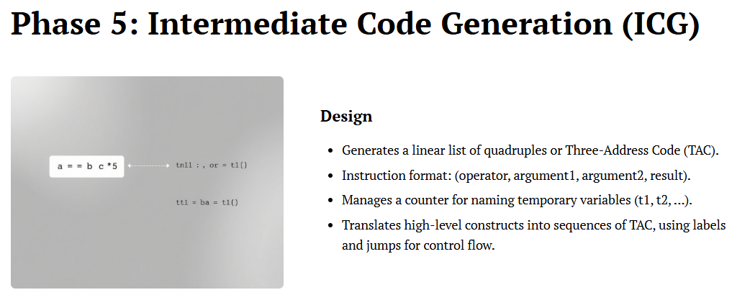
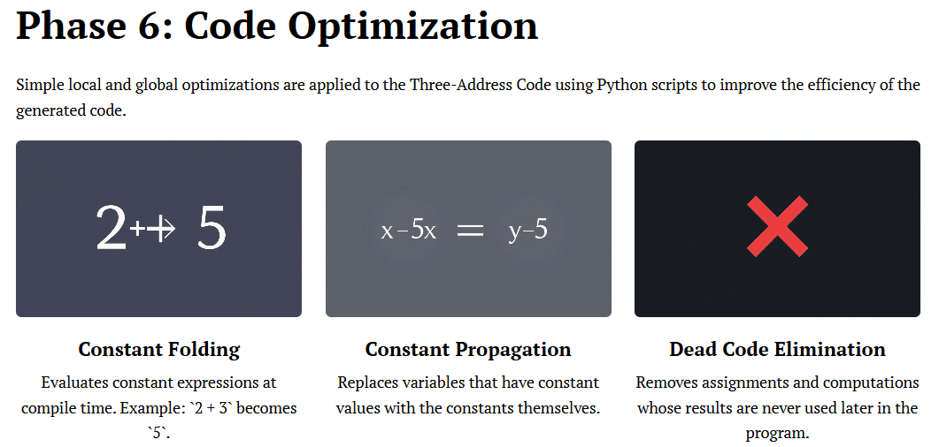
8

Slide 10
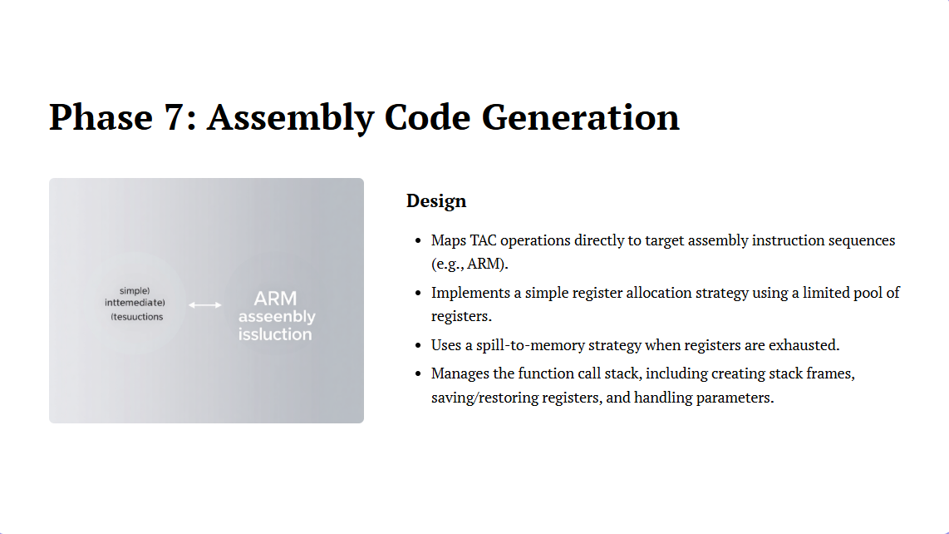
9

Slide 11
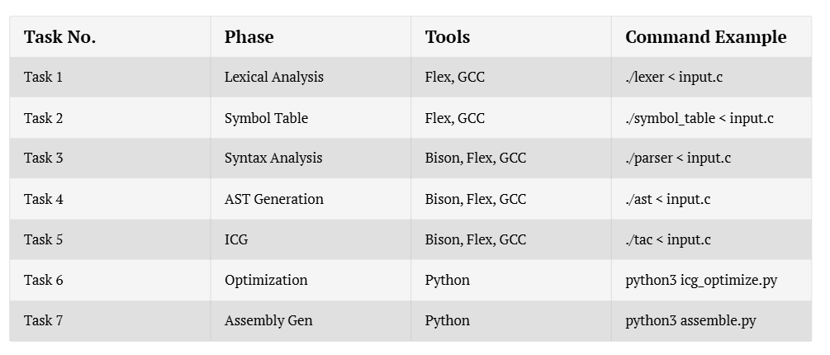
Implementation
Full project can be executed via 'run_and_show.sh'.
10

Slide 12
Results
Each compiler phase successfully executed.
Generated outputs stored in the outputs/ directory:
- task1_lexer_output.txt
- task2_symbol_table_output.txt
- task3_syntax_output.txt
- task4_ast_output.txt
- task5_icg_output.txt
- task6_optimization_output.txt
- task7_assembly_output.txt
11

Slide 13
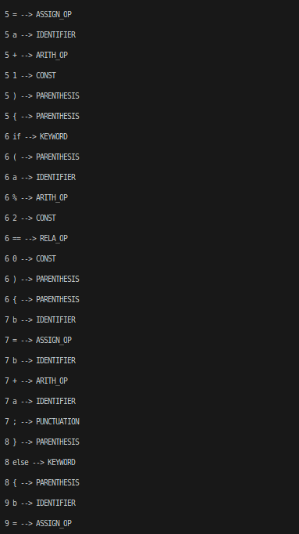
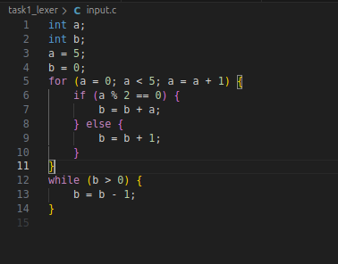
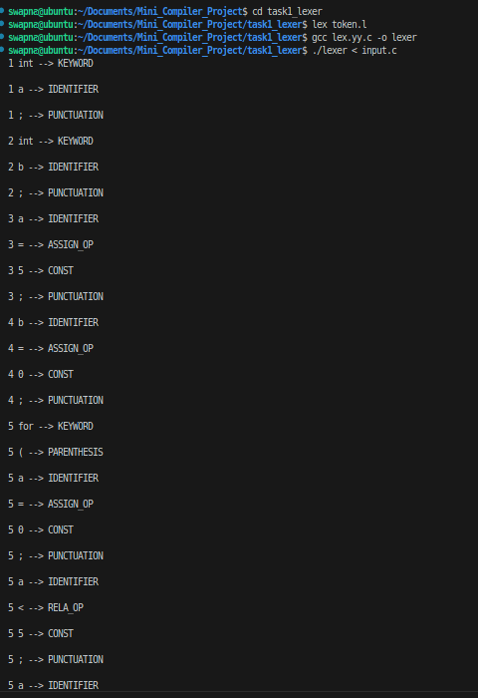
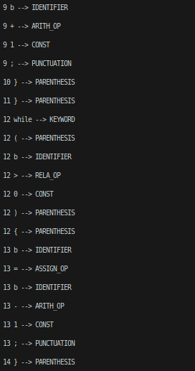
Task 1 - Lexical Analysis(Tokenizer)
Input:
Output:
12

Slide 14
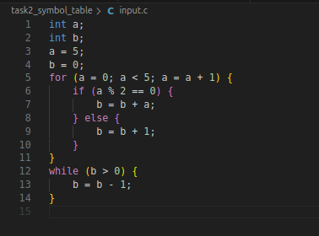
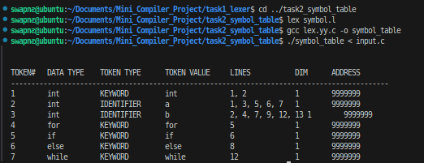
Task 2 - Symbol Table Construction
Input:
Output:
13

Slide 15
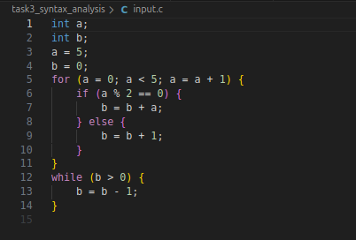
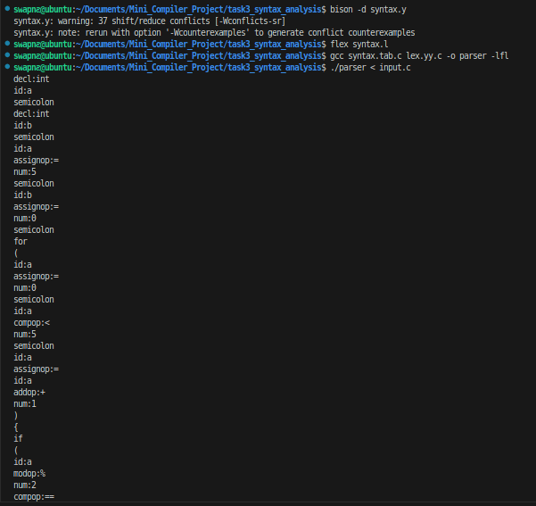
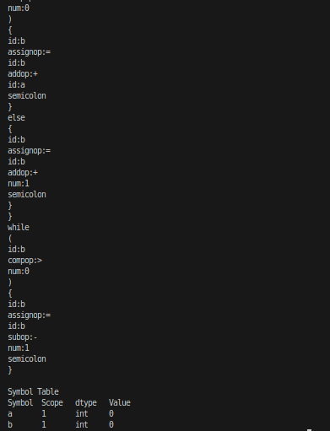
Task 3 - Syntax Analysis
Input:
Output:
14

Slide 16
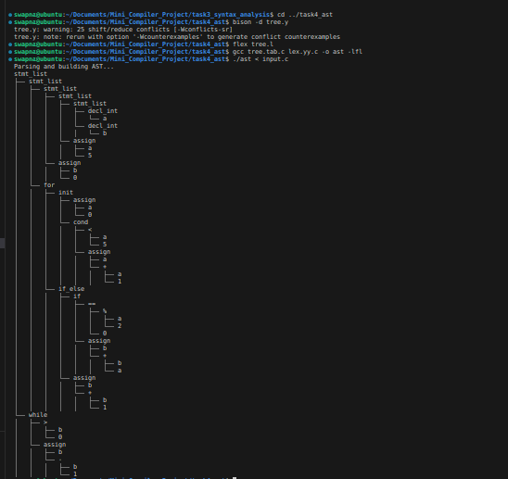
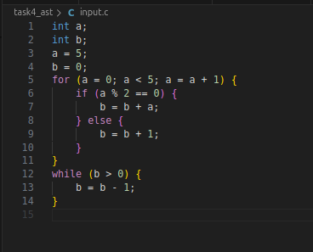
Task 4 - Abstract Syntax Tree (AST)
Input:
Output:
15

Slide 17
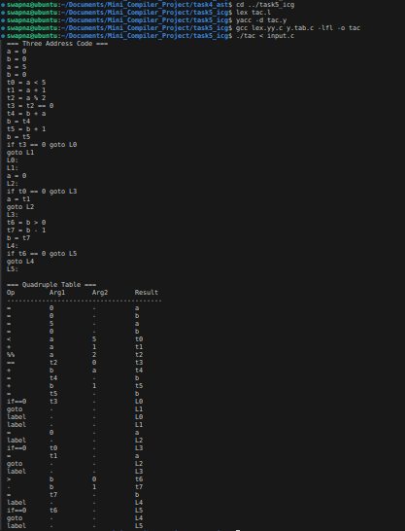
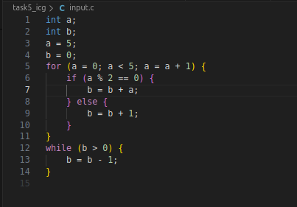
Task 5 - Intermediate Code Generation
Input:
Output:
16

Slide 18
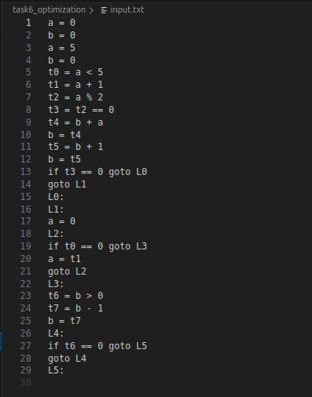
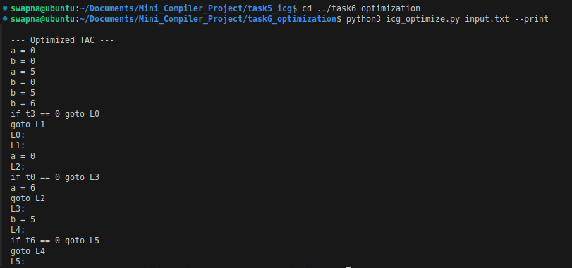
Task 6 - Code Optimization
Input:
Output:
17

Slide 19
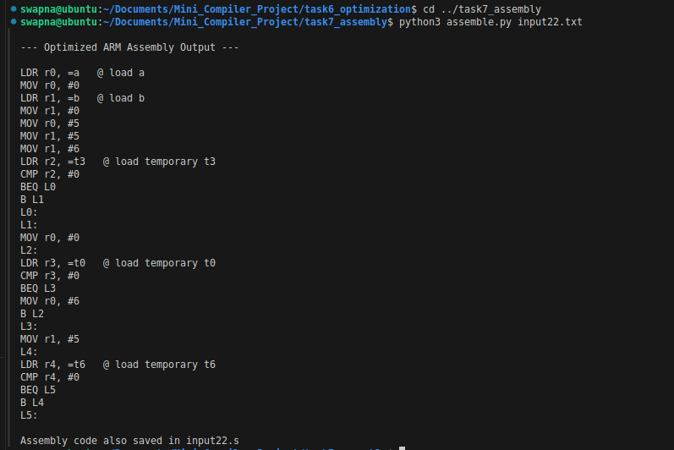
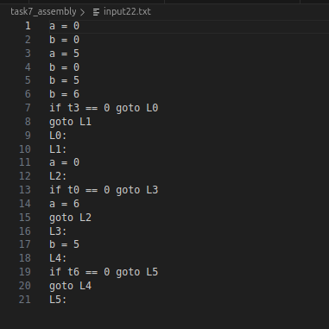
Task 7 - Assembly Code Generation
Input:
Output:
18

Slide 20
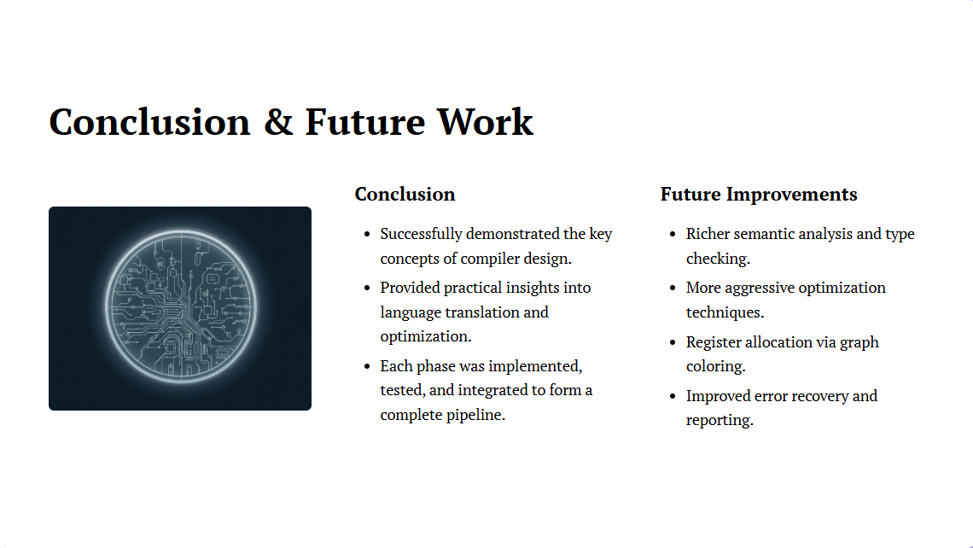
More_Details_Link
19

