Slide 1



Sustainable Biofuel Production
Dr. D Y Patil school of Science & Technology
Swapnaja Ram Waghapure
Harleen Kaur
Rutuja Raju Donde

Slide 2
Problem Statement
Problem Statement: While algae hold immense potential as a source for sustainable biofuels due to their high oil content, rapid growth rate, and ability to utilize CO2, the widespread and cost-effective production of algae-based fuels faces significant challenges that hinder its commercial viability.
Key Objectives:
1.Evaluate algae's potential as a biofuel source.
2.Identify challenges in large-scale production
3.Review current technologies for cultivation and processing.
4.Analyze economic feasibility of algae-based fuels
5.Assess environmental impact of algae farming

Slide 3
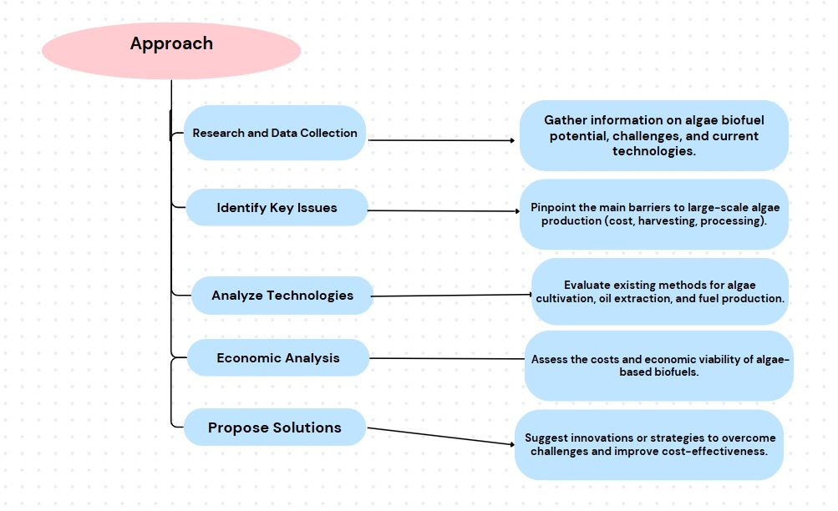
Methodology
Approach:

Slide 4
Algorithms:
Algorithms: Optimize algae strains for better oil yield and growth.
Optimization Algorithms: Improve efficiency in cultivation and harvesting.
Machine Learning: Predict optimal growth conditions and harvest times
CFD: Simulate water and nutrient flow to optimize algae farming.
Image Processing: Monitor algae health and growth using visual data.

Slide 5

Conclusion
Summary:
In conclusion, algae-based biofuels hold great promise as a sustainable energy source due to their high oil content, rapid growth, and CO2 absorption capabilities. However, significant challenges such as high production costs, inefficient harvesting methods, and economic viability still hinder large-scale commercialization. By leveraging advanced technologies, optimization algorithms, and innovative solutions, these challenges can be addressed to improve the efficiency and cost-effectiveness of algae biofuel production. Continued research, development, and policy support will be essential to making algae-based biofuels a viable and sustainable alternative to traditional fuels.
Future Work:
Cost Reduction: Finding more cost-effective methods for large-scale cultivation, harvesting, and oil extraction.
Energy Efficiency: Reducing the energy consumption of algae farming and biofuel production processes.
Sustainability: Ensuring algae biofuels can be produced with minimal environmental impact, including efficient use of water and land.

Slide 6
References
National Renewable Energy Laboratory (NREL) – Algae Biofuels
International Journal of Energy Research – Algae as Biofuel Feedstock This journal often publishes academic papers about algae's potential in biofuels, including challenges in production, scalability, and commercialization.
Sheehan, J., et al., "Aquatic Species Program: Biodiesel from Algae," NREL, Link to the report, 1998.

Slide 7
Thank You
Notes:
Thank You !!

