Slide 1


MAATRICARE AI: A MULTILINGUAL MATERNAL HEALTH RISK MONITORING SYSTEM
An AI-Powered Clinical Decision Support System for Rural Care
Presented By: Group 6
Under Supervision of
Prof. Esha Choudhuri

Slide 2
GROUP MEMBERS DETAILS
Name | Enrollment Number | Department
Rohan Hazra | 12024002028203 | CSE (AI&ML)
Prapti Acharya | 12024002028037 | CSE (AI&ML)
Souryadeep Dutta | 12024002028220 | CSE (AI&ML)
Fardeen Khan | 12024002028024 | CSE (AI&ML)
Swapnaneel Dey | 12024002028229 | CSE (AI&ML)

Slide 3
TABLE OF CONTENTS
Section | Slide Number
CHAPTER - 1:Problem Statement | 4
CHAPTER - 2:Proposed Solution | 5
CHAPTER - 3:Literature Survey | 6
CHAPTER - 4:Technology Stack | 7
CHAPTER - 5:Methodology & System Architecture | 8
CHAPTER - 6:Database Architecture | 9
CHAPTER - 7: ML Risk Pipeline: Data to Decision | 10
CHAPTER - 8: Deployment & Expected Impact | 11
CHAPTER - 9:Conclusion & Future Work | 12

Slide 4

Problem Statement
Maternal complications are frequently identified only after they escalate, especially in rural and resource-limited areas
Health information systems rarely communicate in the patient's or frontline ASHA worker's local language, creating significant communication gaps
Existing tools score risk on a one-time snapshot basis, missing crucial data on how a patient's condition trends across multiple visits .
Rural regions often lack reliable internet, making "always-online" healthcare systems impractical for frontline use
Nearly 287,000 preventable global maternal deaths occur annually, emphasizing the critical need for timely detection tools

Slide 5
Proposed Solution
MaatriCare AI is a multilingual maternal health risk monitoring system that converts routine visit data into clear, actionable, local-language risk guidance for frontline workers
The solution utilizes Explainable Risk ML (XGBoost + SHAP) to classify risk (Low / Medium / High) and provide transparent reasoning, building trust
It features an integrated Multilingual Output layer that delivers prediction results in the worker's local language (Bengali, Hindi, English)
The system uses Trend-Aware Monitoring to track visit history across trimesters and trimesters, rather than just scoring a single snapshot
It is designed to be Offline / SMS-Ready, ensuring that data entry, risk scoring, and critical high-risk alerts function fully in areas with poor internet connectivity

Slide 6
LITERATURE SURVEY
Study (Author & Year) | Methodology / Approach | Key Result | Gap Identified
Sarker et al., 2025 (Healthcare Analytics) | PCA-enhanced XGBoost + SMOTE-ENN | 97.7% accuracy on maternal dataset | No multilingual or offline deployment focus for rural areas
Altaie & Ibrahim, 2026 (DHJ) | Leakage-regulated hybrid XGBoost | ROC-AUC 0.911 with calibration | Lacks explainability (SHAP) layer for frontline workers
Predicting Maternal Risk, 2024 (BMC Preg. & Childbirth) | Comparative models (LR, RF, KNN, XGB) | Model ranks shift post-PCA | Single-point scoring only; no visit trending
Risk via Boosting, 2025 (Springer) | UMAP dimensionality + XGBoost | Improved class separability | Ignores language and accessibility limitations

Slide 7
Technology Stack
Layer | Technology | Purpose
Frontend | HTML | Structure of the web interface
 | CSS | Styling and responsive UI
 | JavaScript | User interaction and frontend logic
Backend | Python | Core backend and AI processing
 | Flask | API/backend server
 | Pandas | Data processing and manipulation
 | XGBoost | Maternal risk prediction
 | Joblib | Saving/loading the trained ML model
Explainable AI | SHAP | Explaining why a patient is classified as high/low risk
Database | SQLite | Storing patients, pregnancies, visits and escalation records
Translation | Google Translation API | Multilingual recommendations
Communication | SMS | Alert/fallback communication for low-connectivity areas

Slide 8
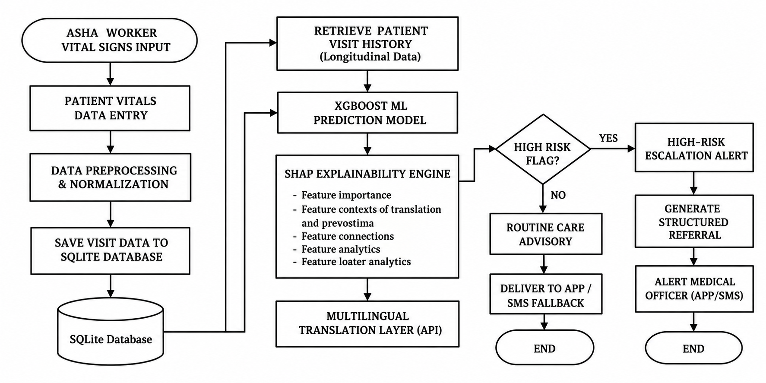
METHODOLOGY & SYSTEM ARCHITECTURE
9

Slide 9
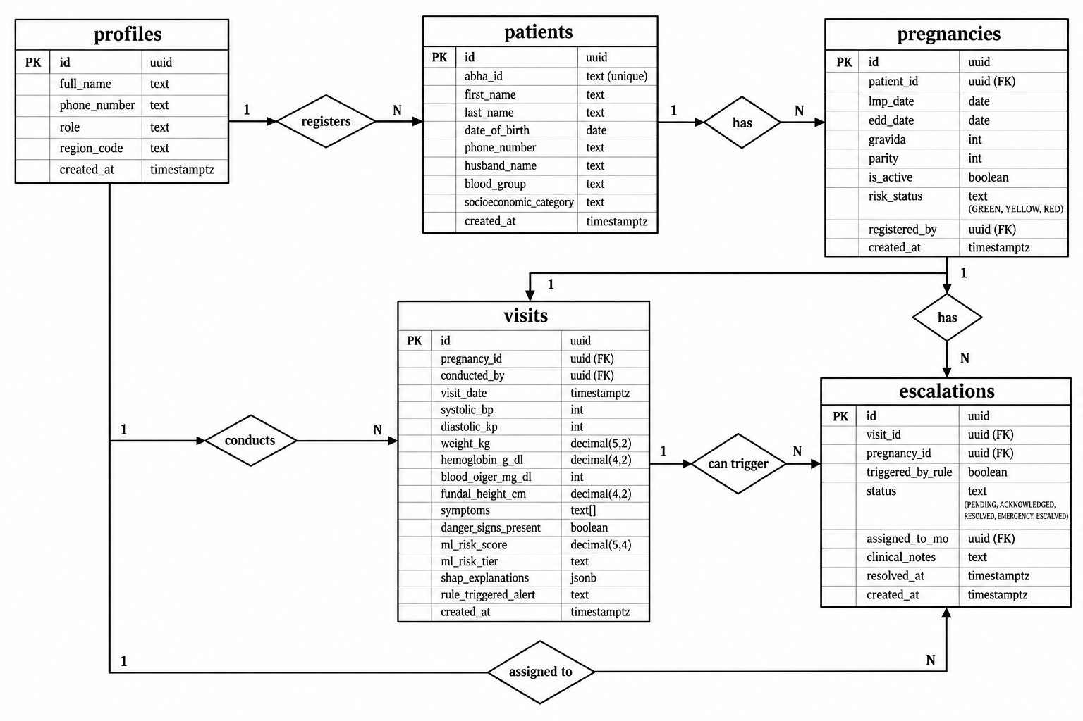
DATABASE ARCHITECTURE

Slide 10
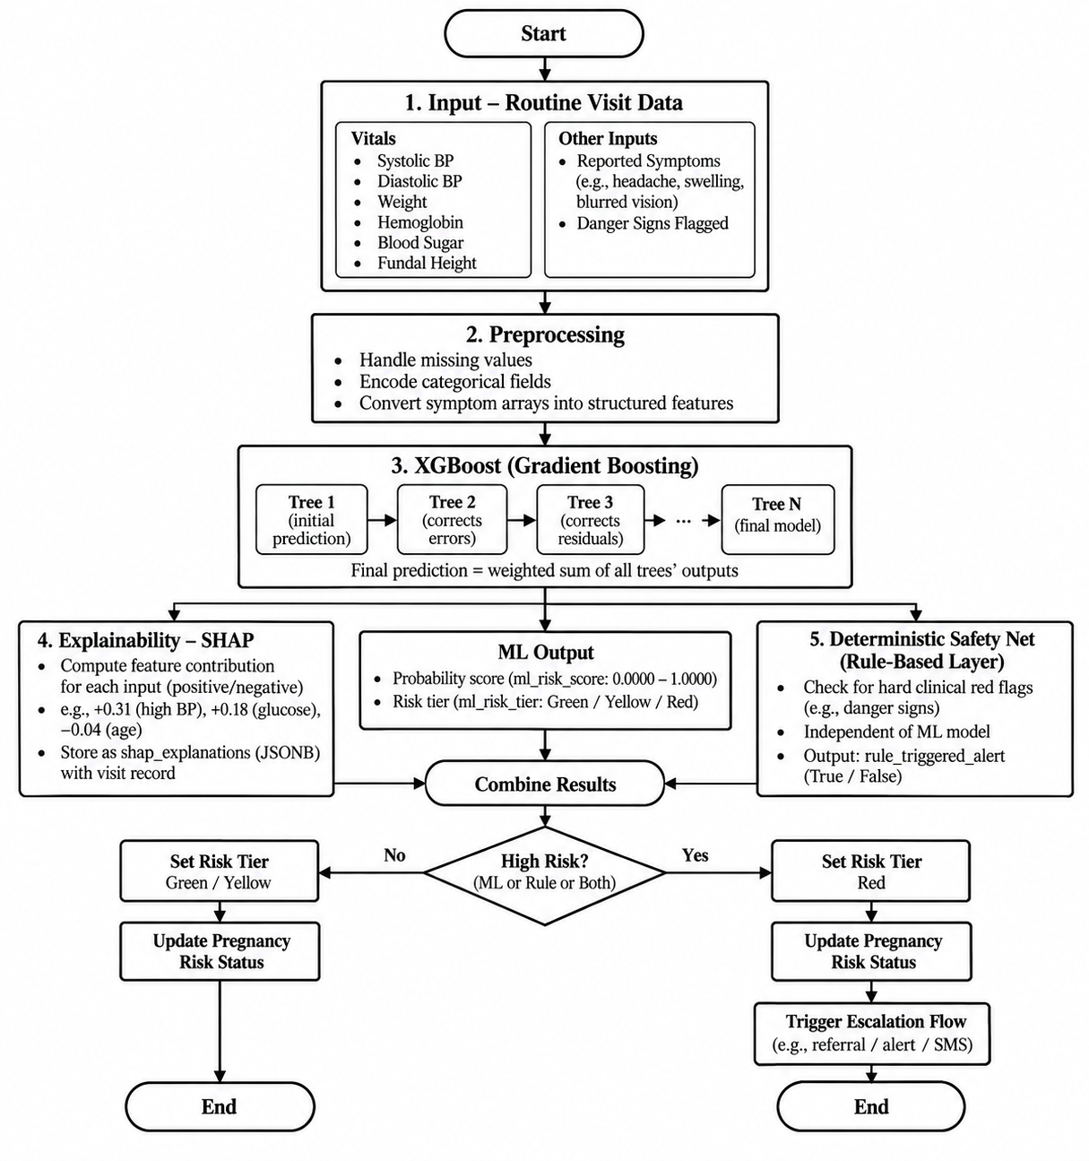
ML Risk Pipeline: Data to Decision
1.Input — Routine Visit Data
Captures vitals at each visit: Systolic/Diastolic BP, Weight, Hemoglobin, Blood Sugar, Fundal Height.
Includes reported symptoms (e.g., headache, swelling, blurred vision) and flags danger signs.
2.Preprocessing
Handles missing values and encodes categorical fields.
Converts symptom arrays into structured features for model ingestion.
3.Core Model — XGBoost (Gradient Boosting)
Builds an sequential ensemble of decision trees; each tree corrects the errors (residuals) of previous ones.
Final prediction is a weighted sum of all trees' outputs.
Output: Probability score (0.0000–1.0000) mapped to a Green / Yellow / Red tier.
4.Explainability — SHAP
Assigns a contribution value (positive or negative) to each input feature for every prediction.
Shows exactly "why" the model flagged a patient (e.g., "+0.31 from high BP, −0.04 from age").
Stored as JSONB format alongside the visit record.

Slide 11
DEPLOYMENT & EXPECTED IMPACT
Deployment | Expected Outcome
Pilot deployment with district health authorities and PHCs | Real-world validation of MaatriCare AI in rural maternal healthcare settings
Train ASHA and ANM workers | Improved adoption of AI-assisted maternal risk monitoring and decision support
Offline-first app with SMS escalation | Continued access and timely alerts even in low-connectivity areas
Integration with ABDM and facility EMRs | Better continuity of patient records and easier coordination between healthcare facilities
State-level rollout across high-burden districts | Wider coverage, earlier identification of high-risk pregnancies, and improved maternal healthcare outcomes

Slide 12
CONCLUSION AND FUTURE WORK
Conclusion
MaatriCare AI successfully combines Explainable AI (SHAP), Multilingual Communication, and Continuous Risk Monitoring into a cohesive system. It acts as a critical decision-support tool, empowering ASHA workers to intercept complications early, specifically designed for the realities of rural offline environments.
Future Work
Production Deployment: Transitioning backend to FastAPI and containerizing with Docker for robust PHC scaling.
▪
Federated Learning: Training the model across diverse geographical regions without centralizing sensitive patient records.
National Scale: Direct integration with national maternal health registries and the ABDM framework.
Language Expansion: Broadening the translation API to support 30+ regional Indian languages with voice-input capabilities.

