Slide 1
SAMJHA
समझा
She cannot read the loan document.
So we prove what she heard.
DataForge × Pathway × Rime

Slide 2
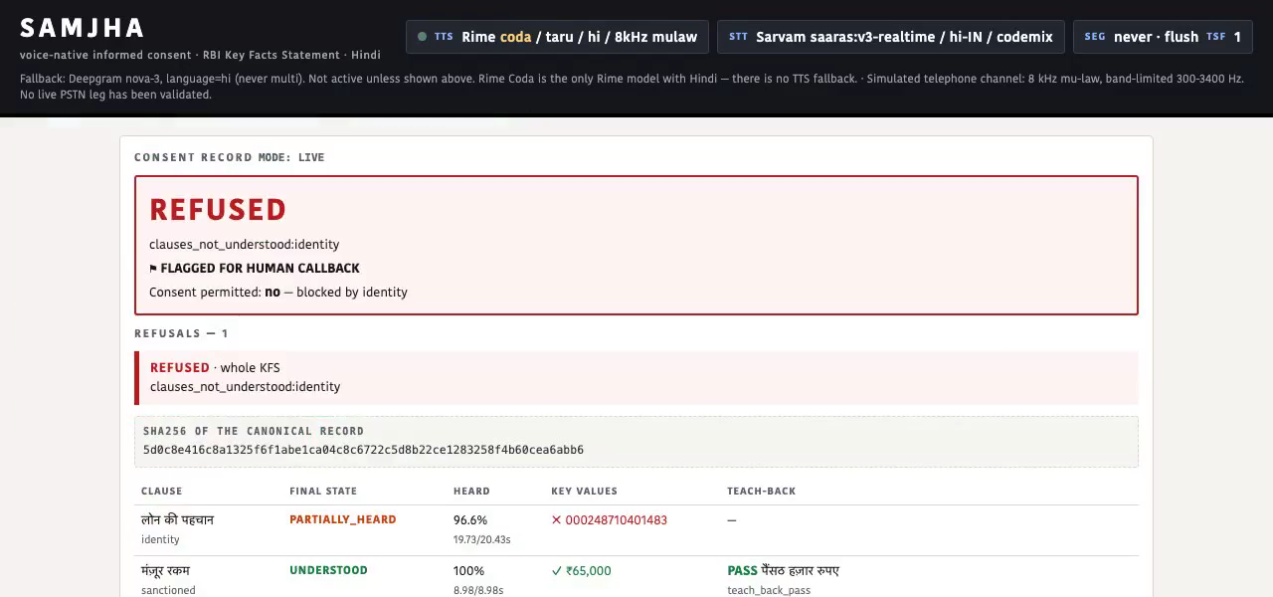
THE THING TO REMEMBER
She heard 96.6% of the clause.
96.6%
of the clause played before she interrupted
CONSENT REFUSED
The account number lived in the last segment.
That segment never finished.
She said yes. The system said no.
The sealed record. A refusal is a row, not an error.

Slide 3
WHY THAT MATTERS
She acknowledges a document she cannot read.
· RBI: every retail loan needs a Key Facts Statement she understands.
· In practice: the lender emails a PDF and collects an OTP.
· The loan was sold on a phone call. There is no screen.
The regulation is satisfied. The borrower is not informed.
Remove speech and the product does not degrade — it ceases to exist.

Slide 4
ARCHITECTURE
Document in. Sealed consent record out.
KFS
PDF or .docx
PARSE
table grid
no OCR, no model
SPEAK
Rime Coda /ws3
mulaw 8 kHz
1 value per segment
CALL
LiveKit
/c/{id} · one tap
Sarvam hears her
RECORD
sha256-sealed
+ doc provenance
THE ONE EDGE THAT IS THE PRODUCT
Rime's bytes
8000 B = 1.000 s
exact, not estimated
HEARD?
did THIS number's
segment finish?
UNDERSTOOD?
she says it back
in her own words
REFUSED / RECORDED
both true, every value
or consent is blocked
No vendor word timestamps — Rime emits none for Hindi. No model in the loop. Arithmetic over Rime's own output, cross-checked against LiveKit's measured playout.

Slide 5
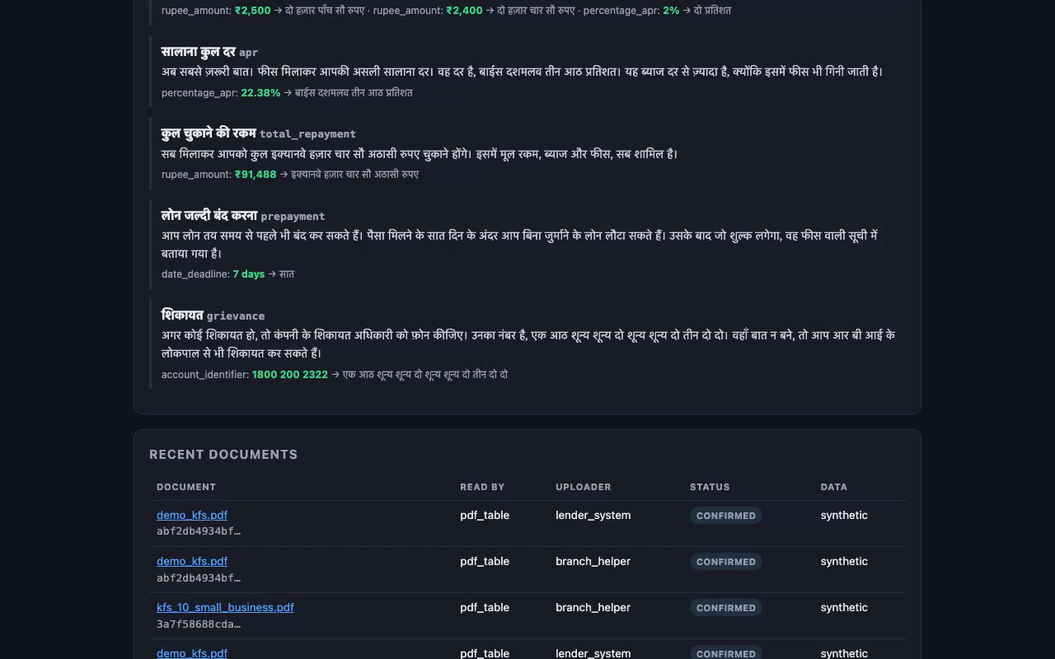
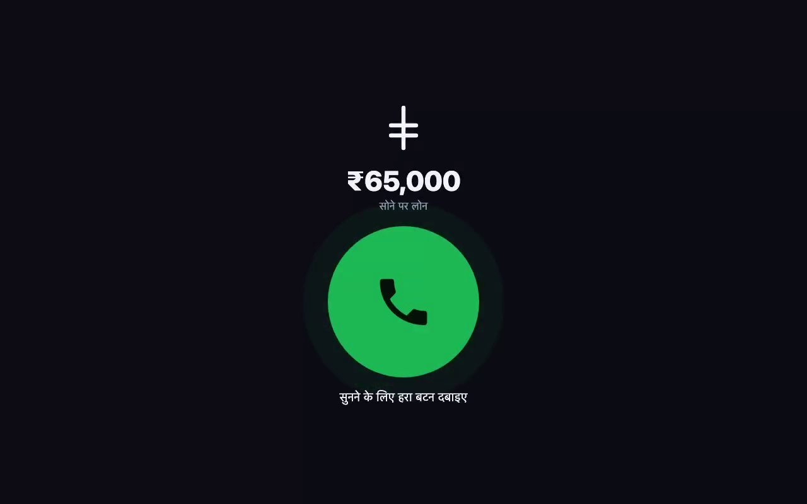
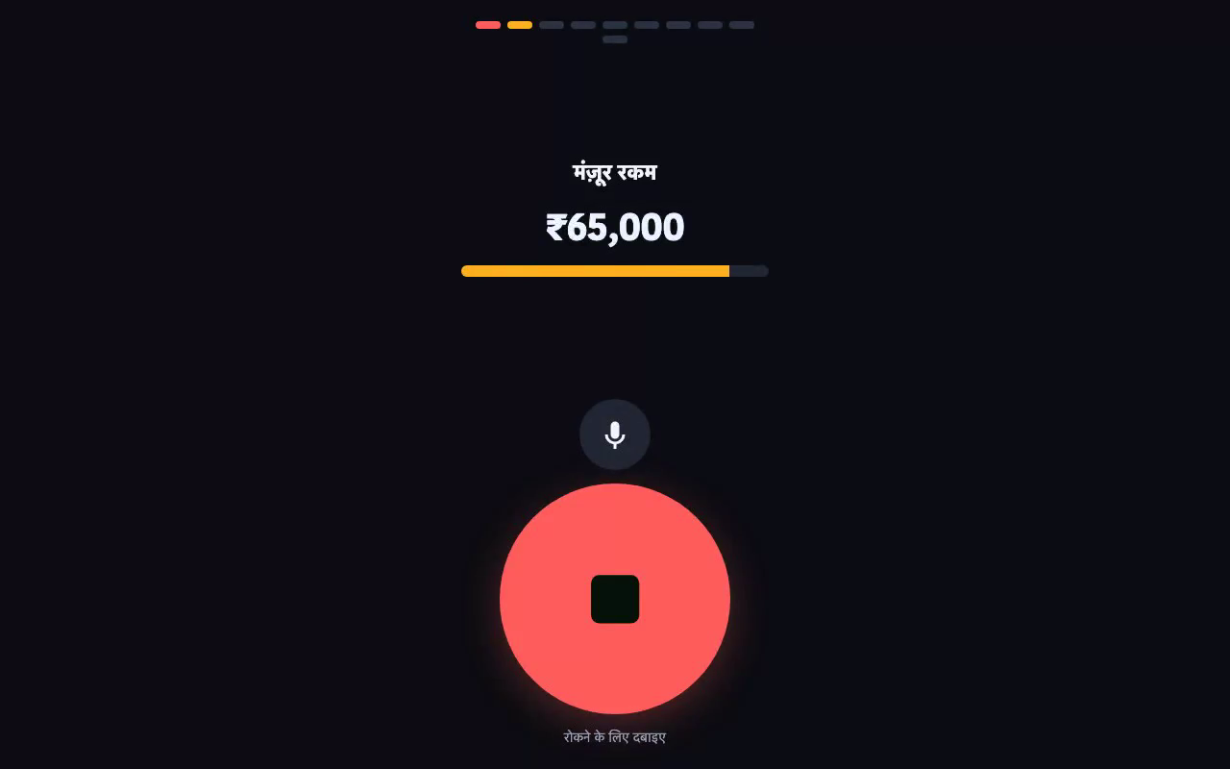
DEMO
Upload a real KFS · take the call in Hindi · interrupt the account number · read the refusal
/ — the officer
/c/{id} — the borrower
/panel — the evidence panel

Slide 6
THE MECHANIC
“Heard” is arithmetic, not a claim.
8000 bytes = 1.000 s
μ-law at 8 kHz is one byte per sample. Exactly.
· One key value per flush segment.
· “Did she hear the APR?” → “did segment k finish?”
· Needs no vendor timestamps. Works in any language.
PARTIALLY_HEARD. The value is struck through, and consent is blocked on this clause.
· Barge-in mid-number → the clause is re-read from the start, never resumed.

Slide 7
THE MEASURED RESULT
Value Error Rate on account identifiers
100% → 0%
75% → 0%
Deepgram nova-3
Sarvam saaras
8 kHz μ-law · model, speaker, lang, sampling rate and timeScaleFactor held constant · both arms are Rime
Read that with its n.
· n = 24 utterances, 4 per category — not the 120 pre-registered.
· Four of six categories show NO effect. We report them.
· Claim written and committed before any product code existed.

Slide 8
RIME
Four things we measured rather than assumed.
· No Hindi word timestamps — and it fails silently, not loudly.
· No cancel primitive. Barge-in closes the socket; a warm spare hides the reconnect.
· The LiveKit plugin hardcodes pcm, so 8 kHz μ-law is unreachable through it.
· /ws3 has no per-flush event. Pipeline the flushes and every chunk is attributed to segment 0. This one bit us in production.
coda / taru / hi · mulaw 8000 · segment=never + explicit flush · timeScaleFactor 1.0, speedAlpha never sent — RIME_EVIDENCE.md

Slide 9
WHAT WE DO NOT CLAIM
Stated before the results, not after.
· The telephone channel is SIMULATED. No live PSTN leg.
· “Heard” means played out of the speaker. We measure playout, not cognition.
· Hindi only — Coda is the only Rime model with Hindi at all.
· Tables, not pictures. A photographed KFS is refused, not guessed at.
· No authentication. A call link is a bearer capability.
· The human listening panel has not been run.

Slide 10
Remove speech and the product
does not degrade — it ceases to exist.
uv sync && make test # 421 tests, no key needed
make stage # GO / NO-GO before a live call
make e2e ARGS="--drive" # upload → Rime → FSM → assert the record
README.md (architecture + executive summary) · RIME_EVIDENCE.md · evals/ACCEPTANCE.md · video/samjha_demo.mp4

