Slide 1
SAMJHA
समझा
Voice-native informed consent for Indian retail lending
RBI Key Facts Statement, read aloud in Hindi, clause by clause —
with proof of what she actually heard.
DataForge × Pathway × Rime

Slide 2
THE PROBLEM
She acknowledges a document she cannot read.
· RBI mandates a Key Facts Statement for every retail loan — in a language the borrower understands, with informed acknowledgement.
· In practice: the lender emails a PDF and collects an OTP.
· The loan was sold on a phone call. There is no screen, and she has low reading fluency.
The regulation is satisfied. The borrower is not informed.
Remove speech and the product does not degrade — it ceases to exist.

Slide 3
WHAT WE BUILT
A document goes in. A defensible consent record comes out.
KFS (PDF or Word)
→ deterministic table parse, no OCR, no model in the loop
→ Hindi clauses, ONE key value per spoken segment
→ Rime Coda over /ws3, 8 kHz μ-law
→ LiveKit to her phone · Sarvam for her replies
→ consent FSM: heard → teach-back → understood
→ sha256-sealed record
Three surfaces, three people
· / the judge's evidence panel
· /intake the officer's review desk
· /c/{id} THE BORROWER — one tap
Choosing a PDF off a filesystem is itself a reading task, so the borrower does not do it. The record names who did (uploaded_by_role). Her part begins at “take the call”.

Slide 4
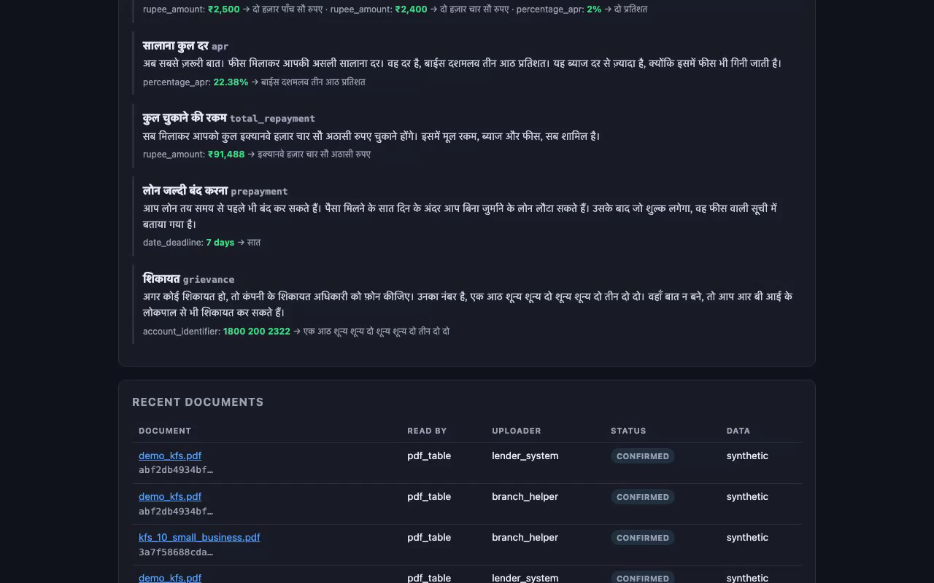
THE OFFICER'S DESK · /INTAKE
Nothing is ever guessed.
· A lender's own wording is absorbed — “APR (%)”, “Loan Proposal No.”
· A label we do not recognise is REPORTED, never folded into a real field
· A required field the document lacks BLOCKS the call until a human types it
Because a missing cooling-off period would otherwise default to 0 — and be read aloud as “इस लोन में कूलिंग-ऑफ की अवधि नहीं है”, denying a statutory right the document may well grant.
The Hindi that will actually be spoken, with each value's spoken form.

Slide 5
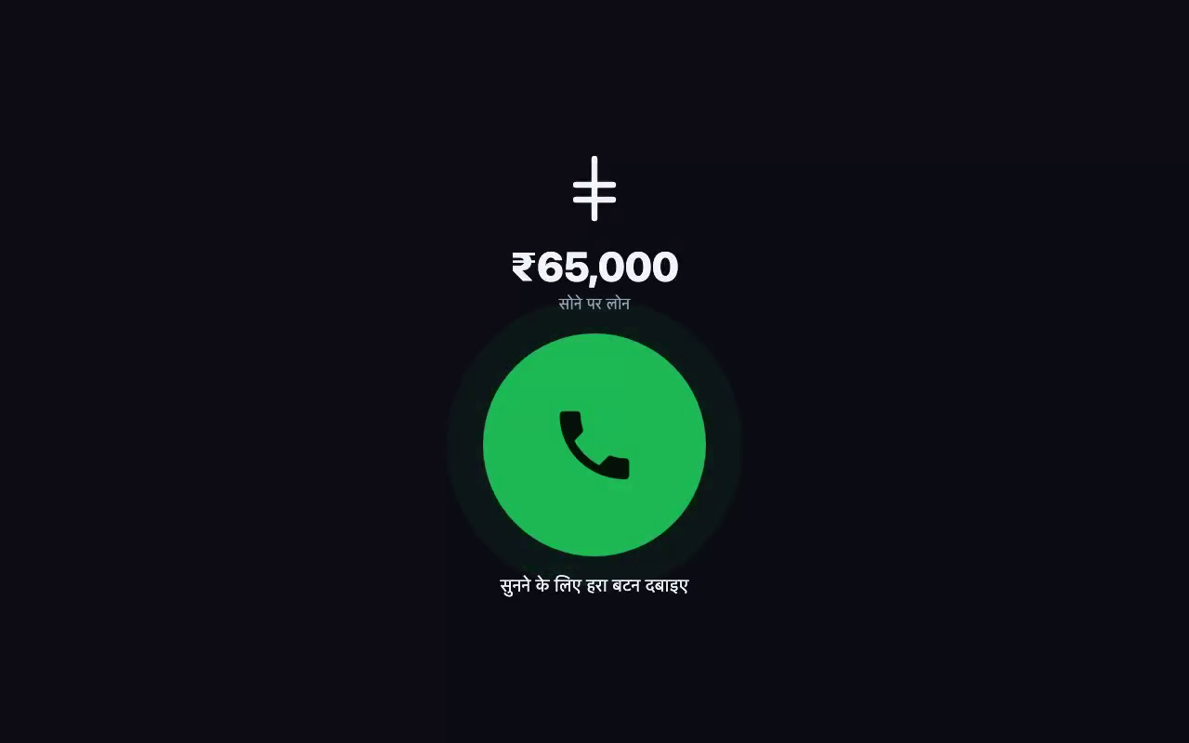
THE BORROWER · /C/{CALL_ID}
One tap. Everything else is spoken.
· No file input. No text input. No navigation.
· Digits are large, because a digit is not reading — ₹65,000 is legible to someone who cannot read a sentence.
· Every instruction is spoken in Hindi, by the same Rime voice that is about to read her loan.
· Refusal is amber, never red: if refusal looks like rejection, she learns the honest path is the punished one.

Slide 6
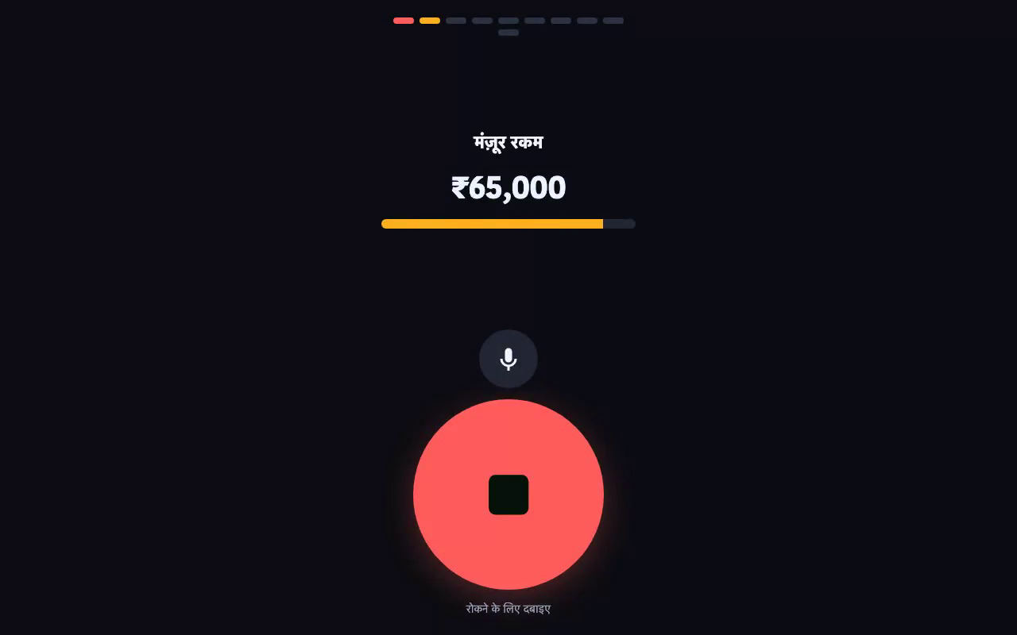
THE MECHANIC
“Heard” means the segment carrying the number finished.
μ-law at 8 kHz is 1 byte per sample.
8000 bytes = 1.000 s, exactly — not an estimate.
One comprehension-critical value per flush segment. So “did she hear the APR?” reduces to “did segment k finish playing?” — arithmetic over Rime's own byte counts.
It needs no vendor word timestamps, which Rime does not emit for Hindi anyway. It works in any language.
Barge-in mid-number: the clause goes PARTIALLY_HEARD and is re-read from the start — never resumed.

Slide 7
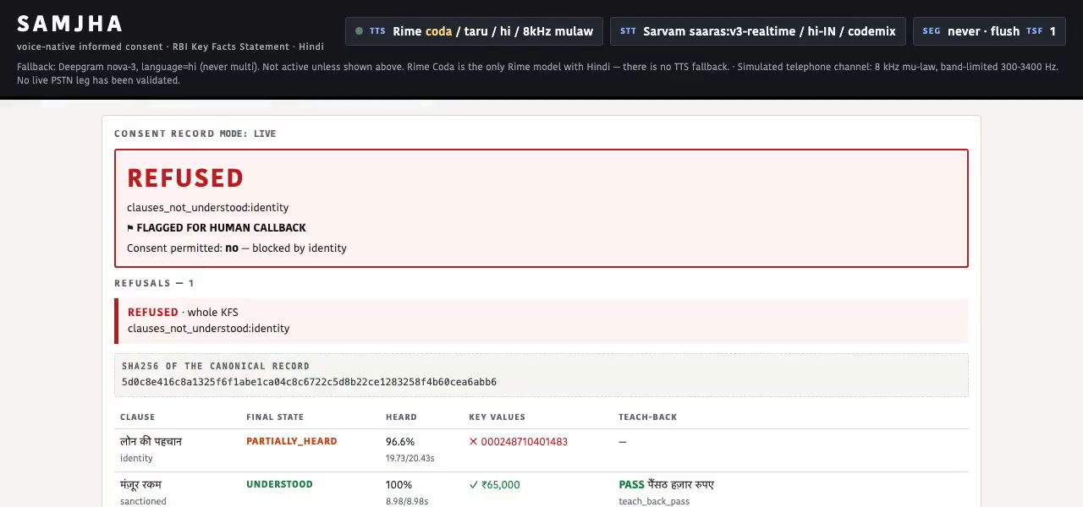
THE ARTIFACT
A refusal is a row, not an error.
· 96.6% of the clause played — and the account number still counts as NOT heard
· Its segment did not finish, so it was never communicated.
· Consent REFUSED · flagged for human callback
· sha256 over a canonical serialisation; provenance of the source document is inside the hash.

Slide 8
THE MEASURED RESULT
Value Error Rate on account identifiers
100% → 0%
75% → 0%
Deepgram nova-3
Sarvam saaras
8 kHz μ-law channel · modelId, speaker, lang, samplingRate and timeScaleFactor held constant · both arms are Rime
Read that with its n.
The published run is 24 utterances — 4 per category — not the 120 / 20 pre-registered in evals/ACCEPTANCE.md. The direction and the mechanism are what the committed per-row evidence supports; the exact percentages rest on n=4 and should be expected to move on a full run.
Four of six categories show NO effect, and are reported as the negative result they are.

Slide 9
RIME
Four things we measured rather than assumed.
· No word timestamps in Hindi, and it fails SILENTLY. With lang omitted they do appear — but are byte-identical across sample rates while duration is not. Unusable. So we use our own flush boundaries.
· No cancel primitive. `clear` does not cancel in-flight synthesis and contextId came back null on every frame. Barge-in closes the socket, with a warm spare.
· The Rime LiveKit plugin hardcodes audioFormat=pcm, so 8 kHz μ-law is unreachable through it. Clause audio goes through our own /ws3 client.
· /ws3 has NO per-flush completion event — only `chunk` and `done`. Pipeline the flushes and every chunk is attributed to segment 0. You must read each flush's `done` before sending the next. This one bit us in production.
Config: coda / taru / hi · mulaw 8000 · segment=never + explicit flush · timeScaleFactor 1.0, speedAlpha never sent

Slide 10
WHAT WE DO NOT CLAIM
Stated before the results, not after.
· The telephone channel is SIMULATED. No live PSTN leg has been validated.
· “Heard” means played out of the speaker, ± the client jitter buffer. We measure playout, not cognition.
· Hindi only, and it cannot currently be otherwise — Coda is the only Rime model with Hindi at all.
· Document upload reads TABLES, not pictures. A photographed KFS is refused, not guessed at.
· The synonym table that absorbs a lender's wording is a hypothesis — there is no real lender's KFS in this repo to test it against.
· No authentication. A call link is a bearer capability.
· n = 24 on the published eval; the human listening panel has not been run.

Slide 11
RUN IT
421 tests, and none of the first four need a key.
uv sync # builds .venv from uv.lock
cp .env.example .env # RIME_API_KEY is the only one you truly need
make test # 421 tests
make demo-fixtures # barge-in and rushed consent, offline
make channel # the 8 kHz μ-law chain
make secrets # no credential ever touched git history
make serve # terminal 1 — /, /intake, /c/{id}
make agent # terminal 2 — the consent worker
make e2e ARGS="--drive" # upload → Rime → FSM → assert the sealed record
Every performance number is backed by a committed artifact under evals/results/. ffmpeg is the one non-Python prerequisite.

Slide 12
Remove speech and the product
does not degrade — it ceases to exist.
video/samjha_demo.mp4 · RIME_EVIDENCE.md · evals/ACCEPTANCE.md

