Slide 1

MYBIKE
Presented by : Swapna Tidke

Slide 2
ABOUT MYBIKE
Showroom experience has always played an important role while buying a new bike. BikeWale brings you the
address, contact details and directions of Honda Showroom to improve your buying experience
TECHNOLOGY USED:- HTML ,CSS
1) LOGIN PAGE
2)BIKE MODEL
3)CONTACT
4)GALARY
5)LOGOUT

Slide 3
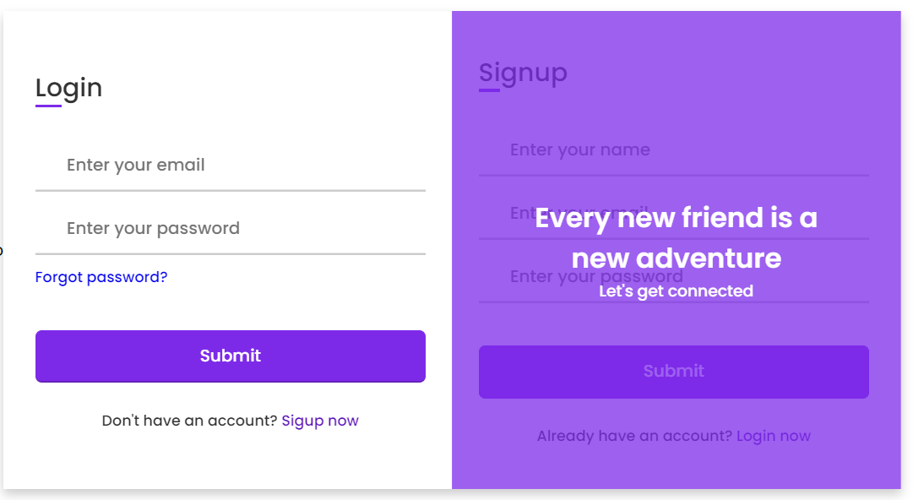
LOGIN

Slide 4
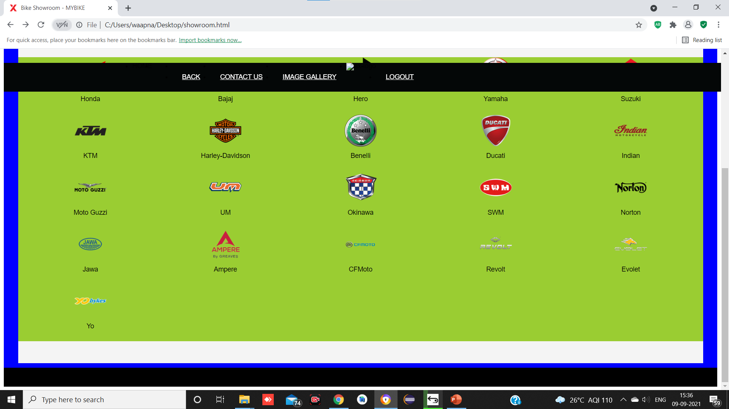
BIKE MODEL

Slide 5
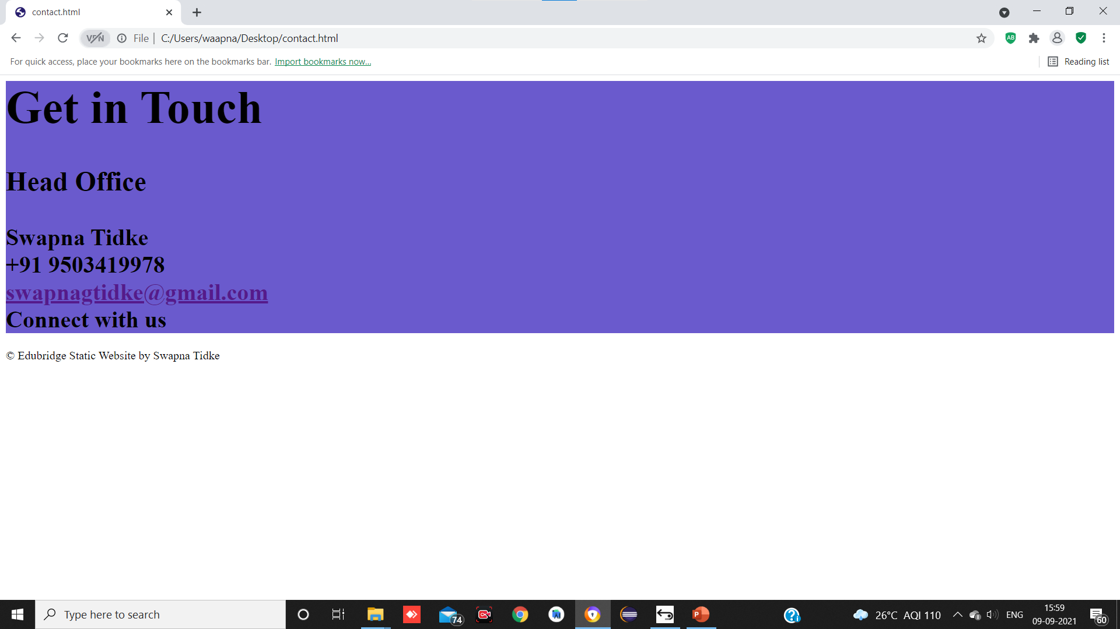
CONTACT

