Slide 1
IBM University Engagement Project Submission
“Exploring the Power of Agentic AI with IBM Granite and LangFlow”

Slide 2

Project Title: LearnEase AI — IBM Granite-powered Course Content Simplification Agent
Domain of Project : Education – Artificial Intelligence (AI)
Student Name | Recent Passport Photo | Email ID | Mobile number [WhatsApp]
Swapnika Mohanty |  | swapnikamohanty2006@gmail.com | 9100008991

Slide 3
Problem Statement -
Problem Statement :LearnEase AI
The Challenge
College students often struggle to understand complex academic materials and spend considerable time preparing notes and exam questions.
The Objective
To develop an AI-powered Course Content Simplification Agent that converts complex study material into simple, structured, and exam-oriented content.
The solution provides:
Content Simplification: Explains difficult concepts in simple language.
Study Notes: Generates definitions, key points, and summaries.
Examples: Provides real-life examples for better understanding.
Exam Preparation: Creates practice questions and answers.
AI Integration: Uses IBM watsonx.ai to generate learning content.
Responsible AI: Encourages verification with textbooks and faculty notes.
Future Scope: Explore LangFlow integration for an automated learning workflow.

Slide 4
Proposed Solution -
Proposed Solution:LearnEase AI
The proposed solution is an AI-powered Course Content Simplification Agent built using IBM watsonx.ai and Granite Models to transform complex academic content into simple, understandable, and exam-ready learning materials.
The system uses IBM Granite models to process academic topics and generate simplified explanations, structured notes, key points, and practice questions.
The system consists of four key functions:
Content Simplification: Converts complex topics into simple language.
Study Notes Generation: Creates definitions, key points, and important concepts.
Question Generation: Generates practice questions and answers for revision.
Summary Generation: Produces short summaries for quick learning.
The solution can be extended with a user-friendly dashboard to display learning materials in one place. IBM watsonx.ai Prompt Lab provides the environment to test Granite models for content generation and summarization.
Overall, LearnEase AI helps students understand difficult topics and prepare for examinations more effectively.

Slide 5
Technology Used
IBM watsonx.ai Prompt Lab: Used to create prompts and test AI-generated responses.
IBM Granite: The model selected during testing was granite-4-h-small.
IBM Cloud: Used to access IBM watsonx.ai.
Prompt Engineering: Used to define the AI assistant's role, instructions, output format, and learning objectives.
Future Enhancement: LangFlow workflow integration can be explored to extend the current prototype into a more automated agent workflow.

Slide 6
Langflow component Used -
Input: Student-provided topic or study material.
Prompt Instructions: Direct the AI to simplify the topic and organize the response.
IBM Granite Model: Generates simplified learning content.
Output: Structured explanations, key points, examples, and practice questions.
Human Review: Students verify the generated information using their textbooks and class notes.
Note: The current prototype was tested in IBM watsonx.ai Prompt Lab. A LangFlow workflow has not yet been implemented.

Slide 7
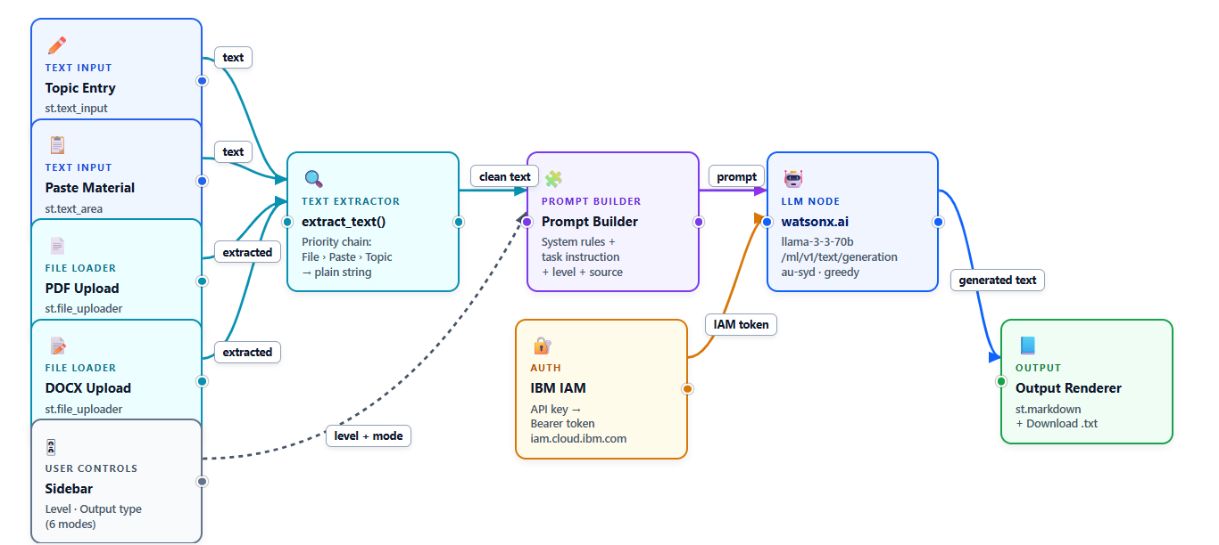
Langflow workflow –

Slide 8
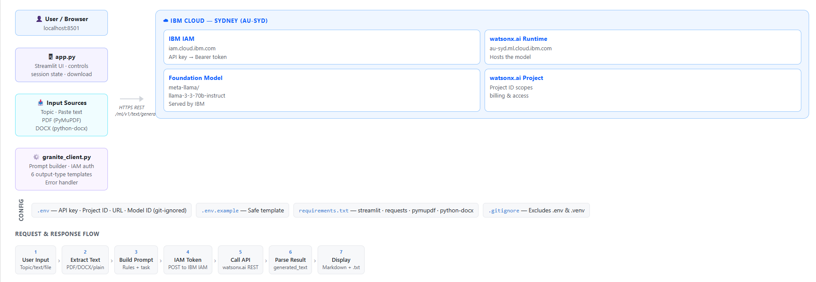
Architecture blueprint

Slide 9

Role of Agentic AI in the solution
Role of AI in LearnEase AI
Understands the learning task described in the prompt.
Simplifies complex technical concepts using student-friendly language.
Organizes content into structured sections for revision.
Generates examples and practice questions when requested.
Supports independent learning and exam preparation.
Human Oversight: The student remains responsible for checking the accuracy of the generated content.
Current Limitation: The prototype uses a single IBM Granite model. A multi-agent workflow has not yet been implemented.

Slide 10
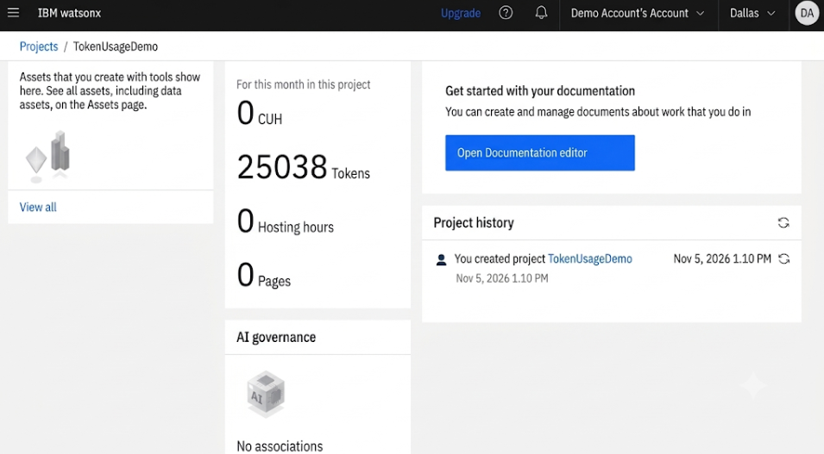
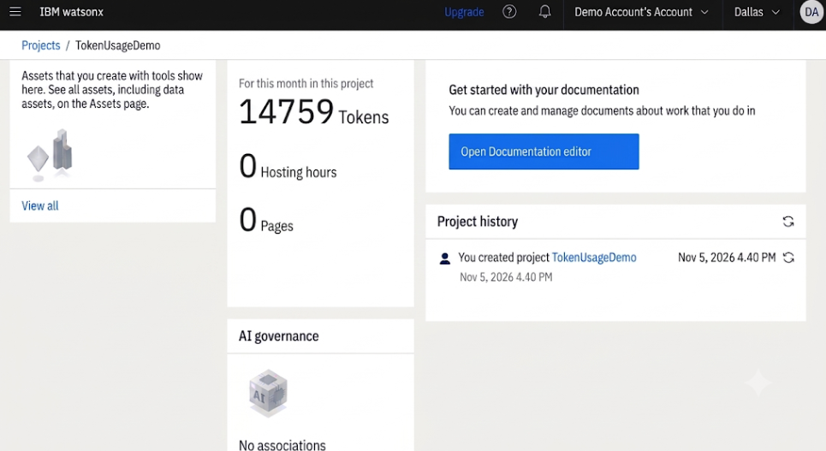
Token Usage
·
·
·

Slide 11
Novelty and Uniqueness
Focuses on simplifying academic content for college students.
Provides structured, exam-oriented learning material.
Combines explanations, examples, and practice questions in one response.
Can be used across different subjects and technical topics.
Helps students begin revision more efficiently.
Unique Feature: The prompt can be adapted to produce different learning formats according to the student's needs.
Limitation: Generated responses may contain errors and must be verified.

Slide 12
Git Hub Link
GitHub Repository: LearnEase AI
The repository includes:
README.md – Project overview, features, setup instructions, and application screenshots.
app.py – Main Streamlit application.
granite_client.py – IBM watsonx.ai integration for AI-powered content generation.
requirements.txt – Required Python libraries and dependencies.
.gitignore – Specifies files and folders excluded from Git tracking.
.streamlit/config.toml – Streamlit application theme configuration.
LearnEase_AI_Screenshots/ – Folder containing all 10 application screenshots.
01_Dashboard.png to 10_Technology Stack Details.png – Ten screenshots available individually in the repository root.
Project problem statement PDF.
Project presentation PPTX.
GitHub URL: https://github.com/Swapnika2229/LearnEase-AI
·
·
·

Slide 13
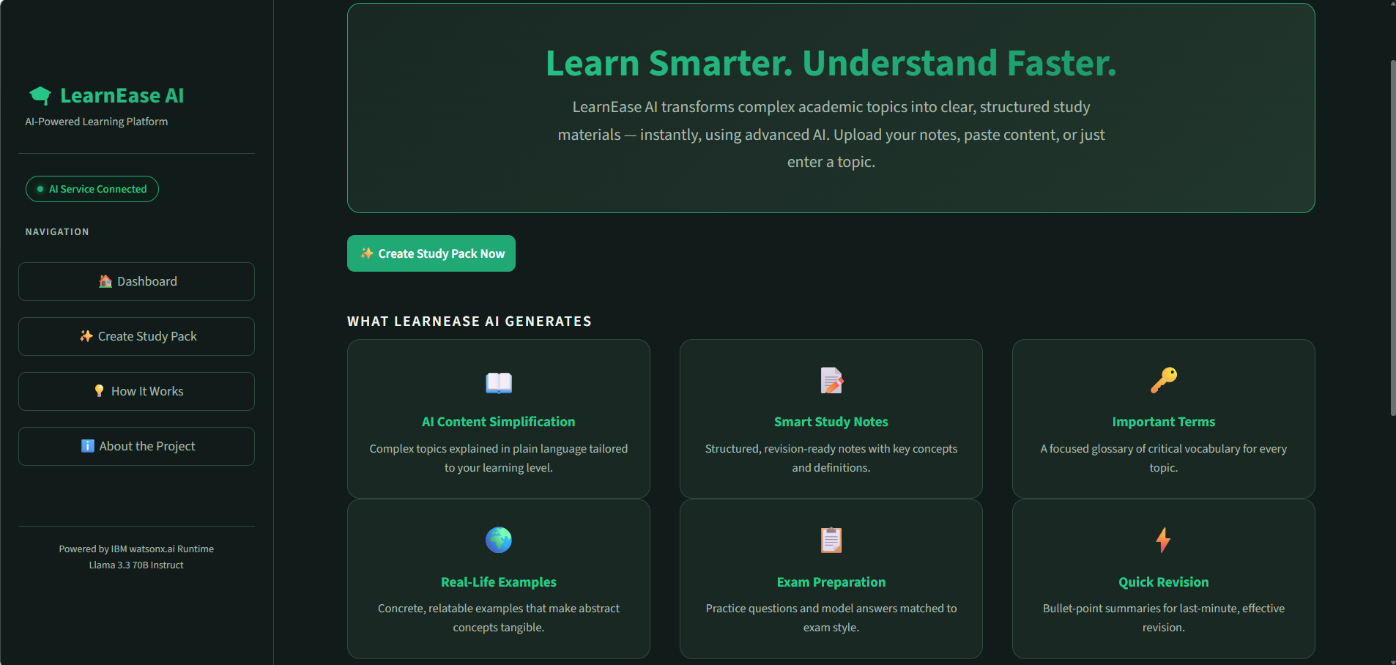
Outputs:
1. Homepage

Slide 14
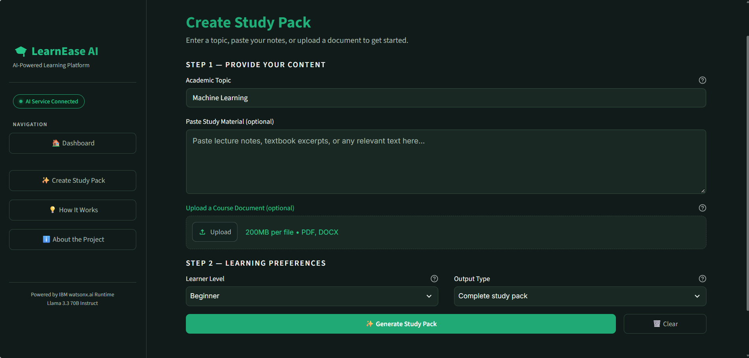
2. Create Study Pack

Slide 15
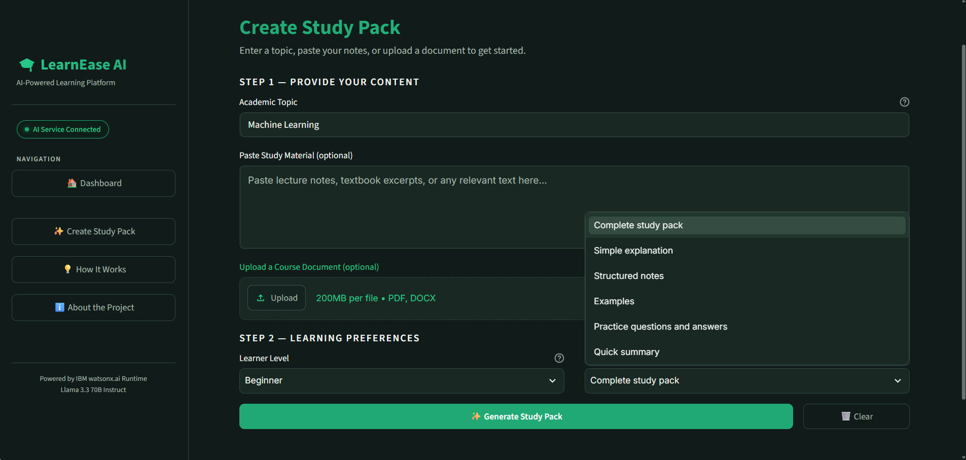
3. Learning Preferences

Slide 16
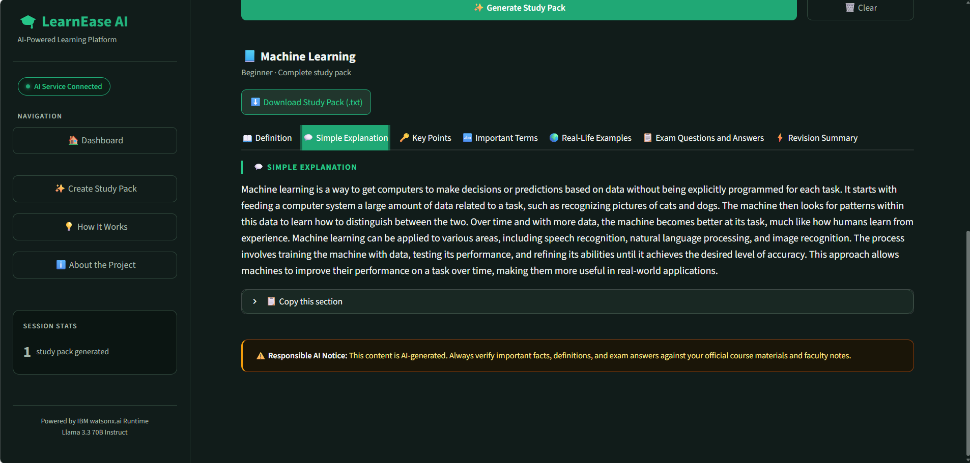
4. Definition and Simple Explanation

Slide 17
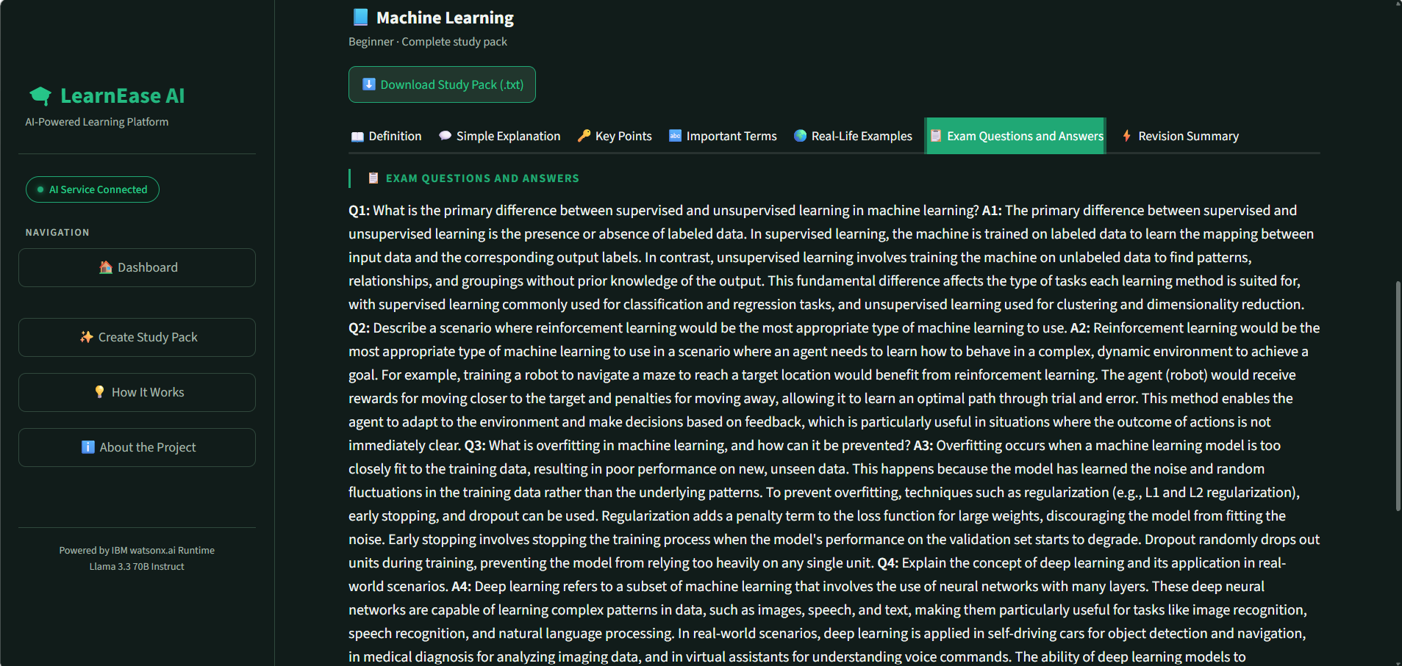
5. Exam Preparation

Slide 18
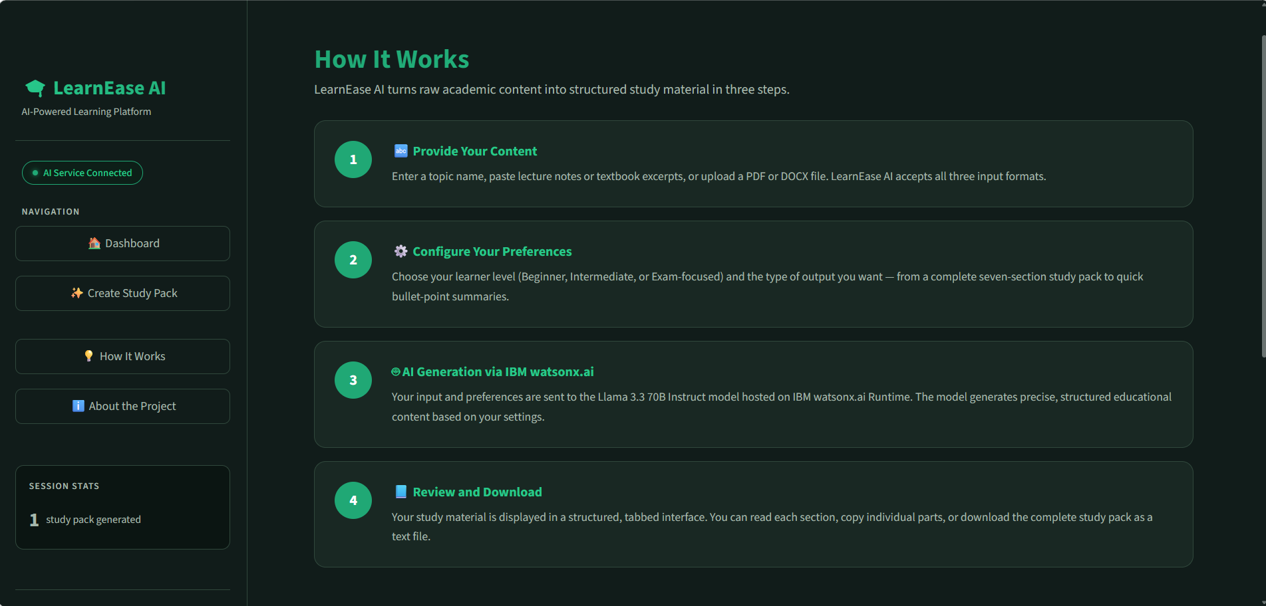
6. How it Works

Slide 19
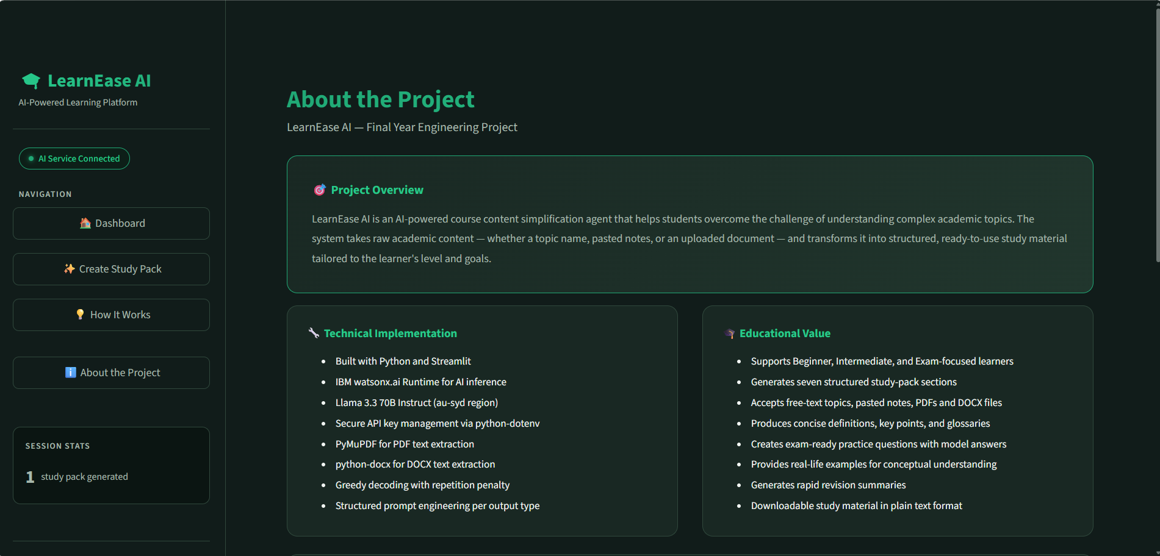
7. About the Project

Slide 20
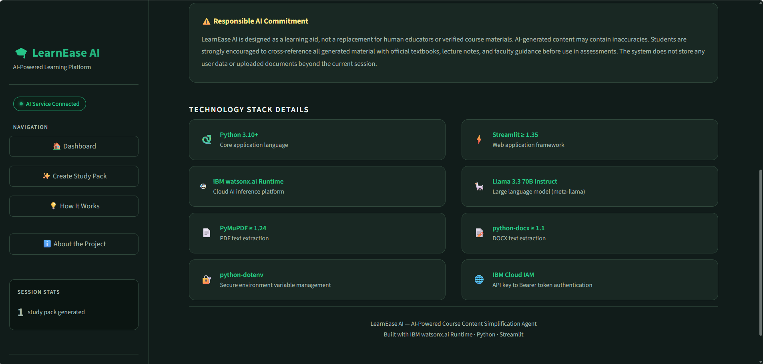
8. Technology Stack Details

Slide 21
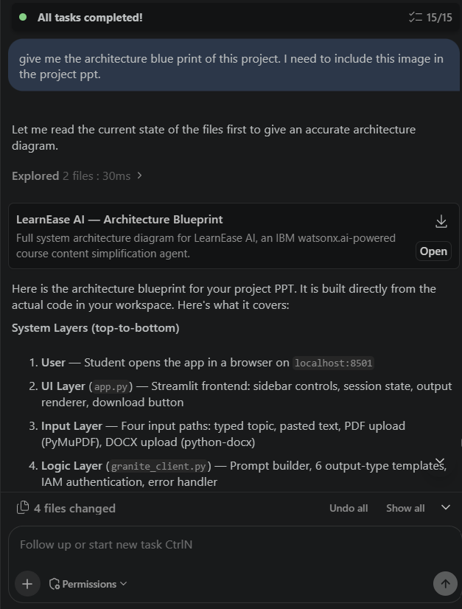
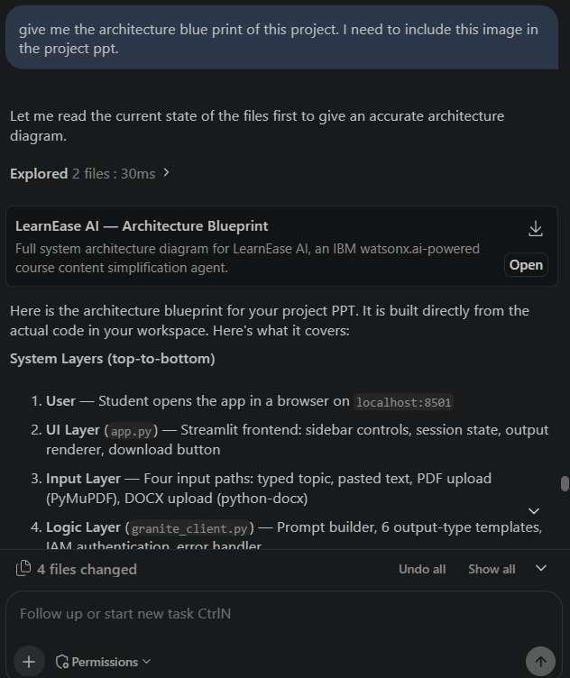
IBM Granite Prompt Lab demonstrations

Slide 22
Future Scope
Develop a user-friendly web application for students.
Add document upload to simplify lecture notes and study materials.
Generate flashcards, quizzes, and short revision summaries.
Explore LangFlow integration for a more automated workflow.
Test the system with additional subjects and evaluate the accuracy of generated content.
Improve reliability through human review and trusted reference materials.
·
·
·

Slide 23
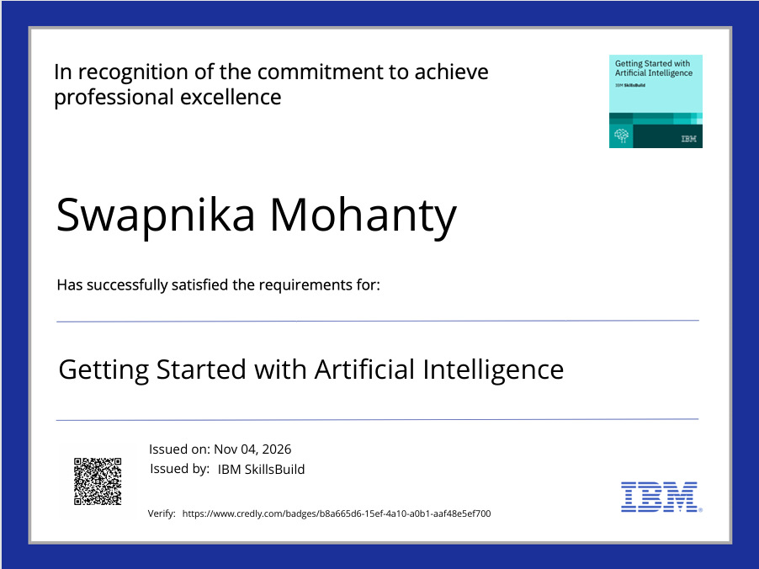
Certificates Earned:

Slide 24
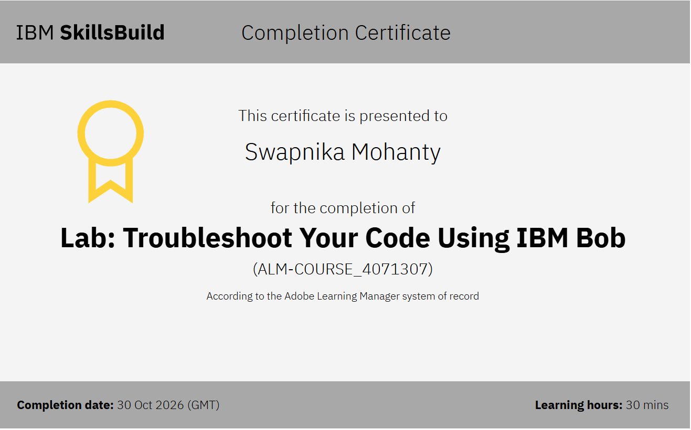
Certificates Earned:​

Slide 25

LearnEase AI — IBM Granite-powered Course Content Simplification Agent
Presented by: Swapnika Mohanty

