Slide 1

A3-PS023-TC301
Minimal Two-Node Cloud Hypervisor VM Controller
Team Member 1
Team Member 2
Team Member 3
Prof. Dr. Baisakhi Das
Debarghaya Mitra
Swapnil Chakraborty
baisakhi.das@iem.edu.in
debarghaya@debarghaya.in
chakrabortyswapnil06@gmail.com
Institute of Engineering and Management, Salt Lake, Kolkata
Institute of Engineering and Management, Salt Lake, Kolkata
Institute of Engineering and Management, Salt Lake, Kolkata
AIORI Hackathon 3
October 14, 2026

Slide 2
Problem Description
AIORI 3 Abstract
A lightweight KVM cloud needs a thin controller, not a stack of heavy daemons.
1
Enterprise hypervisors use multi-daemon architectures whose overhead is too high for lightweight edge deployments.
2
Cloud Hypervisor boots one VM per process on Linux KVM with a minimal footprint, but has no notion of a cluster.
3
Challenge: a controller and two worker agents on two KVM hosts that create, start, stop and list VMs.
4
Placement must follow available host memory, and VM resource limits must be enforced.
5
API failures must be handled and VM processes cleaned up, with no orphaned VMs or leaks.
Das, Mitra, Chakraborty • A3-PS023-TC301 • October 14, 2026
2 / 23

Slide 3
Background
AIORI 3 Background
What is needed to understand the problem and the proposed design.
1
KVM turns Linux into a hypervisor and is exposed to user space through /dev/kvm [6].
2
Cloud Hypervisor is a minimal VMM on KVM; it is controlled through a REST API served on a UNIX socket [1].
3
Each Cloud Hypervisor process runs exactly one VM, so “listing VMs” means asking every supervised process [1], [2].
4
Linux cgroup v2 can cap memory, CPU and process count, and kill every process of a VM at once [5].
5
Bearer tokens over TLS are a standard, light way to authenticate API callers [3], [4].
Das, Mitra, Chakraborty • A3-PS023-TC301 • October 14, 2026
3 / 23

Slide 4
Requirements to Design
AIORI 3 Understanding
Each requirement in the statement and what it means for the design.
Requirement | Design implication
2 KVM hosts, preset networking | Verify /dev/kvm at startup; consume pre-made TAP or bridge
1 prepared VM image | Per-VM reflink copy of the base image
Authenticated controller to worker | Bearer token over TLS; mTLS as hardening
Memory-based placement | Workers report free RAM; controller reserves atomically
Enforced resource limits | Flavors, Cloud Hypervisor config and cgroup v2 caps
Clean failure handling | Supervision, rollback, reconciler, cgroup kill
Das, Mitra, Chakraborty • A3-PS023-TC301 • October 14, 2026
4 / 23

Slide 5
Where the Difficulty Hides
AIORI 3 Understanding
The statement looks simple; these are the parts that decide the result.
1
Orphaned VMs
2
Partial failures
A worker crash can leave cloud-hypervisor processes eating RAM.
vm.create succeeds, vm.boot fails: leaked disk and process.
3
Placement races
4
State divergence
Two requests see the same free memory and overcommit a host.
Controller inventory and worker reality drift after restarts.
Das, Mitra, Chakraborty • A3-PS023-TC301 • October 14, 2026
5 / 23

Slide 6
Assumptions and Non-goals
AIORI 3 Understanding
What we take as given, and what we deliberately leave out.
Assumptions
Non-goals
Linux with KVM, cgroup v2 and a cloud-hypervisor binary
One prepared image at the same path on both hosts
Preconfigured bridge or TAP; controller reaches both workers
Workers run as root or with CAP_NET_ADMIN
Live migration and distributed storage
Browser VNC and an image marketplace
A new hypervisor
Also ours: HA controller, RBAC, CPU overcommit
Das, Mitra, Chakraborty • A3-PS023-TC301 • October 14, 2026
6 / 23

Slide 7
Literature & RFC Review
AIORI 3 Literature & RFC Review
Only the most relevant standards and studies, and how each is used.
Source | Key idea | Used in our design
[1] Cloud Hypervisor API | REST over a UNIX socket: vm.create, vm.boot, vm.shutdown, vm.delete | Worker lifecycle integration
[2] Firecracker (NSDI 2020) | Minimal VMM; one process and one API socket per micro-VM | Process-per-VM supervision
[3] RFC 6750 | Bearer tokens in the Authorization header | Controller and worker API auth
[4] RFC 8446 | TLS 1.3 protects credentials in transit | Encrypted controller-worker link
[5] Linux cgroup v2 | memory.max, cpu.max, pids.max, cgroup.kill | Limits and leak-free teardown
[6] KVM | In-kernel hypervisor exposed as /dev/kvm | Hardware virtualisation
Das, Mitra, Chakraborty • A3-PS023-TC301 • October 14, 2026
7 / 23

Slide 8
Proposed Solution
AIORI 3 Proposed Solution
One controller, two worker agents, one Cloud Hypervisor process per VM.
1
Controller: authenticated REST API, SQLite inventory, memory-based placement and a periodic reconciler.
2
Worker agent (per host): spawns cloud-hypervisor in its own cgroup, drives vm.create, vm.boot, vm.shutdown and vm.delete, reports free memory.
3
Security: bearer token over TLS on both API tiers; VM sockets are owned by the agent only.
4
Cleanup: cgroup kill, parent-death signal, write-ahead metadata and undo lists leave no orphans.
VM lifecycle
PENDING
CREATED
RUNNING
STOPPED
DELETED
Das, Mitra, Chakraborty • A3-PS023-TC301 • October 14, 2026
8 / 23

Slide 9
Cloud Hypervisor Integration
AIORI 3 Solution Details
The management API calls each worker agent relies on.
Endpoint (/api/v1/) | Purpose
vmm.ping GET | Health and version
vm.create PUT | Define VM, do not boot
vm.boot PUT | Boot a created VM
vm.info GET | Config and state
vm.shutdown PUT | Stop the guest
vm.delete PUT | Remove definition
1 : 1
One cloud-hypervisor process per VM, driven over its own UNIX socket. “List VMs” really means “ask each supervised process”.
Das, Mitra, Chakraborty • A3-PS023-TC301 • October 14, 2026
9 / 23

Slide 10
Two Small APIs
AIORI 3 Solution Details
One operator-facing API on the controller, one internal API on each worker.
Controller API (operators)
Worker API (controller only)
POST /v1/vms
create
POST /v1/vms
spawn + define
GET /v1/vms
list
GET /v1/vms
live state
POST /v1/vms/{id}/start
start
POST /v1/vms/{id}/start
boot
POST /v1/vms/{id}/stop
stop
POST /v1/vms/{id}/stop
stop + reap
DELETE /v1/vms/{id}
delete
DELETE /v1/vms/{id}
clean up
GET /v1/workers
capacity
GET /v1/capacity
free memory
Auth: Authorization: Bearer token, constant-time compare, TLS, separate credentials per tier.
Das, Mitra, Chakraborty • A3-PS023-TC301 • October 14, 2026
10 / 23

Slide 11
Memory-based Placement
AIORI 3 Solution Details
Pick a host with enough free RAM, and never overbook.
1
Ask each healthy worker for capacity
Effective free memory
2
Drop workers without enough free RAM
min( MemAvailable − reserve,
total − reserve − Σ guest RAM )
3
Pick the host with the most free memory
Taking the minimum of the real and committed views guards against guest pages not yet faulted in.
4
Reserve it in SQLite under a lock
5
Call the worker; roll back on failure
Das, Mitra, Chakraborty • A3-PS023-TC301 • October 14, 2026
11 / 23

Slide 12
Three Layers of Limits
AIORI 3 Solution Details
A misbehaving request or guest cannot harm the host.
1
2
3
Admission control
Hypervisor config
cgroup v2 caps
Only allowed vCPU and RAM sizes pass; the worker re-validates.
boot_vcpus equals max_vcpus; memory.size exactly as granted.
memory.max = RAM + 128 MiB, cpu.max = vCPUs × 100%, pids.max.
small 1 vCPU · 512 MiB
medium 2 vCPU · 1 GiB
large 4 vCPU · 2 GiB
Das, Mitra, Chakraborty • A3-PS023-TC301 • October 14, 2026
12 / 23

Slide 13
Failure Handling
AIORI 3 Solution Details
Every failure ends in a clean, known state.
Failure | Response
CH fails to start | Kill cgroup, delete disk copy, mark FAILED
vm.create or vm.boot error | Roll back through the undo list
Graceful shutdown hangs | vmm.shutdown, then SIGTERM, then cgroup.kill
Worker unreachable | Mark unhealthy, stop placing, VM becomes UNKNOWN
Agent or CH crash | Startup reconcile: adopt or kill; mark FAILED
Controller dies mid-create | Reconciler resolves leftover PENDING rows
Das, Mitra, Chakraborty • A3-PS023-TC301 • October 14, 2026
13 / 23

Slide 14
No Orphans, by Construction
AIORI 3 Solution Details
Five mechanisms that make leaks practically impossible.
1
cgroup per VM
cgroup.kill ends every descendant at once
2
Parent-death signal
PR_SET_PDEATHSIG: VMs die with the agent
3
Write-ahead metadata
meta.json written before the spawn
4
Reconciler loop
Compares inventory, metadata, live processes
5
Timeouts + undo lists
Every call bounded; every step reversible
Das, Mitra, Chakraborty • A3-PS023-TC301 • October 14, 2026
14 / 23

Slide 15
Optimization Proposed
AIORI 3 Solution Optimization
Before (naive design) versus after (proposed design).
Aspect | Before: naive approach | After: proposed optimization
Placement | Read MemAvailable only; races overcommit | min(real, committed) plus a reservation lock
Teardown | Kill stored PID; children can leak | cgroup.kill, death signal and reconciler
Limits | Recorded only, not enforced | Flavors, CH config and cgroup v2 caps
Disk | Full image copy per VM | Reflink copy (cp --reflink=auto)
Failures | Ad-hoc error handling | Undo list and rollback per operation
Das, Mitra, Chakraborty • A3-PS023-TC301 • October 14, 2026
15 / 23

Slide 16
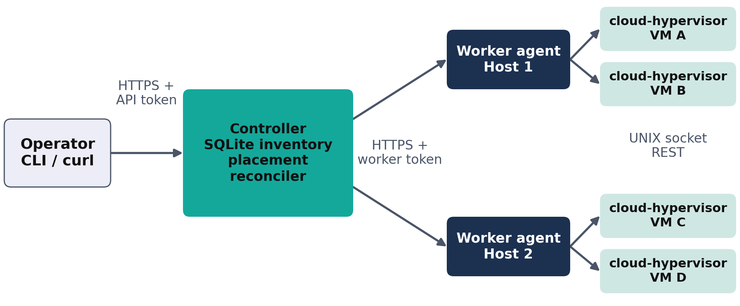
Solution Architecture & Design
AIORI 3 Architecture Design (UML Diagram)
Visual: controller, two workers and their VM processes.
Figure: System architecture (deployment) diagram
Das, Mitra, Chakraborty • A3-PS023-TC301 • October 14, 2026
16 / 23

Slide 17
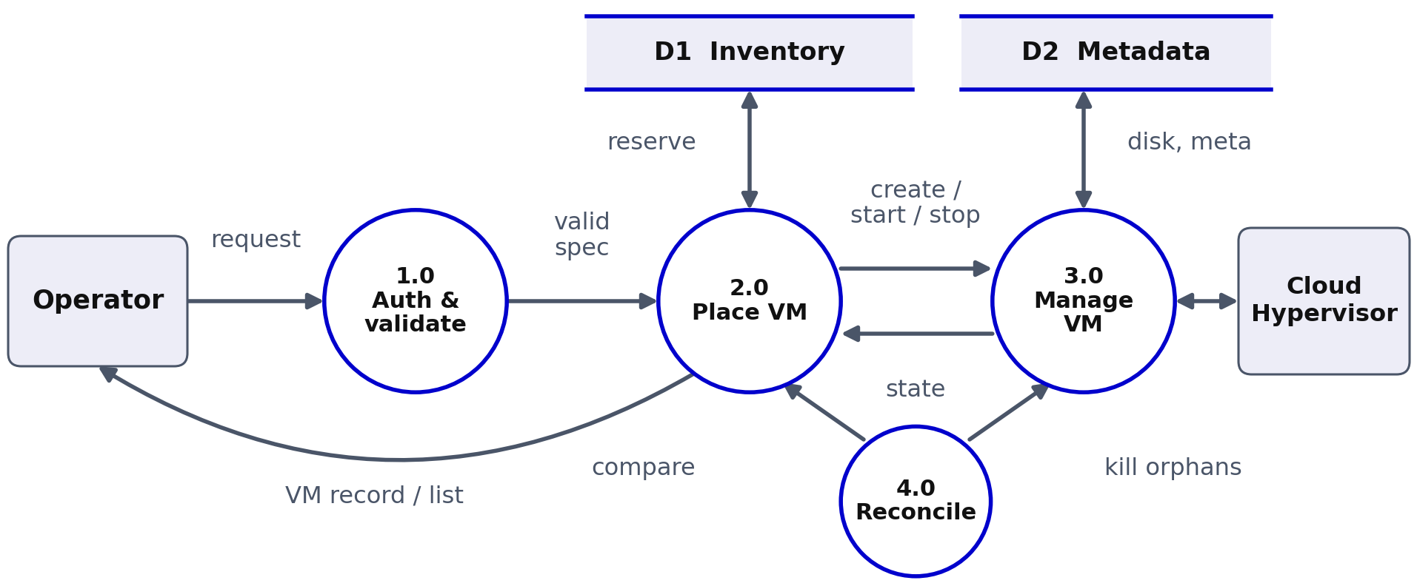
Data Flow Diagram
AIORI 3 Data Flow Diagram
Visual: how a request flows through the system.
Figure: Data Flow Diagram (DFD)
Das, Mitra, Chakraborty • A3-PS023-TC301 • October 14, 2026
17 / 23

Slide 18
Pseudocode: Create Path
AIORI 3 Implementation
Controller placement and worker spawn, with rollback on any error.
Controller
Worker agent
create_vm(req):
authenticate(req)
spec = validate(req)
with placement_lock:
w = best_fit(workers, spec.mem)
if not w: raise NoCapacity
vm = db.insert(PENDING, w)
try:
w.post("/v1/vms", vm.id, spec)
db.set(vm, CREATED)
except:
w.try_delete(vm.id)
db.set(vm, FAILED); raise
agent_create(id, spec):
check_limits(spec)
write_meta(id, "creating")
try:
disk = reflink(BASE_IMG)
cg = cgroup(mem_max, cpu_max)
proc = spawn_ch(sock, in=cg)
wait_ping(sock, 5s)
ch.put("vm.create", cfg(spec))
write_meta(id, "created")
except:
run_undo(); remove_meta(id)
raise
Das, Mitra, Chakraborty • A3-PS023-TC301 • October 14, 2026
18 / 23

Slide 19
Test Strategy
AIORI 3 Validation
Unit, lifecycle, two-host placement and failure-injection tests.
Unit (no KVM)
Lifecycle
Placement, validation, auth, state machine, fake CH socket.
Create, start, stop, delete; nothing left behind.
Two-host placement
Failure injection
Fill Host 1, spill to Host 2, reject oversize.
kill -9 CH or agent, block worker port, kill controller.
Leak check after every test: processes, cgroups, sockets and disks match inventory
Das, Mitra, Chakraborty • A3-PS023-TC301 • October 14, 2026
19 / 23

Slide 20
Demonstration and Deliverables
AIORI 3 Validation
What the mentor sees, and what we hand over.
Live demo (5–7 min)
Deliverables
1
Workers healthy; place two VMs by memory
✓
Private repo A3-PS023-TC301
2
Start both; show serial output or ping
✓
Add aiori-hackathon; transfer ownership
3
Reject a VM too large for either host
✓
PDF report in the repo, given structure
4
Kill a CH process; show FAILED, memory freed
✓
Demo with pseudocode for the mentor
5
Stop, delete, then run the leak check
Das, Mitra, Chakraborty • A3-PS023-TC301 • October 14, 2026
20 / 23

Slide 21
Deployment Timeline
AIORI 3 Deployment Timeline
Official hackathon milestones, and our build plan inside them.
1
2
3
4
5
6
7
14 Oct
16 Oct
16–31 Oct
31 Oct–4 Nov
5 Nov
24–30 Nov
17 Dec
Level 1 steps 1–7 complete
Level 2 teams announced
Mentoring sessions and steps 8–10
Evaluators connect with teams
Regional teams announced
Regional hackathon: Bengaluru, Pune, Kolkata, Noida
Finals: 8 teams at IIT Jammu
Our build plan (inside the 16–31 Oct mentoring window)
Incremental delivery: single-host agent, then controller, then reconciler, then tests, report and demo.
Mentoring sessions review each milestone; each one ends with a leak check on both hosts.
Cloud Hypervisor version pinned so the API schema stays stable.
Das, Mitra, Chakraborty • A3-PS023-TC301 • October 14, 2026
21 / 23

Slide 22
Bibliography I
Bibliography
[1]
Cloud Hypervisor Project. “Cloud Hypervisor REST API documentation.” GitHub, docs/api.md. github.com/cloud-hypervisor/cloud-hypervisor
[2]
Alexandru Agache et al. “Firecracker: Lightweight Virtualization for Serverless Applications.” In: Proc. USENIX NSDI (2020).
[3]
Michael B. Jones and Dick Hardt. “The OAuth 2.0 Authorization Framework: Bearer Token Usage.” RFC 6750, IETF (2012).
[4]
Eric Rescorla. “The Transport Layer Security (TLS) Protocol Version 1.3.” RFC 8446, IETF (2018).
[5]
The Linux Kernel Documentation. “Control Group v2.” docs.kernel.org/admin-guide/cgroup-v2.html.
[6]
Avi Kivity et al. “kvm: the Linux Virtual Machine Monitor.” In: Proceedings of the Linux Symposium (2007).
Das, Mitra, Chakraborty • A3-PS023-TC301 • October 14, 2026
22 / 23

Slide 23
Thank You for Your Attention!

