Slide 1
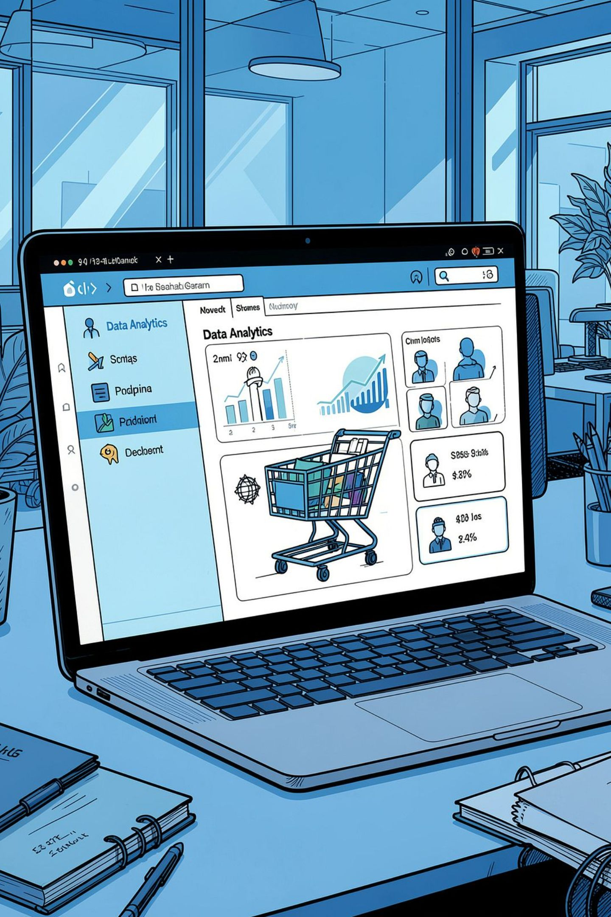
Customer Shopping Behavior Analysis
Uncovering spending patterns, segments, and preferences across 3,900 transactions to guide strategic decisions.

Slide 2

Dataset at a Glance
3,900
18
Transactions
Features
37
Missing Values
Review Rating column only
Key features: demographics, purchase details, shopping behavior, and subscription status.

Slide 3


Data Preparation in Python
Load & Explore
pandas: df.info(), .describe()
Clean
Imputed Review Rating via median; snake_case columns
Engineer
Added age_group & purchase_frequency_days
Load
Cleaned data into PostgreSQL

Slide 4
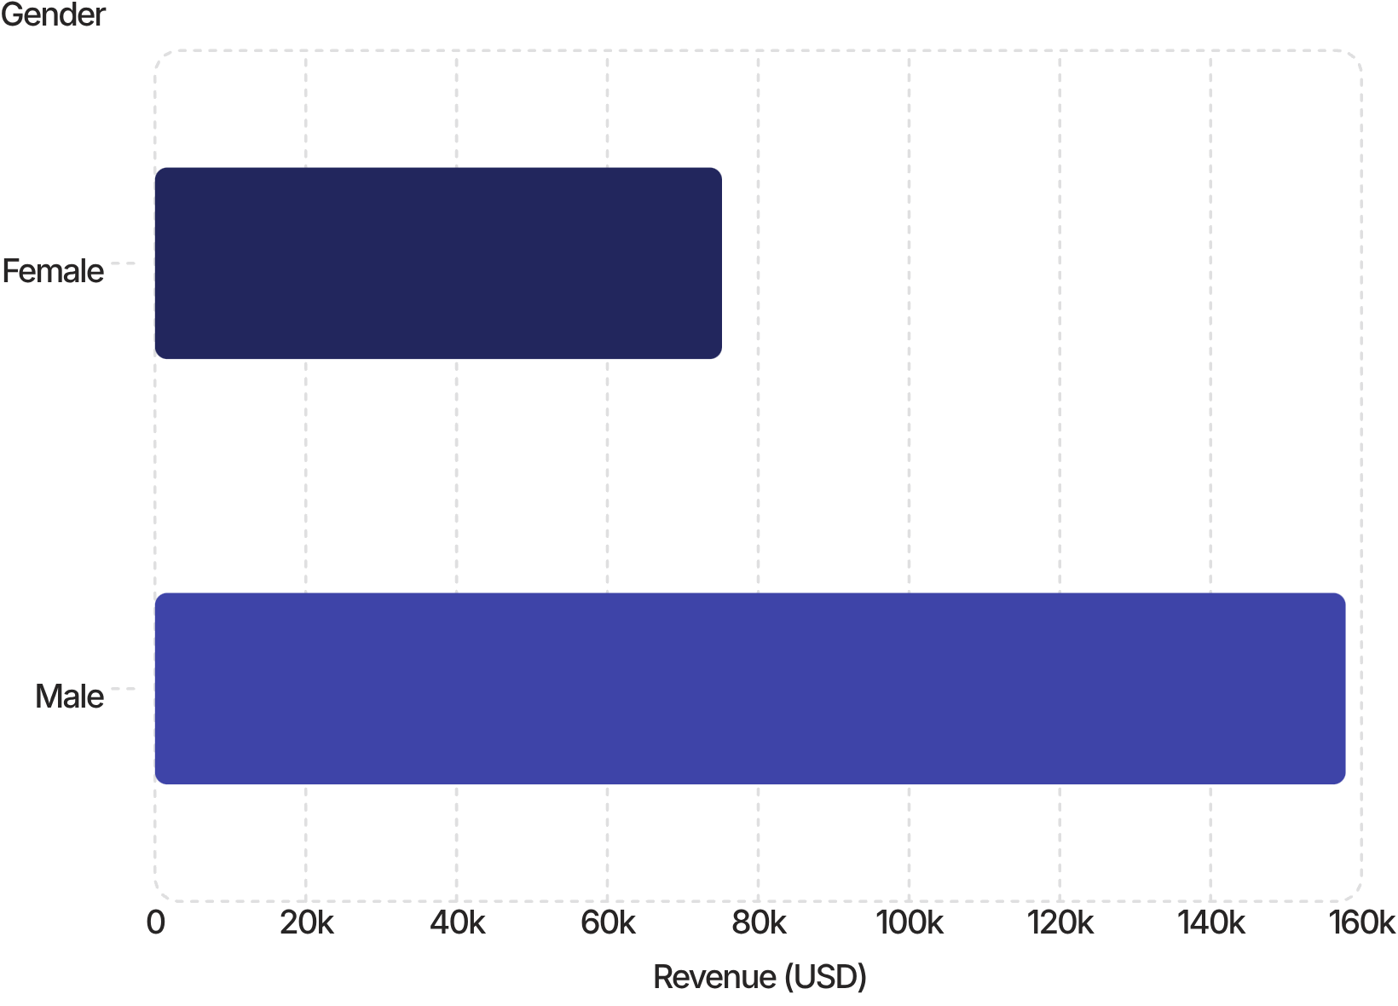

Revenue by Gender
Key Insight
Male customers generated 2.1× more revenue than female customers across all categories.
Male: $157,890 · Female: $75,191

Slide 5
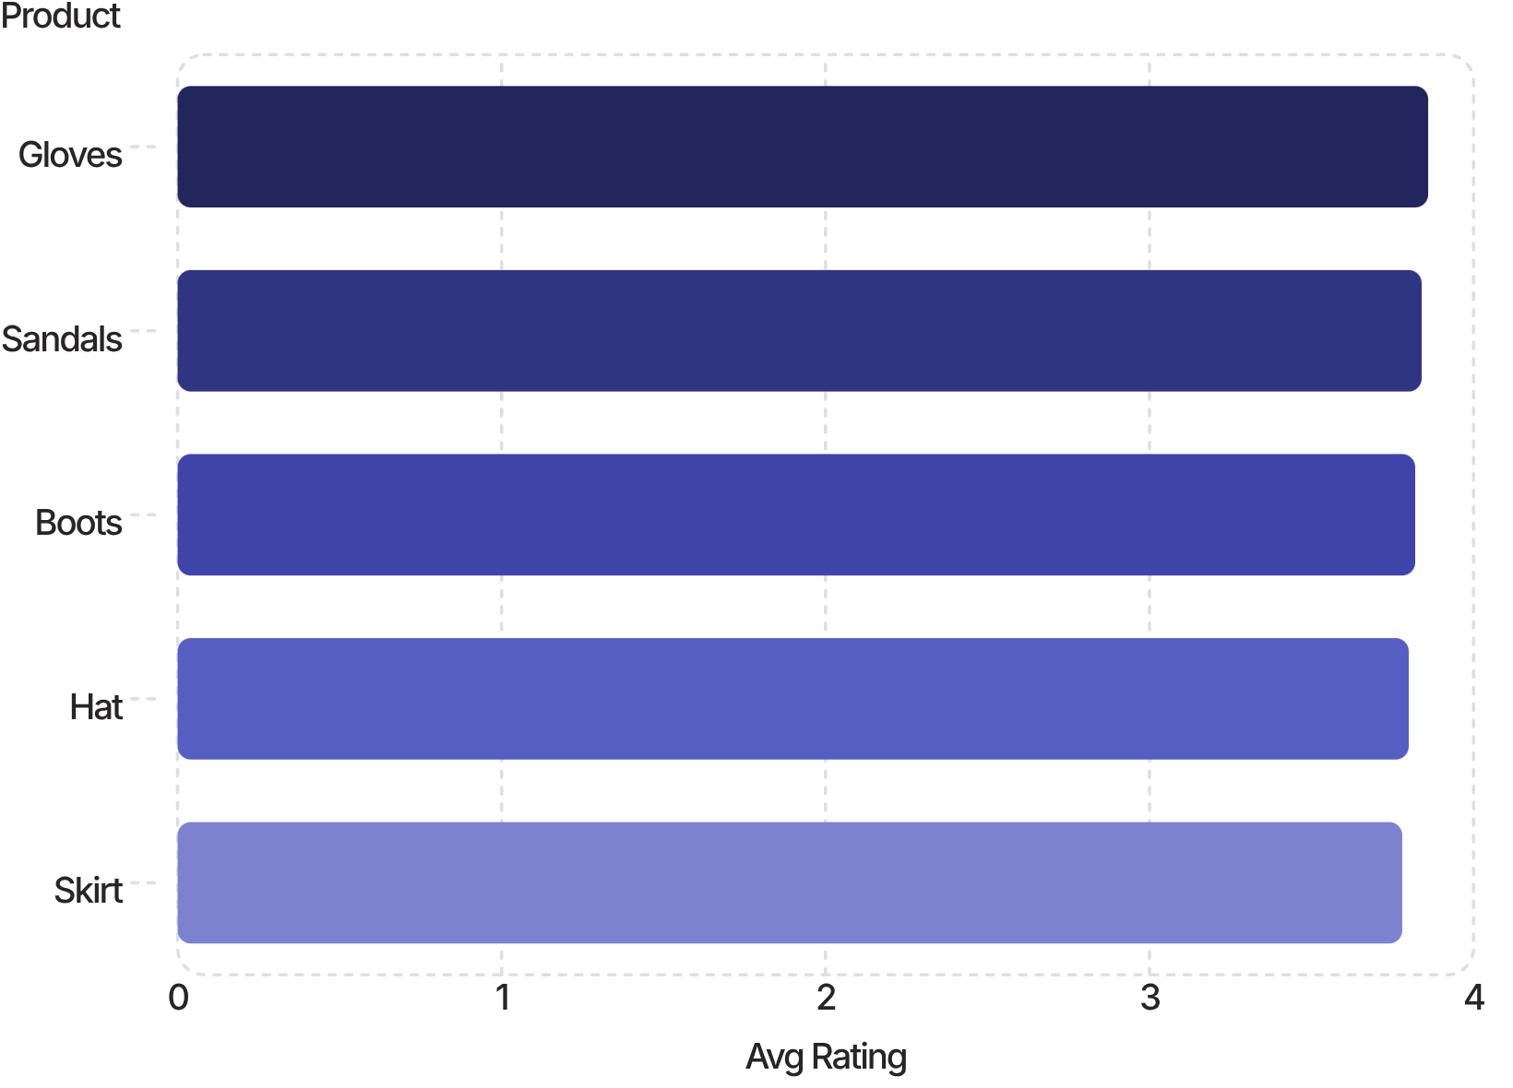

Top Products & Discount Patterns
Highest-Rated Products
Most Discounted Products
Hat
50.00% discounted
Sneakers
49.66% discounted
Coat
49.07% discounted

Slide 6
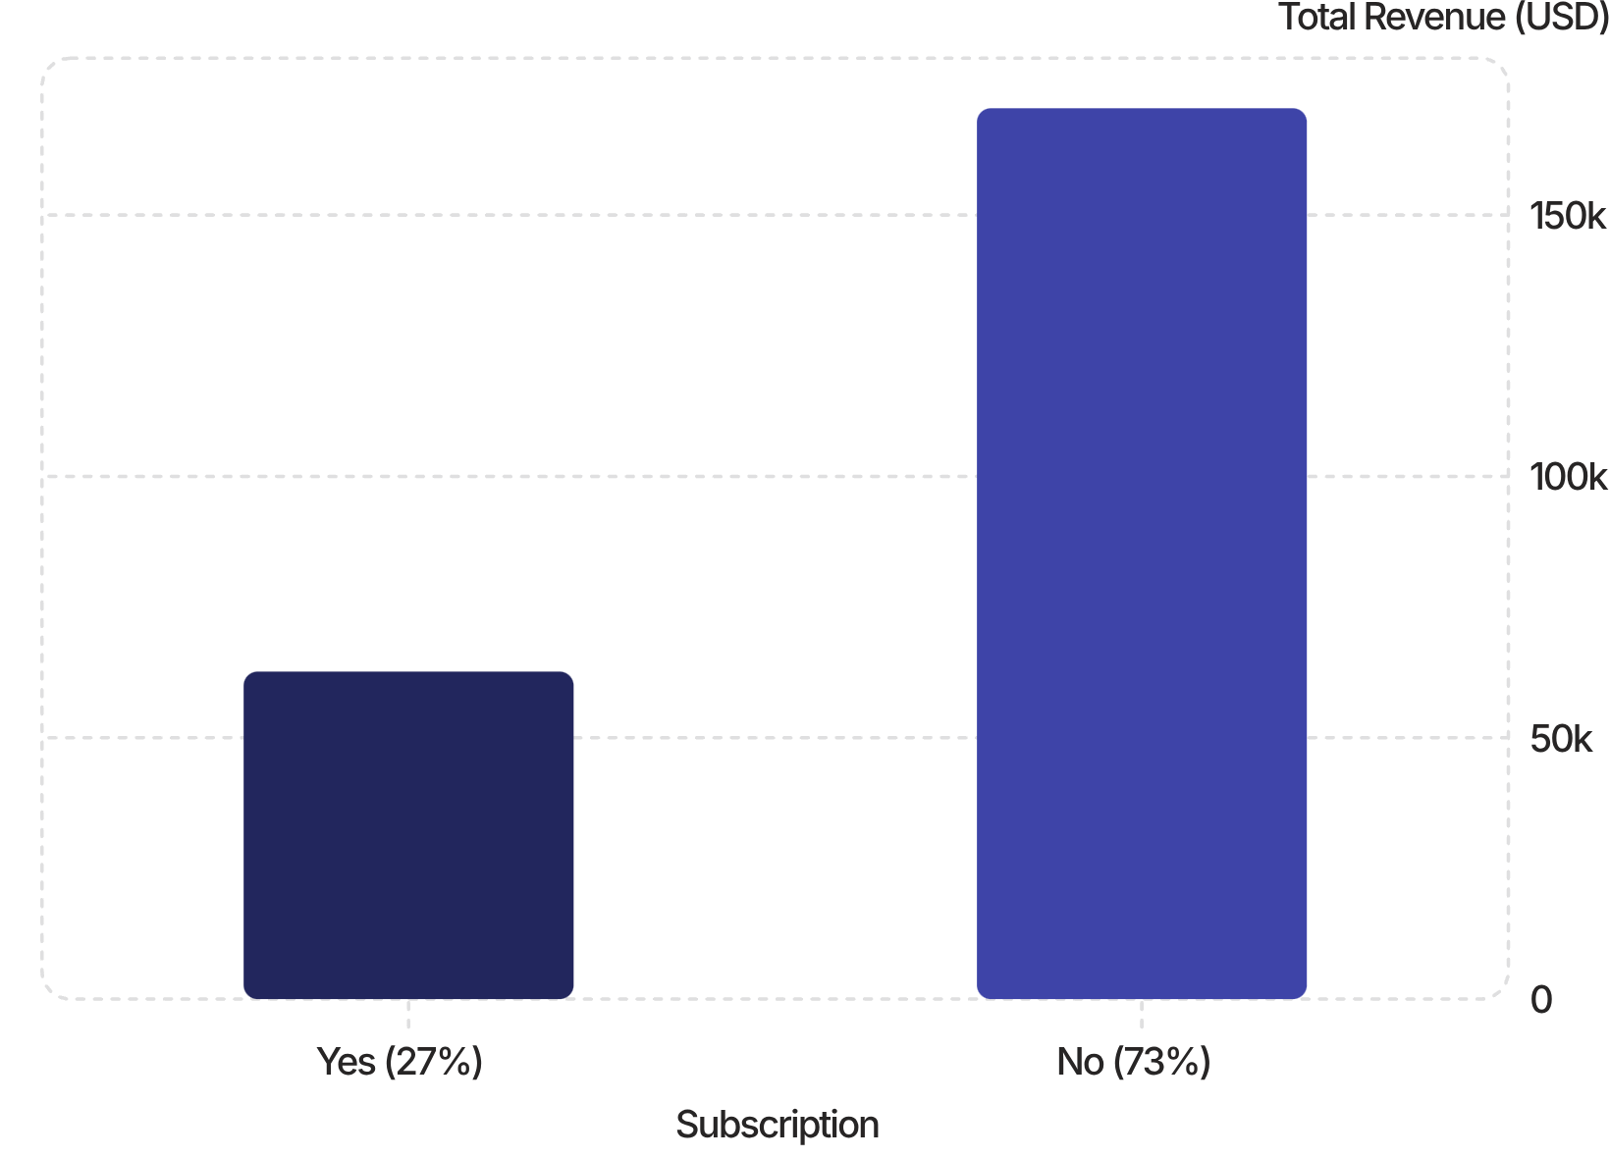
Subscribers vs. Non-Subscribers
Spending Behavior
Average spend is nearly identical: $59.49 (subscribers) vs. $59.87 (non-subscribers).
Non-subscribers drive 73% of total revenue — a major growth opportunity.

Slide 7
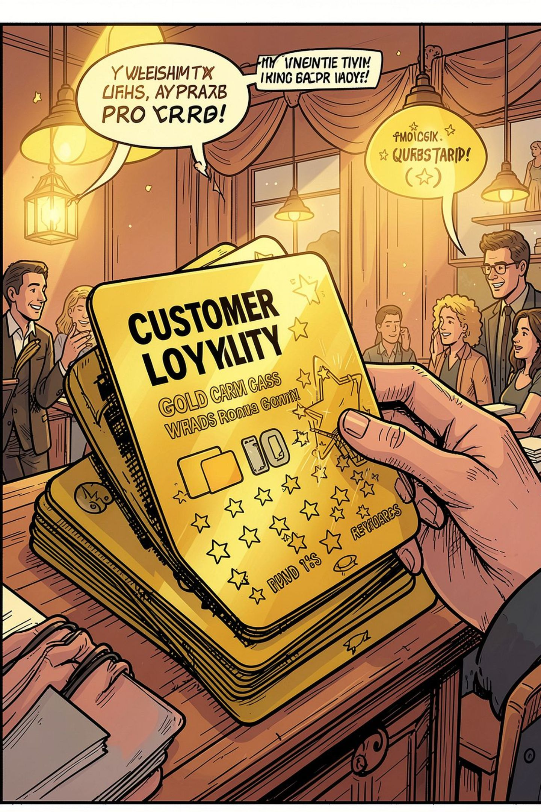
Customer Segmentation
🏆 Loyal
🔄 Returning
3,116 customers
701 customers
🆕 New
83 customers
839 high-spenders used discounts yet exceeded average purchase amounts. Repeat buyers (>5 purchases): 2,518 non-subscribers vs. 958 subscribers.

Slide 8
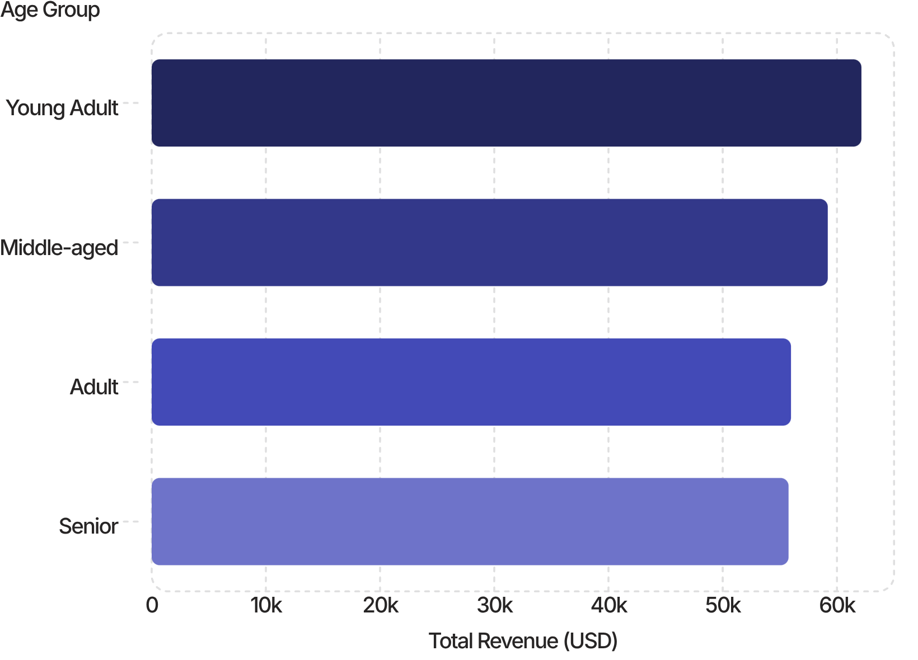
Revenue by Age Group
Takeaway
Young Adults lead revenue at $62,143, but all groups contribute fairly evenly — broad targeting is effective.
Express shipping avg: $60.48 vs. Standard $58.46

Slide 9




Power BI Dashboard
3.9K Customers
$59.76 Avg Purchase
3.75 Avg Rating
Filters: Subscription Status, Gender, Category, Shipping Type. Top revenue: Clothing ($100K) → Accessories ($75K) → Footwear ($30K) → Outerwear ($15K).

Slide 10





Business Recommendations
Boost Subscriptions
Promote exclusive subscriber benefits.
Loyalty Programs
Reward repeat buyers to grow Loyal segment.
Review Discount Policy
Balance sales lift with margin control.
Targeted Marketing
Focus on high-revenue age groups & express-shipping users.

