Slide 1


Sipna College of Engineering & Technology, Amravati
Abuse Related Posts Reporter using Web
Scraping in Python
Guided by :
Dr. P. A. Tijare
Presented by:
Dishil Purswani
Swapnil Chavhan
Vijay Jangid
Shubham Agrawal
Tanishk Rathi

Slide 2
Contents
Introduction
Analysis of Problem
Overview
Technology Used
Implementation
Results
Advantages and Limitations
Conclusion
Future Scope
Reference
publication

Slide 3
Introduction
What if you want to see the data of a hundred more pages at a time? Moreover, when you have to extract the data of hundreds (sometimes, thousands) of webpages, this task can seem strenuous. This is where web scraping comes in.
In our website, we have made use of this technology to solve a important social issue. Many cases of abuse have been increased with the use of Internet. Our website allows the authorized communities to search for such abuse related posts from different websites, while staying on a single webpage.
The user will just have to enter the keyword, for e.g. – women abuse, and he will get the posts from several number of websites on a single webpage. This will help the authorities to save time in searching for such crimes and give more time to solve these issues.

Slide 4
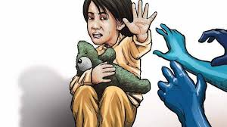
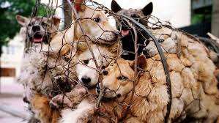
Analysis of Problem
Existing Problem :-
According to [5], India has a wide range of laws to protect children and women and their protection is increasingly accepted as a core component of social development. For e.g.- In 2019, the Protection of Children from Sexual Offences Bill was amended, stipulating stricter punishment for sexual crimes against children. Even after taking so many steps, many people are afraid of reporting and complaining to the concerned authorities. No action can be taken until a abuse is reported.

Slide 5
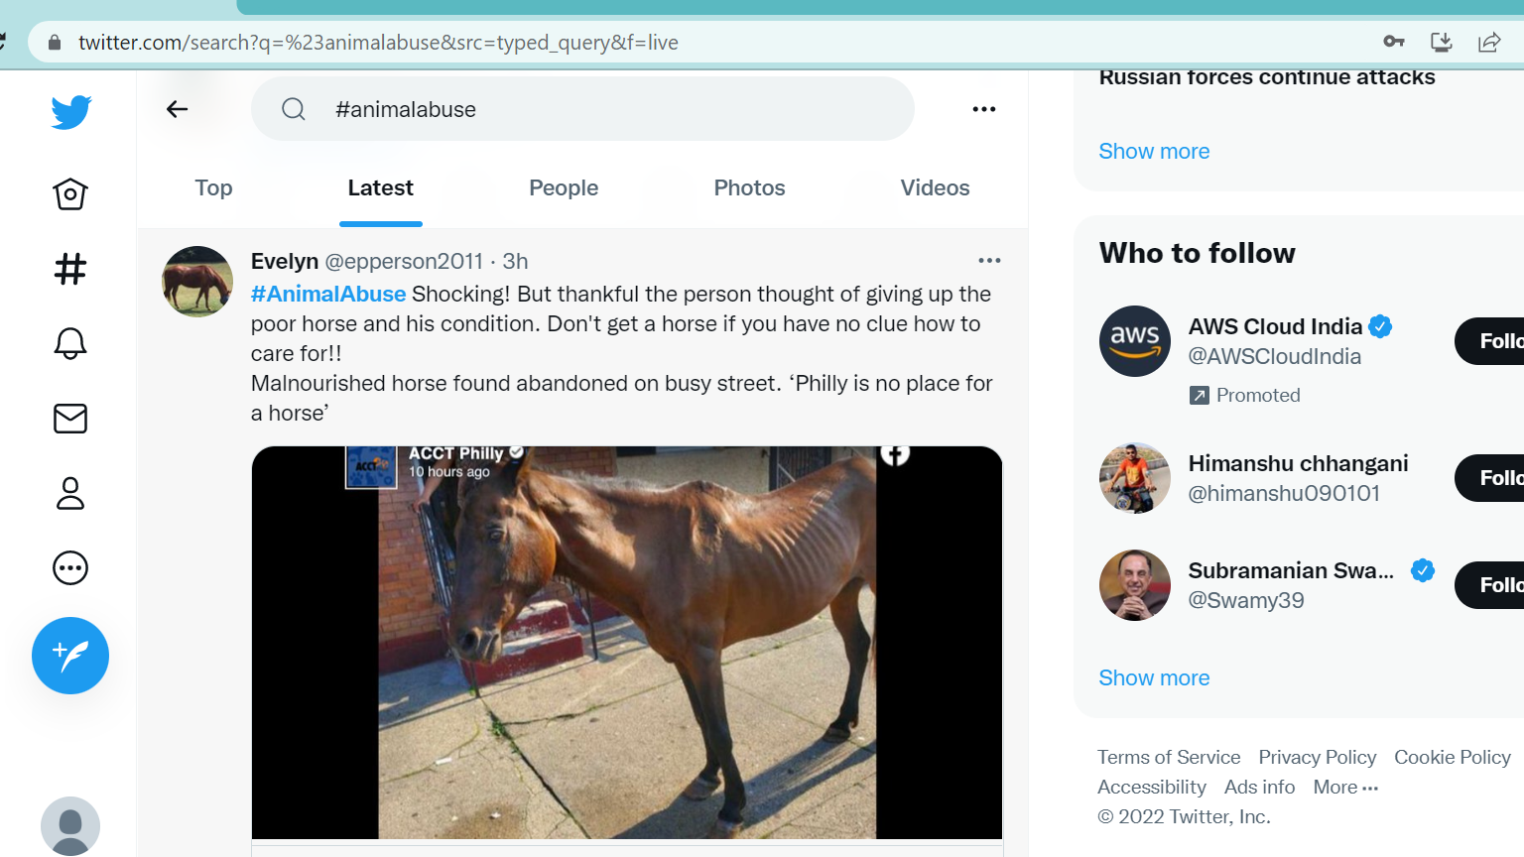
Analysis of Problem
Proposed Solution :-
In all such cases, to help the victims, many socially active people take a initiative by reporting these things on popular social platforms with the use of hashtags. The solution proposed here uses these social platforms to get abuse related posts.

Slide 6
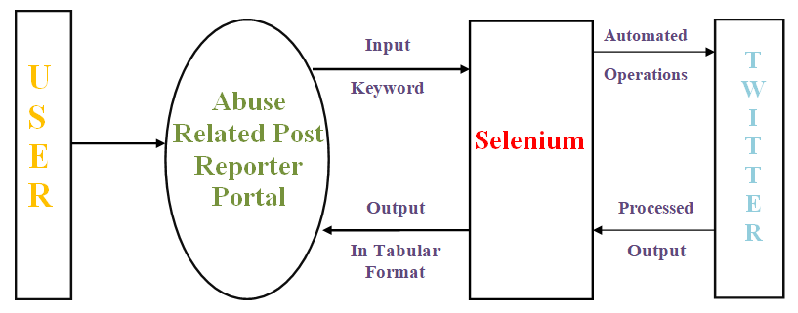
Overview

Slide 7
Technology Used
Python :-
Python is a programming language that has a huge collection of libraries such as Numpy, Matlplotlib,
Pandas, etc., which provides methods and services for various purposes.
DJango :-
DJango is a free and open-source web application framework, written in Python. It helps to develop
websites faster and easier. Our output will be shown on this website.
Selenium :-
Selenium is an open-source web-based automation tool. Selenium is primarily used for testing in the
industry but It can also be used for web scraping.

Slide 8
Technology Used
ChromeDriver :-
Chrome WebDriver (ChromeDriver) is an open-source tool for automated testing of web apps across many browsers. It provides capabilities for navigating to web pages, user input, JavaScript execution, and more.
Front-End :-
It defines the basic design and looks of the website. For the frontend, we have used HTML, CSS, and Bootstrap.
IDEs Used :-
Jupyter Notebook and VS-Code IDEs are being used during the development.

Slide 9
Implementation
Visual Studio Code: IDE used to create, implement and execute our code.
Platform Considered: Twitter
Connection of Web Scrapper and Website: Using DJango framework and Python with Selenium
Templates: Pages to display on Website using HTML and CSS

Slide 10
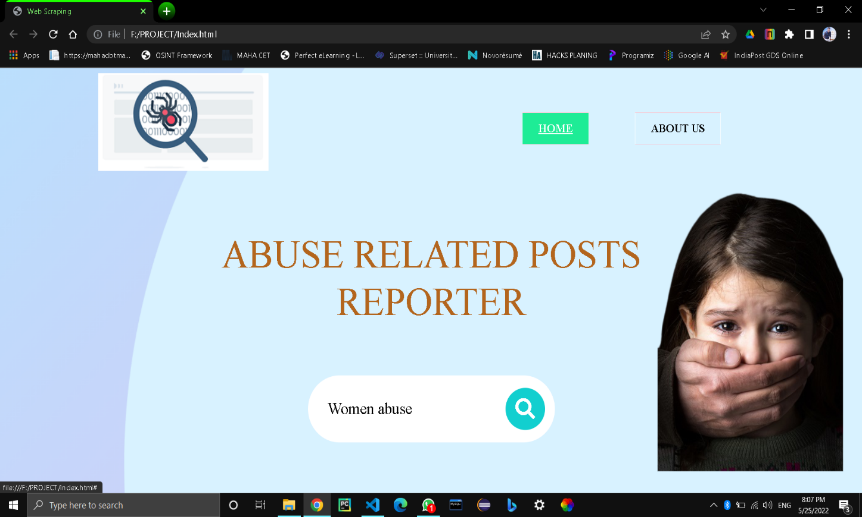
WSGI Server: DJango in-built server.
Interactive UI

Slide 11
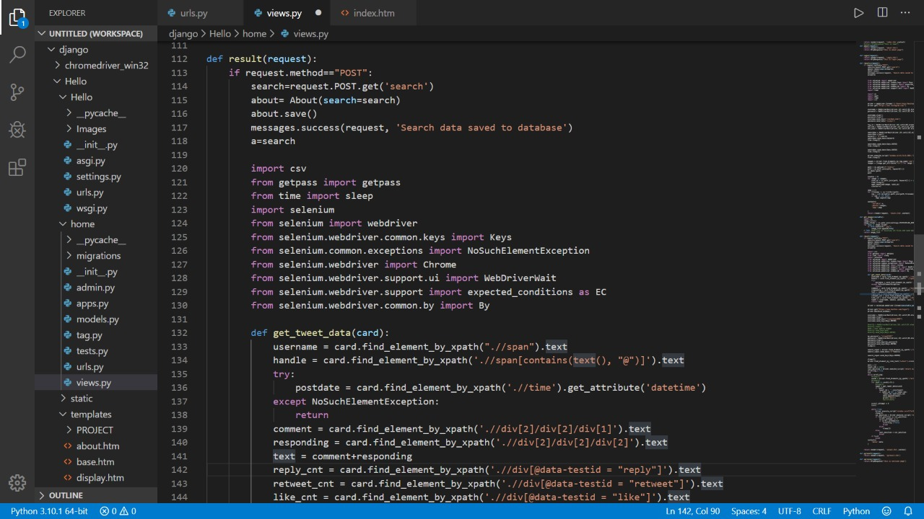
Selenium: Code in backend (in views.py)

Slide 12
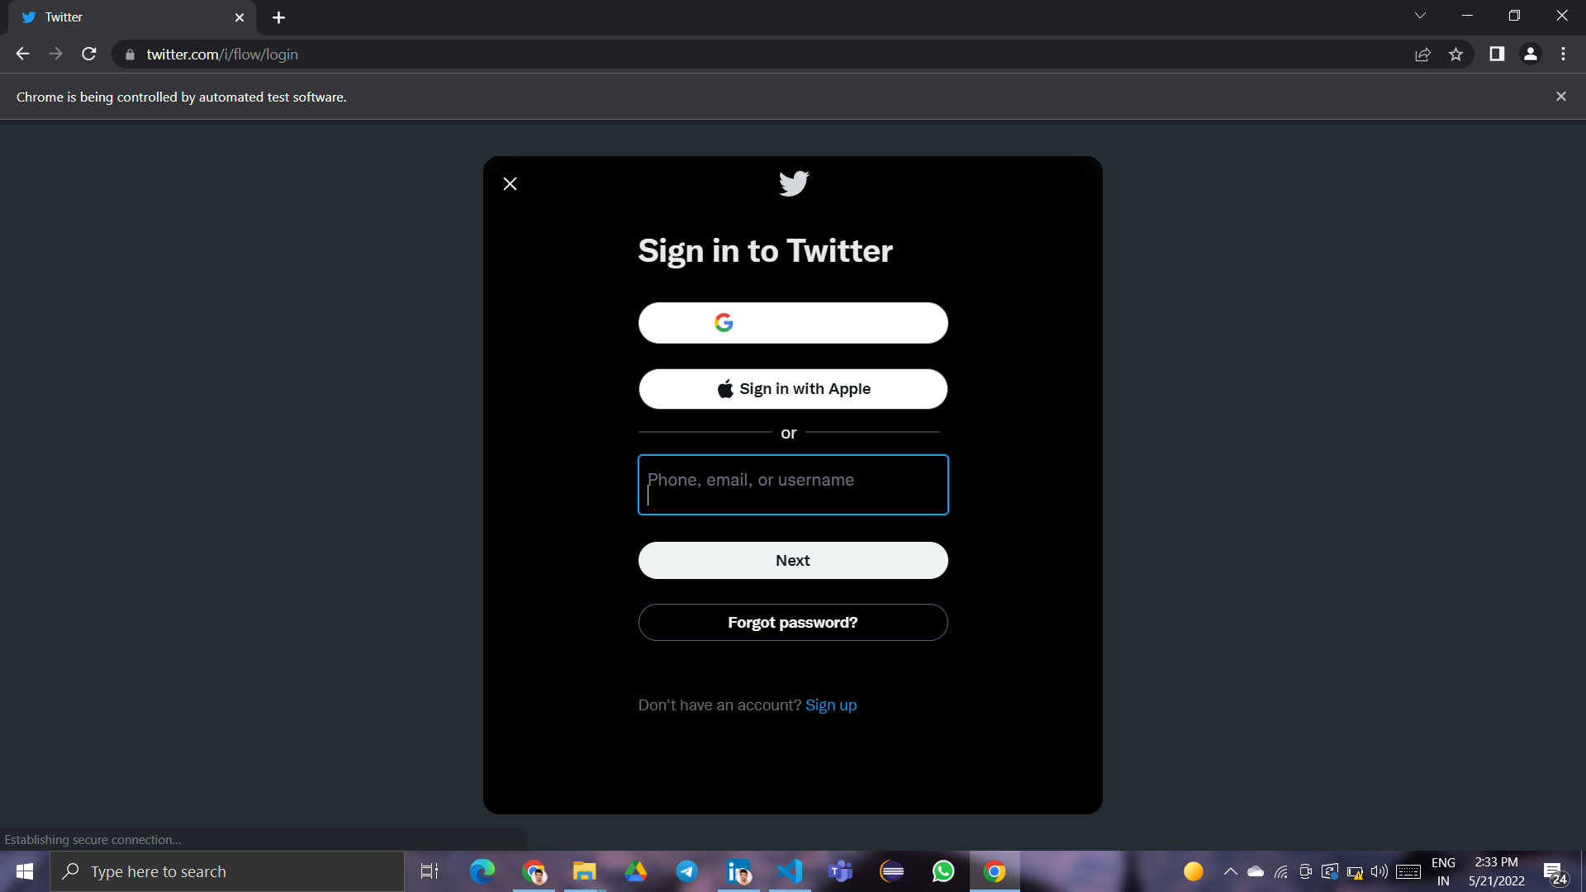
Automated execution using chromedriver (Login)

Slide 13
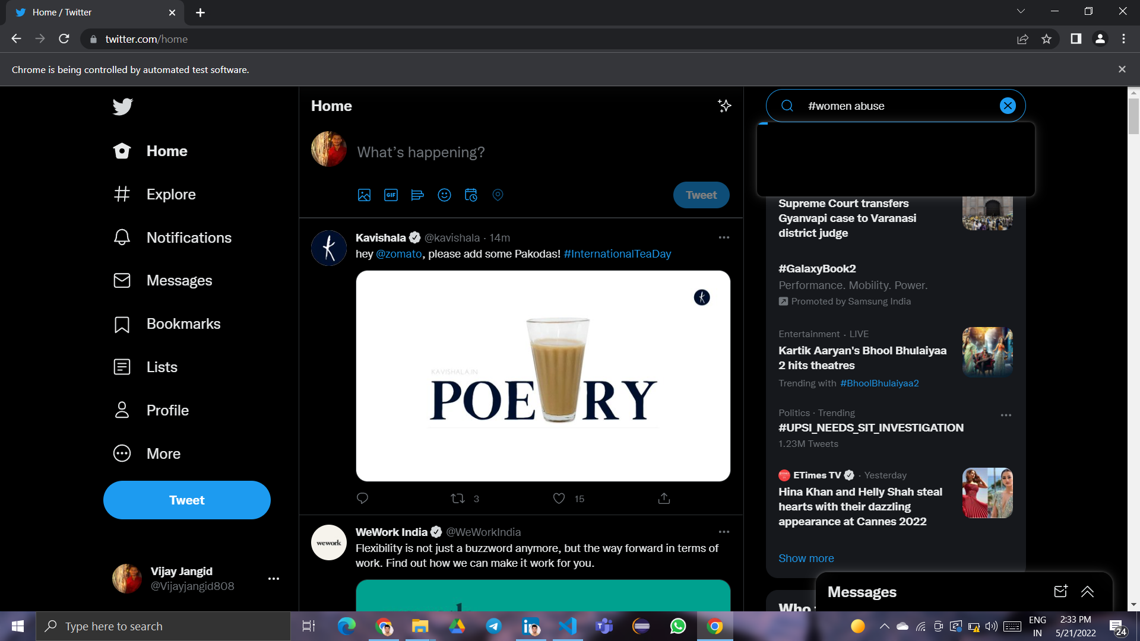
Automatic keyword searching

Slide 14
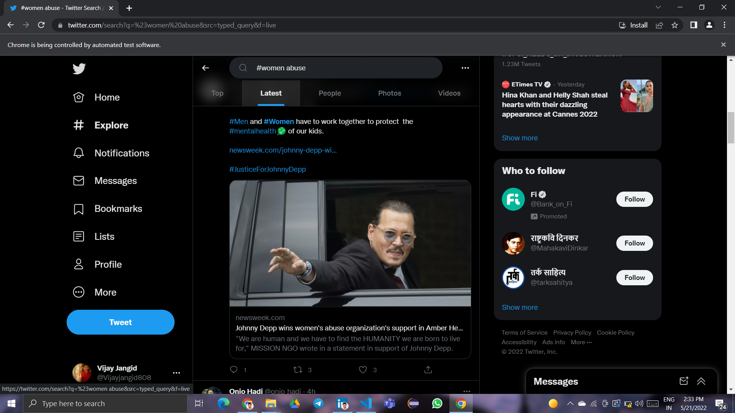
Scrapping of latest posts

Slide 15
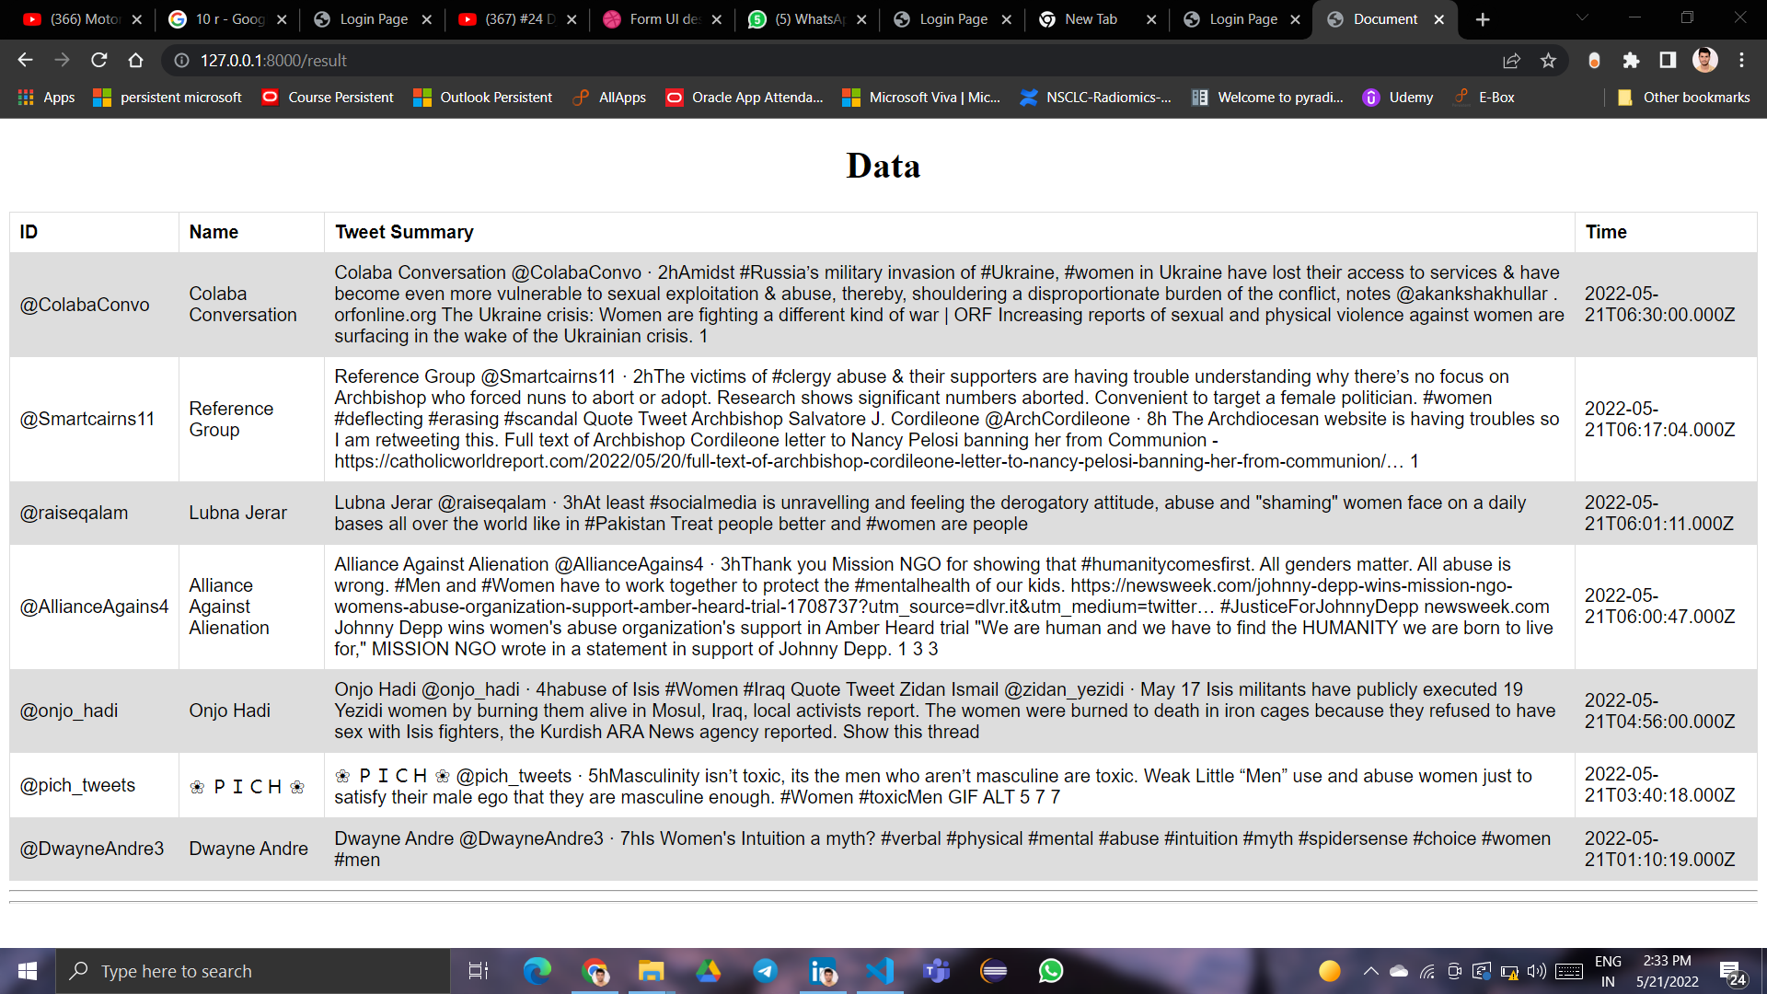
Results
Scrapped Data in Tabular Format

Slide 16
Advantages
Automation :-
The first and most important benefit of web scraping is developing tools that have simplified data
retrieval from different websites to only a few clicks. web scraping tools nowadays make the
extraction of data in large volumes both simple and quick.
Cost-Effective :-
Data extraction by hand is an expensive task that a large workforce and large budgets. Nonetheless,
web scraping, like many other digital techniques, has solved this problem. The Cost will be Efficient
Easy Implementation:-
When a website scraping service begins gathering data. web scraping technologies need little to no
maintenance over time. So, in the long run, services and budgets will not undergo drastic changes in
terms of maintenance.

Slide 17
Advantages
Speed :-
Another feature worth mentioning is the speed with which web scraping services complete actions.
course, that depends on the complexity of the projects, resources, and tools used.
Data Accuracy:-
Web scraping services are not only speed obsessive but also accurate. It’s a fact that human error is
often a factor when performing a task manually, and that can lead to more serious problems later on.
As a result, accurate data extraction for any type of information is critical.

Slide 18
Limitations
Data Analysis:-
Processing the extracted data through web scraping can be a time-consuming and energy-intensive
process. This is because the information comes as HTML code and that can be difficult for some to
read. Don’t worry, though, there is software that can take care of that too!.
Website Changes and Protection Policies:-
Because websites’ HTML structures change regularly, your crawlers will sometimes break. Whether
you use web scraping software or write your own web scraping code, you’ll need to perform some
maintenance periodically to ensure your data collection.

Slide 19
Conclusion
This project demonstrate the web crawling of twitter for various types of abuse related posts. The idea was to extract the data from twitter which is related to abuse and display it on a single webpage.
The distinctive hashtags was searched while extracting the data from twitter. This project is envisioned to address serious social issue that are usually unreported. It describes successful execution on Twitter and can further be used for several different popular social media platforms with legal permissions, thereby, helping many victims

Slide 20
Future Scope
As our website is dynamically based, we can also be able to add further more facilities.
To improve the module in future point of view we can further add some more social media platform such as Instagram, Facebook and general websites with an authorized access, to detect different kinds of information and extracting, analyzing that information for more insightful knowledge from the data.
Using this information, we can help many victims who have faced various abuses.
We will also work on a module which will provide some others details about the keywords/hashtags searched.

Slide 21
Reference
https://kevincurran.org/dissertations/2018%20Thesis%20Evan%20Gallagher%20%20Scraping%20Websites%20for%20Law.pdf
https://blogs.unicef.org/evidence-for-action/five-ways-governments-are-responding-to-violence-against-women-and-children-during-covid-19/
https://www.ncbi.nlm.nih.gov/pmc/articles/PMC7364393/
https://www.upgrad.com/blog/web-scraping-projects-topics-for-beginners/
https://www.unicef.org/india/what-we-do/child-protection.
https://www.cl.cam.ac.uk/~bjc63/tight_scrape.pdf

Slide 22
Publication
[1] Dr. P. A. Tijare, Dishil Purswani, Tanishk Rathi, Swapnil Chavhan, Shubham Agrawal,
Vijay Jangid, (2022) “Abuse Related Posts Reporter Using Web Crawler in Python”,
EPRA International Journal Of Research and Development (IJRD) Issue 5 Vol 7.
pp.230-234

Slide 23
Thank You!

