Slide 1
Credit Risk Specialist - Assignment

Slide 2
SECTION 01
Negative Balance Management
UK · India · Europe — Risk Controls, Regulation & Reporting

Slide 3
Negative Balance — Definition & Risk Landscape
What is a Negative Balance?
Why It Matters
Key Risk Drivers
Negative Balance (NB) occurs when a customer withdraws or spends more than their available account balance, effectively creating unsecured short-term credit exposure.
Key Risk Area Impacted by Negative Balance-
Credit Risk
Liquidity Risk
Regulatory Risk
Fraud Risk
Customer Behaviour Risk
Operational Risk
Provisioning & Financial Impact
Where Does This happen in Fintech/ Banking?
NB is common in:
wallets
prepaid cards
merchant settlement accounts
acquiring / POS
UPI credit / BNPL
credit cards
SME accounts
payment gateway settlements
 | UK (FCA) | EU(EBA) | India (RBI)
Regulatory Focus | Customer Protection, Fair treatment, transparency. | Risk Governance | Conservative, Compliance Driven, Misuse prevention
Customer Approach | Customer Centric, controlled flexibility | Risk Based, data driven | Strict control
NB Strategy | Small NB limit allowed with clear communication | NB treated as credit exposure, strong provisioning | NB tightly restricted, minimal exposure
Key controls | Affordability check, clear terms, alert | ECL provisioning, model-based monitoring | Strong KYC, Low limits, fraud monitoring

Slide 4
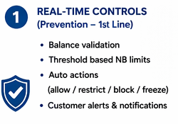
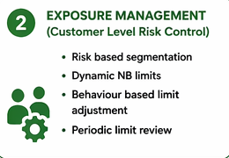
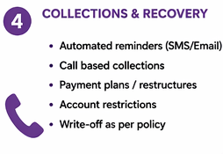
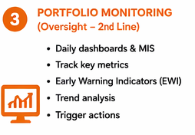
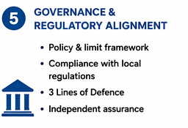
Negative Balance — Risk Management Framework
1st Line — Operations / Product
2nd Line — Credit Risk & Compliance
3rd Line — Internal Audit
Real-time balance checks before payment initiation
Automated block at transaction gateway when Limit Exceed – Create Exposure Limit.
Automated block at transaction gateway.
Customer Communication.
Daily exposure dashboard for Ops team
Independent NB exposure MI — daily ageing buckets (0-7d, 8-30d, 31-60d, 60d+)
Monthly limit reviews on aggregate NB exposure per market
Early warning Indicators.
Regulatory reporting: FCA Gabriel, RBI CRILC, EBA corep templates
Policy Design.
Model & Strategy Validation.
Quarterly audit of NB controls effectiveness
Sample testing of recovery actions vs policy
Validation of provisioning methodology
Regulatory change readiness reviews

Slide 5





Negative Balance Controls Framework — Three Lines of Defence
Key Metrics Monitored
Tools use to Report Negative Balance Exposure
Data Extraction & Storage
SQL Databases
Real-Time Monitoring & Alerting Tools
Transaction Monitoring systems
Event based alert systems
Fraud detection systems
MIS & Reporting Systems
Internal MIS reports
Schedule reporting systems

Slide 6
SECTION 02
Collections Oversight
Negative Balance Recovery — Strategy, Governance & Regulatory Compliance

Slide 7
Collections Framework
Segmentation
Automated Collections Workflow
Monitoring & KPIs
Low Risk Segment – Having Good Credit History – Soft Reminders.
Medium Risk Segment - Occasional delays – Calls+ nudges.
High Risk – Frequent NB / no repayment – Strong Action.
Day 0 (NB Created)
Instant SMS / App notification
Day 1-3
Reminder notifications & Email, App notification.
Day 3-7
SMS + call attempt; restrict outgoing payments (card present)
Day 8-30
Dedicated collections team; payment plan offered; hardship flag if SME distress signals
Day 31-60
Formal demand letter; account suspension; third-party agency referral assessment
Day 60+
IFRS 9 Stage 3; write-off with board approval; legal recovery where economically viable
KPIs
Recovery Rate
Roll Rate
Aging
Cure Rate
Dashboard Layout
Portfolio Overview
Aging & Delinquency analysis
Recovery performance
EWI

Slide 8
SECTION 03
Automated SME Credit Decisioning
Scorecard Monitoring · Cohort Analysis · Thin-File Fairness · Provisioning

