Slide 1
Hand Gesture Recognition Using Machine Learning
Mr. Swapnil Subhash Pawar
Mr. Ruchikkumar Tejani
Mr. Bavly Mikhail
„Project Lab Embedded Systems”
Chemnitz University of Technology, Chemnitz, 26th June 2022

Slide 2
Contents
Introduction
Data Acquisition
Signal Processing
Machine Learning Model
Evaluation Parameters
Results
Conclusion and Future work
References

Slide 3
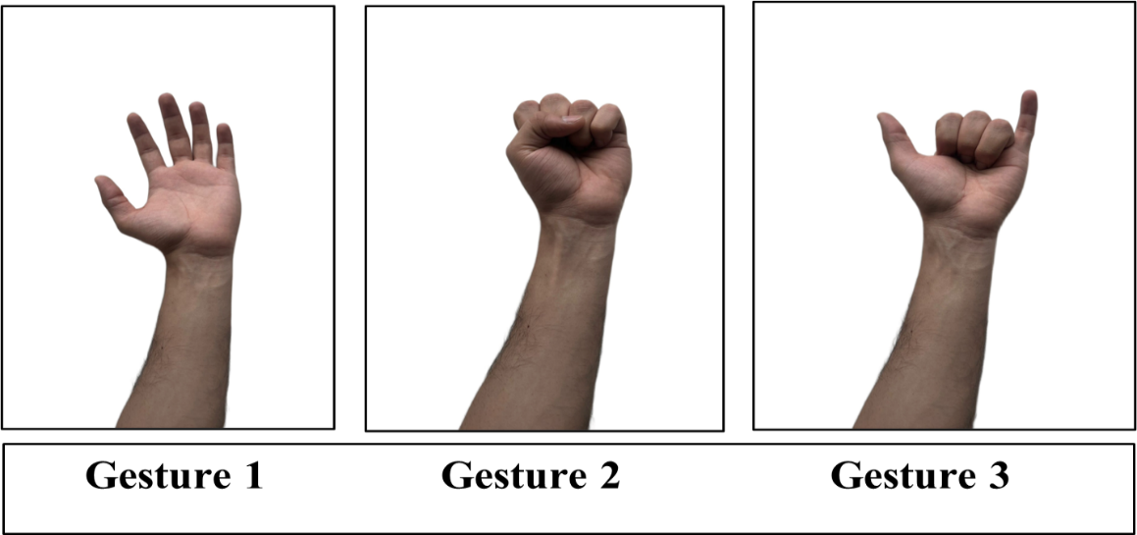
Introduction
Hand Gesture Recognition:
The ability to interpret and understand hand movements to control devices or interact with virtual environments.
EMG Sensor:
Electromyography (EMG) is a technique for measuring electrical muscle activity. EMG sensors detect and record the electrical signals generated by muscles during hand movements.
Figure 1. Types of gestures

Slide 4
Applications
Human-Computer Interaction:
Control computers, smartphones, and smart devices through hand gestures, eliminating the need for physical input devices.
Virtual Reality and Gaming:
Enhance immersion and interaction in virtual reality games and simulations.
Prosthetics and Rehabilitation:
Enable individuals with limb loss to control prosthetic limbs more intuitively.
Sign Language Interpretation:
Facilitate real-time translation of sign language into text or speech.

Slide 5
State of the art
Table 1. State of the art
Reference | Application | Sensors | placement | Signal Processing | Classification Algorithm | Performance Evaluation & accuracy
[1] 2022 | Artificial limb | EMG sensor | Forearm | Low-pass Butterworth filter | DNN | 81.65%
[2] 2022 | 3D printed robotic hand | EMG + IMU | Forearm | Convolution, then feeding it to a fully connected layer | ANN | N/A
[3] 2019 | Wearable arm band | 3 Myoware sensor | Forearm, and wrist | Root-Mean-Square (RMS) based rectification | CNN+ bidirectional-LSTM | 93.7%
[4] 2018 | Robotics, gaming | EMG sensor | Arm cortex, Forearm | Rectify the signal, low-pass Butterworth filter | Feed-forward Neural Network | 90.1%
[5] 2023 | Robotic prosthesis | Myo armband | Forearm | Feature extraction, Frequency features | KNN | N/A
[6] 2023 | Prosthetic hand | Myoware sensor | Forearm | Windowing, Wavelet transform | ELM, SVM, Fine trees | 95%
[7] 2022 | Wearable Sensors for Digital Healthcare | Myo armband | Forearm | Comparison of hand gesture recognition system. | SVC with RBF Kernel, RF | 92%
[8] 2019 | Sign language | visible RGB | N/A | Spatial temporal Semantic Alignment. | 3D-CNNs | 88.4%

Slide 6
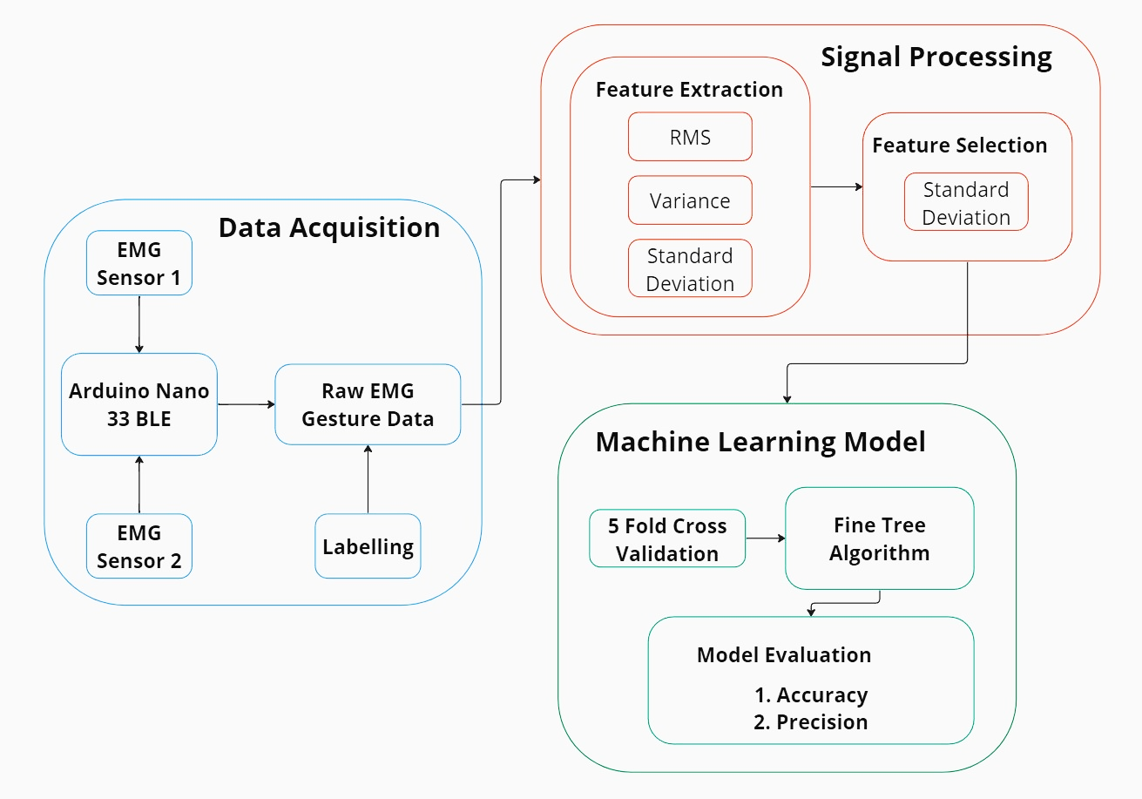
Actual Implementation
Figure 2. Flowchart of actual implementation

Slide 7
Data Acquisition
Controller: Arduino Nano 33 BLE
The Arduino Nano 33 BLE is a compact development board featuring the Nordic Semiconductor nRF52840 microcontroller with a 64 MHz ARM Cortex-M4 processor.
With 14 digital I/O pins, 8 analog pins, and 6 PWM pins, it offers extensive connectivity options for various applications.
The built-in 2.4 GHz BLE connectivity allows seamless wireless communication with BLE-compatible devices, enabling IoT applications and wireless control.
With low power consumption, a small form factor, and extensive support of Arduino ecosystem the Arduino Nano 33 BLE is an efficient and space-saving solution for projects.[9]

Slide 8
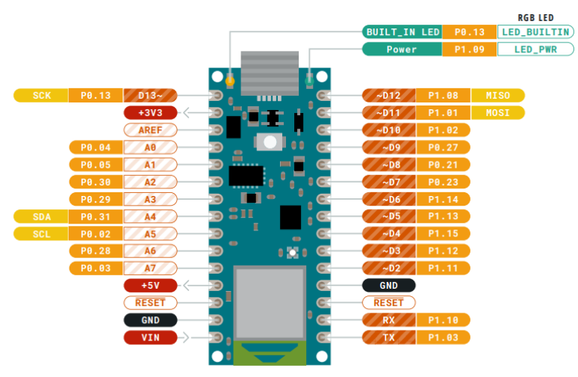
Arduino nano 33 BLE Pinout
Figure 3. Arduino nano 33 BLE Pinout

Slide 9
Hardware Components
Myoware Sensor
The MyoWare sensor comprises a sensor board and electrode pads for amplifying and processing EMG signals.
The electrode pads are designed for easy attachment to the skin and ensure optimal electrical contact using conductive gel.
It provides a user-friendly and compact solution for capturing EMG signals, making it suitable for applications like research and human-computer interaction.
The MyoWare sensor is commonly used in hand gesture recognition systems and projects requiring muscle activity measurement and analysis. [10]

Slide 10
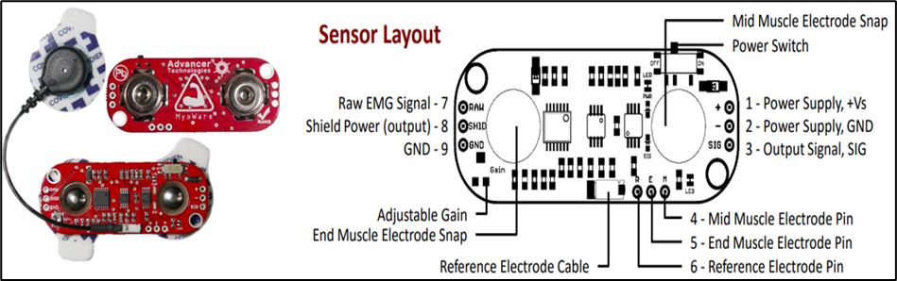
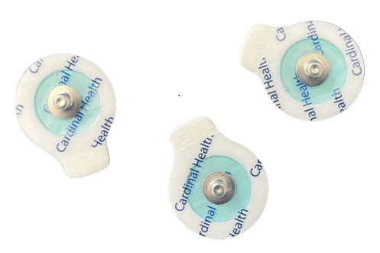
Myoware Sensor
Electrode Patches
Figure 4. Myoware Sensor

Slide 11



Software Components
Arduino IDE: Used to program Arduino Nano 33 BLE for reading EMG data from gestures.
Python : Enables serial communication with Arduino to receive and store EMG data.
MATLAB: Provides tools for data analysis, machine learning, and GUI development for in-depth EMG data analysis and gesture recognition.

Slide 12
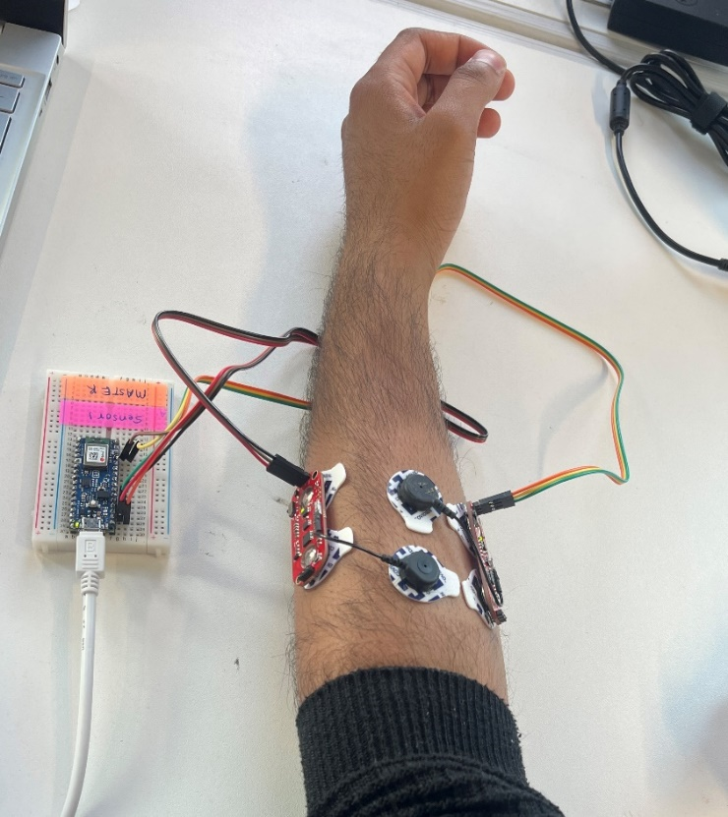
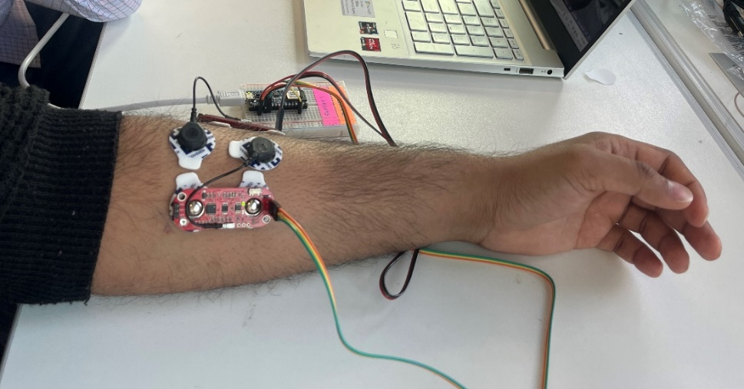
Hardware Setup
Figure 5. Hardware setup
Removing hair from the application area ensures optimal electrode contact, minimizing noise interference and improving the quality of captured EMG signals.

Slide 13
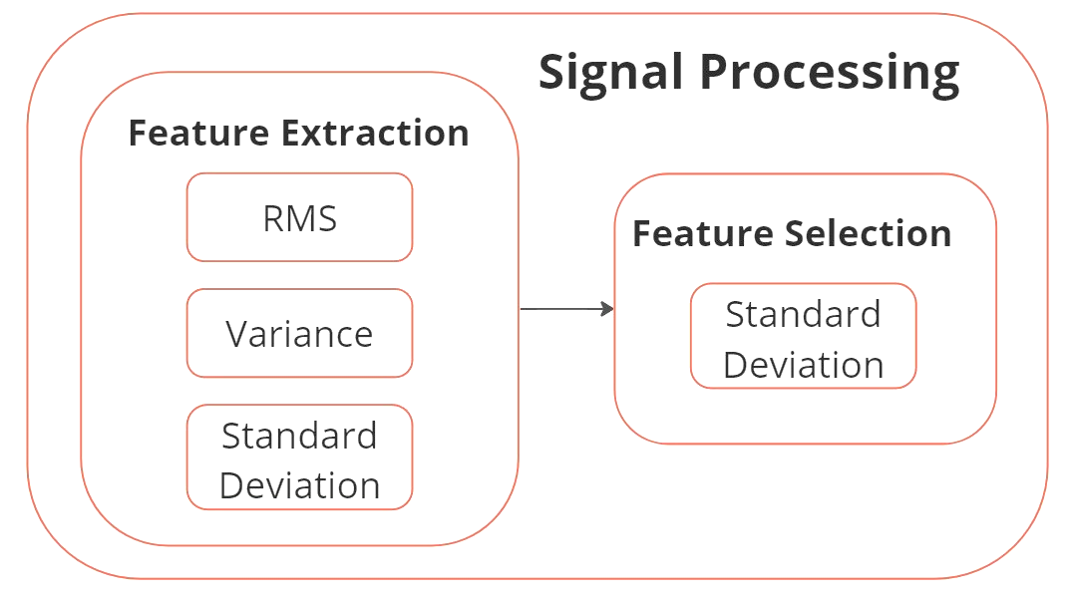
Signal Processing

Slide 14
Feature extraction
Defination
Feature extraction is a fundamental process applied in numerous fields, including machine learning, computer vision, and signal processing.
Its primary objective is to extract essential information or features from raw data, enabling further analysis or modeling.
For our project, we applied the feature extraction on electromyography(EMG) signal to get the useable information, which impacts our model most.
Types of features extraction
In signal processing, various techniques are used for feature extraction to extract relevant information from signals. Here are some commonly used types of feature extraction methods in signal processing:
Time Domain Features
Frequency Domain Features

Slide 15
Feature extraction
Time domain feature extraction:
Extracts relevant information from the time-domain representation of a signal.
Captures properties related to amplitude and temporal behavior.
Computationally efficient and straightforward to calculate.
Examples of time domain features:
Mean
Variance
Standard deviation
Zero-crossing rate

Slide 16
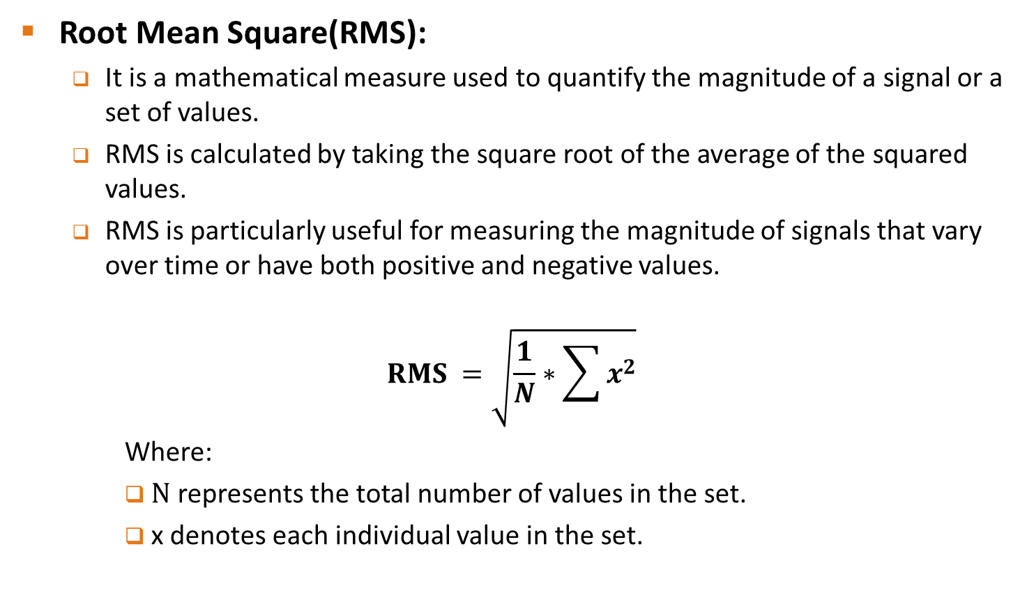
Feature extraction
Root Mean Square(RMS):
It is a mathematical measure used to quantify the magnitude of a signal or a set of values.
RMS is calculated by taking the square root of the average of the squared values.
RMS is particularly useful for measuring the magnitude of signals that vary over time or have both positive and negative values.
$$RMS =\sqrt{\frac{1}{N}∗\sum{x^{2}}}$$
Where:
N represents the total number of values in the set.
x denotes each individual value in the set.

Slide 17
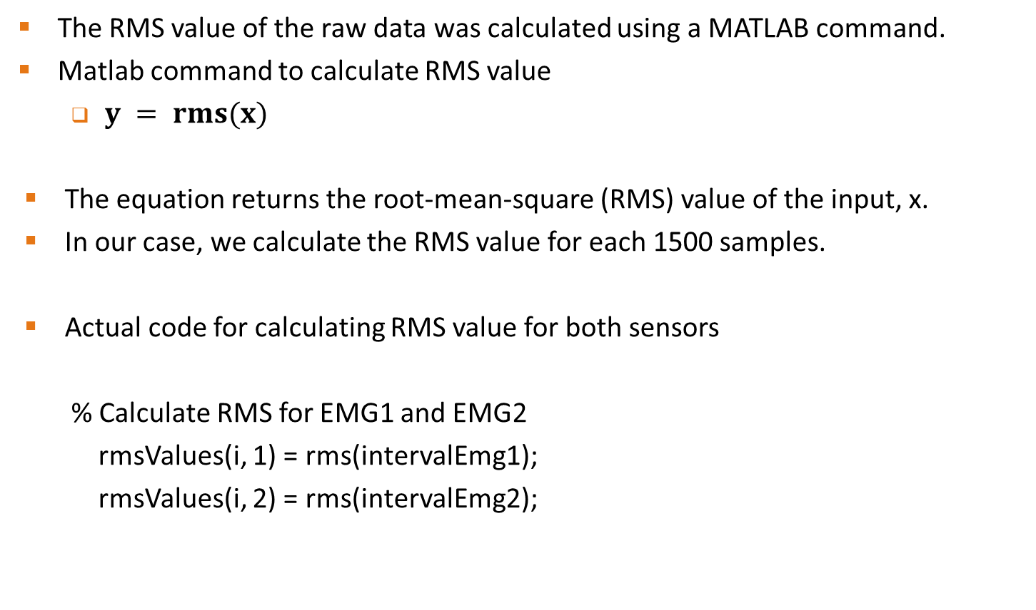
Feature extraction
The RMS value of the raw data was calculated using a MATLAB command.
Matlab command to calculate RMS value
$y = rms(x)$
The equation returns the root-mean-square (RMS) value of the input, x.
In our case, we calculate the RMS value for each 1500 samples.
Actual code for calculating RMS value for both sensors
% Calculate RMS for EMG1 and EMG2
rmsValues(i, 1) = rms(intervalEmg1);
rmsValues(i, 2) = rms(intervalEmg2);

Slide 18
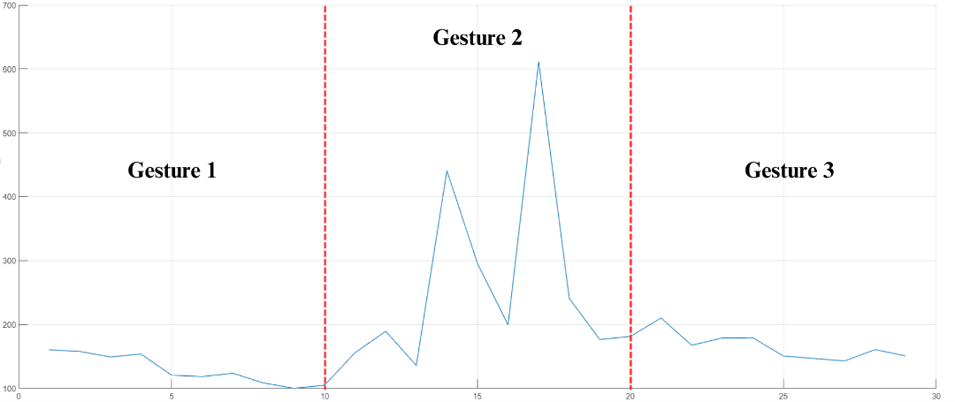
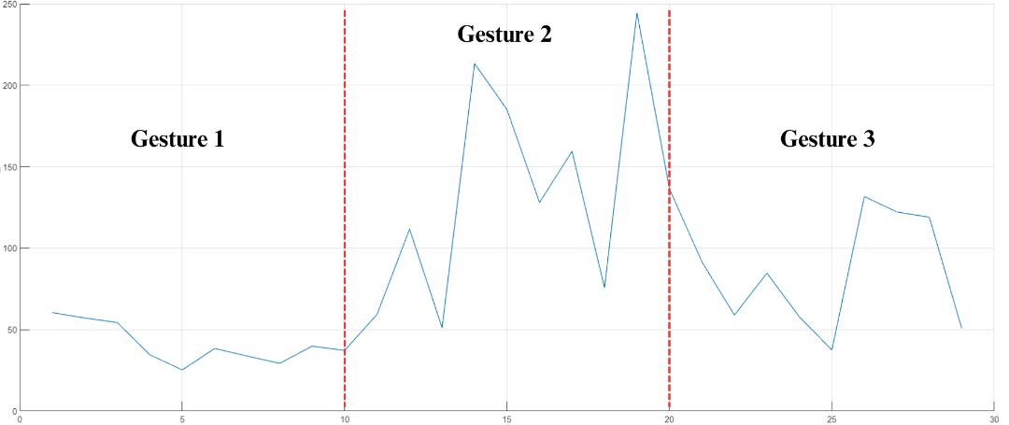
Feature extraction
The waveforms were generated using the data cleaner application from MATLAB.
On the x-axis we have numbers of samples after windowing and Y-axis we have RMS values.
It shows different waveform for each gestures according to their RMS values.
Waveform of gesture 1 and gesture 2 are in almost similar interval of RMS value from 100 to 200.
Feature Value
Feature Value
Number of Samples after windowing
Number of Samples after windowing
Figure 6. RMS waveforms of EMG1 and EMG2

Slide 19
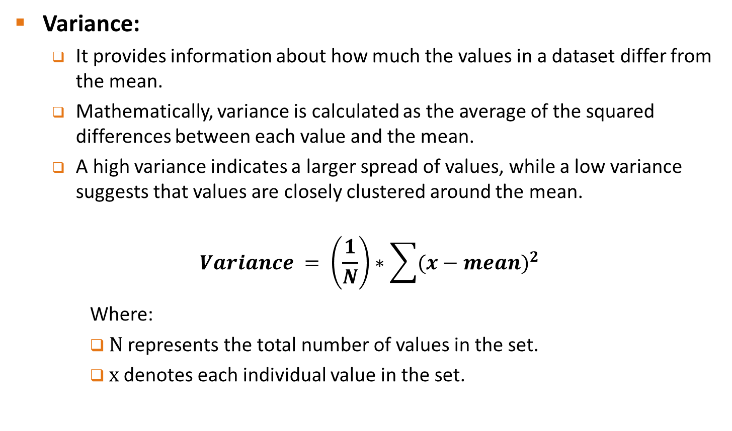
Feature extraction
Variance:
It provides information about how much the values in a dataset differ from the mean.
Mathematically, variance is calculated as the average of the squared differences between each value and the mean.
A high variance indicates a larger spread of values, while a low variance suggests that values are closely clustered around the mean.
$$Variance = \left(\frac{1}{N}\right)∗\sum{{(x−mean)}^{2}}$$
Where:
N represents the total number of values in the set.
x denotes each individual value in the set.

Slide 20
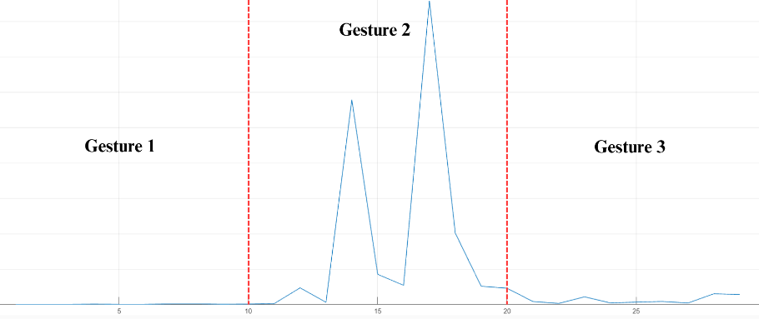
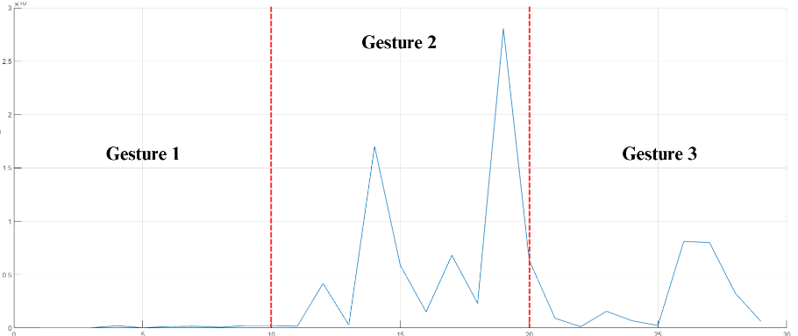
Feature extraction
Matlab command to calculate variance
V = var(A)
Actual command to calculate variance for both sensor
% Calculate variance for EMG1 and EMG2
varValues(i, 1) = var(intervalEmg1);
varValues(i, 2) = var(intervalEmg2);
Feature Value
Feature Value
Number of Samples after windowing
Number of Samples after windowing
Figure 7. Variance waveforms of EMG1 and EMG2

Slide 21
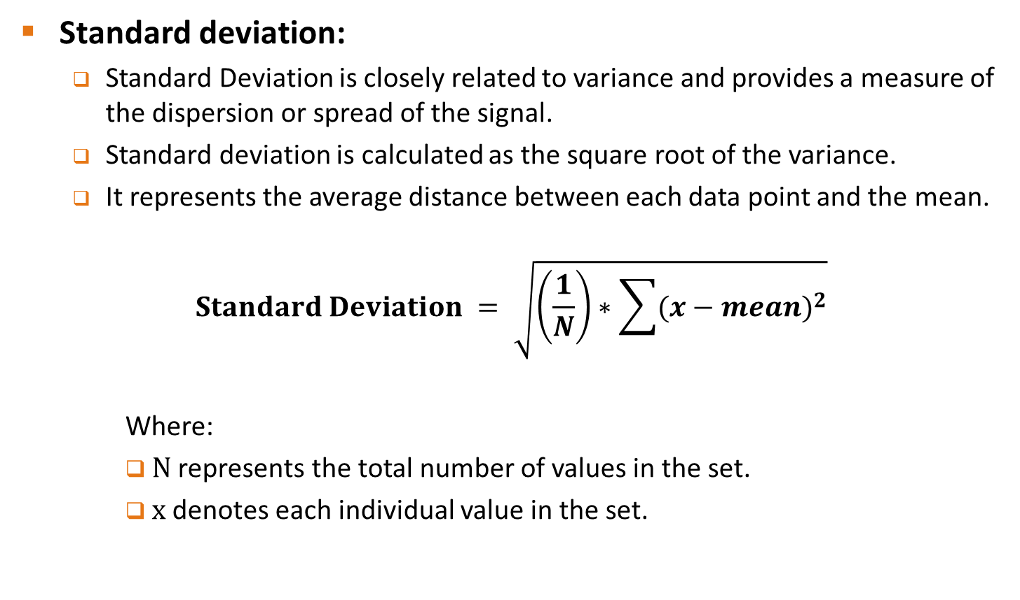
Feature extraction
Standard deviation:
Standard Deviation is closely related to variance and provides a measure of the dispersion or spread of the signal.
Standard deviation is calculated as the square root of the variance.
It represents the average distance between each data point and the mean.
$$Standard Deviation = \sqrt{\left(\frac{1}{N}\right)∗\sum{{(x−mean)}^{2}}}$$
Where:
N represents the total number of values in the set.
x denotes each individual value in the set.

Slide 22
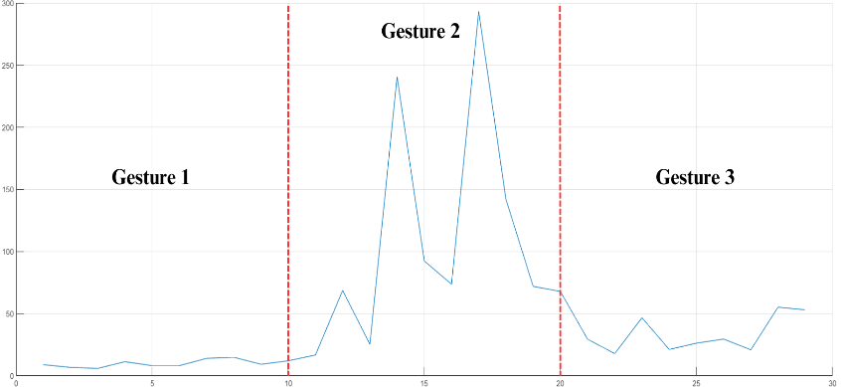
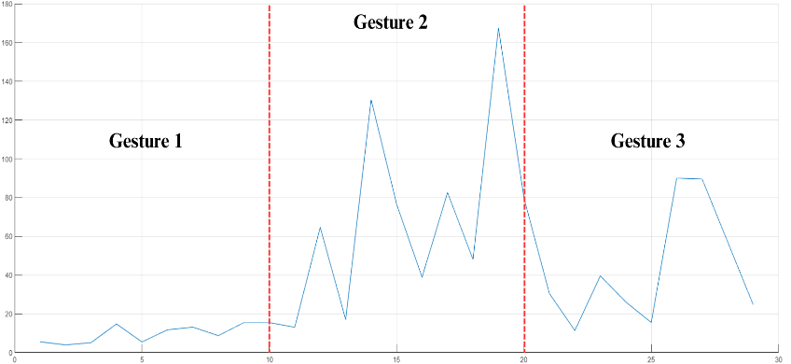
Feature extraction
Matlab command to calculate standard deviation
S = std(A)
Actual command to calculate variance for both sensor
% Calculate standard deviation for EMG1 and EMG2
stdValues(i, 1) = std(intervalEmg1);
stdValues(i, 2) = std(intervalEmg2);
Feature Value
Feature Value
Number of Samples after windowing
Number of Samples after windowing
Figure 8. Standard deviation waveforms of EMG1 and EMG2

Slide 23
Feature selection
Defination:
Feature selection is the process of choosing relevant features from a set of available features to enhance model performance and interpretability by eliminating irrelevant or redundant features.
Why feature selection is important?
Improved model performance: Selecting relevant features enhances predictive accuracy and reduces overfitting.
Computational efficiency: Reducing dimensionality speeds up model training and inference.
Enhanced interpretability: Selecting important features provides insights into relationships and facilitates decision-making.

Slide 24

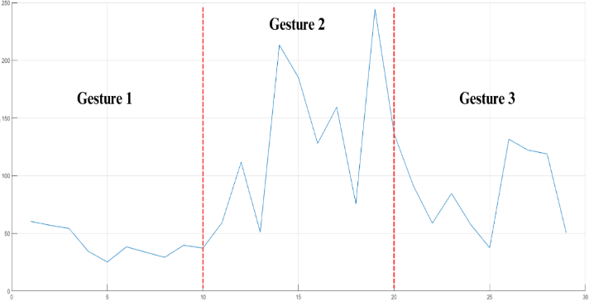
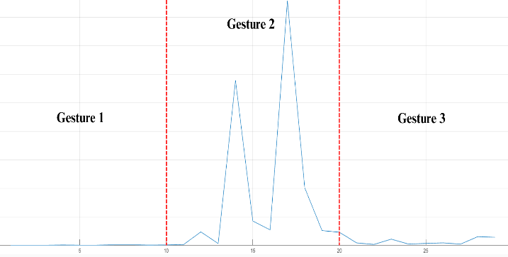
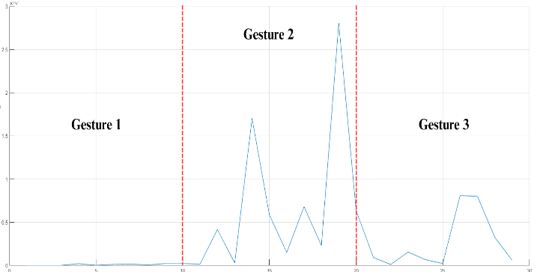
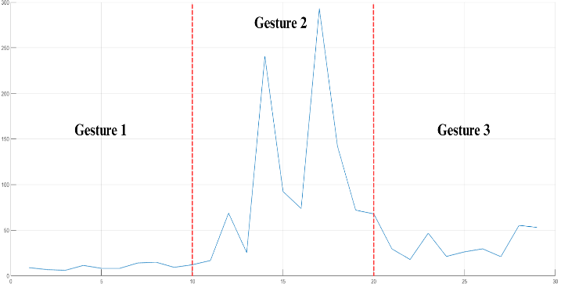
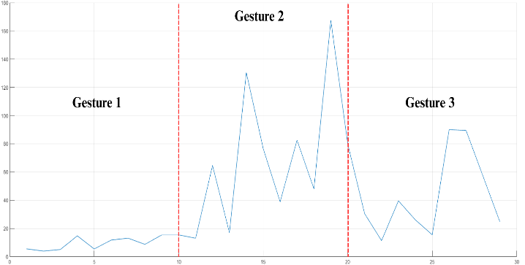
Feature selection
RMS
Variance
SD
Figure 9. Comparison of waveforms of different features

Slide 25
Feature selection
Result of feature selection for our model
Six features extracted from the dataset.
Initial model accuracy of 89.7% using all six features.
Utilized feature selection to identify the most important features.
Standard deviation of the first EMG sensor identified as the most relevant feature.
Using only the single feature resulted in the improved level of accuracy (93.1%).

Slide 26
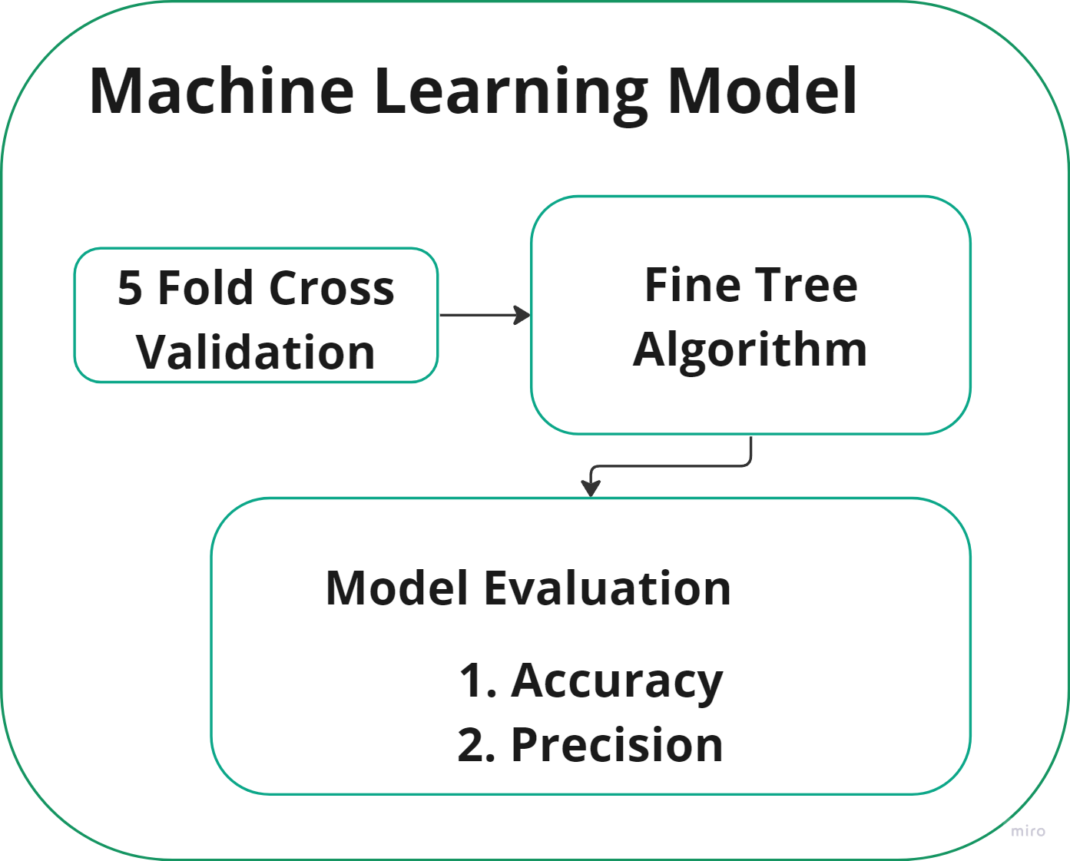
Machine Learning Model
Machine Learning Model
It is a mathematical representation or algorithmic structure that is designed to learn patterns and relationships from data and make predictions based on that learning.

Slide 27
Machine learning model devolpment
Types of machine learning models
Supervised machine learning: Supervised machine learning involves learning from labeled data with known outputs or target variables. It aims to create a model that can predict or classify new data based on the patterns observed in the training data. Example, linear regression, SVM, Decision Tree
Unsupervised machine learning: Unsupervised machine learning involves learning from unlabeled data without any specific output labels. It focuses on discovering patterns, relationships, or clusters within the data to gain insights and extract meaningful information.
In our project we used Fine Decision Tree algorithm to devlop a machine learning model.

Slide 28
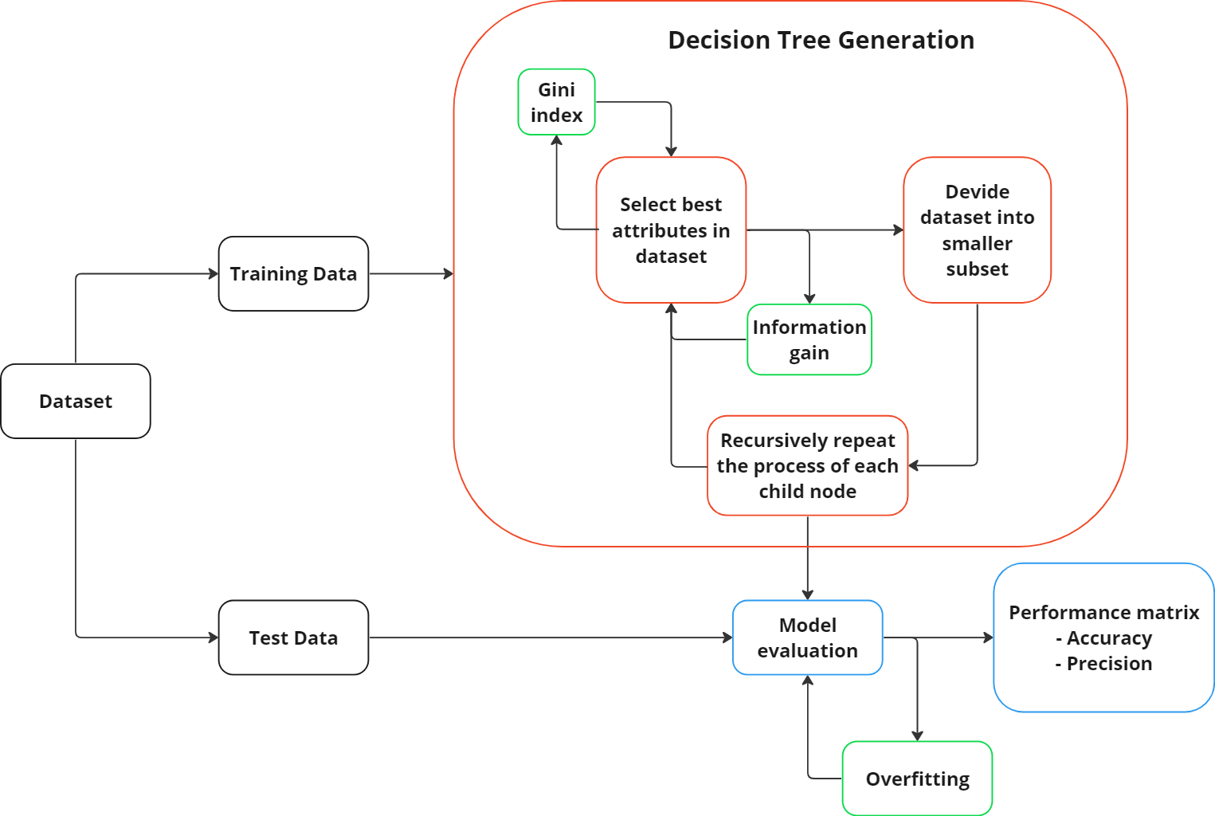
Flowchart for decision tree model
Figure 10. Flowchart for decision tree model

Slide 29
Fine Tree Algorithm
Tree Construction:
Recursive binary partitioning process
Selects best features for splitting based on information gain or Gini impurity
Continues until stopping criterion is met (e.g., maximum tree depth, minimum samples for splitting)
Leaf Node Assignment:
Assigns class labels to the leaf nodes
Majority class of training samples in each node determines the label
Prediction:
Navigates the tree from root to leaf node for unseen data
Considers feature values of the input
Assigned class label of the leaf node is the predicted class for the input
Techniques for Improved Performance:
Pruning to simplify the tree and prevent overfitting
Removal of unnecessary nodes for enhanced generalization capability

Slide 30
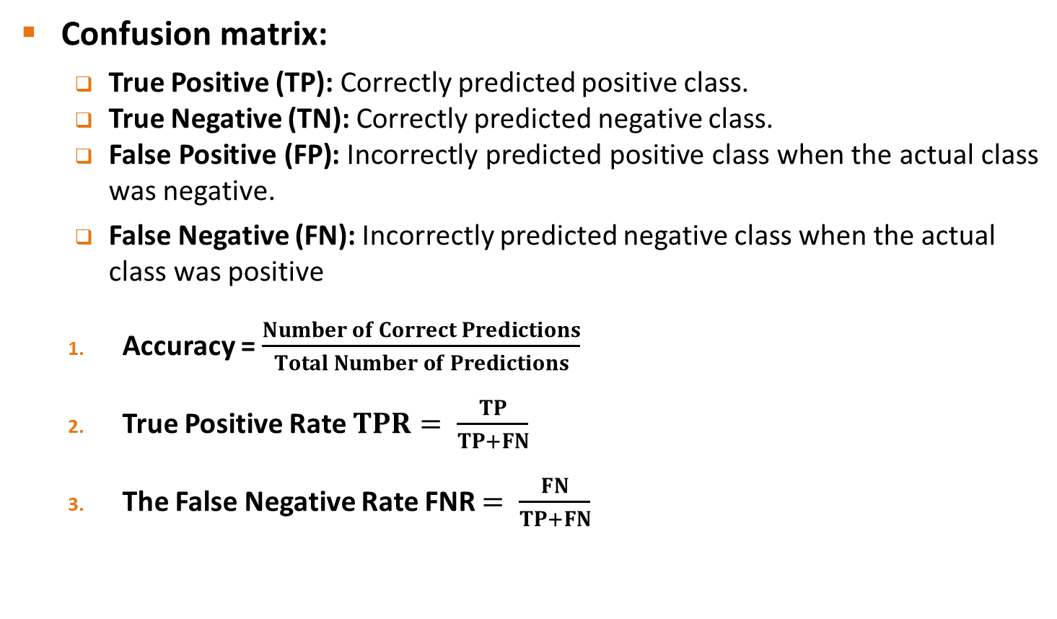
Evaluation Parameters
Confusion matrix:
True Positive (TP): Correctly predicted positive class.
True Negative (TN): Correctly predicted negative class.
False Positive (FP): Incorrectly predicted positive class when the actual class was negative.
False Negative (FN): Incorrectly predicted negative class when the actual class was positive
Accuracy = $\frac{Number of Correct Predictions}{Total Number of Predictions}$
True Positive Rate $TPR= \frac{TP}{TP+FN}$
The False Negative Rate FNR $= \frac{FN}{TP+FN}$

Slide 31
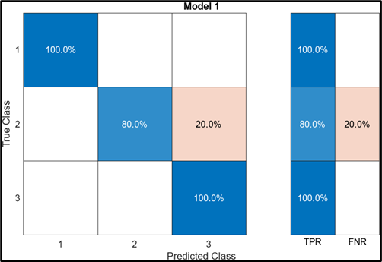
Results
Accuracy = 93.1%
True Positive Rate TPR
Gesture 1 = 100%
Gesture 2 = 80%
Gesture 3 = 100%
False Negative Rate FNR
Gesture 1 = 0%
Gesture 2 = 20%
Gesture 3 = 0%
Figure 11. Confusion matrix

Slide 32
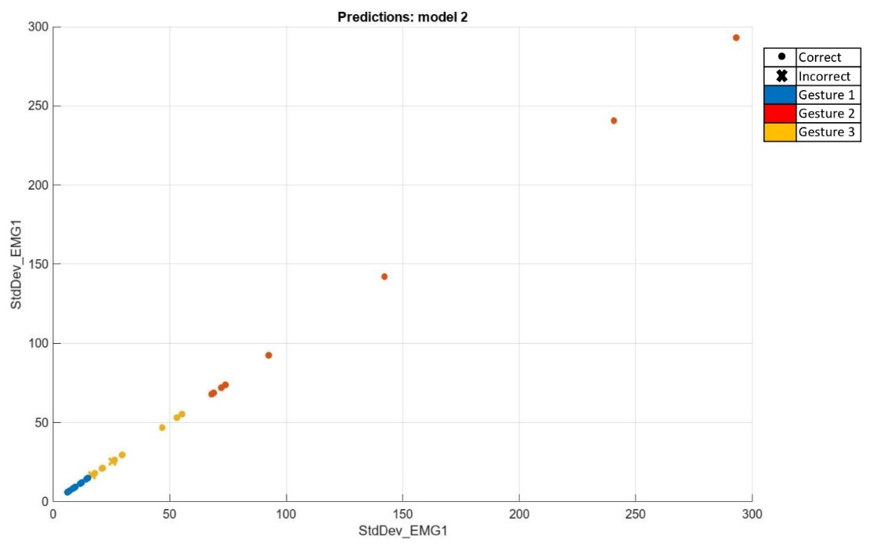
Scatter Plot of Predicted Data
Figure 12. Scatter plot of predicted data

Slide 33
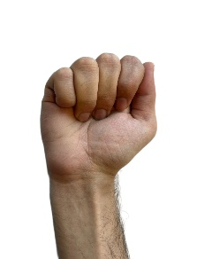
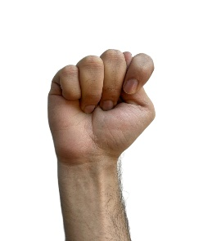
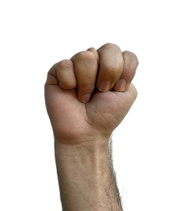
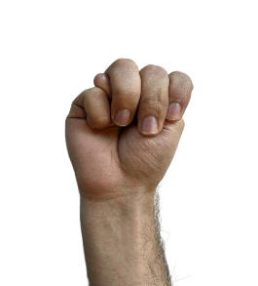
Conclusion and Future work
Accurate classification of three distinctive gestures with 93.1% accuracy
Model struggles with closely related gestures
Future work:
Improve sensor placement for better signal acquisition
Increase the number of sensors to capture more comprehensive hand movements
Explore combinations of different sensors to enhance classification capabilities
Aim to enhance the model's ability to accurately classify both distinctive and closely related gestures

Slide 34
References
[1] A. G. J. J. Marco E. Benalcázar und A. P. V. H. A. A. Zea, „Hand gesture recognition using machine learning and the Myo armband,“ 25th European Signal Processing Conference (EUSIPCO), 2017.
[2] K. P. A. B. A. R. M. A. Afsaneh Kashizadeh, „Myoelectric Control of a Biomimetic Robotic Hand Using Deep Learning Artificial Neural Network for Gesture Classification,“ IEEE Sensors Journal, 2022.
[3] D. W. R. Z. Y. Y. Qian Zhang, „MyoSign: enabling end-to-end sign language recognition with wearables,“ 24th international conference on intelligent user interfaces, 2019.
[4] C. E. A. J. A. Z. P. Z. A. G. J. M. S. Marco E. Benalcázar, „Real-time hand gesture recognition based on artificial feed-forward neural networks and EMG,“ 26th European Signal Processing Conference (EUSIPCO), 2018.
[5] O. A. K. H. F. a. B. H. Kerdjidj, „Implementing Hand Gesture Recognition using EMG on the Zynq Circuit,“ IEEE Sensors Journal, p. 8, 2023.

Slide 35
References
[6] T. P. A. a. S. K. Tyagi, „EMG-based Gesture Recognition using Extreme Learning Machine,“ 3rd International conference on Artificial Intelligence and Signal Processing (AISP) IEEE, p. 6, 2023.
[7] S. M. V. H. M. H.-J. I. A.-K. S. a. M. R. Aarthy, „Recognition of Hand Gesture Using Electromyography Signal: Human-Robot Interaction,“ Journal of Sensors, 2022.
[8] H. R. V. J. V. M. P. Mahdi Abavisani, „Improving the performance of unimodal dynamic hand-gesture recognition with multimodal training,“ IEEE/CVF conference on computer vision and pattern recognition, 2019.
[9] „Arduino nano 33 BLE,“ Product reference manual SKU:ABX00030, p. 12, 2023.
[10]„3-lead Muscle / Electromyography Sensor for Microcontroller Applications,“ Myoware Muscle Sensor Datasheet, p. 8.

Slide 36
Thank You!

