Slide 1



DATA ANALYTICS PROJECT
Olist E-Commerce
Analytics Dashboard
Sales Performance & Delivery Analysis
Brazilian E-Commerce Dataset • 2016–2018
Swapnil Sanjeev | Power BI • Python • Pandas

Slide 2
PROJECT OVERVIEW
What is this project about?
Olist is Brazil's largest department store marketplace. This project analyzes 100K+ real transactions across 3 years to uncover sales patterns, delivery performance, and customer satisfaction drivers.
99.4K
R$16M
3,095
32,951
Orders
Revenue
Sellers
Products
Across 3 years
Total payment value
Active on platform
Unique SKUs
Datasets Used
Dataset | Rows | Key Columns
Orders | 99,441 | status, timestamps, delivery
Order Items | 112,650 | price, freight, product_id
Customers | 99,441 | city, state
Reviews | 99,224 | review_score
Products | 32,951 | category, weight, dimensions

Slide 3
METHODOLOGY
Tools & Approach
01
02
03
04
05
Data Ingestion
Data Cleaning
Feature Engineering
Data Modelling
Visualization
Loaded 8 CSV datasets from Olist
Kaggle repository. Profiled shape,
dtypes, nulls and duplicates
using Python + Pandas.
Converted date strings to datetime.
Filled product category nulls →
'Unknown'. Retained null delivery
dates for non-delivered orders.
Created delivery_days, is_late flag,
processing_days, order_year/
month/day. Aggregated payments
per order_id.
Built star schema in Power BI
across 8 tables. Created DAX
measures: AOV, Avg Rating,
Late %, Delay Impact.
Built 2-page Power BI dashboard:
Sales Overview + Delivery
Analysis..

Slide 4
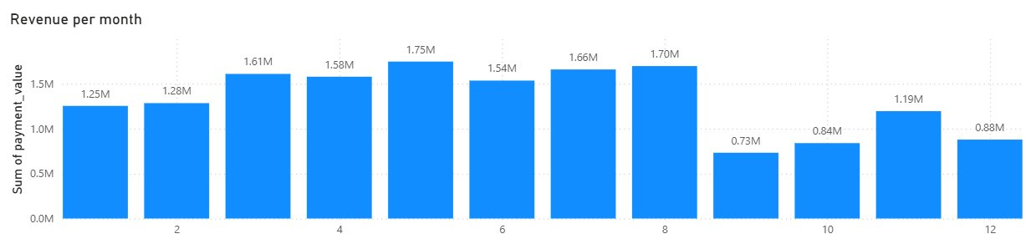
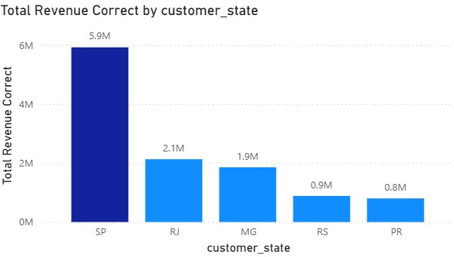
KEY FINDINGS — SALES
Revenue & Order Performance
R$16.01M
R$161
4.09★
99.4K
Total Revenue
Avg Order Value
Avg Rating
Total Orders
2016–2018
Per order
Out of 5
Unique
Revenue per Month
Total Revenue by State (Top 5)

Slide 5
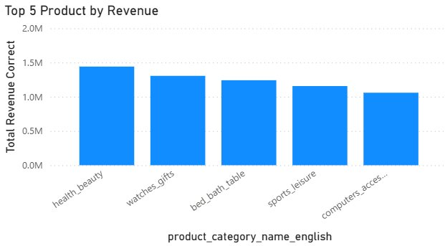
KEY FINDINGS — PRODUCTS
Top 5 Revenue Categories
Top 5 Products by Revenue
Category Insights
Health & Beauty
~R$1.45M • #1 category — strong organic demand year-round
Watches & Gifts
~R$1.28M • Seasonal peaks — gifting-driven purchases
Bed, Bath & Table
~R$1.22M • High frequency home goods category
Sports & Leisure
~R$1.16M • Growing category with room to scale
Computers & Accs
~R$1.07M • High AOV — tech items drive order value

Slide 6
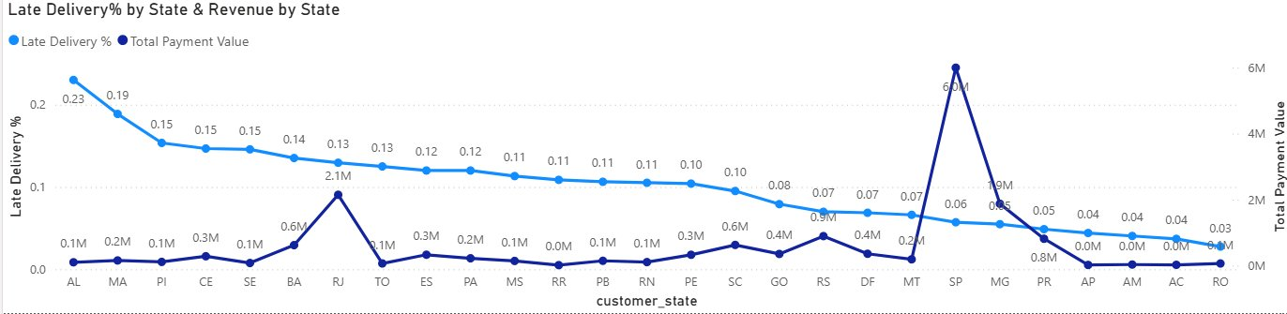
KEY FINDINGS — DELIVERY
Delivery Performance Analysis
8K
12.1
92%
1.65
Late Orders
Avg Delivery Days
On-Time Rate
Rating Drop (late)
Late Delivery % vs Revenue by State

Slide 7
BUSINESS RECOMMENDATIONS
3 Actionable Insights for Olist
01
02
03
Revenue Protection
Growth Opportunity
Seasonal Marketing
Fix RJ Delivery — Highest ROI
Scale Health & Beauty Category
Leverage June–August Peak Season
I identified RJ as a high-risk region. Despite generating ₹2.1M revenue, it has a 13% late delivery rate. Since delayed deliveries reduce ratings by 1.65 points, improving delivery performance here can directly protect revenue and improve customer satisfaction.”
Top revenue category at $1.45M with
strong organic demand year-round.
Targeted seller onboarding and featured
listings in this vertical could drive
disproportionate growth.
Months 6, 7, 8 show the highest revenue
(R$1.75M, R$1.66M, R$1.70M. Businesses can leverage this by increasing inventory and running campaigns before the peak to maximize revenue.

Slide 8
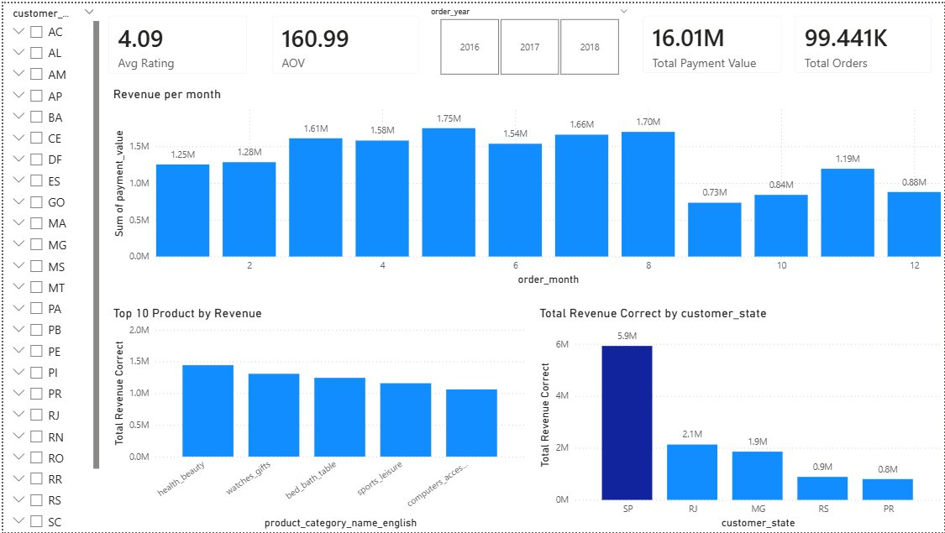
DASHBOARD SCREENSHOTS
Power BI — Sales Report

Slide 9
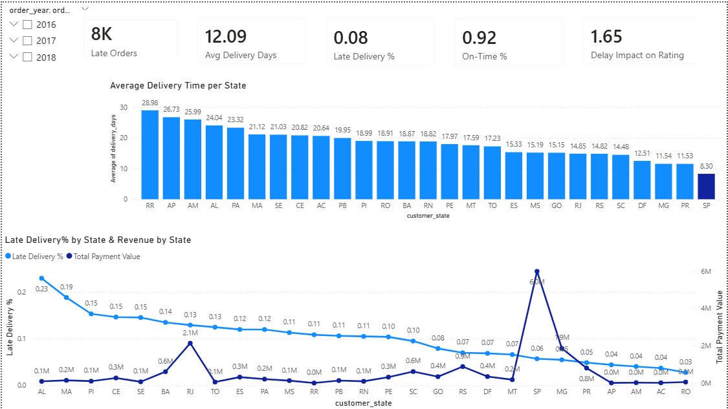
DASHBOARD SCREENSHOTS
Power BI — Delivery Analysis

Slide 10
Thank You
Swapnil Sanjeev
BCA (AI & ML) — Sharda University
Tools: Python • Pandas • Power BI • DAX
Dataset: Olist Brazilian E-Commerce (Kaggle)
99.4K Orders
R$16M Revenue
8K Late Orders
Top 5 Categories

