Slide 1

NEWS CHANNEL WEBSITE
CSE 326
Final Project Report
Section: K19GK
Faculty: Manu Bali
Submitted On: 12th April, 2019
NAME | ROLL NUMBER | REGISTRATION NUMBER
SWAPNIL VAISH | 42 | 11911972
RITUKALPA GOGOI | 44 | 11908566

Slide 2
ACKNOWLEDGEMENT
We would like to express our Special thanks of Gratitude to our University as well as our CSE Faculty Manu Bali ma’am who gave us this opportunity to work on the project “NEWS CHANNEL WEBSITE ”.
It was a great learning experience for all of us.

Slide 3
NEWS CHANNEL WEBSITE
Final Project Report On

Slide 4
Introduction
The world has switched from analog to digitalization. We live in the age of Information Communication and Technology (ICT). Everything little things used today relies on technology and having access to the internet led to the pinnacle of development.
Nowadays, instead of traditional newspaper , people procure their news digitally through TV channels, news applications, news website.

Slide 5
About our Project
The “BUZZ International News Website” has been developed to make fetching the latest news easy and convenient.
We have also taken in account that most people like specific genre of news and hence we have different sections in the homepage to suit their needs. Having different sections helps save time of the viewers as they wouldn’t have to waste time sorting the news.

Slide 6
Technologies Used
Hyper Text Markup Language (HTML): It is the standard markup language for documents designed to be displayed in a web browser. HTML code file is responsible for the structure of websites.
Cascading Style Sheets (CSS): It is a style sheet language used for describing the presentation of a document written in a markup language like HTML. CSS is responsible for styling Websites.
JavaScript (JS): It is a logic-based programming language that can be used to modify website content and make it behave in different ways in response to a user's actions.

Slide 7

Describing the Website
Navigation Bar
Home
Coronavirus Section
International News
Featured News
About Us Section
Sign Up/ Log In Page
Home Page
It the main page of the website which consists of news of all following sections : Coronavirus, International news, About Us.
Clicking on these will lead the user to that specific news sections within the homepage.
Clicking on “Featured News” and “Sign up/Log In” leads the user the a new page, where they browse news or Sign Up/get logged In depending on their selection.

Slide 8
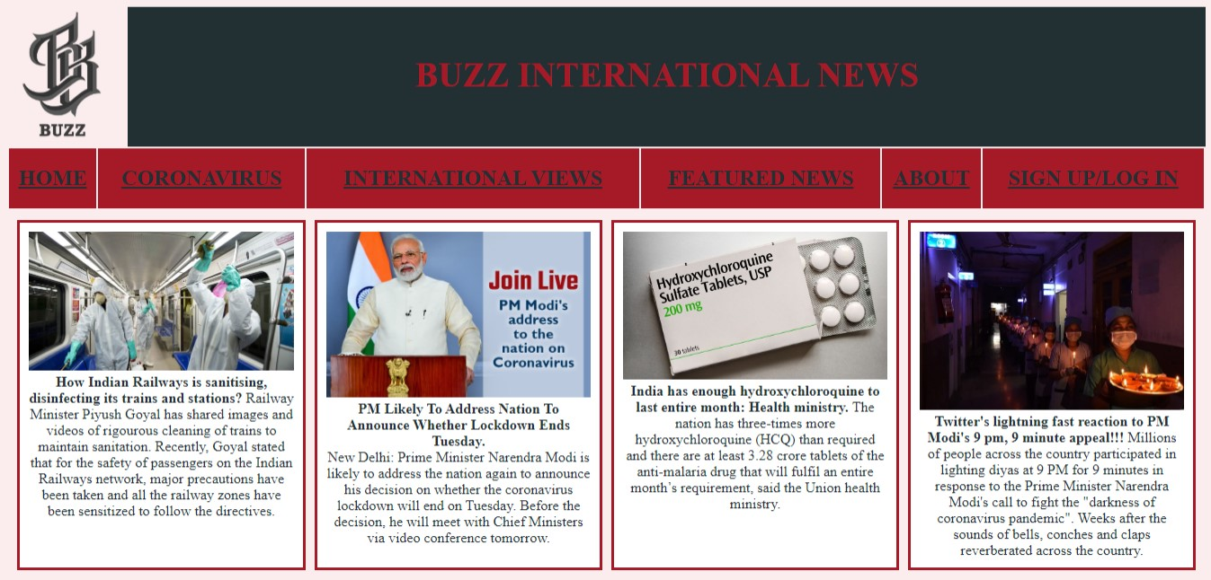
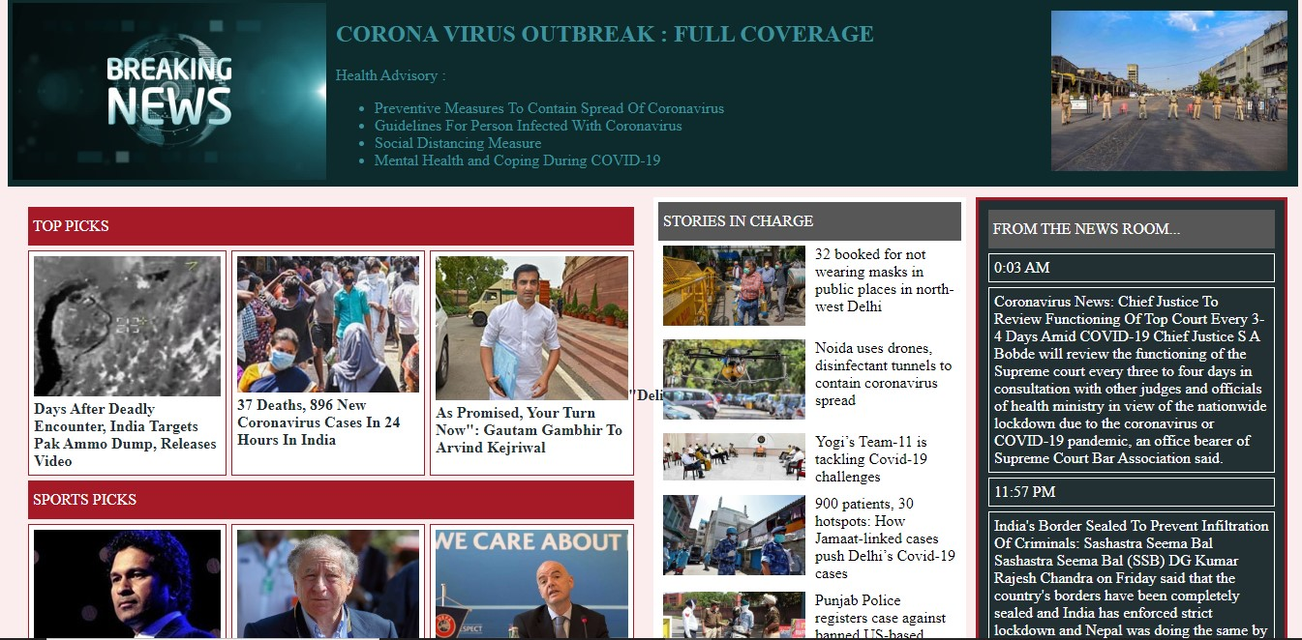
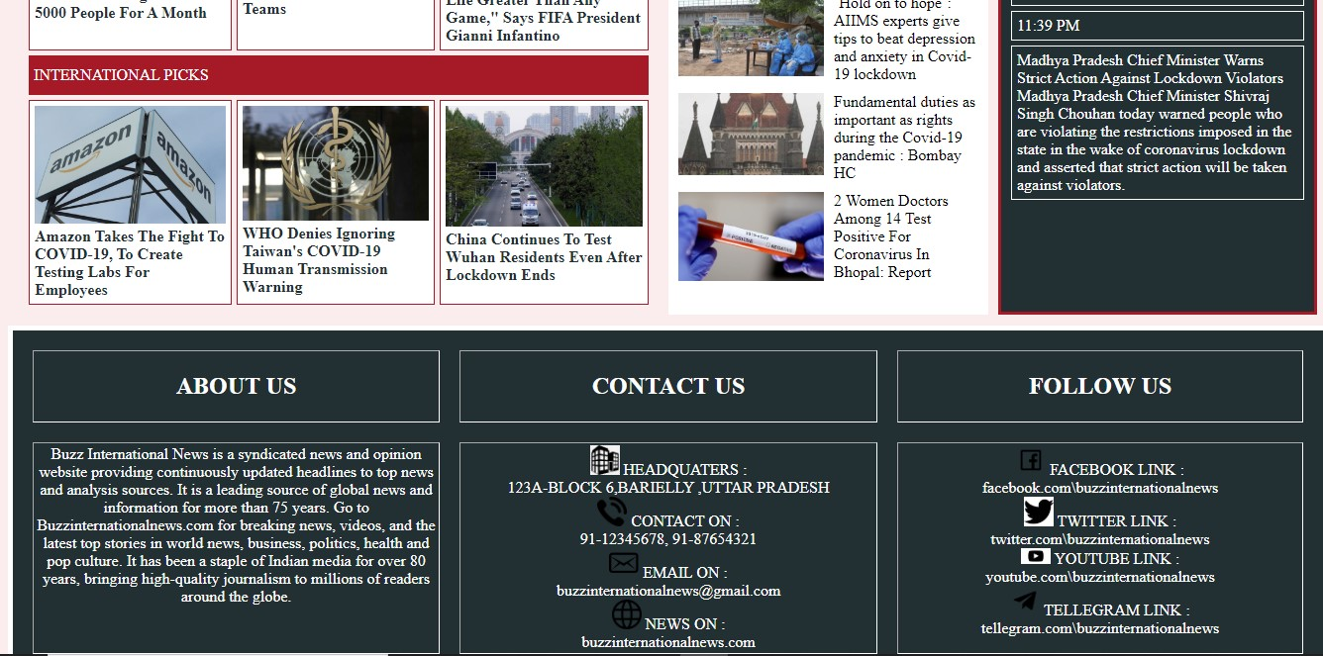

Slide 9
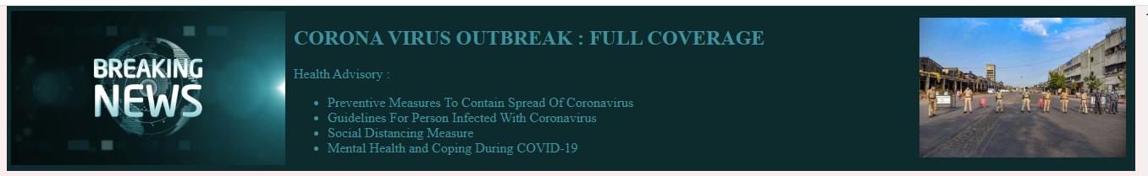
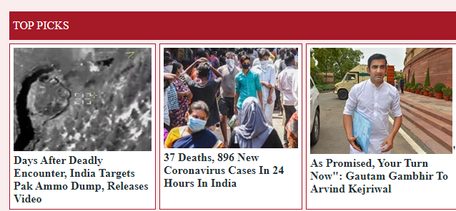
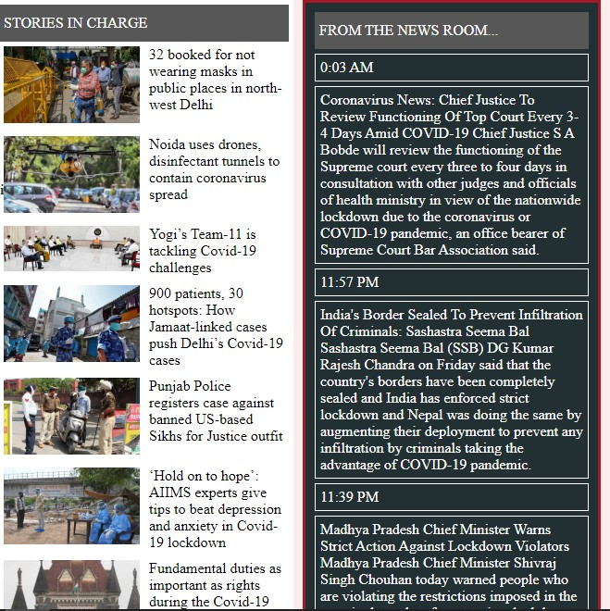

Coronavirus Tab
International Tab

Slide 10
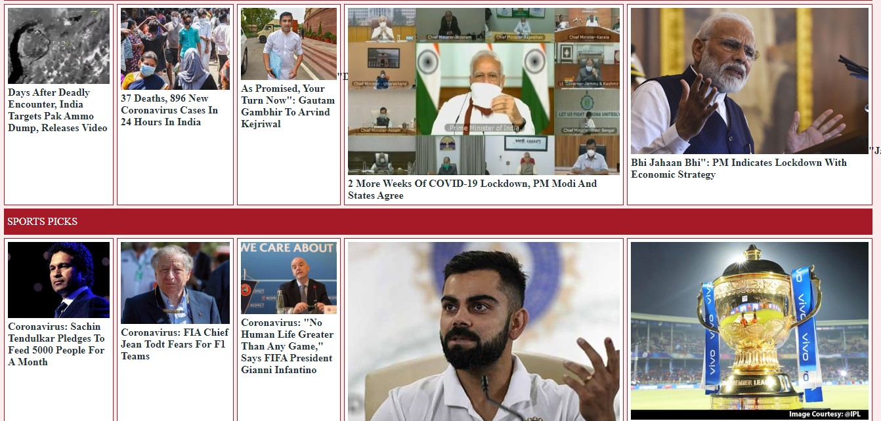
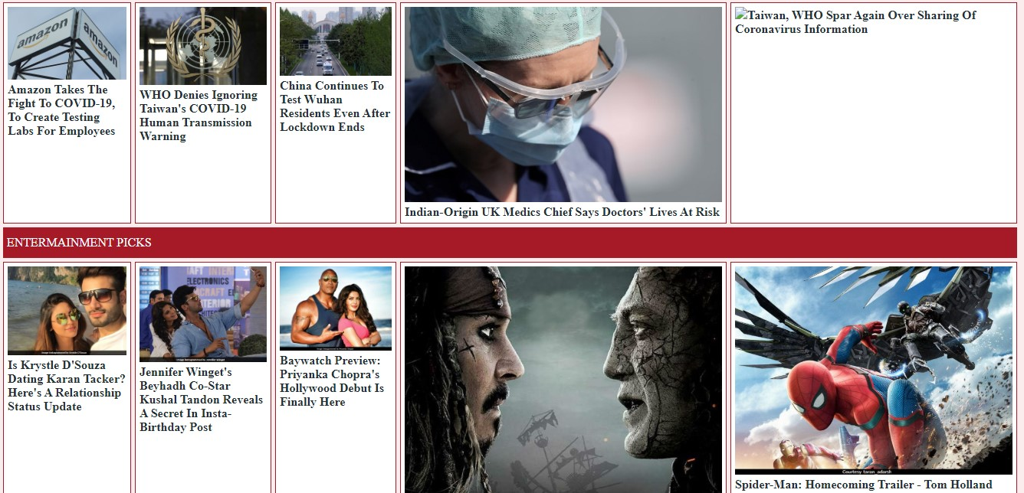
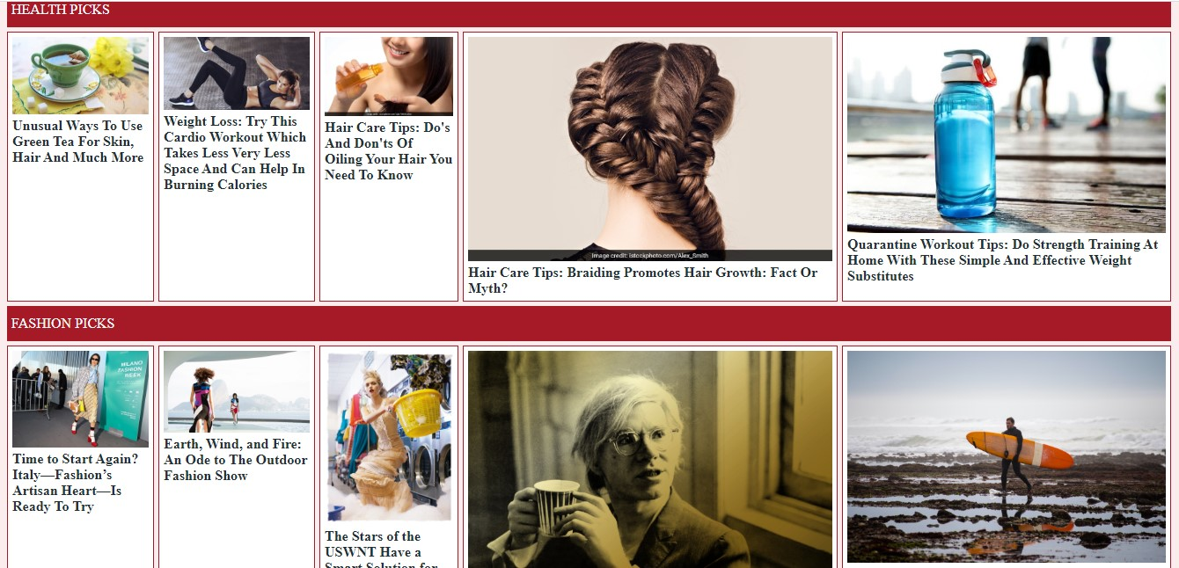
Featured News Tab

Slide 11
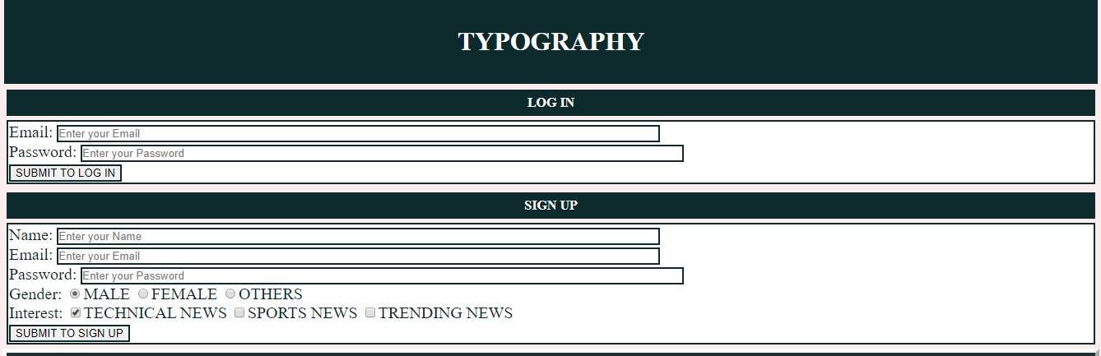
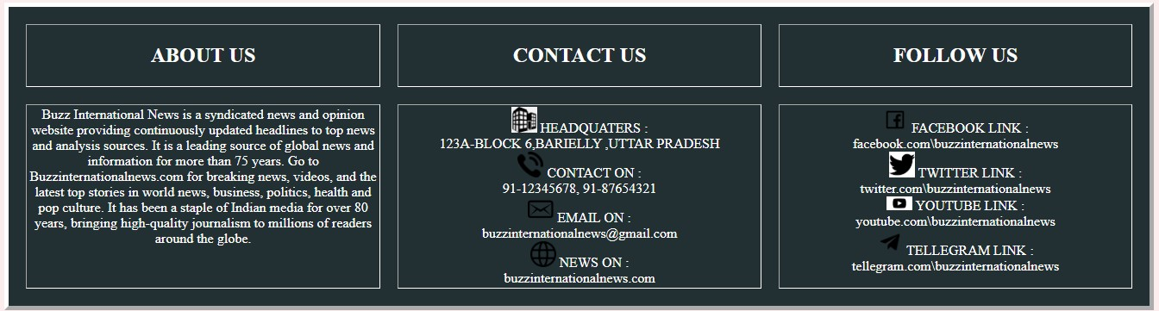
Sign Up/Log In Tab
Other Information

Slide 12
Work Distribution
Swapnil Vaish (11911972) : Has designed the website and done the HTML and entire JavaScript Coding. Prepared synopsis of project.
Ritukalpa Gogoi (11908566) : Has done CSS coding and designed the Sign Up/Log In page. Prepared the project report

Slide 13
Bibliography
https://developer.mozilla.org/en-US/
https://html.com/
https://www.w3schools.com/css/
https://www.w3schools.com/js/
https://www.w3.org/Style/CSS/
https://www.codecademy.com/learn/learn-css
https://www.javascript.com/
https://www.indiatoday.in/news.html
https://www.indiatoday.in/news.html
https://news.un.org/en/
https://www.bbc.com/news/world

