Slide 1



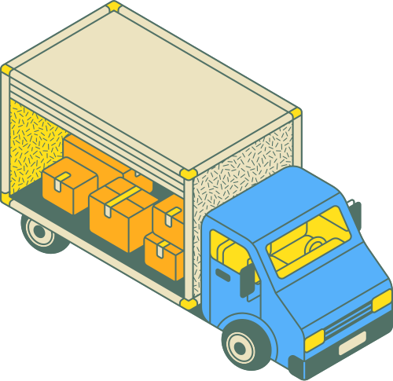
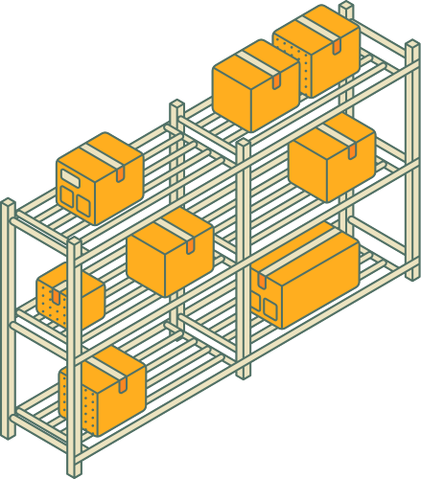
SWIFT-STORE
Smart Multi-Vendor Delivery Optimization Platform

Slide 2

THE TEAM:
SUPERVISED BY :
Vijay Kumar Trivedi
Deepali Kumari - 24BCE11526
MAYANK JOSHI - 24BCE10858
SWAPNIL SONI - 24BCE10071
SAKSHAM AGRAWAL - 24BCE10432
KAYUR SHARMA - 24BCE10869

Slide 3


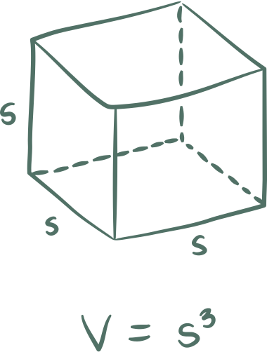
INTRODUCTION
SwiftStore is a smart multi-vendor delivery optimization platform designed to improve efficiency in hyperlocal delivery systems.
It focuses on intelligent delivery partner assignment, secure workflows, and real-time tracking.
With the rise of online ordering, optimized backend systems are critical for faster and reliable delivery

Slide 4
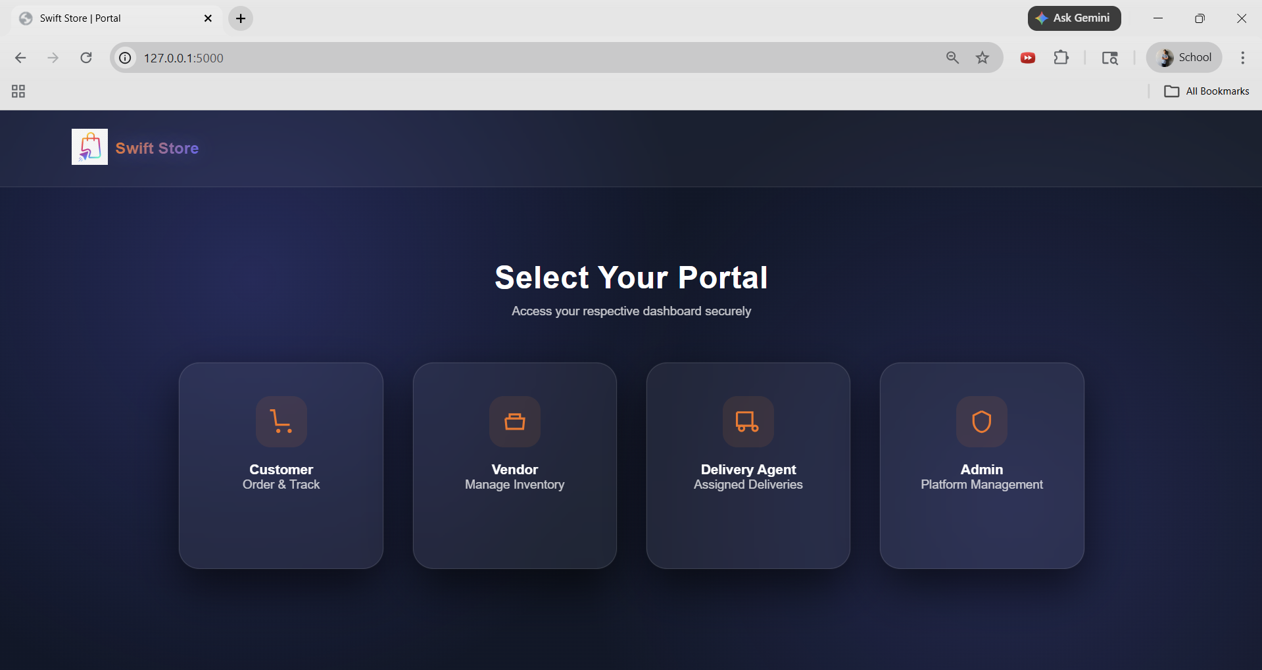
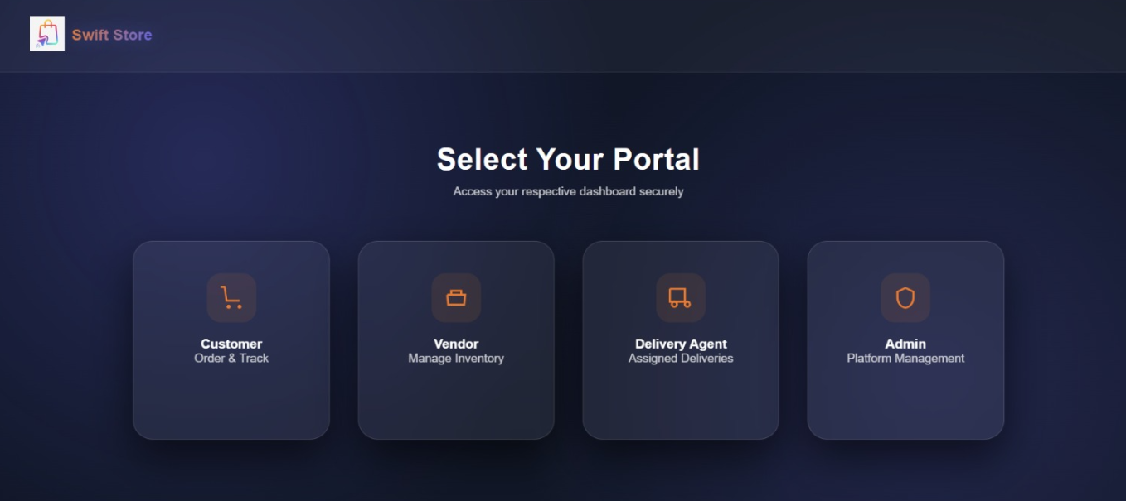

Slide 5
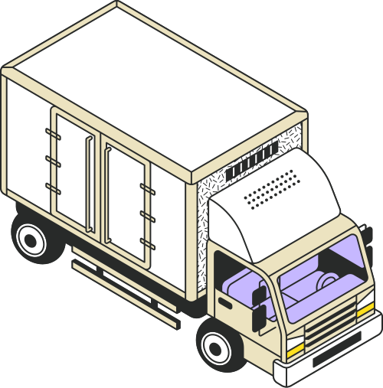

EXISTING SYSTEMS & LIMITATIONS
Platforms like Swiggy, Zomato, and Dunzo dominate the market.
Limitations:
- Limited vendor-level optimization
- Inefficient delivery partner assignment
- Lack of transparency in delivery logic
- Weak integration for small vendors

Slide 6
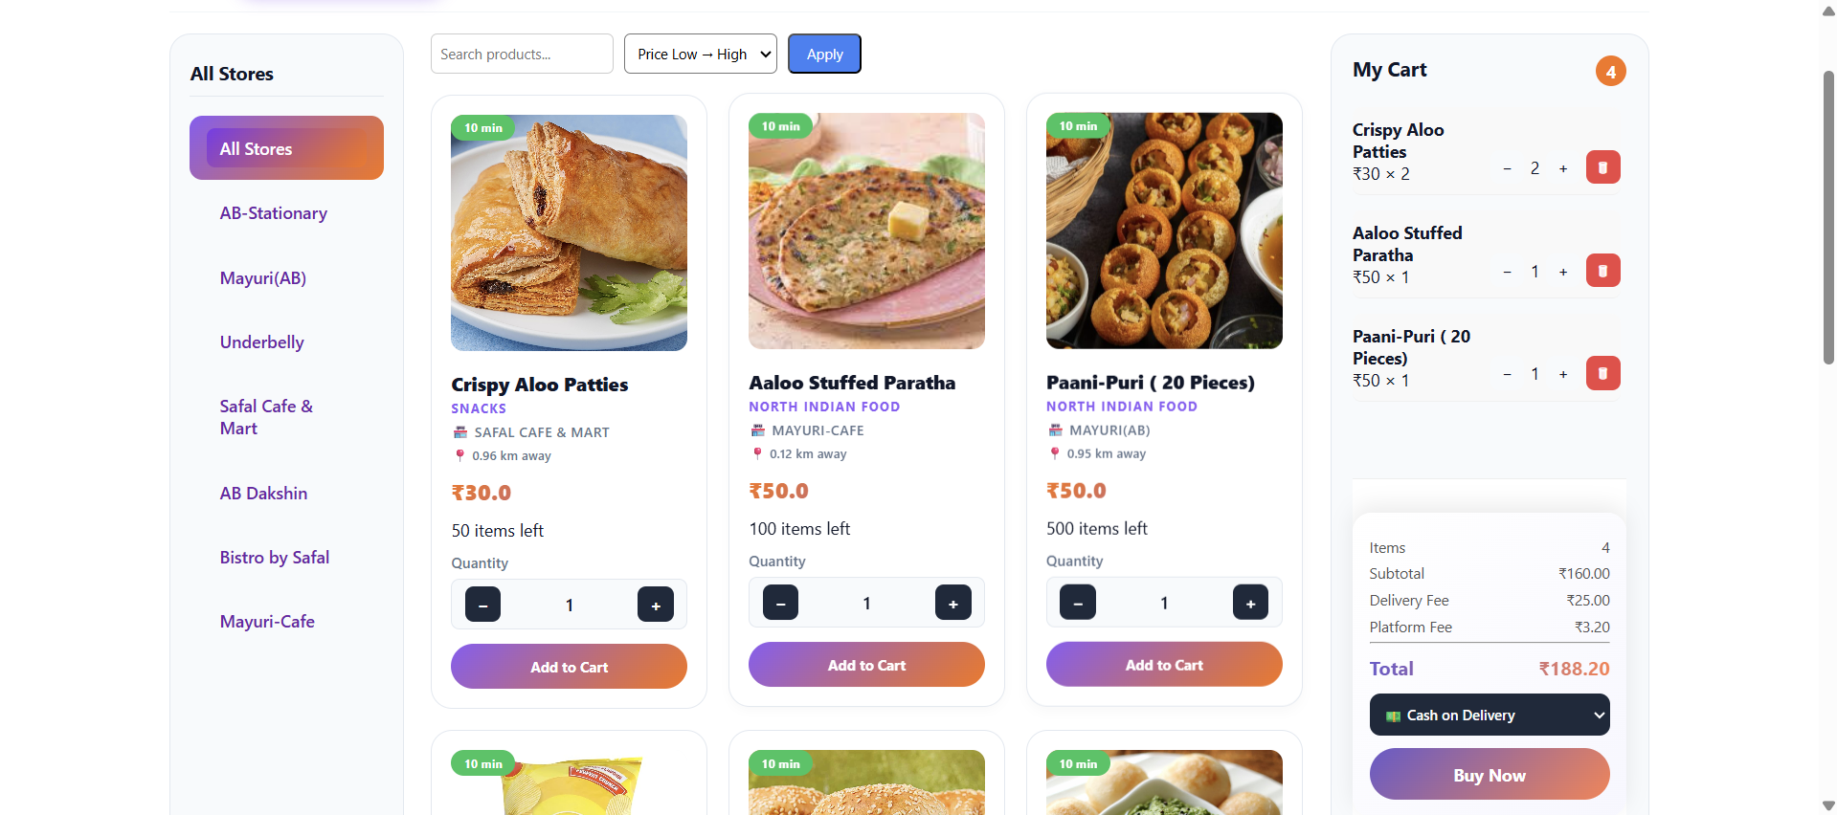
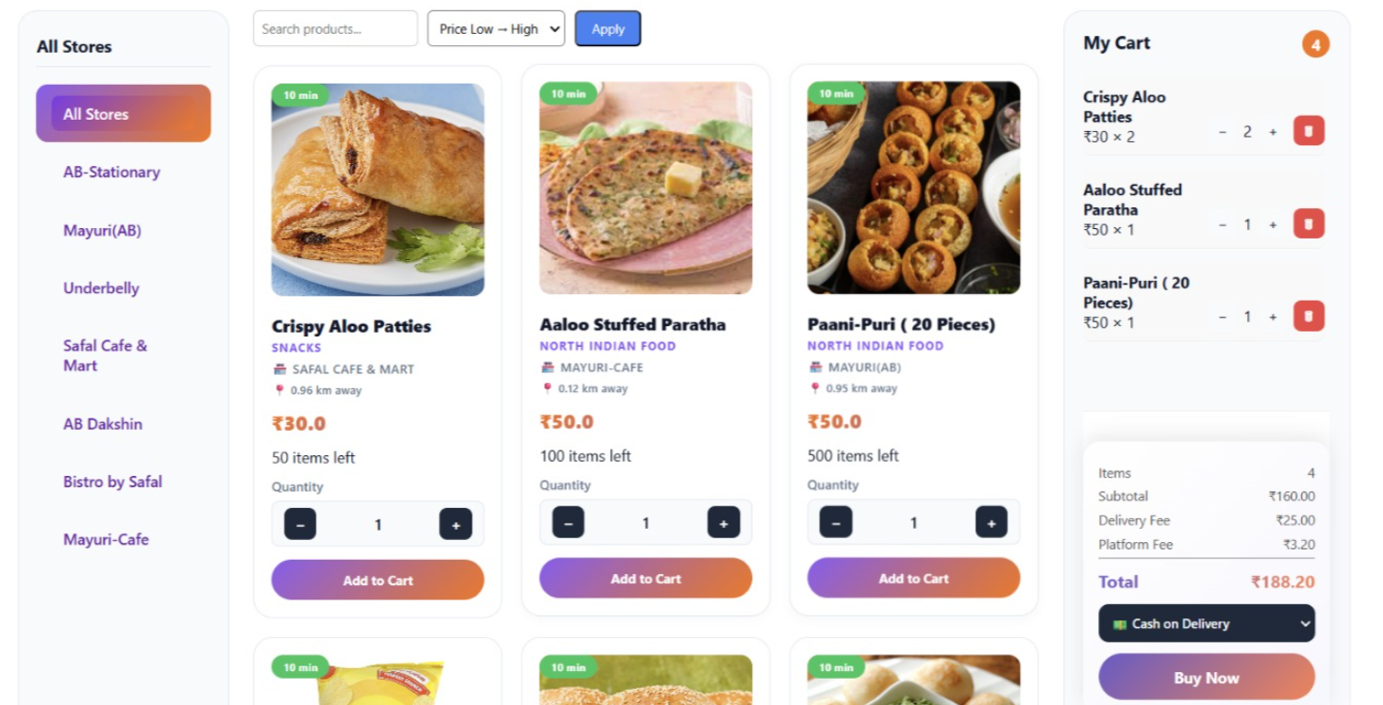

Slide 7


HARDWARE & SOFTWARE REQUIREMENTS
Hardware:
• Server (Cloud/Local)
• User Devices (Mobile/Desktop)
Software:
- Python, Flask
- SQLite Database
- Leaflet.js
- Gmail SMTP
- HTML, CSS, JavaScript

Slide 8

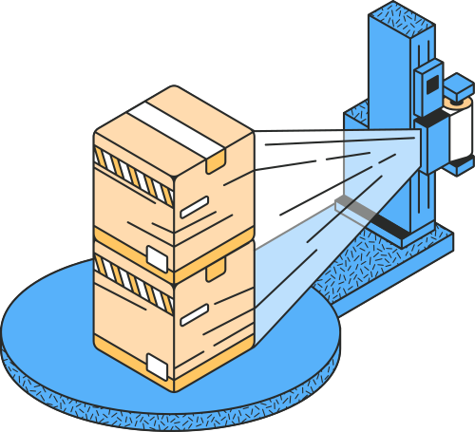
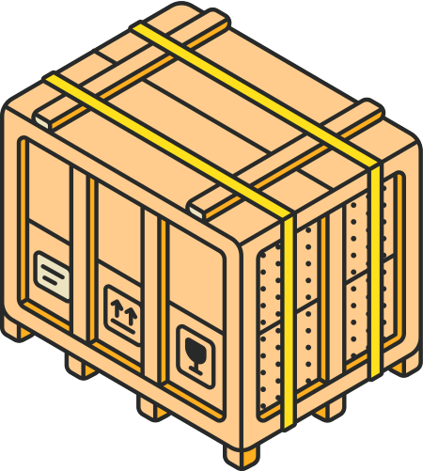
TESTING
Types of Testing Performed:
- Unit Testing (OTP validation, API responses)
- Functional Testing (order placement, assignment)
- Integration Testing (frontend-backend flow)
- Security Testing (authentication, role access)

Slide 9


RESULTS & DISCUSSION
Input:
- User location, order details
Output:
- Nearest vendor selection
- Optimized delivery partner assignment
Result:
- Reduced delivery time
- Improved efficiency
- Better workload distribution

Slide 10

PROBLEM STATEMENT
Most small-scale delivery platforms face operational inefficiencies due to:
Lack of intelligent delivery partner assignment leads to inefficient deliveries.
No geolocation-based optimization results in poor vendor selection
Manual complaint handling slows down issue resolution
Absence of delivery authentication creates security risks
Poor multi-vendor stock synchronization causes inconsistencies
No workload balancing increases delivery delays

Slide 11


PROJECT OBJECTIVE
Design a scalable multi-vendor delivery backend system
Implement smart delivery partner assignment using geospatial logic
Enable secure OTP-based delivery verification
Provide admin analytics and complaint management system
Maintain vendor-specific inventory and order control
Ensure role-based access (Customer, Vendor, Delivery, Admin)

Slide 12


PROPOSED SYSTEM OVERVIEW
Geofencing- Filters vendors within a fixed radius using real-world distance
Nearest-Agent Assignment- Automatically assigns the closest available delivery partner
Secure Delivery Workflow- OTP-based delivery confirmation via email
Live Tracking- Displays rider location for order monitoring

Slide 13
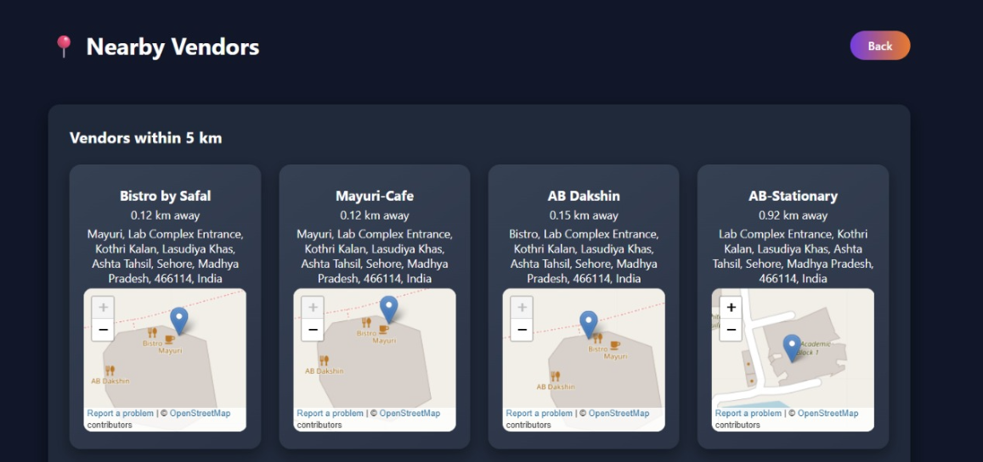
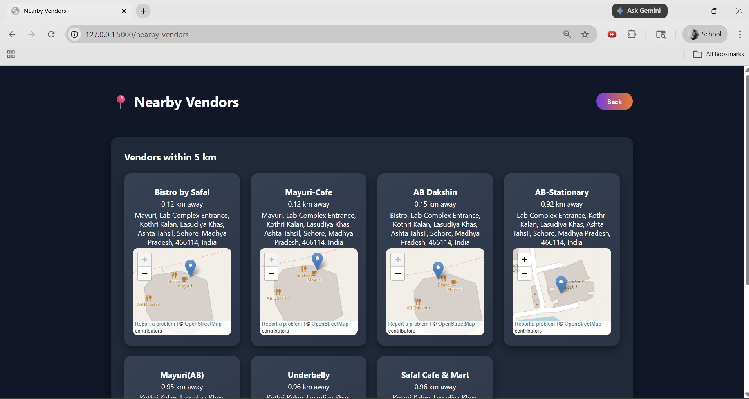

Slide 14


SYSTEM ARCHITECTURE
Frontend Layer
Gmail SMTP
OpenStreetMap Reverse Geocoding
Backend Layer
HTML5
Python
CSS3
Flask
A layered architecture is used to separate user interface, external
services, and backend logic, ensuring secure, scalable, and efficient
multi-vendor delivery management.
JavaScript
SQLAlchemy
Chart.js
Bcrypt
Leaflet.js

Slide 15
SYSTEM ARCHITECTURE
The system follows a client–server architecture to manage users, orders, and deliveries efficiently.
Web Client handles user interaction
Flask Backend processes business logic
SQLite Database stores all system data
Email SMTP service sends OTP and notifications

Slide 16





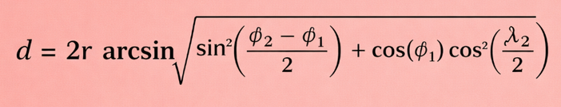
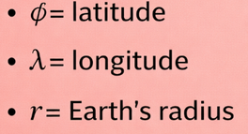
GEOFENCING USING HAVERSINE FORMULA
Why not Euclidean distance?
The system calculates distance between user and vendors using the Haversine formula.
Euclidean distance causes inaccuracy
Earth is spherical
Latitude and longitude are angular measurements

Slide 17




















Location Permission
Item Selection
Delivery Partner Assignment
Live Tracking
The system requests and obtains the user's live location for accurate service.
User selects products from
multiple vendors available
in the nearby area.
The nearest available delivery
partner is automatically assigned
based on distance and availability.
User can track the delivery
partner in real time until
the order arrives.
SYSTEM
2
4
6
8
WORKFLOW
1
3
5
7
9
Vendor Filtering
Order Placement
OTP Generation
Delivery Confirmation
User Access
User opens the website or application to start the ordering process.
Backend filters nearby vendors
using geofencing based on
the user’s location.
Selected items are confirmed
and the order is successfully
placed.
A secure OTP is generated and
sent to the user via email
for delivery verification.
OTP verification is completed
and the delivery is
successfully confirmed.

Slide 18

TECHNICAL SIGNIFICANCE
Geospatial Computation- Real-world distance calculation using Haversine formula
Backend Optimization- Intelligent nearest-agent assignment logic
Secure System Design- OTP-based authentication and role-based access
Scalable Architecture- Clear separation of frontend and backend components

Slide 19


DELIVERY ASSIGNMENT LOGIC
The system assigns delivery partners using a multi-factor scoring approach.
Formula:
Factors Considered:
• Distance from customer
Score = 0.6 × Distance + 0.25 × Workload + 0.15 × Rating Penalty
• Current workload
• Previous delivery ratings

Slide 20


















ORDER LIFECYCLE FLOW
Placed
Approved by Vendor(s)
Assigned
Picked Up
Out for Delivery
Delivered
Additional Scenarios:
• Order cancellation
• Partial item rejection

Slide 21

VENDOR PAYMENT SYSTEM
Payment Calculation:
• Gross Amount = Price × Quantity
• Platform Commission = 5%
• Payment Gateway Fee = 2%
• Net Payable = Gross − Commission − Fee
Settlement:
• VendorLedger records all transactions
• Admin settles payments weekly

Slide 22
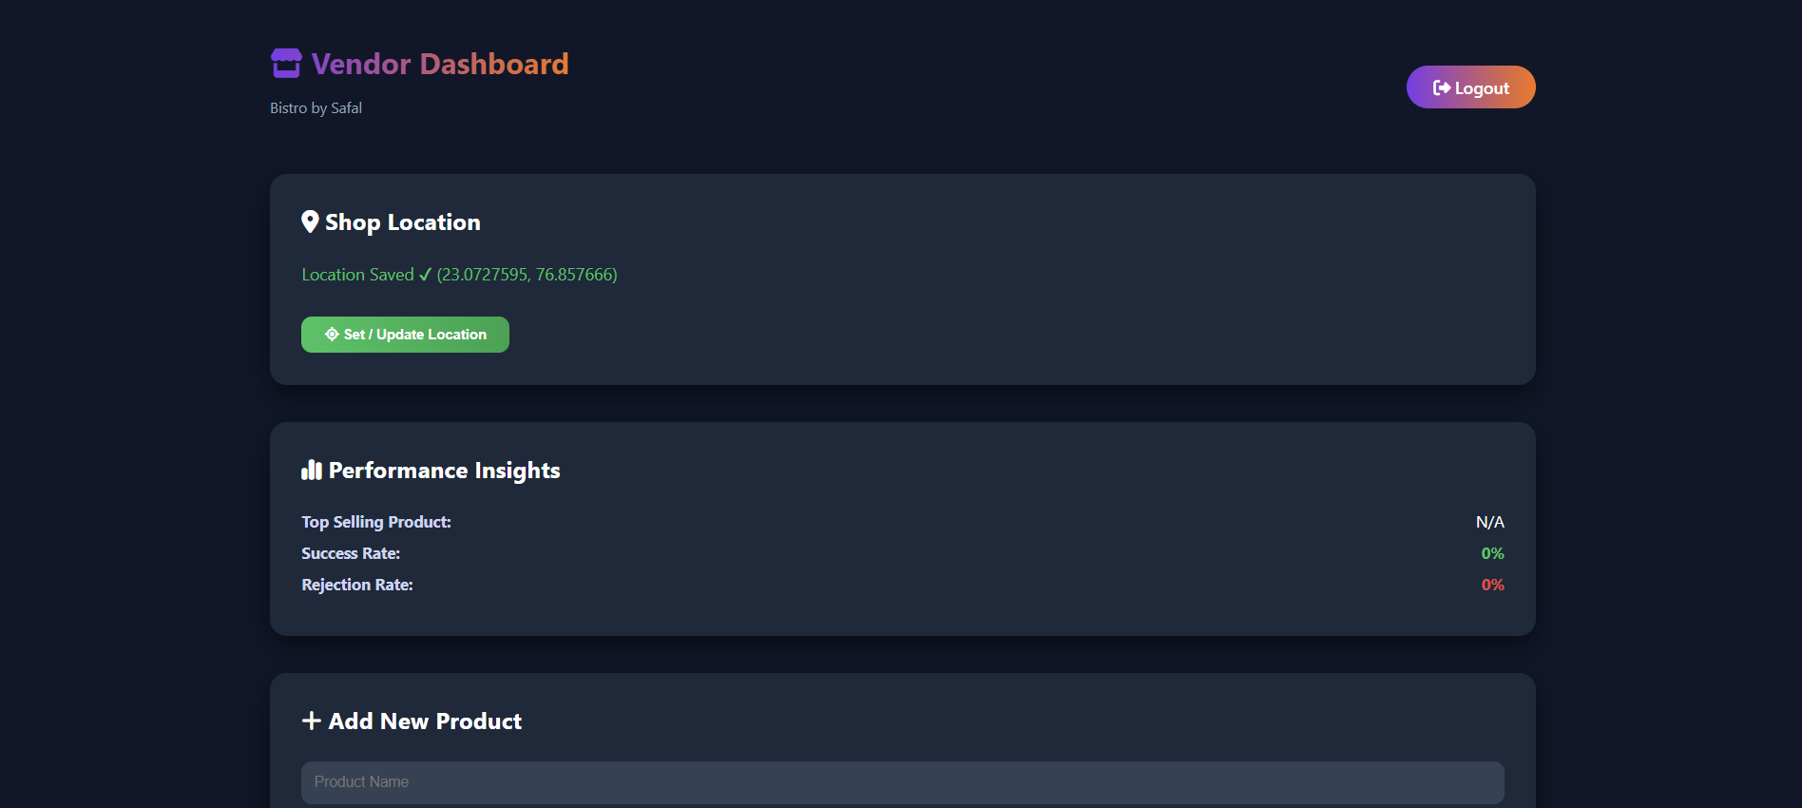
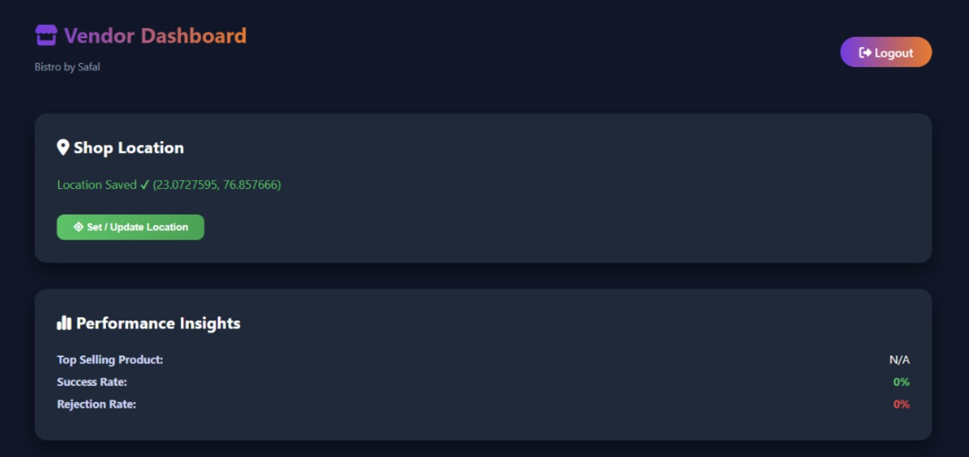

Slide 23
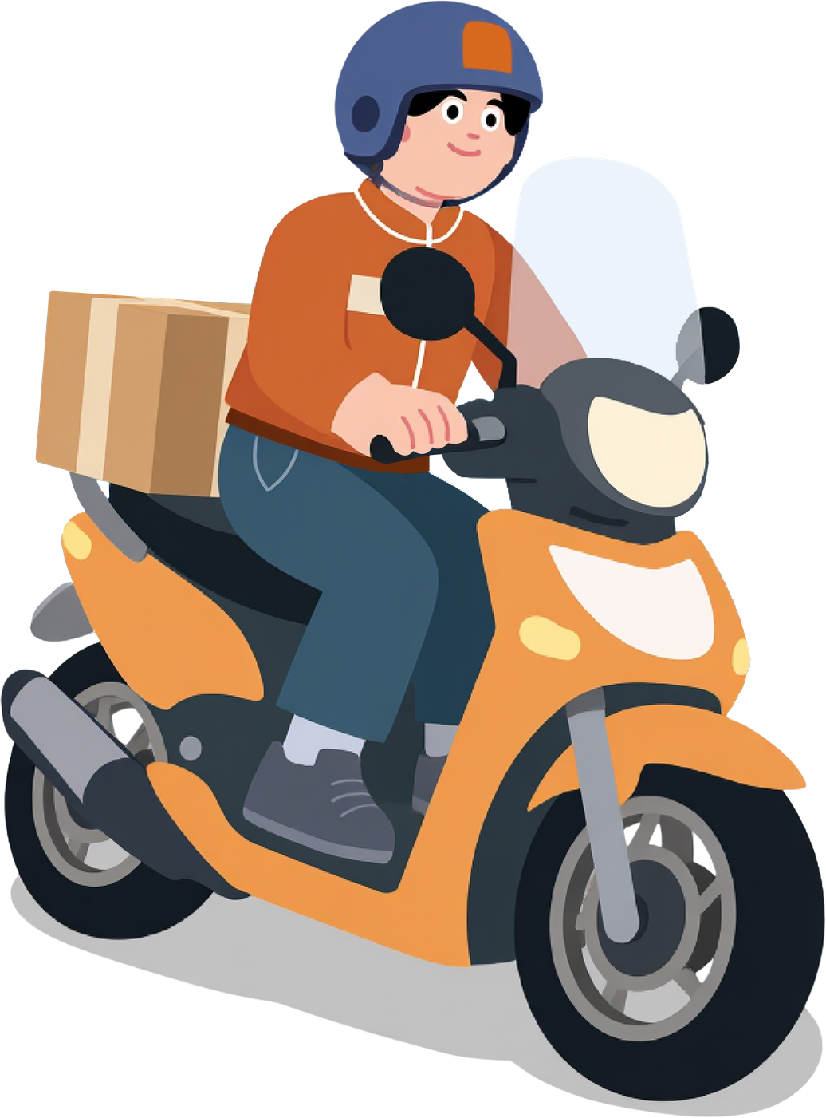
DELIVERY EARNINGS
Earning Structure:
₹25 fixed earning per delivery
Additional 2% of order value
Earnings visible on delivery dashboard
Real-time ratings and delivery history

Slide 24




SECURITY, NOTIFICATIONS & USER EXPERIENCE
Security & Validation
Notifications & User Experience
Earning Structure:
Secure authentication and login validation
Email notifications for order and delivery updates
Role-based access control for all users
Dashboard alerts for real-time order status
OTP-based delivery confirmation system
Live delivery tracking interface
Backend input validation to prevent invalid requests
Ratings and feedback system for service quality

Slide 25
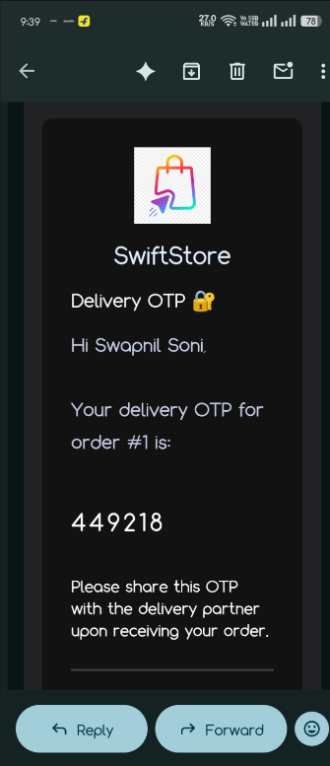



Slide 26
CHALLENGES & SOLUTIONS
Challenges
Solutions
Earning Structure:
Multi-vendor order handling
Item-level order mapping
Delivery partner selection
Scoring-based delivery assignment
Payment settlement logic
VendorLedger settlement system
Preventing unauthorized actions
Role verification at API level

Slide 27
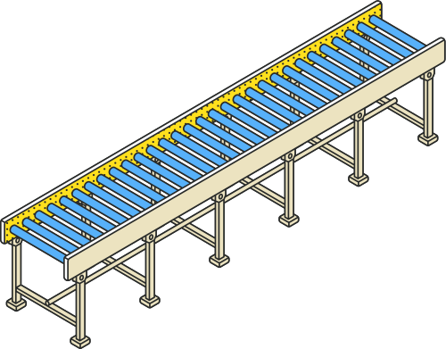


FUTURE ENHANCEMENTS
Automated weekly settlements
SMS-based OTP verification
Microservice architecture
Improved UI/UX design
Database optimization & scaling

Slide 28
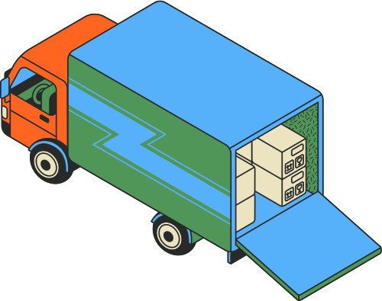
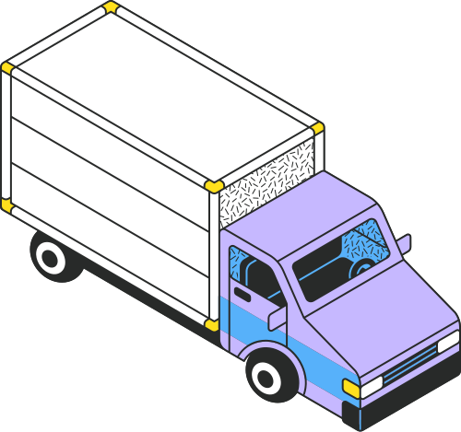
CONCLUSION
Swift-Store provides an optimized hyperlocal delivery model by combining:
Multi-vendor consolidation
Geofencing-based vendor filtering
Nearest delivery partner assignment
Secure OTP-based delivery confirmation
The system improves delivery efficiency, security,
and backend scalability.

Slide 29

DEMO VIDEO
Demo Video Link:
(https://drive.google.com/file/d/1YmHnPctyQWPD48DGeTNIy9DNclPL9i1d/view?usp=sharing)
You can also use QR code for quick access

Slide 30
THANK YOU !
For your attention!

