Slide 1
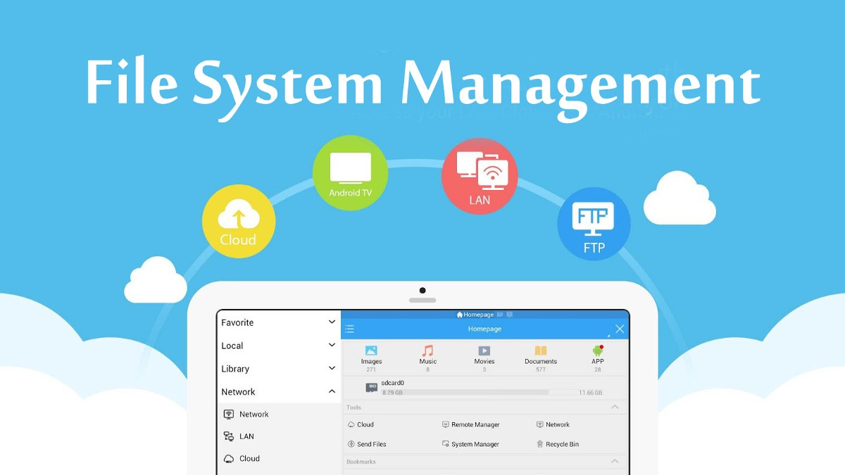
File Management System

Slide 2
Swapnil Patil
(59)
Devyani Ushir
(75)
Team Members
Komal Shinde (69)
Aditya Vhanmane (76)
Notes:
Hello Everyone, Good Morning this is group 1st and the name of the topic on which we are going to give presentation is role of data science in share trading , Let's move to the contents ,this all are the contents of presentation respectively,and ok so let's start with the introduction !!!

Slide 3
TABLE OF CONTENTS
01
02
03
BACKGROUND
INTRODUCTION
PROJECT PARADIGM
04
05
06
FUNCTIONALITIES
FUTURE WORK
CONCLUSION

Slide 4
BACKGROUND
In the 20th century, vertical filing cabinets were introduced to store a different kind of files.
File management is one of the basic and important features of operating system
File management is defined as the process of manipulating files in computer system.
File management is a process of maintaining any kind of records in a proper manner
Notes:
One of the fundamental and crucial components of an operating system is file management. Computer systems' operating systems are used to manage their files. The operating system is responsible for managing all files with various extensions. A file is a grouping of certain information kept in a computer system's memory. The act of generating, changing, and deleting files is included in the definition of file management, which is the manipulation of files within a computer system. Our files include several popular features by default. Each file has data, but it also contains metadata that the operating system (OS) uses to control how the file functions and is stored. File information such as the author, file creation date, and updated date is recorded in metadata. File management is the process of keeping all records in order, such as your job documents or your financial information. This is the process of breaking things down into smaller, written pieces so that they can later be easily located when needed. Vertical filing cabinets were developed in the 20th century to store various types of files. Then, with the aid of the LAN/WAN network, the computer was utilized to store a different type of file in the system. Then came portable flash drives, which could be used to transmit data between systems and store files. After then, cloud storage became available, making it simple to store files from anywhere. When cloud storage was launched, it became simple to store information from any computer and anywhere, protecting the user from data loss and other threats thanks to their high-security measures.

Slide 5
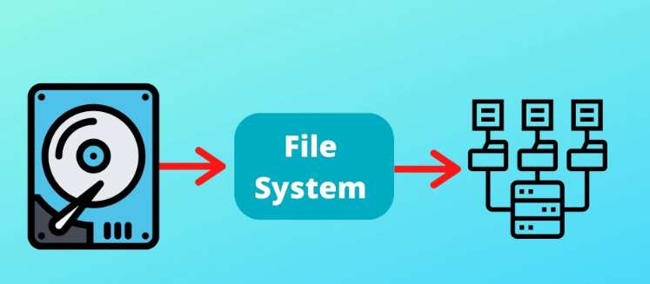
INTRODUCTION
Computer users spend time every day interacting with digital files and folders, including creating, downloading, naming,etc.
File management is an art of storing, naming, sorting and handling documents files in a systematic manner.
some of the tasks performed by file management of operating system of any computer system

Slide 6
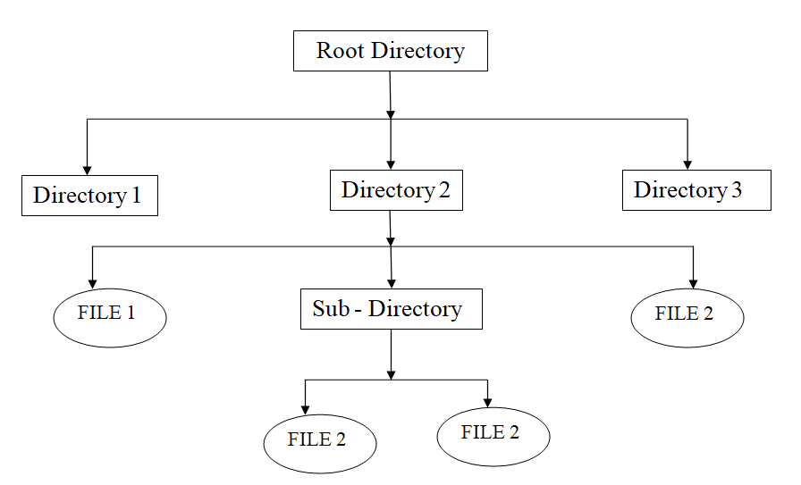
PROJECT PARADIGM

Slide 7
FUNCTIONALITIES
The following are some of the functionalities or tasks performed by file management system:
List all Files and Directories.
Create New Files.
Delete Existing Files.
Rename an Existing Files.
Edit Files Content.
Search for Files.
Details of Particular File.
View Content of File.
Sort Files Content.
List only Directories
List Files of particular Extension.
Count Number of Directories.
Sort all Files in a Directories.

Slide 8
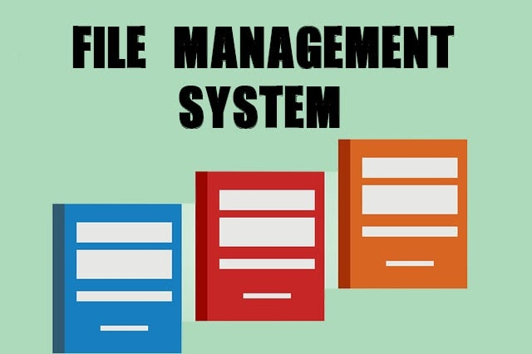
FUTURE WORK
This is the most basic version of file management system. So in future we can improve the current version’s functionalities and can add more new functionalities to the system.

Slide 9
CONCLUSION
The project contains some basic functionalities regarding file management like creating new files, delete existing files, rename files, edit files, read or write files and so on. All the functionalities are working on the basis of user’s input from keyboard. There are different basic functions that users can perform on files.

Slide 10
REFERENCE
https://www.tutorialspoint.com/unix/unix-file-management.htm
https://www.codingninjas.com/codestudio/library/implementing-directory-management-using-shell-script

