Slide 1
Design Analysis and Algorithm
COURSE PROJECT
Sudoku Solver Using Backtracking Algorithm
Under the Guidance of : Prof. Siddharth Bhorge

Slide 2
GROUP MEMBERS
Roll No. | Name | GR No.
59 | Swapnil Patil | 12120131
69 | Komal Shinde | 1212
75 | Devyani Ushir | 12120175
76 | Aditya Vhanmane | 1212

Slide 3
INDEX
Problem Statement
Introduction
Objective
Backtracking
Algorithm for Sudoku solver using Backtracking
Pseudo Code
Implementation and results
Analysis of the algorithm
Conclusion

Slide 4
PROBLEM STATEMENT
People nowadays always busy for working and cope for the challenges on their life. With the increasing busyness of the life, stress become a common issue that faced by the society. A long term of facing a particular problem will make a people to feel pressure and stress themselves badly.
Therefore, they need some break to take their mind off from working materials before they continue to work. Sometimes, a challenges mini game like Sudoku can helps to exercise their brain and reduce stress.

Slide 5
INTRODUCTION
Like all Other Backtracking Algorithm ,Sudoku can be solved by assigning numbers one by one to empty cells. Before assigning a number, check whether it is safe to assign.
Check that the same number is not present in the current row, current column and current 3X3 sub grid.
After checking for safety, assign the number, and recursively check whether this assignment leads to a solution or not.

Slide 6
OBJECTIVE
The purpose is to implement a more efficient algorithm and then compare it with another Sudoku solver named as brute force algorithm.
Understanding the algorithm behind Sudoku puzzle. Identify an algorithm to generate a complete Sudoku puzzle with the rules that the digit 1-9 appear exactly once in each row, each columns, and each 3×3 sub grids. Identify the ways of removing cells from the complete Sudoku puzzle to create a valid game. Generate Sudoku with different difficulty level. Identify the algorithm to solve the Sudoku puzzle.

Slide 7
Rules For Solving Sudoko
Each of the digits 1-9 must occur exactly once in each row.
Each of the digits 1-9 must occur exactly once in each column.
Each of the digits 1-9 must occur exactly once in each of the 9 3x3 sub-boxes of the grid.
The '.' character indicates empty cells.

Slide 8
Algorithm for Sudoku solver using Backtracking
1.Find an unfilled cell (i,j) in grid
2.If all the cells are filled then
2.1. A valid sudoku is obtained hence return true
3.For each num in 1 to 9
3.1. If the cell (i,j) can be filled with num then fill it with num temporarily to
Check
3.2. If sudoku Solver(grid) is true then return true
3.3. If the cell (i, j) can't be filled with num the mark it as unfilled to trigger
backtracking
4.If none of the numbers from 1 to 9 can be filled in cell (i,j) then return false as
there is no solution for this sudoku

Slide 9
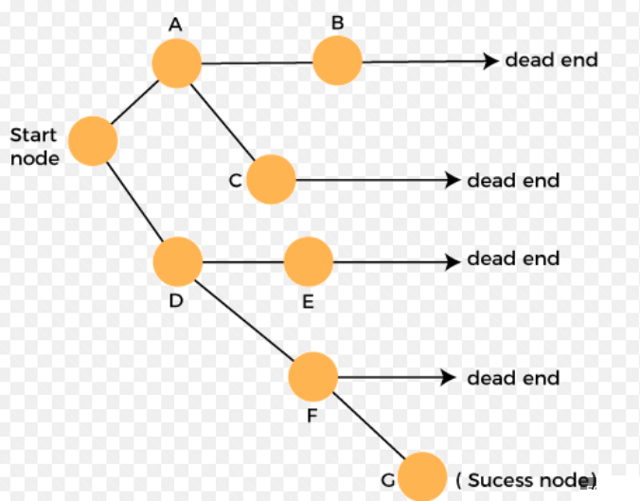
BACKTRACKING
Backtracking is one of the techniques that can be used to solve the problem. We can write the algorithm using this strategy. It uses the Brute force search to solve the problem, and the brute force search says that for the given problem, we try to make all the possible solutions and pick out the best solution from all the desired solutions.

Slide 10
Pseudo Code
bool Solve(configuration conf)
{
if (no more choices) // BASE CASE
return (conf is goal state);
for (all available choices)
{
try one choice c;
// solve from here, if works out, you're done
if (Solve(conf with choice c made))
return true;
unmake choice c;
}
return false; // tried all choices, no soln found
}

Slide 11
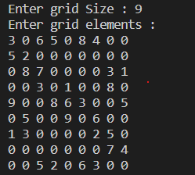
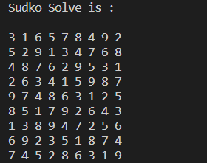
Implementation and results
This program takes input of 9×9 numbers. Blank cells have to be filled with 100 while feeding input. Along with this it sets up a flag array, which will be used to implement backtrack and forward.
It will find the first blank position and store in p1.
RESULTS :-
Input :- Output:-

Slide 12
Analysis of the algorithm
Time Complexity
Worst Case Time Complexity: O(9^{n})
Average Case Time Complexity: O(9^{n})
Best Case Time Complexity: O(n²) [This takes place when the number of backtracking steps are minimized]
Space Complexity
At most, there can be n function calls in the recursion stack. Hence the space complexity would be O(n).

Slide 13
Conclusion
Backtracking algorithm is an appropriate method to find a solution faster and more efficient compared to the brute force algorithm. The proposed algorithm is able to solve such puzzles with any level of difficulties in a short period of time (less than one second).A Sudoku (top) being solved by backtracking. Each cell is tested for a valid number, moving "back" when there is a violation, and moving forward again until the puzzle is solved. A Sudoku designed to work against the brute force algorithm.

Slide 14
THANK YOU
FOR LISTENING!!

