Slide 1





Data Fiesta 3.0 Case Study
Team DataCore
Jadavpur University
Batch of 2023
TEAM MEMBERS
Swapnil Ghatak
B.E. Construction Engineering
Dipta Surjya Neogi
B.E. Construction Engineering
Soumyadeep Sinha
B.E. Construction Engineering

Slide 2
Serial No. | Table Name | Description
1 | All Channel Sales Units | Sales Units
2 | All Channel Sales Volume | Revenue
3 | COGS | MSRP & COGS
4 | Classification | Product information
5 | SKU | Product merged SKUs
6 | SKU Region | SKUs region
7 | Region | Region description
8 | Company | Channel description
9 | Line | Product line
10 | OOS | Out-of-Stock Product
s
Problem Statement - ABC Inc. is a Custom products distributor with majority in cosmetics products selling to different types of stores across the U.S but also internationally.
Goal – To build an insightful dashboard with key metrics and help the client take the business decision accordingly

Slide 3

Steps followed
1. Basic Metrics Calculation
2. Data Cleaning and Pre-processing
3. Data Modelling and creating the relations
4. Creating Dashboard
5. Generating insights
6. Preparing Presentation

Slide 4

BASIC METRIC CALCULATION
Sl. No. | Metric | Total
1 | Total Revenue | $ 263,684,225.95
2 | Net Sales | 5368885
3 | Average Unit Retail | $ 49.11
4 | COGS | $ 12,91,21,686.77
5 | Gross Margin % | 51%
6 | TY Total Revenue | $ 6,96,11,883.00
7 | LY Total Revenue | $ 12,50,49,117.00
8 | TY Net Sales | 1469235
9 | LY Net Sales | 2539952
10 | YOY % for 2017-2018 | 81.16% (Growth)
11 | YOY % for 2018-2019 | 44% (Decline)

Slide 5
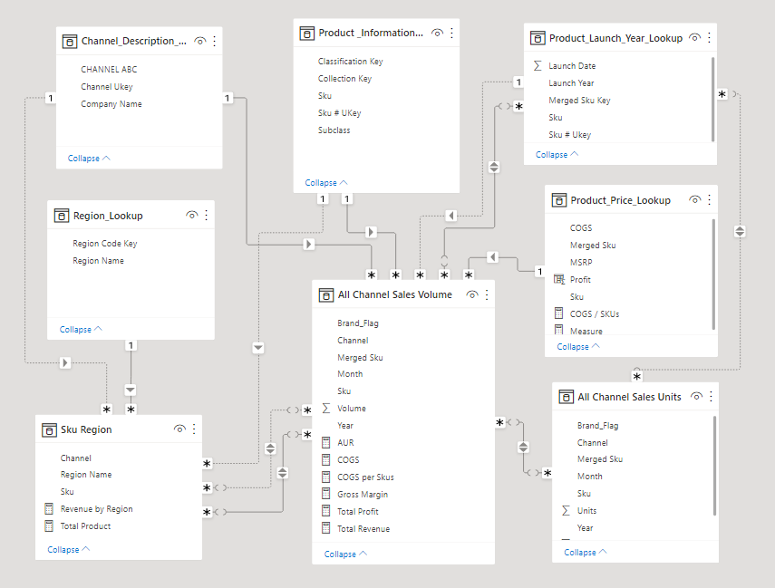
Data Modelling

Slide 6
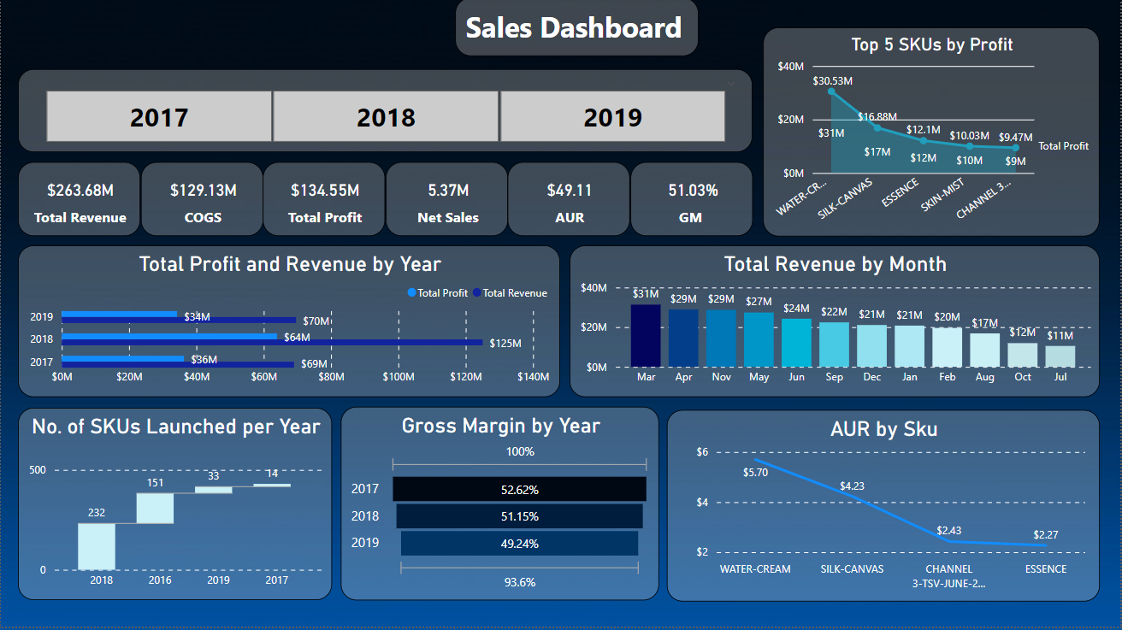

Slide 7
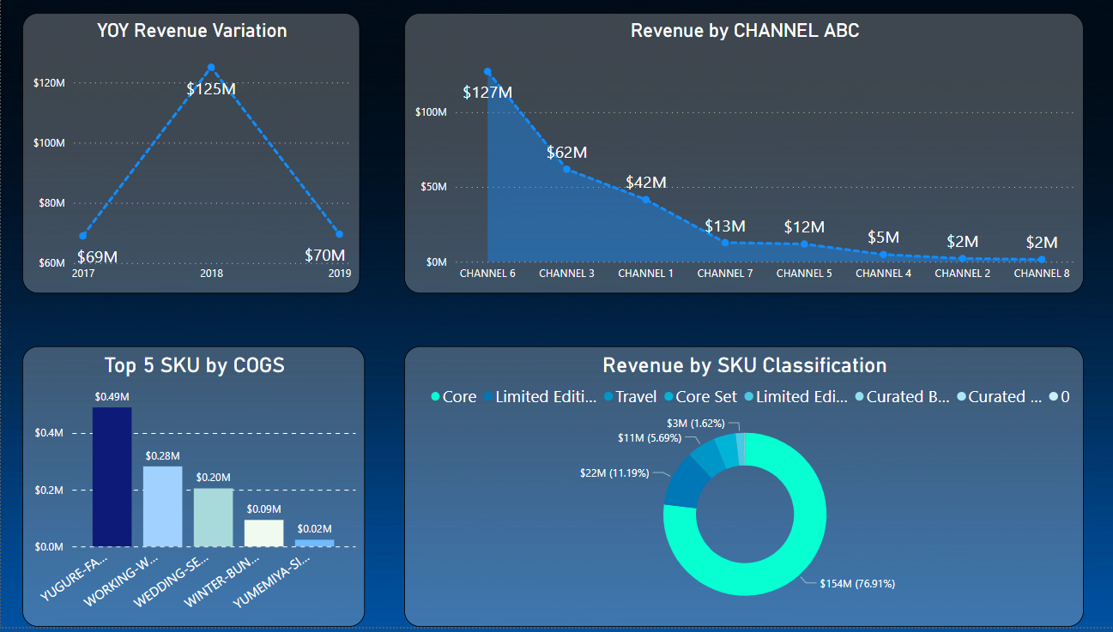
Link to PowerBI file : https://drive.google.com/file/d/1biUWy8W5eoQz5eemlbA0KIGP0eJ5caU6/view?usp=sharing

Slide 8
Top 10 Insights
Revenue growth (81.18 % increase) was observed between 2017 and 2018. Between 2018 and 2019, 44.33 % decline in revenue was observed.
Net Sales was highest in the year 2018 at 2.54M.
﻿﻿At $30.53M, Water-Cream has the highest Profit accounting for 22.78% of the total Profit.
Profit % increased from to 76.10 % , between 2017 and 2018 whereas between 2018 and 2019 the profits decreased by 46.42 %.
Overall Gross Margin (GM) is 51.03 %, and Average Unit Retail (AUR) amounts to $49.11.
Total revenue (monthly) in 2017 was maximum for the month of November ($12M), whereas for 2018 and 2019, total revenue was maximum in the months of November ($17M) and March ($17M) respectively.
The Year Over Year (YOY) revenue experienced growth from 2017 to 2018 at the rate of 81.16 % and declined by 44 % from 2018 to 2019.
Highest number of SKU’s were launched in the year 2018 (232) while the lowest number of SKU’s were launched in the year 2017 (14), which is 16.7 times less than the highest of 232 in 2018.
Core sector accounts for 65.39 % of total revenue, which is the highest, at $154M.
Channel 6 generates the highest revenue of $127M which is 48.24 % of the total.

Slide 9
Data Cleaning and Preprocessing
a) Checking for Null Values
b) Duplicate Rows Check
﻿﻿c) Spelling Check ( Check for jumbled words )
d) Checking for errors in the dataset.

