Slide 1
Horse Racing
Predicting drivers of handle

Slide 2
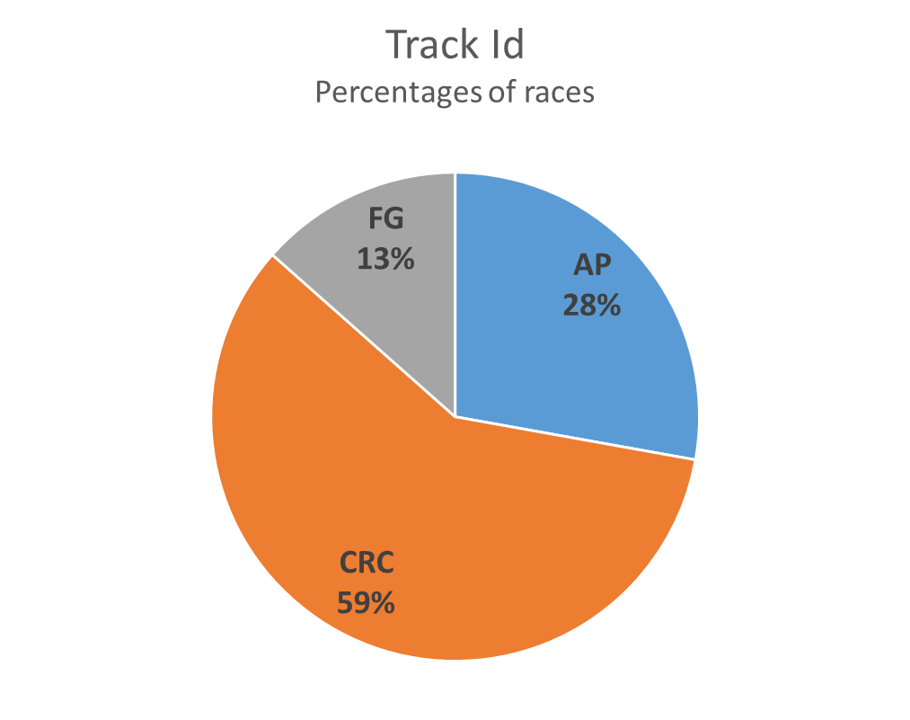
Introduction
The analysis is performed on races happening in Illinois, Florida and Louisiana states of North America on their race track AP, CRC and FG respectively, between the year 2005-2006.

Slide 3
Qualitative variables
Variable | Sample Values
age_restriction | 2,3,3U,4U
conditions_of_race | Non winners of 3 races in last 8 months, non winners of $2000
course_type | Dirt or Turf
race_type | allowance, claiming, maiden claiming, handicap, stakes
sex_restriction | Adult female, filly
stakes_indicator | Yes, No
state | Florida, Kentucky
surface | Dirt or Turf
track_condition | Fast, firm, sloppy, yielding, muddy
track_id | CRC,AP,FG
weather | Clear, cloudy, rainy, hazy, showery

Slide 4
Quantitative variables
Variable | Description | N | Mean | Std Dev | Minimum | Maximum
race_number | Serial number of race that day on that track | 10715 | 5.6419039 | 3.0370585 | 1 | 15
distance_id | Race distance in Furlongs | 10715 | 7.030766216 | 1.334975395 | 2.00 | 16.00
purse_usa | Total prize money | 10715 | 29037.79 | 37732.36 | 7000 | 1000000
wps_pool | Combined winning money on win, place and show bets | 10715 | 149081.76 | 114232.33 | 20347 | 1946736
minimum_claim_price |  | 10715 | 13896.57 | 16425.58 | 0 | 100000
maximum_claim_price |  | 10715 | 15010.69 | 16925.87 | 0 | 100000
number_of_runners |  | 10715 | 8.0438637 | 1.9023527 | 3 | 14
handle | Total money on bet | 10715 | 443226.41 | 318690.63 | 51978 | 4980481
num_start |  | 10715 | 9.1878675 | 2.5497628 | 0 | 18

Slide 5
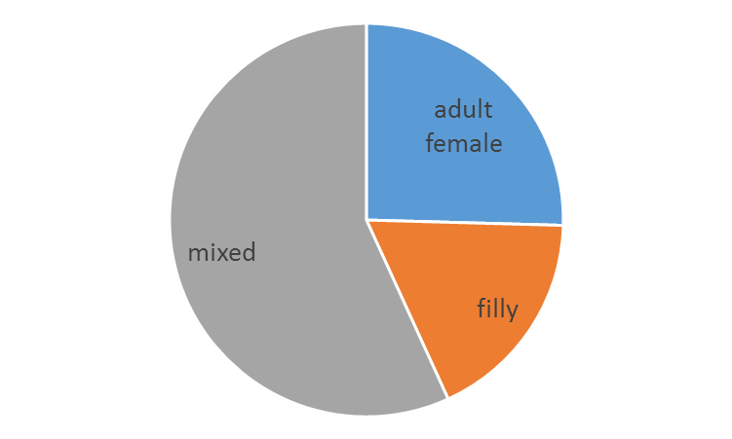
Sex restriction
25% races are for mares, 18% are for filly and rest 57% have
no sex restrictions (supposing mixed)
Fillies are more popular in maiden races and less
popular in condition races like ‘NW of...’
There are no filly and mare races for Optional claiming
stakes, Starter handicap and Starter stakes race types
Pie chart – Sex restriction

Slide 6
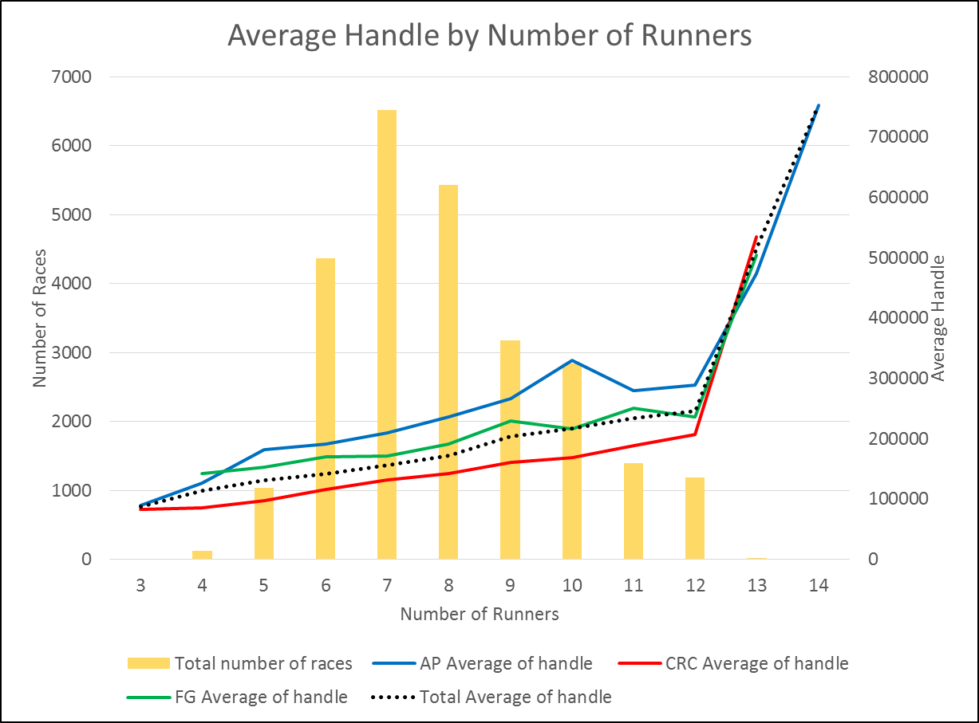
Number of Runners
The graph suggest that average handle bet is more for maximum number of runners.
Having 10 number of runners is the optimal choice for any race.

Slide 7
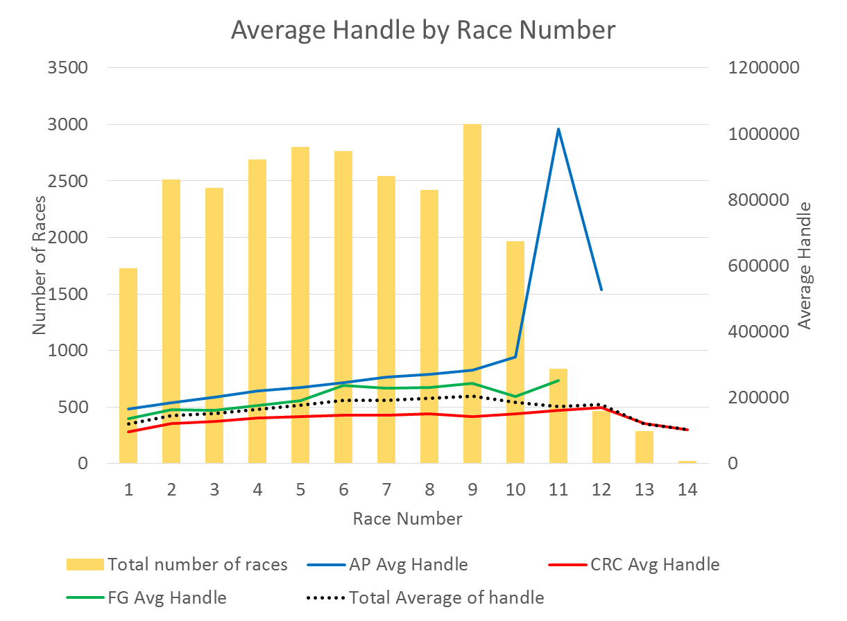
Race Number
We can see a general trend line suggesting that average handle bet is higher for races which are ran later in the day.
Average handle is least for the Track Id CRC for all the races.
Average handle is highest for the Track Id AP for all the races.

Slide 8
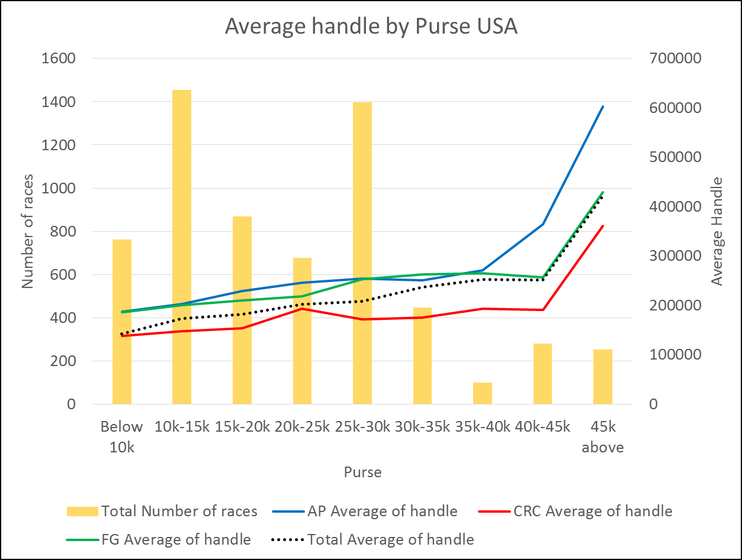
Purse
The graph shows that average handle is same for almost all purse categories, except when the purse is above $ 40,000.
Average Purse for CRC is the least throughout all purse categories.

Slide 9
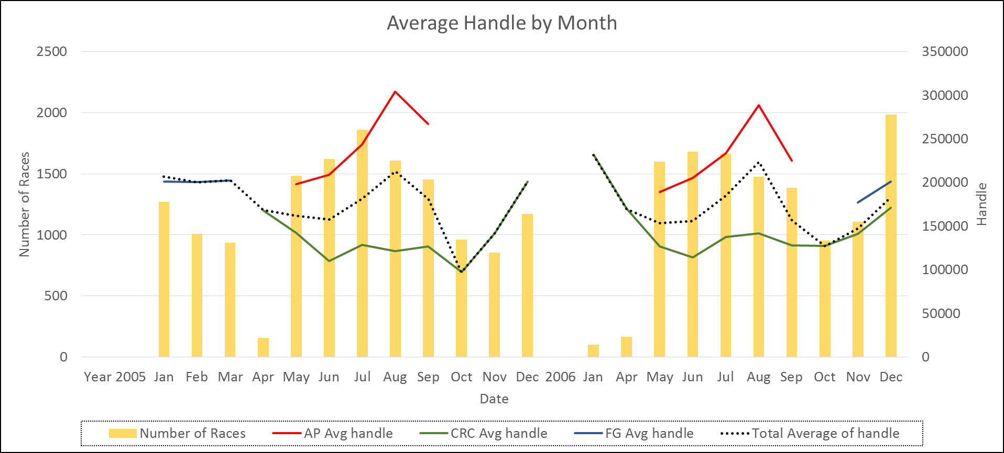
Since each state allows horse racing during specific months only , we need to further investigate this on
the track level.

Slide 10
Age restriction
Table – Eligibility for races age wise
As evident, maximum races exist for 3 and 4 year olds followed by 5 and older. Proves why criteria 3U is the most popular
Table – Age restriction distribution

Slide 11
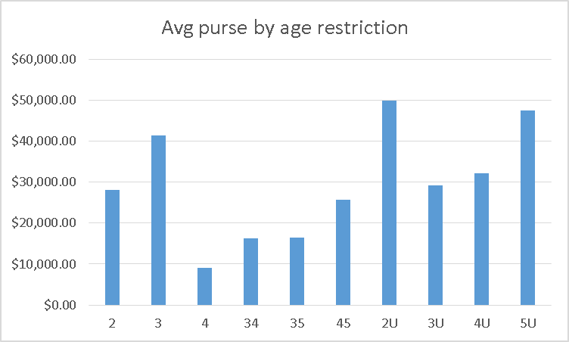
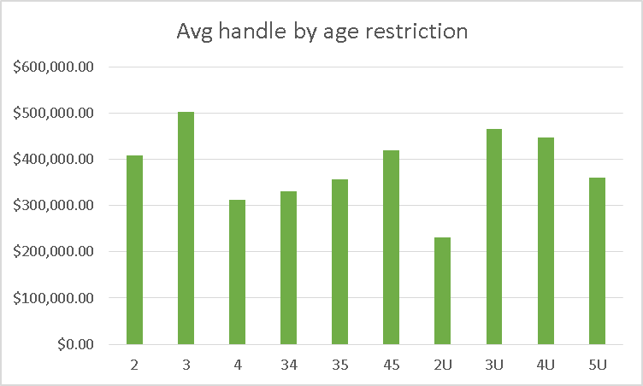
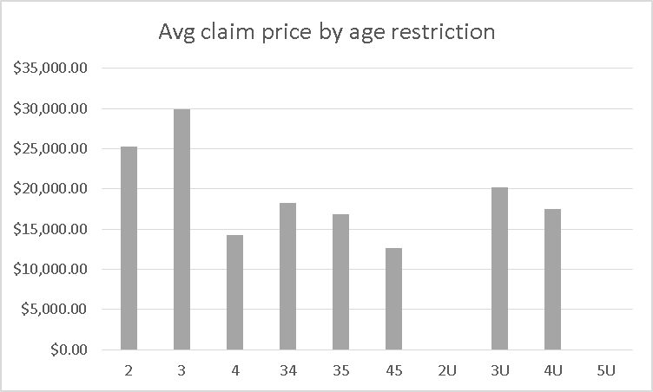
Chart - Average purse by age restriction
Chart - Average handle by age restriction
Chart - Average claim price by age restriction

Slide 12
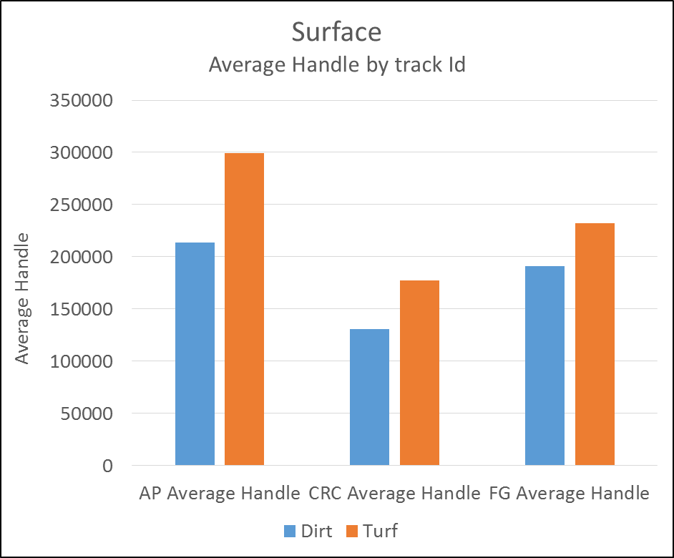
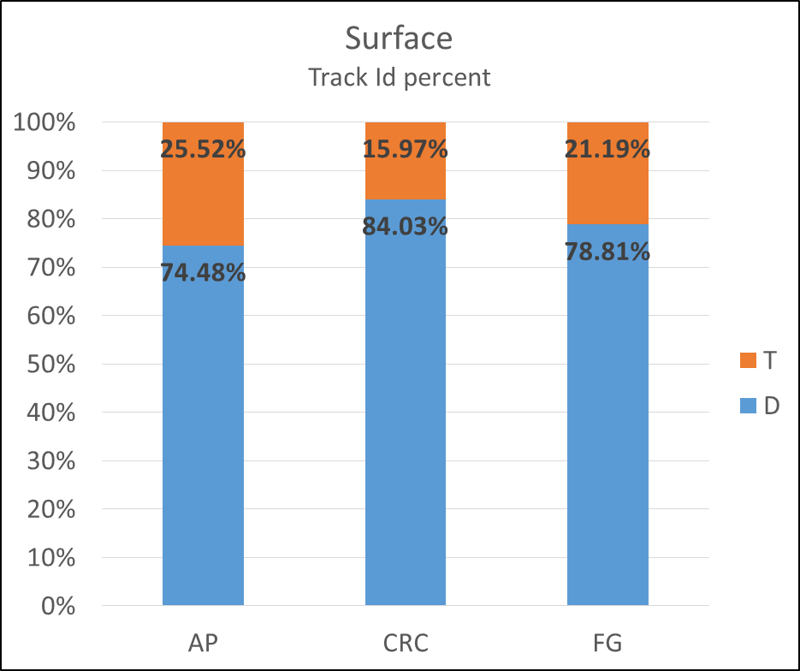
Surface On average, Turf surfaces have higher handle bet on for all the tracks, compared to Dirt surfaces.

Slide 13
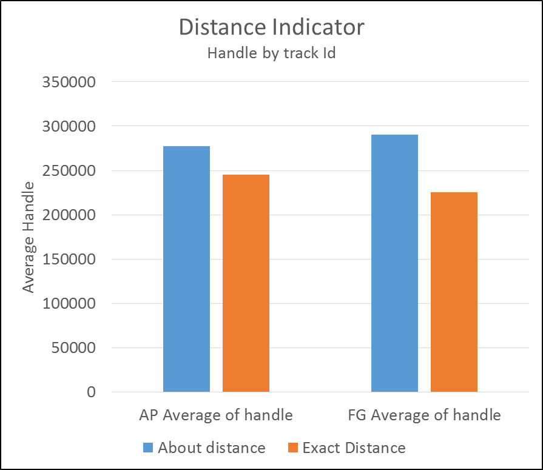
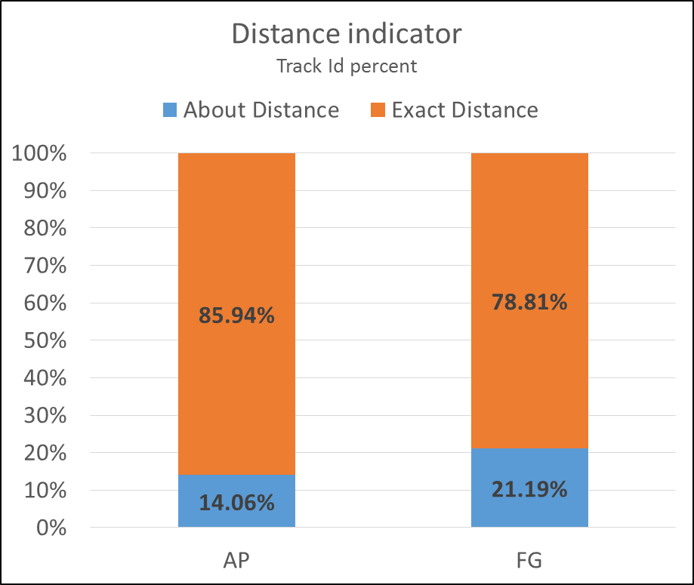
Distance Indicator On Average, about distance indicator has higher handle bet on compared to exact distance.

Slide 14
The End

