Slide 1
ZOHO SETU | PROJECT ID: SWFW_5S_08
Deploy High-Performance Storage for Kubernetes
OpenEBS Mayastor (SPDK + NVMe-oF) & KubeVirt Virtualization
Target Baseline (Candidate B): Kubernetes v1.36.6 · containerd 2.3.x LTS · Calico v3.33.0 BGP · Ubuntu 24.04 LTS
Storage & Virtualization: OpenEBS 4.6.2 / Mayastor v2.12.2 · KubeVirt v1.9.1 · CDI v1.66.1 · kube-prometheus-stack v93.2.0
Repository: github.com/Swapnil220705/k8s-high-performance-storage | Honest Verification: IMPLEMENTED / VALIDATED / INFRASTRUCTURE-DEPENDENT
Academic Evaluation Presentation · November 11, 2026 · MIT Licensed Open-Source Engineering Package
Notes:
Welcome evaluators. Project SWFW_5S_08 designs and automates a 4-node high-performance Kubernetes storage and KubeVirt virtualization platform built cleanly around Candidate B non-EOL software releases.

Slide 2
Problem Statement & Motivation
PROBLEM SCOPE
Why Kubernetes VMs need user-space NVMe-oF storage and explicit RWX semantics
1. Kernel Storage I/O Bottleneck
Conventional CSI/SDS stacks route I/O through Linux VFS, page cache, and interrupt handlers, wasting CPU cycles on fast NVMe flash.
User-space SPDK polling bypasses kernel interrupts on dedicated cores for predictable sub-millisecond block access.
2. RWO Speed vs. RWX Live Migration Tension
Raw block NVMe volumes natively bind ReadWriteOnce (RWO), preventing simultaneous attach on source & destination migration hosts.
Naive RWX filesystems corrupt under concurrent writers; safe KubeVirt migration requires NFSv4.1 RWX or fenced RWX Block.
3. Synchronous Replication & Recovery
Stateless replicas fail under host crashes. Persistent VMs need synchronous N=3 replication with write-log partial rebuilds.
Data-plane availability must stay decoupled from Kubernetes etcd quorum outages.
4. Academic Rigor Without Institutional Stalling (ADR-011)
College 4-node NVMe hardware was pending allocation, while local laptop has 3.5 GiB WSL2 RAM.
Solution: Preserve 100% full 4-node target scope, build turn-key IaC + validators, and enforce strict 3-state honesty.
Zoho SETU — Project SWFW_5S_08 | Deploy High-Performance Storage for Kubernetes
Slide 2 / 15
Notes:
Key problem drivers: kernel context-switch tax, RWO vs RWX migration conflict, N=3 synchronous fault tolerance, and decoupling engineering progress from pending physical lab hardware via ADR-011.

Slide 3
Objectives & Non-Functional Requirements
REQUIREMENTS
Full target feature parity paired with strict safety, security, and sizing constraints
Core Functional & Performance Objectives
4-node Kubernetes cluster (1 CP + 3 Workers) over Calico Pure BGP.
OpenEBS Mayastor N=3 synchronous replication + NVMe-oF TCP.
KubeVirt hardware KVM VMs across RWO FS, RWO Block, and RWX tiers.
Live migration + runtime CPU, memory, and disk hot-plugging.
Reproducible FIO benchmark matrix + Prometheus/Grafana stack.
Reversible fault-injection and replica rebuild observation drills.
Hard Engineering & Resource Guardrails
Zero EOL Components: Purged K8s 1.28/1.34 & containerd 1.7/2.2 (ADR-010).
Strict Memory Sizing: 32 GB RAM/worker standard avoiding 16GB migration OOM.
SPDK CPU Budget: >=6 physical cores/worker (2 cores dedicated busy-polling).
Security: Zero private keys/secrets in Git; internal ClusterIP monitoring.
Safety Refusal Gates: Unconditionally block live/destructive apply on WSL2.
Three-State Tracking: IMPLEMENTED vs VALIDATED vs INFRASTRUCTURE-DEPENDENT.
Zoho SETU — Project SWFW_5S_08 | Deploy High-Performance Storage for Kubernetes
Slide 3 / 15
Notes:
Highlight the distinction between core Zoho SETU deliverables on the left and the audited engineering safeguards (zero EOL, 32 GB migration headroom math, WSL2 refusal gates) added during implementation on the right.

Slide 4
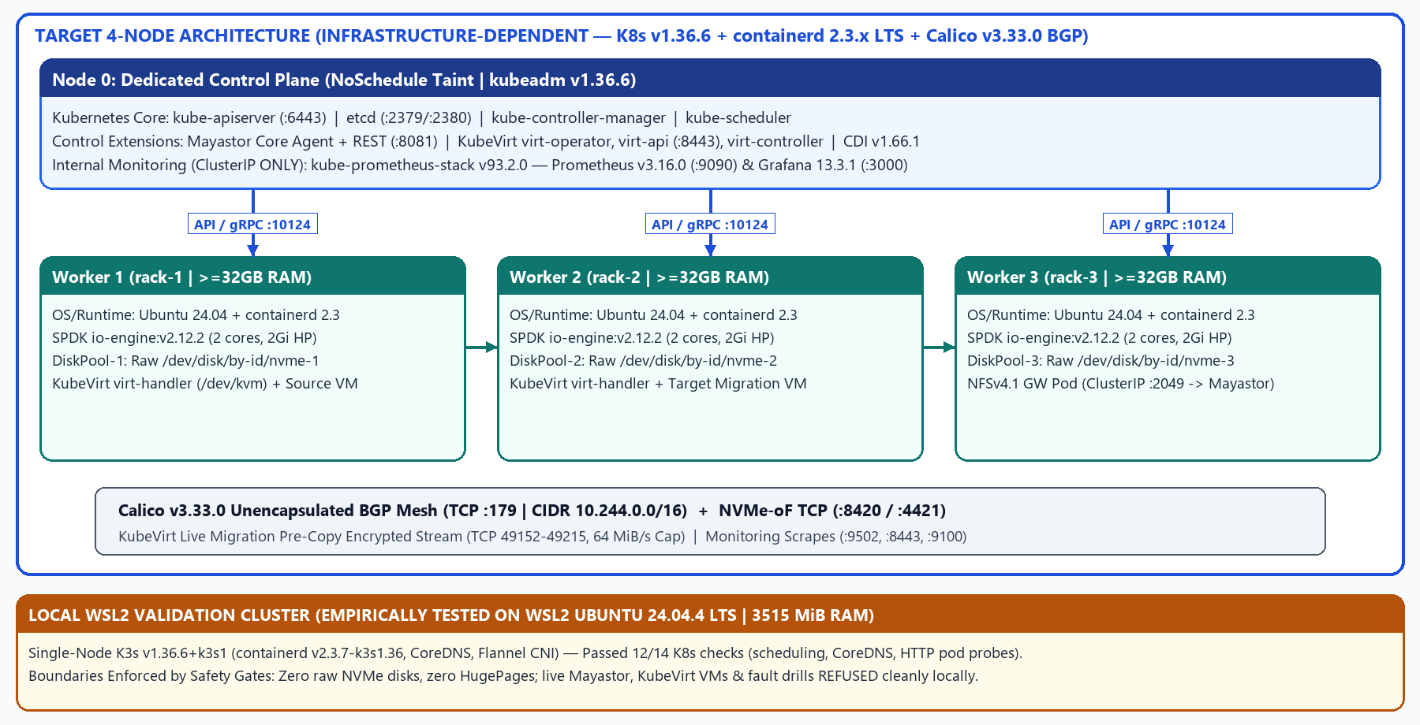
Proposed 4-Node Target vs. Local Dev Architecture
ARCHITECTURE
Decoupled control plane (Node 0), 3 SPDK/KVM workers, and honest K3s WSL2 sandbox
Zoho SETU — Project SWFW_5S_08 | Deploy High-Performance Storage for Kubernetes
Slide 4 / 15
Notes:
Explain Node 0 isolation via NoSchedule taint, Calico pure routed BGP mesh on TCP 179 preserving MTU, and how local single-node K3s validates Kubernetes 1.36 APIs without pretending to emulate 3-node NVMe-oF storage.

Slide 5
Pinned Technology Stack & Version Audit
STACK MATRIX
Every component version verified directly against metadata, charts, and upstream releases
Subsystem | Pinned Version | Verification & Lifecycle Basis | Repo Artifact
Target OS / Kernel | Ubuntu Server 24.04 LTS (6.8 LTS) | Dev audited on WSL2 24.04.4 (6.6.87.2) | ARCHITECTURE.md / preflight
Kubernetes | v1.36.6 (kubeadm v1beta4) | EOL June 2027; local API tested on K3s v1.36.6+k3s1 | kubeadm-init-config.yaml
Container Runtime | containerd 2.3.x LTS | LTS through April 2028 (v2.3.7-k3s1.36 locally) | containerd-config-v3.toml
CNI Plugin | Calico v3.33.0 (Operator v1.44.0) | Qualified K8s 1.35-1.37; Pure BGP (encapsulation: None) | calico/installation.yaml
Storage Engine | OpenEBS 4.6.2 / Mayastor v2.12.2 | CI E2E up to v1.35.6 (1.36 gap documented) | openebs/chart-metadata.yaml
Virtualization | KubeVirt v1.9.1 + CDI v1.66.1 | Supports >=1.35 <1.37; virtctl v1.9.0 | kubevirt/installation/
NFS RWX Fallback | csi-driver-nfs v4.9.0 + alpine:12 | nfs.csi.k8s.io over 30Gi Mayastor RWO PVC | storage/nfs/
Observability | kube-prometheus-stack v93.2.0 | Prom v3.16.0, Op v0.95.2, Grafana 13.3.1, promtool | monitoring/release-metadata.yaml
Benchmarking / QA | fio 3.36, Python 3.12.3, 12 CLI tools | kubeconform v0.8.0, shellcheck 0.9.0, shfmt 3.8.0 | install-dev-tools.sh
Zoho SETU — Project SWFW_5S_08 | Deploy High-Performance Storage for Kubernetes
Slide 5 / 15
Notes:
Point out that preliminary drafts (CDI 1.61.x, kube-prometheus-stack v62.x, Kubernetes 1.28) were audited and upgraded to verified November 2026 releases, while transparently noting Mayastor 2.12.2's upstream E2E ceiling at K8s 1.35.6.

Slide 6
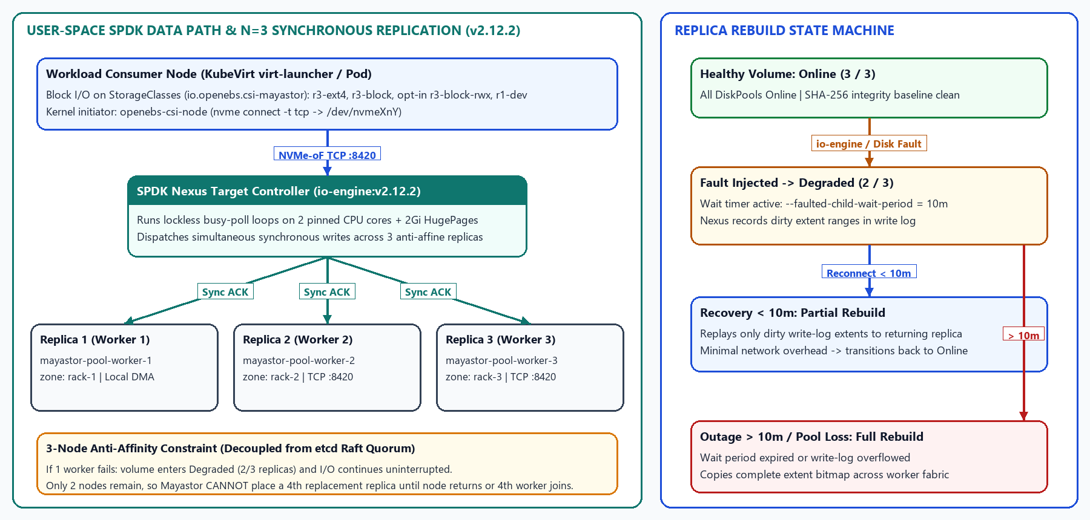
OpenEBS Mayastor SPDK & NVMe-oF Storage Design
MAYASTOR
User-space Nexus replication, verified v2.12.2 CSI parameters, and rebuild state machine
Zoho SETU — Project SWFW_5S_08 | Deploy High-Performance Storage for Kubernetes
Slide 6 / 15
Notes:
Highlight verified v2.12.2 findings: provisioner is io.openebs.csi-mayastor, thin parameter was verified non-existent in CSI source (governed globally in values.yaml), and partial rebuild window is --faulted-child-wait-period=10m.

Slide 7
Replication & Storage Resilience Framework
RESILIENCE
Safe automated drill suite, SHA-256 integrity checks, and honest local vs. hardware boundaries
Reversible Failure Scenarios (tests/storage/resilience-scenarios.yaml)
1. io-engine-restart: Restarts 1 SPDK pod (< 10m) -> tests write-log Partial Rebuild & post-recovery SHA-256 integrity.
2. worker-cordon-drain: Simulates node maintenance -> verifies N=3 anti-affinity barrier prevents invalid co-located replicas.
3. pool-degradation-check: Inspects DiskPool Online/Degraded/Faulted status and REST /v0/volumes rebuild progress.
4. nfs-gateway-restart: Restarts mayastor-nfs-server -> checks Mayastor RWO re-attach & NFSv4.1 hard-mount continuity.
Data Integrity & Guardrails
verify-volume-checksum.sh: fsync + SHA-256 readback passed locally (2 MiB cycle).
run-resilience-drills.sh defaults to dry-run/simulate.
EXIT trap uncordons workers; --mode execute refused on WSL2.
Resilience Validation Result
validate-storage-resilience.sh: PASS=3 | WARN=1 | FAIL=0 | N/T=5
Live replica rebuild & node crash tests remain INFRASTRUCTURE-DEPENDENT.
Zoho SETU — Project SWFW_5S_08 | Deploy High-Performance Storage for Kubernetes
Slide 7 / 15
Notes:
Clarify that validate-storage-resilience.sh and run-resilience-drills.sh verify configuration, scripts, and SHA-256 readback locally, while honestly marking live DiskPool/io-engine rebuilds as NOT_TESTABLE on single-node WSL2.

Slide 8
KubeVirt VM Integration & Persistent Storage Tiers
KUBEVIRT VMs
Explicit separation between high-throughput RWO Block, Safe NFS RWX, and Opt-In Experimental RWX
VM Manifest | StorageClass | Mode | Live Migrate? | Architectural Purpose
vm-ubuntu-rwo-filesystem.yaml | mayastor-nvme-r3-ext4 | RWO / FS | No (None) | General Linux OS + secondary 10Gi ext4 PVC
vm-ubuntu-mayastor-rwo-block.yaml | mayastor-nvme-r3-block | RWO / Block | No (None) | Zero host VFS double-journaling; direct /dev/vdb FIO
vm-ubuntu-rwx-nfs-migration.yaml | nfs-mayastor-rwx | RWX / FS | Yes (Default) | Safe POSIX NFSv4.1 GW over 30Gi Mayastor RWO
vm-ubuntu-rwx-block-experimental.yaml | mayastor-nvme-r3-block-rwx | RWX / Block | Yes (Manual) | Opt-in research (--include-experimental-rwx)
vm-cirros-dev-minimal.yaml | Ephemeral containerDisk | Ephemeral | No (Manual) | Minimal 256Mi KVM sanity guest
KubeVirt v1.9.1 & CDI v1.66.1 Controls + Cloud-Init Security
GA Feature Gates: LiveMigration, VMLiveUpdateFeatures, HotplugVolumes active natively; deprecated gates omitted; useEmulation: false enforces KVM.
cloud-init-secret.yaml installs qemu-guest-agent, fio, nvme-cli, lsscsi; lock_passwd: true; SSH public key injected dynamically at deploy (--ssh-key-file).
Schema Validation: 06-deploy-kubevirt.sh --dry-run (10/10 resources) & 07-deploy-vm-examples.sh --dry-run (13/13 resources) PASS against strict schemas.
Zoho SETU — Project SWFW_5S_08 | Deploy High-Performance Storage for Kubernetes
Slide 8 / 15
Notes:
Emphasize why experimental Mayastor RWX block is Manual opt-in only: Mayastor provides no distributed lock manager (DLM), so standards-compliant NFS RWX serves as the default safe migration baseline.

Slide 9
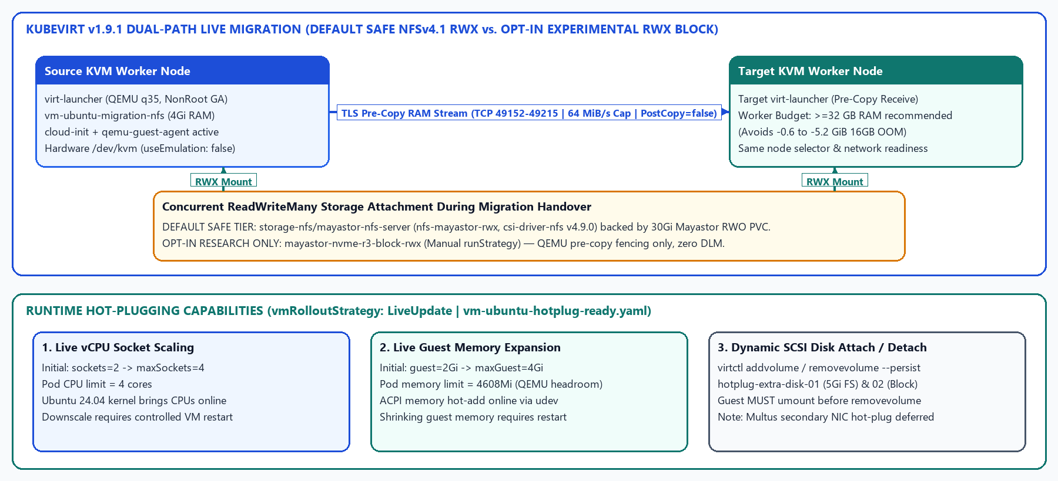
Live Migration & Runtime Resource Hot-Plugging
MIGRATION / HOTPLUG
TLS pre-copy MigrationPolicy guardrails and LiveUpdate CPU, Memory & SCSI Disk automation
Zoho SETU — Project SWFW_5S_08 | Deploy High-Performance Storage for Kubernetes
Slide 9 / 15
Notes:
Highlight pod resource headroom (limits cpu=4, mem=4608Mi vs initial 2/2Gi) to prevent cgroup OOMKill during live memory expansion, plus honest disclosure that shrinking CPU/RAM needs a restart and NIC hot-plug is deferred.

Slide 10
FIO Performance Benchmarking Framework
FIO BENCHMARKS
Reproducible 6-profile suite, device safety protections, and environment-isolated JSON analytics
Profile File | Pattern | Block Size | Default QD / Jobs | Measurement Purpose
4k-randread.fio | randread | 4k | qd=32 / jobs=1 | Peak random read IOPS & clat p50..p99.9
4k-randwrite.fio | randwrite | 4k | qd=32 / jobs=1 | 3-way synchronous write replication latency
4k-randrw-70-30.fio | randrw (70/30) | 4k | qd=16 / jobs=2 | Mixed transactional OLTP VM pattern
64k-seqread.fio | read | 64k | qd=16 / jobs=1 | Streaming sequential read throughput
64k-seqwrite.fio | write | 64k | qd=16 / jobs=1 | Streaming sequential write pipeline
1m-bandwidth.fio | read + write | 1m | qd=8 / jobs=2 | NIC & NVMe-oF fabric bandwidth ceiling (MiB/s)
Execution & Safety Guards
Omit filename= inside .fio files.
Checks root device (findmnt /) & df free space (+1 GiB).
Target Tiers: local-baseline, mayastor-rwo-fs, mayastor-rwo-block, nfs-rwx.
summarize-results.py refuses mixed environment_class comparisons (exit 2).
Strict Measurement Honesty Notice (AGENTS.md Sec 2 & 6)
ZERO physical NVMe hardware benchmarks were recorded locally. Running fio on WSL2 virtual disks yields non-representative VM numbers.
Local Validation Executed: 6/6 profiles pass fio-3.36 --parse-only; Python unittest passes 3/3 parser tests; --mode synthetic-fixture validated.
Zoho SETU — Project SWFW_5S_08 | Deploy High-Performance Storage for Kubernetes
Slide 10 / 15
Notes:
Reiterate to examiners: we never fabricated IOPS graphs on a laptop virtual disk. Instead, all 6 job files pass fio --parse-only and the Python aggregation parser passes automated unit tests with strict environment-mismatch rejection.

Slide 11
Prometheus & Grafana Observability
OBSERVABILITY
Source-verified Mayastor v2.12.2 & KubeVirt v1.9.1 telemetry, promtool rules, and gap honesty
Pinned Stack: kube-prometheus-stack v93.2.0
Prometheus v3.16.0 (:9090 ClusterIP) + Operator v0.95.2.
Grafana 13.3.1 (chart 14.4.1, :3000 ClusterIP via port-forward).
node-exporter 5.1.0 + kube-state-metrics 9.0.0 + lightweight overlay.
Strict Security: Zero NodePort/Ingress exposure; secrets outside Git.
3 Dashboards & 10 promtool-Verified Alerts
mayastor-storage-performance.json (pool & volume IOPS/BW/latency).
kubevirt-vm-telemetry.json (VMI phase, storage, CPU/RAM, migrations).
cluster-node-resources.json (HugePages & 2-core SPDK saturation).
Alerts: DiskPoolDegraded/Faulted/IOStalled/Cap>85%, MigrationFailed.
Upstream Exporter Source Verification & Explicit Gap Documentation (ADR-015)
Verified against openebs/mayastor-extensions v2.12.2 (Rust) & kubevirt v1.9.1 (Go) — zero invented metric names.
Gap 1 (Latency Percentiles): metrics-exporter-io-engine v2.12.2 exposes cumulative *_latency_us totals (mean rates) — tail p50..p99 come from FIO.
Gap 2 (Rebuild % & NFS): v2.12.2 omits volume_rebuild_progress_percent (polled via REST /v0/volumes) & Alpine nfsd lacks an exporter.
Zoho SETU — Project SWFW_5S_08 | Deploy High-Performance Storage for Kubernetes
Slide 11 / 15
Notes:
Reading Mayastor v2.12.2 Rust exporter collectors directly prevented hallucinating non-existent Prometheus histograms or rebuild-percent gauges; documented those gaps cleanly in dashboards and ADR-015.

Slide 12
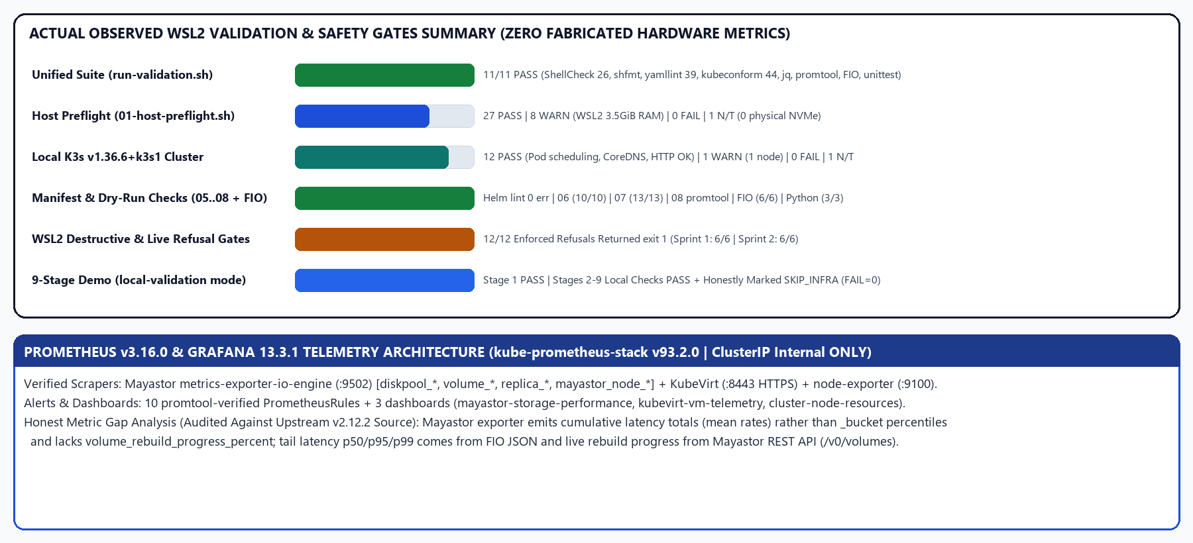
Implementation & Empirical Validation Results
VALIDATED
All actual counts directly extracted from archived WSL2, K3s, schema, promtool & demo logs
Zoho SETU — Project SWFW_5S_08 | Deploy High-Performance Storage for Kubernetes
Slide 12 / 15
Notes:
Walk through observed validation numbers: 11/11 unified validation pass, 26 ShellCheck-clean scripts, 39 YAML files with zero warnings, 44/44 kubeconform strict schemas, 12/12 K3s cluster runtime passes, and 12/12 safety refusal gates.

Slide 13
Development Environment & Hardware Constraints
CONSTRAINTS
Transparent comparison between the 3.5 GiB WSL2 sandbox and required bare-metal hardware
Resource / Constraint | Local WSL2 Dev Host (Audited) | Target 4-Node Cluster Required | Engineering Impact
OS & Kernel | Ubuntu 24.04.4 (6.6.87.2-WSL2) | Ubuntu Server 24.04 (6.8 LTS) | Local validates syntax/K8s API only
CPU & Virtualization | Ryzen 5 7535HS (12 vCPU, svm, /dev/kvm) | >=6 physical cores/worker (2 SPDK) | Host KVM works; root:kvm ACL gated locally
System RAM | 3515 MiB Total (~2.4 GiB avail) | >=32 GB/worker (MemTotal ~29.3+ GiB) | 16 GB triggers OOM on loaded target move
2MiB HugePages | 0 pages configured | 1024 x 2MiB pages (2 GiB)/worker | SPDK io-engine cannot start on WSL2
Physical Block Disks | Virtual WSL2 ext4/swap disks only | Blank /dev/disk/by-id/* NVMe/SSDs | Zero DiskPools / NVMe benchmarks locally
Cluster Nodes | 1 Node (K3s v1.36.6+k3s1) | 4 Nodes (1 CP + 3 Workers, Calico BGP) | No multi-node BGP, rebuilds, or migration
Key Memory Finding (ARCHITECTURE.md Section 2.1): Loaded 16 GB worker nodes hit -0.60 to -5.20 GiB OOM deficit during concurrent cutover; 32 GB per worker is strictly required for safe multi-VM live migration.
Zoho SETU — Project SWFW_5S_08 | Deploy High-Performance Storage for Kubernetes
Slide 13 / 15
Notes:
Explain clearly why 3.5 GiB WSL2 RAM cannot host 2 GiB HugePages plus Mayastor and 4 GiB VMs, and summarize the MemTotal math proving why target workers need 32 GB RAM for concurrent live migration.

Slide 14
Remaining Infrastructure-Dependent Work & Future Scope
FUTURE WORK
Turn-key execution plan awaiting multi-node Ubuntu + NVMe lab infrastructure
Immediate Target-Cluster Validation Roadmap
1. Provision 4 Ubuntu 24.04 nodes via 02..04 scripts with blank NVMe drives.
2. Empirically qualify OpenEBS 4.6.2 / Mayastor v2.12.2 runtime behavior on Kubernetes v1.36.x.
3. Execute run-fio-benchmarks.sh across local-baseline, RWO FS, RWO Block & NFS RWX to measure Hypervisor & NFS overhead.
4. Execute io-engine-restart & worker-cordon-drain drills to quantify actual rebuild times & post-fault CRC/SHA-256 parity.
Extended Engineering Enhancements
5. Exercise KubeVirt live migration across NFS RWX vs. experimental RWX Block paths & validate pre-copy convergence.
6. Implement Multus CNI secondary interface YAML + test NIC hot-plugging (currently deferred beyond CPU/RAM/SCSI).
7. Capture live Prometheus/Grafana screenshots & render publication FIO comparison plots under reports/graphs/.
8. Optional dedicated isolated storage/migration NIC VLAN evaluation on 10 GbE campus lab switches.
Zoho SETU — Project SWFW_5S_08 | Deploy High-Performance Storage for Kubernetes
Slide 14 / 15
Notes:
Outline exact next engineering steps once physical/lab multi-node servers with 32 GB RAM and blank NVMe disks become accessible, including Multus NIC hot-plugging and Mayastor 1.36 runtime qualification.

Slide 15
Conclusion & Verification Takeaway
CONCLUSION
Project SWFW_5S_08 — Ready for Zoho SETU Technical Evaluation & Multi-Node Lab Execution
Engineering Contributions & Submission Readiness
Complete Infrastructure-as-Code Stack: Zero-EOL software baseline spanning kubeadm, Calico BGP, OpenEBS/Mayastor, KubeVirt/CDI, NFS RWX gateway, FIO profiles, and kube-prometheus-stack.
Rigorous Quality & Honesty Protocol: 11/11 validation checks, 44/44 strict schemas, real promtool v3.16.0 verification, Python parser unit tests, 12/12 safety refusal gates, and strict Three-State documentation.
Turn-Key Reproducibility: Any compatible 4-node Ubuntu 24.04 environment can execute scripts 01..08 and run-project-demo.sh directly.
Reproduce Local Validation & Demo Immediately:
./scripts/validate/validate-project-integration.sh # Runs 11-step QA suite, docs audit & 9-stage safe demo
Primary Deliverables: reports/final/Zoho_SETU_High_Performance_Kubernetes_Storage_Report.md | FINAL_PROJECT_STATUS.md | docs/diagrams/
Zoho SETU — Project SWFW_5S_08 | Deploy High-Performance Storage for Kubernetes
Slide 15 / 15
Notes:
Thank you for reviewing Project SWFW_5S_08. Every deliverable in the repository is reproducible, cleanly version-controlled, honestly documented, and ready to execute on multi-node NVMe hardware.

