Slide 1

Welcome

Slide 2

E-Ticketing System in Public
Transportation
Using Blockchain
Presented By
Swapnil()
Prity()
Rahat(19-40647-1)
Asif(19-40746-1)

Slide 3
Outline
Introduction
Literature Review
Problem Statements
Objective
Expected Outcomes
References

Slide 4
Introduction
What is E-Ticket?
What is Blockchain ?

Slide 5
Introduction to E-Ticket
A paperless electronic document.
An online ticketing system.

Slide 6
Introduction to Blockchain
A distributed database or ledger[1]
A secure and decentralized network
Decentralized blockchains are immutable
All users collectively retain control.
Reduces the need for trusted third parties

Slide 7
Problem Statement
Authenticity
Security
Transparency
Efficiency

Slide 8
Research Objective
Specialized knowledge about electronic ticketing systems
Outlining their key security requirements
Finding the limitations and challenges of current technology
Solution of the limitations and challenges
Integration of blockchain technology with the system

Slide 9
Literature Review
E-Ticketing Systems in Public Transportation
Limitations of Traditional E-Ticketing Systems
Applications of Blockchain in Transportation

Slide 10
Current E-ticketing System Challenges
Susceptible to fraud and unauthorized access
Often leading to financial losses
Compromised user data

Slide 11
Benefits of Blockchain in E-ticketing
Enhanced security through encryption and decentralized data storage
Improved transparency through tamper-proof records
Increased efficiency by eliminating intermediaries in transactions
Reduce staffing costs

Slide 12
Challenges and Limitations of Blockchain Adoption in Public Transportation
Scalability
Performance and Speed
Energy Consumption
Interoperability and Integration
User Adoption and Experience

Slide 13

Expected Outcomes
Fake ticket problem fixed
Solved security vulnerabilities
Solved lack of interoperability
Solved payment processing issues

Slide 14

Methodology
System Architecture
Ticket interface
Use Case
Class Diagram
Activity Diagram
Sequence Diagram

Slide 15
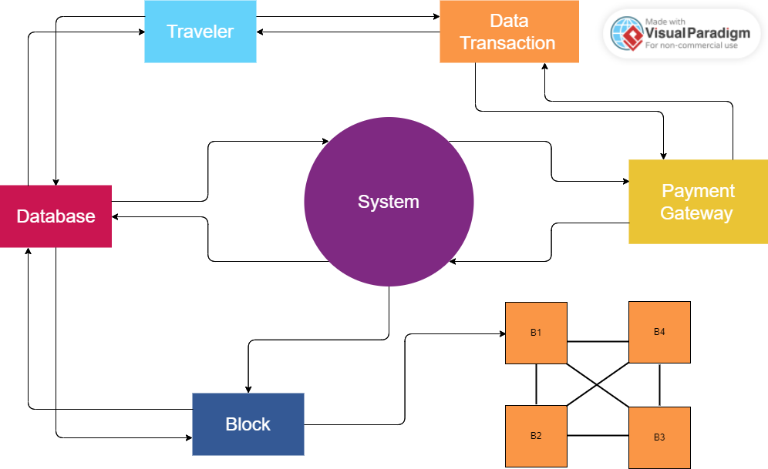
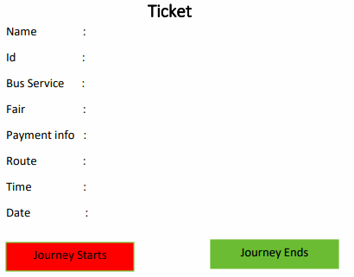
Fig: Ticket Interface Design
Fig: System Architecture Diagram​​​

Slide 16
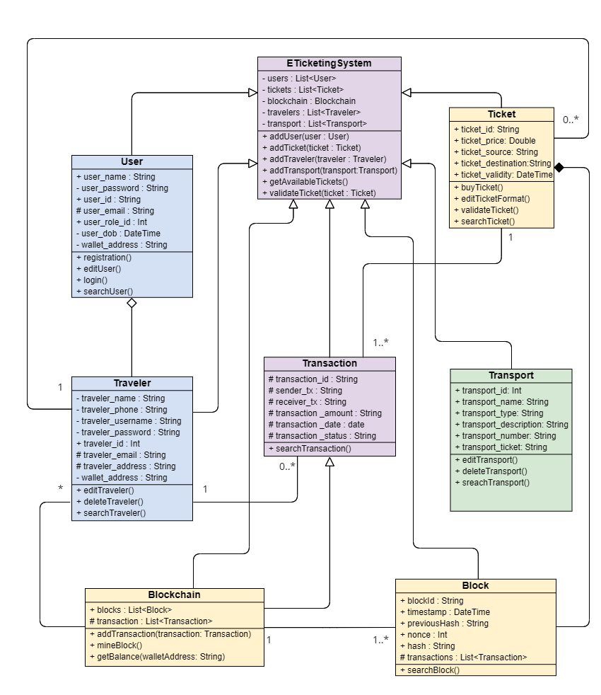
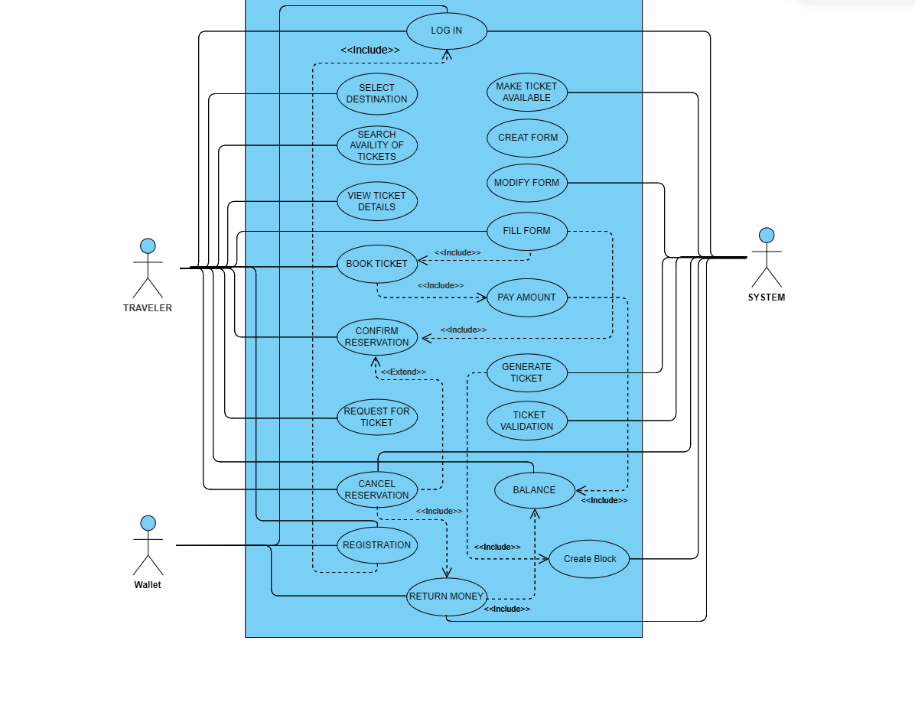
Fig: Use Case Diagram​​
Fig: Class Diagram​​

Slide 17
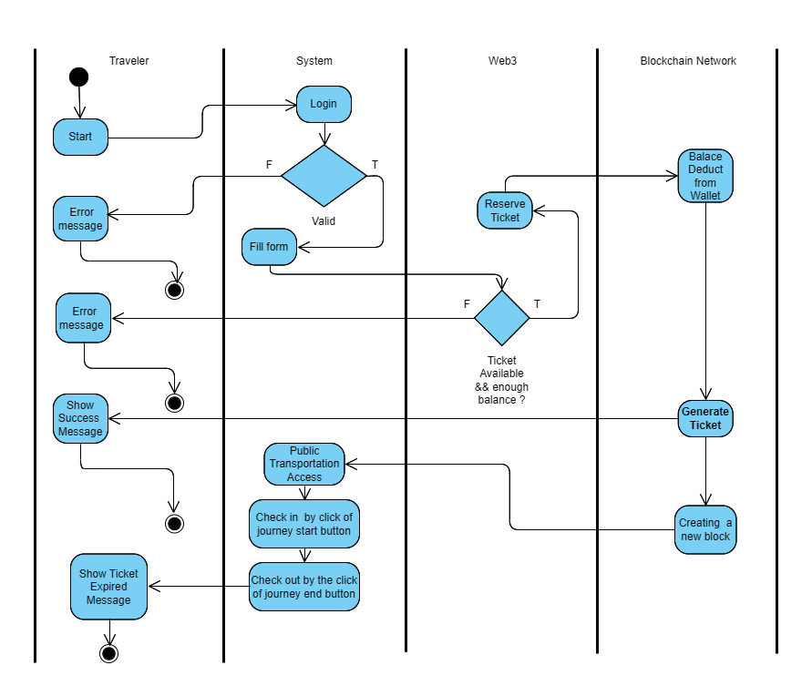
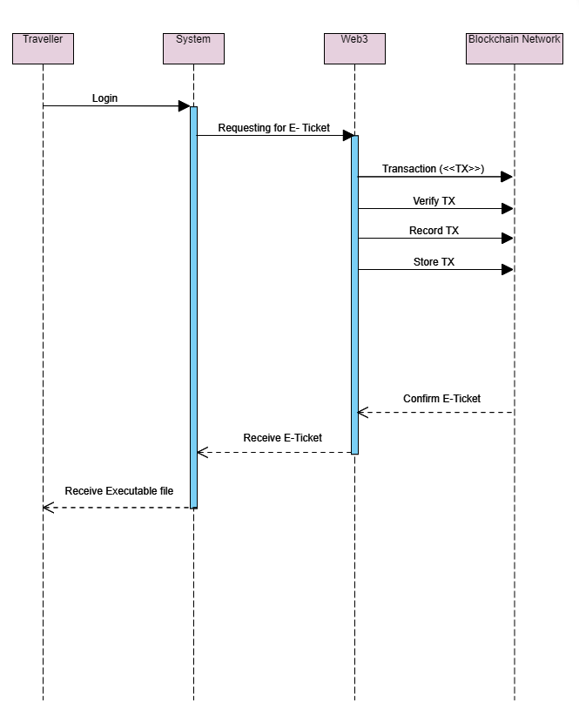
Fig: Activity Diagram
Fig: Sequence Diagram​

Slide 18

Discussion and Results
Tickets can be an executable entity
Customers can easily confirm the validity and authenticity of their tickets
A smooth purchasing experience
Blockchain may not always be the best solution

Slide 19
Future Work
Implementation
Focusing on the challenges

Slide 20

References 1. Blockchain Facts: What Is It, How ItWorks, and How It Can Be Used (investopedia.com) 2. What is an e-ticket (electronic ticket)? – TechTarget Definition

Slide 21

Questions?

Slide 22

Acknowledgments

Slide 23

Social Media
mdratulhasanrahat@gmail.com
Swapnilkhan43@gmail.com
shabrinaprity785@gmail.com
Asifchowdhury5252@gmail.com
Feel free to contact us you need any information regarding our research.

Slide 24

Thank you!

