Slide 1
Icare BOT
By:- MALOTH PRABHAS
GUIDE:- Prof. Subhrabrata Choudary

Slide 2
Index
Index
Creator
Problem statement
Working
Advantages & Limitations
Future Scope
References
Thankyou
1
2
3-4
6-9
10
11
12
13

Slide 3
Hello!
I am Prabhas Maloth
Lead of “ICARE ”.
You can find me at:
@mp.17u10106@b.tech.nitdgp.ac.in

Slide 4
Through chat bots one can communicate with text or voice interface and get reply through artificial intelligence. Typically, a chat bot will communicate with a real person. Chat bots are used in applications such as ecommerce customer service, call centers and Internet gaming. Chat bots are programs built to automatically engage with received messages.
Chat bots can be programmed to respond the same way each time, to respond differently to messages containing certain keywords and even to use machine learning to adapt their responses to fit the situation. A developing number of hospitals, nursing homes, and even private centers, presently utilize online Chat bots for human services on their sites. These bots connect with potential patients visiting the site, helping them discover specialists, booking their appointments, and getting them access to the correct treatment.
An ML model has to be created wherein we could give any text input and on the basis of training data it must analyze the symptoms. A Supervised Logistic Regression machine learning algorithm can be implemented to train the model with data sets containing various diseases CSV files. The goal is to compare outputs of various models and suggest the best model that can be used for symptoms in real-world inputs. Data set contains CSV file having many diseases compiled together.

Slide 5
The logistic regression algorithm in ML allows us to process the data efficiently. The goal here is to model the underlying structure or distribution of the data in order to learn more from the training set.
In any case, the utilization of artificial intelligence in an industry where individuals’ lives could be in question, still starts misgivings in individuals. It brings up issues about whether the task mentioned above ought to be assigned to human staff. This healthcare chatbot system will help hospitals to provide healthcare support online 24 x 7, it answers deep as well as general questions. It also helps to generate leads and automatically delivers the information of leads to sales. By asking the questions in series it helps patients by guiding what exactly he/she is looking for.

Slide 6
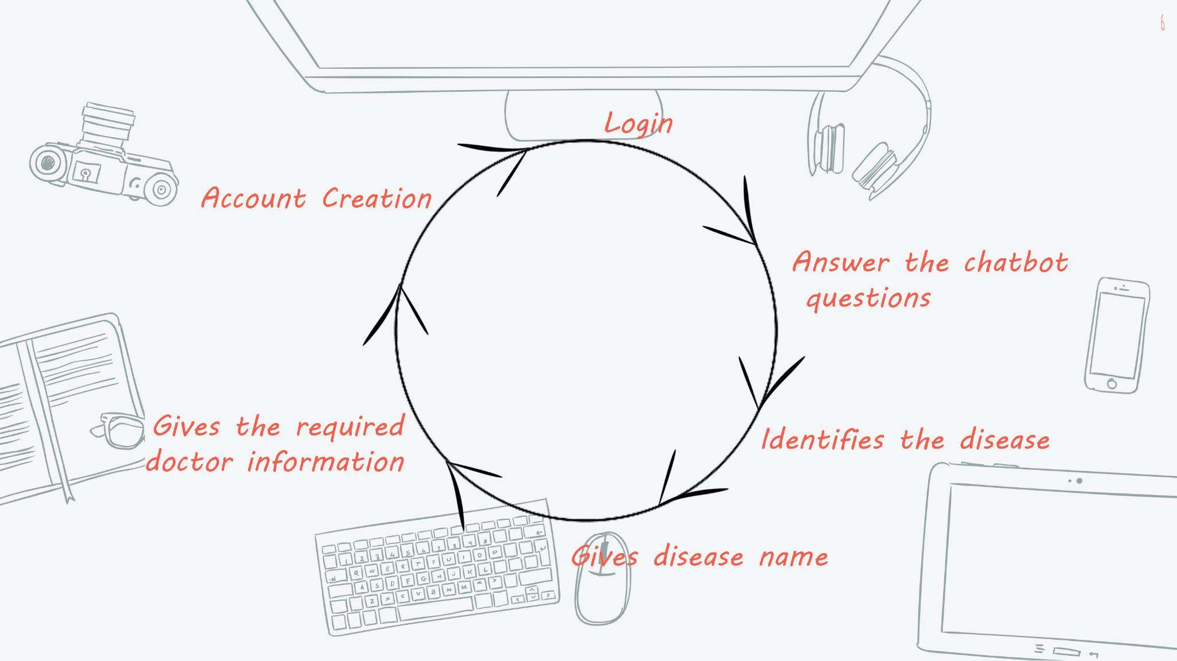
WORKING
Quotations are commonly printed as a means of inspiration and to invoke philosophical thoughts from the reader.

Slide 7
Account CREATION
Login
Give user name,choose a password.
Creates a TXT file saving your credentials
Input user name and password.
Checks the credentials from the TXT files
If matches, logs you in.
If it doesn't match, reminds you to check the input data

Slide 8
Answering the chatbot questions
Identification and display
There is a questionnaire about the symptoms
Answer them as per your noticeable symptoms
Checks for the symptoms match in XLSX files
Gives the disease name if any match.
Suggests you a doctor, and gives his profile.

Slide 9

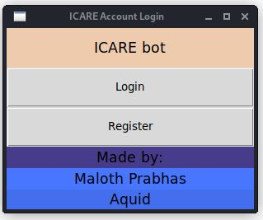
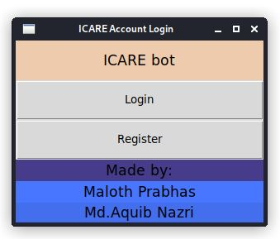
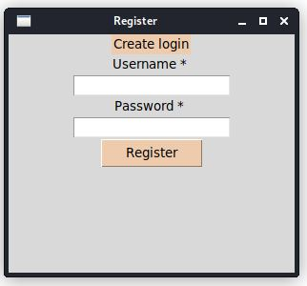
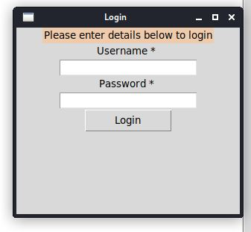
It Works
Choose window
Account Creation window
Login window

Slide 10
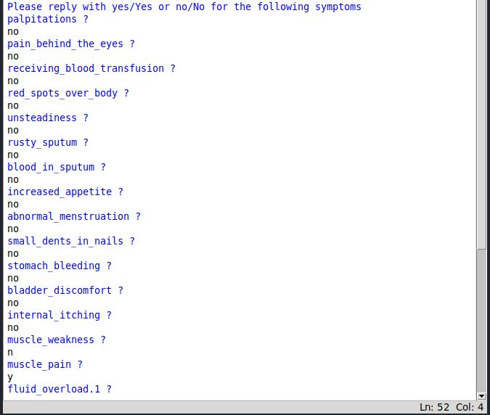
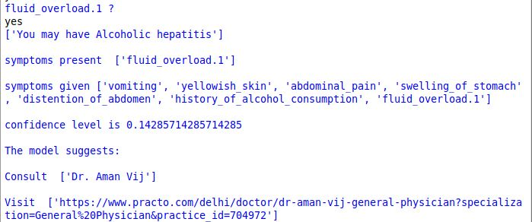
It Works
Questionnaire
Output after answer

Slide 11
Everything comes with limitations
Advantages
Limitations
Helps in emergency
Offline help
Saves time
Gives a doctor suggestion
Confidence level can give you the idea of emergency
Helps in self medication
Keeps track of your data
Not efficient as a Doctor
Not suggestable in critical situations
Can't create appointment

Slide 12
BIG PICTURE
Chat bots are a thing of the future which is yet to uncover its full potential but with its rising popularity and craze among companies, they are bound to stay here for long. Machine learning has changed the way companies were communicating with their customers. With new platforms to build various types of chatbots being introduced, it is of great excitement to witness the growth of a new domain in Health technology while surpassing the previous threshold.

Slide 13
References
https://en.wikipedia.org/wiki/Chatbot https://en.wikipedia.org/wiki/Disease
https://data-flair.training/blogs/python-chatbot-project/
https://www.youtube.com/playlist?list=PLQVvvaa0QuDdc2k5dwtDTyT9aCja0on8j

Slide 14
Thankyou
Project “Icare”

