Slide 1



E-Commerce Website
This report details the development of an e-commerce website designed to provide a user-friendly and secure online shopping experience for both buyers and sellers. The project addresses common challenges faced by existing e-commerce platforms, focusing on improved usability, accessibility, and security.
by Plaksha Tiwari

Slide 2
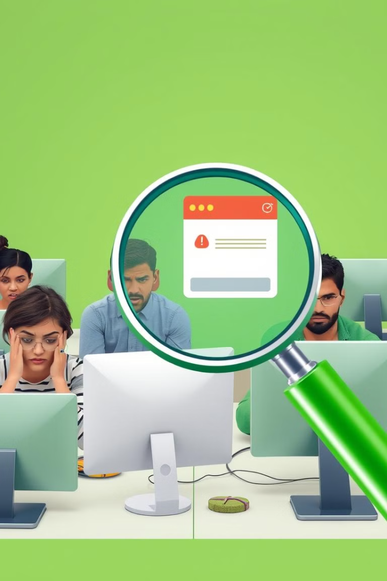
Problem Statement
1
Complex Registration and Login Systems
Users often encounter confusing registration and login processes, with inadequate error handling, leading to frustration and abandoned sign-ups.
2
Poor Mobile Compatibility
Many e-commerce websites lack optimal mobile responsiveness, failing to cater to the growing number of users accessing websites on mobile devices.
3
Weak User Role Management
Most platforms lack a clear distinction in account management between buyers and sellers, leading to inefficiencies in user interaction.
4
Security Concerns
Online platforms are vulnerable to unauthorized access and data breaches. A lack of secure authentication systems compromises user trust and discourages use.

Slide 3
Proposed Solution
User Registration and Authentication
Role-Based Account Management
Error Handling and User Feedback
A secure and intuitive sign-up and login system for both buyers and sellers is provided. Real-time form validation, password matching checks, and error messages ensure data integrity and prevent unauthorized access.
The system distinguishes between buyers and sellers during registration, allowing for customized experiences based on user roles. Buyers have access to browsing and purchasing functionalities, while sellers can create and manage product listings.
Real-time error messages during registration and login guide users through the correct inputs. Clear and specific error messages provide helpful feedback, reducing frustration and input errors.

Slide 4
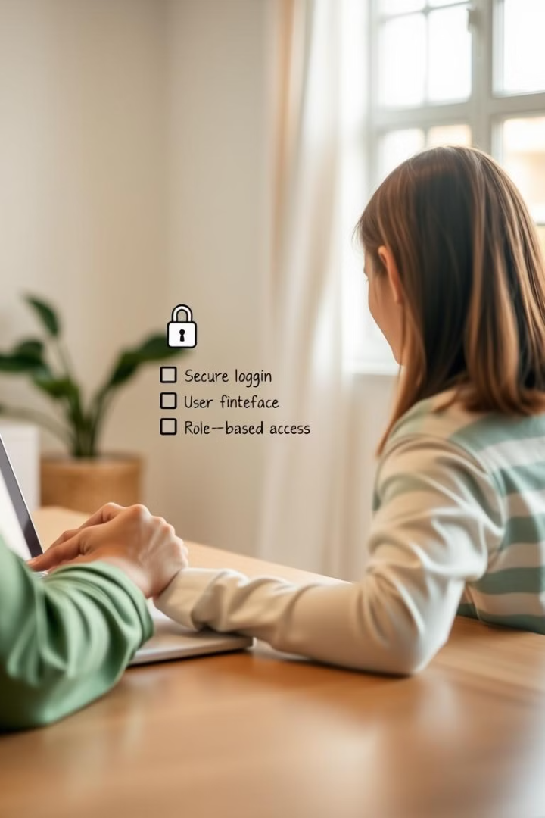
Objectives
1
Accessible and User-Friendly Registration and Login System
The system should allow users to select their role (buyer or seller) during registration and redirect them to role-specific dashboards upon login.
2
Data Security
Secure password requirements, real-time error messages, and password hashing algorithms should be implemented to protect user data.
3
Interactive Interface
A clear and interactive interface should guide users through registration, login, and account management, with simple registration flow, helpful tooltips, and responsive design.
4
Real-Time Form Validation
Real-time validation on fields like email and password should provide instant feedback to users, improving the overall user experience.

Slide 5

Software Requirements
Frontend
HTML5 and CSS3 for structure and styling, JavaScript for client-side validation, and Bootstrap 5 for responsive design.
Backend
PHP for server-side scripting and XAMPP for local server and MySQL database support (for development purposes).
Database
MySQL for storing user data, including credentials and account information.

Slide 6
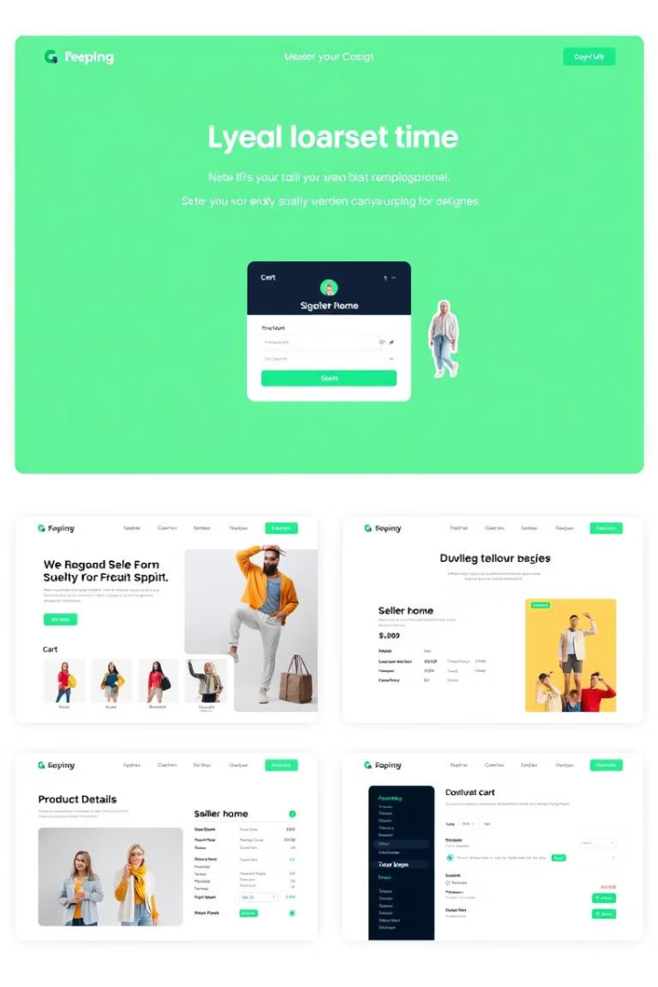
Web Pages Overview
Page
Purpose
Key Features
Login Page (login.html)
User login interface
Username and password fields, responsive styling, error handling, role-based redirection.
Login Failed Page (Login_Failed.html)
Notify users of login failure
Error message, return button.
Signup Page (Signup.html)
User account creation
Registration form, validation, role selection dropdown, error display.
Login Processing Script (Login.php)
Handles login authentication
Session management, database query, role-based redirection, error redirection.
Signup Processing Script (Signup.php)
Handles user registration
Username check, user insertion, error handling and redirect.
Seller and Buyer Home Pages (Seller/Home.php and Buyer/Home.php)
Landing pages for sellers and buyers
Role-specific content, session-based access.

Slide 7

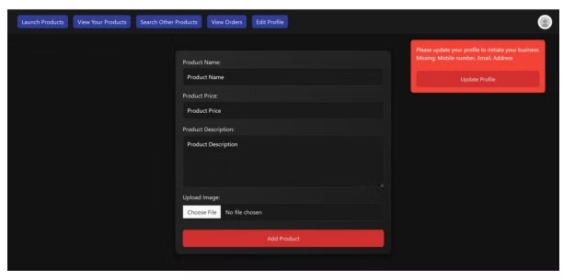






Sellers
Product Management Page
Sellers can view and manage their listed products, including product name, price, image, and options for editing or deleting.
Profile Update Popup
A popup prompts sellers to update their profile when certain information is missing or incomplete.
Orders Management Page
Sellers can manage and update the status of each order received, with options to update the status for each order.
Launch Product Button
Sellers can add products to their inventory, with a popup for missing profile information to ensure the profile is complete before proceeding.
Order Status Update
Sellers can update the status of orders from Pending to Shipped, Delivered, or Cancelled.
Popup For Missing Profile Information
A warning displays when the seller's profile information is incomplete, preventing certain actions until the profile is updated.
General UI and Design
The design ensures an intuitive user experience with a dark theme and modern layout that is easy to navigate.

Slide 8

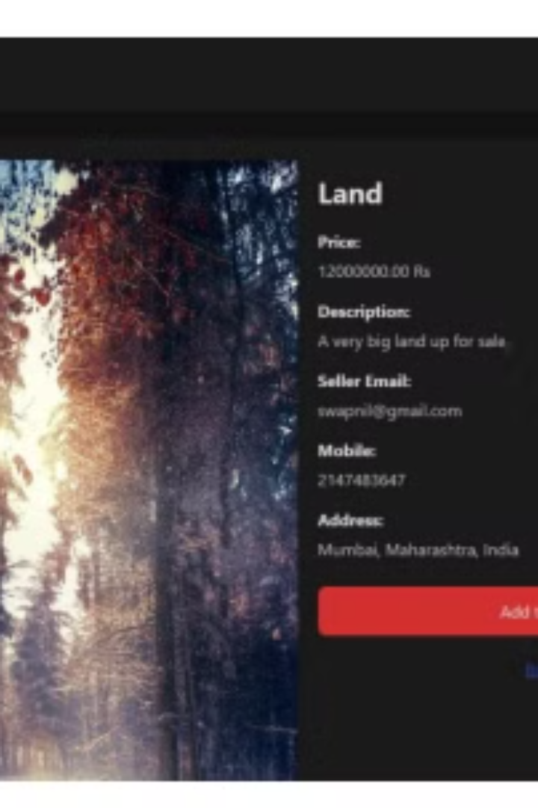



Buyers
Product Browsing Page
Buyers can browse and search for products listed by sellers, with product details including name, price, image, seller information, and ratings.
Product Details Page
Detailed information about a selected product is provided, including high-quality product images, detailed product description, size/variant options, available stock, seller ratings and reviews, and an "Add to Cart" button.
Cart Management
Buyers can view and manage items in their cart, with options to edit quantity or remove items, and a summary of total cost.
Order History Page
Buyers can view past and current orders, with details including order ID, product(s) purchased, total amount, order date, and current status.

Slide 9
Thankyou!!
Presented by –
B058 Swapnil Kale
B066 Plaksha Tiwari

