Slide 1
AHSANULLAH UNIVERSITY OF SCIENCE AND TECHNOLOGY · DHAKA, BANGLADESH
A Comparative Evaluation of Twelve Deep Learning Architectures for Multi-Class Tire Health Assessment
Field-Collected Images and Deep Learning
Ifti Bin Islam Mahin · Azad Ragib Nehal · Arhan Tibro · Mahdi Khan Chowdhury · Swapnil Basher
Department of Computer Science and Engineering
📁 414 Images
🏷️ 5 Classes
Field-collected dataset
Fine-grained conditions
🤖 12 Models
🎯 0.731
Architecture benchmark
Best test accuracy

Slide 2
PROBLEM & MOTIVATION
Five-Class Tire Health Assessment
Why This Problem?
Tire condition is difficult to judge reliably by eye
Worn/damaged tires affect braking, grip, and safety
Real-world inspection uses consumer smartphone cameras
Field images contain uncontrolled lighting, angles, occlusion, and background clutter
Existing approaches focus on binary defective/qualified classification
This work investigates fine-grained five-class tire condition assessment
✅ Healthy
⬇️ Low Tread
❌ Zero Tread
⚠️ Sidewall Damaged
Serviceable
Schedule replacement
Remove immediately
Remove immediately
🔀 Uneven Wear
Mechanical fault upstream

Slide 3

PROBLEM & MOTIVATION
Research Gaps Addressed
Gap 1 — Binary Framing
Gap 2 — Controlled Acquisition
Gap 3 — Single-Architecture on Large Corpora
Defective vs. qualified collapses intervention-specific conditions, obscuring crucial detail for maintenance decisions.
Existing research relies heavily on X-ray or factory imagery; real-world roadside capture remains underexplored.
Limited evidence exists for effective model selection when working with only a few hundred images, rather than thousands.
This work addresses all three gaps with five-class field imagery and a comprehensive 12-model comparison.

Slide 4
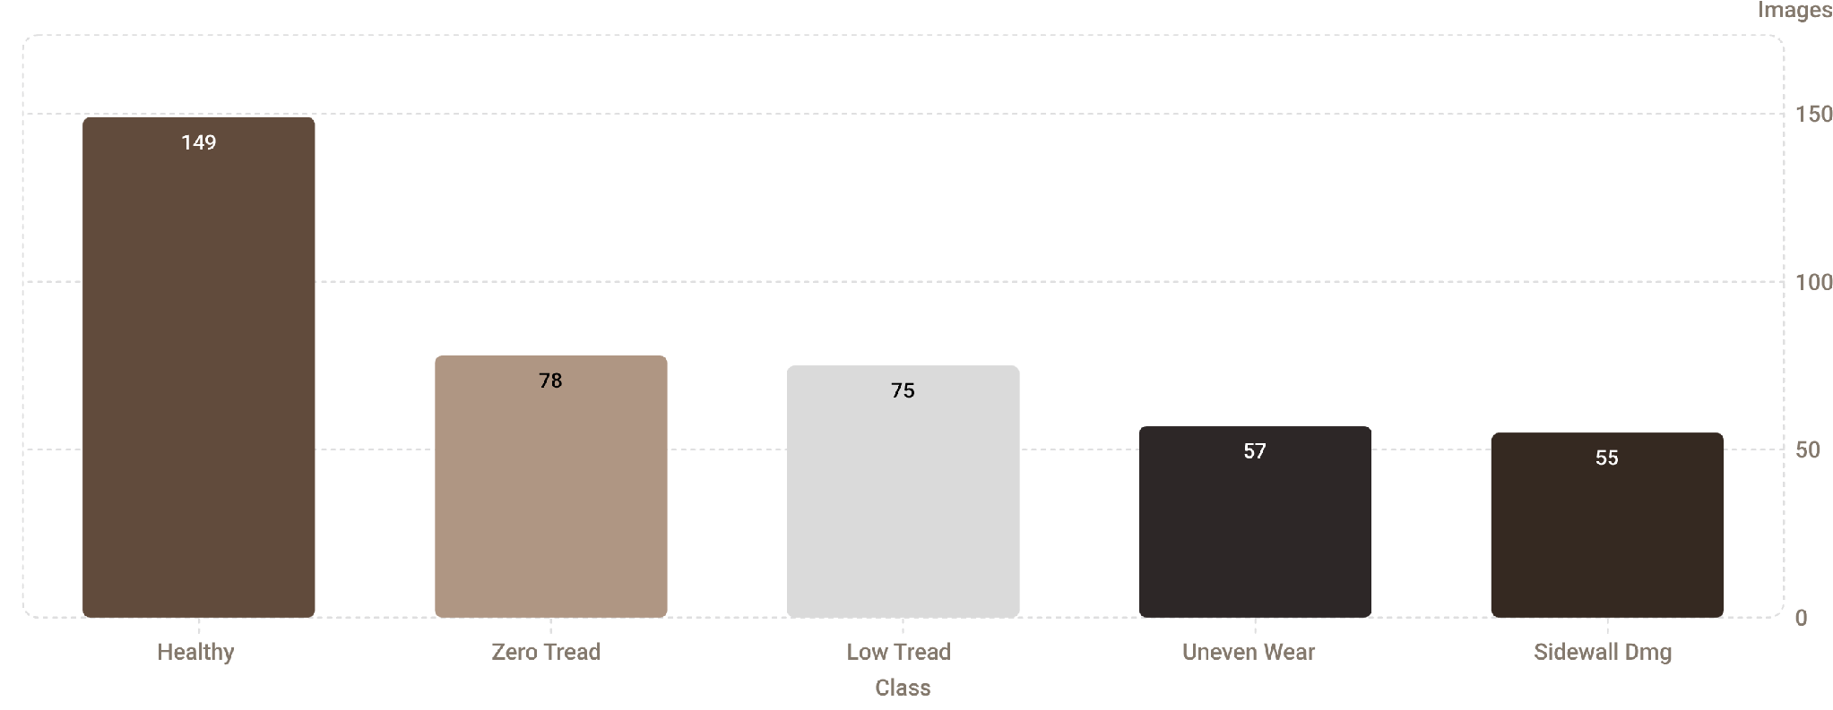
DATASET & OBJECTIVES
Dataset Collection & Contributions
Field-Collected Dataset — Dhaka, Bangladesh
414 original tire images captured with consumer smartphones
Locations: public roads, apartment garages, police impound areas, rickshaw/CNG/commercial stands
Collection restricted to daylight hours (evening sessions had high discard rates)
Private vehicles deliberately under-sampled (predominantly Healthy)
Commercial/para-transit vehicles preferentially sampled for class coverage

Slide 5

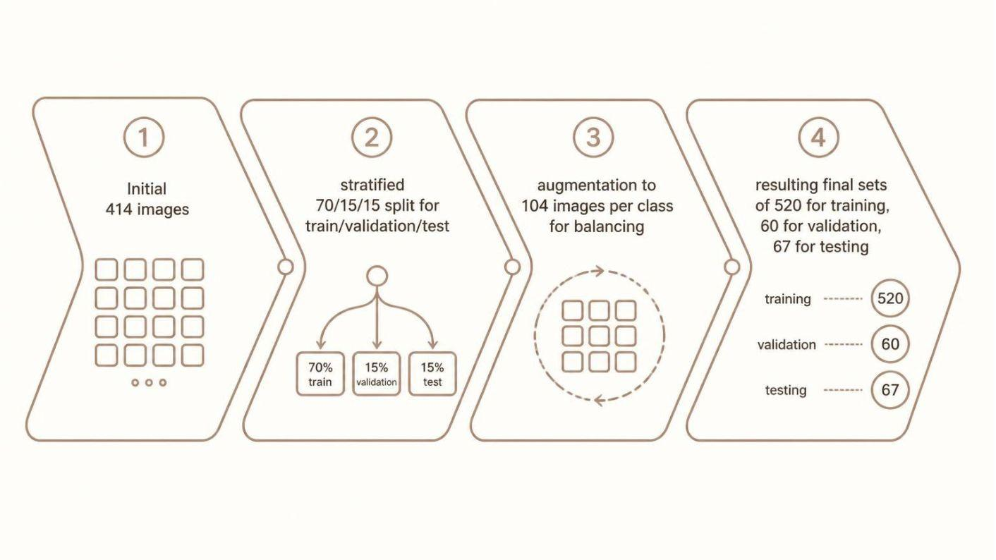



DATASET & OBJECTIVES
Contributions & Data Pipeline
Data Partitioning & Balancing Pipeline
Field-Collected Dataset
414 real tire images, five condition classes, real roadside acquisition in Dhaka.
Controlled Benchmark
12 architectures, same stratified split, shared metric implementation, seed = 42.
Error Analysis
Initial Dataset
Stratified Split
Class-wise F1 performance, Grad-CAM saliency attribution per class.
414 Images
70/15/15
Augmentation
Final Partitions
104 per class
520 Train | 60 Val | 67 Test
Data Constraint Analysis
67-image test set; small differences between leading models must be interpreted cautiously.

Slide 6
METHODOLOGY
Experimental Pipeline & Model Architectures
12 Evaluated Architectures
From Scratch
ImageNet Transfer Learning
YOLO Classification
Custom CNN (3-block, ~0.16M params, 128×128)
SqueezeNet 1.1 · MobileNetV3-Large · RegNetY-400MF · EfficientNet-B0 · ResNet-18 · ResNet-50 · DenseNet-121 · ConvNeXt-Small · ViT-B/16
YOLO11n-cls (lightweight) · YOLOv8x-cls (heavy)
Preprocessing & Augmentation
Scratch CNN: 128×128 · Pretrained: 224×224 or 384×384
ImageNet normalization for pretrained backbones
YOLO: native [0,1] scaling
Augmentation: rotation ±15°, horizontal flip, brightness ×0.7–1.3
Source images drawn with replacement

Slide 7


METHODOLOGY
Training Strategy & Experimental Setup
Two-Phase Training Strategy
Experimental Setup
Phase 1: Frozen Backbone
Platform
Stack
Freeze pretrained backbone, train new 5-class head only. Utilize a higher learning rate to accelerate head convergence while protecting pretrained features from large early gradients.
Google Colab, powered by an NVIDIA Tesla T4 GPU with 14.9 GB of dedicated memory.
Python 3.13, PyTorch 2.11.0, CUDA 12.8, and Ultralytics 8.4.163 for YOLO models.
Phase 2: Full Fine-Tuning
Metrics
Reproducibility
Unfreeze the full backbone for end-to-end network fine-tuning. A learning rate 1-2 orders of magnitude lower is applied, with checkpointing on the best validation accuracy.
Comprehensive evaluation using Accuracy, Precision, Recall, and F1-score, both per-class and overall.
Global seed set to 42 for Python, PyTorch, and CUDA operations to ensure consistent results.

Slide 8
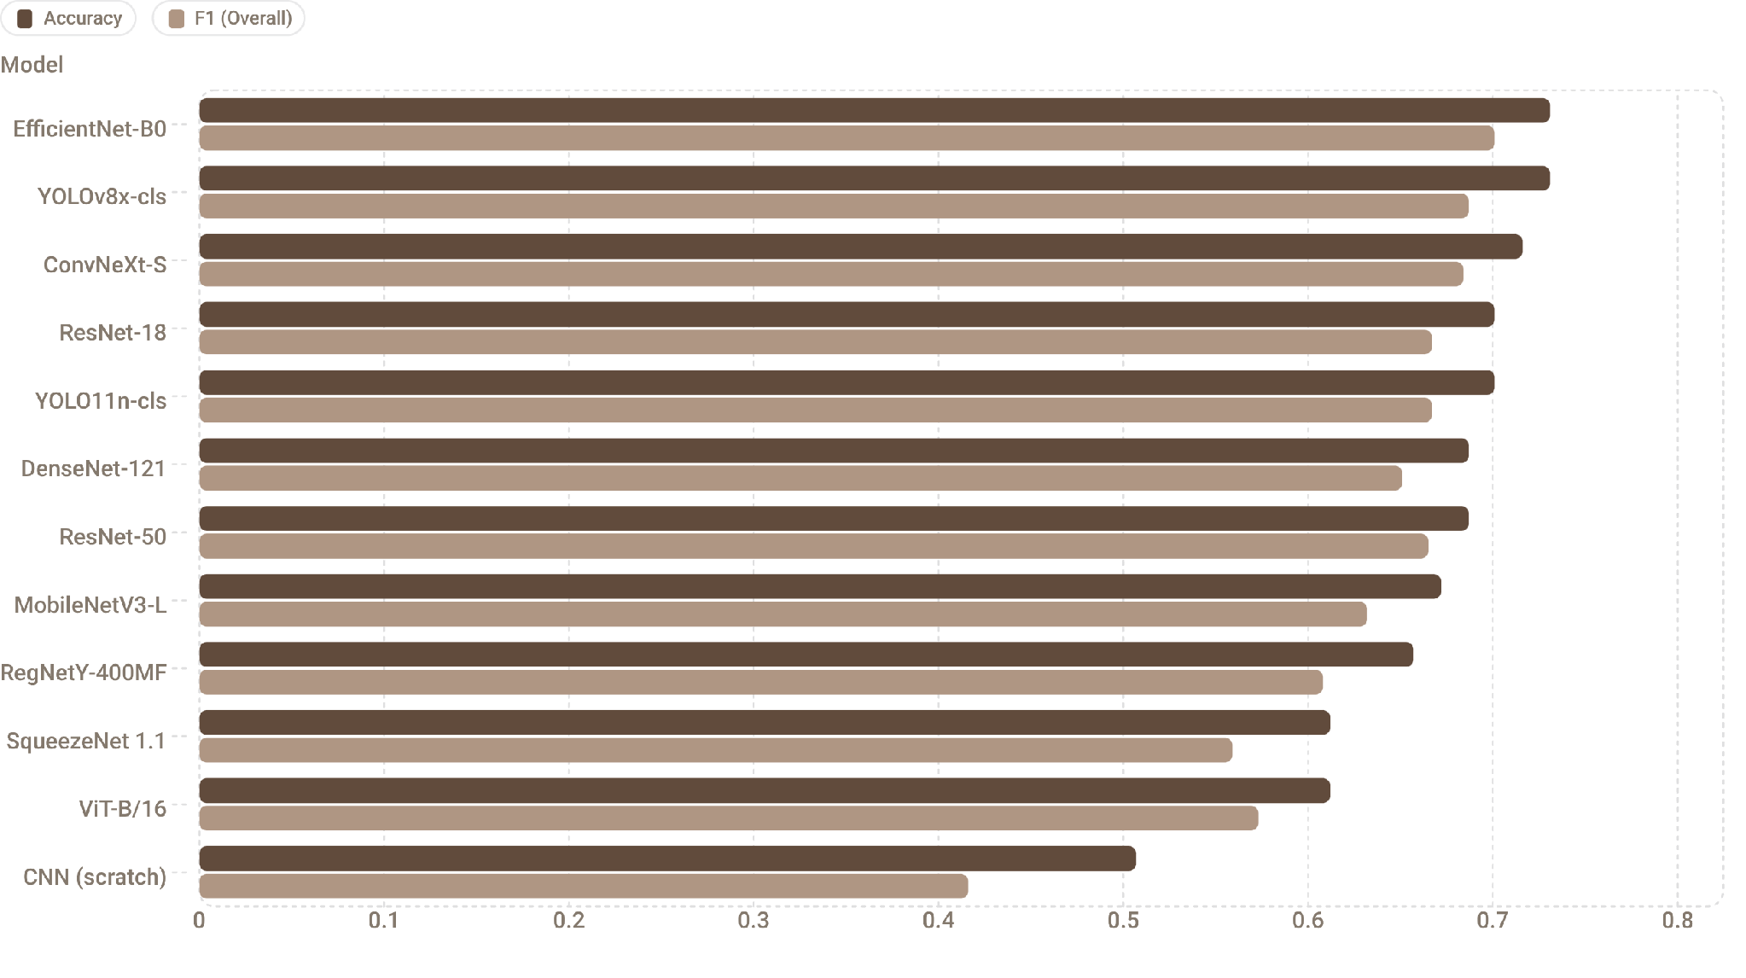
OVERALL RESULTS
Model Performance — All 12 Architectures (n = 67 test images)

Slide 9

OVERALL RESULTS
Transfer Learning Impact & Test-Set Constraints
Impact of Transfer Learning
Test-Set Resolution Limit
With n = 67 images in the test set, each image corresponds to a significant change in accuracy:
From Scratch CNN
Accuracy: 0.507
F1: 0.416
1 image ≈ 1.49 pp accuracy change
Top 2 models: 49/67 correct
Rank 3: 48/67
Ranks 4–5: 47/67
Ranks 6–7: 46/67
The top seven models are separated by only 3 test images.
Architecture differences within this group should be interpreted cautiously.
Best Pretrained (EfficientNet-B0)
Accuracy: 0.731
F1: 0.701
+22.4 pp accuracy improvement from transfer learning. Every pretrained model — including the smallest (SqueezeNet 1.1, 1.2M params) — outperformed the scratch CNN.

Slide 10
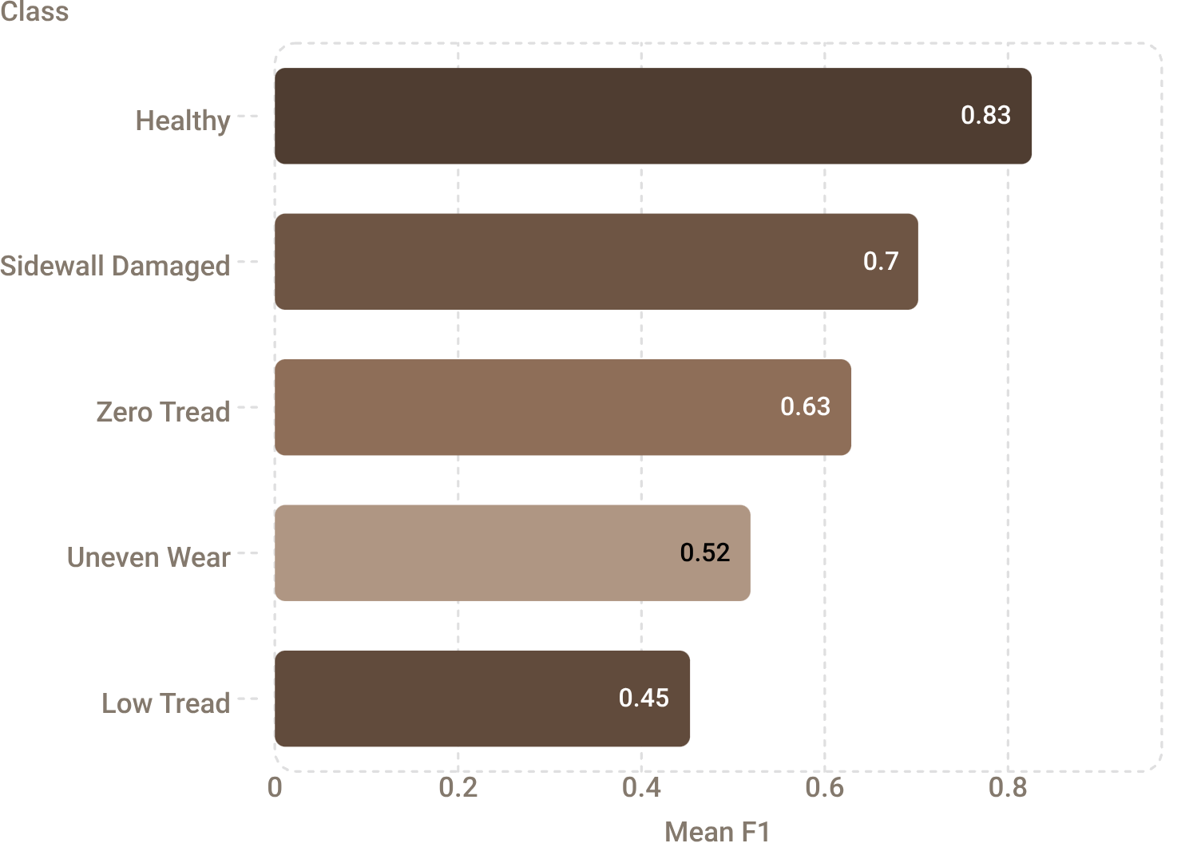

CLASS-WISE ANALYSIS
Where Classification Succeeds and Fails
Mean Class-Wise F1 Across All 12 Models
Why the Difficult Classes Fail
Low Tread vs. Zero Tread
Uneven Wear
Both represent advanced tread degradation · Difference is degree only · Visual boundary is subtle in a photograph · Models collapse a continuous physical quantity toward its endpoints
Spatial pattern (differential wear across tread width) · Arbitrary viewing angle may not show full tread width · Single-image input hides the distinguishing pattern · Not a localization failure — a data representation failure
Root Cause: Data, Not Model Capacity
Minority classes balanced via duplication, not new real images
Uneven Wear: 39 distinct originals → nominally 104 training images
Sidewall Damaged: 38 originals → nominally 104 training images
Less visual variation than nominal count suggests
Class difficulty ranking is stable across all architectures. No model ranks Low Tread above Healthy. Best Low Tread F1 achieved by any model (0.583, EfficientNet-B0) is below the worst Healthy F1 of any model (0.766, ViT-B/16).

Slide 11
CROSS-VALIDATION & EXPLAINABILITY
Validation Robustness & Grad-CAM Analysis
Stratified k-Fold Cross-Validation (n = 347 real images)
Model | k | CV Acc. | Std. Dev. | Test Acc.
YOLO11n-cls | 3 | 0.718 | 0.023 | 0.701
ResNet-18 | 3 | 0.654 | 0.017 | 0.701
ViT-B/16 | 3 | 0.628 | 0.022 | 0.612
SqueezeNet 1.1 | 3 | 0.582 | 0.042 | 0.612
CNN (scratch) | 5 | 0.444 | 0.060 | 0.507
CV estimates broadly track single-split test estimates
Fold-to-fold std. dev. decreases monotonically with model quality
Top 3 test-score models were not cross-validated
CV figures are conservative — shorter training schedules per fold

Slide 12
CROSS-VALIDATION & EXPLAINABILITY
Grad-CAM Explainability & Failure Modes
To understand where our models succeed and, more importantly, where they fail, we conducted a comprehensive Grad-CAM analysis across five representative architectures and all five tire conditions.
The grid above illustrates the Grad-CAM results, showing the regions of the input image that each model focuses on for its classification decision.
Three Key Failure Modes Identified
🏞️ Background Leakage
🔩 Wheel-Structure Confusion
🎯 Intermediate-State Collapse
Saliency often extends beyond the tire onto walls or background elements, particularly in the scratch CNN. This suggests spurious shortcuts where models correlate background features (e.g., vehicle type) with tire condition.
For 'Sidewall Damaged' tires, saliency sometimes inappropriately fixates on rims or spokes. In one instance, 4 out of 5 models misclassified a spoked wheel as 'Healthy', with only EfficientNet-B0 correctly identifying the damage despite the distracting wheel structure.
'Uneven Wear' tires were frequently misclassified as 'Zero Tread'. Grad-CAM showed correct saliency on the tire's tread, but the model struggled to differentiate between these two classes representing a continuous physical degradation. This highlights a data representation, not a localization, issue.

Slide 13
KEY FINDINGS & LIMITATIONS
Summary of Results & Identified Constraints
Key Findings
1
Transfer Learning is Decisive
2
Best Accuracy = 0.731 (EfficientNet-B0)
+22.4 pp accuracy over scratch CNN · Every pretrained model outperformed the baseline · Even smallest pretrained model (SqueezeNet 1.1) exceeded scratch CNN by 10.5 pp
But top seven models differ by only 3 test images — architecture selection within the pretrained family is not the main lever
3
Low Tread & Uneven Wear Fail Universally
4
Grad-CAM Reveals Spurious Shortcuts
Mean F1: 0.453 and 0.519 respectively · Consistent across all 12 architectures · Root cause: insufficient real training examples, not model capacity
Background leakage, wheel-rim confusion, and intermediate-state collapse confirmed visually

Slide 14
KEY FINDINGS & LIMITATIONS
Identified Constraints & Limitations
A closer look at the inherent challenges and limiting factors influencing our model's performance and real-world applicability:
Dataset Size
Class Imbalance
Image Variability
Limited to 414 original images, with a small 67-image test set. Each test image represents a significant 1.49 percentage point impact on overall accuracy, making subtle differences between top models difficult to interpret.
Significant imbalance across classes (e.g., Healthy: 149 vs. Uneven Wear: 57, Sidewall Damaged: 55). Minority classes heavily depend on synthetic augmentation, potentially limiting true visual diversity and generalizability.
Lack of control over acquisition parameters (uncontrolled lighting, exposure, resolution, camera distance, framing) introduces confounding factors. Models may inadvertently learn acquisition characteristics rather than fundamental tire conditions.

Slide 15
KEY FINDINGS & LIMITATIONS
Data & Methodological Constraints
Delving deeper into the inherent challenges and limiting factors that influenced our model's performance and its real-world applicability:
Class Overlap
Incomplete Cross-Validation
The visual distinction between 'Low Tread' and 'Zero Tread' is often subtle, representing a continuous degradation. Grouping these into a single 'Degraded Tread' class might offer more robust and tractable classification, simplifying the problem for the models.
The top 3 test-score models on the single test split were not subjected to full cross-validation. Furthermore, cross-validation fold schedules differed from the final training schedules, impacting the robustness and generalizability assessment of these models.

Slide 16






FUTURE WORK
Roadmap for Improvement
Targeted Data Collection
Richer Augmentation
Increase real Low Tread and Uneven Wear samples · Roughly double these two classes · Priority over any architectural change
Combine multiple transformations per copy · Add perspective and shadow augmentation · Cycle source images rather than sampling with replacement
Background Suppression
Standardized Capture Protocol
Crop/segment tire region before classification · Reduce background leakage confirmed by Grad-CAM · Expose spatial Uneven Wear signature more clearly
Guarantee full tread-width visibility · Consider multi-view input · Ensures Uneven Wear spatial pattern is observable
Stronger Evaluation Protocol
Scope Extension
Cross-validate every model at a common k · Use validation only for model selection · Test partition informs no decision other than final reported figure
Add tire manufacturing-date (DOT code) extraction · Service age and visual condition are complementary safety signals

Slide 17
Conclusion
📦 Dataset & Scope
⚡ Transfer Learning
🎯 Best Performance
⚠️ Binding Constraints
Five-class tire-condition classifier evaluated on 414 field-collected images · Twelve deep learning architectures benchmarked under a common pipeline
Transfer learning substantially outperformed the scratch CNN · +22.4 pp accuracy improvement · Every pretrained model exceeded the baseline
Leading test accuracy: 0.731 (EfficientNet-B0) · Overall F1: 0.701 · Small test set prevents strong claims about fine-grained model differences
Low Tread (mean F1 0.453) and Uneven Wear (0.519) remain unresolved across all architectures
🔭 Key Takeaway
Results point toward improving real data diversity rather than simply increasing model complexity
Thank You — Questions & Discussion
A Comparative Evaluation of Twelve Deep Learning Architectures for Multi-Class Tire Health Assessment · Ahsanullah University of Science and Technology · Dhaka, Bangladesh
Ifti Bin Islam Mahin · Azad Ragib Nehal · Arhan Tibro · Mahdi Khan Chowdhury · Swapnil Basher

