Slide 1
BE Project 2012 on
Localization and Mapping with a Mobile Robot and Kinect sensor
Fr. Conceicao Rodrigues College of Engineering
Ashish Belokar
Kshitij Dholakia
Swapnil Kate

Slide 2
Problem Statement
To develop a Mobile Robot
Localization
Pose estimates: (x, y, theta)
Mapping
Register observations

Slide 3
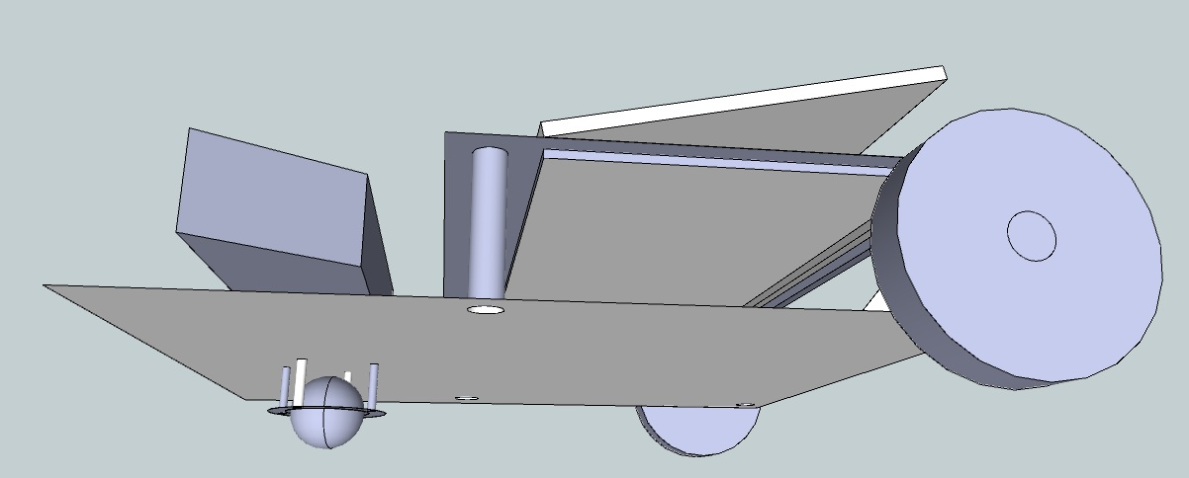

Slide 4
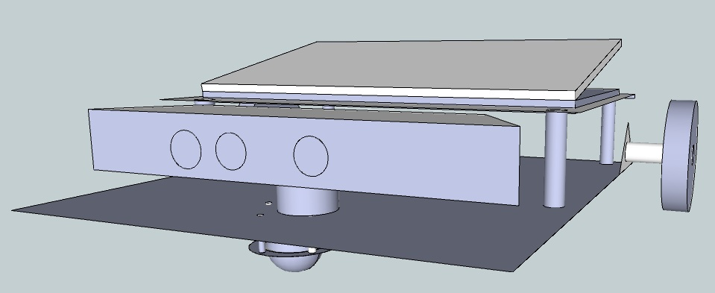

Slide 5
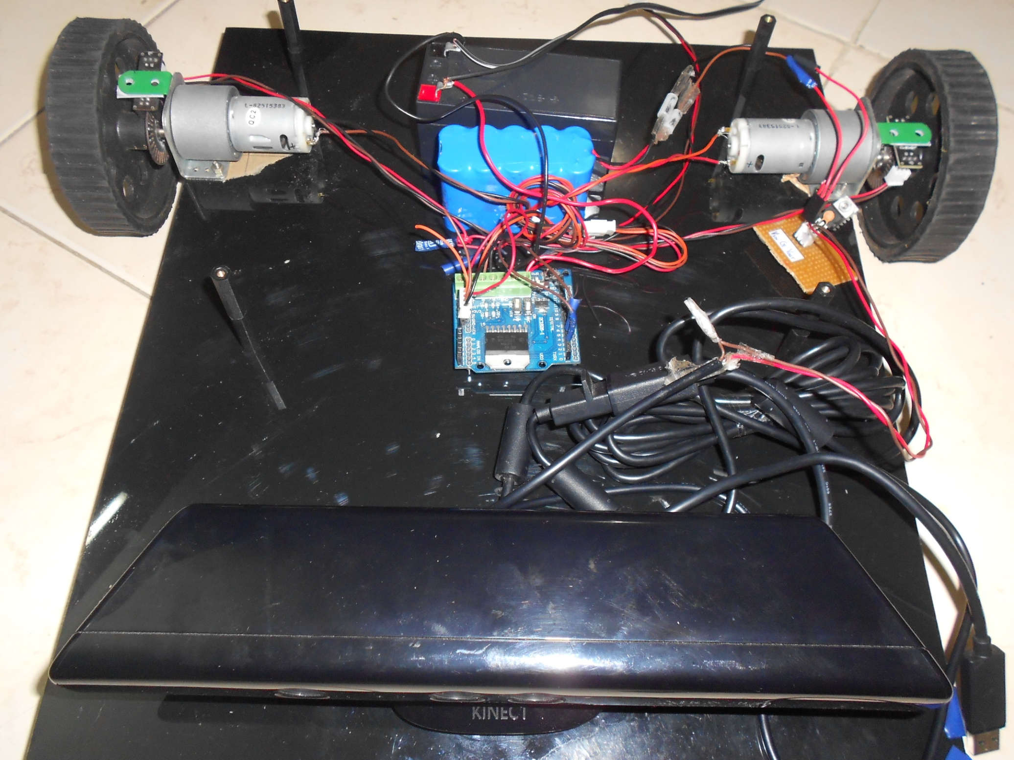

Slide 6
Robot Description
Drive
Motors
Motor Driver
Encoders
Batteries
Microcontroller
Kinect sensor

Slide 7
Kinect sensor
RGB from VGA camera
Depth/Distance values from IR sensor
Result = Point Cloud

Slide 8
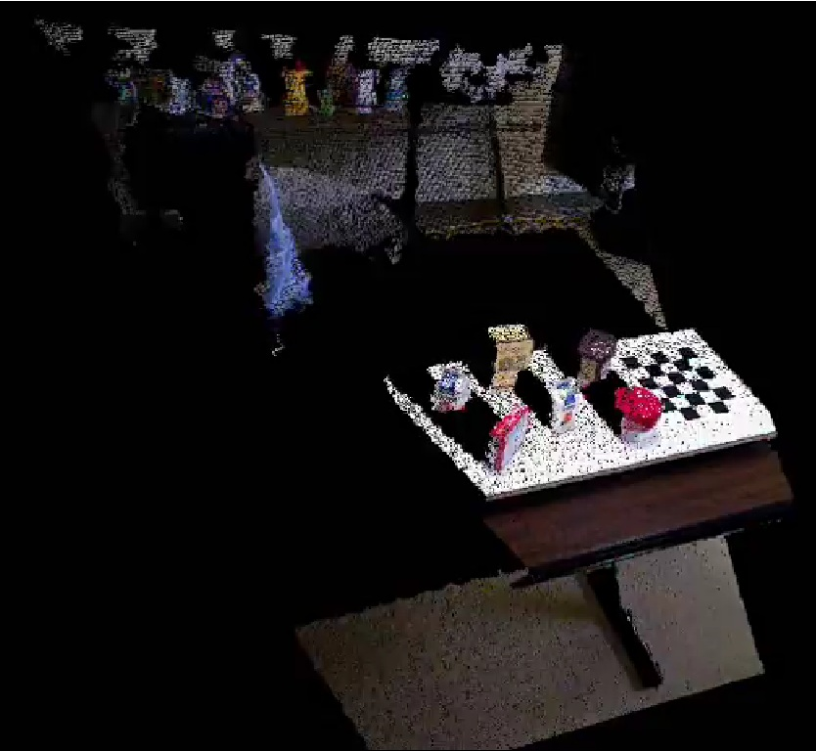

Slide 9
Software Requirements
Operating System
Ubuntu 11.10
Robot Operating System
Programming
C++
Drivers
OpenNI for Kinect

Slide 10
Robot Operating System
Hardware abstraction
Low-level device control
Process Management
Message Passing System
Synchronous
Asynchronous

Slide 11
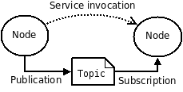
ROS Concepts
File System:
Packages and Stacks
Computational Graph:
Nodes (Publisher and/or Subscriber)
Topics
Messages

Slide 12
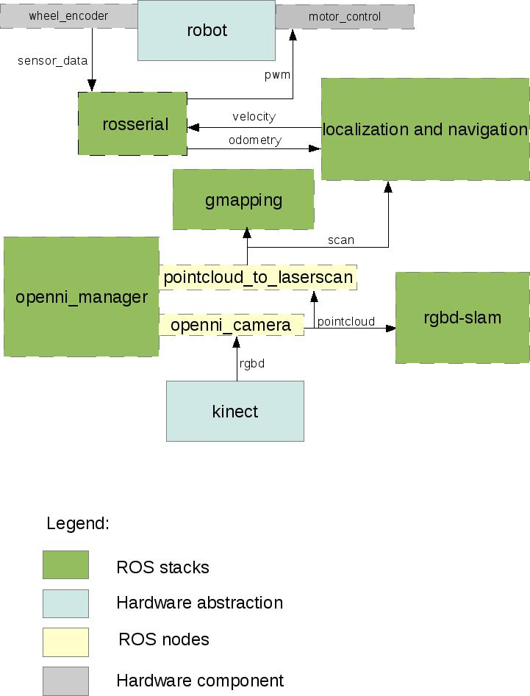
ROS Architecture

Slide 13
Kinematic analysis
30 slots in the wheel encoder
30 interrupts/counts ≡ 2*PI*R centimeters
Therefore, distance in cm for count value “x”:
= (2*PI*R*x)/30
Distance travelled D =
(Left motor (D_{l}) + Right motor (D_{r}))/2

Slide 14
Kinematic analysis
D_{l}
=
D_{r}

Slide 15
Kinematic analysis
b
(D_{l} ⁻ D_{r})

Slide 16
Kinematic analysis
b
(D_{l} ⁻ D_{r})
Theta = (D_{l} ⁻ D_{r})/b

Slide 17
Kinematic analysis
b
(D_{l} ⁻ D_{r})
Theta = (D_{l} ⁻ D_{r})/b
X = D*cos(theta)
Y = D*sin(theta)

Slide 18
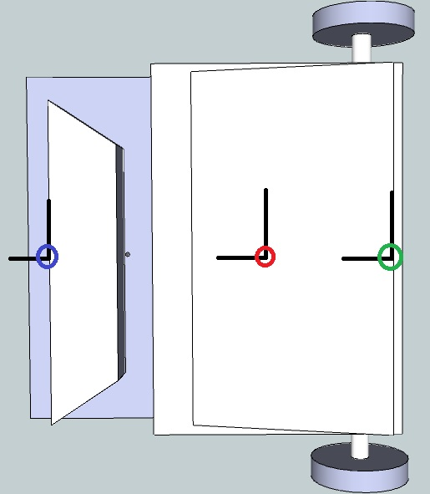
Coordinate Frame Transforms

Slide 19
Modeling it into ROS
Using ROS Message type:
geometry_msgs/PoseStamped
Timestamp
x, y, theta
Using /tf ROS package

Slide 20
Gmapping
Depth Map to Laser Scan
Odometry values
/tf
P((x, y, theta), map | control_signal, scan_observation)

Slide 21
Future Work
Output is a 2D Occupancy Grid
Navigation
Path planning
Kinect -> Point clouds
3D Occupancy grid
Trajectory planning for robot manipulators

