Slide 1
QA Automation — AM Squad
Biweekly Status · October 01, 2026 · 3:00 PM ET (Rescheduled from Fri Sep 25)
Rajib · Henry · Persistent Delivery Managers

Slide 2
Executive Pulse
At a glance
26.16 closeout → 26.17
GitLab merges
Sprint 26.16 items – Sub-Tasks
MSC coding
Stage1 health
ETA track
18
180
100%
Recovered
~70% of Orig. ETA
MSC coding + Bruno on main; V3 profile/bank
MRs landing
Board items across 26.16–26.17
Coding 100% · SharePoint hub publishing · ENVP QA-600 closed
Post DB-refresh / IDP co-work
Ahead of original plan
What leadership should know
• MSC coding 100% · ENVP QA-600 closed · SharePoint hub publishing next
• Perf regression healthy · Enrollment MSC perf is last MSC perf gap
• API GitLab nightly still pending DevOps (batch/job ready — need DB files + owner)
• Critical asks: MFA Stage1 support · Stage5/CAT takeover · V3 IDP/UE sustaining owner
Sources: Jira AMSQUAD board · GitLab (3 repos) · Jenkins/GitLab nightly logs
2

Slide 3
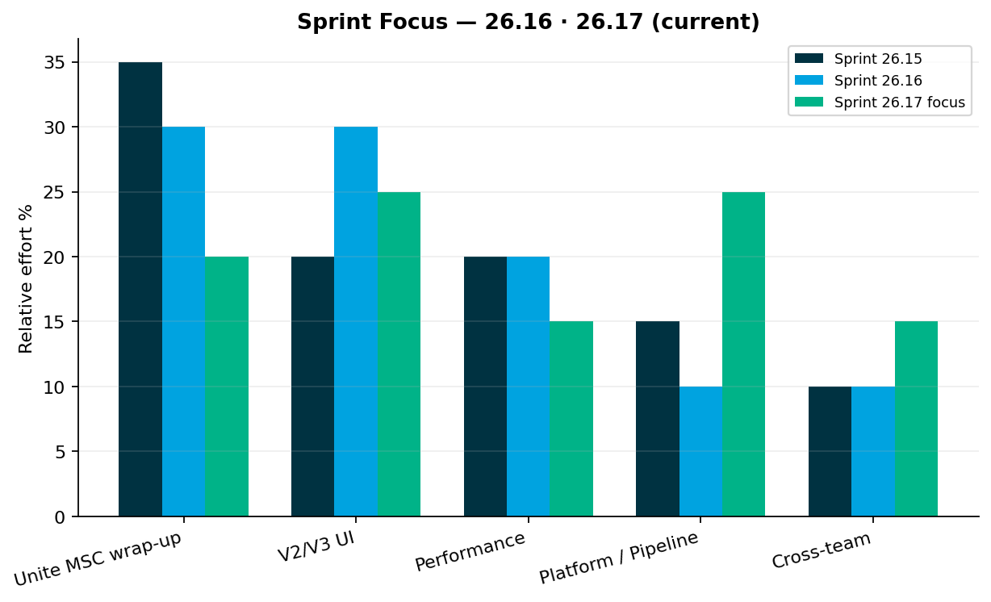
Sprint Delivery Focus
Delivery
Sprints 26.15 · 26.16 (current)
Key messages
• Sprint 26.15: QA-1938 merged (!268); Bruno Postman migration started
• Sprint 26.16: MSC wrap-up (SharePoint, qTest, QC4) + V2/V3 gap execution
• Perf: M2 done · M1 done by Sep 26 · Enrollment remaining · Jenkins jobs ready
• V2→V3: Venkatesh/Sunil enroll/login/reg almost done; member flows migrating to V3
Relative effort index — not FTE hours
3

Slide 4
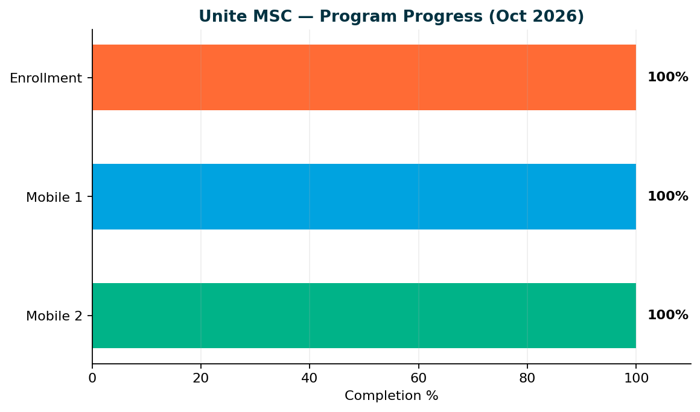
Unite MSC — Program Status
MSC
Mobile 2 100% · Mobile 1 100% · Enrollment 100%
Key messages
• Mobile 2: 25/25 endpoints — sign-off ready
• Mobile 1: 26/26 in-scope operations — sign-off ready
• Enrollment: 25/28 catalog (100%) — sign-off ready (standard 15/15 + subsequent 5/5)
• Deferred: Partner submit (QA-1808), Upromise (QA-1807), OAuth token
• Wrap-up: SharePoint KT hub publish (parent + 11 children) – Almost Done, Enrollment performance (Preeti)…
• Target: SharePoint publish this sprint · API nightly when DevOps owns · Enrollment perf closes MSC perf
Coding complete. Docs publishing in flight. API nightly blocked on DevOps ownership — not on missing automation design.
4

Slide 5
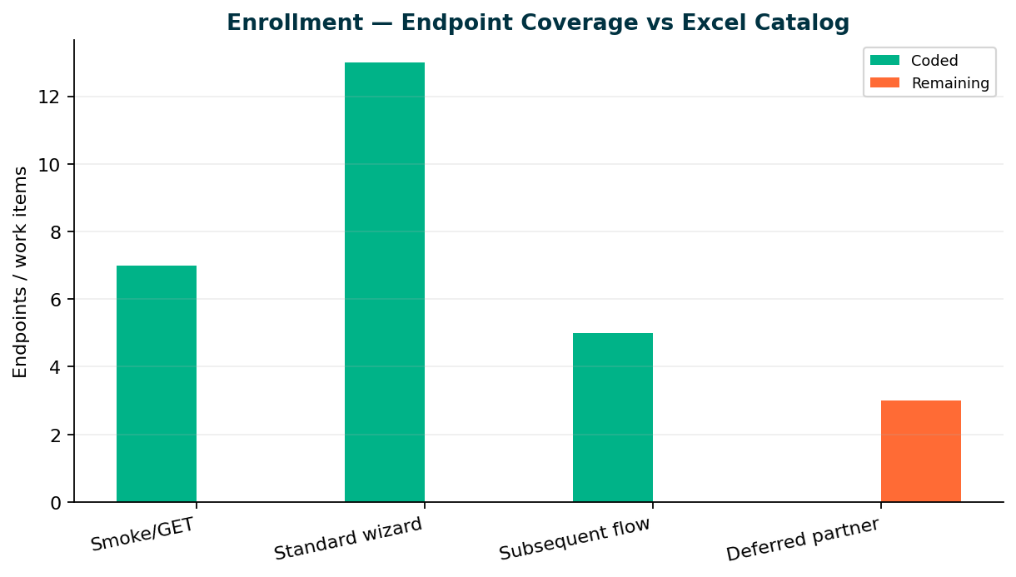
Enrollment — Endpoint Coverage
Enrollment
Core E2E 15/15 · Catalog 25/28
Key messages
• 25 TestNG classes on main — standard + subsequent E2E complete
• MR !268 (QA-1938) merged Sep 11 · Bruno M1/M2/Enrollment merged Sep 21 (!271)
• 3 deferred partner endpoints: Partner submit (QA-1808), Upromise (QA-1807), OAuth token
• Wrap-up: SharePoint KT, qTest manual cases, QC4 E2E proof — end Sprint 26.16
• KB: programs/unite-msc/api-test-automation/mappings/enrollment-endpoint-current-state.csv
Repo: api-test-automation/mobile/enrollment
5

Slide 6
Team Status by Owner
Team
Sprint 26.17 — who is doing what
Preeti — Performance
Venkatesh — V2
• Mobile 2: Done
• Mobile 1: Done
• Enrollment: Remaining MSC perf gap — in progress
• Perf Jenkins jobs ready and running — performance regression healthy
• Enroll/login/reg retire-or-migrate largely complete
• Member flows → V3 for Direct→universal; CSR Actions on Stage1 nightly (+39 methods Sep)
• Continue V2 gap closure; Stage5 regression needs handover owner
Sunil — V3 (Gaps & Enhancements) · Dinesh — MSC wrap-up & V3 fine Tune, migration util
• Sunil: V3 IDP profile + enrollment coverage continuing
• Sunil: IDP profile fixes; bank/bene coverage with Sunil (MR !235 × 4 plans) · V3 IDP + Universal Enrollment support still needs a named sustaining owner
• Dinesh: Complete — MR !268 + Bruno !271 on main
• Target: MSC docs + KT published; API GitLab nightly still needs DevOps ownership
Stage1 recovered after DB refresh. Swapnil currently owns MFA disable + Stage5/CAT regression support for the squad — both need sustaining o
6

Slide 7
Leadership Decision — API Nightly / Regression
Ask
API GitLab nightly + regression ownership
The gap
• API MSC GitLab nightly is still pending DevOps. Batch/job and remote setup are largely created. Once DB files are copied to the server and an owner is named, nightly should run. API regression is not scheduled yet. Performance regression is already working.
• Proposed owner: DevOps (Dong / pipeline owner) + QA named sustaining contact
• Track: QA-892 suite packaging · ENVP / GitLab nightly follow-on
• Perf regression already healthy — no change. API regression waits on nightly ownership.
Support ownership
Stage1 MFA / DB updates — Offshore has no update access; after every DB refresh or new account I disable MFA. Need Stage1 update support so this isn’t only me.
Stage5 / CAT regression — Per Brian, I’ve been running V2 + V3 CAT suites. Need someone to own Stage5 regression ongoing.
V3 IDP + Universal Enrollment — Need a sustaining owner for suite health / defects (not ad hoc).
API GitLab nightly — Batch/job/remote mostly ready; need DevOps to copy DB files to the server and own the job.
API nightly regression — Pending until nightly is owned and scheduled. Perf regression is already healthy — no ask there.
Release support (Monthly release) — Product pulls me into release testing every cycle (~2–3 days).
  Next: release ends Oct 14; I’m in through ~Oct 16. Need a designated automation contact for release sign-off so I’m not the default every month.
Please confirm DevOps owner on this call — API regression waits on nightly
7

Slide 8
Support Ownership — Decisions Needed
Critical
Several production-support duties are currently single-threaded on Swapnil. Need named own
Stage1 · Stage5 · V3
API nightly · Perf
• Stage1 MFA / DB update support: Arrange Stage1 support (update access or on-call) so MFA disable / account prep is not a single point of failure.
• Stage5 / CAT regression: Name an owner to take over Stage5/CAT regression support for V2 and V3.
• V3 IDP + Universal Enrollment: Name sustaining support for V3 IDP + Universal Enrollment (defects, suite health, plan coverage).
• API GitLab nightly: Confirm DevOps owner; complete server DB copy; turn on API nightly. API regression pending until then.
• Performance regression: No ask — keep as-is; Enrollment MSC perf is the remaining MSC perf gap.
Today these duties are single-threaded on Swapnil — need named owners
8

Slide 9
TCs Added — Jul / Aug / Sep
Metrics
Dhanashree Jul–Sep fill (Apr–Jun unchanged)
V2 / V3 (Apr–Jun unchanged)
Why Jul–Aug V2/V3 looked lower
• V2: Jul 33 · Aug 8 · Sep 39 (Sardine · stabilize · CSR Actions)
• V3: Jul 10 · Aug 8 · Sep 16 (WebRereg ×3 · bank/bene ×4)
• Stage5/CAT Sep +49 (remainder after Apr/May stand-up)
• MSC API (×3 plans): Jul 99 · Aug 75 · Sep 6
• Perf JMeter: Jul 12 · Aug 22 · Sep 47
• Capacity on MSC + Perf + Stage5/CAT — Sep V2/V3 uptick intentional
• Shared with Dhanashree for QA AUTO monthly chart fill
MSC = methods × OKD/NYD/NMD · Removals not counted as negative adds
9

Slide 10
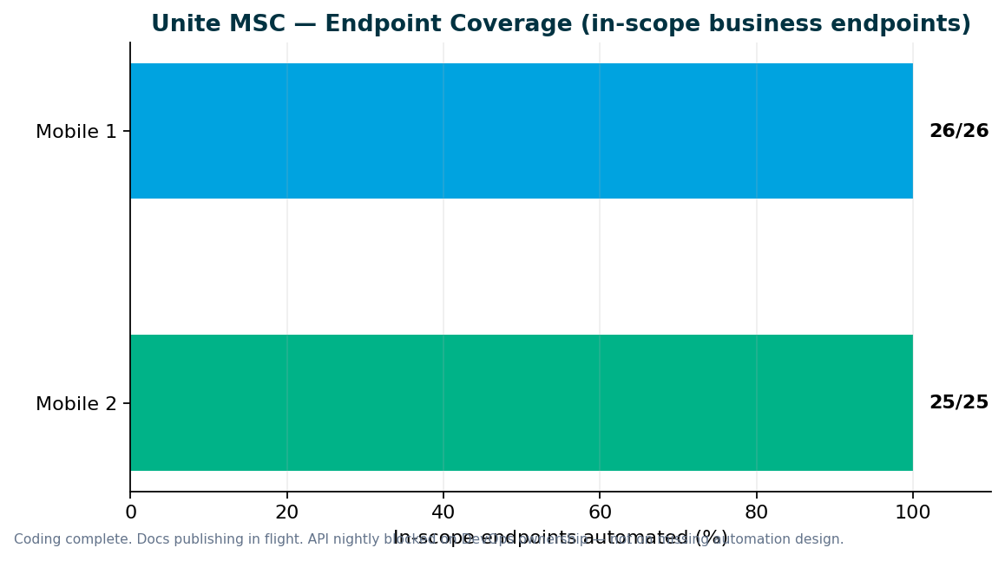
Unite MSC — Endpoint Coverage
MSC
M2 25/25 · M1 26/26 in-scope
Key messages
• All in-scope business endpoints automated — 100% for Mobile 1 and Mobile 2
• Destructive endpoints run in smoke/integration — not duplicated in master regression
• Stage1: IDP + non-IDP paths validated; QC4 hybrid proof pending env stability
• GitLab nightly + ENVP pipeline integration (QA-1405, QA-1544–1549)
• Need leadership to name sign-off owners for M1, M2, pipeline, and perf
Repo: programs/unite-msc/api-test-automation/mappings/
10

Slide 11
Pipeline & Environments
Infrastructure
Hybrid QC4 + Stage1 model
Current state
What we need
• Stage1 healthy — MFA disable for offshore still single-threaded on Swapnil after DB refresh / new accounts
• QC4 / Stage1 hybrid proof continuing
• API GitLab nightly PENDING DevOps — batch/job/remote mostly ready; need DB files copied to server + named owner. API regression not nightly yet. Perf regression already running healthy.
• QC4 has no non-IDP plants in lower env today — need product owner to confirm test plans
• Pipeline is not 'done' until QC4 proof passes — design is ready
• DevOps owner: copy DB files to server · own API GitLab nightly job (setup mostly ready)
• Stage1 MFA / DB update support for offshore (today: Swapnil only)
• Stage5/CAT + V3 IDP/UE sustaining owners so support is not single-threaded
Aligned with Jul 2025 hybrid decision — Stage1 primary until QC4 stabilizes
11

Slide 12
V2 & V3 UI Automation
UI
Sprint 26.17 — V2 Stage5/CAT + CSR Actions; V3 IDP/UE + bank/bene; Stage1 MFA support gap
V3 (GitLab) — maintenance + stabilization
V2 (Jenkins) — sunset discussion needed
• Sep: Member bank + beneficiary × 4 plans (+16 TCs) — Sunil MR !235
• Jul: WebRereg × 3 plans (+6) plus other UE/reg adds
• V3 IDP + Universal Enrollment still need named sustaining support
• Sep: CSR Actions suite new on Stage1 nightly (+39 methods)
• Stage5/CAT regression suites created and running (Brian request) — Swapnil supporting today
• Jul–Sep V2 TCs added for leadership chart: 33 / 8 / 39
• Confirm: member flows permanently on V3 for migrated Direct plans — retire V2 member IDP suites?
Regression bugs — Sprints 26.15–26.16
• QA-2014: V3 Universal Enrollment — unable to create account (26.15)
• QA-2013: V3 CSR Member Personal Information validation (26.15)
• QA-1990: V3 withdrawal voucher invalid (26.15)
• QA-1989: V2 CSR withdrawal voucher invalid (26.15)
• QA-2199: SEQ_FIN_TXN_ID null — contrib/withdrawal/investment stabilization (26.16)
Inventory cleanup ≠ zero work — Aug V2/V3 kept non-zero for stabilize/flaky MRs while MSC/Perf/CAT took capacity
12

Slide 13
V2 Regression — Gap Analysis
V2
By Venkatesh Mallela
P0 — Turn on existing automation (@dailyrun)
P1 — Extend coverage · P2 — Build new
• CSR Actions on Stage1 nightly — landed Sep (+39 methods)
• Stage5/CAT V2 smoke suites running — need sustaining owner
• Member-related cases — migrate to V3 (V2 member IDP obsolete for migrated Direct plans)
• Share adjustment / CSR daily wiring continue
• Enrollment / login / registration retire-or-migrate largely done
• Contribution / withdrawal / investment stabilization after SEQ_FIN_TXN_ID issues
• Stage5/CAT expansion and green-suite triage
• —
• P2: YTD bucket, financial history, failed txns, bank history…
CSR Actions added to Stage1 nightly (+39 methods Sep). Stage5/CAT smoke in active regression. Member→V3 migration contin…
13

Slide 14
Performance Testing
Perf
Perf regression healthy · M1/M2 done · Enrollment MSC perf remaining
Sprint 26.15–26.16
Sprint 26.16
Sprint 26.17
Mobile 2 MSC performance
Mobile 1 auth / owner-profile / device-p…
Enrollment MSC performance
Prior MSC M2 perf
QA-2159–2163
Enrollment MSC perf
Sprint deliverables
• Mobile 2 MSC performance: Done
• Mobile 1 auth / owner-profile / device-push JMeter: Done
• Enrollment MSC performance: Remaining — last MSC perf gap
Ongoing baseline track
• Performance regression suite already running and healthy — no nightly ask. API GitLab nightly / API regression still pending DevOps ownership.
Perf intake governance — see next slide
14

Slide 15
Performance Governance — Leadership Ask
Ask
Stop last-minute emergency intake
In progress (Sprint 26.15)
What we need from leadership
• Perf intake template + SLAs by change size (QA-1965–1969)
• Confluence Performance Testing Hub governance guidance
• Train Dev/QA/PM stakeholders on standard intake process
• Mandate perf gate for IDP login, enrollment, contributions, withdrawals before release
• Route requests through SDLC intake — not last-minute before deploy
• Approve M1 perf script priority: NY, NMD, OKD (QA-1983–1986)
Contribution JMX delivered Sprint 26.14 — M1 scripts in flight
15

Slide 16
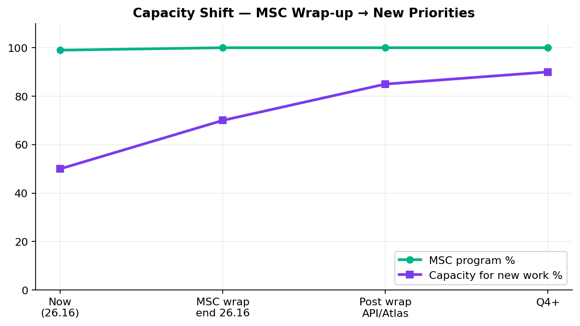
Capacity — MSC Wrap-up vs New Work
Capacity
MSC wrap-up end 26.16 · capacity opens for API suites / Atlas / V2-V3
Key messages
• SharePoint hub publish + Enrollment perf · API nightly waits on DevOps
• New work capacity: Support handovers (MFA, Stage5/CAT, V3 IDP/UE) unlock Swapnil capacity for roadmap
• Dinesh + Swapnil → SharePoint, qTest, QC4 wrap-up
• Preeti → Enrollment MSC perf (last MSC perf gap)
• Ask: name MFA / Stage5 / V3 / API-nightly owners — then Atlas vs suite packaging
MSC coding done — support handovers unlock capacity
16

Slide 17
V2 → V3 Migration Path
Strategy
Reduce Jenkins footprint
Plan
• Retire obsolete V2 member/login/enrollment as Direct→universal completes; expand daily with existing automation
• Stage1 Direct plans on universal — V2 member IDP no longer valid
• Approve permanent retirement of V2 member IDP for migrated plans and V3 as source of truth?
• Lead: Venkatesh Mallela
• Outcome: lighter GitLab-based V3 suites; retire duplicate V2 enrollment from Jenkins
Aligns with platform direction — V3 as source of truth
17

Slide 18
Incoming: ACS-5678 Atlas
New work
Traffic distribution & load balancer rebalancing
AHA summary (Brian Danilczyk)
• ACS-5678 — Atlas Traffic Distribution & Load Balancer Rebalancing — #2 on Michael's list
• Estimate: 2–3 sprints · Target: October 2026 delivery
• Status: Ready after MSC wrap-up — confirm queue vs API nightly ownership + support handovers
• Dependency: Redis session-management initiative
• Scope: validate traffic distribution after Redis session externalization; load + perf testing
• Main squad can start intake next sprint while 1 resource finishes MSC wrap-up
Confirm priority vs MSC wrap-up, V2 sunset, and other AHA items
18

Slide 19
Leadership Asks & Decisions Needed
Decisions
Please respond on this call — by area
Support ownership (critical)
• Stage1 MFA / DB update support for offshore — name owner or grant update path (today: Swapnil only)
• Stage5 / CAT regression takeover — V2 + V3 smoke suites running; name sustaining owner
• V3 IDP + Universal Enrollment — name sustaining support owner
• API GitLab nightly — confirm DevOps owner; copy DB files to server; turn on job (setup mostly ready)
Roadmap & capacity
• Confirm post-MSC queue: Atlas (Oct) vs API suite packaging (QA-892) vs V2/V3 + Stage5 support?
• Accept: Performance regression is healthy — no change needed
Unite MSC / API automation
• Accept M1/M2/Enrollment coding complete — remaining = SharePoint publish + Enrollment perf + API nightly
• API regression still pending until GitLab nightly is owned and scheduled
• Name ACM / sustaining reader for MSC SharePoint hub after publish
V2 / V3 / Stage5
• Approve Stage5/CAT as ongoing regression support (not ad hoc Swapnil duty)
• Approve retirement of V2 member IDP for Direct plans now on universal — migrate to V3
Performance
• Enrollment MSC perf is the last MSC perf gap — keep priority
• Perf governance: route requests through intake (not last-minute before deploy)
Full ask list in companion DOCX · Swapnil Patil · QA Automation AM Squad
19

Slide 20
Questions & Discussion
Detailed briefing + PDF shared · Swapnil Patil · QA Automation AM Squad

