Slide 1
Automation Bug Lifecycle
QA Automation Operating Standard
Version July 24, 2026 · Applicable to all teams
qa-automation-kb · AMSQUAD
Triage
Evidence
Cursor H
GitLab PM
Classify first
One folder
All comms
Change set

Slide 2
What This Standard Defines
Operating norm for all teams
Repeatable response when V2 (Jenkins) or V3 (GitLab) regression fails
Applies to any QA Automation team — UI, API, performance, any program
Single source of truth: qa-automation-kb (00_SYSTEM through 11_BACKLOG)
Integrates triage rules, Prompt H, leadership-approved comms, and GitLab change-set tooling
Goal: fast, accurate footprint — not ad-hoc firefighting or noisy JIRA
QA Automation Standard · Automation Bug Lifecycle · Internal
2

Slide 3
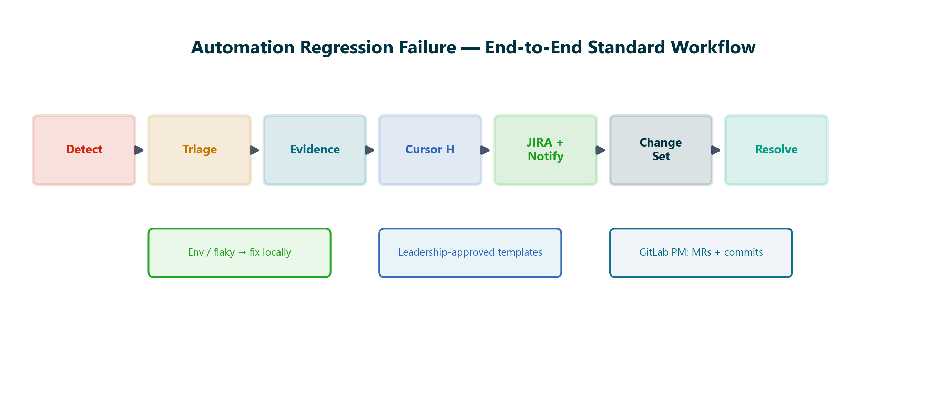
End-to-End Workflow
Seven steps — every regression failure
Detect → Triage → Evidence → Cursor H → JIRA/Notify → Change Set → Resolve
QA Automation Standard · Automation Bug Lifecycle · Internal
3

Slide 4
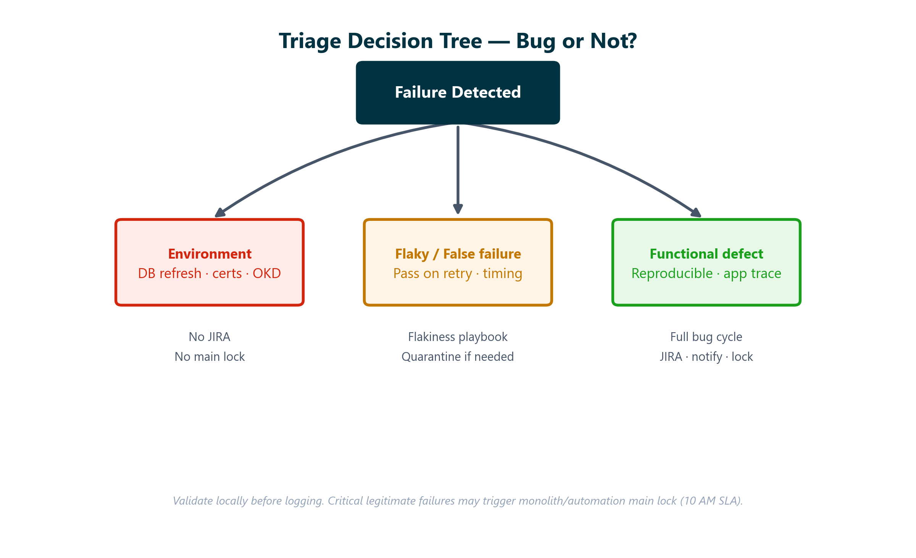
Step 1 — Triage Before You Log
Decision tree validated against TRIAGE_RULES.md + FLAKINESS_PLAYBOOK.md
Environment and flaky failures do not enter the full bug cycle
QA Automation Standard · Automation Bug Lifecycle · Internal
4

Slide 5
Act on a Real Defect
Evidence · Communications · Change set

Slide 6
Four Pillars of the Standard
Validated against repository standards
01
02
Triage & classify
Evidence folder
Per 04_EXECUTION/TRIAGE_RULES.md. Rerun locally. Env vs flaky vs defect. Do not log JIRA for noise.
10_IMPORTS_RAW/regression_reports/[MMDDYYYY]/ — screenshots, logs, test data, one bug .md per issue.
03
04
Cursor Prompt H
GitLab change set
00_SYSTEM/PROMPTS.md — JIRA block, failure email, Teams message, resolution placeholder in one file.
GitLab Project Manager — who merged, who committed, which branches between last green run and failure.
QA Automation Standard · Automation Bug Lifecycle · Internal
6

Slide 7
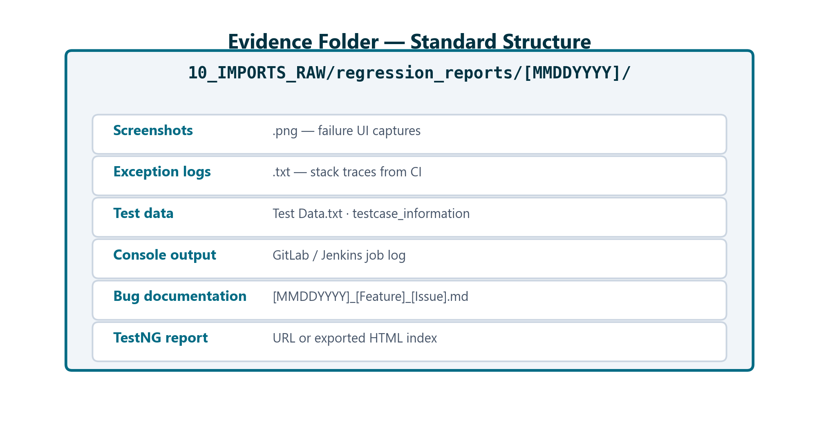
Evidence Folder Structure
BUG_REPORTING_PROCESS.md
Naming: [MMDDYYYY]_[Feature]_[IssueType].md
QA Automation Standard · Automation Bug Lifecycle · Internal
7

Slide 8
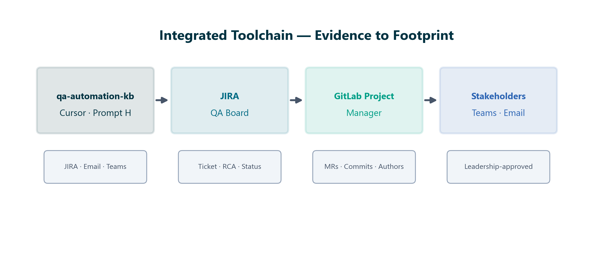
Cursor Prompt H — One Prompt, All Deliverables
05_ONBOARDING/HOW_TO_REPETITIVE_TASKS.md
Open qa-automation-kb in Cursor
00_SYSTEM/PROMPTS.md → section H
Provide: date, feature, error, report URL, folder path, file list
Attach failure screenshots in chat for richer context
Output sections:
• JIRA copy-paste block (Summary, Steps, Env, Priority)
• Failure email — leadership-approved To/Cc
• Teams message with JIRA + report links
• Resolution email placeholder (template 1b)
Prompt H toolchain
QA Automation Standard · Automation Bug Lifecycle · Internal
8

Slide 9
Communication Standards
Leadership-approved templates
Teams and email templates are approved by leadership and senior QA resources
Use Prompt H output — do not improvise distribution lists or email structure
To: AGS Tech Leads, AGS Chapter Leads, AGS Development, Brian Danilczyk
Cc: Rajib Akhter · Henry Dittmer · Phuong Huynh · Automation.Squad
Subject: [Priority] [Feature] — [Issue Type]
Sources: Confluence Bug Handling PDFs (1. Failure · 1b. Resolution)
QA Automation Standard · Automation Bug Lifecycle · Internal
9

Slide 10
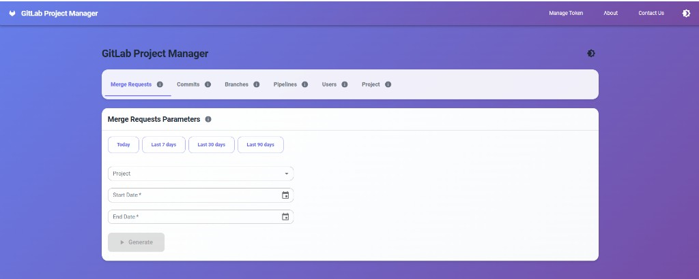
GitLab Project Manager — UI
Change-set investigation tool
Local utility: GitLabInfoProjUI (read-only GitLab API)
Manage Token — PAT with read_api scope
Select project + date range (last pass → failure)
Tabs: Merge Requests · Commits · Branches · Pipelines
Filter Merged · Search by author or branch
Export CSV/Excel or Copy to clipboard
Parameter panel — project, date presets, Generate
QA Automation Standard · Automation Bug Lifecycle · Internal
10

Slide 11
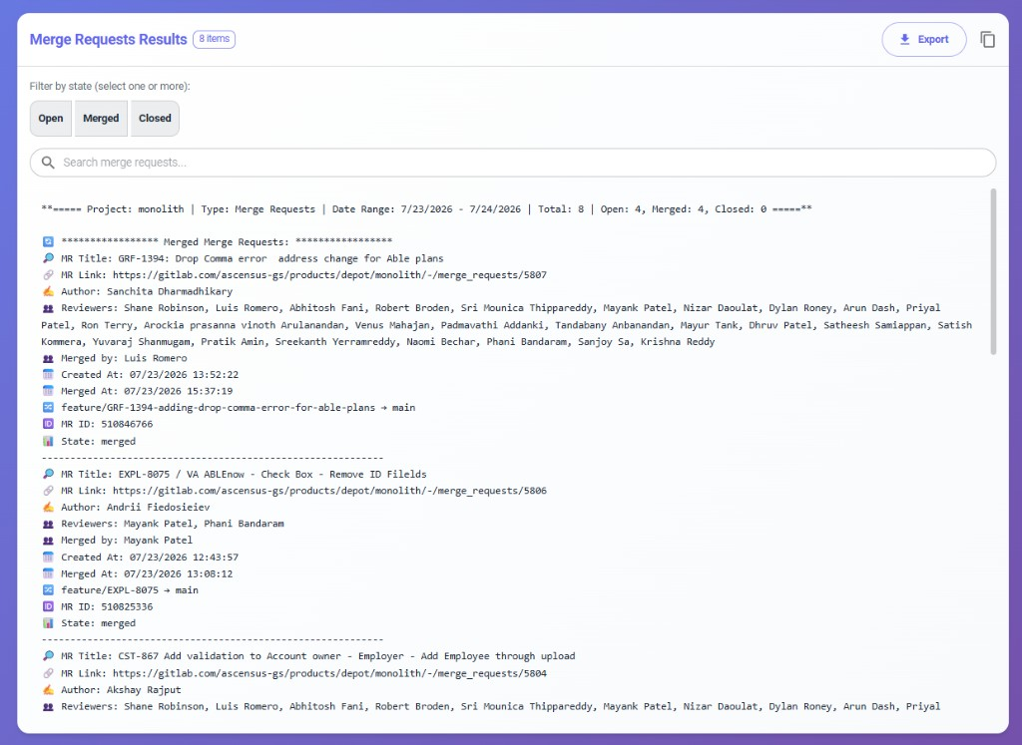
GitLab Project Manager — Sample Output
Who changed what — application footprint
Project: monolith · Type: Merge Requests
Date range: last green run → failure date
Per MR: Title · Author · Reviewers · Merged by
Branch flow: source → target (e.g. feature/GRF-1394 → main)
Created At · Merged At (EST timestamps)
Paste Change Set section into JIRA comment or failure email
Real output — 8 MRs in window, 4 merged
QA Automation Standard · Automation Bug Lifecycle · Internal
11

Slide 12
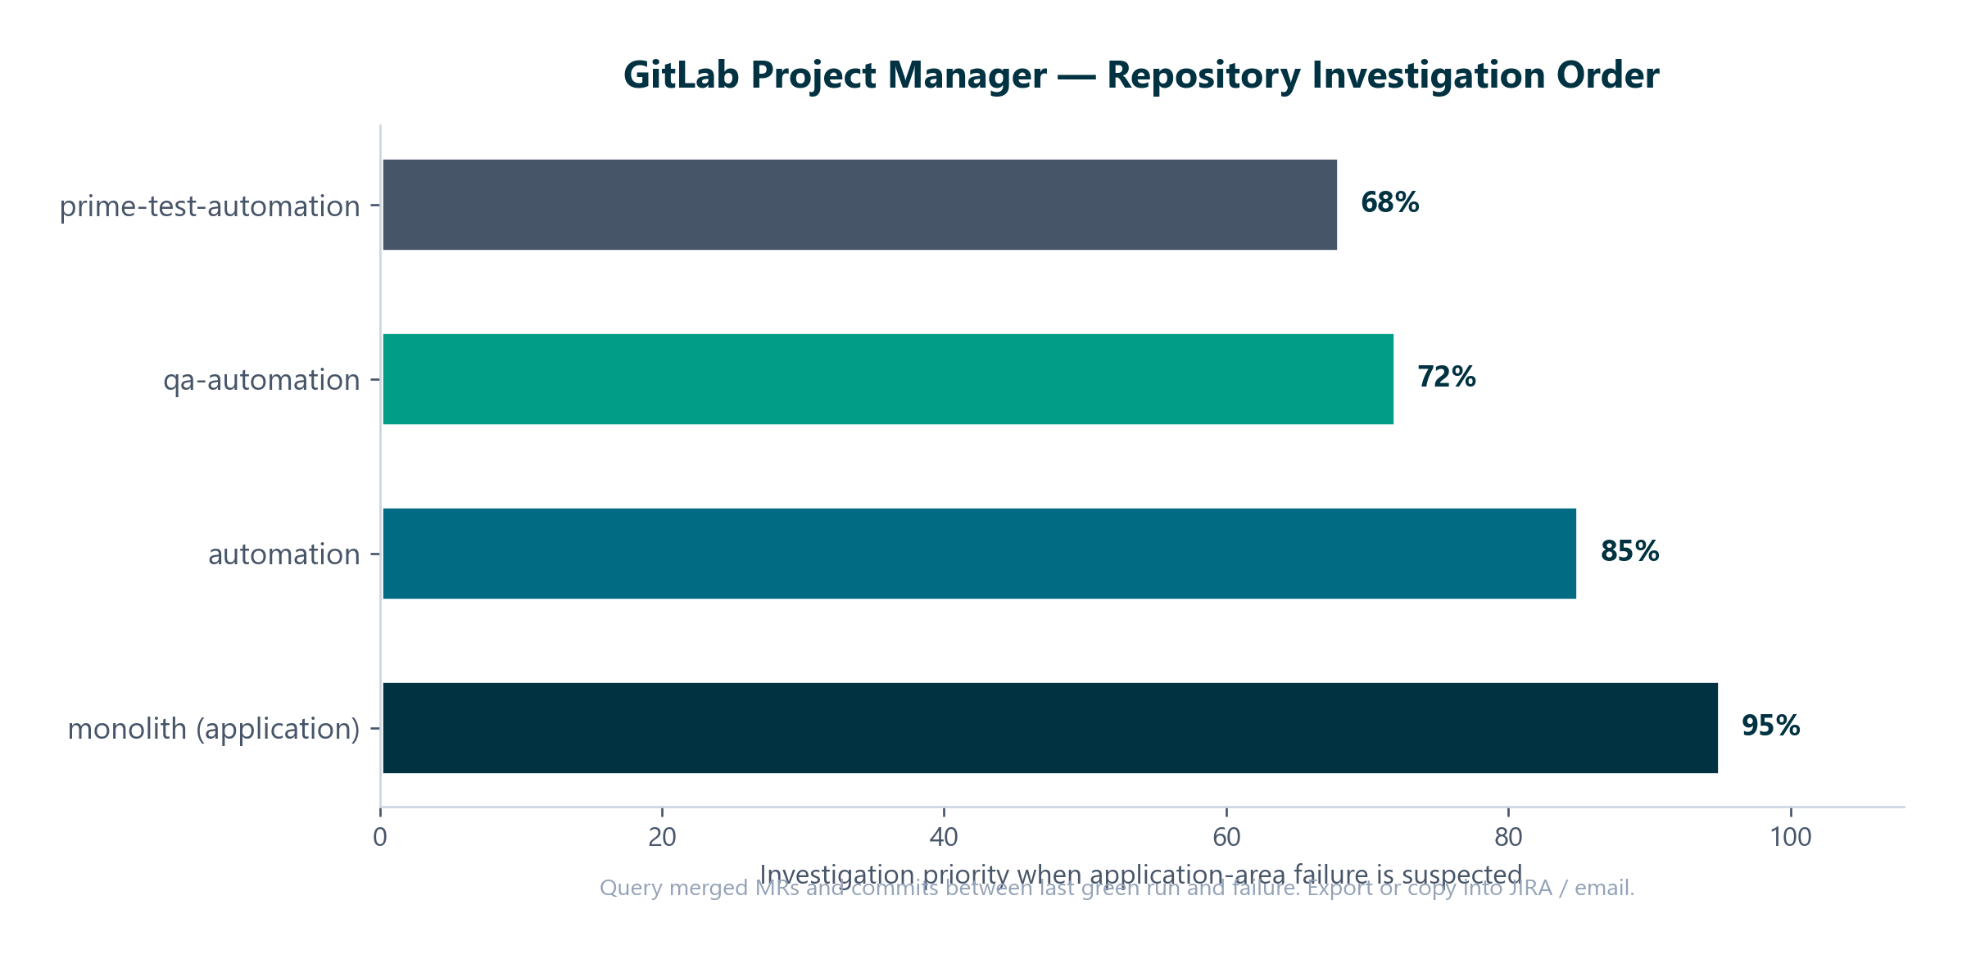
Repository Investigation Order
Cross-reference MR authors with failing test area
Start monolith (app) → automation → qa-automation → prime-test-automation
QA Automation Standard · Automation Bug Lifecycle · Internal
12

Slide 13
Close the Loop
Resolution · Unlock · Knowledge capture

Slide 14
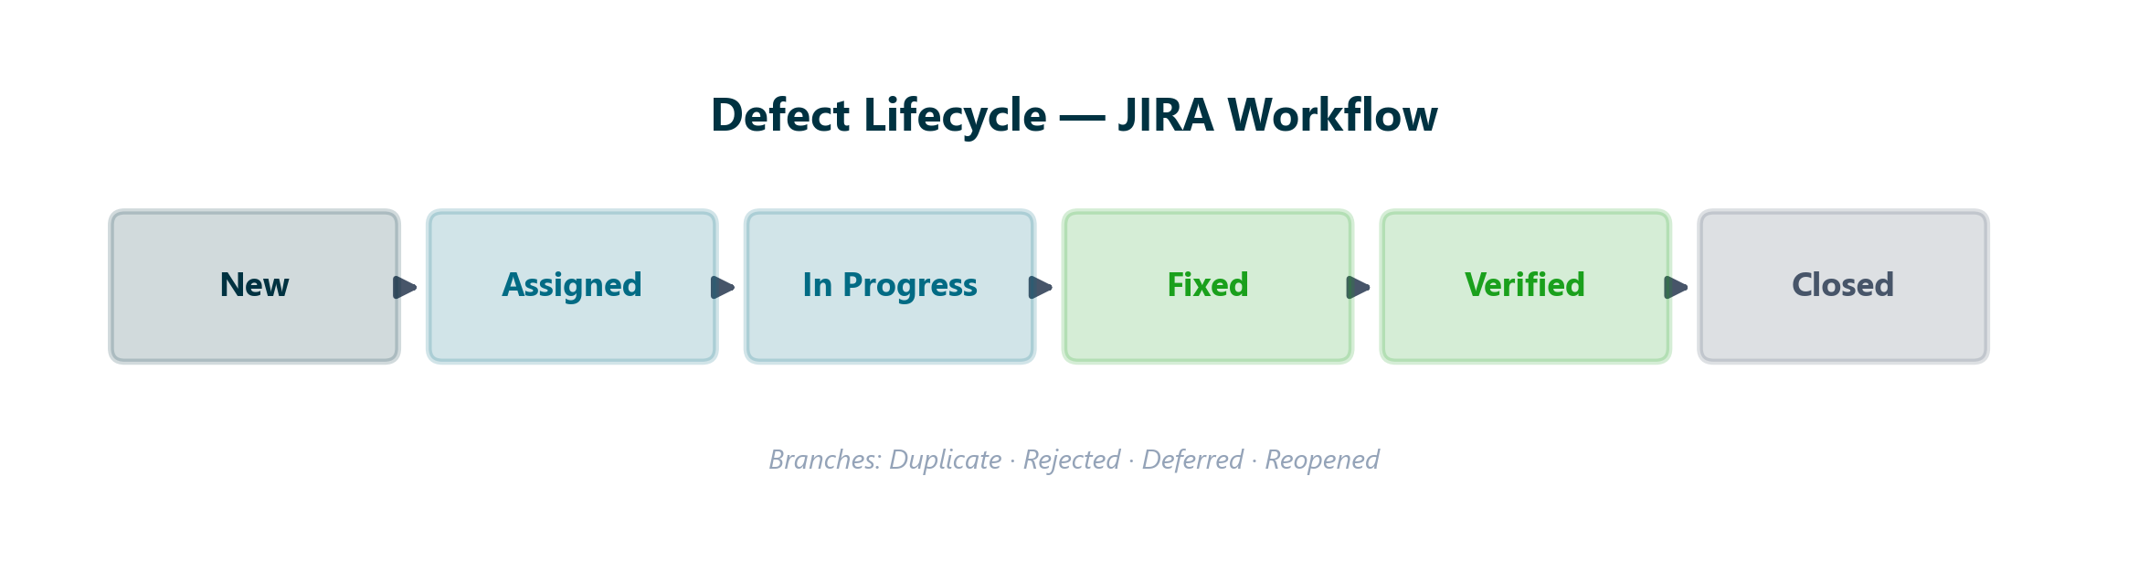
Defect Lifecycle
JIRA states
04_EXECUTION/DEFECT_LIFECYCLE.md · TRIAGE_RULES.md
QA Automation Standard · Automation Bug Lifecycle · Internal
14

Slide 15
Resolution Standard
Confluence 1b. Automation Bug Resolution Follow-Up
Dev delivers fix or revert on affected branch
QA reruns impacted scenarios (full regression optional)
Update JIRA with RCA → Verified → Closed
Send resolution email — same To/Cc as failure (template 1b)
Unlock monolith/main + automation/main if locked
Update bug .md: JIRA link, Status Closed, resolution section filled
QA Automation Standard · Automation Bug Lifecycle · Internal
15

Slide 16
Multi-Failure Rollup
When many tests fail at once
Large nightly failures (e.g. 62/358) — group by feature/plan, not per test
Build failure matrix with root-cause hints per traunch
One JIRA per root cause — umbrella + children when needed
Single combined email/Teams with matrix reference
Example: 04202026_DailyRegression_PipelineFailureRollup.md
QA Automation Standard · Automation Bug Lifecycle · Internal
16

Slide 17
Repository Map — Where Standards Live
If it's not in the repo, treat as unknown — per ROLE.md
00_SYSTEM — PROMPTS.md (H), ROLE.md, CONSTRAINTS.md, GLOSSARY.md
04_EXECUTION — DEFECT_LIFECYCLE, TRIAGE_RULES, FLAKINESS_PLAYBOOK, RCA_PROCESS
05_ONBOARDING — HOW_TO_REPETITIVE_TASKS.md (step-by-step)
06_TEMPLATES — JIRA_TICKET_TEMPLATE, RCA_TEMPLATE
10_IMPORTS_RAW — regression_reports/, Confluence Bug Handling PDFs
This module — automation-bug-lifecycle/ (playbook + deck + generator)
QA Automation Standard · Automation Bug Lifecycle · Internal
17

Slide 18
Key Takeaways
QA Automation operating norm
Triage first — not every failure is a defect
One evidence folder · one Prompt H run · one bug .md per issue
Communications use leadership-approved templates — no improvisation
GitLab PM answers who merged and committed in the failure window
Standard applies to any team, any program, going forward
Full playbook: automation-bug-lifecycle/_output/Automation-Bug-Lifecycle-Playbook.docx
QA Automation Standard · Automation Bug Lifecycle · Internal
18

