Slide 1
Automation Bug Lifecycle
QA Automation Operating Standard
Version August 3, 2026 · Applicable to all teams
qa-automation-kb · AMSQUAD
Triage
Evidence
Cursor H
GitLab PM
Classify first
One folder
All comms
Change set

Slide 2
Continuation — Where We Left Off
From standard to daily practice
Prior sessions: defined the Automation Bug Lifecycle standard (triage → evidence → notify → resolve)
Today: how we operationalize it with this repo, Cursor AI, and GitLab Project Manager
Goal: any engineer can run the full workflow in ~15 minutes per real defect
Not meeting-specific — QA Automation operating norm for all teams and programs
Evidence examples already in evidence/regression-reports/ — real failures, real outputs
QA Automation Standard · Automation Bug Lifecycle · Internal
2

Slide 3
The Challenge — Visibility
Why we built this module
Who merged or committed between last green run and failure?
Communications inconsistent — JIRA and email drafted differently every time
Evidence scattered — screenshots in chat, logs in CI, no single folder
Critical defects lacked clear accountability and resolution timeline
Tribal knowledge — process lived in people's heads, not the repo
QA Automation Standard · Automation Bug Lifecycle · Internal
3

Slide 4
The Solution — Repo + AI Agent + GitLab PM
Three tools, one repeatable flow
qa-automation-kb/automation-bug-lifecycle/ — prompts, process, evidence, deliverables
Evidence folder — drop screenshots, logs, report URL under regression-reports/MMDDYYYY/
Cursor Prompt H — one prompt → JIRA block + email + Teams in one .md file
GitLab Project Manager — change set: MRs, commits, authors in the failure window
Shell guide: WORKFLOW.md · Checklist: QUICK-START.md
QA Automation Standard · Automation Bug Lifecycle · Internal
4

Slide 5
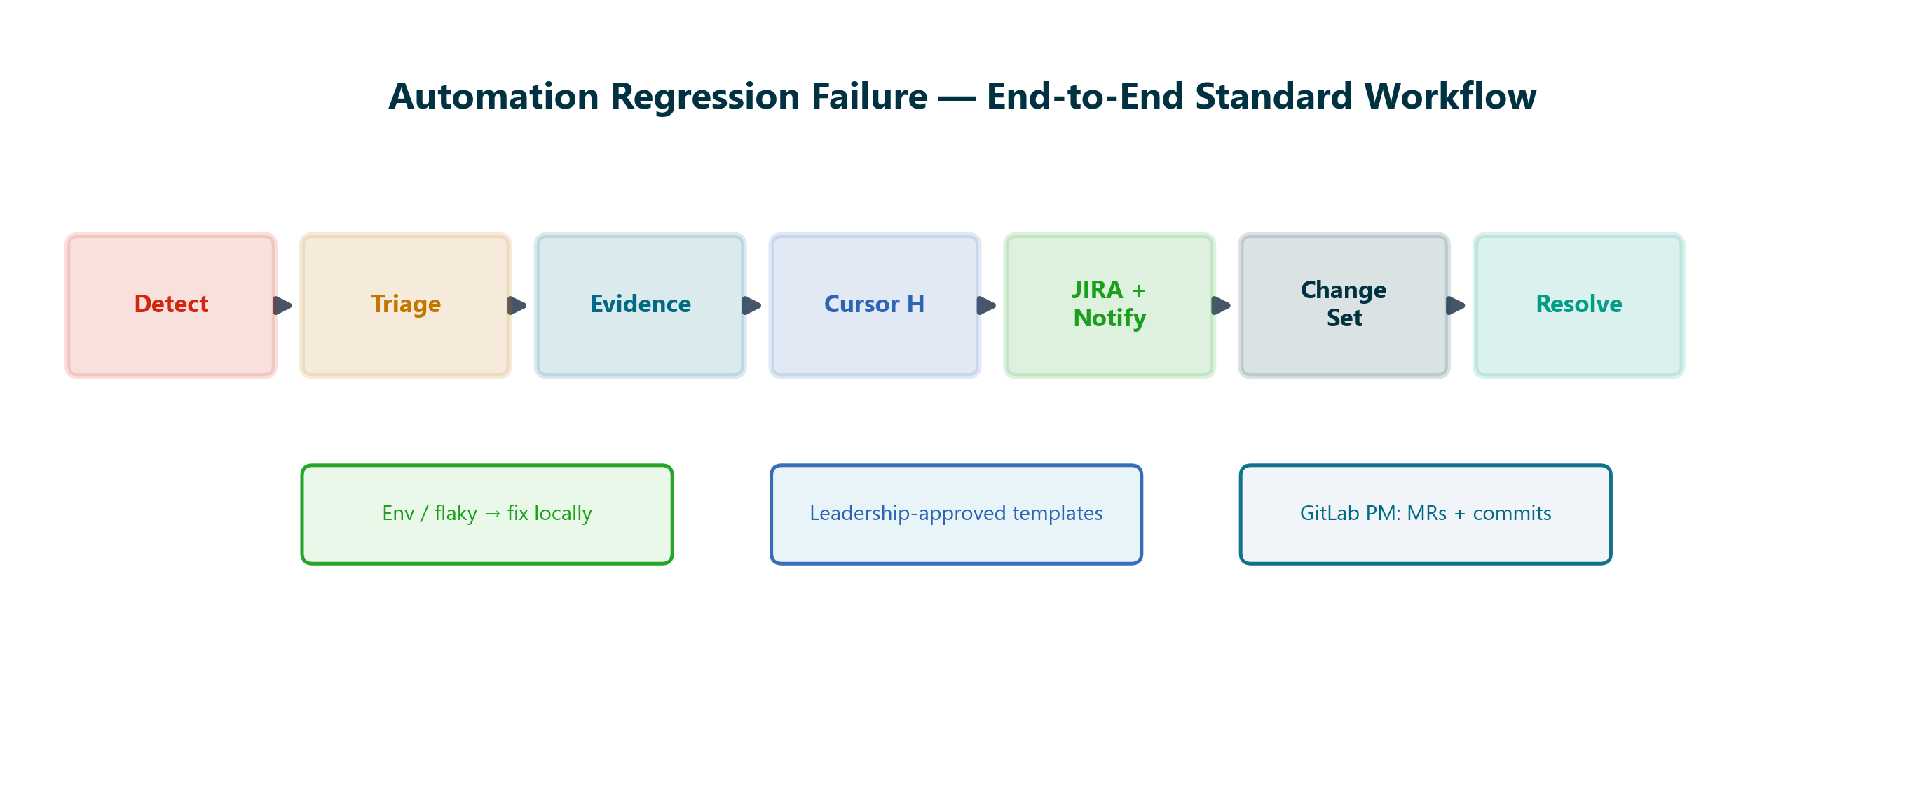
End-to-End Workflow
Seven steps — every regression failure
Detect → Triage → Evidence → Cursor H → JIRA/Notify → Change Set → Resolve
QA Automation Standard · Automation Bug Lifecycle · Internal
5

Slide 6
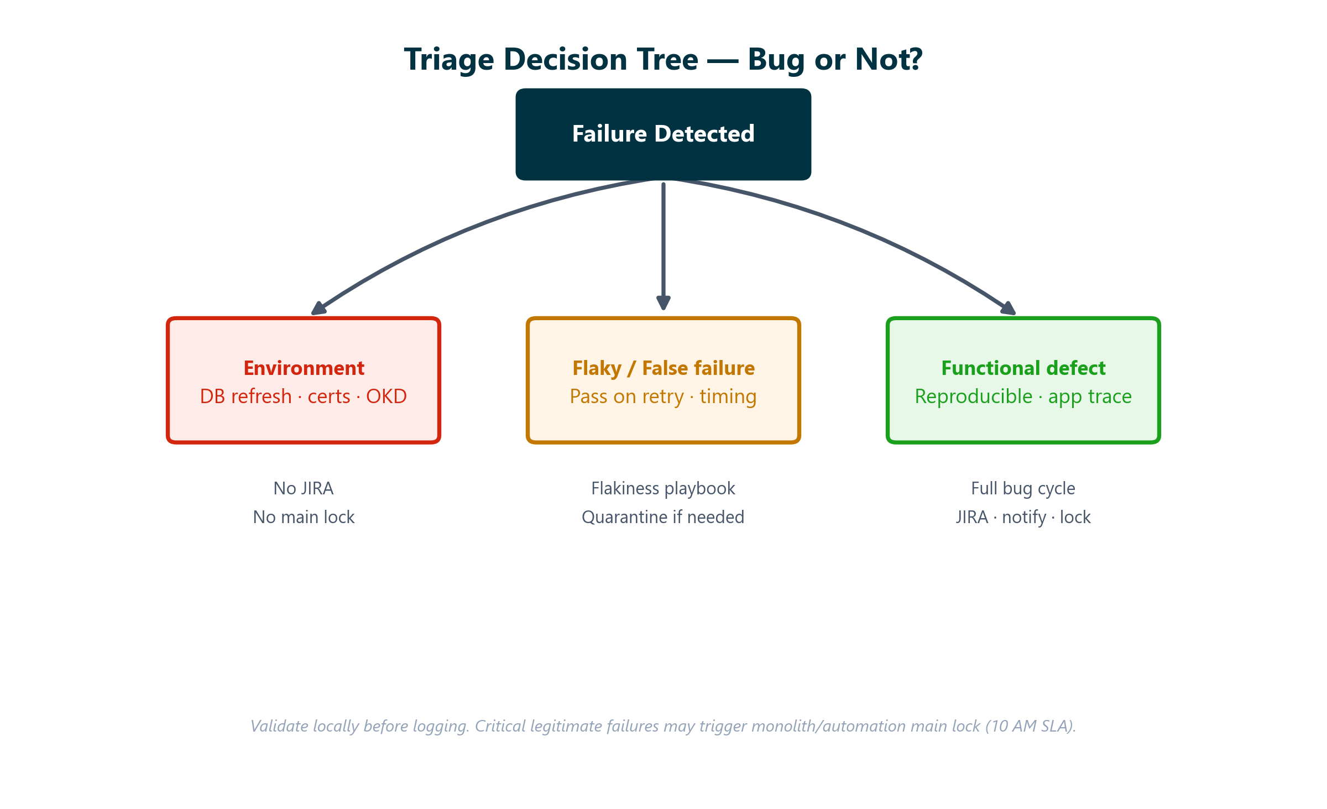
Step 1 — Triage Before You Log
Decision tree — TRIAGE_RULES.md + FLAKINESS_PLAYBOOK.md
Environment and flaky failures do not enter the full bug cycle
QA Automation Standard · Automation Bug Lifecycle · Internal
6

Slide 7
Act on a Real Defect
Evidence · Prompt H · Change set · Notify

Slide 8
Four Pillars of the Standard
What your team runs on every real defect
01
02
Triage & classify
Evidence folder
process/TRIAGE_RULES.md. Rerun locally. Env vs flaky vs defect. Do not log JIRA for noise.
evidence/regression-reports/[MMDDYYYY]/ — screenshots, logs, test data, one bug .md per issue. scripts/new-evidence-folder.ps1
03
04
Cursor Prompt H
GitLab change set
prompts/02-bug-report-prompt-h.md — JIRA block, failure email, Teams message, resolution placeholder in one file.
GitLab Project Manager — who merged, who committed, which branches between last green run and failure.
QA Automation Standard · Automation Bug Lifecycle · Internal
8

Slide 9
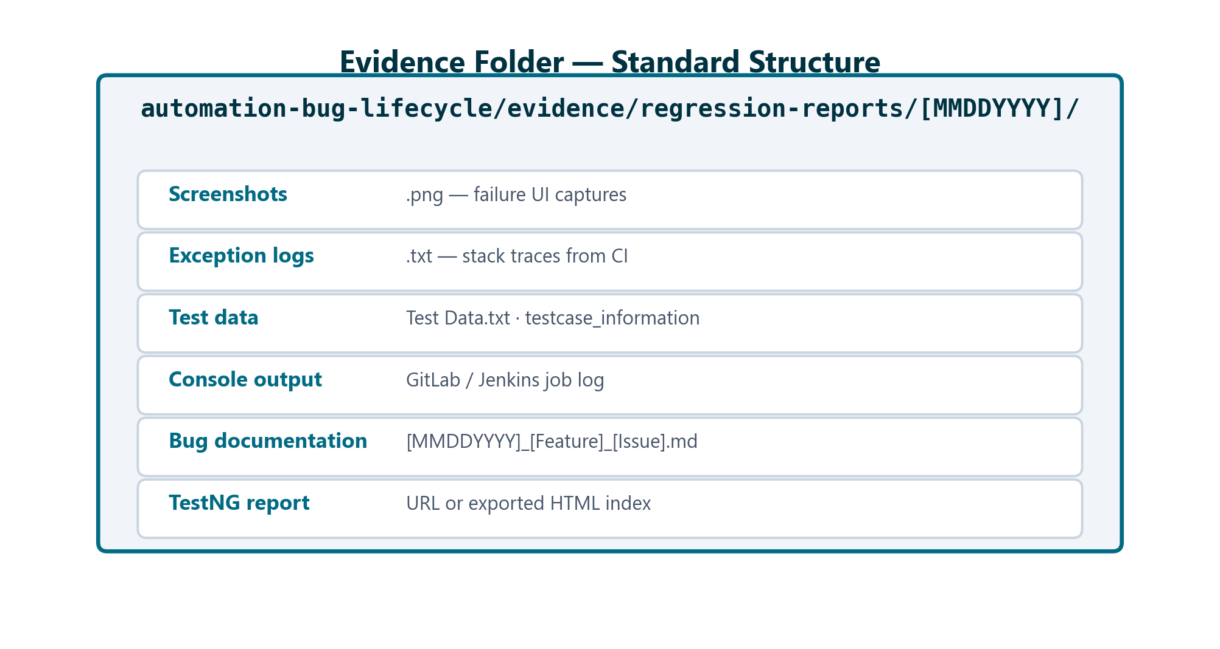
Evidence Folder — Copy Artifacts Here
BUG_REPORTING_PROCESS.md
Naming: [MMDDYYYY]_[Feature]_[IssueType].md
QA Automation Standard · Automation Bug Lifecycle · Internal
9

Slide 10
Prompt H in Plain English
One prompt, all deliverables
You have a dated evidence folder with screenshots and logs
Open prompts/02-bug-report-prompt-h.md — fill date, feature, error, report URL, file list
Attach failure images in Cursor chat and paste the prompt
Cursor writes ONE file with:
• JIRA copy-paste block ready for QA board
• Failure email — leadership-approved To/Cc (do not improvise)
• Teams message with JIRA + report links
• Resolution email placeholder for when bug is fixed
Then: create JIRA → send email → post Teams — copy from that one file
QA Automation Standard · Automation Bug Lifecycle · Internal
10

Slide 11
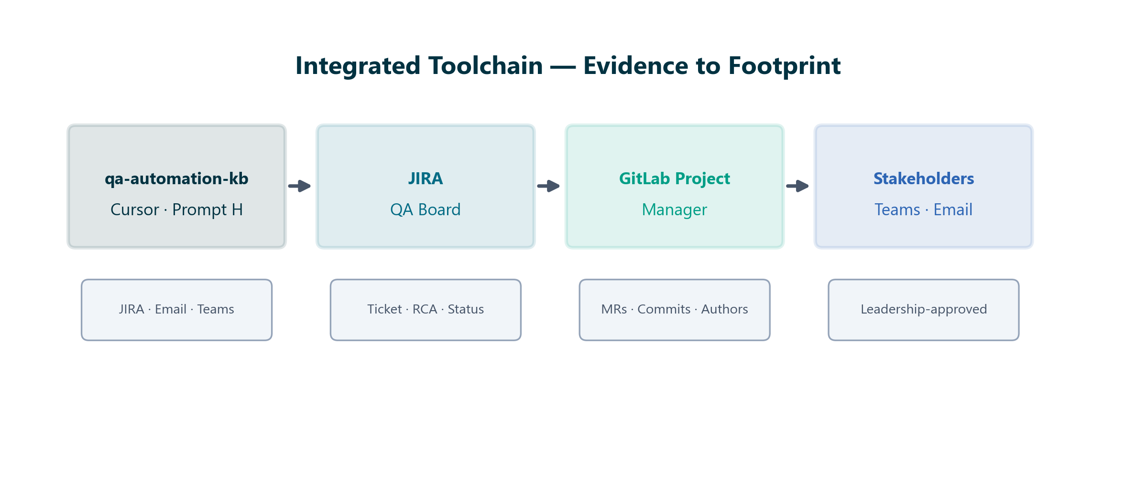
Cursor + Repo Toolchain
Integrated toolchain
qa-automation-kb open in Cursor
Evidence under regression-reports/MMDDYYYY/
Prompt H → single bug .md output
Create JIRA from generated block
GitLab PM → change set extract
Paste JIRA link + change set back into Cursor (optional Prompt 03)
Dump email/Teams content — send as-is
Evidence → Comms → Footprint
QA Automation Standard · Automation Bug Lifecycle · Internal
11

Slide 12
Communication Standards
Leadership-approved templates
Teams and email templates are approved by leadership and senior QA resources
Use Prompt H output — do not improvise distribution lists or email structure
To: AGS Tech Leads, AGS Chapter Leads, AGS Development, Brian Danilczyk
Cc: Rajib Akhter · Henry Dittmer · Phuong Huynh · Automation.Squad
Subject: [Priority] [Feature] — [Issue Type]
Sources: Confluence Bug Handling PDFs (1. Failure · 1b. Resolution)
QA Automation Standard · Automation Bug Lifecycle · Internal
12

Slide 13
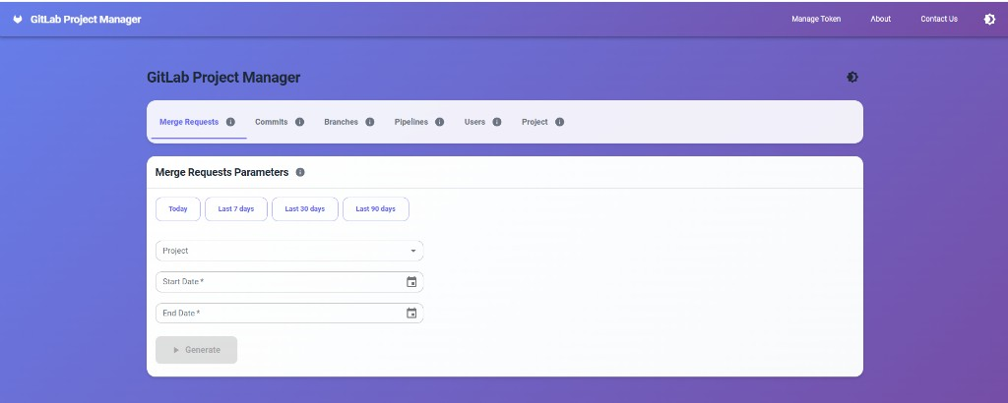
GitLab Project Manager — UI
Change-set investigation tool
Local utility: GitLabInfoProjUI (read-only GitLab API)
Manage Token — PAT with read_api scope
Select project + date range (last pass → failure)
Tabs: Merge Requests · Commits · Branches · Pipelines
Filter Merged · Search by author or branch
Export CSV/Excel or Copy to clipboard
Parameter panel — project, date presets, Generate
QA Automation Standard · Automation Bug Lifecycle · Internal
13

Slide 14
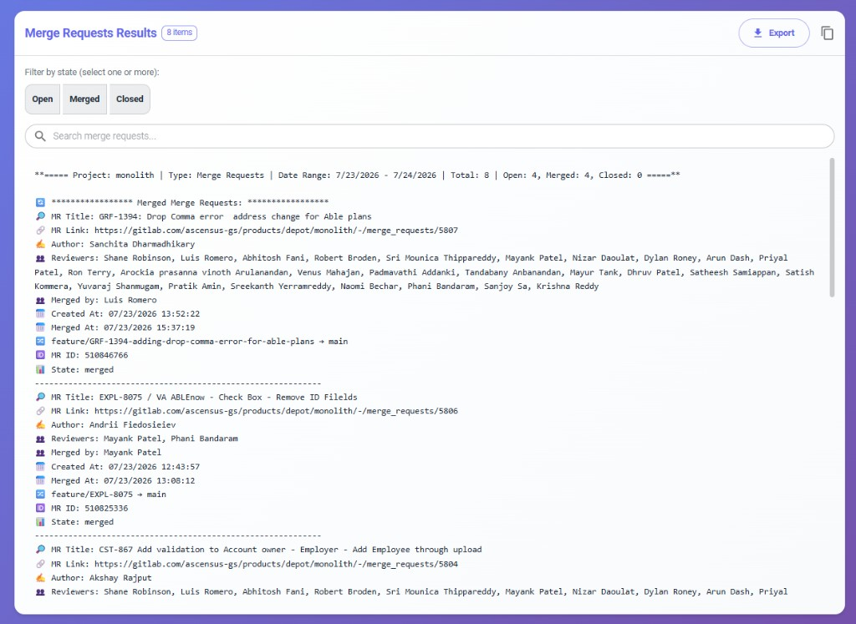
GitLab Project Manager — Sample Output
Who changed what — application footprint
Project: monolith · Type: Merge Requests
Date range: last green run → failure date
Per MR: Title · Author · Reviewers · Merged by
Branch flow: source → target (e.g. feature/GRF-1394 → main)
Created At · Merged At (EST timestamps)
Paste Change Set section into JIRA comment or failure email
Real output — MRs in window with authors and branches
QA Automation Standard · Automation Bug Lifecycle · Internal
14

Slide 15
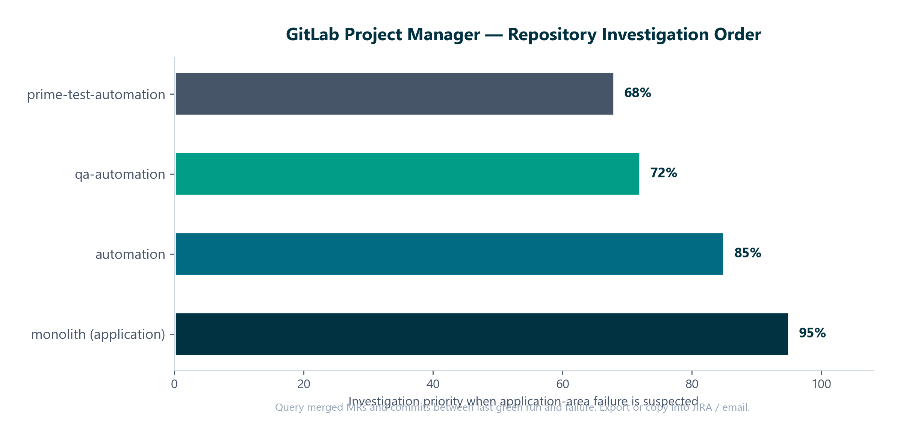
Repository Investigation Order
Cross-reference MR authors with failing test area
Start monolith (app) → automation → qa-automation → prime-test-automation
QA Automation Standard · Automation Bug Lifecycle · Internal
15

Slide 16
Critical Path
Lock · Respond · Resolve within 24 hours

Slide 17
Critical Defects — Main Lock & SLA
Accountability when the pipeline must stop
Legitimate critical defect → lock monolith/main + automation/main
Responsible party must respond immediately — name visible in change set
Target: resolution within 24 hours (revert or fix + verified regression)
Not for environment, data, or flaky failures
Notify: failure email + Teams from Prompt H output
Track: JIRA with change set comment until Verified → Closed
Close: resolution email → unlock main branches
QA Automation Standard · Automation Bug Lifecycle · Internal
17

Slide 18
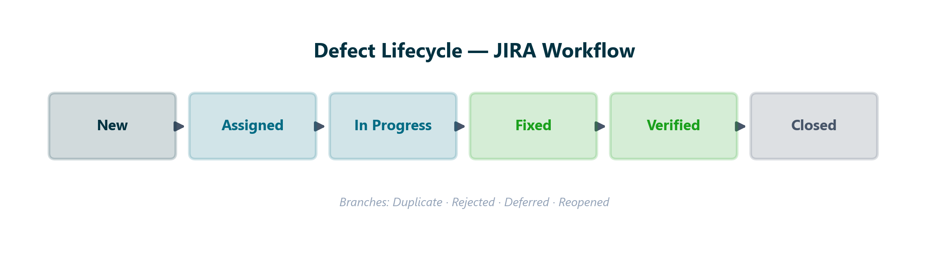
Defect Lifecycle
JIRA states
process/DEFECT_LIFECYCLE.md · TRIAGE_RULES.md
QA Automation Standard · Automation Bug Lifecycle · Internal
18

Slide 19
Resolution Standard
Confluence 1b. Automation Bug Resolution Follow-Up
Dev delivers fix or revert on affected branch
QA reruns impacted scenarios (full regression optional)
Update JIRA with RCA → Verified → Closed
Send resolution email — same To/Cc as failure (template 1b)
Unlock monolith/main + automation/main if locked
Update bug .md: JIRA link, Status Closed, resolution section filled
QA Automation Standard · Automation Bug Lifecycle · Internal
19

Slide 20
How Your Team Tries It
Hands-on adoption — start with a real or sample failure
One-time: copy cursor-kit/SKILL.md → .cursor/skills/ · clone GitLab PM
Per failure: new-evidence-folder.ps1 → drop screenshots and logs
Triage: prompts/01 — env/flaky stops here; defect continues
Prompt H: prompts/02 — attach images → one .md with JIRA + email + Teams
Create JIRA, send email, post Teams — copy from generated file
GitLab PM: date range → paste change set → optional prompts/03
When fixed: prompts/04 resolution email · unlock main · close JIRA
QA Automation Standard · Automation Bug Lifecycle · Internal
20

Slide 21
Multi-Failure Rollup
When many tests fail at once
Large nightly failures (e.g. 62/358) — group by feature/plan, not per test
Build failure matrix with root-cause hints per traunch
One JIRA per root cause — umbrella + children when needed
Single combined email/Teams with matrix reference
prompts/05-multi-failure-rollup.md
QA Automation Standard · Automation Bug Lifecycle · Internal
21

Slide 22
Repository Map
If it's not in the repo, treat as unknown — per ROLE.md
WORKFLOW.md — detailed shell guide (this presentation's companion)
evidence/regression-reports/ — drop zone + real examples
prompts/ 01–05 — triage, Prompt H, change set, resolution, rollup
process/ — TRIAGE_RULES, FLAKINESS_PLAYBOOK, DEFECT_LIFECYCLE, RCA
deliverables/ — this deck + Automation-Bug-Lifecycle-Playbook.docx
qa-knowledge-base/00_SYSTEM/PROMPTS.md — master Prompt H reference
QA Automation Standard · Automation Bug Lifecycle · Internal
22

Slide 23
Key Takeaways
QA Automation operating norm
Visibility solved: evidence folder + change set + consistent comms
Triage first — not every failure is a defect
One folder · one Prompt H run · one bug .md per issue
Dump and send — leadership-approved templates, no improvisation
Critical defects: lock main, responsible party responds, 24-hour resolution
Full playbook: deliverables/Automation-Bug-Lifecycle-Playbook.docx
QA Automation Standard · Automation Bug Lifecycle · Internal
23

