Slide 1
QA Automation — AM Squad
Biweekly Status · August 14, 2026
Rajib · Henry · Persistent Delivery Managers

Slide 2
Executive Pulse
At a glance
AM Squad Sprint: 26.11 – 26.13
GitLab merges
Sprint 26.13 items
MSC in-scope APIs
Regression bugs
ETA track
~70% of
original ETA
28
152
51/51
6
Jul 8 – Aug 10 · 3 automation repos
Board items in Sprint 26.13
M1 26 + M2 25 · 100% automated
Regression bugs since Sprint 26.11
3-sprint delivery window
What leadership should know
• Scope: Sprints 26.11, 26.12, and 26.13 (current) — not Apr–Aug historical totals
• Mobile 1 and Mobile 2 are 100% of in-scope business endpoints; enrollment is the active build track
• Team delivers across MSC API, V2/V3 UI, performance, pipeline, and standards in parallel
Sources: Jira AMSQUAD board · GitLab (3 repos) · Jenkins/GitLab nightly logs
2

Slide 3
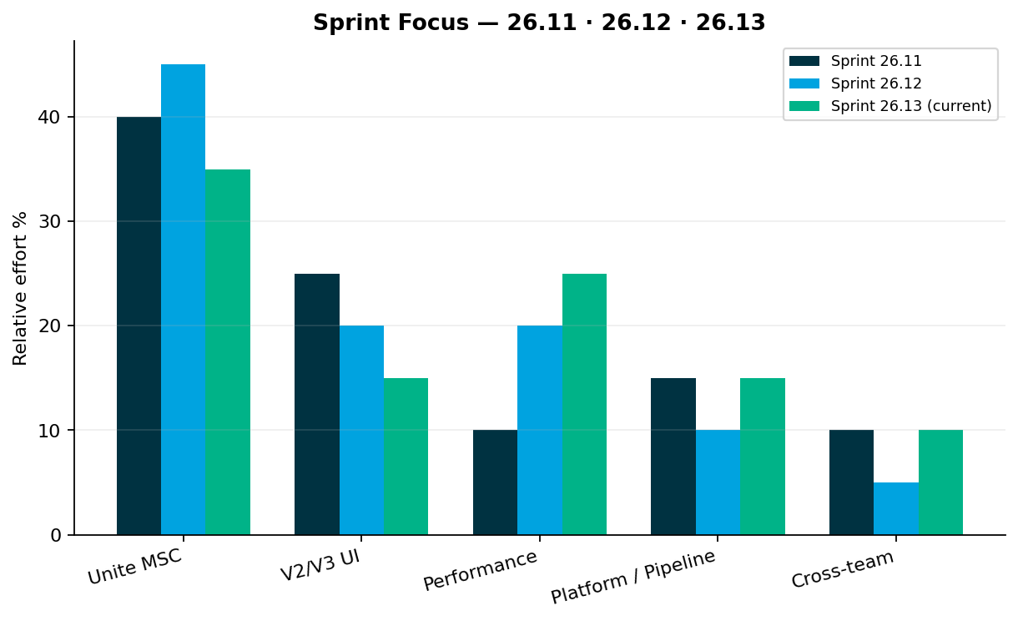
Sprint Delivery Focus
Delivery
Sprints 26.11 · 26.12 · 26.13 (current)
Key messages
• Sprint 26.11: Mobile 1/2 API completion, nightly regression ops, perf MSC login
• Sprint 26.12: MSC sign-off package, enrollment kickoff, emergency perf (barcode + Jahia)
• Sprint 26.13: Enrollment API slices (QA-1595–1603), GitLab nightly, M1/M2 sign-off prep
• V2/V3 nightly regression and triage continue in parallel every sprint
Relative effort index — not FTE hours
3

Slide 4
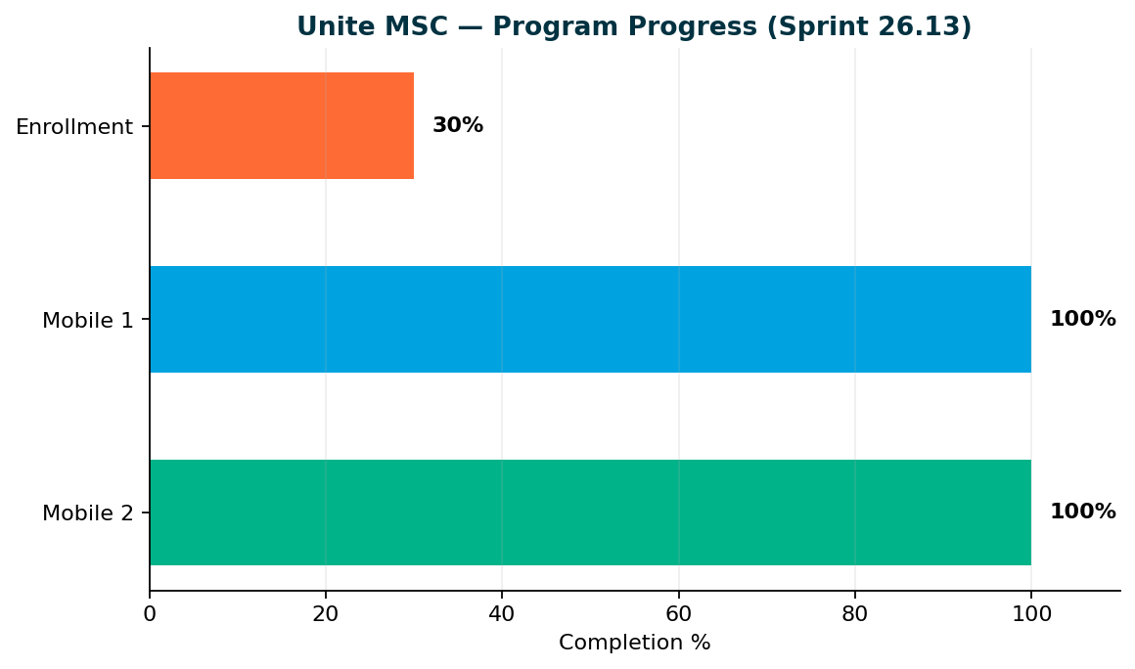
Unite MSC — Program Status
MSC
Mobile 2 100% · Mobile 1 100% · Enrollment ~30%
Key messages
• Mobile 2: 25/25 endpoints — ready for leadership sign-off
• Mobile 1: 26/26 in-scope operations — 100% coded and suite-routed*
• Enrollment: ~30% — first API vertical slices in Sprint 26.13
• Target: program complete End of Sprint 26.13 — MSC program sign-off + 1-resource maintenance mode
• *Regression, integration, or smoke per endpoint; docs/health routes excluded
100% = all in-scope business endpoints automated. Destructive/functional endpoints run in smoke or integration suites — not duplicated in master regression.
4

Slide 5
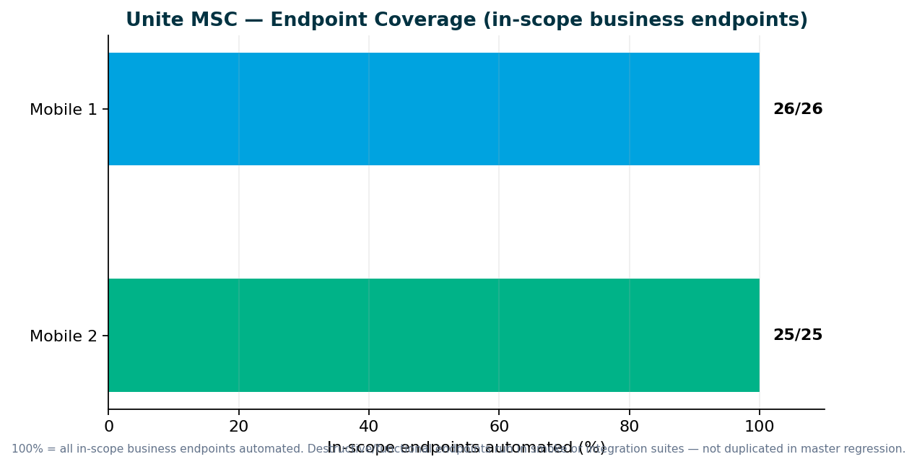
Unite MSC — Endpoint Coverage
MSC
M2 25/25 · M1 26/26 in-scope
Key messages
• All in-scope business endpoints automated — 100% for Mobile 1 and Mobile 2
• Destructive endpoints run in smoke/integration — not duplicated in master regression
• Stage1: IDP + non-IDP paths validated; QC4 hybrid proof pending env stability
• GitLab nightly + ENVP pipeline integration (QA-1405, QA-1544–1549)
• Need leadership to name sign-off owners for M1, M2, pipeline, and perf
Repo: programs/unite-msc/api-test-automation/mappings/
5

Slide 6
Pipeline & Environments
Infrastructure
Hybrid QC4 + Stage1 model
Current state
What we need
• IDP + non-IDP paths validated for Mobile 1 and Mobile 2 on Stage1
• Unstable — hybrid model; pipeline design complete, QC4 proof pending stability
• Mobile 2 GitLab nightly job in flight (QA-1405, QA-1544–1549)
• QC4 has no non-IDP plants in lower env today — need product owner to confirm test plans
• Pipeline is not 'done' until QC4 proof passes — design is ready
• DevOps: GitLab nightly job for MSC regression (in progress)
• Leadership: identify non-IDP plan contacts for lower-environment testing
• Sign-off: names for M1/M2 acceptance before we schedule review sessions
Aligned with Jul 2025 hybrid decision — Stage1 primary until QC4 stabilizes
6

Slide 7
V2 & V3 UI Automation
UI
Sprints 26.11–26.13 — maintenance and stabilization, not greenfield expansion
V3 (GitLab) — maintenance + stabilization
V2 (Jenkins) — sunset discussion needed
• Web registration stabilization, entity flows, flaky-test fixes (QA-1462, QA-1366)
• V3 is the long-term source of truth on GitLab as direct plans migrate off V2
• CSR maintenance modules; legacy enrollment cases under sunset review
• Plans migrating legacy → universal platform — need decision on which Jenkins suites to retire
• Which plan types stay on V2 Jenkins vs move to V3 GitLab? When do we retire duplicate enrollment coverage?
Regression bugs — Sprints 26.11–26.13
• QA-1694: V3 IDP Login regression failure (26.13)
• QA-1691: V3 Universal Enrollment IDP Login failure (26.13)
• QA-1693: Perf IDP login resources JMX fix (26.13)
• QA-1520: V3 Member Personal Information validation (26.12)
• QA-1519: V3 Member Personal Information validation (26.12)
Small test-case adds for regression stability — not reporting Apr–Aug inventory totals
7

Slide 8
Performance Testing
Perf
Deliverables in Sprints 26.11–26.13 only
Sprint 26.12
Sprint 26.12–26.13
Sprint 26.13
Barcode SYN-443
(Synergy return-mail API…
Jahia / IDP server patch —
post-login ba…
IDP login regression JMX
resource fix
QA-1550, QA-1463
QA-1593, QA-1647, QA-1690
QA-1693
Delivered (last 3 sprints)
• Barcode SYN-443 (Synergy return-mail API): Delivered — baselines at 30/45/60 SPM; sign-off comms in flight
• Jahia / IDP server patch — post-login banner perf: Delivered — pre/post patch BlazeMeter comparison on Stage1
• IDP login regression JMX resource fix: Delivered — IDP_login_resources.jmx corrected for nightly suite
Ongoing baseline track
• IDP login, legacy login, MSC login baselines in weekday regression; MSC endurance suite (QA-1229)
Emergency work delivered — governance ask on next slide
8

Slide 9
Performance Governance — Leadership Ask
Ask
Stop last-minute emergency intake
What happened
What we need from leadership
• Two emergency perf requests in two sprints — barcode (Synergy) and Jahia/IDP server patch
• Teams approached us days before deploy — we dropped sprint work and delivered in ~1 week each
• Scripts ran and results accepted — but KB, check-in, test data, and standards steps were skipped
• Add QA Automation at SDLC design — not at deploy approval
• Mandatory perf gate for IDP login, enrollment, contributions, withdrawals before release
• Route requests through standard intake — time to document, check in, and expand coverage
• We will always help in emergencies — but repeated ad-hoc work blocks the roadmap
Delivered under pressure — asking for a sustainable model
9

Slide 10
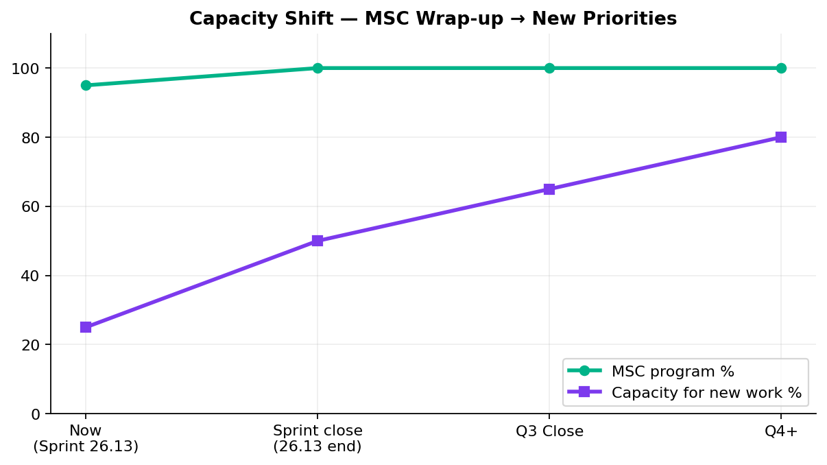
Capacity Opening Up
Capacity
MSC wraps Sprint 26.13 — team needs next priorities
Key messages
• 1–2 resources free after MSC sign-off (target: end of Sprint 26.13)
• Dinesh → enrollment completion · Sunil → MSC manual test case package
• Wence/Venkatesh → V2 sunset / CSR enrollment migration to V3 on GitLab
• We need a 2-quarter roadmap to plan epics and Jira stories now
Without roadmap we cannot commit ETAs for Q4
10

Slide 11
V2 → V3 Migration Path
Strategy
Reduce Jenkins footprint
Plan
• Retire V2 enrollment from Jenkins; migrate CSR enrollment flows to V3 on GitLab
• Direct plans migrated to V3; reduce Jenkins footprint as legacy becomes obsolete
• Need leadership alignment on per-plan migration timeline and which V2 regression cases to retire vs maintain during transition
• Lead: Wence / Venkatesh (when MSC capacity frees)
• Outcome: lighter GitLab-based V3 suites; retire duplicate V2 enrollment from Jenkins
Aligns with platform direction — V3 as source of truth
11

Slide 12
Incoming: ACS-5678 Atlas
New work
Traffic distribution & load balancer rebalancing
AHA summary (Brian Danilczyk)
• ACS-5678 — Atlas Traffic Distribution & Load Balancer Rebalancing (QA Automation) — #2 on Michael's list
• Estimate: 2–3 sprints · Target: Q4 2026 — pre peak-season
• Dependency: Redis session-management initiative
• Scope: validate even traffic distribution after Redis session externalization; load + perf testing
• Success: eliminate hotspot nodes; dynamic routing vs IP-hash sticky sessions
Confirm priority vs MSC wrap-up, V2 sunset, and other AHA items
12

Slide 13
Leadership Asks & Decisions Needed
Decisions
Please respond on this call — by area
Roadmap & capacity
• Publish a 2-quarter automation roadmap — we will provide ETAs once priorities are confirmed
• Confirm post-MSC priorities: ACS-5678 Atlas vs V2 sunset vs V3 expansion vs other AHA items from Brian
• Team consistently delivers within ~70% of stated ETA — need confirmed priorities to plan Q4 epics
Unite MSC / API automation
• Name sign-off owners for Mobile 1, Mobile 2, pipeline, and perf baselines
• Accept M1 (26/26) and M2 (25/25) as 100% of in-scope business endpoints — suite-tier routing is intentional
• Identify non-IDP plan contacts for lower environments (QC4 has no non-IDP plants today)
V2 regression (Jenkins)
• As plans migrate legacy → universal platform, which V2 Jenkins suites should we retire?
• CSR enrollment sunset timing — align retirement with plan migration schedule
• Should obsolete legacy-only test cases be removed now or maintained until full migration?
V3 universal platform (GitLab)
• Confirm V3 as source of truth for migrated plans — what expansion areas are priority after MSC?
• IDP login regression ownership — recent failures QA-1694, QA-1691 need product/env alignment
Performance & stress testing
• Route performance requests through SDLC intake — not last-minute before deploy
• Mandate performance validation for IDP login, enrollment, contributions, withdrawals before release
• Name sign-off owners for IDP/MSC perf baselines and emergency exception process
Pipeline & environments
• Approve GitLab nightly MSC regression job (QA-1405, QA-1544–1549)
• QC4 hybrid model — need env stability and non-IDP test-plan owners before proof sign-off
• Confirm Stage1-as-primary until QC4 stabilizes (Jul 2025 hybrid decision)
Full ask list in companion DOCX · Swapnil Patil · QA Automation AM Squad
13

Slide 14
Questions & Discussion
Detailed briefing document shared · KB: programs/leadership-updates/2026-08-14-rajib-henry-biweekly/

