Slide 1
QA Automation — AM Squad
Biweekly Status · August 28, 2026
Rajib · Henry · Persistent Delivery Managers

Slide 2
Executive Pulse
At a glance
26.13 – 26.14
GitLab merges
Sprint 26.14 items
MSC in-scope APIs
Regression bugs
ETA track
51/51 + enrollment 95%
< time than orig ETA
34
148
6
Aug 5 – Aug 26 · 3 automation repos
Board items in Sprint 26.14
M1 26 + M2 25 complete · Enroll core E2E 19/20
Regression bugs since Sprint 26.13
3-sprint delivery window
What leadership should know
• Scope: Sprints 26.13 and 26.14 (current) — not Apr–Aug historical totals
• Mobile 1 and Mobile 2: 100% — sign-off ready; enrollment core E2E ~95% (19/20)
• Coding complete ≠ program closed: 1 resource ~1 sprint for docs, qTest, Bruno, KT
• DB refresh completed this week — test data and SQL stabilized for enrollment runs
Sources: Jira AMSQUAD board · GitLab (3 repos) · Jenkins/GitLab nightly logs
2

Slide 3
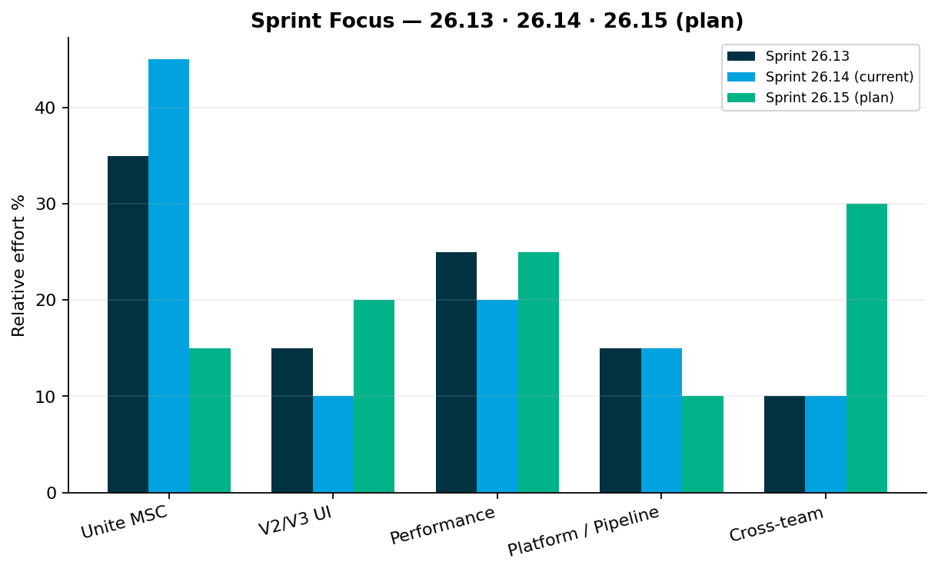
Sprint Delivery Focus
Delivery
Sprints 26.13 · 26.14 (current) · 26.15 plan
Key messages
• Sprint 26.13: Enrollment API slices, M1/M2 sign-off prep, GitLab nightly delivered
• Sprint 26.14: Enrollment wizard completion, DB refresh, submit + Stage1 E2E
• Sprint 26.15 (plan): MSC wrap-up (1 resource) + Atlas intake / V2-V3 backlog
• Perf: Preeti on contribution JMX; M1+enrollment perf scripts next sprint
Relative effort index — not FTE hours
3

Slide 4
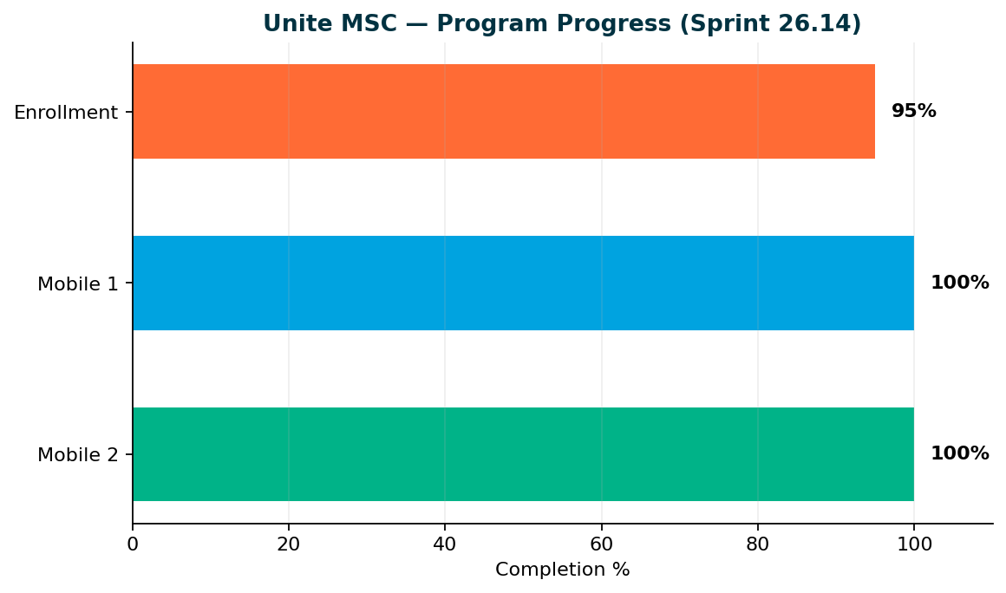
Unite MSC — Program Status
MSC
Mobile 2 100% · Mobile 1 100% · Enrollment 95%
Key messages
• Mobile 2: 25/25 endpoints — sign-off ready
• Mobile 1: 26/26 in-scope operations — sign-off ready
• Enrollment: 19/20 core E2E (95%) — 17 test classes in repo
• Remaining coding: POST review-confirm-entered (account creation)
• Target: Enrollment coding end Sprint 26.14 · program close-out ~1 sprint with 1 dedicated resource
100% = all in-scope business endpoints automated. Enrollment 95% = core happy-path E2E (19/20); 5 partner/subsequent catalog endpoints deferred with research.
4

Slide 5
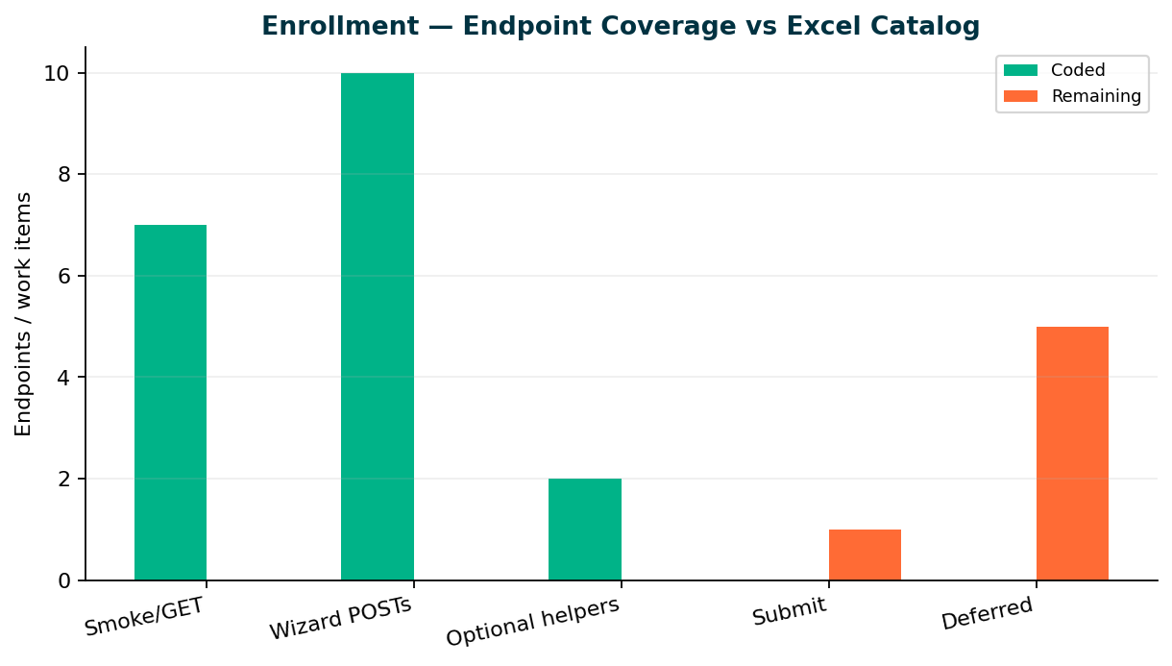
Enrollment — Endpoint Coverage
Enrollment
Core E2E 19/20 · Catalog 19/25
Key messages
• 17 TestNG classes: smoke GETs + full wizard through allocations + optional helpers
• Submit (review-confirm-entered) — target end Sprint 26.14 for account creation
• Deferred next sprint: subsequent enrollment, Vanguard, Upromise, OAuth (research)
• Stage1/QC4 test data refreshed this week — team stabilized branding, fund lookup, and disposable account SQL
• Postman/Excel source of truth synced in KB — Endpoint catalog + E2E collection
Repo: api-test-automation/mobile/enrollment
5

Slide 6
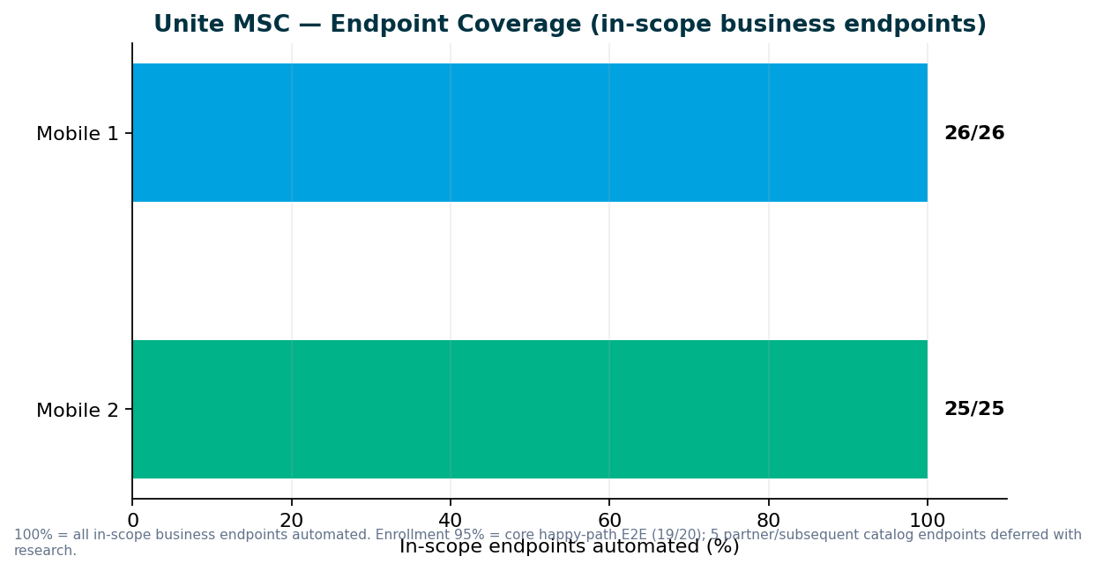
Unite MSC — Endpoint Coverage
MSC
M2 25/25 · M1 26/26 in-scope
Key messages
• All in-scope business endpoints automated — 100% for Mobile 1 and Mobile 2
• Destructive endpoints run in smoke/integration — not duplicated in master regression
• Stage1: IDP + non-IDP paths validated; QC4 hybrid proof pending env stability
• GitLab nightly + ENVP pipeline integration (QA-1405, QA-1544–1549)
• Need leadership to name sign-off owners for M1, M2, pipeline, and perf
Repo: programs/unite-msc/api-test-automation/mappings/
6

Slide 7
Pipeline & Environments
Infrastructure
Hybrid QC4 + Stage1 model
Current state
What we need
• IDP + non-IDP paths validated for Mobile 1 and Mobile 2 on Stage1
• Hybrid model; DB refresh completed — integration proof continuing
• Mobile 2 GitLab nightly job delivered (QA-1405)
• QC4 has no non-IDP plants in lower env today — need product owner to confirm test plans
• Pipeline is not 'done' until QC4 proof passes — design is ready
• DevOps: GitLab nightly job for MSC regression (in progress)
• Leadership: identify non-IDP plan contacts for lower-environment testing
• Sign-off: names for M1/M2 acceptance before we schedule review sessions
Aligned with Jul 2025 hybrid decision — Stage1 primary until QC4 stabilizes
7

Slide 8
V2 & V3 UI Automation
UI
Sprints 26.13–26.14 — maintenance and stabilization; capacity shifting to MSC close-out + new priorities
V3 (GitLab) — maintenance + stabilization
V2 (Jenkins) — sunset discussion needed
• Web registration stabilization, entity flows, flaky-test fixes
• V3 is the long-term source of truth on GitLab as direct plans migrate off V2
• IDP login regression flakes — product/env alignment ongoing
• CSR maintenance modules; legacy enrollment cases under sunset review
• QA-1275: V2 cases removed/updated for plans migrated Non-IDP → IDP
• Plans migrating legacy → universal platform — need decision on which Jenkins suites to retire
• Which plan types stay on V2 Jenkins vs move to V3 GitLab? When do we retire duplicate enrollment coverage?
Regression bugs — Sprints 26.11–26.13
• QA-1820: V2 IDP-impacted legacy cases — Stage1 daily regression stabilization (26.14)
• QA-1694: V3 IDP Login regression failure (26.13)
• QA-1691: V3 Universal Enrollment IDP Login failure (26.13)
• QA-1520: V3 Member Personal Information validation (26.12)
• QA-1519: V3 Member Personal Information validation (26.12)
Small test-case adds for regression stability — team can resume V2/V3 expansion as MSC coding completes
8

Slide 9
Performance Testing
Perf
Sprints 26.13–26.14 — one resource (Preeti); slightly behind plan due to IDP + emergency barcode work
Sprint 26.13
Sprint 26.14
Sprint 26.15
MSC IDP Login BlazeMeter analysis
Unite MSC Contribution full-flow JMX
MSC Mobile 1 + Enrollment perf scenarios
QA-1429
QA-1802
QA-1229
Delivered (last 3 sprints)
• MSC IDP Login BlazeMeter analysis: Delivered — QA-1429
• Unite MSC Contribution full-flow JMX: In progress — QA-1802
• MSC Mobile 1 + Enrollment perf scenarios: Planned — Preeti; after API E2E stable
Ongoing baseline track
• IDP login, legacy login baselines in weekday regression; MSC endurance suite in repo — scheduling after M1/enrollment perf scripts
Emergency work delivered — governance ask on next slide
9

Slide 10
Performance Governance — Leadership Ask
Ask
Stop last-minute emergency intake
What happened
What we need from leadership
• Two emergency perf requests in two sprints — barcode (Synergy) and Jahia/IDP server patch
• Teams approached us days before deploy — we dropped sprint work and delivered in ~1 week each
• Scripts ran and results accepted — but KB, check-in, test data, and standards steps were skipped
• Add QA Automation at SDLC design — not at deploy approval
• Mandatory perf gate for IDP login, enrollment, contributions, withdrawals before release
• Route requests through standard intake — time to document, check in, and expand coverage
• We will always help in emergencies — but repeated ad-hoc work blocks the roadmap
Delivered under pressure — asking for a sustainable model
10

Slide 11
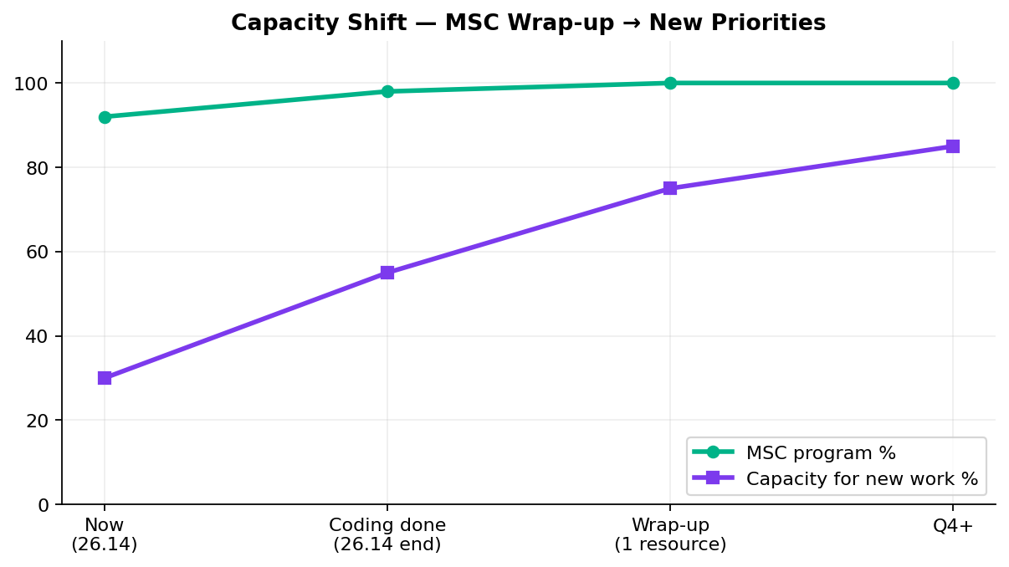
Capacity — MSC Wrap-up vs New Work
Capacity
1 resource close-out · 3.5 FTE for next priority
Key messages
• 1 resource ~1 sprint after enrollment coding (docs, qTest, Bruno, KT, sign-off) — NOT full squad exit
• New work capacity: 3.5 FTE (incl. Swapnil) available for Atlas + V2/V3/API backlog once enrollment coding lands
• Sunil → MSC wrap-up: qTest, Bruno, coverage matrix, handover docs
• Preeti → perf: contribution JMX now; M1+enrollment perf next sprint
• Main squad → ACS-5678 Atlas (Oct) OR V2/V3 backlog — need leadership queue
Coding complete end 26.14 — not a full squad exit from MSC
11

Slide 12
V2 → V3 Migration Path
Strategy
Reduce Jenkins footprint
Plan
• Retire V2 enrollment from Jenkins; migrate CSR enrollment flows to V3 on GitLab
• Direct plans migrated to V3; reduce Jenkins footprint as legacy becomes obsolete
• Need leadership alignment on per-plan migration timeline and which V2 regression cases to retire vs maintain during transition
• Lead: Wence / Venkatesh (when MSC wrap-up completes)
• Outcome: lighter GitLab-based V3 suites; retire duplicate V2 enrollment from Jenkins
Aligns with platform direction — V3 as source of truth
12

Slide 13
Incoming: ACS-5678 Atlas
New work
Traffic distribution & load balancer rebalancing
AHA summary (Brian Danilczyk)
• ACS-5678 — Atlas Traffic Distribution & Load Balancer Rebalancing (QA Automation) — #2 on Michael's list
• Estimate: 2–3 sprints · Target: October 2026 delivery
• Status: Intake pending — Brian sent AHA ~2 weeks ago; awaiting leadership queue confirmation
• Dependency: Redis session-management initiative
• Scope: validate traffic distribution after Redis session externalization; load + perf testing
• Main squad can start intake next sprint while 1 resource finishes MSC wrap-up
Confirm priority vs MSC wrap-up, V2 sunset, and other AHA items
13

Slide 14
Leadership Asks & Decisions Needed
Decisions
Please respond on this call — by area
Roadmap & capacity
• Confirm post-MSC priority queue: ACS-5678 Atlas (Oct delivery) vs V2 sunset vs V3 expansion
• Acknowledge 1-resource MSC wrap-up sprint — coding complete ≠ program closed
• Name sustaining owner (ACM) and sign-off contacts for M1, M2, enrollment, pipeline, perf
Unite MSC / API automation
• Accept M1 (26/26) and M2 (25/25) as 100% in-scope — ready for formal sign-off
• Enrollment: 95% core E2E — submit step target end Sprint 26.14; partner flows next sprint
• Approve handoff of API automation assets to named sustaining team
V2 regression (Jenkins)
• Which V2 Jenkins suites retire as plans migrate to universal platform?
• CSR enrollment sunset timing — align with plan migration schedule
V3 universal platform (GitLab)
• Confirm V3 as source of truth for migrated plans — expansion priority after MSC?
• IDP login regression ownership — recent failures need product/env alignment
Performance & stress testing
• Route performance requests through SDLC intake — team slightly behind due to emergency work
• Preeti: M1 + enrollment perf scripts planned next sprint after API E2E stable
• We continue owning nightly + perf regression unless leadership redirects to sustaining team
Pipeline & environments
• Mobile 2 GitLab nightly delivered (QA-1405) — enrollment nightly to follow in wrap-up sprint
• DB refresh complete — QC4 integration proof can proceed
• Confirm Stage1-as-primary until QC4 fully stable
Full ask list in companion DOCX · Swapnil Patil · QA Automation AM Squad
14

Slide 15
Questions & Discussion
Detailed briefing document shared · KB: programs/leadership-updates/2026-08-28-rajib-henry-biweekly/

