Slide 1
FULL PORTFOLIO VIEW
QA Automation — AM Squad
Detailed Leadership Update · April – August 2026
V2 UI
V3 UP
API/MSC
Perf
Pipeline
Standards

Slide 2
Executive Scorecard
Live metrics
GitLab merges
Story points
V2 Stage1 nightly
V3 Stage1 nightly
121
545
592
442
3 repos · Apr–Aug
Sprints 26.04–26.12
Aug 4 · ~12 mo build
GitLab · Aug 4
Perf cases
MSC M2
MSC M1
Period delivery
323
25/25
~25/29
1212
Labels × plans
Endpoints
Core endpoints
Est. cases Apr–Aug
V2/V3 = Stage1 nightly snapshots only (built since Q2 2025). Excludes smoke, Stage 2/5, integrations, +33 CSR Actions.
How to read these numbers
• 592 V2 + 442 V3 = Stage1 nightly snapshots (Aug 4) — built since Q2 2025, not in Apr–Aug alone.
• Excludes smoke (Stage 2/5), integration suites, and +33 CSR Actions pending wire — more coverage exists.
• We are NOT claiming 1,212 + 592 + 442 — period delivery vs inventory are different metrics.
• ~1,212 estimated new coverage in Apr–Aug from 225 Jira stories; nightly totals include pre-April foundation.
• Apr–Aug shows acceleration (MSC API sprint Jun–Jul), not greenfield from zero.
Note: 592 V2 and 442 V3 are Stage1 nightly snapshots only — accumulated since Q2 2025, not built in Apr–Aug alone. Smoke (Stage 2/5), integrations, and +33 CSR Actions are additional coverage and are not added to these totals.
Sources: GitLab MR export · Jira AMSQUAD · Jenkins/GitLab nightly logs
2

Slide 3
Executive Headline
Overview
Key points
• 121 merged changes to main across 3 automation repositories
• 545 Jira story points · 245 work items · 20 bugs found
• ~80% of monthly release validations automated (17 FTE → 2 FTE)
• Unite MSC rescued — Mobile 2 at 25/25 endpoints, ~50% ETA savings
• Six parallel tracks: V2 · V3 · API/MSC · Perf · Pipeline · Standards
Note: Apr–Aug reporting window on a team formed Q2 2025 — acceleration phase, not greenfield.
Executive summary
3

Slide 4
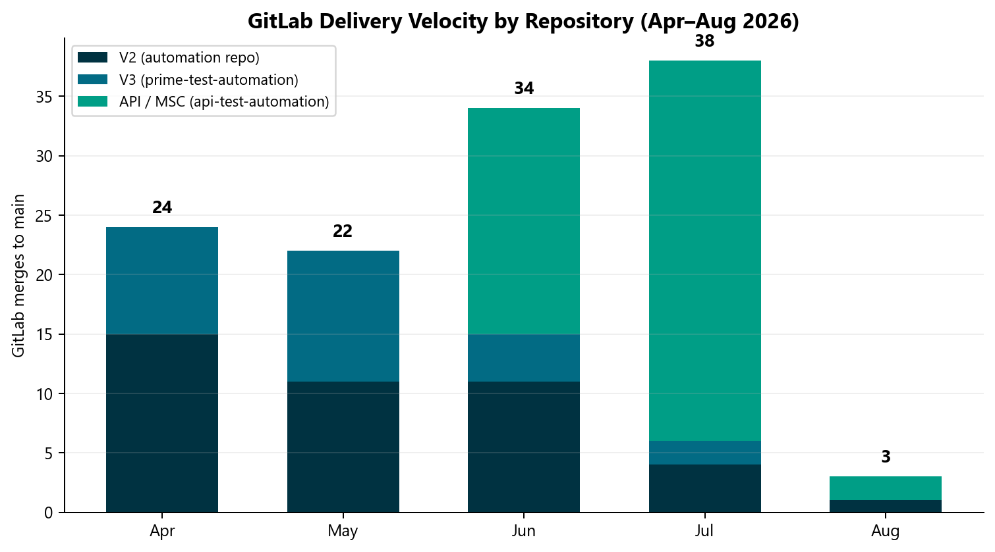
GitLab Delivery Velocity
GitLab
What this shows
• 121 total merges
• July peak: 38 merges during MSC sprint
• Separate from test case counts
Note: July = 38 merges (highest month). Merge count ≠ test cases or story points.
GitLab MR export · Apr 1 – Aug 4, 2026
4

Slide 5
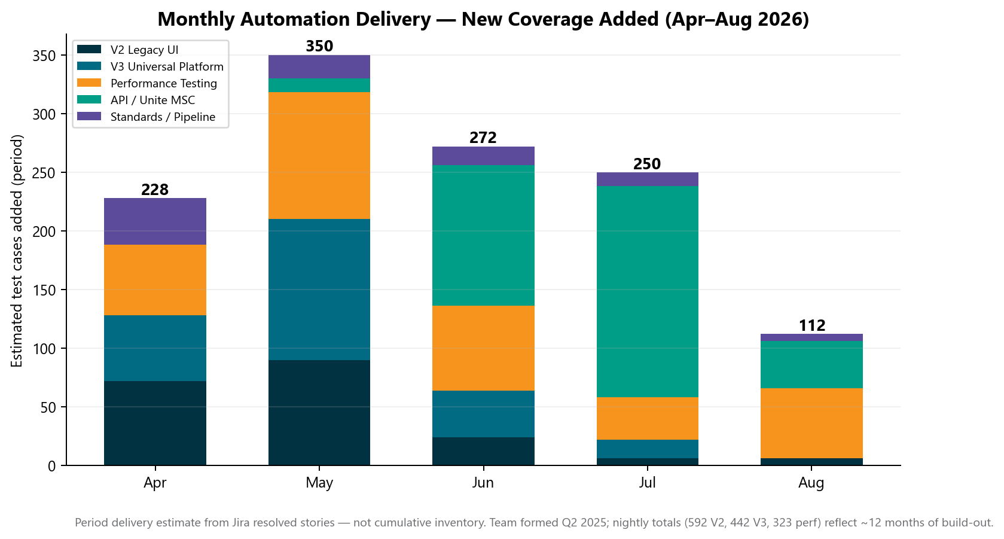
Monthly Automation Delivery
Automation
Period delivery (not inventory)
• 592 V2 + 442 V3 = Stage1 nightly snapshots (Aug 4) — built since Q2 2025, not in Apr–Aug alone.
• Excludes smoke (Stage 2/5), integration suites, and +33 CSR Actions pending wire — more coverage exists.
• We are NOT claiming 1,212 + 592 + 442 — period delivery vs inventory are different metrics.
• ~1,212 estimated new coverage in Apr–Aug from 225 Jira stories; nightly totals include pre-April foundation.
Note: Estimated from 225 closed Jira stories — period velocity only, not added to nightly inventory.
Jira AMSQUAD · period delivery estimate
5

Slide 6
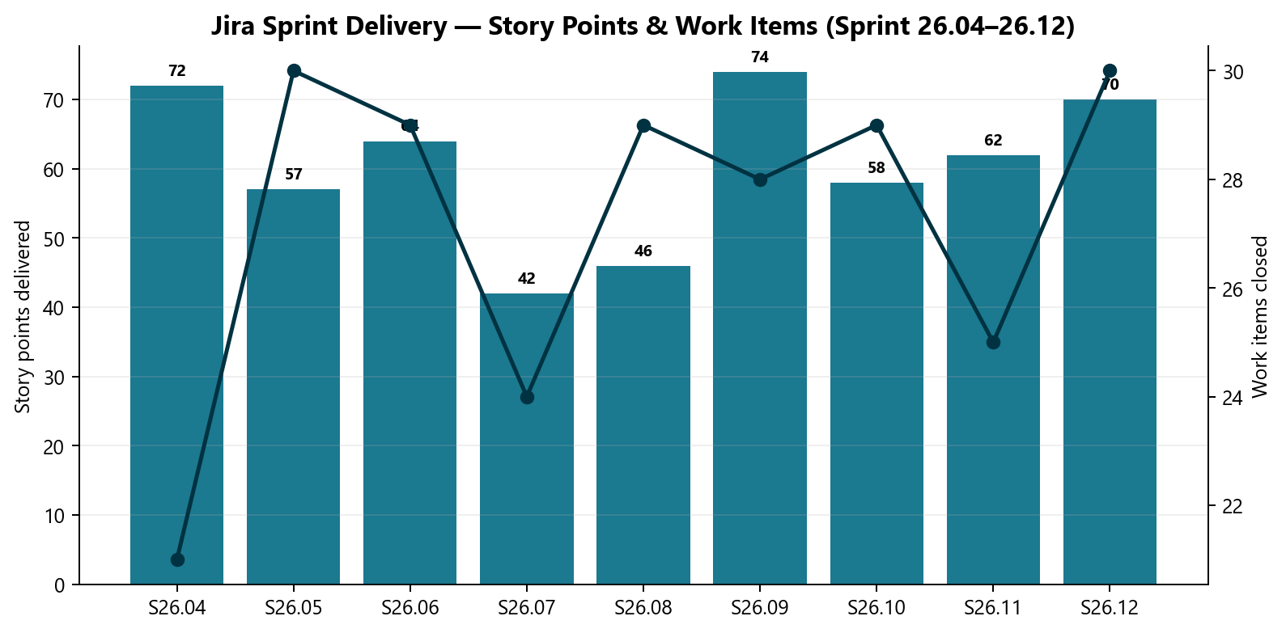
Jira Sprint Delivery
Jira
Sprint outcomes
• 245 items · 545 SP
• 20 bugs logged
Note: Story points = committed sprint work closed across 9 sprints in the reporting window.
Jira AMSQUAD Sprints 26.04–26.12
6

Slide 7
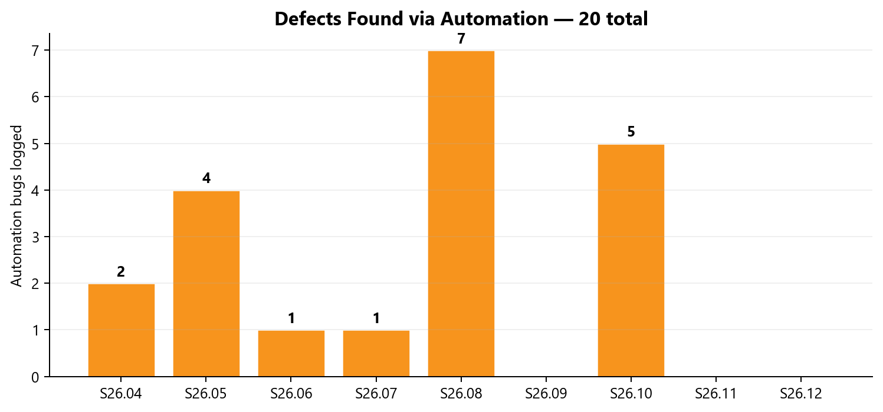
Automation Defects Discovered
Quality
Quality signal
• Defects found via nightly regression triage
• Fed into automation bug lifecycle standard
Note: Bugs logged by automation team from nightly failures — not all production defects.
Jira AMSQUAD
7

Slide 8
Beyond the Metrics
Value
Key points
• Framework architecture & canonical repo design
• AI-accelerated docs, Postman, TestNG boilerplate
• qTest master suite & automation bug lifecycle standard
• Pipeline/DevOps co-design & module switches
• Cross-team emergency support & release triage
Note: These investments are not fully captured in delivery charts or merge counts.
Additional value not captured in merge or test-count metrics
8

Slide 9
V2 Legacy UI Automation
Jenkins Stage1 nightly · built since Q2 2025

Slide 10
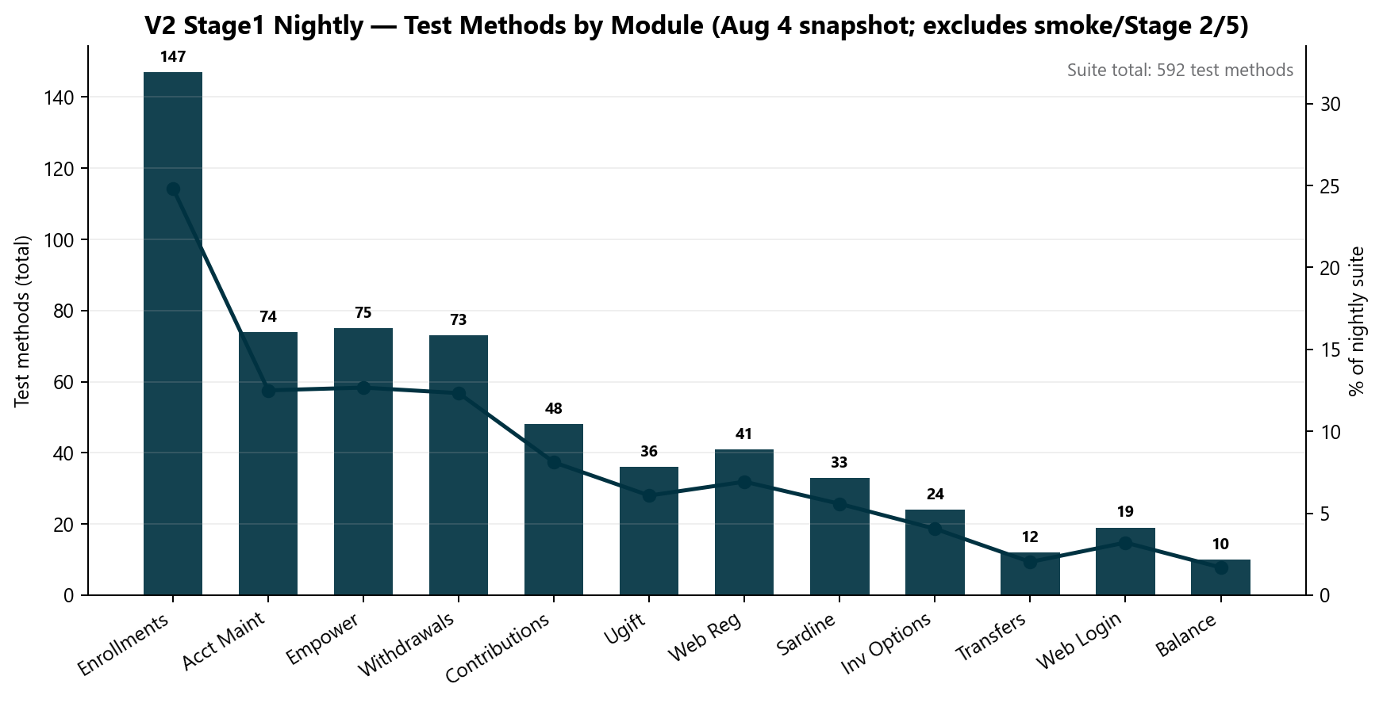
V2 Stage1 Nightly Snapshot
V2
What this counts
• 592 methods — Stage1 primary nightly only (Aug 4)
• Built since Q2 2025 — not Apr–Aug alone
• Excludes smoke, Stage 2/5, +33 CSR Actions pending wire
• CSR maintenance added Apr–Jul on earlier foundation
Note: Additional V2 coverage: Stage 5 smoke, Stage 2 smoke, on-demand fast smoke, +33 CSR Actions.
Jenkins STAGE1-Daily-Unite-Prime-Regression · Aug 4
9

Slide 11
V2 Business Value
V2
Key points
• Core member journeys covered nightly before release
• CSR maintenance gaps closed — high-risk flows automated
• Enrollments/login triage separates env vs product defects
V2 value
10

Slide 12
V3 Universal Platform
GitLab CI nightly · built since Q2 2025

Slide 13
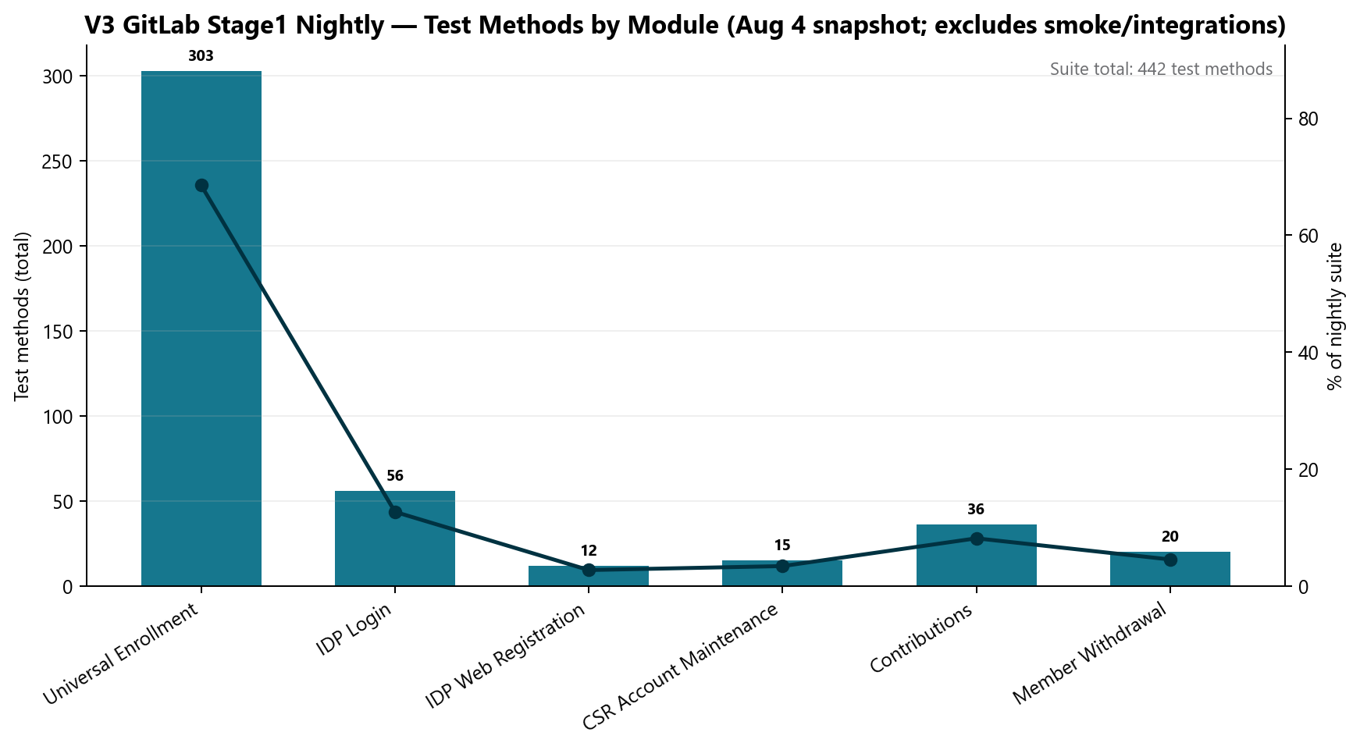
V3 Stage1 Nightly Snapshot
V3
What this counts
• 442 methods — GitLab Stage1 nightly only (Aug 4)
• Framework + CI/CD accumulated over ~1 year
• UE 303 = scenarios × plan/traunch matrix
• Entity suites expanding — not all in Aug 4 log
Note: Additional V3 coverage: Stage 5 smoke (UE + IDP), integration profiles, Entity track — not in 442.
GitLab scheduled_regression_job · Aug 4
11

Slide 14
V3 Delivery Highlights
V3
Key points
• Entity registration/login suites expanded
• IDP open-account and member withdrawal regression
• Flaky-test stabilization and web registration flows
• Stage 5 smoke suites for UE + IDP
V3 highlights
12

Slide 15
API / Unite MSC
Rescued · accelerated

Slide 16
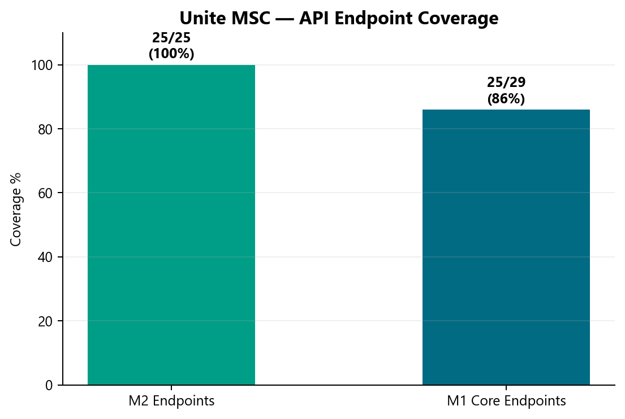
MSC Endpoint Coverage
MSC
MSC status
• M2 25/25
• M1 ~25/29
• ~50% ETA savings
• P0: GitLab nightly (QA-1405)
Note: M2 = full mobile endpoint catalog. M1 ~86% of 29 core categories — master suite in progress.
api-test-automation
13

Slide 17
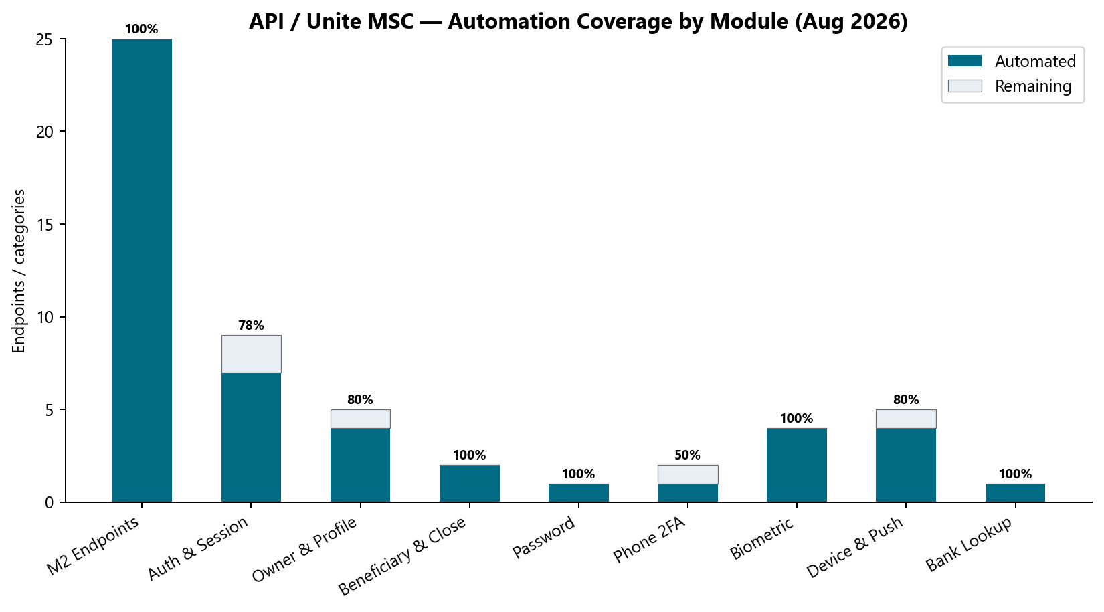
API Module Breakdown
API
M1 categories
• Auth, profile, biometric, device, bank
• Master suite in progress
• Endpoints × branding plans
Note: OKD non-IDP + NYD/NMD IDP brandings expand endpoint permutations beyond raw count.
api-test-automation
14

Slide 18
Performance Testing
Labels × plans model

Slide 19
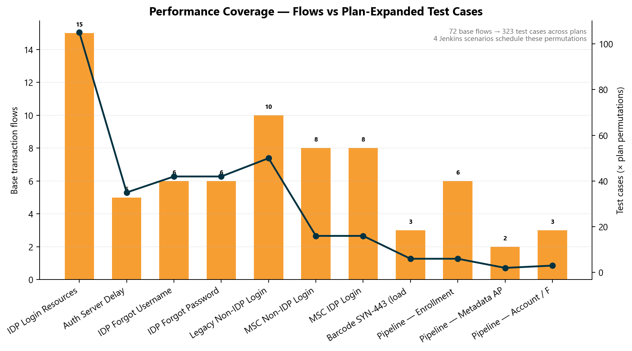
Perf Test Case Inventory
Perf
Why the numbers look large
• 83 base transaction flows → 323 plan-expanded cases
• Bars = flows; line = cases after × plan matrix
• 4 Jenkins scenarios schedule these permutations
• IDP alone: 15 labels × 7 plans = 105 cases
Note: 4 Jenkins jobs schedule runs — not 323 separate jobs. Barcode SYN-443 delivered in ~1 week.
Perf inventory
15

Slide 20
Performance Value
Perf
Key points
• Repeatable baselines — no manual re-run each release
• Evidence for platform team pre/post patch comparison
• Department perf DoD and BlazeMeter reporting standard
Perf value
16

Slide 21
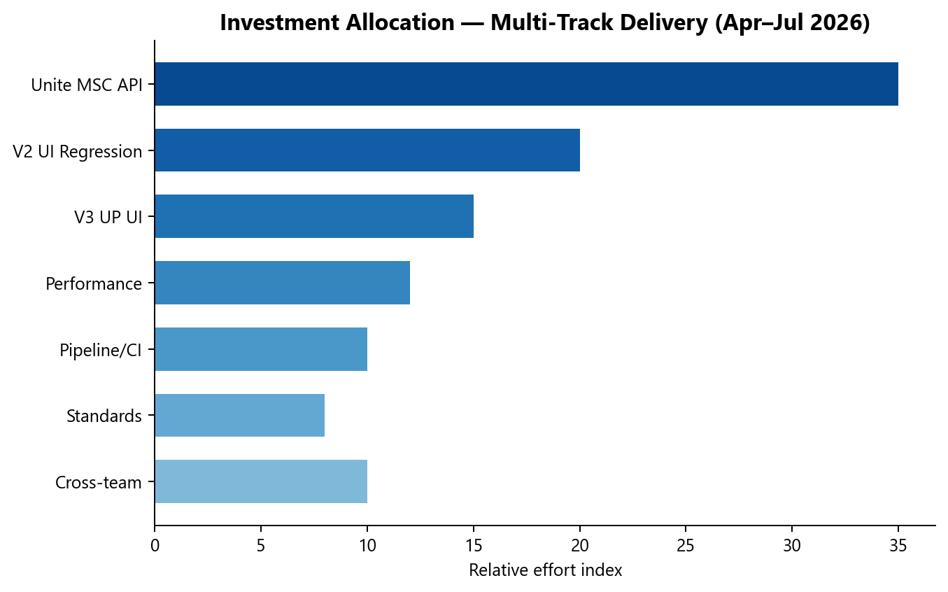
Investment Allocation
Portfolio
Effort mix
• MSC API 35%
• V2 UI 20%
• V3 UP 15%
• Perf 12%
• Pipeline/Standards remainder
Note: Relative effort index — not headcount FTE. MSC sprint drove Jun–Jul concentration.
Squad estimate Apr–Jul
17

Slide 22
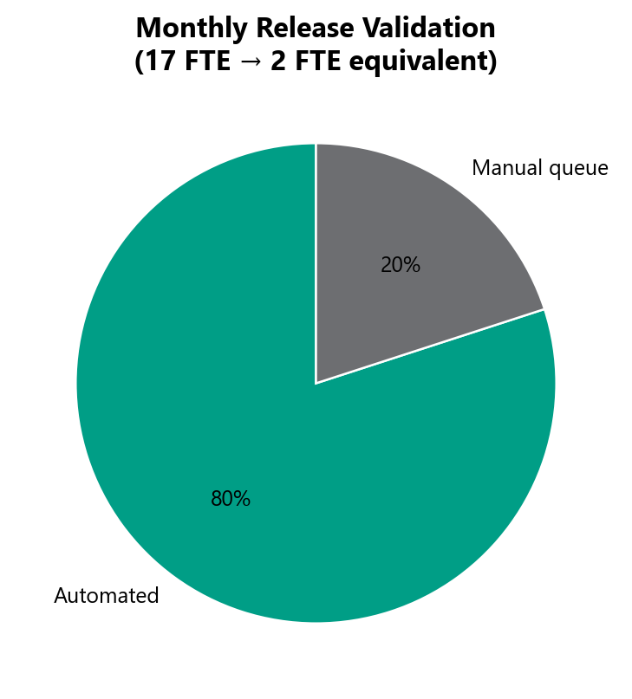
Release Automation Impact
Value
Business value
• ~80% automated
• 17 FTE → 2 FTE equivalent
• Team focuses on triage + net-new
Note: FTE equivalent = manual validation hours replaced by nightly regression, not headcount reduction.
Release validation model
18

Slide 23
AI Acceleration
AI
Key points
• MSC migration agents — Postman, docs, TestNG boilerplate
• Automation bug lifecycle — Cursor skill + standardized reporting
• Chart & metrics generators — reproducible leadership packs
• Coverage intelligence foundation for monthly dashboard
AI tooling portfolio
19

Slide 24
Roadmap Q3–Q4 2026
Roadmap
Key points
• P0: MSC GitLab nightly · M1 master suite
• P1: MSC enrollment API · CSR Actions expansion (+33 scenarios)
• P2: Entity V3 nightly · automated dashboard
• Engage AM Squad at SDLC start, not sign-off deadline
Roadmap
20

Slide 25
Leadership Asks
Asks
Key points
• Roadmap visibility at SDLC start
• Admin capacity for architecture lead & AI tooling
• 30-min live walkthrough recommended for Q&A
Note: Concise executive view: AM-Squad-Leadership-Executive-Glimpse-Aug2026.pptx
Asks
21

Slide 26
Thank you

