Slide 1
EXECUTIVE DASHBOARD
QA Automation — AM Squad
Leadership Glimpse · April – August 2026
V2 UI
V3 UP
API/MSC
Perf
Pipeline
Standards

Slide 2
Executive Scorecard
Live metrics
GitLab merges
Story points
V2 Stage1 nightly
V3 Stage1 nightly
121
545
592
442
3 repos · Apr–Aug
Sprints 26.04–26.12
Aug 4 · ~12 mo build
GitLab · Aug 4
Perf cases
MSC M2
MSC M1
Period delivery
323
25/25
~25/29
1212
Labels × plans
Endpoints
Core endpoints
Est. cases Apr–Aug
V2/V3 = Stage1 nightly snapshots only (built since Q2 2025). Excludes smoke, Stage 2/5, integrations, +33 CSR Actions.
How to read these numbers
• 592 V2 + 442 V3 = Stage1 nightly snapshots (Aug 4) — built since Q2 2025, not in Apr–Aug alone.
• Excludes smoke (Stage 2/5), integration suites, and +33 CSR Actions pending wire — more coverage exists.
• We are NOT claiming 1,212 + 592 + 442 — period delivery vs inventory are different metrics.
• ~1,212 estimated new coverage in Apr–Aug from 225 Jira stories; nightly totals include pre-April foundation.
• Apr–Aug shows acceleration (MSC API sprint Jun–Jul), not greenfield from zero.
Note: 592 V2 and 442 V3 are Stage1 nightly snapshots only — accumulated since Q2 2025, not built in Apr–Aug alone. Smoke (Stage 2/5), integrations, and +33 CSR Actions are additional coverage and are not added to these totals.
Sources: GitLab MR export · Jira AMSQUAD · Jenkins/GitLab nightly logs
2

Slide 3
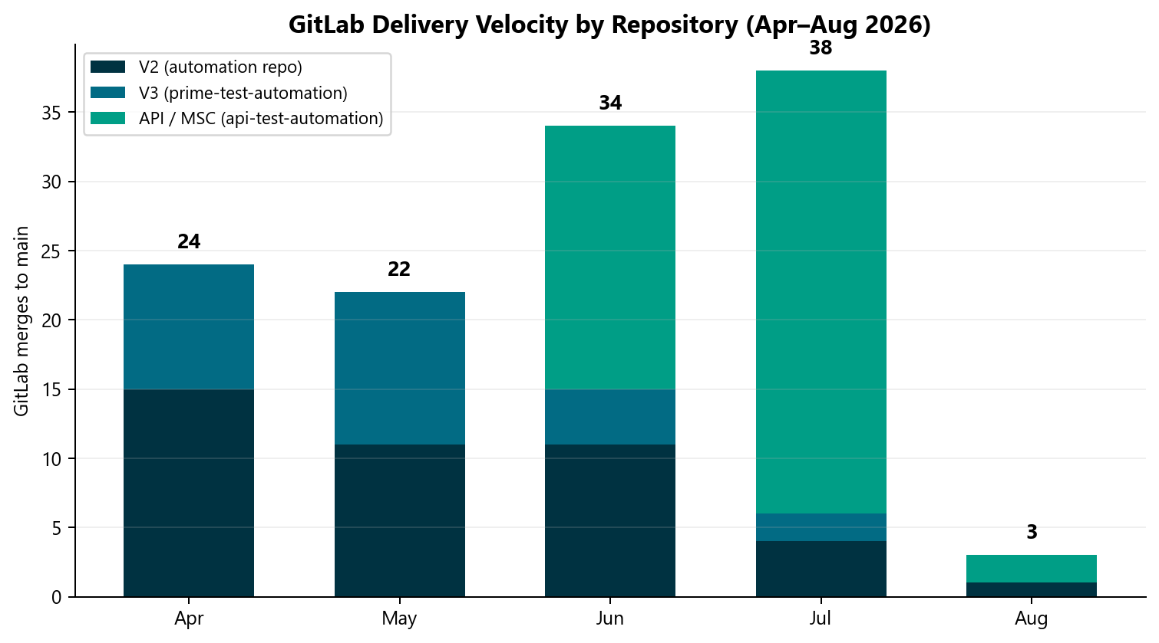
GitLab Delivery Velocity
GitLab
What this shows
• 121 merges to main across automation, prime-test-automation, and api-test-automation
• July peak: 38 merges during Unite MSC API sprint
• Code delivery metric — separate from test case counts
Note: July = 38 merges (highest month). Counts merged code changes, not test cases or story points.
GitLab MR export · Apr 1 – Aug 4, 2026
3

Slide 4
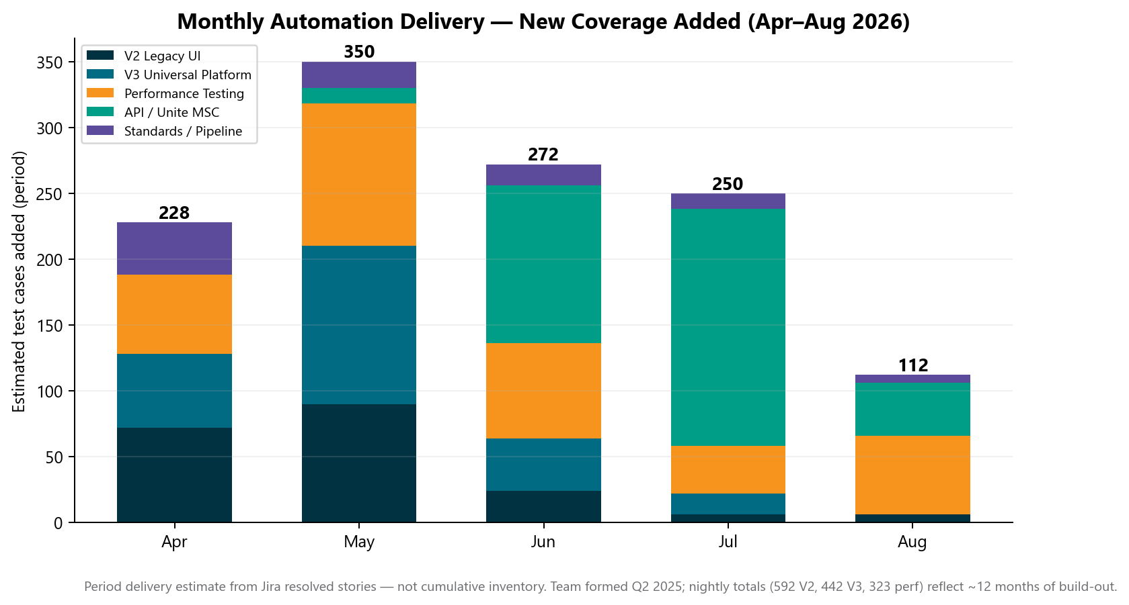
Monthly Automation Delivery
Automation
How to interpret
• ~1212 est. new test cases delivered Apr–Aug (not cumulative)
• 225 Jira stories closed × channel-specific averages
• Includes multi-plan, multi-env, pos/neg permutations
• Pre-Apr foundation sits in nightly inventory — chart shows when work landed
Note: Period velocity only — do not add ~1,212 to scorecard inventory (592+442+323).
Jira AMSQUAD Sprints 26.04–26.12 · period delivery estimate
4

Slide 5
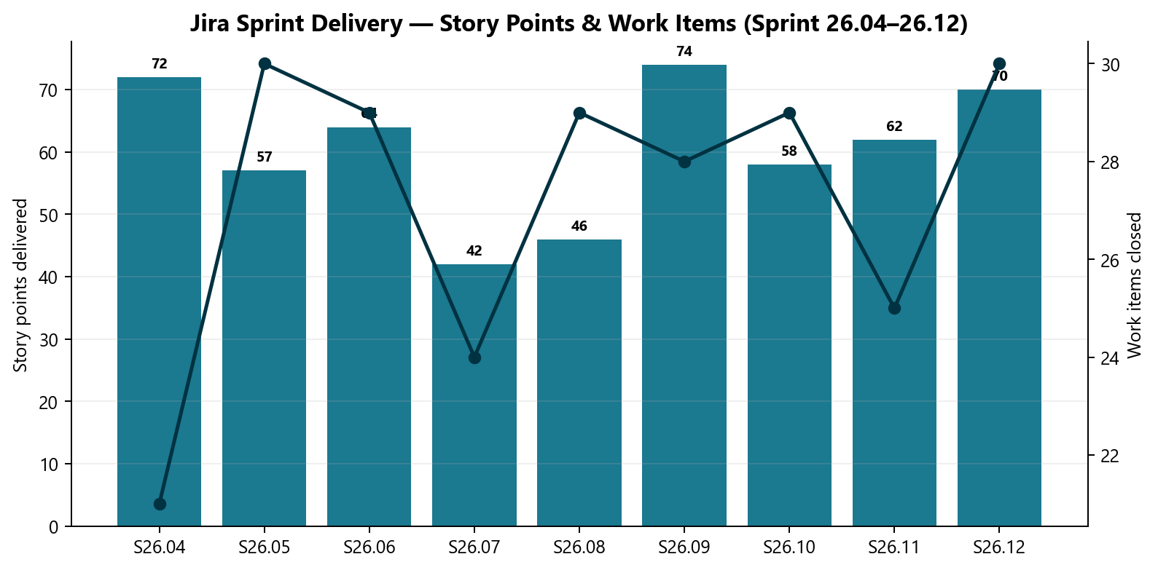
Jira Sprint Delivery
Jira
Sprint outcomes
• 245 work items · 545 story points
• 20 automation-discovered defects logged
• Sustained delivery across 9 sprints in reporting window
Note: Story points = committed sprint work closed. Bugs = defects found via nightly regression triage.
Jira AMSQUAD export · Sprints 26.04–26.12
5

Slide 6
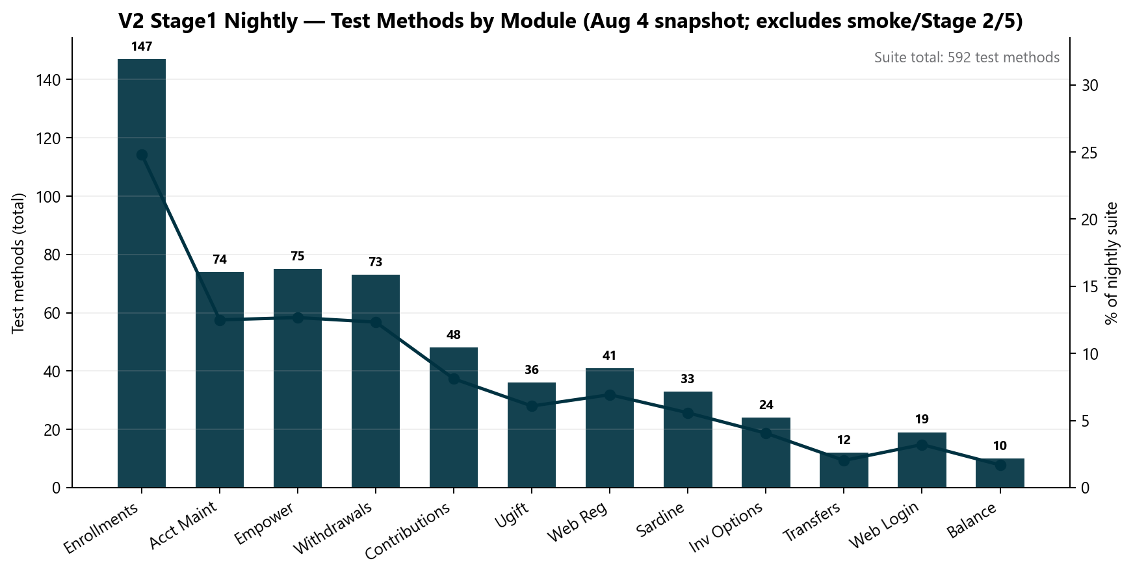
V2 Legacy UI — Stage1 Nightly Snapshot
V2
What this counts
• 592 test methods — Jenkins Stage1 nightly only (Aug 4)
• Built since Q2 2025 — not delivered in Apr–Aug alone
• Bars = methods per module; excludes smoke, Stage 2/5, CSR Actions (+33)
• CSR maintenance modules added Apr–Jul on top of earlier foundation
Note: Additional V2 coverage exists outside this snapshot: Stage 5 smoke, Stage 2 smoke, +33 CSR Actions (pending nightly wire), on-demand fast smoke.
Jenkins STAGE1-Daily-Unite-Prime-Regression · Aug 4 snapshot
6

Slide 7
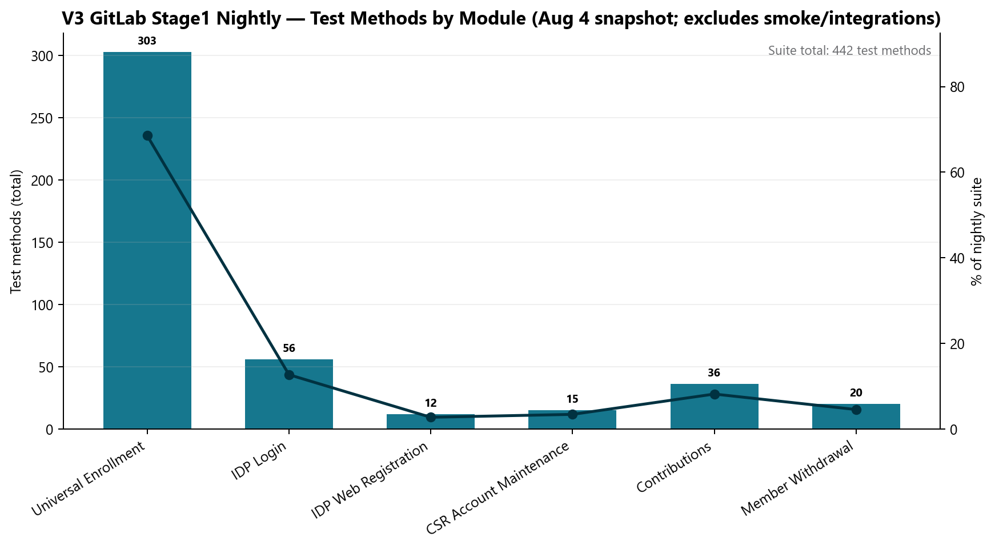
V3 Universal Platform — Stage1 Nightly Snapshot
V3
What this counts
• 442 test methods — GitLab Stage1 nightly only (Aug 4)
• Built since Q2 2025 — framework, CI/CD, suites accumulated over ~1 year
• UE 303 = scenarios × plan/traunch — not 303 unique scripts
• Entity suites expanding — not all in Aug 4 nightly log
Note: Additional V3 coverage exists outside this snapshot: Stage 5 smoke (UE + IDP), integration XML profiles, Entity track — not added to 442.
GitLab scheduled_regression_job · Aug 4 snapshot
7

Slide 8
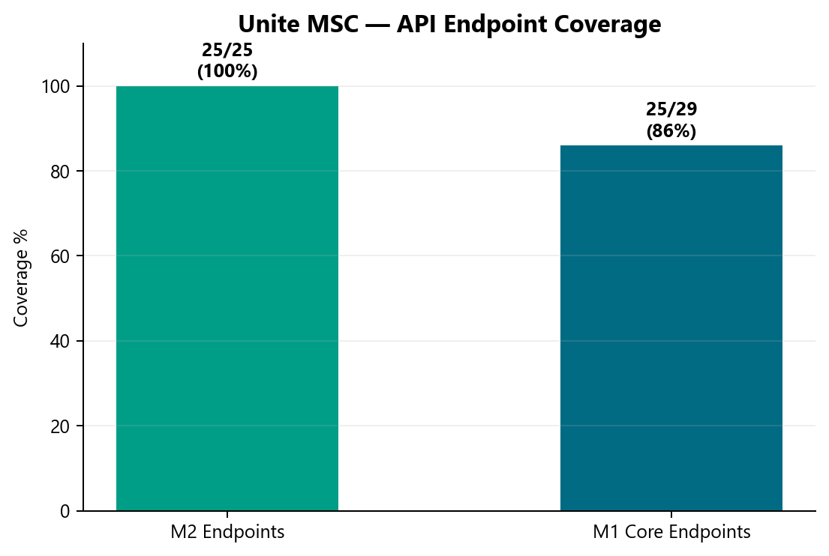
API / Unite MSC — Coverage
API
MSC rescue
• M2 25/25 endpoints · M1 ~25/29 core categories
• Delivered in ~50% of original ETA
• AI-assisted migration + canonical TestNG framework
• P0: GitLab nightly scheduling (QA-1405)
Note: M2 = full mobile endpoint catalog. M1 ~86% of 29 core categories — master suite still in progress.
api-test-automation repo inventory
8

Slide 9
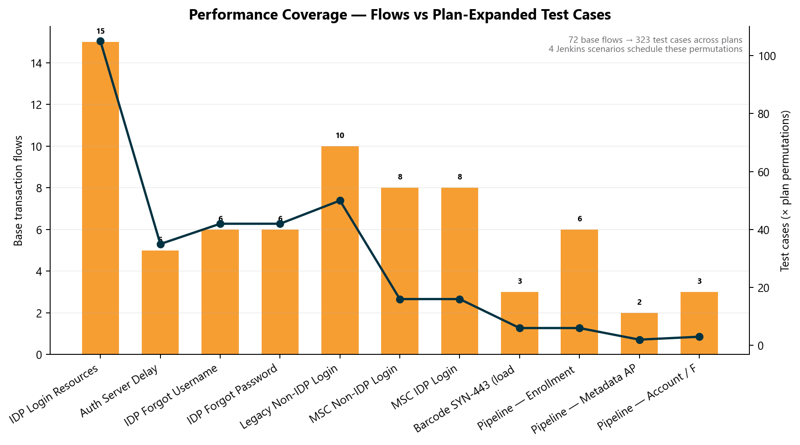
Performance — Test Case Inventory
Perf
Perf counting model
• 83 base transaction flows → 323 plan-expanded cases
• Bars = flows; line = cases after × plan matrix
• IDP: 15 labels × 7 plans = 105 cases alone
• Barcode SYN-443 delivered in ~1 week
Note: 4 Jenkins scenarios schedule runs — not 323 separate jobs. Plan expansion is standard perf counting.
Perf inventory model · Jenkins + BlazeMeter
9

Slide 10
Leadership Asks & Next Steps
Asks
Key points
• Roadmap visibility — engage AM Squad at SDLC start, not sign-off deadline
• Administrative capacity — free lead for architecture & AI tooling
• P0: MSC GitLab nightly · M1 master suite · enrollment API
• ~80% release validation automated (17 FTE → 2 FTE equivalent)
Note: Team formed Q2 2025; Apr–Aug is the 5-month delivery window on top of ~12 months of build.
Full detail: AM-Squad-Leadership-Detailed-Modern-Aug2026.pptx
10

Slide 11
QA Automation AM Squad
Delivering across six automation channels · Team since Q2 2025

