Slide 1
PORTFOLIO BRIEFING
QA Automation — AM Squad
Leadership Update · April – August 2026
V2 UI
V3 UP
API/MSC
Perf
Pipeline
Standards

Slide 2
Executive Scorecard
Live metrics
GitLab merges
Story points
V2 Stage1 nightly
V3 Stage1 nightly
121
545
592
442
3 repos · Apr–Aug
Sprints 26.04–26.12
Aug 4 · ~12 mo build
GitLab · Aug 4
Perf cases
MSC M2
MSC M1
Period delivery
323
25/25
~25/29
1212
Labels × plans
Endpoints
Core endpoints
Est. cases Apr–Aug
V2/V3 = Stage1 nightly snapshots only (built since Q2 2025). Excludes smoke, Stage 2/5, integrations, +33 CSR Actions.
How to read these numbers
• 592 V2 + 442 V3 = Stage1 nightly snapshots (Aug 4) — built since Q2 2025, not in Apr–Aug alone.
• Excludes smoke (Stage 2/5), integration suites, and +33 CSR Actions pending wire — more coverage exists.
• We are NOT claiming 1,212 + 592 + 442 — period delivery vs inventory are different metrics.
• ~1,212 estimated new coverage in Apr–Aug from 225 Jira stories; nightly totals include pre-April foundation.
• Apr–Aug shows acceleration (MSC API sprint Jun–Jul), not greenfield from zero.
Note: 592 V2 and 442 V3 are Stage1 nightly snapshots only — accumulated since Q2 2025, not built in Apr–Aug alone. Smoke (Stage 2/5), integrations, and +33 CSR Actions are additional coverage and are not added to these totals.
Sources: GitLab MR export · Jira AMSQUAD · Jenkins/GitLab nightly logs
1

Slide 3
Executive Headline
Overview
Key points
• 121 merged changes to main across 3 automation repositories
• 545 Jira story points · 245 work items · 20 bugs found
• ~80% of monthly release validations automated (17 FTE → 2 FTE)
• Unite MSC rescued — Mobile 2 at 25/25 endpoints, ~50% ETA savings
• Six parallel tracks: V2 · V3 · API/MSC · Perf · Pipeline · Standards
Executive summary
2

Slide 4
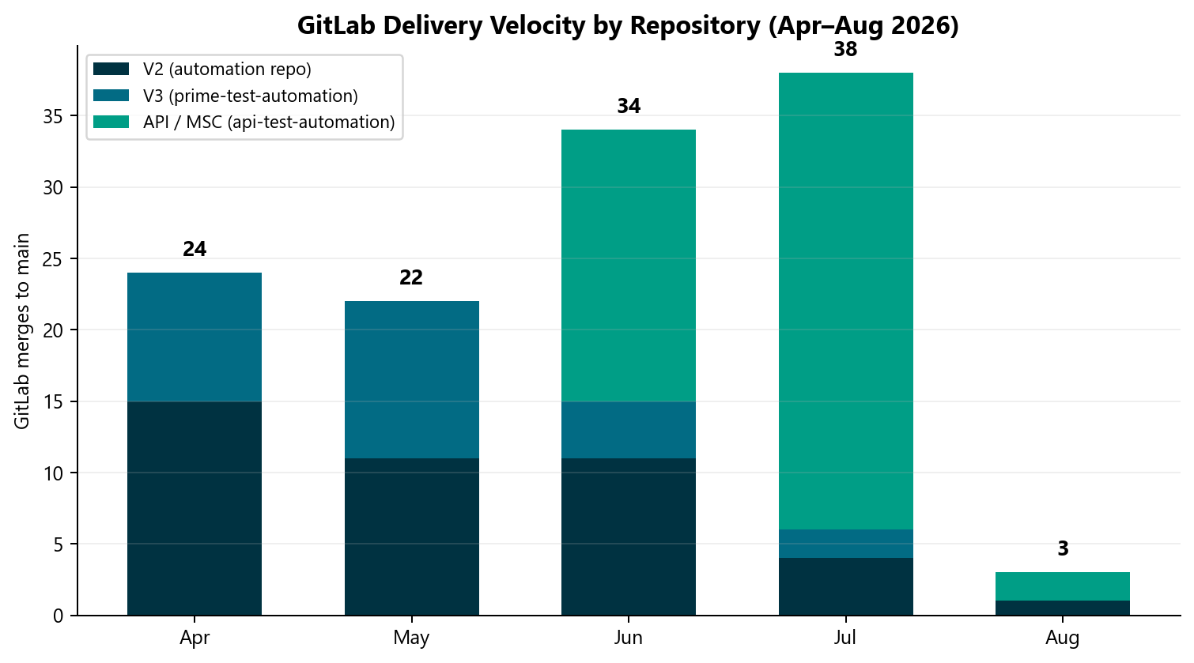
GitLab Delivery Velocity
GitLab
What this shows
• 121 total merges
• July peak: 38 merges during MSC sprint
• Separate from test case counts
GitLab MR export · Apr 1 – Aug 4, 2026
3

Slide 5
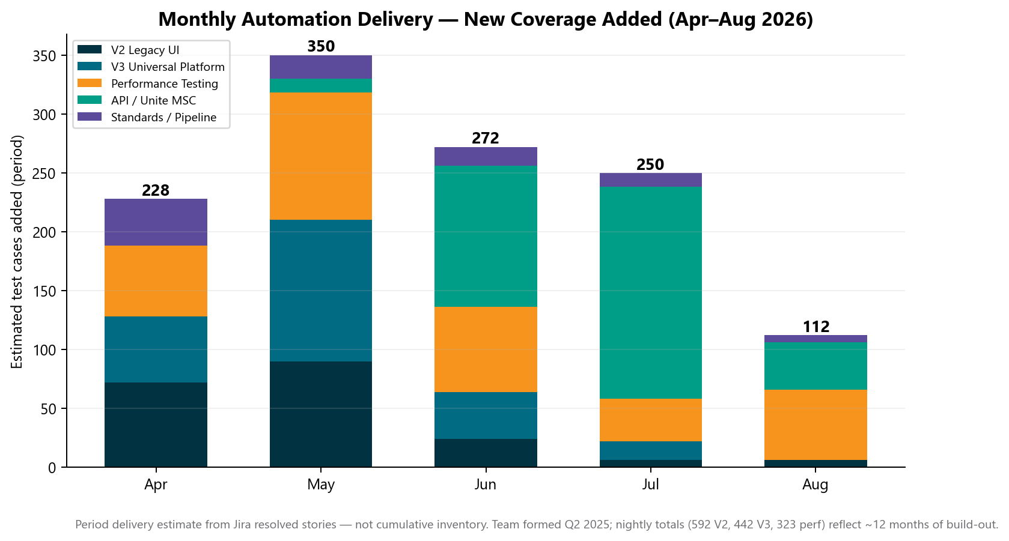
Monthly Automation Delivery
Automation
Period delivery
• 592 V2 + 442 V3 = Stage1 nightly snapshots (Aug 4) — built since Q2 2025, not in Apr–Aug alone.
• Excludes smoke (Stage 2/5), integration suites, and +33 CSR Actions pending wire — more coverage exists.
• We are NOT claiming 1,212 + 592 + 442 — period delivery vs inventory are different metrics.
• ~1,212 estimated new coverage in Apr–Aug from 225 Jira stories; nightly totals include pre-April foundation.
Jira AMSQUAD · period delivery estimate
4

Slide 6
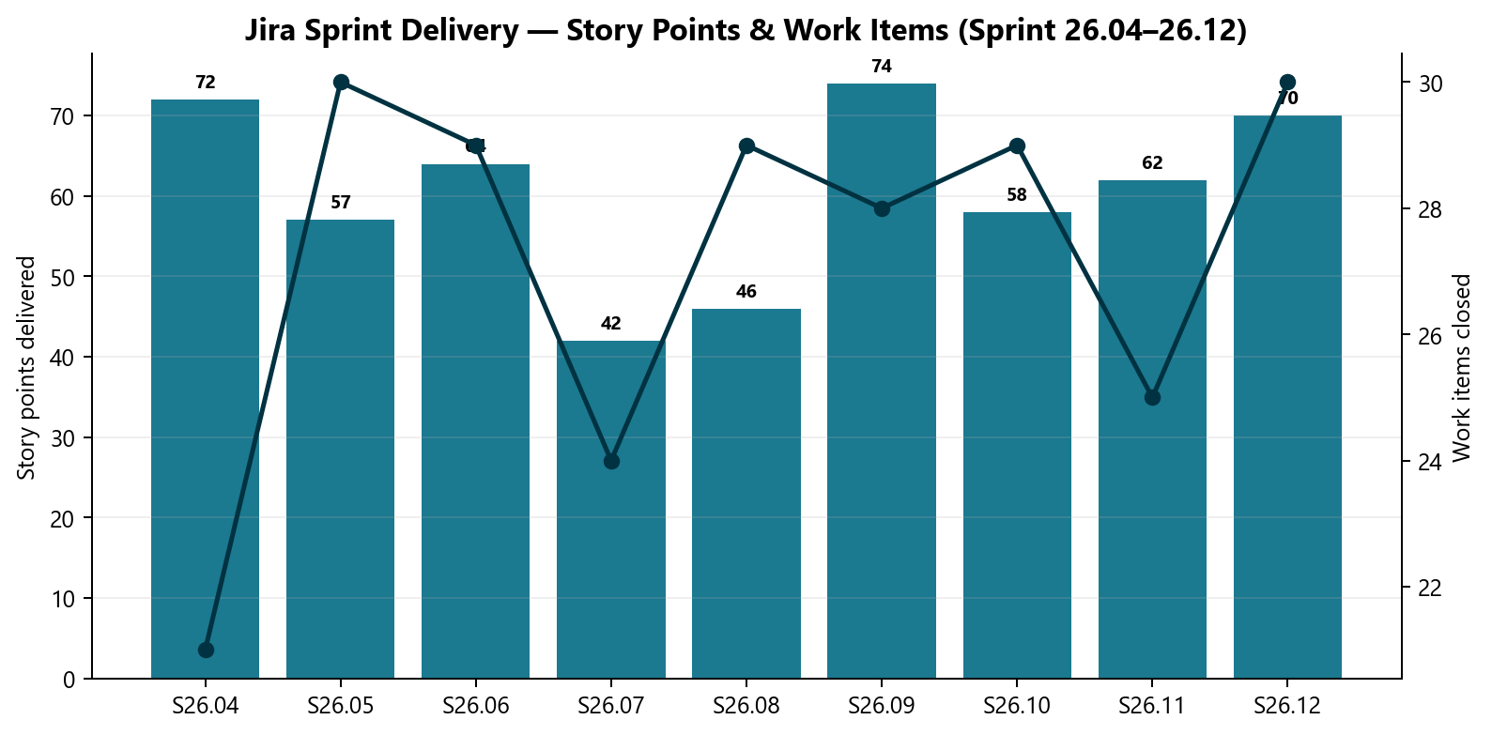
Jira Sprint Delivery
Jira
Sprint outcomes
• 245 items · 545 SP
• 20 bugs logged
Jira AMSQUAD Sprints 26.04–26.12
5

Slide 7
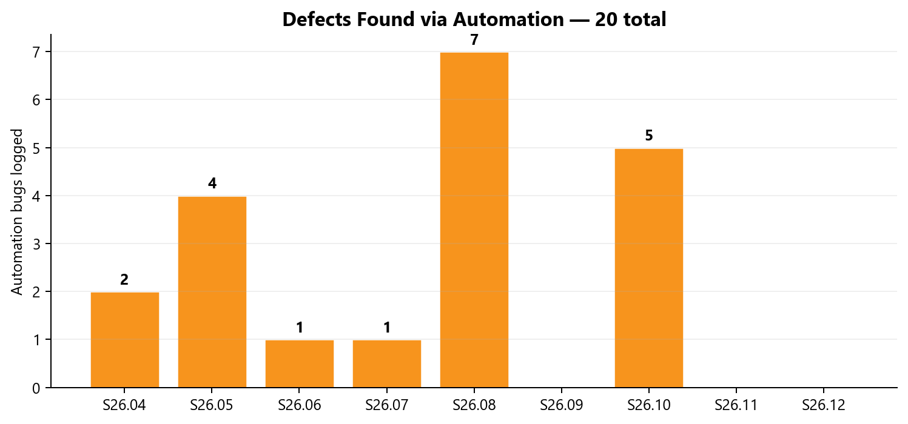
Automation Defects Discovered
Quality
Quality signal
• Defects found via nightly triage
• Fed into automation bug lifecycle
Jira AMSQUAD
6

Slide 8
Beyond the Metrics
Value
Key points
• Framework architecture & canonical repo design
• AI-accelerated docs, Postman, TestNG boilerplate
• qTest master suite & automation bug lifecycle standard
• Pipeline/DevOps co-design & module switches
• Cross-team emergency support & release triage
These investments are not fully captured in delivery charts.
Additional value not captured in merge or test-count metrics
7

Slide 9
V2 Legacy UI Automation
Jenkins Stage1 nightly · built since Q2 2025

Slide 10
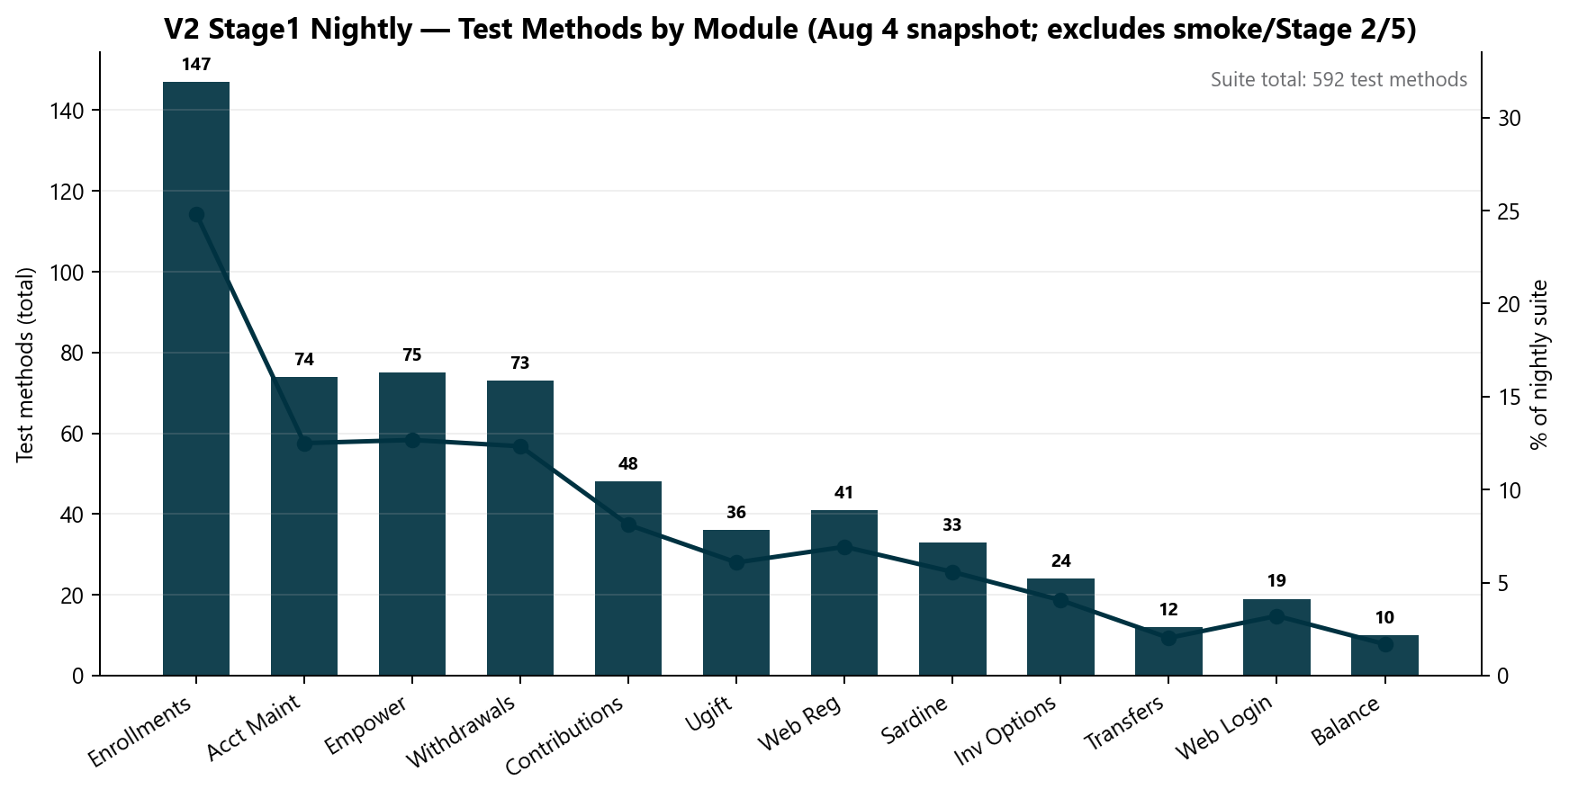
V2 Stage1 Nightly Snapshot
V2
What this counts
• 592 methods — Stage1 primary nightly only (Aug 4)
• Built since Q2 2025 — not Apr–Aug alone
• Excludes smoke, Stage 2/5, +33 CSR Actions pending wire
• CSR maintenance added Apr–Jul on earlier foundation
Note: Additional V2 coverage: Stage 5 smoke, Stage 2 smoke, on-demand fast smoke, +33 CSR Actions.
Jenkins STAGE1-Daily-Unite-Prime-Regression · Aug 4
8

Slide 11
V2 Business Value
V2
Key points
• Core member journeys covered nightly before release
• CSR maintenance gaps closed — high-risk flows automated
• Enrollments/login triage separates env vs product defects
V2 value
9

Slide 12
V3 Universal Platform
GitLab CI nightly · built since Q2 2025

Slide 13
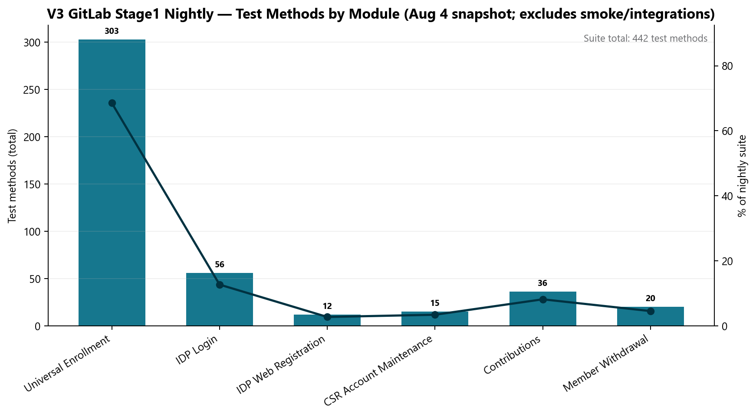
V3 Stage1 Nightly Snapshot
V3
What this counts
• 442 methods — GitLab Stage1 nightly only (Aug 4)
• Framework + CI/CD accumulated over ~1 year
• UE 303 = scenarios × plan/traunch matrix
• Entity suites expanding — not all in Aug 4 log
Note: Additional V3 coverage: Stage 5 smoke (UE + IDP), integration profiles, Entity track — not in 442.
GitLab scheduled_regression_job · Aug 4
10

Slide 14
V3 Delivery Highlights
V3
Key points
• Entity registration/login suites expanded
• IDP open-account and member withdrawal regression
• Flaky-test stabilization and web registration flows
• Stage 5 smoke suites for UE + IDP
V3 highlights
11

Slide 15
API / Unite MSC
Rescued · accelerated

Slide 16
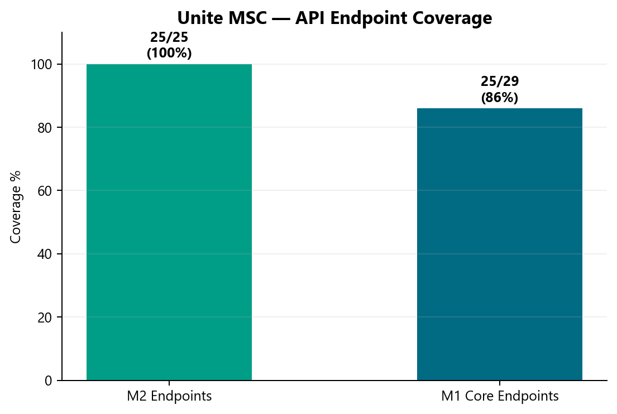
MSC Endpoint Coverage
MSC
MSC status
• M2 25/25
• M1 ~25/29
• ~50% ETA savings
api-test-automation
12

Slide 17
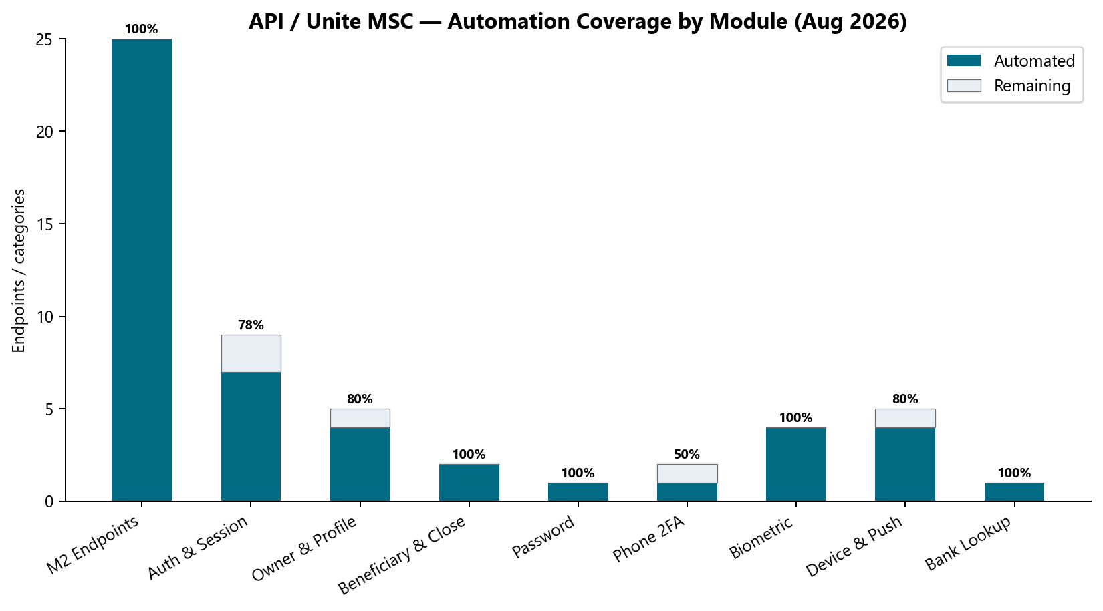
API Module Breakdown
API
M1 categories
• Auth, profile, biometric, device, bank
• Master suite in progress
api-test-automation
13

Slide 18
Performance Testing
Labels × plans model

Slide 19
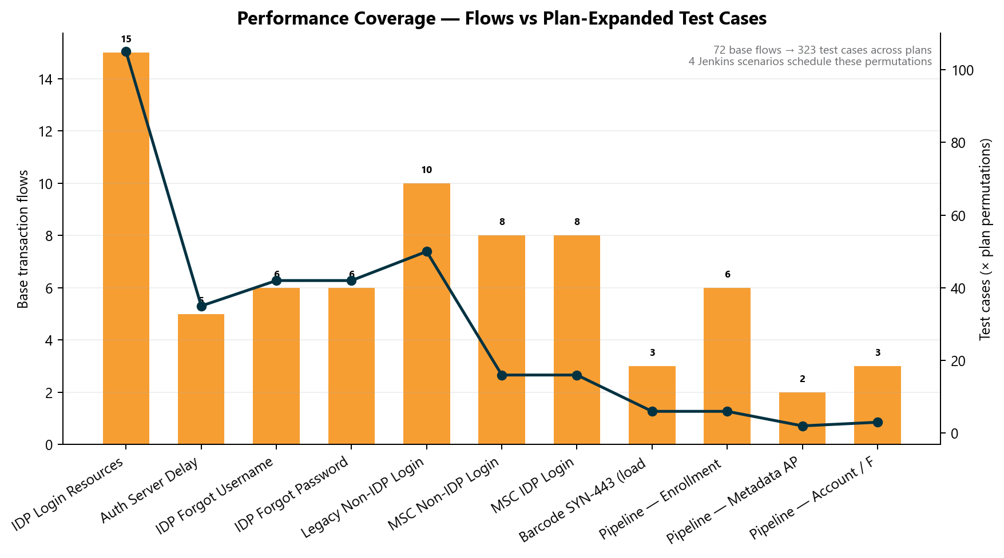
Perf Test Case Inventory
Perf
Why the numbers look large
• 72 base transaction flows → 323 plan-expanded cases
• Bars = flows; line = cases after × plan matrix
• 4 Jenkins scenarios schedule these permutations
• IDP alone: 15 labels × 7 plans = 105 cases
Perf inventory
14

Slide 20
Performance Value
Perf
Key points
• Repeatable baselines — no manual re-run each release
• Evidence for platform team pre/post patch comparison
• Department perf DoD and BlazeMeter reporting standard
Perf value
15

Slide 21
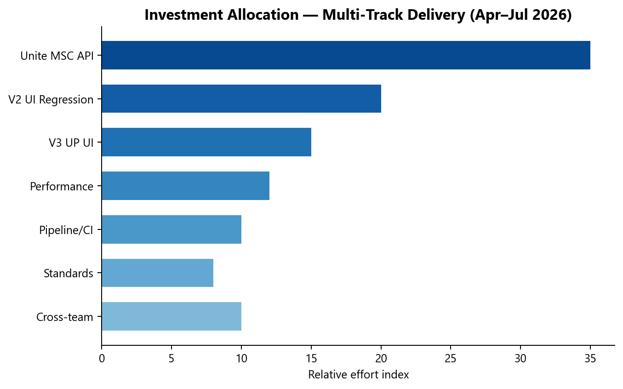
Investment Allocation
Portfolio
Effort mix
• MSC API 35%
• V2 20%
• V3 15%
• Perf 12%
Squad estimate Apr–Jul
16

Slide 22
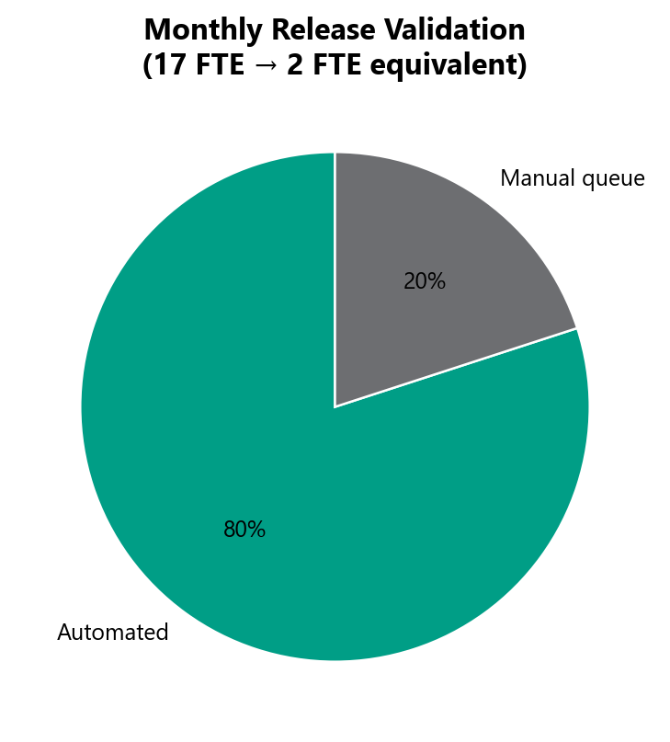
Release Automation Impact
Value
Business value
• ~80% automated
• 17 FTE → 2 FTE equivalent
Release validation
17

Slide 23
AI Acceleration
AI
Key points
• MSC migration agents — Postman, docs, TestNG boilerplate
• Automation bug lifecycle — Cursor skill + standardized reporting
• Chart & metrics generators — reproducible leadership packs
• Coverage intelligence foundation for monthly dashboard
AI tooling
18

Slide 24
Roadmap Q3–Q4 2026
Roadmap
Key points
• P0: MSC GitLab nightly · M1 master suite
• P1: MSC enrollment API · CSR Actions nightly expansion
• P2: Entity V3 nightly · automated monthly dashboard
Roadmap
19

Slide 25
Leadership Asks
Asks
Key points
• Roadmap visibility — AM Squad at SDLC start, not sign-off deadline
• Administrative capacity — free lead for architecture & AI tooling
• Recommended: 30-minute live walkthrough
Asks
20

Slide 26
QA Automation AM Squad
Delivering across six automation channels · Team since Q2 2025

