Slide 1
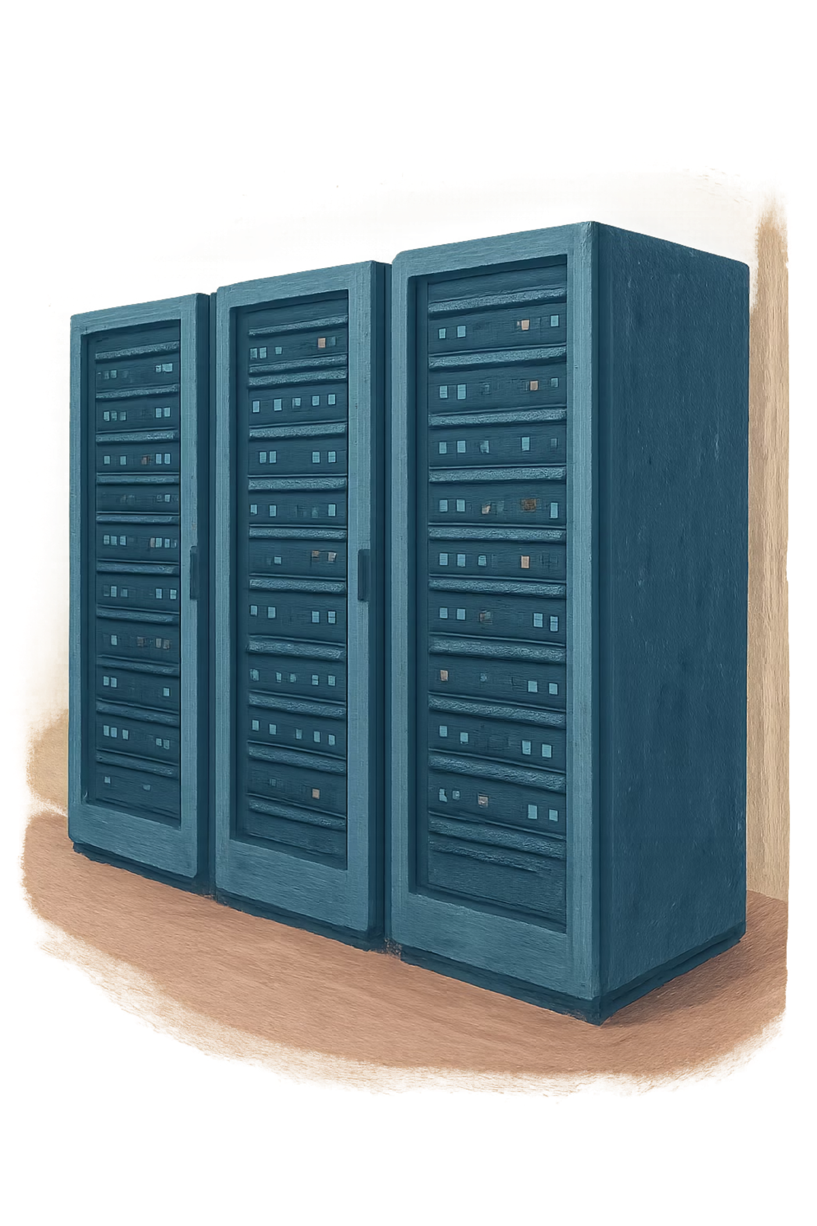
Unite MSC Automation Program
Weekly Leadership Update · July 17, 2026
QA AUTOMATION
AMSQUAD
Prepared for: Rajiv/Rajib, Henry, Kevin

Slide 2
Executive Summary
From fragmented legacy coverage to reusable canonical automation
Mobile 2 API
Mobile 1 API
Performance
Baseline functionally complete — 88% endpoint coverage verified. Ready for leadership sign-off pending evidence refresh.
Active sprint focus. Authentication foundation complete; business endpoint automation now underway.
Foundation live on MSC Jenkins. Non-IDP login flow complete; IDP and nightly schedule expanding.
Pipeline
V2/V3 UI
GHA deployment validation slice complete. GitLab nightly regression job pending DevOps story approval.
Stable nightly regression running. Daily triage cadence established and maintained by the team.

Slide 3
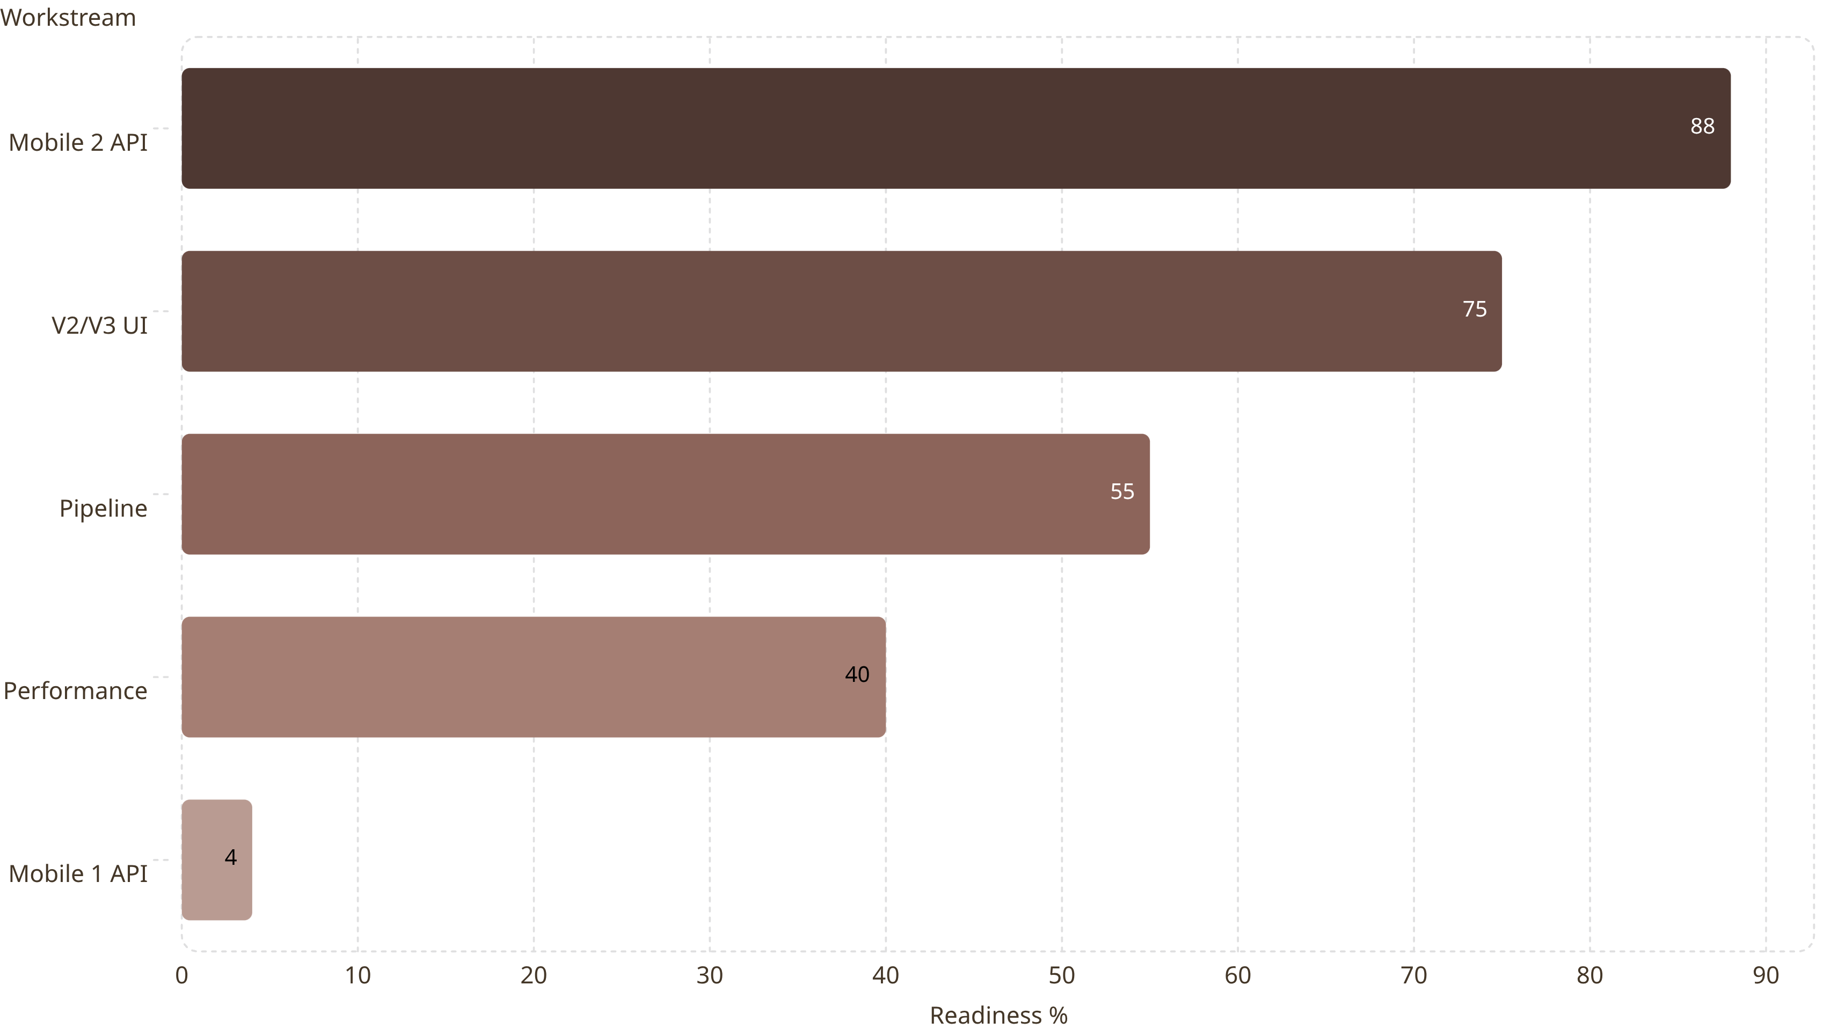
Program Metrics Snapshot
Readiness by workstream — as of July 17, 2026, in Percentile
Note: Mobile 2 and Mobile 1 percentages reflect endpoint automation coverage. Pipeline, Performance, and V2/V3 UI reflect qualitative program readiness assessments.

Slide 4
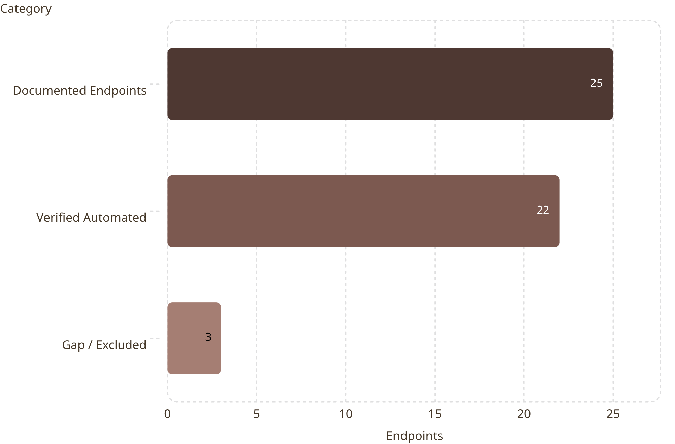
Mobile 2 Endpoint Coverage
88% Verified
As of 2026-07-14 — the formal validation checkpoint.
Coverage is not claimed at 100%. Three endpoints remain excluded or in-gap pending team disposition.
Projected coverage increases after post-07/14 merges are incorporated. A refreshed validation run is required before final sign-off.

Slide 5

Mobile 2 Sign-Off Path
Baseline functionally complete — pending evidence refresh
✅ COMPLETED
🔲 OPEN ITEMS
Canonical TestNG Migration
Final MR Merge
Full migration from legacy framework to reusable canonical TestNG structure complete.
Outstanding merge request must be closed before evidence snapshot is refreshed.
OKD + NMD Environment Support
QC4 + Stage 1 Execution Run
Full suite execution required on QC4 and Stage 1 environments to confirm stability.
Test suites validated against both OKD and NMD deployment targets.
Dynamic SQL Auth + Master Suites
GitLab Nightly Job Creation
DevOps story approval required to establish the scheduled regression job in GitLab.
Dynamic authentication via SQL and master suite orchestration fully implemented.

Slide 6
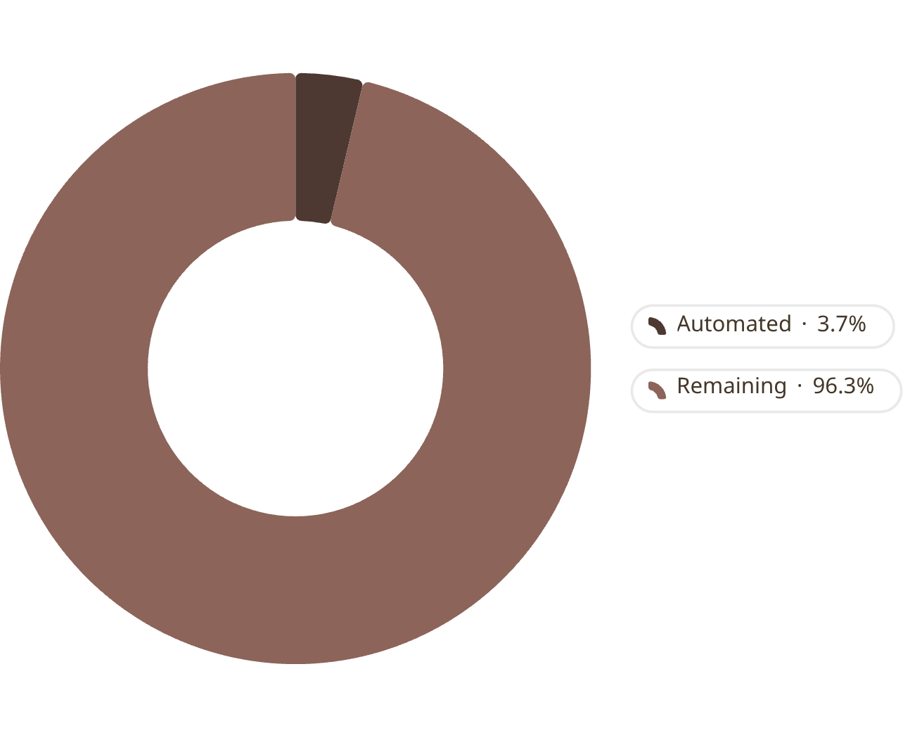
Mobile 1 — Active Sprint Focus
Authentication Foundation Complete
The non-IDP authentication baseline has been established, enabling systematic business endpoint automation to begin this sprint. IDP compatibility work is scoped for the following sprint.
This Sprint (26.11)
1
Mobile 1 Non-IDP baseline — core business endpoint automation
2
Next Sprint (26.12)
Mobile 1 IDP compatibility + suite hardening and stabilization
1 of 27 endpoints automated to date

Slide 7

CI/CD Pipeline Workflow
GitHub Actions deployment validation is distinct from GitLab nightly regression
Source Code
Maven Build
Nexus Archive
GitHub Actions
✅ COMPLETE
🔶 IN PROGRESS
⬜ PENDING
GitHub Actions Dashboard — Deployment validation slice confirmed live and operational.
Module Suites — Suite wiring to GHA pipeline actively being configured and tested.
GitLab Nightly — Scheduled regression job requires DevOps story creation and approval.

Slide 8

Performance Regression Status
MSC Jenkins Job
✅ Available — Performance regression job provisioned on MSC Jenkins. Foundation infrastructure is live.
Non-IDP Login → Dashboard
✅ Complete — End-to-end non-IDP login through dashboard flow validated and passing.
IDP MSC Login
🔶 In Progress — IDP-based login flow under active development. Blocked on clean manual validation baseline.
Nightly Schedule
⬜ Pending — Nightly execution will be enabled after manual validations pass cleanly and consistently.
Next flows in queue: Contribution, Banks, Activity, Mobile 1 — to be sequenced after IDP flow stabilization.

Slide 9
Risks & Dependencies
RAG Status — July 17, 2026
Risk / Dependency
Severity
Impact & Mitigation
GitLab Nightly Not Created
🔴 High
Blocks continuous regression signal for Mobile 2 sign-off. Requires DevOps story approval this sprint.
Stage 1 / Stage 5 / QC2 Test Data
🟡 Medium
Missing or inconsistent test data in environments delays suite execution and sign-off evidence.
Enrollment Encryption / Test-Data Utility
🟡 Medium
Multi-sprint complexity. Dependency on shared utility development cadence outside team control.
Reporting / Admin Load
🟡 Medium
Administrative overhead reducing available engineering sprint capacity. Escalation support requested.
Ad-Hoc Intake (Unstructured)
🟡 Medium
Unplanned requests disrupting sprint commitments. Structured backlog intake enforcement needed.

Slide 10
Leadership Asks & Sprint Roadmap
Leadership Actions Requested
Sprint Roadmap
01
Sprint 26.11
1
Approve DevOps Story
Mobile 2 sign-off · Mobile 1 non-IDP baseline · Pipeline GHA module wiring
Authorize GitLab nightly regression job for Mobile 2 — critical for sign-off evidence.
2
Sprint 26.12
02
Mobile 1 IDP compatibility · Suite hardening · GitLab nightly regression live
Confirm Mobile 2 Sign-Off
Horizon
3
Review and approve sign-off after refreshed evidence run is submitted by the team.
Enrollment API — multi-sprint effort · Performance full flow coverage
03
Confirm Mobile 1 Priority
Affirm sprint commitment to Mobile 1 non-IDP baseline this sprint (26.11).
04
Support Pipeline & Environments
Ensure environment readiness and DevOps alignment across Stage 1, QC4, and GitLab.
05
Enforce Backlog Intake + Protect Capacity
Structured intake for all ad-hoc requests. Support 30–40% capacity protection from BA/Scrum/admin load.

