Slide 1
Unite MSC Automation
Scope Alignment · July 23, 2026 Rajib · Henry · QA Automation

Slide 2
Why We Are Here
Follow-up from Jul 17 bi-weekly — Henry raised SQL validation scope concern
Rajib asked: how deep should we go with Unite MSC automation?
Today: align on what is DELIVERED vs what is OPTIONAL enhancement
Confirm hybrid environment strategy (QC4 unstable → Stage 1 primary)
Identify SMEs for sign-off and performance criteria

Slide 3
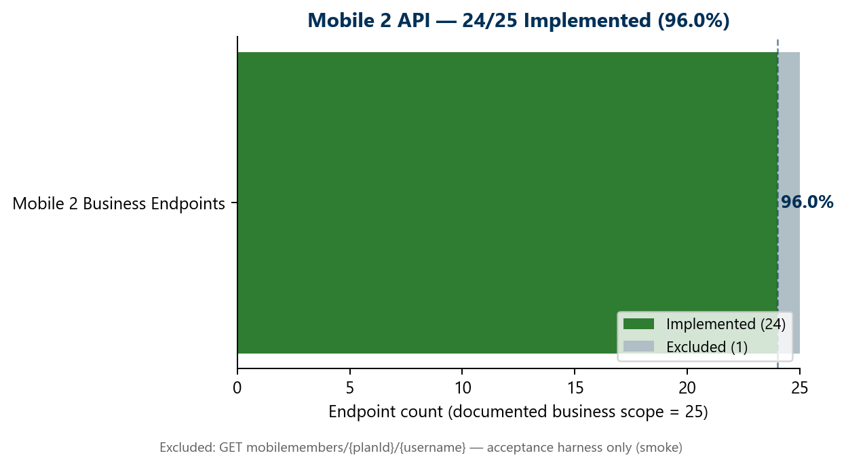
Program Status — Jul 23
Mobile 2: 24/25 endpoints (96.0%) — COMPLETE
Mobile 1: 6/27 endpoints (22.2%) — IN PROGRESS
Canonical TestNG framework on main — shared across QA
Performance: regulations + DoD live; nightly Jenkins on Stage 1
GHA pipeline: Dashboard slice validated

Slide 4
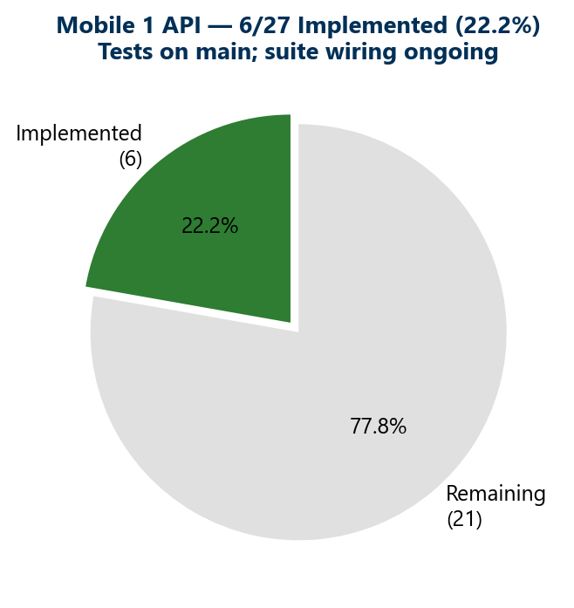
Mobile 1 Progress
Tests exist on main — suite wiring is weekly hygiene, not a delivery blocker

Slide 5
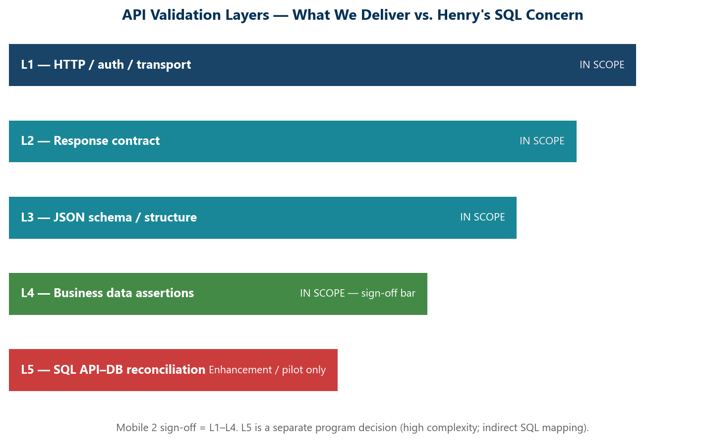
API Validation Layers
Sign-off bar = L1–L4. L5 SQL is a separate program decision.

Slide 6
Concern — SQL Validation
Current delivery: HTTP + schema + business assertions (L1–L4)
L5 SQL API–DB compare = JDBC queries mapped to API JSON fields
Unite MSC BFF layer makes 1:1 SQL mapping very difficult
Developers also struggle with indirect SQL-to-endpoint mapping
Recommendation: L5 as optional pilot — NOT a Mobile 2 blocker

Slide 7
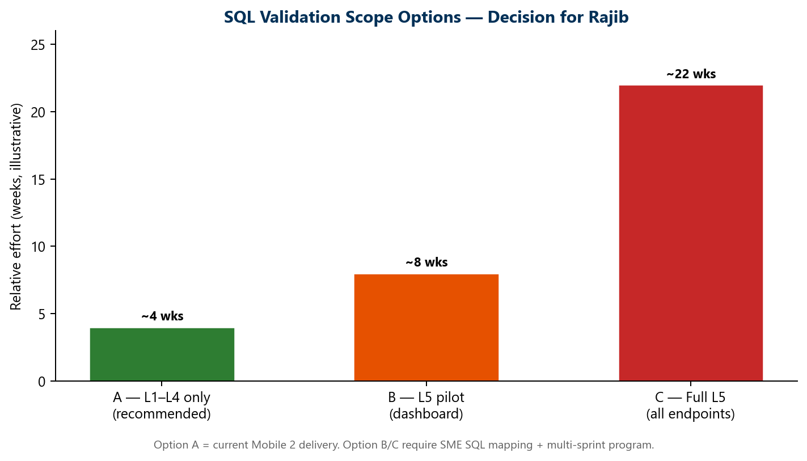
Scope Options for Rajib
Option A = recommended. Options B/C need SME commitment + multi-sprint plan.

Slide 8
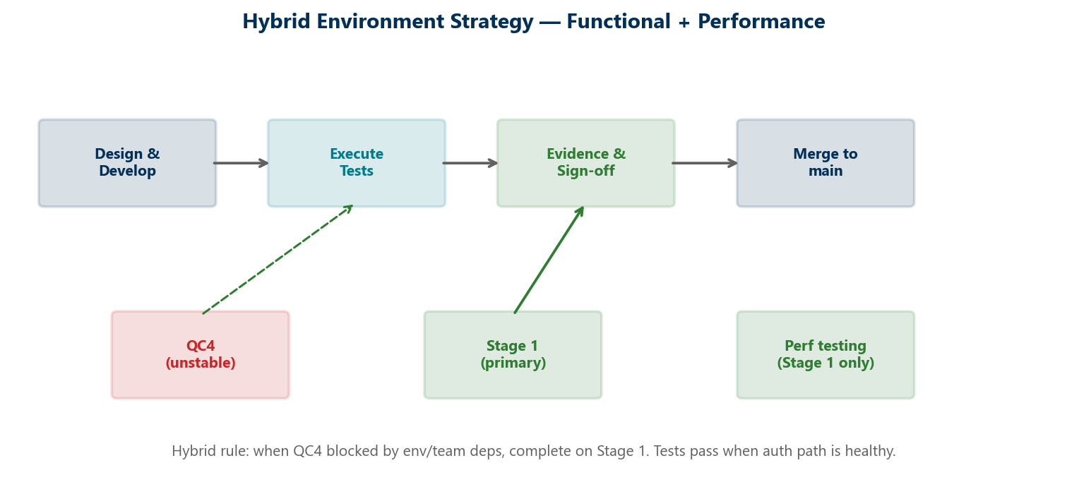
Hybrid Environment Strategy
Stage 1 primary for functional + performance while QC4 has team dependencies.

Slide 9
Mobile 2 — What We Delivered
24/25 business endpoints — framework + dashboard + custom reporting
OKD + NMD branding; module + master regression suites
Excluded: mobilemembers harness endpoint (smoke only)
Stage 1 verified Jul 22 — tests pass when auth path healthy
Sign-off: merge pending items + refreshed evidence run

Slide 10
Mobile 1 — Delivered Endpoints
POST mobilemembersession — auth foundation
GET mobileowner, mobileOwnerMenu, mobileprofilemenu
GET mobilebeneficiaryByExt/{ext}
GET mobilebankinfobyroutingnum/{routingNum}
21 endpoints remaining — active sprint migration

Slide 11
Performance — Stage 1 Only
Priti: Stage 1 only — stable, production-like load
Regulations + DoD from scratch; nightly Jenkins live
25-user baseline; BlazeMeter reports
SME input needed for production-like success criteria
Henry to help identify performance criteria owner

Slide 12
Decisions Needed Today
1. Confirm L1–L4 as Mobile 2 sign-off bar
2. L5 SQL — defer, pilot (dashboard), or full program?
3. Approve hybrid Stage 1 strategy
4. Identify sign-off + performance SMEs
5. Confirm MSC automation strategic direction

