Slide 1
Unite MSC Automation
Scope Alignment
July 23, 2026
QA Automation · AMSQUAD
Mobile 2
Mobile 1
Sign-off
Environment
24/25
6/27
L1–L4
Stage 1

Slide 2
Why We Are Here
Meeting objective
● Follow-up from Jul 17 bi-weekly — SQL validation scope raised
● Leadership asked: how deep should Unite MSC automation go?
● Align on what is DELIVERED vs OPTIONAL enhancement
● Confirm hybrid environment strategy (QC4 unstable → Stage 1 primary)
● Identify SMEs for sign-off and performance criteria
● Identify SMEs for Performance testing final Prod Like criterion review, approval & selection
Unite MSC Automation · Scope Alignment · Internal
2

Slide 3
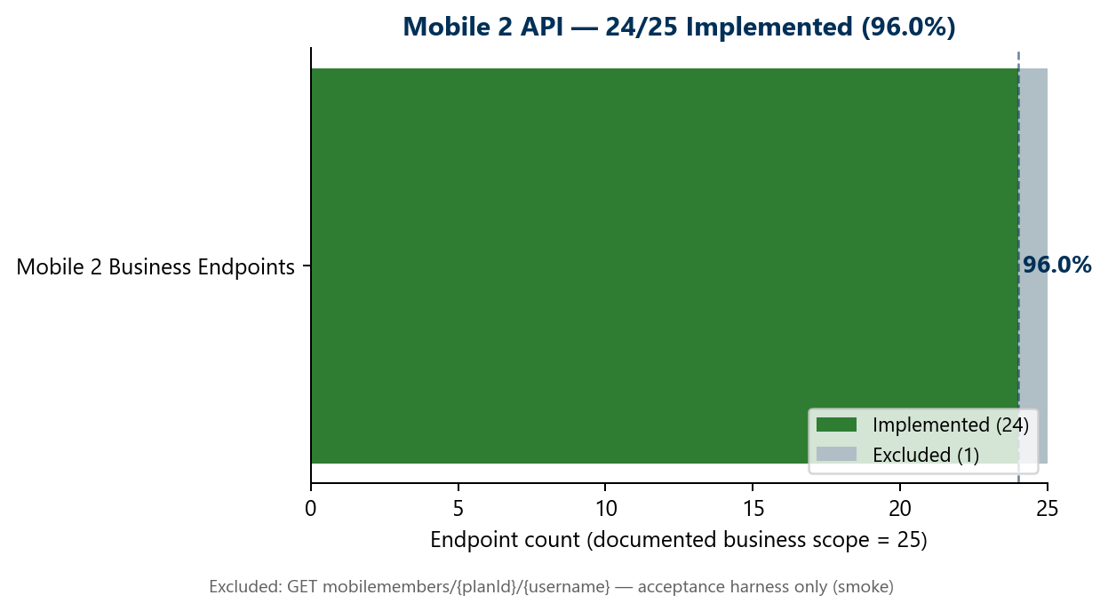
Program Status
Updated July 23, 2026
Mobile 2 API
Mobile 1 API
Performance
Pipeline
24/25
6/27
Live
GHA
96.0% · COMPLETE
22.2% · IN PROGRESS
Stage 1 · Nightly Jenkins
Dashboard · Slice validated
24 business endpoints implemented — 1 harness endpoint excluded by design | This endpoint used to look up a member for test harness / acceptance flows — not a customer-facing business endpoint; Has a smoke test (MobileMembersRequestTest) but is intentionally not counted in the 24/25 business numerator
3
Unite MSC Automation · Scope Alignment · Internal

Slide 4
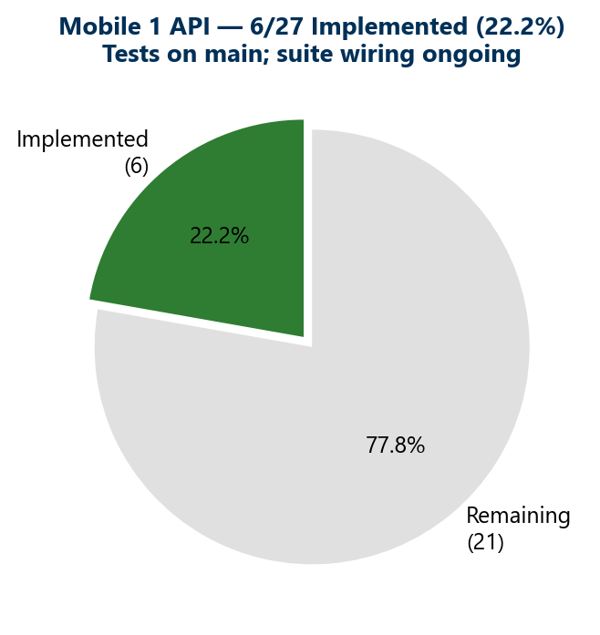
Mobile 1 Progress
● 6 of 27 endpoints implemented (22.2%)
● Auth foundation complete on main
● Owner, profile, beneficiary, bank info delivered
● Tests exist — suite wiring is weekly hygiene
● 21 endpoints remaining in active migration
Implemented = canonical test on main
Unite MSC Automation · Scope Alignment · Internal
4

Slide 5
Validation Scope
What we deliver vs. optional enhancement

Slide 6
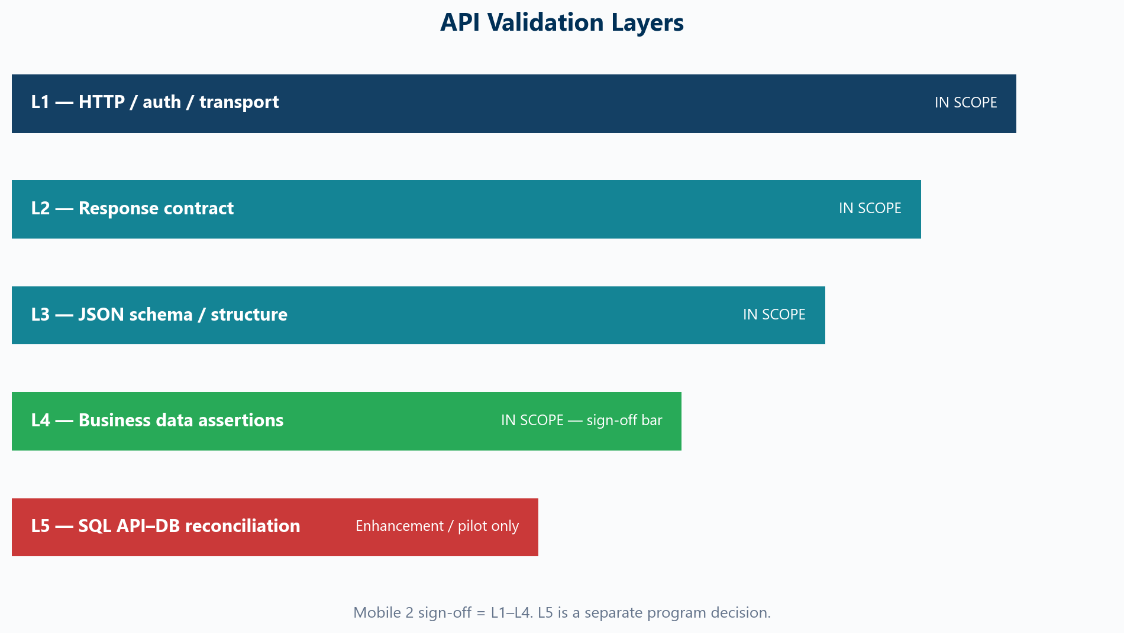
API Validation Layers
Addressing the SQL validation scope concern
Sign-off bar = L1–L4 · L5 SQL is a separate program decision
Unite MSC Automation · Scope Alignment · Internal
6

Slide 7
SQL Validation — Discussion Topic
For leadership discussion
● Current delivery: HTTP + schema + business assertions (L1–L4)
● L5 SQL API–DB compare = JDBC queries mapped to API JSON fields
● Unite MSC BFF layer makes 1:1 SQL mapping very difficult
● Development team also struggles with indirect SQL-to-endpoint mapping
● Recommendation: L5 as optional pilot — NOT a Mobile 2 blocker
● Scope options chart available as reference asset (not in deck)
Unite MSC Automation · Scope Alignment · Internal
7

Slide 8
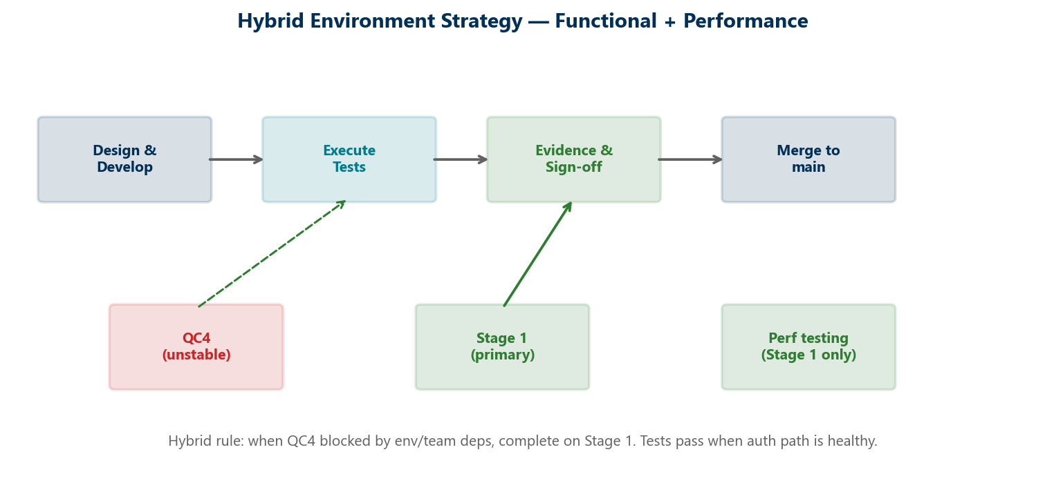
Hybrid Environment Strategy
QC4 instability workaround
Stage 1 primary for functional + performance while QC4 has team dependencies
Unite MSC Automation · Scope Alignment · Internal
8

Slide 9
Mobile 2 — Delivered
● 24/25 business endpoints complete
● Framework + dashboard + custom reporting
● OKD + NMD branding; module + master suites
● Excluded: mobilemembers harness (smoke only)
● Stage 1 verified Jul 22 when auth path healthy
Unite MSC Automation · Scope Alignment · Internal
9

Slide 10
Performance — Stage 1 Only
Performance regression program
● Stage 1 only — stable, production-like load possible
● Regulations + DoD established; nightly Jenkins live (weekdays)
● 25-user baseline; BlazeMeter reports
● SME input needed for production-like success criteria
● Expansion: Dashboard → Contribution → Banks → Activity
Unite MSC Automation · Scope Alignment · Internal
10

Slide 11
Decisions Needed Today
Scope · Environment · SMEs
01
Confirm L1–L4 as Mobile 2 sign-off bar
02
L5 SQL — defer, pilot (dashboard), or full program?
03
Approve hybrid Stage 1 strategy while QC4 unstable
04
Identify sign-off + performance SMEs
05
Confirm MSC automation strategic direction
Unite MSC Automation · Scope Alignment · Internal
11

