Slide 1
QA Automation — AM Squad
Biweekly Status · September 11, 2026
Rajib · Henry · Persistent Delivery Managers

Slide 2
Executive Pulse
At a glance
26.14 – 26.15 (current)
GitLab merges
Sprint 26.15 items
MSC in-scope APIs
Regression bugs
ETA track
~70% of
original ETA
14
165
76/79
8
Aug 27 – Sep 10 · api-test-automation repo
Board items in Sprint 26.15
M1 26 + M2 25 + Enrollment 25/28 (3 partner deferred)
Regression bugs in Sprints 26.14–26.15
3-sprint delivery window
What leadership should know
• Scope: Sprints 26.14 and 26.15 (current) — MSC API coding is done on main
• M1/M2/Enrollment: 76/79 in-scope endpoints — 3 partner APIs deferred by design
• Pending MR !265: suite wiring + negatives — blocked on Snyk gate
• Sign-off sprint in progress: docs, traceability matrix, qTest, Bruno, KT (QA-2039–2047)
Sources: Jira AMSQUAD board · GitLab (3 repos) · Jenkins/GitLab nightly logs
2

Slide 3
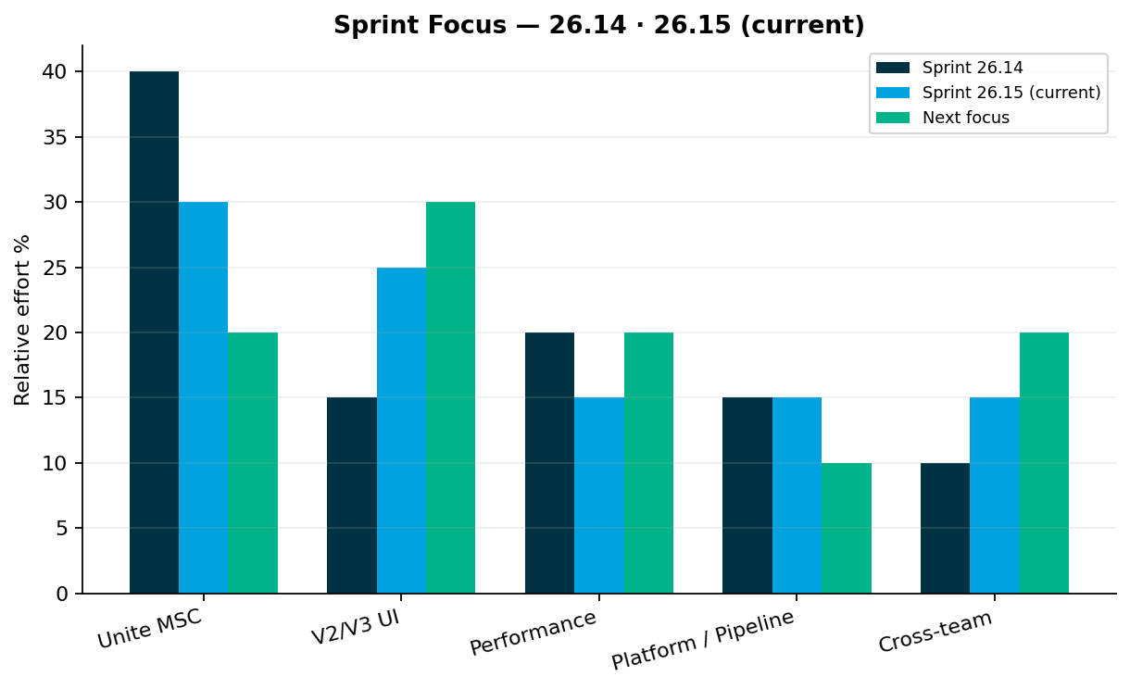
Sprint Delivery Focus
Delivery
Sprints 26.14 · 26.15 (current)
Key messages
• Sprint 26.14: Enrollment E2E complete on main (MRs 255–262); contribution perf JMX
• Sprint 26.15: Sign-off docs, traceability, MR !265 merge, V2 gap analysis (Venkatesh)
• V2: 8 P0 gaps are wire existing automation to daily regression — not greenfield
• Perf: M1 auth/login JMeter scripts in progress (QA-1983–1986)
Relative effort index — not FTE hours
3

Slide 4
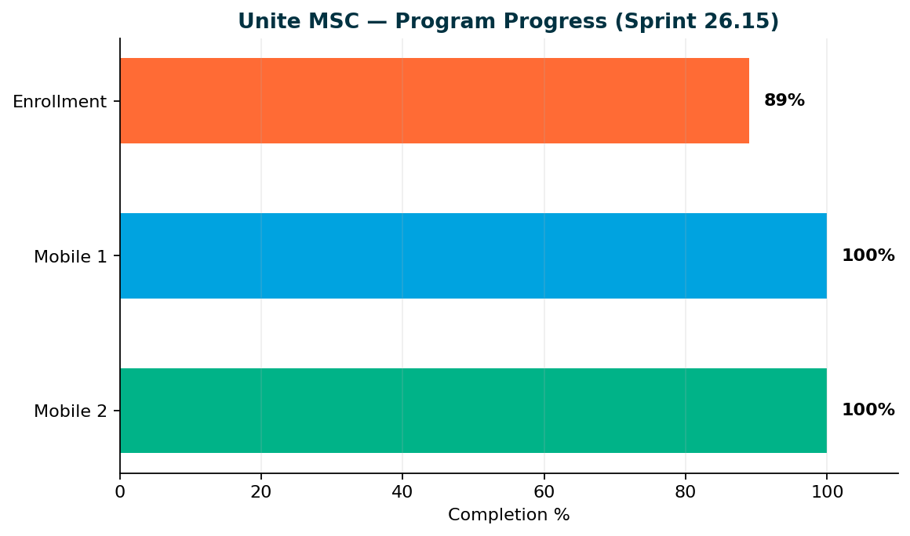
Unite MSC — Program Status
MSC
Mobile 2 100% · Mobile 1 100% · Enrollment 89%
Key messages
• Mobile 2: 25/25 endpoints — sign-off ready
• Mobile 1: 26/26 in-scope operations — sign-off ready
• Enrollment: 25/28 catalog (89%) — standard 15/15 + subsequent 5/5
• Deferred: Partner submit (QA-1808), Upromise (QA-1807), OAuth token
• Wrap-up: Sign-off docs (QA-2043), GitLab enrollment nightly…
• Target: Sprint 26.15 close — coding done; sign-off + handoff sprint in progress
Coding/design complete for M1, M2, and enrollment MSC scope. MR !265 finalizes suite wiring + validation gaps. Program close = docs, traceability, sign-off owners.
4

Slide 5
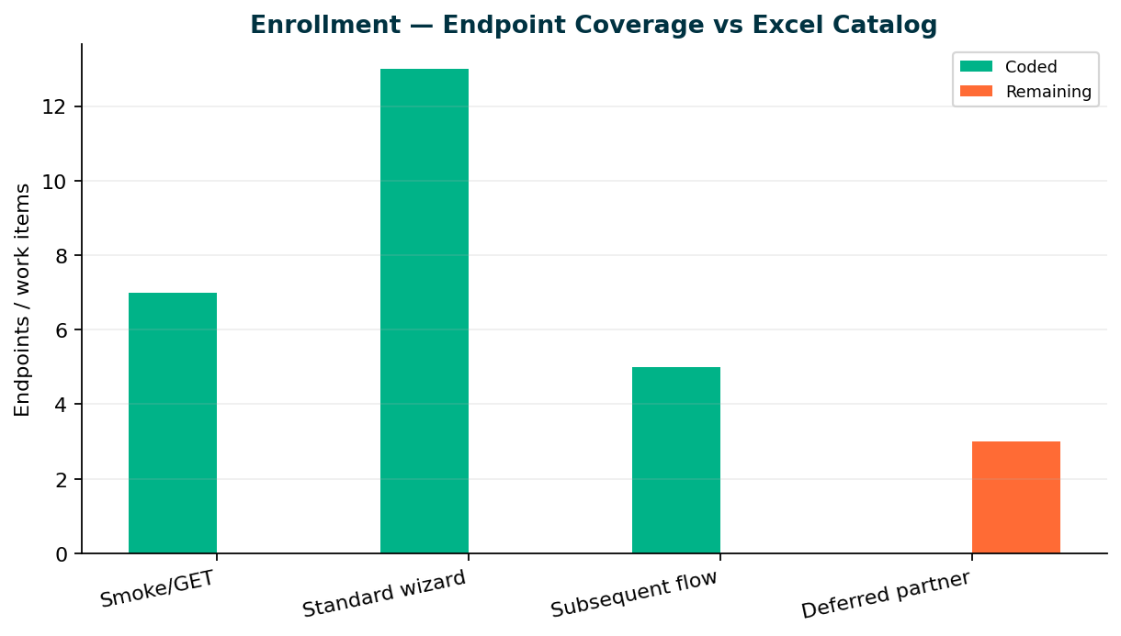
Enrollment — Endpoint Coverage
Enrollment
Core E2E 15/15 · Catalog 25/28
Key messages
• 25 TestNG classes on main — standard + subsequent E2E complete
• MR !265 (QA-1938): negatives, optional-step config, M1/M2 suite XML wiring
• 3 deferred partner endpoints: Partner submit (QA-1808), Upromise (QA-1807), OAuth token
• Sign-off: coverage matrix, qTest, Bruno, enrollment GitLab nightly
• KB: programs/unite-msc/api-test-automation/mappings/enrollment-endpoint-current-state.csv
Repo: api-test-automation/mobile/enrollment
5

Slide 6
Pending Merge — !265
GitLab
QA-1938 — Validate E2E coverage & automate remaining standard-flow gaps
Changes
Author
Status
110
Dinesh Kumar
Open
Files in MR
Jira: closes QA-1938
Snyk scan / security gate — merge when pipeli
What this MR delivers
• M1/M2 suite wiring (integration + regression TestNG XML), enrollment README, gap closures + negatives from QA-1938 subtasks
• 30 M1 + 25 M2 TestNG suite XML updates (integration + regression)
• Enrollment gap closures: content, enrollment-started, recurring, allocation-funds + negatives
• Reviewers: Swapnil Patil, Venkatesh Mallela
https://gitlab.com/ascensus-gs/products/depot/qa-automation/api-test-automation/-/merge_requests/265
6

Slide 7
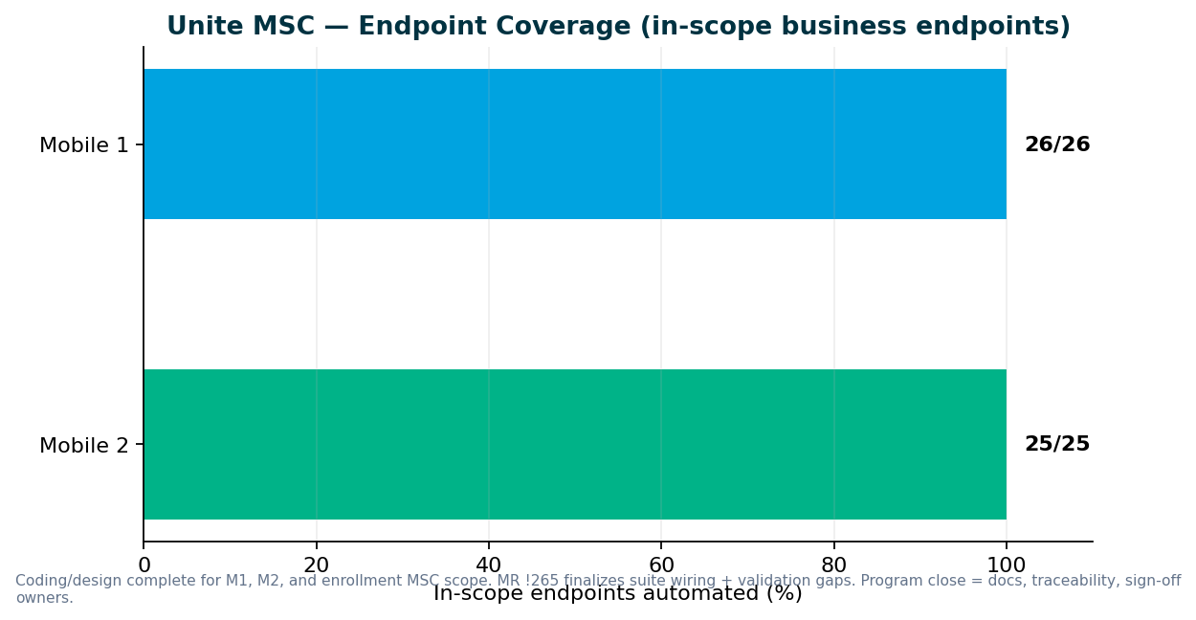
Unite MSC — Endpoint Coverage
MSC
M2 25/25 · M1 26/26 in-scope
Key messages
• All in-scope business endpoints automated — 100% for Mobile 1 and Mobile 2
• Destructive endpoints run in smoke/integration — not duplicated in master regression
• Stage1: IDP + non-IDP paths validated; QC4 hybrid proof pending env stability
• GitLab nightly + ENVP pipeline integration (QA-1405, QA-1544–1549)
• Need leadership to name sign-off owners for M1, M2, pipeline, and perf
Repo: programs/unite-msc/api-test-automation/mappings/
7

Slide 8
Pipeline & Environments
Infrastructure
Hybrid QC4 + Stage1 model
Current state
What we need
• IDP + non-IDP paths validated for M1/M2/Enrollment on Stage1
• Hybrid model — integration proof continuing post DB refresh
• Mobile 2 nightly delivered (QA-1405); enrollment nightly in wrap-up
• QC4 has no non-IDP plants in lower env today — need product owner to confirm test plans
• Pipeline is not 'done' until QC4 proof passes — design is ready
• DevOps: GitLab nightly job for MSC regression (in progress)
• Leadership: identify non-IDP plan contacts for lower-environment testing
• Sign-off: names for M1/M2 acceptance before we schedule review sessions
Aligned with Jul 2025 hybrid decision — Stage1 primary until QC4 stabilizes
8

Slide 9
V2 & V3 UI Automation
UI
Sprint 26.15 — V2 gap analysis (Venkatesh) + V3 maintenance; MSC wrap-up parallel
V3 (GitLab) — maintenance + stabilization
V2 (Jenkins) — sunset discussion needed
• Universal enrollment account creation failures (QA-2014)
• Member personal information validation flakes (QA-2012, QA-2013)
• V3 is source of truth for migrated plans — invalid contact scenarios may move from V2
• Venkatesh completed V2 regression suite inventory — 8 P0 gaps are 'turn on what we already have'
• Jira epic QA-1943–QA-2010 tracks suite inventory, classification, and adding missing daily coverage
• Active bugs: voucher invalid on withdrawal (QA-1989 V2, QA-1990 V3), PAB enrollment allocation (QA-1988)
• Classify each V2 test retain/migrate/replace/retire (QA-1962) before suite changes — do not retire solely because failing (QA-1963)
Regression bugs — Sprints 26.14–26.15
• QA-2014: V3 Universal Enrollment — unable to create account (26.15)
• QA-2013: V3 CSR Member Personal Information validation (26.15)
• QA-1990: V3 withdrawal voucher invalid on Review and Submit (26.15)
• QA-1989: V2 CSR withdrawal voucher invalid (MND, NYD, MID, WVD, IND) (26.15)
• QA-1988: V2 PAB legacy enrollment — allocation field blocks Step 6 (26.15)
V2 focus: wire existing features to daily regression before building new automation
9

Slide 10
V2 Regression — Gap Analysis
V2
By Venkatesh Mallela
P0 — Turn on existing automation (@dailyrun)
P1 — Extend coverage · P2 — Build new
• Reversal — Reversal.feature exists; add @dailyrun to stage1-csr-actions (1–2 scenarios first)
• Plan transfer / rollover — add @dailyrun for Rollover In + Plan Transfer from Partner on Direct/Advisor
• Inter-plan transfer — restore one daily test from Archive (e.g. NYD); confirm traunch valid
• Share adjustment / Conversion — add Direct/Advisor to CSR_ShareAdjustment.feature @dailyrun
• Principal update (P&E) — add one daily row for Direct (CSR_PandE.feature)
• stage1-acct-overview — optional ABLE (NYB) balance row
• stage1-csr-acct-maintenance — invalid contact, authorized individual, bank negatives, trusted contact
• stage1-csr-actions — advisor greenscreen fees; optional ABLE contrib/fees
• —
• P2: YTD bucket, financial history, failed txns, bank history…
Daily regression covers contrib, fees, withdrawals, investments, G100, profile maintenance — but misses reversal, plan t…
10

Slide 11
Performance Testing
Perf
Sprint 26.15 — Mobile 1 perf scripts in progress; contribution JMX delivered
Sprint 26.14
Sprint 26.15
Sprint 26.15
MSC contribution
full-flow JMX
Mobile 1 auth/login
JMeter scripts
Perf governance
process + intake templat…
QA-1802
QA-1983–QA-1986
QA-1965–QA-1969
Sprint deliverables
• MSC contribution full-flow JMX: Delivered
• Mobile 1 auth/login JMeter scripts: In progress — NY, NMD, OKD parameterized
• Perf governance process + intake template: In progress
Ongoing baseline track
• IDP login, legacy login, MSC login baselines in weekday regression
Perf intake governance — see next slide
11

Slide 12
Performance Governance — Leadership Ask
Ask
Stop last-minute emergency intake
In progress (Sprint 26.15)
What we need from leadership
• Perf intake template + SLAs by change size (QA-1965–1969)
• Confluence Performance Testing Hub governance guidance
• Train Dev/QA/PM stakeholders on standard intake process
• Mandate perf gate for IDP login, enrollment, contributions, withdrawals before release
• Route requests through SDLC intake — not last-minute before deploy
• Approve M1 perf script priority: NY, NMD, OKD (QA-1983–1986)
Contribution JMX delivered Sprint 26.14 — M1 scripts in flight
12

Slide 13
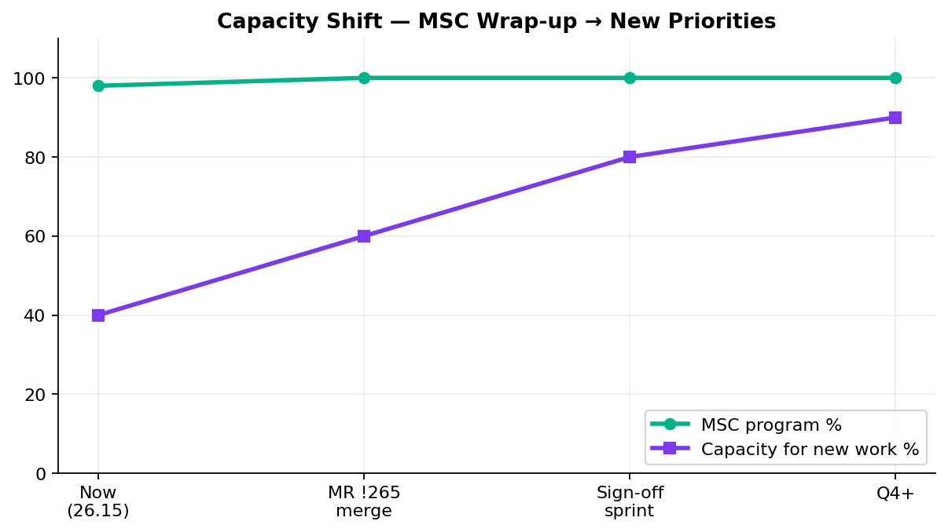
Capacity — MSC Wrap-up vs New Work
Capacity
1 resource close-out · 3.5 FTE for next priority
Key messages
• Coding complete — Sunil + docs stories (QA-2039–2047) for sign-off package
• New work capacity: 3+ FTE pivoting to V2 gap closure + Atlas intake post MR !265 merge
• Sunil → MSC wrap-up: qTest, Bruno, coverage matrix, handover docs
• Preeti → perf: contribution JMX now; M1+enrollment perf next sprint
• Main squad → ACS-5678 Atlas (Oct) OR V2/V3 backlog — need leadership queue
MSC coding done — sign-off + handoff in progress
13

Slide 14
V2 → V3 Migration Path
Strategy
Reduce Jenkins footprint
Plan
• Retire obsolete V2 Jenkins cases as plans migrate to V3; expand daily regression with existing automation first
• Venkatesh gap analysis shows 8 P0 items need @dailyrun wiring — not new code
• Leadership: approve P0 daily regression additions before P2 new-screen builds?
• Lead: Venkatesh Mallela / Wence
• Outcome: lighter GitLab-based V3 suites; retire duplicate V2 enrollment from Jenkins
Aligns with platform direction — V3 as source of truth
14

Slide 15
Incoming: ACS-5678 Atlas
New work
Traffic distribution & load balancer rebalancing
AHA summary (Brian Danilczyk)
• ACS-5678 — Atlas Traffic Distribution & Load Balancer Rebalancing — #2 on Michael's list
• Estimate: 2–3 sprints · Target: October 2026 delivery
• Status: Ready for intake once MSC sign-off closes
• Dependency: Redis session-management initiative
• Scope: validate traffic distribution after Redis session externalization; load + perf testing
• Main squad can start intake next sprint while 1 resource finishes MSC wrap-up
Confirm priority vs MSC wrap-up, V2 sunset, and other AHA items
15

Slide 16
Leadership Asks & Decisions Needed
Decisions
Please respond on this call — by area
Roadmap & capacity
• MSC coding is done — confirm sign-off sprint + sustaining owner (ACM) this week
• Post-MSC queue: Atlas (Oct) vs V2 P0 daily regression vs V3 expansion?
• Approve merge of MR !265 once Snyk gate clears
Unite MSC / API automation
• Formal sign-off for M1 (26/26), M2 (25/25), Enrollment (25/28 MSC scope)
• Accept 3 deferred partner endpoints (submit, Upromise, OAuth) as out of scope
• Name sign-off contacts for pipeline and perf baselines
V2 regression (Jenkins)
• Approve P0 daily regression additions from Venkatesh gap analysis (8 items — mostly @dailyrun wiring)
• Confirm plan-migration rules before retiring legacy direct-plan cases (QA-1961–1964)
• Prioritize P0 turn-on vs P2 new-screen builds for Q4 capacity
V3 universal platform (GitLab)
• IDP enrollment account creation failures (QA-2014) — product/env owner?
• Invalid contact / security-question scenarios — confirm V3 ownership vs V2 maintenance
Performance & stress testing
• M1 perf scripts in progress (QA-1983–1986) — confirm NY/NMD/OKD priority
• Approve perf intake template + SDLC gate (QA-1965–1969)
Pipeline & environments
• Enrollment GitLab nightly — schedule in wrap-up sprint
• QC4 integration proof — env stability + non-IDP plant contacts
Full ask list in companion DOCX · Swapnil Patil · QA Automation AM Squad
16

Slide 17
Questions & Discussion
Detailed briefing document shared · KB: programs/leadership-updates/2026-09-11-rajib-henry-biweekly/

