Slide 1
QA Automation — AM Squad
Biweekly Status · September 25, 2026
Rajib · Henry · Persistent Delivery Managers

Slide 2
Executive Pulse
At a glance
26.15 – 26.16 (current)
GitLab merges
Sprint 26.16 items
MSC coding
Stage1 health
ETA track
5
180
100%
Recovered
~70% of Ori ETA
Sep 11 – Sep 21 · api-test-automation
(incl. QA-1938 + Bruno)
Board items in Sprint 26.16
M1+M2+Enrollment coding 100% ·
wrap-up in flight
Post DB-refresh / IDP co-work
Ahead of original plan
What leadership should know
• Scope: Sprints 26.15 and 26.16 (current) — MSC API coding 100% on main (MR !268 merged)
• Wrap-up this sprint: SharePoint KT, qTest, QC4 — only Enrollment perf remains after that
• Team: Preeti (M1 perf by tomorrow) · Venkatesh (V2→V3) · He (V3 IDP profile) · Dinesh (MSC handoff)
• Ask: confirm Dinesh packages remaining universal APIs into regression/integration/nightly (QA-892)
Sources: Jira AMSQUAD board · GitLab (3 repos) · Jenkins/GitLab nightly logs
2

Slide 3
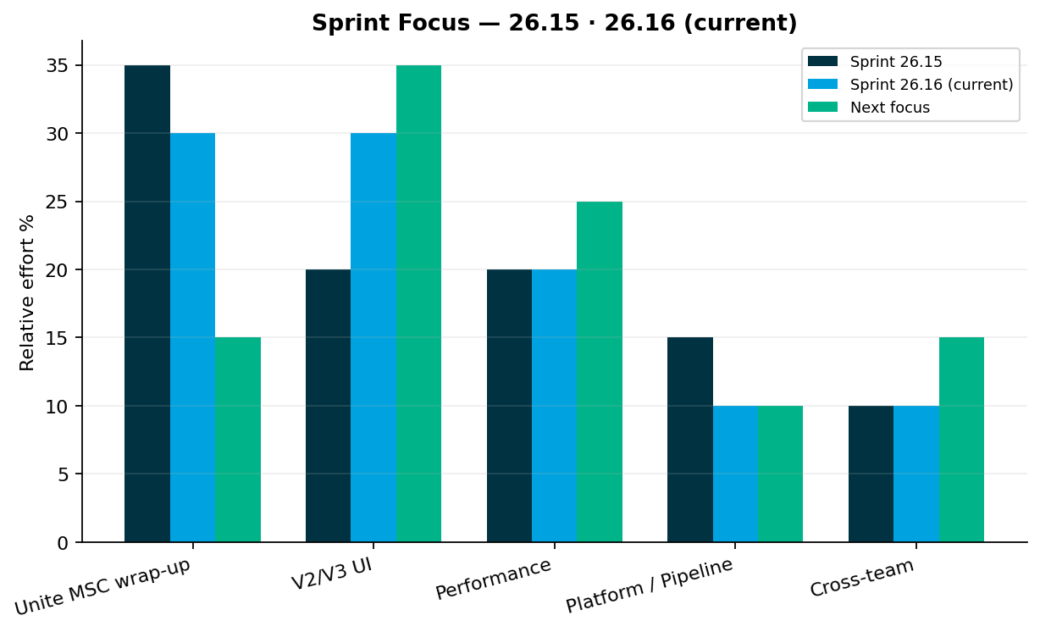
Sprint Delivery Focus
Delivery
Sprints 26.15 · 26.16 (current)
Key messages
• Sprint 26.15: QA-1938 merged (!268); Bruno Postman migration started
• Sprint 26.16: MSC wrap-up (SharePoint, qTest, QC4) + V2/V3 gap execution
• Perf: M2 done · M1 done by Sep 26 · Enrollment remaining · Jenkins jobs ready
• V2→V3: Venkatesh enroll/login/reg almost done; member flows migrating to V3
Relative effort index — not FTE hours
3

Slide 4
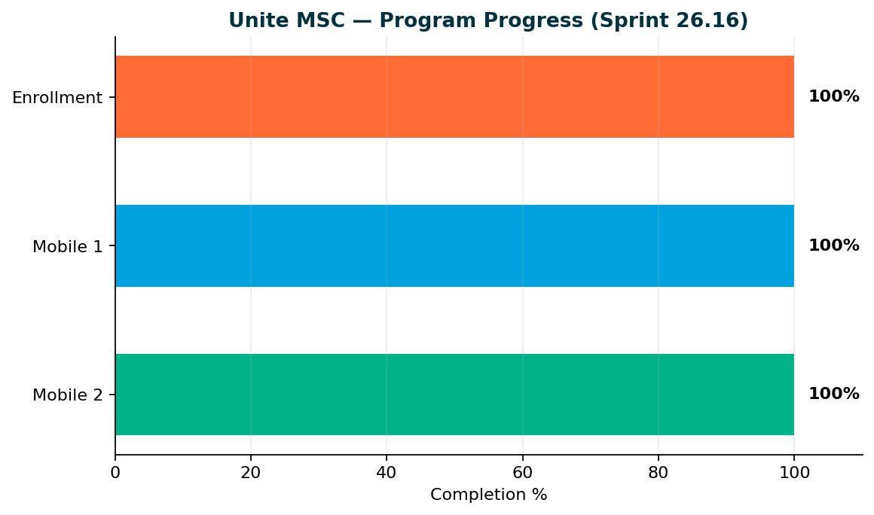
Unite MSC — Program Status
MSC
Mobile 2 100% · Mobile 1 100% · Enrollment 100%
Key messages
• Mobile 2: 25/25 endpoints — sign-off ready
• Mobile 1: 26/26 in-scope operations — sign-off ready
• Enrollment: 25/28 catalog (100%) — standard 15/15 + subsequent 5/5
• Deferred: Partner submit (QA-1808), Upromise (QA-1807), OAuth token
• Wrap-up: SharePoint KT + sign-off pack, qTest manual cases…
• Target: End Sprint 26.16 — MSC automation + docs 100%; Enrollment perf follows
Coding/design complete. Wrap-up = SharePoint, qTest, Bruno usage docs, QC4 proof. Only Enrollment API performance remains after that.
4

Slide 5
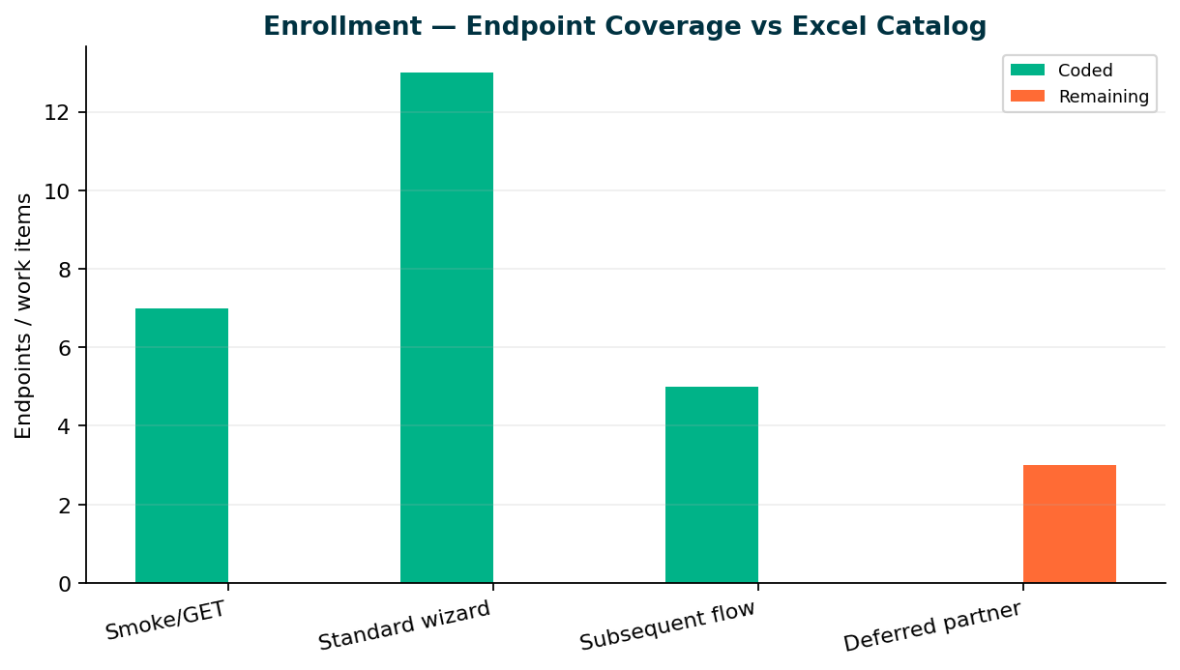
Enrollment — Endpoint Coverage
Enrollment
Core E2E 15/15 · Catalog 25/28
Key messages
• 25 TestNG classes on main — standard + subsequent E2E complete
• MR !268 (QA-1938) merged Sep 11 · Bruno M1/M2/Enrollment merged Sep 21 (!271)
• 3 deferred partner endpoints: Partner submit (QA-1808), Upromise (QA-1807), OAuth token
• Wrap-up: SharePoint KT, qTest manual cases, QC4 E2E proof — end Sprint 26.16
• KB: programs/unite-msc/api-test-automation/mappings/enrollment-endpoint-current-state.csv
Repo: api-test-automation/mobile/enrollment
5

Slide 6
Team Status by Owner
Team
Sprint 26.16 — who is doing what
Preeti — Performance
Venkatesh — V2
• Mobile 2: Done
• Mobile 1: Done by tomorrow (Sep 26) — owner/profile, device/push, auth login JMeter (QA-2159–2163)
• Enrollment: Remaining — last MSC perf gap
• Jobs added and ready; not yet scheduled for nightly — scheduling next
• Almost done — fix / retire / migrate enrollment, login, registration to V3
• Direct plans migrated to universal on Stage1 — member IDP no longer works on V2; migrating member cases to V3
• New V2 areas from gap analysis + select migrations to V3
Sunil — V3 · Dinesh — MSC wrap-up
• He: On/off last couple weeks due to illness — back and productive
• He: Fixed several IDP profile issues · Adding missing V3 profile test cases for IDP plans
• Dinesh: Complete — MR !268 (QA-1938) merged Sep 11; Bruno collections MR !271 merged Sep 21
• Target: Unite MSC automation deliverables 100% by end of Sprint 26.16 — only Enrollment perf remains
Stage1 was unstable after DB refresh (IDP + multi-team issues). Squad co-worked with other teams; Stage1 / V2 / V3 now in better shape.
6

Slide 7
Leadership Decision — API Suite Packaging
Ask
Universal API — regression & integration suite packaging
The gap
• Not all universal/MSC endpoints are wired into master regression and integration suites for DevOps nightly. Leadership can assign this to Dinesh as the next API automation project.
• Proposed owner: Dinesh Kumar
• Jira: QA-892 — Validate and Wire Master, Integration, Regression, and Nightly Suites
• Enables DevOps / nightly jobs to run full universal API regression + integration
Please confirm yes/no on this call so we can plan Sprint 26.17
7

Slide 8
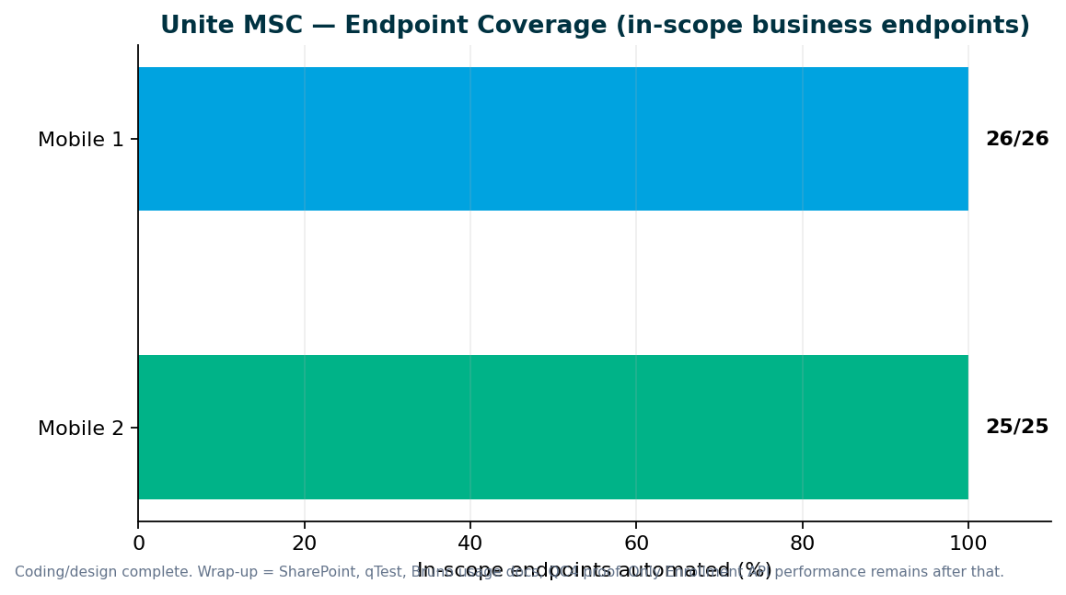
Unite MSC — Endpoint Coverage
MSC
M2 25/25 · M1 26/26 in-scope
Key messages
• All in-scope business endpoints automated — 100% for Mobile 1 and Mobile 2
• Destructive endpoints run in smoke/integration — not duplicated in master regression
• Stage1: IDP + non-IDP paths validated; QC4 hybrid proof pending env stability
• GitLab nightly + ENVP pipeline integration (QA-1405, QA-1544–1549)
• Need leadership to name sign-off owners for M1, M2, pipeline, and perf
Repo: programs/unite-msc/api-test-automation/mappings/
8

Slide 9
Pipeline & Environments
Infrastructure
Hybrid QC4 + Stage1 model
Current state
What we need
• Stage1 health recovered post DB refresh — V2/V3 stable
• QC4 E2E proof in sprint (QA-2086 series)
• Mobile 2 nightly delivered; enrollment nightly + API suite packaging = leadership decision
• QC4 has no non-IDP plants in lower env today — need product owner to confirm test plans
• Pipeline is not 'done' until QC4 proof passes — design is ready
• DevOps: GitLab nightly job for MSC regression (in progress)
• Leadership: identify non-IDP plan contacts for lower-environment testing
• Sign-off: names for M1/M2 acceptance before we schedule review sessions
Aligned with Jul 2025 hybrid decision — Stage1 primary until QC4 stabilizes
9

Slide 10
V2 & V3 UI Automation
UI
Sprint 26.16 — V2 migration + V3 IDP profile expansion; Stage1 recovered
V3 (GitLab) — maintenance + stabilization
V2 (Jenkins) — sunset discussion needed
• He: IDP profile issues fixed; adding missing profile coverage for IDP plans
• V3 stable again after Stage1 DB-refresh disturbance
• Member personal information E2E investigation continues (QA-1845)
• Venkatesh: enrollment/login/registration retire-or-migrate nearly complete
• Member IDP cases moving to V3 — Direct plans on universal platform in Stage1
• CSR actions + share adjustment daily regression wiring this sprint
• Confirm: member flows permanently on V3 for migrated Direct plans — retire V2 member IDP suites?
Regression bugs — Sprints 26.15–26.16
• QA-2014: V3 Universal Enrollment — unable to create account (26.15)
• QA-2013: V3 CSR Member Personal Information validation (26.15)
• QA-1990: V3 withdrawal voucher invalid (26.15)
• QA-1989: V2 CSR withdrawal voucher invalid (26.15)
• QA-2199: SEQ_FIN_TXN_ID null — contrib/withdrawal/investment stabilization (26.16)
V2 and V3 both stable — focus is gap closure and plan-migration alignment, not greenfield volume
10

Slide 11
V2 Regression — Gap Analysis
V2
By Venkatesh Mallela
P0 — Turn on existing automation (@dailyrun)
P1 — Extend coverage · P2 — Build new
• Enrollment / login / registration — fix, retire, or migrate to V3 (almost done)
• Member-related cases — migrate to V3 (V2 member IDP obsolete for migrated Direct plans)
• stage1-csr-actions.xml → Jenkins daily (QA-2187, QA-2197)
• Share adjustment credit/debit/conversion scenarios (QA-2143–2148)
• Remove obsolete web login from V2 Jenkins where retired (QA-2186)
• Additional gaps designed but not yet on daily — wiring through end of Sprint 26.16
• Contribution / withdrawal / investment stabilization after Stage1 SEQ_FIN_TXN_ID issues (QA-2199–2203)
• —
• P2: YTD bucket, financial history, failed txns, bank history…
Enrollment/login/registration classification nearly done. Member flows must move to V3 as Direct→universal migration bro…
11

Slide 12
Performance Testing
Perf
Sprint 26.16 — Mobile 2 done · Mobile 1 done by Sep 26 · Enrollment next
Sprint 26.15–26.16
Sprint 26.16
Sprint 26.16–26.17
Mobile 2 MSC
performance
Mobile 1 auth / owner-
profile / device-p…
Enrollment MSC
performance + nightly sch…
Prior MSC M2 perf
QA-2159–2163, QA-2160 Done
Schedule API perf jobs
Sprint deliverables
• Mobile 2 MSC performance: Done
• Mobile 1 auth / owner-profile / device-push JMeter: Done by tomorrow (Sep 26)
• Enrollment MSC performance + nightly schedule: Remaining — Jenkins jobs ready, nightly schedule pending
Ongoing baseline track
• Jenkins API perf jobs created and ready — need leadership/ops OK to schedule nightly
Perf intake governance — see next slide
12

Slide 13
Performance Governance — Leadership Ask
Ask
Stop last-minute emergency intake
In progress (Sprint 26.15)
What we need from leadership
• Perf intake template + SLAs by change size (QA-1965–1969)
• Confluence Performance Testing Hub governance guidance
• Train Dev/QA/PM stakeholders on standard intake process
• Mandate perf gate for IDP login, enrollment, contributions, withdrawals before release
• Route requests through SDLC intake — not last-minute before deploy
• Approve M1 perf script priority: NY, NMD, OKD (QA-1983–1986)1
Contribution JMX delivered Sprint 26.14 — M1 scripts in flight
13

Slide 14
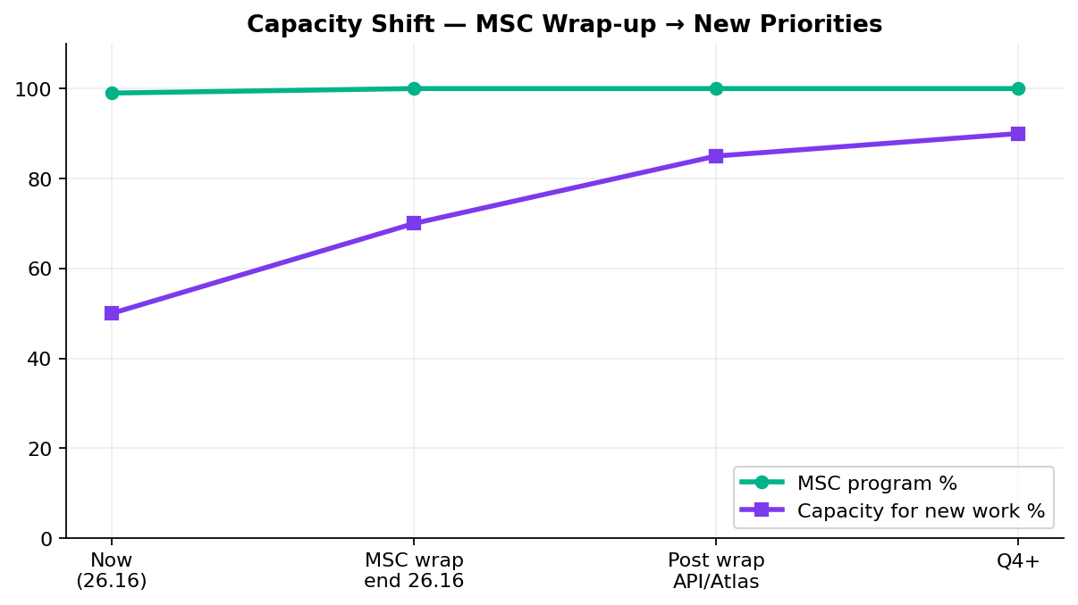
Capacity — MSC Wrap-up vs New Work
Capacity
MSC wrap-up end 26.16 · capacity opens for API suites / Atlas / V2-V3
Key messages
• End Sprint 26.16 — SharePoint + qTest + QC4; then Dinesh available for suite packaging or Atlas
• New work capacity: Post wrap-up: V2/V3 gap expansion + Enrollment perf + optional API suite packaging (QA-892)
• Dinesh + Swapnil → SharePoint, qTest, QC4 wrap-up
• Preeti → M1 perf (by tomorrow) then Enrollment MSC perf + nightly schedule
• Ask: QA-892 API suite packaging OR Atlas OR continue V2/V3 gaps
MSC coding done — sign-off + handoff in progress
14

Slide 15
V2 → V3 Migration Path
Strategy
Reduce Jenkins footprint
Plan
• Retire obsolete V2 member/login/enrollment as Direct→universal completes; expand daily with existing automation
• Stage1 Direct plans on universal — V2 member IDP no longer valid
• Approve permanent retirement of V2 member IDP for migrated plans and V3 as source of truth?
• Lead: Venkatesh Mallela
• Outcome: lighter GitLab-based V3 suites; retire duplicate V2 enrollment from Jenkins
Aligns with platform direction — V3 as source of truth
15

Slide 16
Incoming: ACS-5678 Atlas
New work
Traffic distribution & load balancer rebalancing
AHA summary (Brian Danilczyk)
• ACS-5678 — Atlas Traffic Distribution & Load Balancer Rebalancing — #2 on Michael's list
• Estimate: 2–3 sprints · Target: October 2026 delivery
• Status: Ready after MSC wrap-up — confirm queue vs API suite packaging + V2/V3 gap work
• Dependency: Redis session-management initiative
• Scope: validate traffic distribution after Redis session externalization; load + perf testing
• Main squad can start intake next sprint while 1 resource finishes MSC wrap-up
Confirm priority vs MSC wrap-up, V2 sunset, and other AHA items
16

Slide 17
Leadership Asks & Decisions Needed
Decisions
Please respond on this call — by area
Roadmap & capacity
• Confirm post-MSC queue: Atlas (Oct) vs API suite packaging (QA-892) vs V2/V3 gap expansion?
• MSC wrap-up completes end Sprint 26.16 — Dinesh free for next API project after that
Unite MSC / API automation
• Accept M1/M2/Enrollment coding as complete — wrap-up is docs/qTest/SharePoint/QC4
• Confirm: assign Dinesh to wire remaining universal endpoints into regression + integration + nightly suites (QA-892)?
• Name ACM / sustaining owner for MSC API assets on SharePoint
V2 regression (Jenkins)
• Approve retirement of V2 member IDP for Direct plans now on universal — migrate to V3
• Confirm P0 daily wiring (csr-actions, share adjust) before P2 new-screen builds
V3 universal platform (GitLab)
• V3 IDP profile expansion underway — confirm IDP plan coverage priority
• Member personal information / enrollment defects — product/env owners for lingering Stage1 issues?
Performance & stress testing
• Approve scheduling API/MSC perf Jenkins jobs for nightly (jobs ready, not scheduled)
• Enrollment MSC perf is the last MSC perf gap after M1 lands tomorrow
Pipeline & environments
• Stage1 health recovered — acknowledge cross-team fix for DB refresh / IDP instability
• QC4 E2E proof this sprint — confirm non-IDP plant contacts if still needed
Full ask list in companion DOCX · Swapnil Patil · QA Automation AM Squad
17

Slide 18
Questions & Discussion
Detailed briefing document shared · KB: programs/leadership-updates/2026-09-25-rajib-henry-biweekly/

