Slide 1
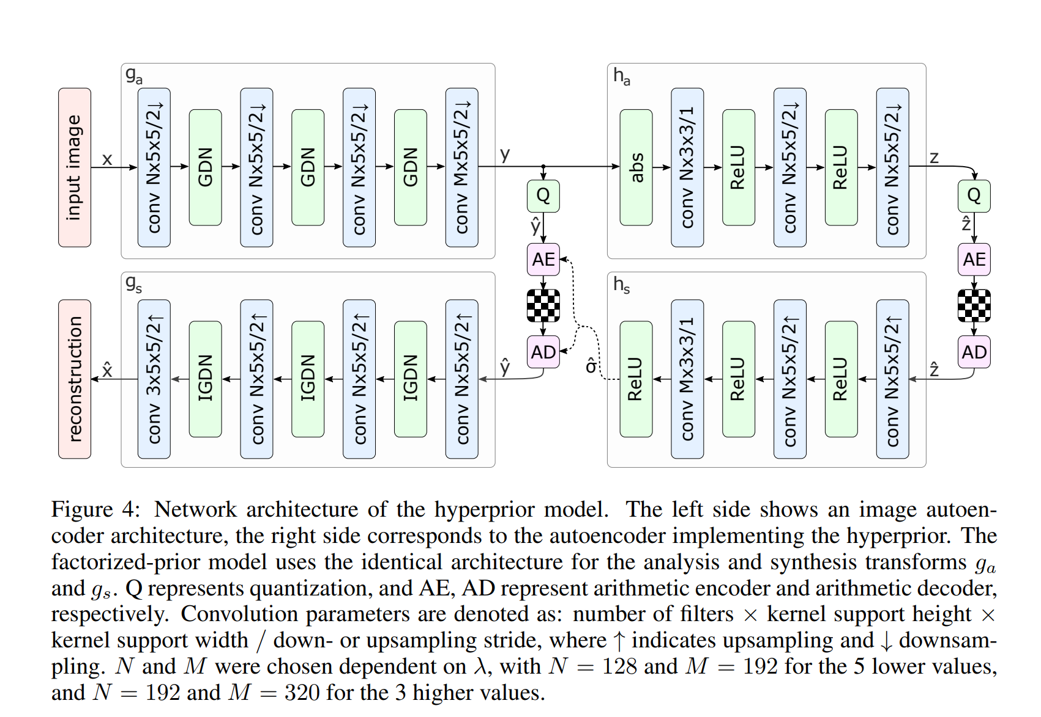
Original Model is designed for 3 channel RGB images.
We changed this to 1 channel gray.
6400 parameters and weights reduced.
Figure: DL model used by us for image compression.

Slide 2
This part which learns to encode the images is trained for RGB images so maybe in grayscale version it is having problem to find and learn features.
Need to fine tune this part by training it with grayscale dataset.
Figure: DL model used by us for image compression.

