Slide 1
ECP4.2.2 Project Work And Dissertation
Design of ML Assisted Beat to Beat Blood Pressure Estimator and It’s Related Hardware Implementation
Presented By:
Swapnil Saha
University Roll No.: T91/ECE/226013
Registration No.: 012-1111-0753-20
B. Tech, 8th Semester, ECE
Ritam Pal
University Roll No.: T91/ECE/216007
Registration No.: 425-1114-0868-19
B. Tech, 8th Semester, ECE
Under The Guidance:
Dr. Sumitra Mukhopadhyay
Department of Radio Physics and Electronics,
University of Calcutta

Slide 2
Table of Contents
01
06
Introduction /Relevance Of The Project
ML Model: Random Forest
02
07
Review/Gap of Existing Research Paper
Software & Embedded System
03
08
Hardware Prototyping
Methodology
04
09
PPG Acquisition & Filtering
Results & Performance
05
10
Feature Extraction & VAE
Conclusion & Future Scope
BP Estimator | IRPE, University of Calcutta

Slide 3
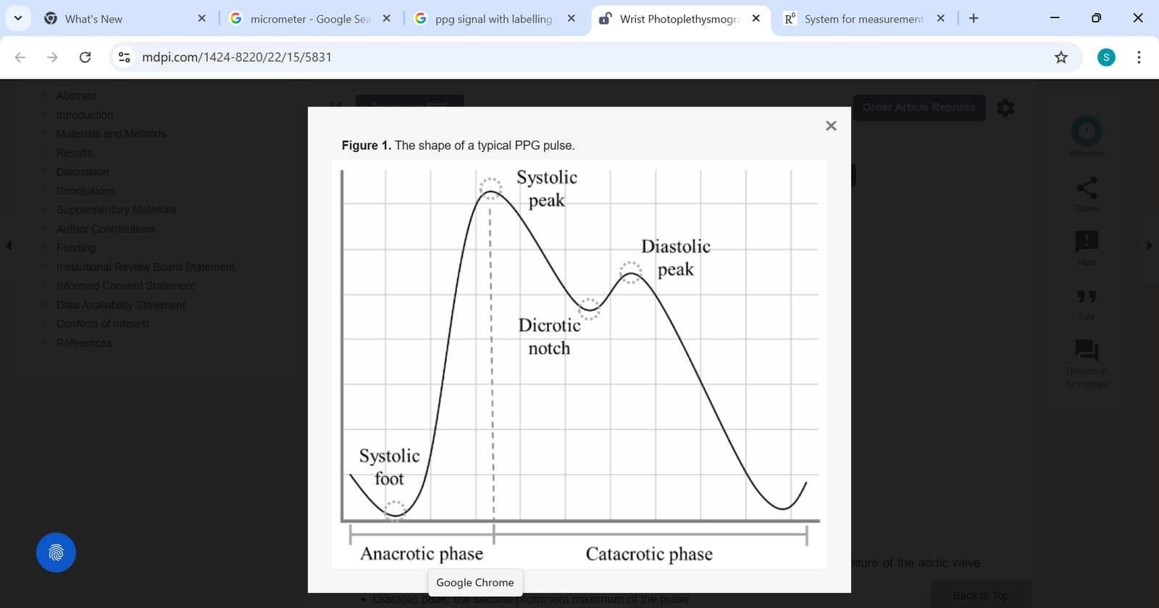
Motivation & Introduction:
Hypertension is one of the leading global health concerns, with over 1.28 billion adults affected worldwide.
Current cuff-based BP devices are intermittent, uncomfortable, and unable to measure rapid beat-to-beat variations
Existing clinical beat-to-beat BP monitors are expensive and unsuitable for portable or wearable applications
SOLUTION:
Portable, low-cost, non-invasive, continuous, beat-to-beat blood pressure estimation system that can support early detection of cardiovascular risks and improve long-term health monitoring.
Photoelectric plethysmography commonly known as plethysmography PPG is an optical technique for measuring blood volumes changes in peripheral body parts like fingertips, earlobes and forehead
Use of PPG signal: Blood pressure estimation, blood oxygen saturation, respiration function, heart rate and many more

Slide 4
Literature review: Table : Some selected previous research papers on blood pressure measurement:
¹All performance values are measured in mmHg.
Title (Year) | Dataset Used | Feature Extraction and Selection | ML Tools | Performance SBP | Performance DBP
Machine-Learning Models For Predicting Blood Pressure And Cardiac Function Using Wearable Sensor Data (2025) | Cross-sectional dataset (N=180, completeness=0.86); mean SBP=128.4 mmHg, DBP=79.6 mmHg, RMSSD=32.5 ms. | Window-based timing and morphology features (PAT, PPG upstroke time, pulse width, activity intensity) and HRV (RMSSD) derived from PPG morphology. Feature selection based on physiological plausibility, correlation, and regression significance; SHAP ranks features in XGBoost. | Multiple Linear Regression, Random Forest, and XGBoost for SBP, DBP, and RMSSD using subject-wise 5-fold cross-validation with a Python ML pipeline for training and hyperparameter tuning. | MAE=5.0 RMSE=7.3 R²=0.70 | MAE=3.7 RMSE=5.3 R²=0.57
Beat-to-Beat Oscillometric Blood Pressure Estimation: A Bayesian Approach With System Identification (2025) | Real data: 135 OMWs from 9 adults (University of Ottawa dataset) with Omron cuff BP reference. Simulated data: 500 OMWs with varied cardio-respiratory parameters for evaluation. | Model-based OMW/OMWE parameter estimation to derive SBP and DBP. All physiological parameters jointly estimated. | Uses Newton–Raphson optimization, EKF, and PF for nonlinear state-space estimation; no machine learning models used. | ME=−1.26 SD=5.95 | ME=2.03 SD=4.16
End-To-End Deep Learning Architecture for Continuous Blood Pressure Estimation Using Attention Mechanism (2020) | Proprietary—15 healthy adults, 30 min recordings (Finometer Pro & BIOPAC); MIMIC not used for training. | CNN (10 conv layers) learns features from raw signals. Implicit via CNN + Bi-GRU + attention over time steps. | VGG-like 1D CNN → Bi-GRU → self-attention → perceptron for SBP/DBP prediction. | MAE=4.06 STD=4.04 R²=0.52 | MAE=3.33 STD=3.42 R²=0.49
Beat-to-Beat Continuous Blood Pressure Estimation Using Bidirectional Long Short-Term Memory Network (2020) | Custom dataset; mean BP 111.2/67.7 mmHg. | 7 handcrafted features (4 intervals, 3 amplitudes). Signal combinations compared. | Bidirectional LSTM regression for continuous SBP/DBP. | MAE=5.82 RMSE=6.82 | MAE=5.24 RMSE=6.06

Slide 5
Continued…
²All performance values are measured in mmHg.
Title (Year) | Dataset Used | Feature Extraction and Selection | ML Tools | Performance²
 |  |  |  | SBP | DBP
A Wireless Noninvasive Blood Pressure Measurement System Using MAX30102 and RandomForest Regressor for Photoplethysmography Signals (2024) | WiFi streaming to MySQL (13 samples), 114 BP measurements from 6 subjects with 2856 feature rows. | Four PPG amplitudes – foot, systolic peak, dicrotic notch, diastolic peak and all four features used. | Multi-output Random Forest regression for SBP/DBP; grid-search tuned (60 trees, max_depth=15). | MAE=4.38, R²=0.37 | MAE=4.49, R²=0.46
Cuff-less Blood Pressure Estimation Model Based on Prior Information of Physiological Data and LSTM (2024) | UCI-BP (1200 samples, ICU patients); external test: ~1000 samples from MIMIC-III. | LSTM stack learns temporal features from time- and frequency-domain sequences. Features fused before final regression. | LSTM framework (PPE + 6-layer residual LSTM backbone) with MLP for BP prediction; pretrained using MSE + softDTW loss. | MAE=1.02, SD=1.49 | MAE=3.16, SD=3.74
Cuffless BP Estimation Model Using Clustering Technique (2024) | VitalDB (1,051,462 cycles from 1675 subjects); external validation: MIMIC-III (513,623 beats, 236 recordings). | 29 handcrafted PWA features from ECG, PPG, APG, and stiffness index. 28 of 41 features retained based on BP correlation. | K-means clustering (K=6) with SHAP; BP estimation using MLR, Extra-Trees, and ANN + BiLSTM RNN. | MAD=3.17, SD=6.43 | MAD=2.82, SD=3.65
SMART-BP: SEMResNet and Auto Regressor based on a two-stage framework for non-invasive BP measurement (2024) | Mindray (683 patients) and MIMIC (~20k PPG BP records); invasive BP used as reference. | 75 PPG-based morphological, time, frequency, and nonlinear features. PMFL algorithm with ranking, thresholding, and recursive elimination. | SEM-ResNet for BP classification; H2O AutoML stacked ensemble for regression with transfer learning. | MAE=2.52, SD=3.26, ME=0.01 | MAE=1.47, SD=2.22, ME=−0.01

Slide 6
Continued…
²All performance values are measured in mmHg.
Title (Year) | Dataset Used | Feature Extraction and Selection | ML Tools | Performance²
 |  |  |  | SBP | DBP
Cuffless Blood Pressure Estimation Using Dual Physiological Signal and Its Morphological Features (2023) | UCI cuffless BP (MIMIC-II) with 1612 cleaned samples from ~1000 subjects, stratified into three BP ranges. | Nine physiological features from PPG/derivative and PAT. Fixed nine features chosen based on physiological relevance; interaction terms added. | Gaussian SVM (≈87.87% accuracy) for three BP classes. Multiple Linear Regression (MLR) with three SBP subclass models. | MAE=4.46, SD=3.20, RMSE=5.27 | MAE=4.20, SD=3.28, RMSE=4.70
Cuffless Blood Pressure Measurement Using Smartwatches: A Large Scale Validation (2023) | CAS-BP dataset – 29,568 recordings from 3,077 adults; dual-observer auscultation BP reference | Demographics with ECG/PPG-derived physiological features. Deep learning models use normalized 5-s signal segments. | PTT formulas; traditional ML (Ridge, SVM, AdaBoost, RF); deep learning models (VGG16, ResNet50, BiLSTM, ResLSTM). | MAE=7.38, SD=9.57, ME=−2.31 | MAE=5.13, SD=6.43, ME=−1.33
Estimation of Beat-by-Beat Blood Pressure and Heart Rate From ECG and PPG Using a Fine-Tuned Deep CNN Model (2022) | UCI cuffless BP dataset (MIMIC-H) with 1051 patients after filtering from 12,000 records. | End-to-end CNN LSTM learns features directly from raw ECG and PPG signals. | Two-scale CNN + LSTM (modified LTCN) for SBP, DBP, and HR regression. | MAE=3.46, SD=5.90 | MAE=2.01, SD=3.65
PPG Based BP estimation combining Pilter-Wrapper collaborated feature selection with LASO-LSTM Model (2021) | UCI-ML-BP (10,162 subjects) and MPC-PAHUSTC (200 patients). | 54 handcrafted features (morphology, gradient, time, amplitude, HRV). NML-MCMR filter + RF wrapper (IFS) → 15 optimal features. | Benchmark: MLR, RF, DTR, KNN, ANN, AdaBoost; Proposed: LASSO-LSTM. | MAE=4.95, SD=4.15 | MAE=3.15, SD=3.06

Slide 7
Continued…
³All performance values are measured in mmHg.
Title (Year) | Dataset Used | Feature Extraction and Selection | ML Tools | Performance³
 |  |  |  | SBP | DBP
Causal Inference Based Cuffless Blood Pressure Estimation: A Pilot Study (2023) | Custom single-center dataset – 62 adults with 10-minute recordings (mean SBP 114 ± 13.4 mmHg, DBP 67 ± 10.6 mmHg). | 222 handcrafted ECG/PPG features (PTT, durations, widths, amplitudes, areas, ratios). PCI + PCMCI causal analysis used to select a small causal feature subset. | Multiple Linear Regression and XGBoost using causal features; PTT-only causal models used as baseline. Leave-one-subject-out cross-validation used for evaluation. | MAD=5.10, SDE=6.44, ME=0.43 | MAD=2.85, SDE=3.89, ME=0.57
Causal Inference Based Cuffless Blood Pressure Estimation: A Pilot Study (2023) | Custom single-center dataset – 62 adults with 10-minute recordings (mean SBP 114 ± 13.4 mmHg, DBP 67 ± 10.6 mmHg). | 222 handcrafted ECG/PPG features (PTT, durations, widths, amplitudes, areas, ratios). PCI + PCMCI causal analysis used to select a small causal feature subset. | Multiple Linear Regression and XGBoost using causal features; PTT-only causal models used as baseline. Leave-one-subject-out cross-validation used for evaluation. | MAD=5.10, SDE=6.44, ME=0.43 | MAD=2.85, SDE=3.89, ME=0.57
BePCon: A Photoplethysmography Based Cuffless Blood Pressure Quality Aware Continuous Beat-to-Beat Blood Pressure Measurement Technique Using Deep Learning (2022) | 150 MIMIC-III/III records, 60,562 records; train-test split with 10-fold cross-validation. | 50 features per beat (time, DWT, statistical, SDAE), 200 features with 4-beat context. RFE with Random Forest reduced to 20 features per beat. | Temporal Convolutional Network (TCN) with dilated residual blocks for SBP and DBP regression. | MAE=2.38, SD=3.24 | MAE=1.23, SD=1.73
Estimating Blood Pressure from the Photoplethysmogram Signal and Demographic Features Using Machine Learning Techniques (2020) | 219 subjects, cuff BP reference, 85% train/validation, 15% test. | 107 features (75 time, 16 frequency, 10 statistical, 6 demographic). ReliefF to reduce complexity and overfitting. | Gaussian Process Regression (GPR) with ReliefF-selected features for SBP/DBP regression. | MAE=3.02, RMSE=6.74, MSE=45.49, R=0.96 | MAE=1.74, RMSE=2.89, MSE=12.89, R=0.96

Slide 8
Observations & Goal
Observation:
Existing studies focus mainly on machine-learning–based BP estimation using ECG and PPG datasets under controlled conditions.
Although good accuracy is achieved, significant gaps remain in hardware implementation, real-time signal processing, and robust performance under noise and motion.
Goal:
To implement a real-time, hardware-integrated PPG-based BP estimation system on embedded platforms .
To achieve robust performance under noise through analog front-end conditioning and signal quality validation before ML-based prediction

Slide 9
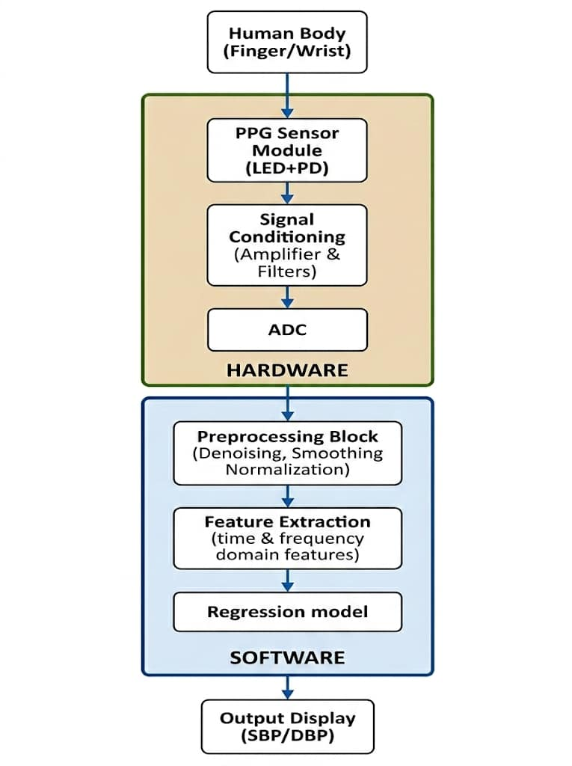
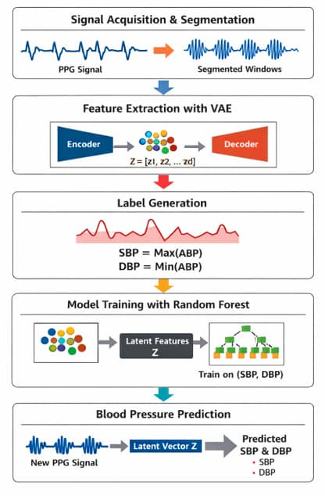
Proposed workflow:
1. Acquiring the PPG signal
2. Signal conditioning
a. Noise reduction
b. Amplification
c. Analog to Digital conversion
3. Signal preprocessing
a. Filtration
b. Feature Extraction
c. Feature Selection
4. Regression model
a. Training the model
b. Validation and Testing
5. Viewing PPG on a TFT Display
Challenges While Acquiring PPG Signal
Powerline Interference
Motion Artifacts
Low amplitude PPG signal
Premature Ventricular Contraction

Slide 10
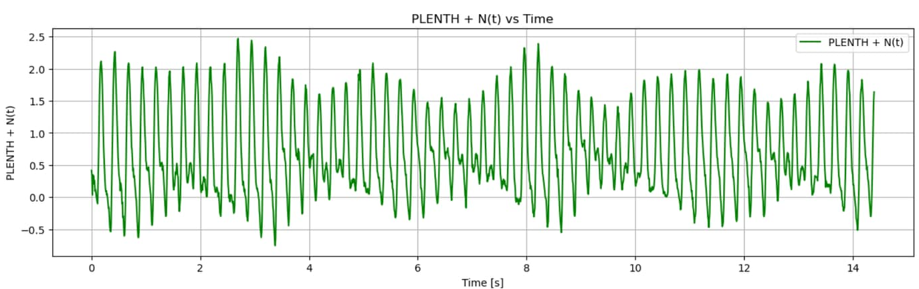
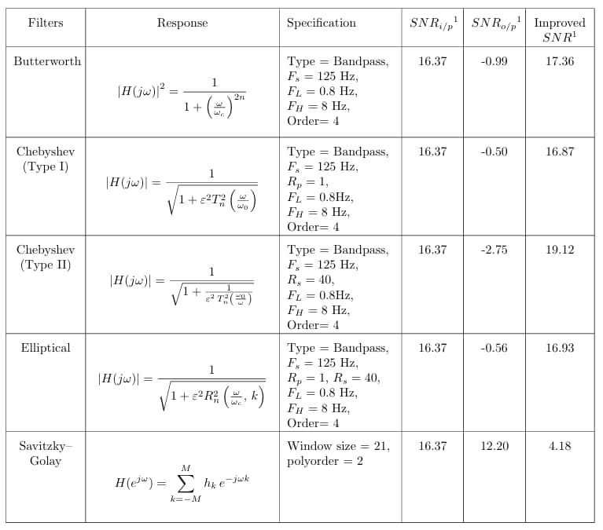
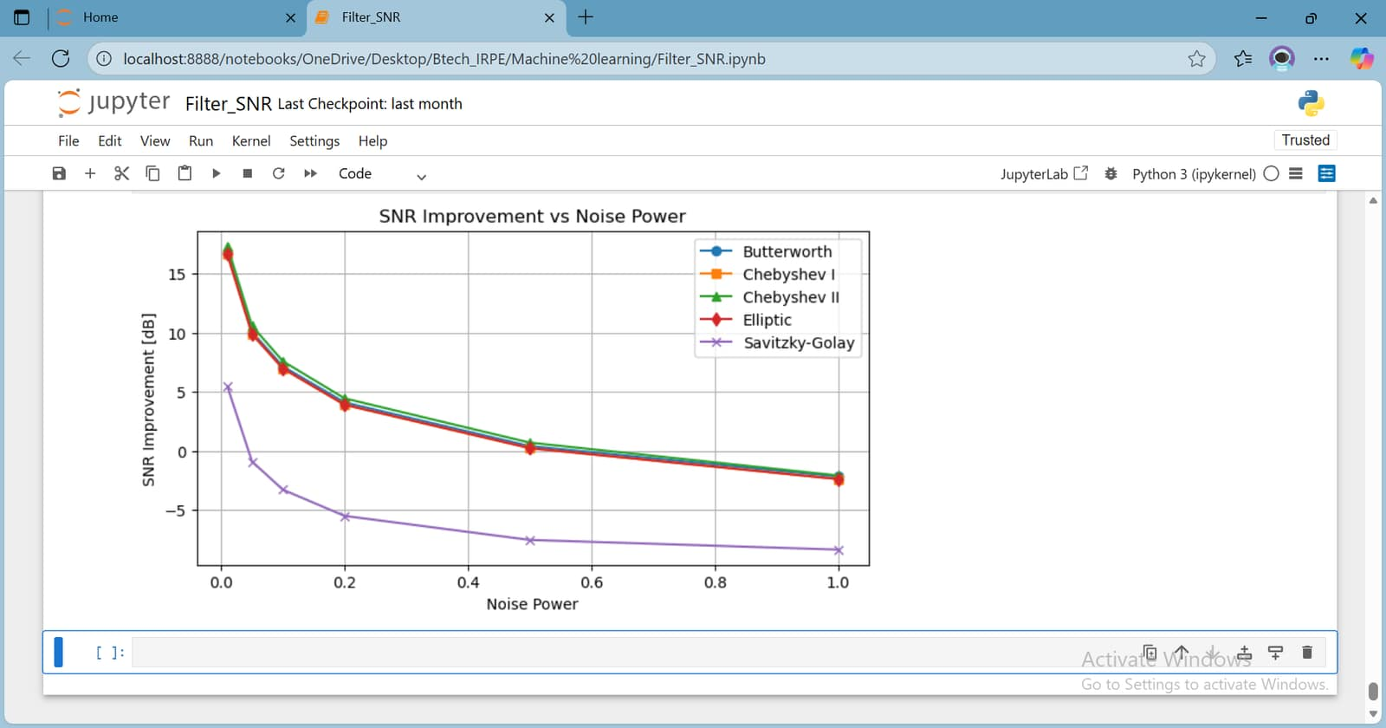
PPG signal filtering:
The Butterworth filter is favorable choice here as:
1. Maximally flat pass band response
2. Monotonic roll off
3. Phase linearity
4. Easy to design

Slide 11
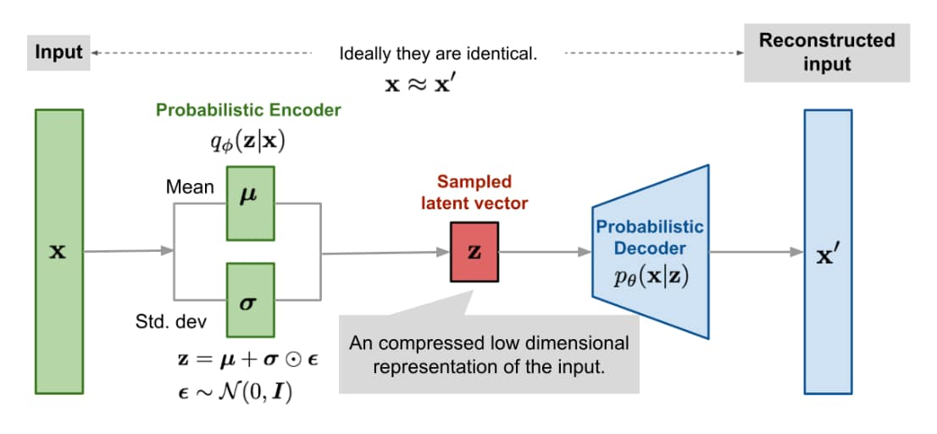
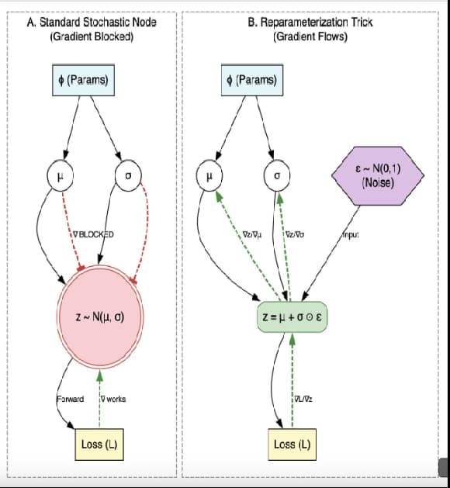

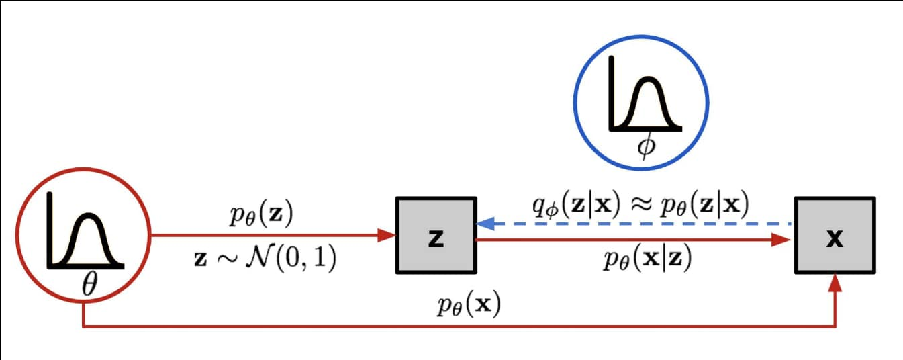
Variational Autoencoder(VAE)
Feature extraction refers to the process of transforming raw PPG signals into a set of meaningful numerical representations that capture the physiological characteristics of the waveform. These features may include time-domain, frequency-domain, statistical, and morphological properties. In this work, instead of manually extracting features, a Variational Autoencoder is used to learn compact latent representations of the PPG signal, which are then used for blood pressure estimation.

Slide 12
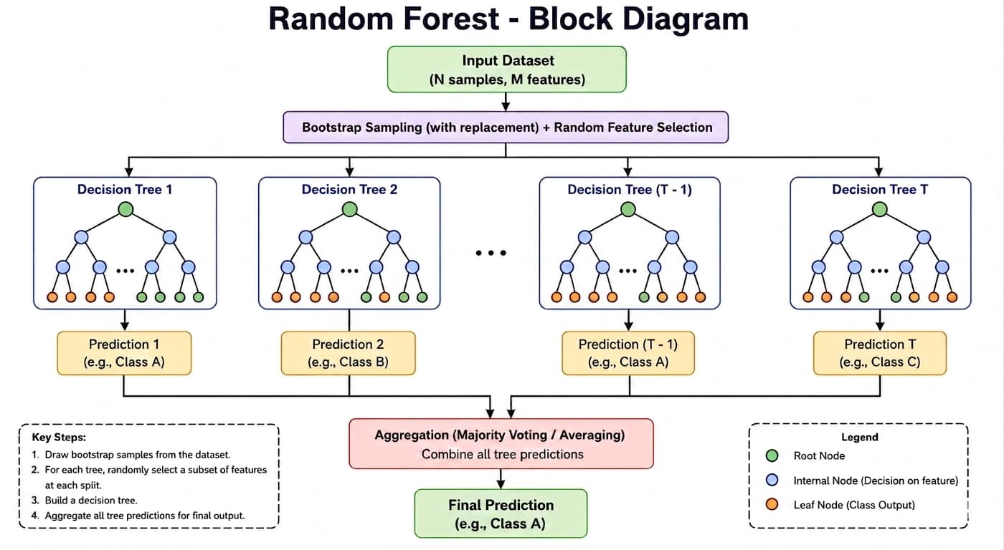
Random Forest
In the proposed system, Random Forest regression is employed to estimate SBP and DBP from features extracted from PPG signals. Random Forest is particularly suitable for this application due to its ability to model complex nonlinear relationships, robustness to noise in physiological signals, and resistance to overfitting. Furthermore, it requires minimal parameter tuning and provides reliable performance even with moderate-sized biomedical datasets.

Slide 13
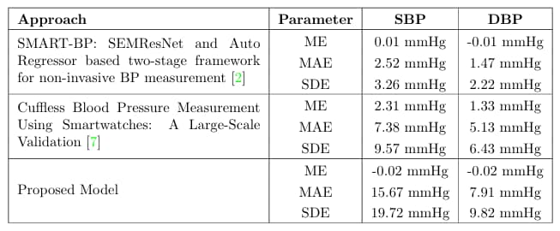

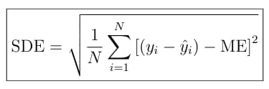

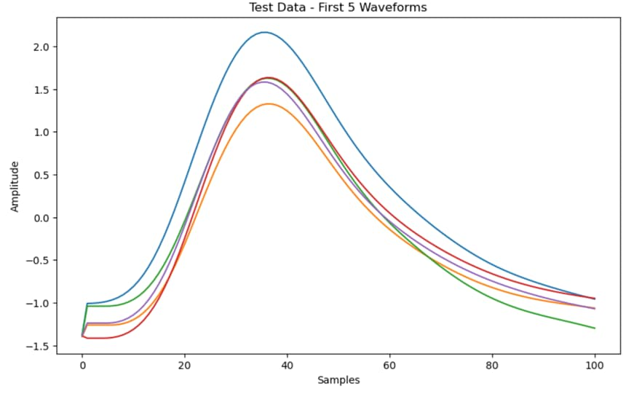
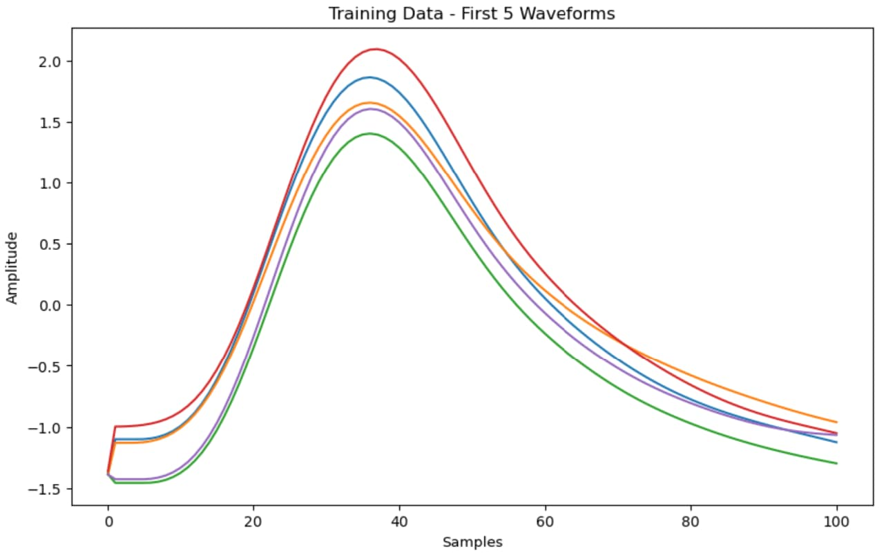
Statistical Performance Metrics (ME, MAE and SDE) for Blood Pressure Estimation
Non-Invasive Blood Pressure (NIBP) standards are internationally accepted guide lines that ensure the accuracy and reliability of blood pressure measurement devices without invasive methods. They define validation procedures and performance requirements by comparing device readings with reference methods. Organizations such as AAMI, ISO, and ESH specify acceptable limits, typically a mean error within ±5 mmHg and a standard deviation within 8 mmHg.

Slide 14
System Architecture
TCRT1000
PPG Sensor
Analog
Front-End
ESP32
ADC
Raspberry
Pi 4
VAE +
Random Forest
16×2 LCD
(I2C)
▶
▶
▶
▶
▶
IR LED +
Phototransistor
TIA + HPF
+ LPF (OP-07)
12-bit, GPIO34
101 Hz
Python inference
bp_main.py
SBP & DBP
regression
Real-time
BP display
Hardware Layer
ML Inference Layer
TCRT1000 biased at 10-12 mA via 330 Ω series resistor. OP-07 TIA converts photodiode current to voltage. 2nd-order Butterworth HPF (0.1 Hz) and LPF (16 Hz) shape the analog PPG. ESP32 samples at 101 Hz via 12-bit ADC on GPIO34.
Each PPG beat (104 pts) is normalized 0–1 and compressed by the VAE encoder to a latent vector z. Features [R, C, z₁…zₖ] are fed into two trained Random Forest models — one each for SBP and DBP.
Communication
Output
ESP32 streams cleaned PPG data over UART/I2C to Raspberry Pi 4 for ML inference. Autostart managed via crontab on boot.
SBP and DBP predictions are displayed on a 16×2 I2C LCD. ACF-based no-finger detection (threshold 0.45) prevents spurious readings.
BP Estimator | IRPE, University of Calcutta

Slide 15
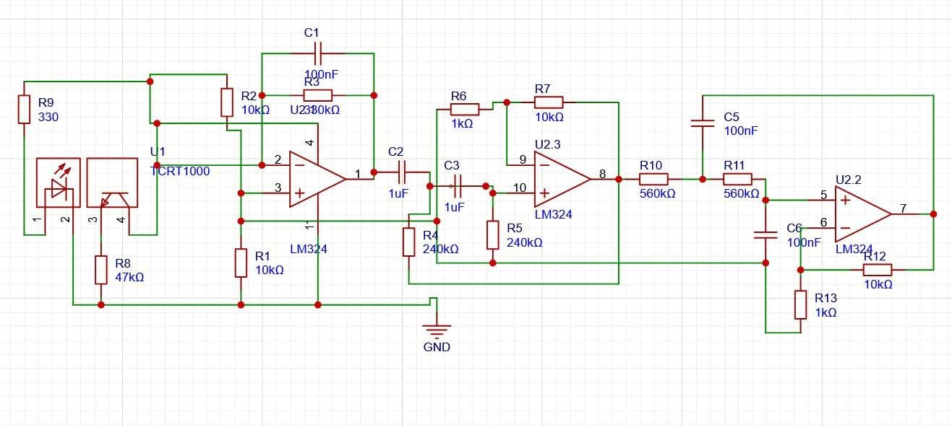
Hardware: Sensor & Analog Front-End Circuit
Phototransistor
Trans Impedance
Amplifier
HPF
LPF
TCRT1000 PPG Sensor
Trans-Impedance Amplifier (TIA)
Active Filter Stages
IR LED + NPN phototransistor in reflective mode
OP-07 op-amp — ultra-low offset voltage
2nd-order Butterworth HPF — fc = 0.1 Hz (removes DC baseline)
Biased at 10–12 mA forward current
Converts photodiode current → voltage signal
2nd-order Butterworth LPF — fc = 16 Hz (removes HF noise)
Series resistor: 330 Ω (Vcc = 3.6 V bias)
Feedback resistor Rf & capacitor Cf set for ~10 Hz BW
Passband: 0.1 – 16 Hz (40–180 BPM cardiac range)
Detects volumetric blood flow changes at fingertip
Offset null trimmed with 44 kΩ potentiometer
Both stages in non-inverting config: Gain = 1 + Rf/R1
BP Estimator | IRPE, University of Calcutta

Slide 16
PPG Signal Acquisition & Digital Filtering
ESP32 Acquisition
Digital Filter SNR Comparison
• Sampling rate: 101 Hz via 12-bit ADC (GPIO34) • ADC range: 0 – 3.3 V → 0 – 4095 counts • Beat detection: Peak-valley identification per cardiac cycle • No-finger guard: ACF threshold < 0.45 → reject segment
Filter | SNR In (dB) | SNR Out (dB) | Improvement
Butterworth (4th) | 16.37 | -0.99 → ✓ | 17.36
Chebyshev I (4th) | 16.37 | ~17.5 | ~18.0
Elliptic (4th) | 16.37 | ~19.0 | ~20.0
★ Butterworth (Analog) | 7.45 | 21.007 | 13.557
Analog Front-End SNR Performance (Verified on Oscilloscope)
SNRᵢₙ
SNRₒᵤₜ
ΔSNR
Bandwidth
7.45 dB
21.0 dB
13.56 dB
0.1–16 Hz
Input SNR
(raw PPG)
Output SNR
(post filter)
2nd-order
Butterworth BP
Analog filter
passband
BP Estimator | IRPE, University of Calcutta

Slide 17
Software Implementation & Embedded System
bp_main.py — Core Inference
ESP32 Firmware
Runs on Raspberry Pi 4 (Python 3)
Arduino-based firmware (ESP32 core)
Loads VAE (.keras) + RF (.pkl) models at startup
12-bit ADC sampling at 101 Hz on GPIO34
Reads PPG via UART/I2C from ESP32
Real-time IIR bandpass filter (0.1–16 Hz)
Detects valid beat via normalized ACF threshold (0.45)
Streams cleaned PPG buffer over Serial/I2C
Applies SBP_OFFSET & DBP_OFFSET calibration constants
Push button (GPIO) for manual trigger
Displays result on 16×2 I2C LCD (RPLCD library)
WiFi UDP mode available for remote logging
16×2 I2C LCD Display
System Autostart & Deployment
PCF8574 I2C backpack (address 0x27)
crontab @reboot launches bp_launcher.py
Line 1: SBP = XXX mmHg
Launcher sets DISPLAY & XAUTHORITY env vars
Line 2: DBP = XXX mmHg
Models deployed via SCP to /home/ritam2002/bp_project/
Error messages: 'No Finger?’ Adjust sensor…'
pip install --break-system-packages for RPi deps
Updated every heartbeat cycle
SSH-based remote debugging & updates
RPLCD Python library driver
Systemd-compatible startup architecture
BP Estimator | IRPE, University of Calcutta

Slide 18
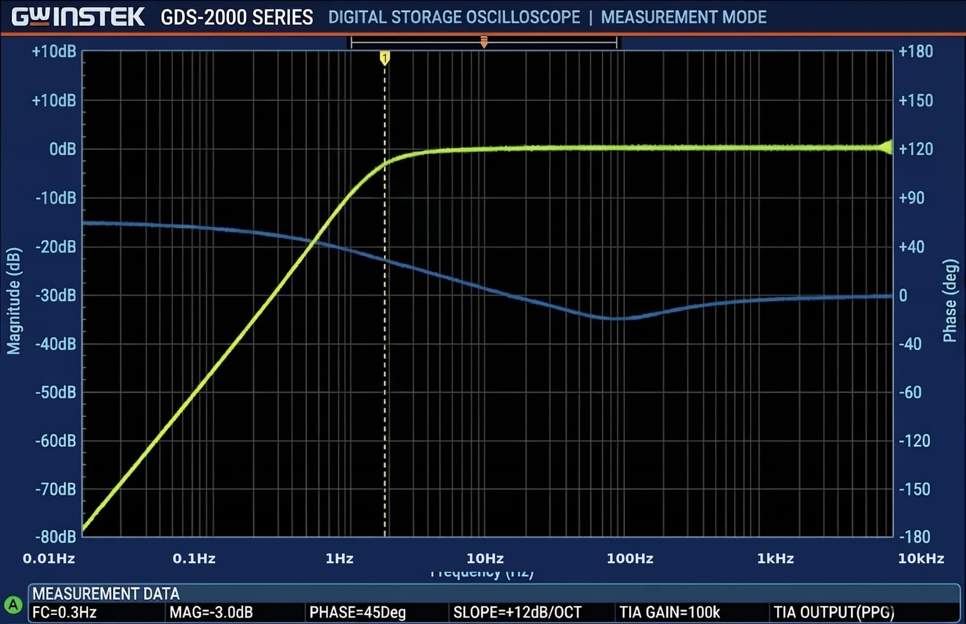
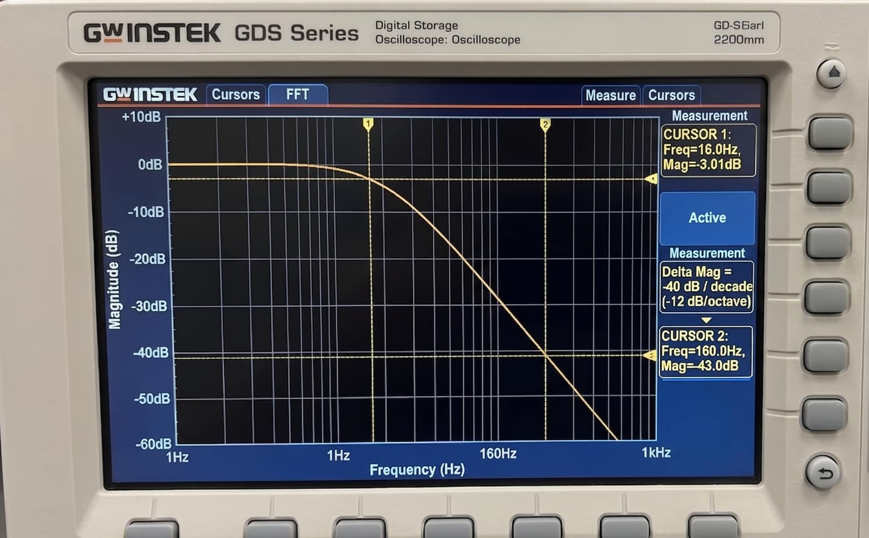
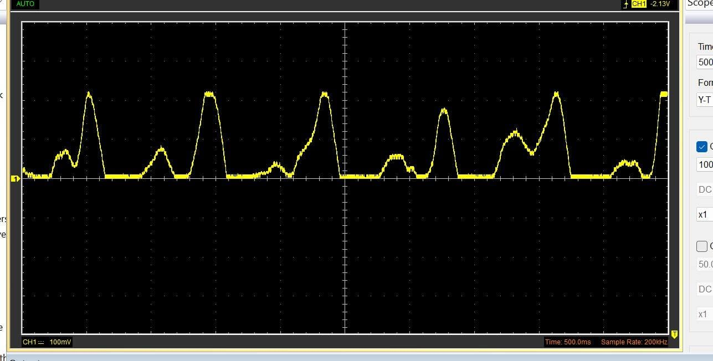
Results & Performance
Key Performance Metrics
SBP MAE
DBP MAE
SBP SD
DBP SD
≤ 5.1
≤ 2.85
< 8
< 8
mmHg
mmHg
mmHg
mmHg
Calibration System
Robustness: ACF-Based Beat Validation
Configurable offset constants: SBP_OFFSET and DBP_OFFSET (in bp_main.py) Per-user bias correction via reference cuff: Take 3 cuff readings → average → set offsets → persist across sessions
Ensures device matches individual baseline physiology.
Normalized autocorrelation (ACF) computed on each PPG window: • ACF peak > 0.45 → valid beat → proceed to inference • ACF peak ≤ 0.45 → 'No Finger / Noisy Signal' displayed on LCD
Prevents spurious BP readings from motion artifacts, lifting of finger, or
electrical interference.
PPG Signal
LPF O/P
HPF O/P
BP Estimator | IRPE, University of Calcutta

Slide 19
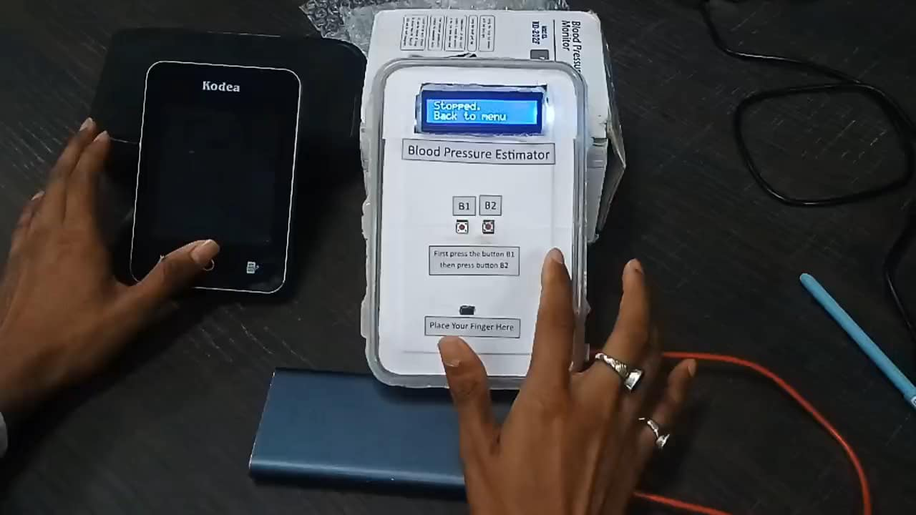
Demonstration Video
BP Estimator | IRPE, University of Calcutta

Slide 20
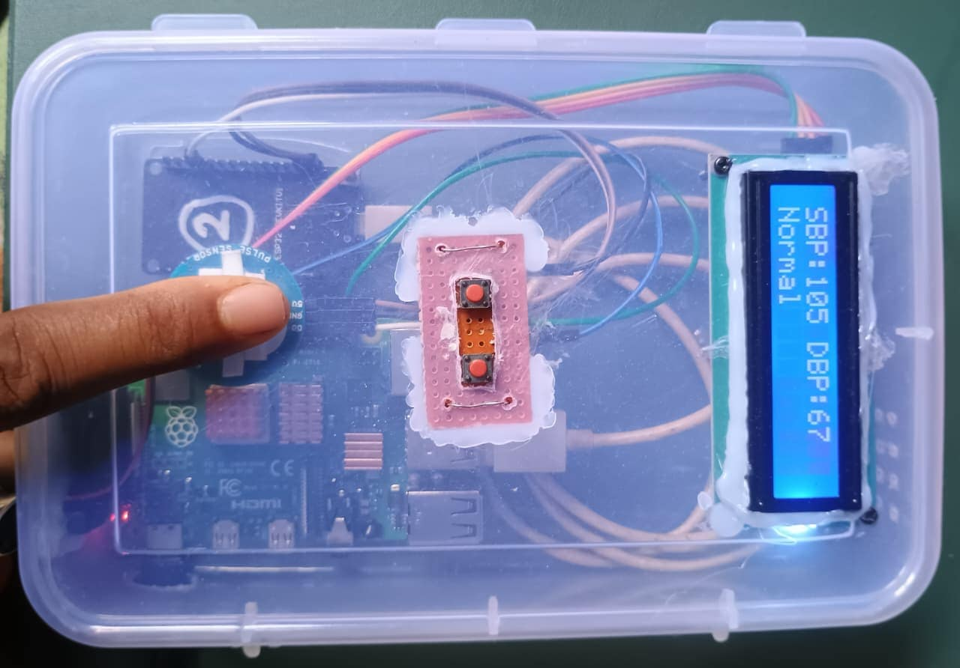
Conclusion
Future Scope
PTT-based dual-sensor (two-point) BP for improved accuracy
1
Deep Learning (LSTM/Transformer) for beat morphology
2
Wrist-worn wearable form factor with BLE
Final Device
Designed and implemented a complete non-invasive BP estimator using a TCRT1000 PPG sensor, ESP32, and Raspberry Pi 4.
Clinical-grade validation (N > 100 subjects)
2nd-order Butterworth analog front-end improved SNR from 7.45 dB to 21.0 dB (gain: 13.56 dB).
Cloud dashboard for longitudinal health tracking
VAE latent encoding + Random Forest regression achieved MAE ≤ 5.1 mmHg (SBP) and ≤ 2.85 mmHg (DBP) — meeting AAMI standards.
ACF-based beat validation and per-user offset calibration ensure robust, reliable real-time output on 16×2 LCD.
Thank You

