Slide 1
PROJECT
ON
REMOTE REWORK
UPDATE SYSTEM

Slide 2
AIM OF THE PROJECT:
To develop a communication system enabling communication from the reworker to multiple debugging engineers
WORKING PRINCIPLES:
The communication system is designed such that, on the master side, a button switch S0 is used to select which receiver will receive the message. Another switch, S1, is used to send different messages to a single receiver. The messages sent to the receiver are as follows:
Blue LED indicates that the reworker is free to work on a component.
Red LED indicates that the reworker has been assigned a component.
Yellow LED indicates that work is in progress on a component.
Green LED indicates that the reworker has completed the required work on a component, and a buzzer will be activated at the receiver end for 5 seconds.

Slide 3
COMPONENTS USED AT TRANSMITTER END
Arduino Uno R3
12V to 3.3V voltage regulator (made by two diodes, LD33CV, heat sink, resistors(22ohms) and capacitors)
NRF24L01 (having PA and LNA)module
D flipflops(IC7474)
2 to 4 decoders (IC74139)
1:4 demultiplexer(IC74155)
JK flipflop(IC7476)
LEDS(blue, red, yellow and green)
Breadboard and jumperwires

Slide 4
COMPONENTS USED AT RECIEVER END
Arduino Uno R3
12V to 3.3V voltage regulator (made by two diodes, LD33CV, heat sink, resistors(22ohms) and capacitors)
NRF24L01 (having PA and LNA)module
LEDS(blue, red, yellow and green) and an active buzzer
Breadboard and jumperwires

Slide 5
CIRCUIT DIAGRAM OF TRANSMITTER
5v
J
CLK
K
Q
Q
J
CLK
K
2 to 4 decoder
330Kohm
7
8
11
12
13
CE
CSN
MOSI
MISO
SCK
Arduino Uno R3
NRF24L01
5
C
Y0
Q
J
CLK
K
J
CLK
K
1 to 4 DEMUX
Q
2 to 4 decoder
Y1
330Kohm
Vcc
GND
2
B
J
CLK
K
Q
Q
Y2
J
CLK
K
2 to 4 decoder
330Kohm
GND
3
A
Y3
3.3v
J
CLK
K
Q
Q
J
CLK
K
2 to 4 decoder
VOLTAGE REGULATOR
330Kohm
12v
So
330Kohm
A0
4
D
Q
D
Q
D
Q
D
Q
S1
6
CLK
CLK
CLK
A1
CLK
10Kohm

Slide 6
ARDUINO CODE FOR TRANSMITTER SIDE
#include <SPI.h>
#include <nRF24L01.h>
#include <RF24.h>
RF24 radio(7, 8); // CE, CSN
// 5-byte addresses for 4 receivers
const byte addresses[4][6] = {
"R0001", // Receiver 0
"R0002", // Receiver 1
"R0003", // Receiver 2
"R0004" // Receiver 3
};
// Inputs
const int patternShiftButton = A0; // Change target receiver
const int pulseButton = A1; // Send signal
// Outputs
const int pin2 = 2; // Logic out
const int pin3 = 3; // Logic out
const int dataPin = 4; // Data for shift
const int pulsePin = 5; // Pulse trigger
const int clockPin = 6; // Clock for shift
// State variables
int patternState = 0;
bool lastPatternBtn = HIGH;
bool lastPulseBtn = HIGH;
int shiftData[4] = {1, 0, 0, 0}; // Custom data for each receiver
int currentBit = 0;
void setup() {
Serial.begin(9600);
radio.begin();
radio.setPALevel(RF24_PA_MAX);
radio.setDataRate(RF24_1MBPS);
radio.stopListening();
pinMode(patternShiftButton, INPUT_PULLUP);
pinMode(pulseButton, INPUT_PULLUP);
pinMode(pin2, OUTPUT);
pinMode(pin3, OUTPUT);
pinMode(dataPin, OUTPUT);
pinMode(clockPin, OUTPUT);
pinMode(pulsePin, OUTPUT);
digitalWrite(pulsePin, LOW);
digitalWrite(dataPin, LOW);
digitalWrite(clockPin, LOW);
}
void loop() {
// --- Change receiver address ---
bool currentPatternBtn = digitalRead(patternShiftButton);
if (currentPatternBtn == LOW && lastPatternBtn == HIGH) {
patternState = (patternState + 1) % 4;
// Indicate address on logic outputsk
switch (patternState) {
case 0: digitalWrite(pin2, LOW); digitalWrite(pin3, LOW); break;
case 1: digitalWrite(pin2, LOW); digitalWrite(pin3, HIGH); break;
case 2: digitalWrite(pin2, HIGH); digitalWrite(pin3, LOW); break;
case 3: digitalWrite(pin2, HIGH); digitalWrite(pin3, HIGH); break;
}
// Simulate one bit shift
digitalWrite(dataPin, shiftData[currentBit]);
digitalWrite(clockPin, HIGH);
delay(1);
digitalWrite(clockPin, LOW);
currentBit = (currentBit + 1) % 4;
delay(200); // debounce
}
lastPatternBtn = currentPatternBtn;
// --- Send signal to selected receiver ---
bool currentPulseBtn = digitalRead(pulseButton);
if (currentPulseBtn == LOW && lastPulseBtn == HIGH) {
// Pulse signal
digitalWrite(pulsePin, HIGH);
delay(100);
digitalWrite(pulsePin, LOW);
// Transmit to selected receiver
radio.openWritingPipe(addresses[patternState]);
bool success = radio.write(&patternState, sizeof(patternState));
Serial.print("Sent index ");
Serial.print(patternState);
Serial.print(" to ");
Serial.print((char*)addresses[patternState]);
Serial.println(success ? " ✔️ OK" : " ❌ Failed");
delay(200); // debounce
}
lastPulseBtn = currentPulseBtn;
}

Slide 7
SCHEMATIC DIAGRAM OF RECIEVER
CE
CSN
MOSI
MISO
SCK
7
8
11
12
13
NRF24L01
3
Vcc
GND
4
GND
330kohm
3.3v
GND
Arduino Uno R3
VOLTAGE REGULATOR
5
12v
6
10
buzzer

Slide 8
ARDUINO CODE FOR RECIEVER SIDE
#include <SPI.h>
#include <nRF24L01.h>
#include <RF24.h>
RF24 radio(7, 8); // CE, CSN
const byte thisAddress[6] = "R0001"; // Unique address for this receiver
// Output pins
const int ledPins[4] = {3, 4, 5, 6}; // LEDs: pin 3 to 6
const int buzzerPin = 10; // Buzzer: pin 10
int currentStep = 0; // Index to track which pin to activate (0 to 3)
void setup() {
Serial.begin(9600);
// Initialize LED pins and buzzer
for (int i = 0; i < 4; i++) {
pinMode(ledPins[i], OUTPUT);
digitalWrite(ledPins[i], LOW);
}
pinMode(buzzerPin, OUTPUT);
digitalWrite(buzzerPin, LOW);
// Set up nRF24L01
radio.begin();
radio.setPALevel(RF24_PA_MAX);
radio.setDataRate(RF24_1MBPS);
radio.openReadingPipe(0, thisAddress);
radio.startListening();
Serial.println("Receiver R0001 is ready...");
}
void loop() {
if (radio.available()) {
int receivedIndex;
radio.read(&receivedIndex, sizeof(receivedIndex));
Serial.print("Received index: ");
Serial.println(receivedIndex);
if (receivedIndex == 0) {
// Turn off all LEDs and buzzer
for (int i = 0; i < 4; i++) {
digitalWrite(ledPins[i], LOW);
}
digitalWrite(buzzerPin, LOW);
// Turn ON the current LED
digitalWrite(ledPins[currentStep], HIGH);
Serial.print("Turning ON pin: ");
Serial.println(ledPins[currentStep]);
// If the current pin is pin 3 (index 0), turn ON buzzer for 10 sec
if (currentStep == 0) {
digitalWrite(buzzerPin, HIGH);
Serial.println("Buzzer ON for 5 seconds");
delay(5000); // Blocking delay for buzzer
digitalWrite(buzzerPin, LOW);
Serial.println("Buzzer OFF");
}
// Move to the next step (0 → 1 → 2 → 3 → 0 ...)
currentStep = (currentStep + 1) % 4;
}
}
}

Slide 9
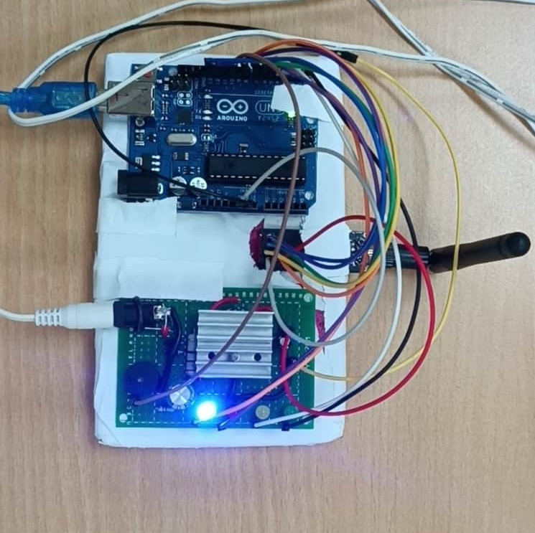
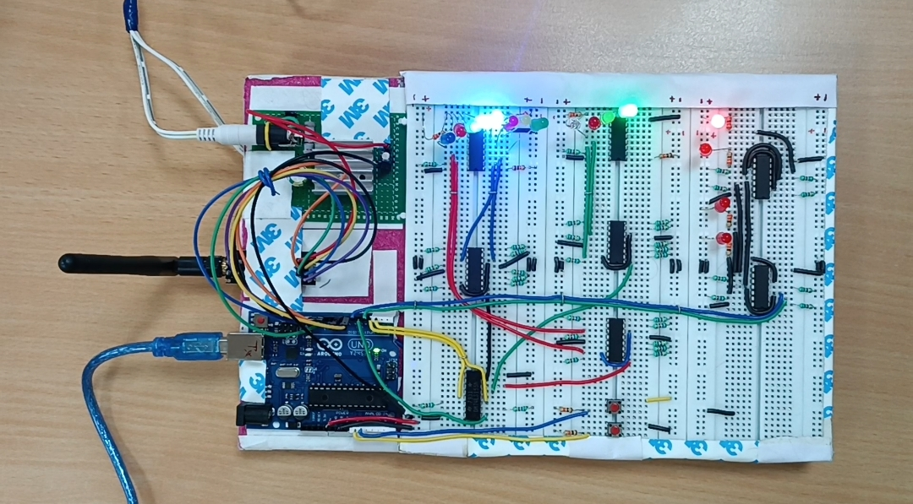
PICTURE OF TRANSMITTER AND RECEIVER
TRANSMITTER
RECEIVER

Slide 10
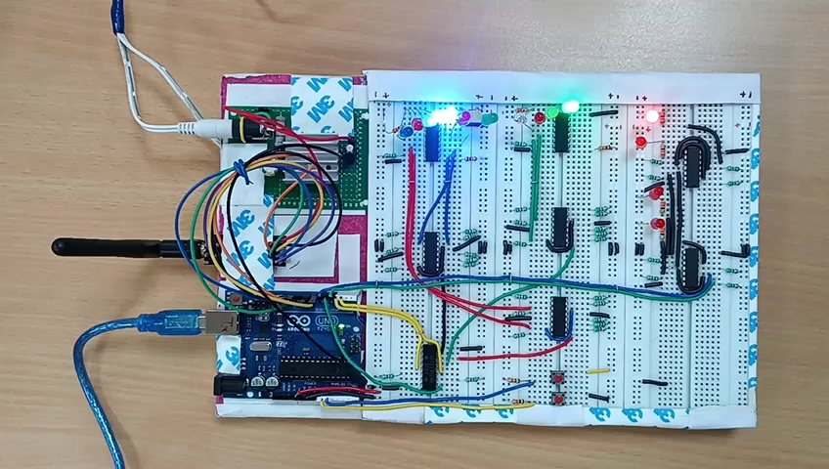
VIDEO DEMONSTRATION

Slide 11
THANK YOU

