Slide 1
SPORE
Classroom & Personal
Event Organizer for Students

Slide 2
System Features
System manages calendar events
Syllabus for whole class consists of an event list
Students can belong to multiple classes
Each student can add personal events to calendar
Student calendar consists of –
Multiple class events (syllabus for each enrolled class)
Individual events
Calendar view can be filtered with events from –
Personal events
An enrolled class events
A combination of enrolled classes and personal events
All events
System front-end to be deployed on PC, Smart-devices etc.

Slide 3
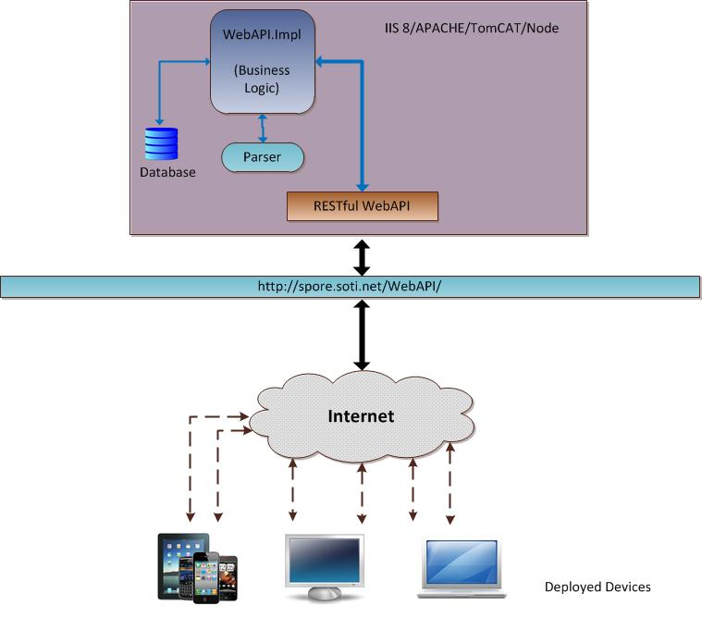
System Architecture

Slide 4
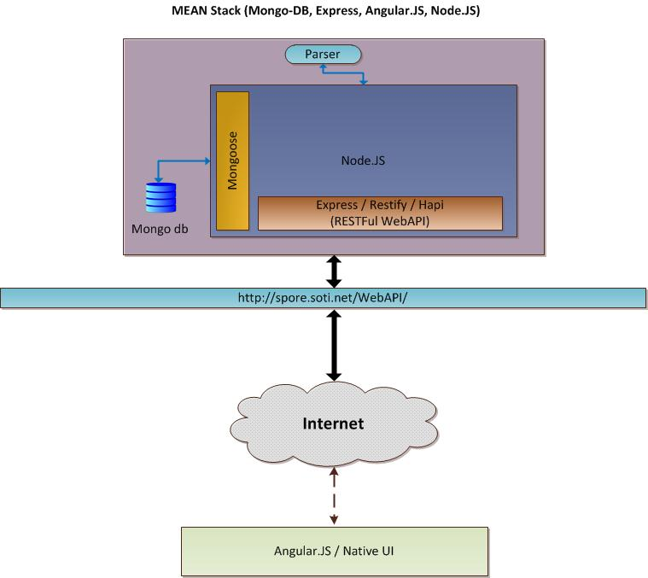
Technology Stack

