Slide 1

`
Deep Learning Models for Time Series Forecasting:
Applications in SKU Forecasting and Soft Sensing
Swapnil Sharma
Roll No : CH20B024
Guide : Dr. M. Nabil
Department of Chemical Engineering
May 10, 2024
Swapnil Sharma
Deep Learning Models for Time Series Forecasting: Applications in SKU Forecasting and Soft Sensing
1

Slide 2
Outline
Introduction
Problem Statement
Time Series Models (Phase-I)
Machine Learning Models
Light Gradient Boosting Machine (Phase-II)
Deep Learning Models
Recurrent Neural Networks (Phase-II)
Long Short-Term Memory (Phase-II)
Case Study
Case Study 1: Simulated Data (Phase-II)
Application 1: SKU Forecasting (Phase-I &Phase-II)
Application 2: Soft Sensing (Phase-II)
Conclusion and Potential Extensions
Swapnil Sharma
Deep Learning Models for Time Series Forecasting: Applications in SKU Forecasting and Soft Sensing
2

Slide 3
Introduction – SKU Forecasting and Soft Sensing
The primary challenge in SKU forecasting lies in the fluctuating and intricate factors impacting product demand, including seasonality, promotions, and external market dynamics.
Objective 1: To accurately forecast SKU demand by addressing the challenges posed by factors like seasonality, promotions, and external market dynamics.
The challenge arises in industrial processes when certain variables are hard to measure or cannot be measured due to difficulties, high costs, or impracticality.
Objective 2: To estimate or infer process variables indirectly which are difficult, impractical and costly to predict without measuring them directly.
Pointers from literature survey:
[Perez et al., 2022] used RNN and Transformer architecture to forecast the SKU on Corporacion Favorita dataset.
[Jicheng Li et al., 2023] used LSTM to predict the butane concentration at the bottom of the debutanizer column.
[Curreri F. et al., 2021] used RNN and LSTM for predicting H₂S and SO₂ concentration in SRU (Sulphur Recovery Unit).
Our focus: To provide solutions for SKU forecasting and soft sensing by leveraging advanced deep learning techniques.
Swapnil Sharma
Deep Learning Models for Time Series Forecasting: Applications in SKU Forecasting and Soft Sensing
3

Slide 4




Time Series Models
Auto Regressor (AR) model
Moving Average (MA) model
Auto-regressive Moving Average (ARMA) Model
$$y_{t}= \sum_{iεS}{∝_{i}y_{t−i}+ε_{t}}$$
$$y_{t}= \sum_{jεS_{1}}{θ_{j}ε_{t−j}+ε_{t}+μ}$$
$$y_{t}= \sum_{iεS}{∝_{i}y_{t−i}+\sum_{jεS_{1}}{θ_{j}ε_{t−j}}{+ε}_{t}+c}$$
Auto-regressive Integrated Moving Average (ARIMA) Model
$$(1−\sum_{iεS}{α_{i}B^{i}){(1−B)}^{d}y_{t}=(1+\sum_{jεS_{1}}{θ_{j}B^{j})ε_{t}}}$$
$S$is set of significant lags and $S_{1}$ is the set of significant lagged error terms or white noise and the B is the backshift operator. c and b are the respective constant terms of the AR and ARMA model, $μ$is the mean of the time series and $y_{t}$is the SKU sales at time t. $ε_{t}$ is the white noise error or residuals at time t.
Swapnil Sharma
Deep Learning Models for Time Series Forecasting: Applications in SKU Forecasting and Soft Sensing
4

Slide 5


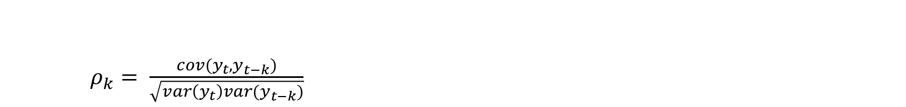

PACF and ACF
PACF and ACF
While PACF calculates the correlation after removing the influence of the intermediate lags $y_{t−1}$, $y_{t−2}$…… $y_{t−k+1}$when you calculate the partial auto correlation between $y_{t}$ and $y_{t−k }$.
PACF and ACF helps you to find the order of the AR and MA model respectively and also helps to find the significant lags.
Partial Auto Correlation Function
$$φ_{kk}= \frac{ρ_{k } −(\sum_{i=1}^{k−1}{φ_{k−1,i}}{∗ρ}_{k−1 })}{(1−\sum_{i=1}^{k−1}{φ_{k−1,i}∗}ρ_{j })}$$
$φ_{k,j}$ is the PACF between $y_{t−k}$ and $y_{t−j. }$.
where, $φ_{k,j}=φ_{k−1,j}−φ_{kk}φ_{k−1,k−j}$
There is always dependence of $y_{t−1 }{,y}_{t−2}…..y_{t−m}$ on $y_{t}$where m is the maximum possible lags$.$ So, while calculating the auto correlation between $y_{t}$ and $y_{t−k }$it gives you the correlation after having the influence of intermediate lags $y_{t−1}$, $y_{t−2}$…… $y_{t−k+1}.$
$ρ_{k}= \frac{cov(y_{t},y_{t−k})}{\sqrt{var\left(y_{t}\right)var(y_{t−k})}}$
Auto Correlation Function
$ρ_{k}$ is the ACF between $y_{t}$ and $y_{t−k }$.
Swapnil Sharma
Deep Learning Models for Time Series Forecasting: Applications in SKU Forecasting and Soft Sensing
5

Slide 6
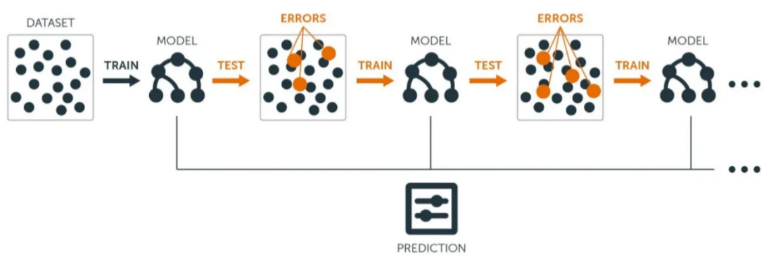
Light Gradient Boosting Machine (LGBM)
LightGBM is an ensemble learning technique. LightGBM uses three novel features: Gradient-based One Side Sampling (GOSS), Bin way of splitting and Exclusive Feature Bundling (EFB).
LightGBM has several advantages:
Faster training speed and higher efficiency.
Better accuracy.
Compatibility with Large Datasets.
Swapnil Sharma
Deep Learning Models for Time Series Forecasting: Applications in SKU Forecasting and Soft Sensing
6

Slide 7
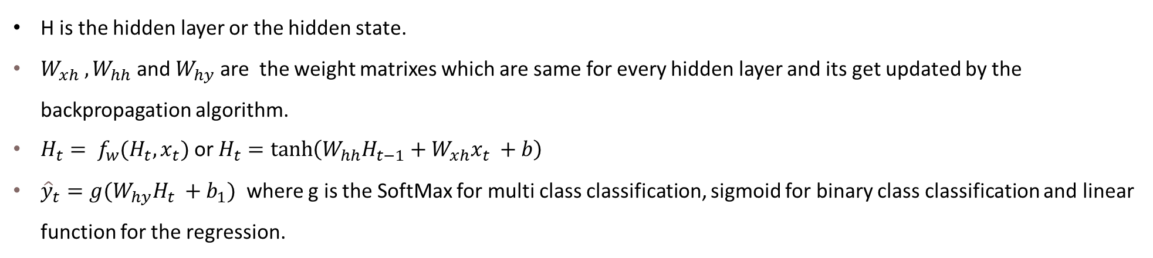









Recurrent Neural Networks (RNNs)
Y
$${\hat{y}}_{t}$$
$${\hat{y}}_{t+1}$$
$${\hat{y}}_{t+2}$$
RNN
$$H_{t−1}$$
$$H_{t}$$
$$H_{t+1}$$
X
W
$$x_{t}$$
$$x_{t+1}$$
$$x_{t+2}$$
H is the hidden layer or the hidden state.
$W_{xh} ,W_{hh}$ and $W_{hy}$are the weight matrixes which are same for every hidden layer and its get updated by the backpropagation algorithm.
$H_{t}= f_{w}(H_{t},x_{t})$ or $H_{t}=\tanh\left(W_{hh}H_{t−1}+W_{xh}x_{t} +b\right)$
${\hat{y}}_{t}=g(W_{hy}H_{t} +b_{1})$ where g is the SoftMax for multi class classification, sigmoid for binary class classification and linear function for the regression.
Swapnil Sharma
Deep Learning Models for Time Series Forecasting: Applications in SKU Forecasting and Soft Sensing
7

Slide 8
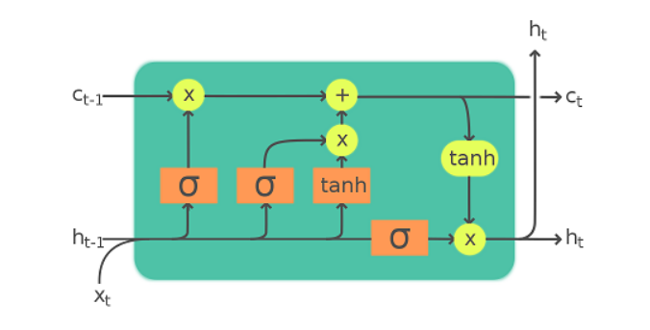

Long Short-Term Memory (LSTM)
Forget gate
Output gate
$o_{t}=σ\left(Wh_{t−1}+Ux_{t} +b_{0}\right)$ where $o_{t}$ is the output gate.
$f_{t}=σ\left(Wh_{t−1}+Ux_{t} +b_{f}\right)$ where $i_{t}$ is known as forget gate.
$i_{t}=σ\left(Wh_{t−1}+Ux_{t} +b_{i}\right)$ where $i_{t}$ is known as input gate.
$\tilde{c_{t}}= σ\left(Wh_{t−1}+Ux_{t} +b_{c}\right)$where $\tilde{c_{t}}$ is known as cell state.
$c_{t}=f_{t}\text{∘}c_{t−1}+i_{t}$ $\tilde{c_{t}}$
$h_{t}=o_{t}\text{∘}\text{tanh}\text{(}c_{t}\text{)}$
Input gate
Swapnil Sharma
Deep Learning Models for Time Series Forecasting: Applications in SKU Forecasting and Soft Sensing
8

Slide 9
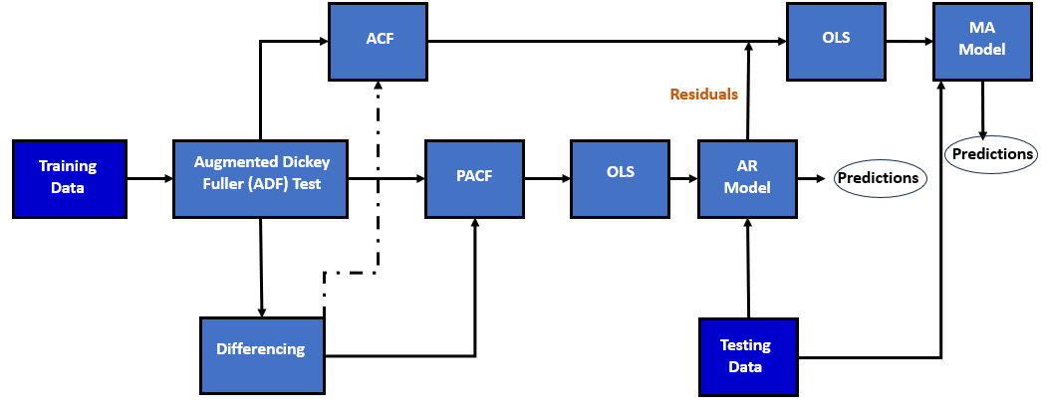
Methodology
OLS is the Ordinary Least Squares method to get the coefficients of the models. ADF Test helps to check whether the time series is stationary or not. Non-stationary time series will go through differencing to convert in stationary one.
Swapnil Sharma
Deep Learning Models for Time Series Forecasting: Applications in SKU Forecasting and Soft Sensing
9

Slide 10
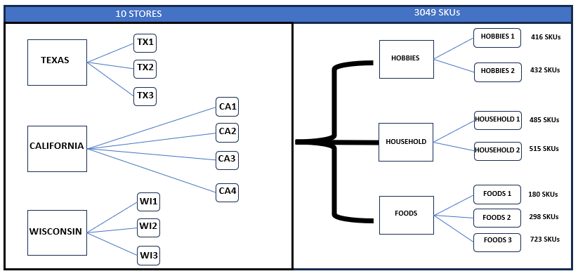
Case Study and Dataset Description
Walmart Dataset
Types of Features
ID | Special Offer
State ID | Units Sold
Store ID | Day
Dept ID | Sell Price
Category ID | Month
Holiday Name | Year
Holiday Type
Datasets consist of all information of public holidays, promotional events and sell price of the 1941 days. 1913 days for the training and 28 days for testing. It is classic M5 Forecasting dataset of Walmart stores taken from Kaggle.
Swapnil Sharma
Deep Learning Models for Time Series Forecasting: Applications in SKU Forecasting and Soft Sensing
10

Slide 11
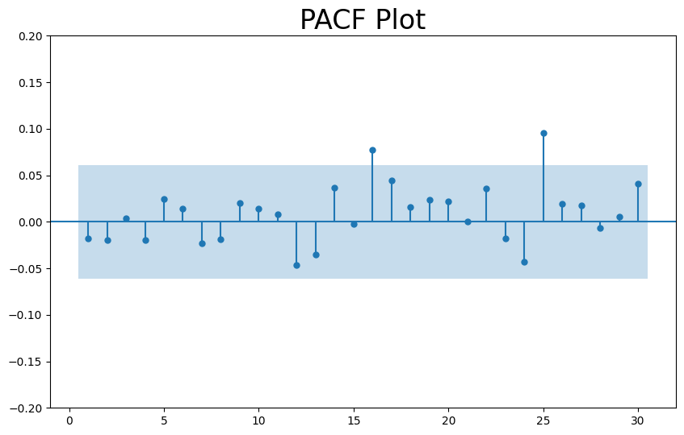
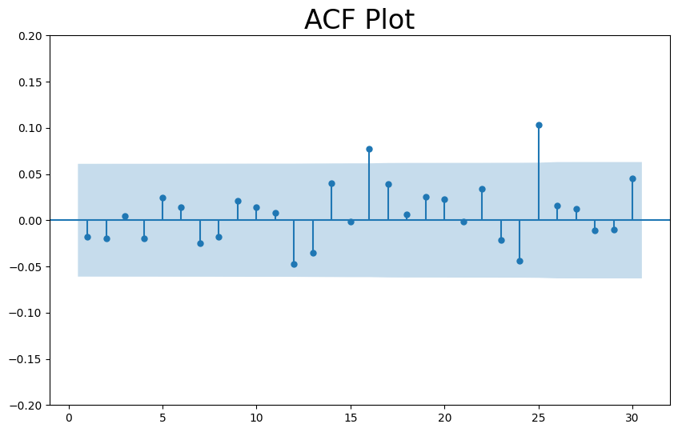
Results (Walmart Dataset)
The table of the performance of the respective time series models on the training set is created. The forecasting is done on the store id = "CA_2" and category id = "HOBBIES_1_001". Same has been done for the testing set.. From the ACF and PACF we got the significant lags to be t-16 i.e. of 16 days and t-25 i.e. of 25 days for the AR and for MA model errors to be considered at day t and t-25.
Swapnil Sharma
Deep Learning Models for Time Series Forecasting: Applications in SKU Forecasting and Soft Sensing
11

Slide 12
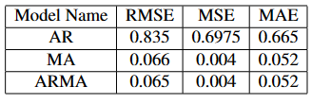
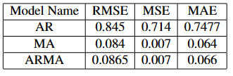
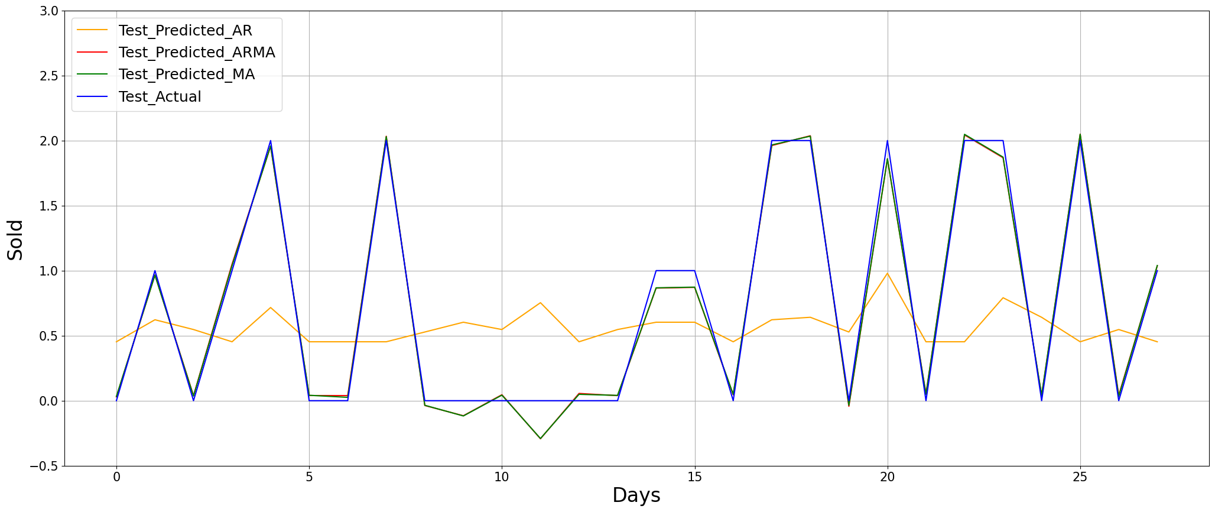
Results (Walmart Dataset)
Table 1: Performance Table of Training Set.
Table 2: Performance Table of Testing Set.
Figure: Actual vs Predicted on testing set.
Swapnil Sharma
Deep Learning Models for Time Series Forecasting: Applications in SKU Forecasting and Soft Sensing
12

Slide 13
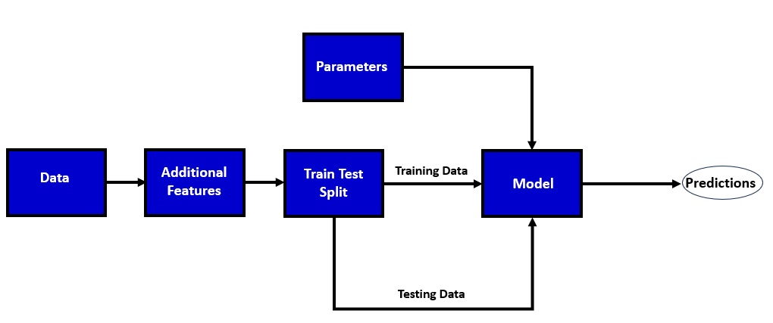
Methodology for Machine Learning and Deep Learning Models
Additional features include expanding sold mean, rolling sold mean, lags etc. Here model can be any Machine Learning or Deep Learning model.
Swapnil Sharma
Deep Learning Models for Time Series Forecasting: Applications in SKU Forecasting and Soft Sensing
13

Slide 14
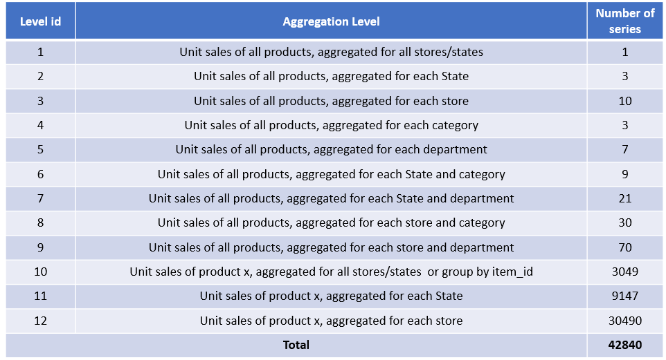
Performance Metrics of LGBM model
Results (Walmart Dataset)
Level | MSE | RMSE | MAE
1 | 9632.951 | 98.147 | 76.468
2 | 1693.9228 | 40.922 | 33.0746
3 | 1079.2604 | 32.8521 | 29.887
4 | 1154.5722 | 33.979 | 29.944
5 | 1049.1 | 32.328 | 28.991
6 | 458.6033 | 18.151 | 14.673
7 | 197.567 | 10.740 | 8.340
8 | 111.929 | 8.35641 | 6.7064
9 | 47.739 | 4.9100 | 3.8132
10 | 72.600 | 8.521 | 7.44
11 | 34.25 | 5.852 | 4.61
12 | 0.105097 | 0.306477 | 0.066
Results:- Performance table on the testing set. Average over different time series in that level.
Swapnil Sharma
Deep Learning Models for Time Series Forecasting: Applications in SKU Forecasting and Soft Sensing
14

Slide 15
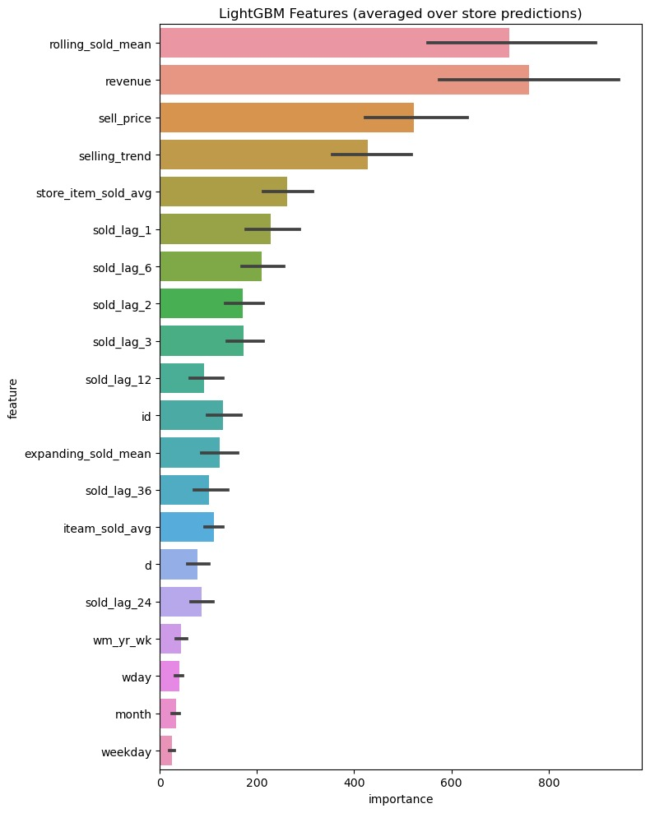
Features Importance Plot for LGBM model
The plot displays the relative importance of each feature in the trained LightGBM model. Features with higher importance values contribute more to the model's predictions.
This metric simply counts how many times a feature is used to split the data across all trees.
In splitting of node in trees, only those features are considered which give maximum difference in variance between child node and parent node.
Swapnil Sharma
Deep Learning Models for Time Series Forecasting: Applications in SKU Forecasting and Soft Sensing
15

Slide 16
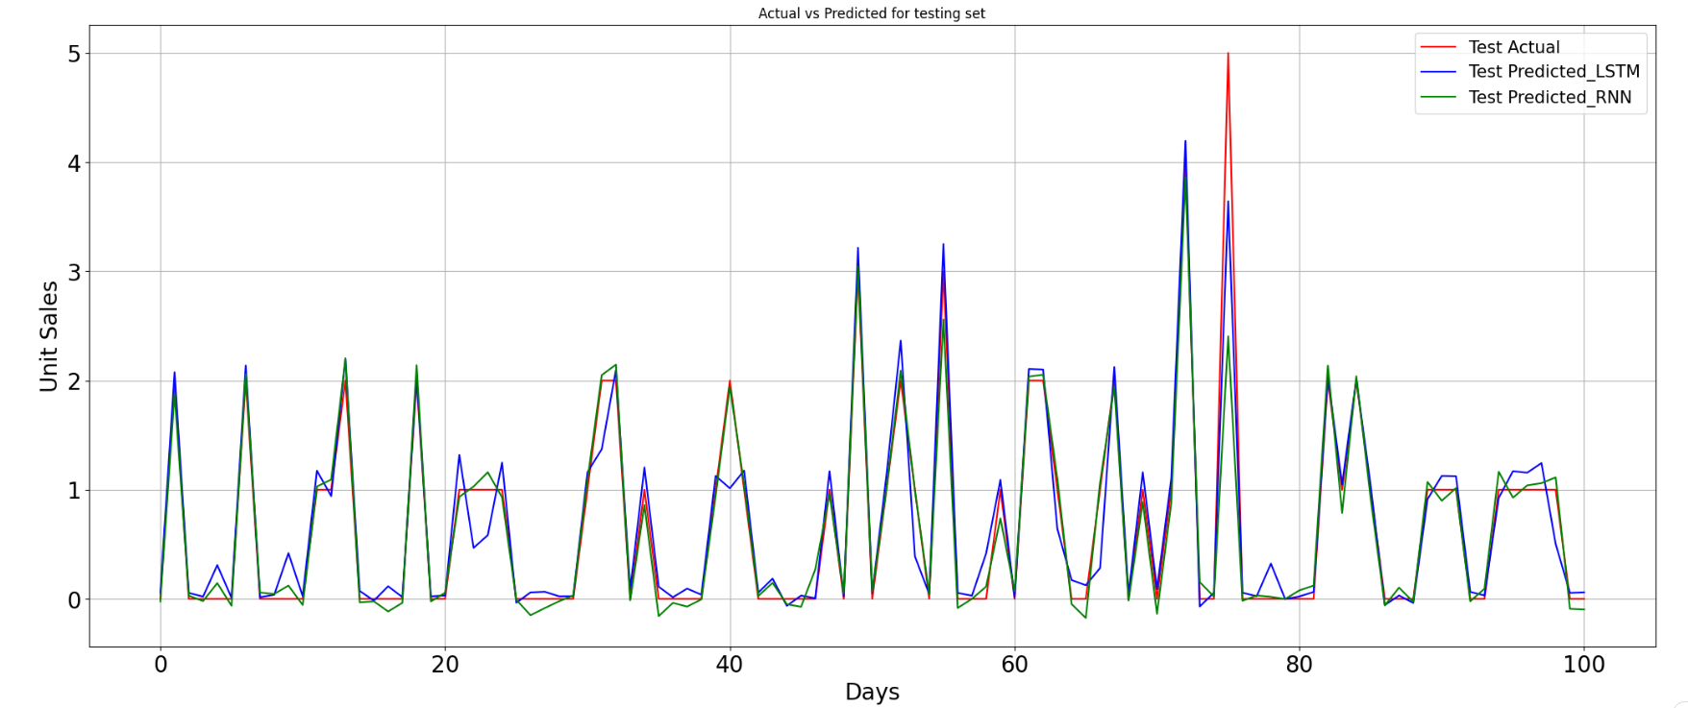
Results and Performance Metrics of RNN and LSTM Univariate
 | RNN |  |  | LSTM
MSE | 0.0287 | 0.0288 | 0.0673 | 0.0091 | 0.0120 | 0.100
RMSE | 0.1695 | 0.1699 | 0.2595 | 0.0954 | 0.1096 | 0.316
MAE | 0.1324 | 0.1317 | 0.1794 | 0.0529 | 0.0587 | 0.150
 | Training | Validation | Testing | Training | Validation | Testing
Table: Performance Metrics for store = ‘CA1’ and item_id = ‘HOBBIES_1_001’.
Swapnil Sharma
Deep Learning Models for Time Series Forecasting: Applications in SKU Forecasting and Soft Sensing
16

Slide 17
Case Study and Dataset Description
Corporacion Favorita dataset
Types of Features
Date | Str_nbr (Store number) | Cluster (which cluster the particular store lies in with store number.)
Locale (Local holiday, Regional or National holiday) | Item_nbr (item number) | Type (Type of the store)
Locale_name (if National then Ecuador else region/state name for regional or local name | Family (of item number) | City (city of store)
Description of holiday | Class (of item number) | State (state of store)
Transferred(True Or False) | Perishable (True or False for item number) | Type of holiday( Holiday or Additional)
Daily oil price | On promotion (with respect to date, item number, store number)
Total transactions (on particular store on particular date.) | Unit sales.
17 clusters
15 stores
16 states
44 cities
33 types
1235 days
18154 SKUs
Swapnil Sharma
Deep Learning Models for Time Series Forecasting: Applications in SKU Forecasting and Soft Sensing
17

Slide 18
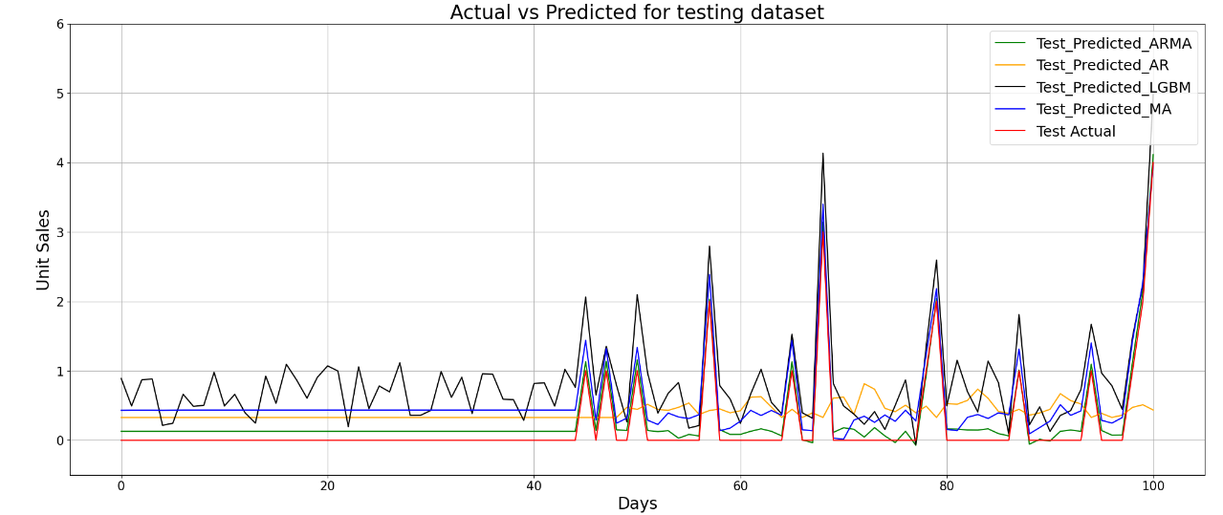
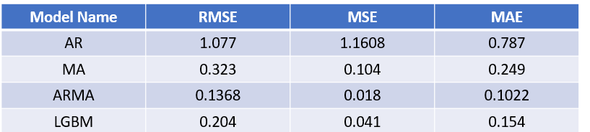
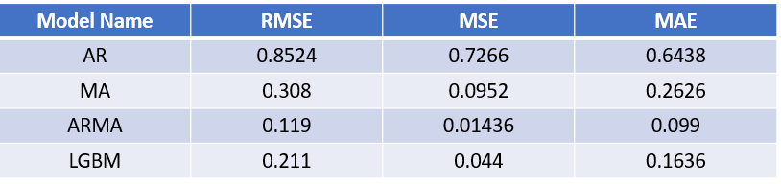
Results (Corporacion Favorita Dataset)
The forecasting is done for the particular item_nbr = 108701 and the store_nbr = 25.
Table : Performance metrics of testing dataset.
Figure : Actual vs Predicted plot for testing dataset.
Table : Performance metrics of training dataset.
Swapnil Sharma
Deep Learning Models for Time Series Forecasting: Applications in SKU Forecasting and Soft Sensing
18

Slide 19
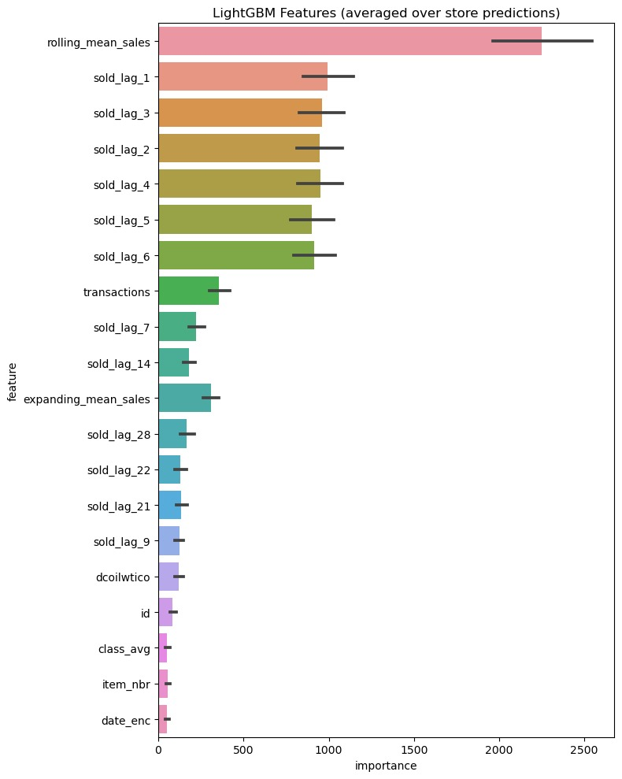
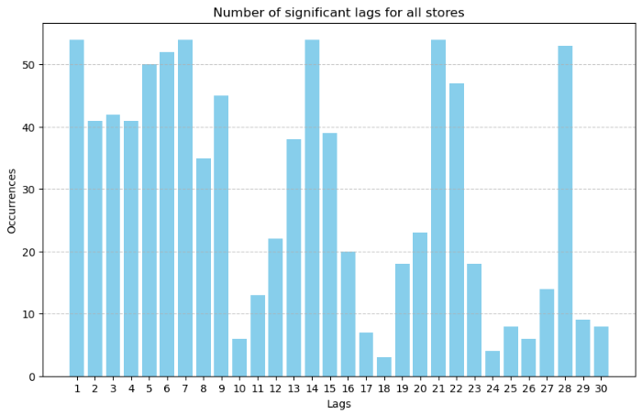
Plots
Figure : To find the most common significant lags.
Figure : Features Importance plot.
Swapnil Sharma
Deep Learning Models for Time Series Forecasting: Applications in SKU Forecasting and Soft Sensing
19

Slide 20
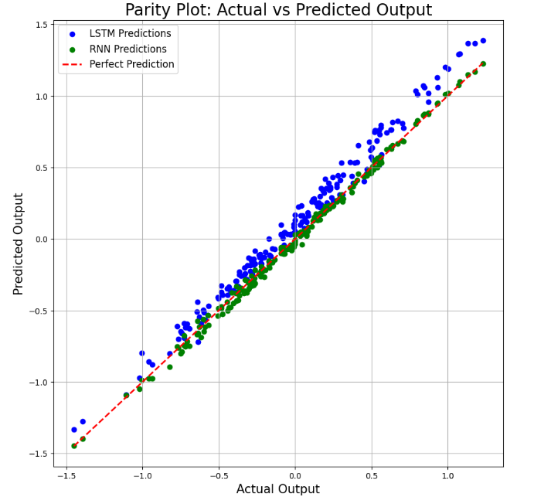
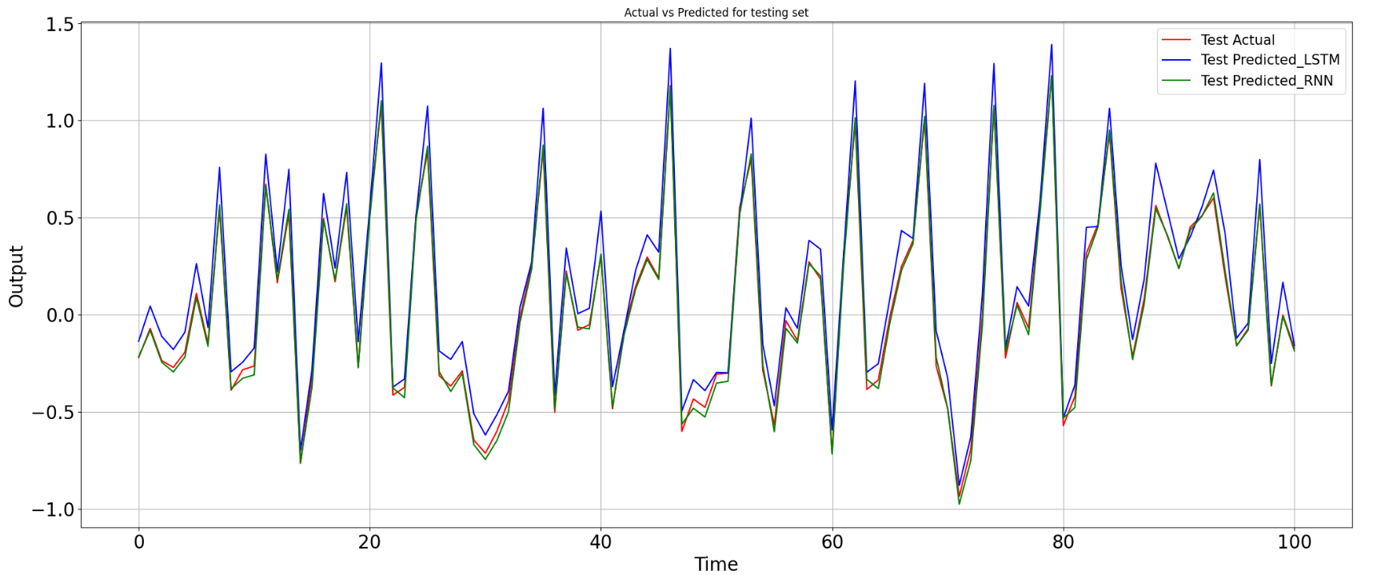
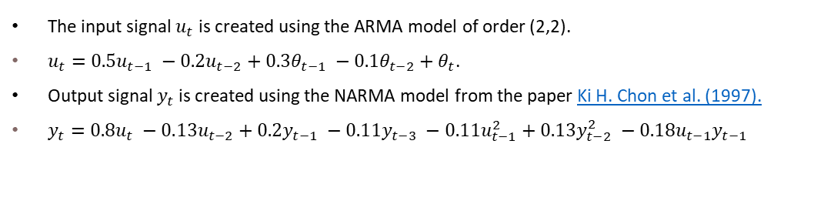
NARMA (Nonlinear ARMA) Simulated Series
 | RNN |  |  | LSTM
MSE | 0.004 | 0.004 | 0.004 | 0.003 | 0.004 | 0.003
RMSE | 0.064 | 0.063 | 0.063 | 0.063 | 0.063 | 0.058
MAE | 0.052 | 0.052 | 0.051 | 0.050 | 0.054 | 0.050
 | Training | Validation | Testing | Training | Validation | Testing
The input signal $u_{t}$ is created using the ARMA model of order (2,2).
$u_{t}=0.5u_{t−1} −0.2u_{t−2}+0.3θ_{t−1} −0.1θ_{t−2}+θ_{t}$.
Output signal $y_{t}$is created using the NARMA model from the paper Ki H. Chon et al. (1997).
$y_{t}=0.8u_{t} −0.13u_{t−2}+0.2y_{t−1} −0.11y_{t−3} −0.11u_{t−1}^{2}+0.13y_{t−2}^{2} −0.18u_{t−1}y_{t−1}$
Table: Performance Metrics.
Figure :Actual vs predicted plot for testing set.
Swapnil Sharma
Deep Learning Models for Time Series Forecasting: Applications in SKU Forecasting and Soft Sensing
20

Slide 21
SRU(Sulphur Recovery Unit) and Debutanizer Column Dataset
The process variables for each process are defined below:
Variables | Notation | Description
Inputs | x₁ | Top temperature
 | x₂ | Top pressure
 | x₃ | Reflux flow
 | x₄ | Flow to next process
 | x₅ | 6th tray temperature
 | x₆ | Bottom temperature
 | x₇ | Bottom temperature
Output | y | Butane (C4) content in the debutanizer column bottom
Variables | Notation | Description
Inputs | x₁ | MEA gas flow (Monoethanolamine)
 | x₂ | First air flow
 | x₃ | Second air flow
 | x₄ | Gas flow in SWS zone
 | x₅ | Air flow in SWS zone
Outputs | y₁ | Concentration of H₂S.
 | y₂ | Concentration of SO₂
Table: Debutanizer column variables.
Table: SRU variables.
Swapnil Sharma
Deep Learning Models for Time Series Forecasting: Applications in SKU Forecasting and Soft Sensing
21

Slide 22
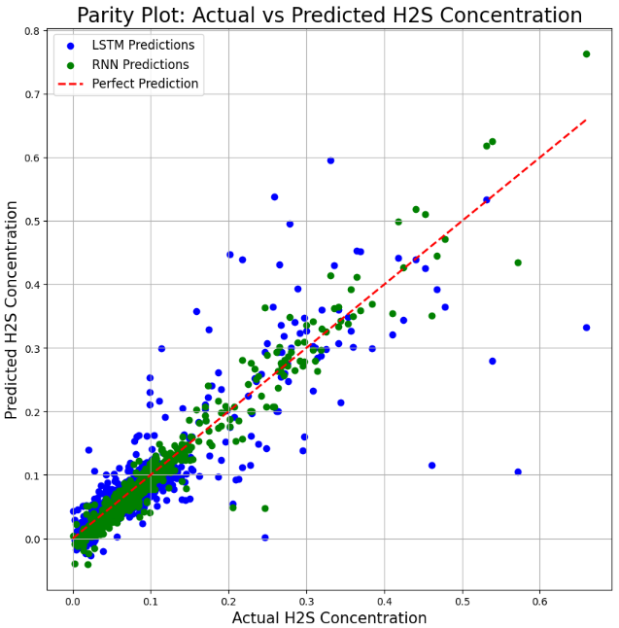
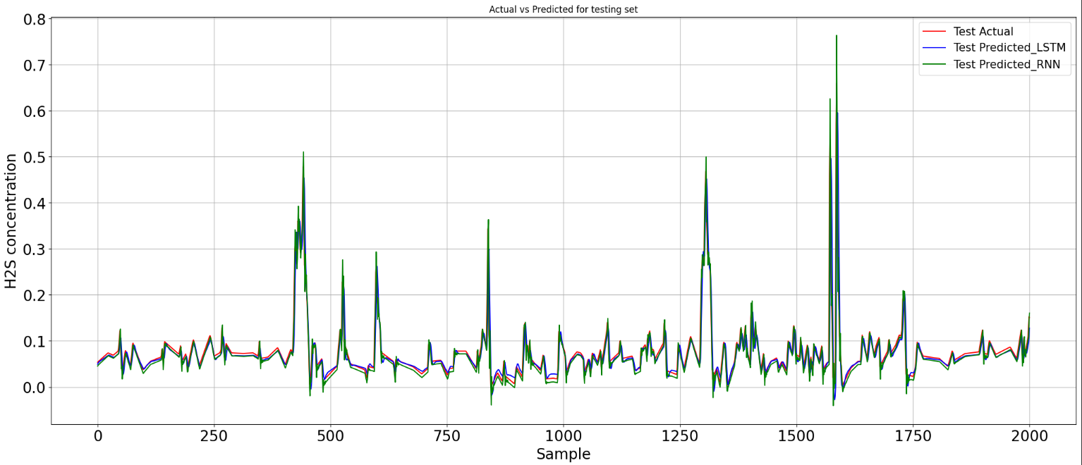
Results and Performance Metrics (SRU Dataset H₂S) of RNN and LSTM Univariate
 | RNN |  |  | LSTM
MSE | 0.000192 | 0.00018 | 0.00020 | 0.0008 | 0.0008 | 0.00128
RMSE | 0.01386 | 0.01356 | 0.0141 | 0.028 | 0.029 | 0.0357
MAE | 0.00571 | 0.0054 | 0.0067 | 0.0155 | 0.0150 | 0.0182
 | Training | Validation | Testing | Training | Validation | Testing
Figure : Actual vs predicted plot on testing set.
Swapnil Sharma
Deep Learning Models for Time Series Forecasting: Applications in SKU Forecasting and Soft Sensing
22

Slide 23
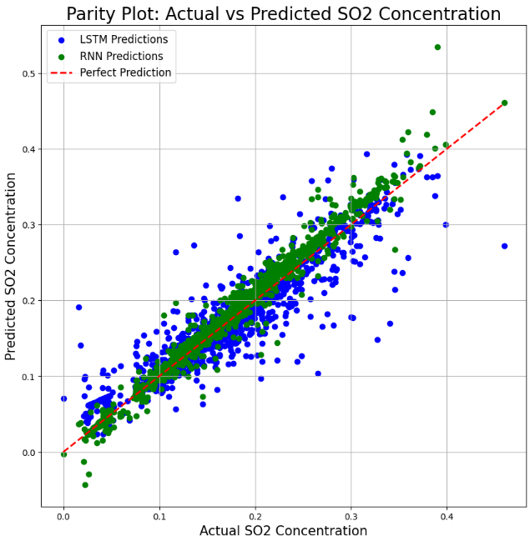
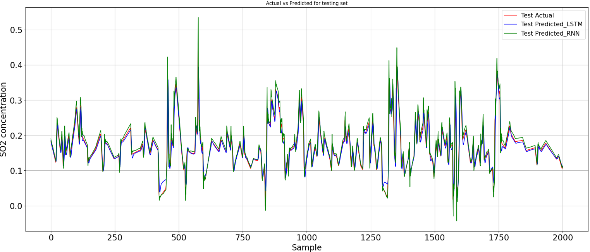
Results and Performance Metrics (SRU Dataset SO₂) of RNN and LSTM Univariate
 | RNN |  |  | LSTM
MSE | 0.00032 | 0.00027 | 0.00028 | 0.0013 | 0.0008 | 0.0009
RMSE | 0.01799 | 0.01653 | 0.01679 | 0.0365 | 0.0286 | 0.0312
MAE | 0.0122 | 0.0119 | 0.0129 | 0.0233 | 0.0210 | 0.0230
 | Training | Validation | Testing | Training | Validation | Testing
Figure : Actual vs predicted plot on testing set.
Swapnil Sharma
Deep Learning Models for Time Series Forecasting: Applications in SKU Forecasting and Soft Sensing
23

Slide 24
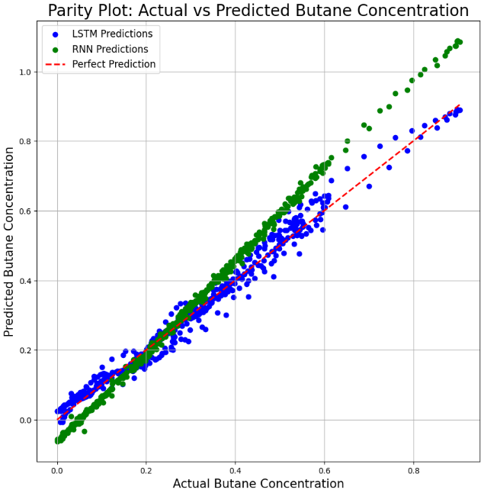
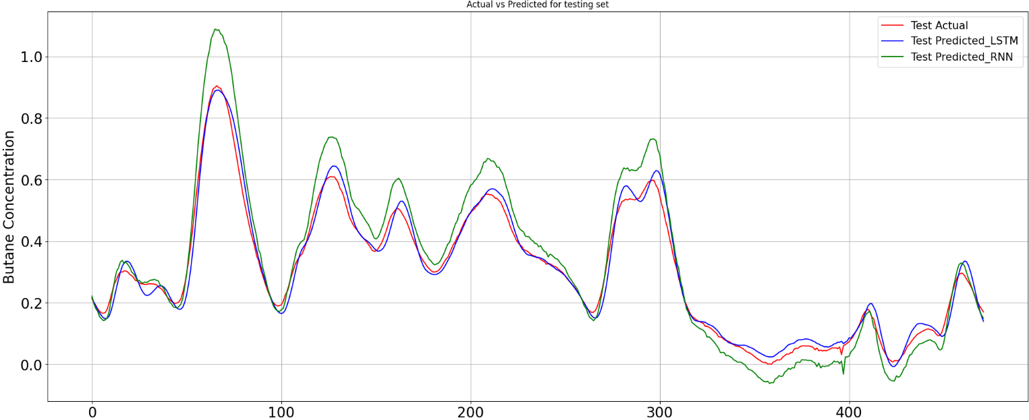
Results and Performance Metrics (Debutanizer Dataset) of RNN and LSTM Univariate
 | RNN |  |  | LSTM
MSE | 0.0018 | 0.00256 | 0.0046 | 0.00038 | 0.00054 | 0.0007
RMSE | 0.04258 | 0.0506 | 0.068 | 0.0196 | 0.0233 | 0.0269
MAE | 0.0283 | 0.034 | 0.0545 | 0..0137 | 0.0143 | 0.0205
 | Training | Validation | Testing | Training | Validation | Testing
Figure: Actual vs predicted plot on testing set.
Swapnil Sharma
Deep Learning Models for Time Series Forecasting: Applications in SKU Forecasting and Soft Sensing
24

Slide 25
Discussions
The decision of taking the significant lags is totally dependent on us. We always try to reduce the number of the significant lags as to reduce the computational complexity.
We didn’t implement the ARIMA model as it is mainly used for the non-stationary time series. In all datasets we didn’t find any non-stationary time series.
Have implemented the RNN and LSTM on Corporacion Favorita dataset but due to some missing days, any interpolation method did not give good results with any of the RNN and LSTM.
As we created univariate RNN and LSTM models, we have considered the lags of output value as the features.
Swapnil Sharma
Deep Learning Models for Time Series Forecasting: Applications in SKU Forecasting and Soft Sensing
25

Slide 26
Conclusions and Potential Extensions
Conclusions
AR model didn’t perform well as MA and ARMA on both Walmart and Corporacion Favorita dataset.
PACF and ACF are the most important concepts that will help you to get the significant lags and will help you to improve the performance of any whether it is time series model, machine learning model or deep learning models. You can include the significant lags as your features.
Implementing time series and univariate deep learning model is easy to implement as compared to machine learning model but have more computational complexity if want to do forecasting for large number of time series in once.
After accounting the effect of significant lags, the deep learning models like RNN and LSTM show very good improvement.
LSTM performed well as compared to RNN in soft sensing but for Walmart dataset RNN performed well.
Univariate deep learning model can be used to forecast the single time series however the multivariate deep learning model is capable to forecast the different time series.
Deep Learning models are capable to handle the non-stationary time series also.
Potential Extensions
Using Transformers and Seq2Seq for SKU forecasting and soft sensing.
Swapnil Sharma
Deep Learning Models for Time Series Forecasting: Applications in SKU Forecasting and Soft Sensing
26

Slide 27

References
Taghiyeh, S., Lengacher, D. C., Sadeghi, A. H., Sahebi-Fakhrabad, A., & Handfield, R. B. (2023, September)
A novel multi-phase hierarchical forecasting approach with machine learning in supply chain management.
Supply Chain Analytics, 3, 100032.
Curreri, F., Patané, L., & Xibilia, M. G. (2021).
and LSTM-Based soft sensors transferability for an industrial process.
Sensors, 21(3), 823.U
Li, J., & Qin, S. J. (2023).
Applying and dissecting LSTM neural networks and regularized learning for dynamic inferential modeling.
Computers & Chemical Engineering, 175, 108264.
Vallés-Ṕerez, I., Soria-Olivas, E., Martínez‐Sober, M., Serrano-López, A. J., Gómez-Sanchís, J., & Mateo, F. (2022).
Approaching sales forecasting using recurrent neural networks and transformers
Expert Systems With Applications, 201, 116993.
Ki H. Chon , Richard J. Cohen(1997, March).
Linear and Nonlinear ARMA Model Parameter Estimation Using an Artificial Neural Network.
IEEE TRANSACTIONS ON BIOMEDICAL ENGINEERING, VOL. 44, NO. 3.
University of Nicosia, Kaggle (2020)
Kaggle dataset link:- M5 Forecasting - Accuracy | Kaggle
CORPORACIÓN FAVORITA, Kaggle (2018)
Kaggle dataset link:- Corporación Favorita Grocery Sales Forecasting | Kaggle
Swapnil Sharma
Deep Learning Models for Time Series Forecasting: Applications in SKU Forecasting and Soft Sensing
27

