Slide 1

Sprocket Central Pty Ltd
Data analytics approach
Work Done By :Swapnil Prabhakar Wagh

Slide 2
Agenda
Introduction
Data Exploration
Model Development
Interpretation

Slide 3
Introduction
DATA INTRODUCTION:
* For Analysis:
Customer Demographic.
Customer Addresses.
Transaction data in the past three months.
* For Model Development:
New customer list

Slide 4
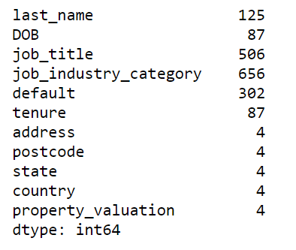
Data Quality Assessment
The given Data Have Poor Quality
* INCOMPLETNESS
Many missing values are present in dataset
* INACCURACY
column like default have unwanted script instead of proper data .

Slide 5
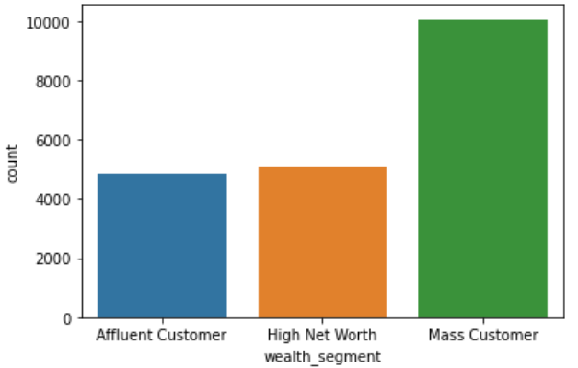
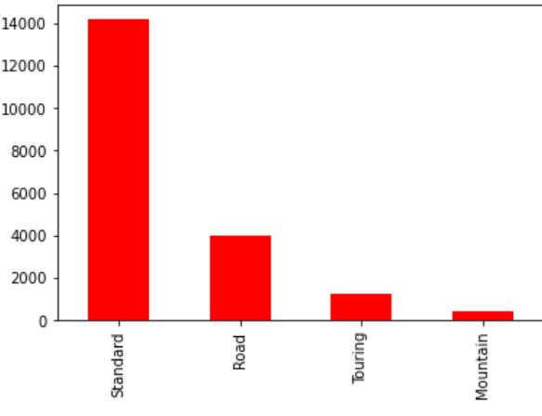
Data Exploration
Univarient Analysis:Standard have most transaction
Place any information about this point here.

Slide 6
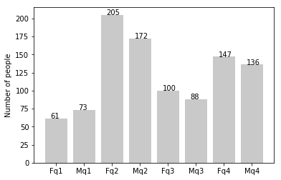
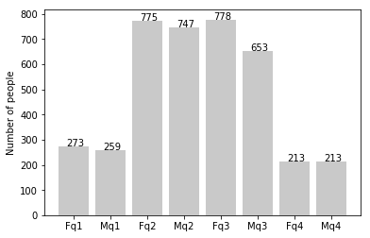
Data Exploration
new
Customers’ age distribution
As we can see, mostly our new customers are between 25 to 48 years old.
Number of customers from 48 to 59 years old has big drops on percentages.
There is a slightly increase in number of customers over 59 years old in term of percentages
It looks like the percentages of under 25 years old not really change.
old

Slide 7
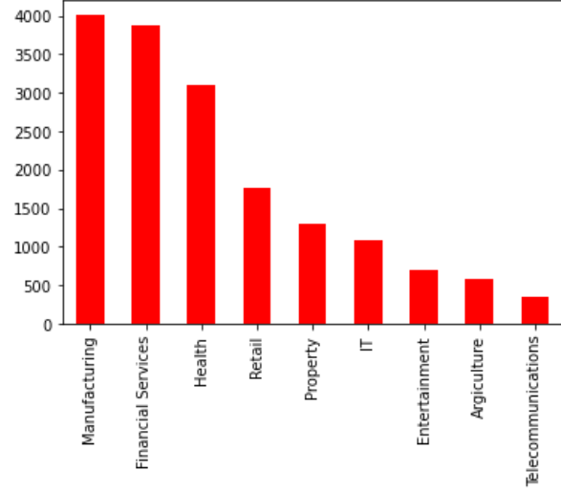
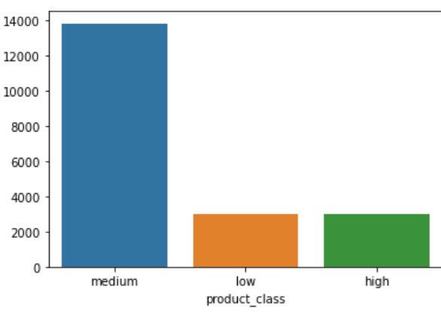

Slide 8
Model Development
Steps:
1. Droping Unwanted column like country , deceased_indicator (only 1 records) and DOB not useful for modeling.
2.Missing values should be filled by as per their relevent features .
3. Post code is have float datatype which cannot be possible.
4. Age is a continous numeric features .which can be convert in Range format
5. From transaction dataset we can calculate.other remaining information.

Slide 9
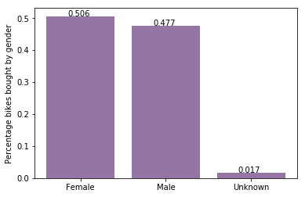
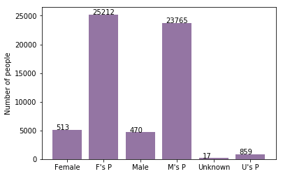
Note: The data and information in this document is reflective of a hypothetical situation and client. This document is to be used for KPMG Virtual Internship purposes only.
Model Development
Bike purchases last 3 years
As we can see, our new customers mostly Female with 50.6% purchases with total of 25,212 bikes
Male contributed to 47.7% purchases with 23,765 bikes
So we should focus on advertises on Female customers than Male customers

Slide 10
Interpretation
Model Interpretation: From model we can interpret below points
1. Solex & Giant Bicycles Brand will be on high demand
2. Standard Product line have hugh transaction.
3. Product class Medium is have very good demand
4. Most of the bicycles standard price will be 0 to 1400dollars.
5. Online order product have very high chance of approval.
6. Most of the state where order done is NSW thats why trek Bicycles have very low demand

Slide 11
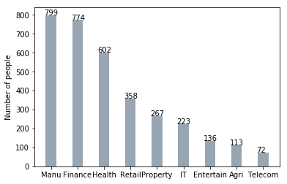
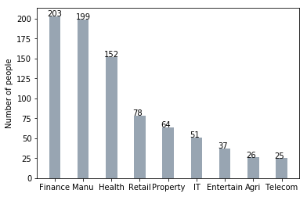
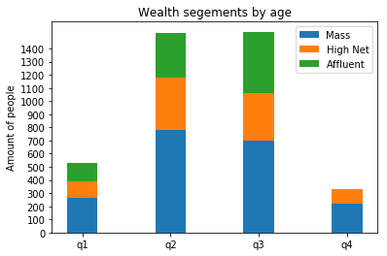
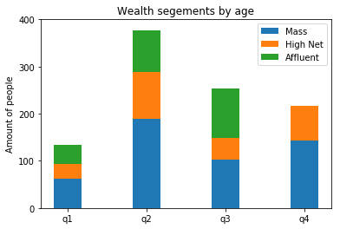
Note: The data and information in this document is reflective of a hypothetical situation and client. This document is to be used for KPMG Virtual Internship purposes only.
Interpretation
Job industry category
Mostly our new customers are on Finance industry and our Manufacturing customers are still on top 2.
The rest industries is still same
Wealth segments
In all ages, the number of Mass Customers is the highest so we should focus on this social class.
After that, we should focus on High Net Customer.
Then Affluent Customers but mostly second and third quadrant

Slide 12
Appendix

Slide 13
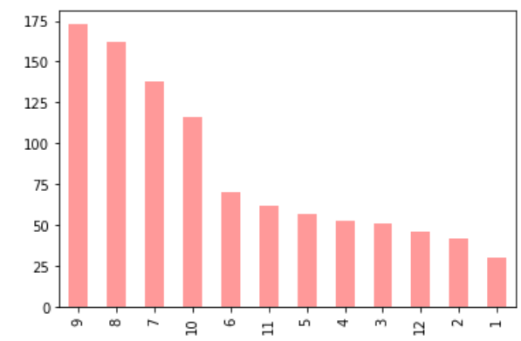
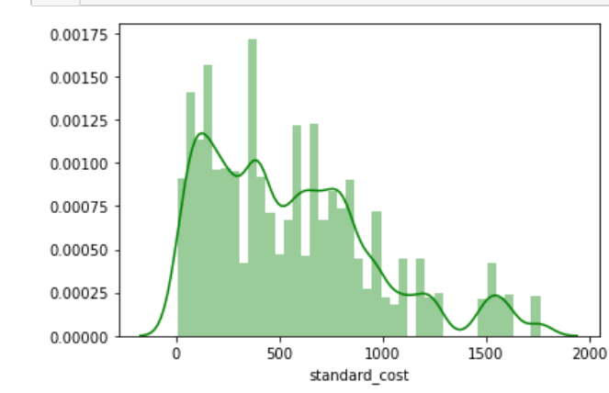
Appendix

Slide 14
THANK YOU.....

