Slide 1



Freshop – Online Vegetable store
IACSD Akurdi,Pune
PG-DAC
Project Group No. 95
Sharma Ganesh Vinod (230341220169)
Swapnil Kumar Tamrakar (230341220206)
Supervisor : Mr. Harshal, Mrs. MONIKA
Center for Development of Advanced Computing

Slide 2

IACSD,PUNE
INTRODUCTION
MOTIVATION
OBJECTIVE
TECHNILOGY USED
UML DIAGRAM
SCREENSHOTS
S/W AND H/W REQUIREMENTS
FUTURE SCOPE
CONCLUSION
REFERENCES

Slide 3
IACSD,PUNE
INTRODUCTION
Freshop is an Online Web App, which is developed to provide efficient platform to Buy and Sell fresh Vegetables online.
This is a portal which will be available for 24/7.
There are 3 major component of this portal, 1st Admin, 2nd Customer, and 3rd Seller.
Admin has full control over the Customer and the Seller. Admin handles Management on both the components.
Customer is here to search for the require product and maintain cart.
Customer can make payments online.

Slide 4
IACSD,PUNE
MOTIVATION
As we know that searching for fresh vegetables is so tedious job, so this website is developed to providing the simple and good searching and delivery option.
With the help of this app customer can search for fresh vegetable as per there liking and get the lot of options easily available to them.
And by this website the sellers can sell there products at best possible pricing.

Slide 5
IACSD,PUNE
OBJECTIVE
The Freshop is a website that is to be developed to provide the Easy access to Customers and suppliers , online buying and selling fresh vegetables.
This system provides service to the Customers and Suppliers.
This WebApp will allow Suppliers to establish one to one relationships with candidates.
This app will primarily focus on Management of Fresh Veggies.
By this Customer can easily search for Fresh vegetables and maintain their cart.

Slide 6
IACSD,PUNE
TECHNILOGY USED
Front End : For front end ReactJS has been used.
Back End : For back end Spring Boot has been used.
Back End Database : For back end database MySQL has been used.

Slide 7
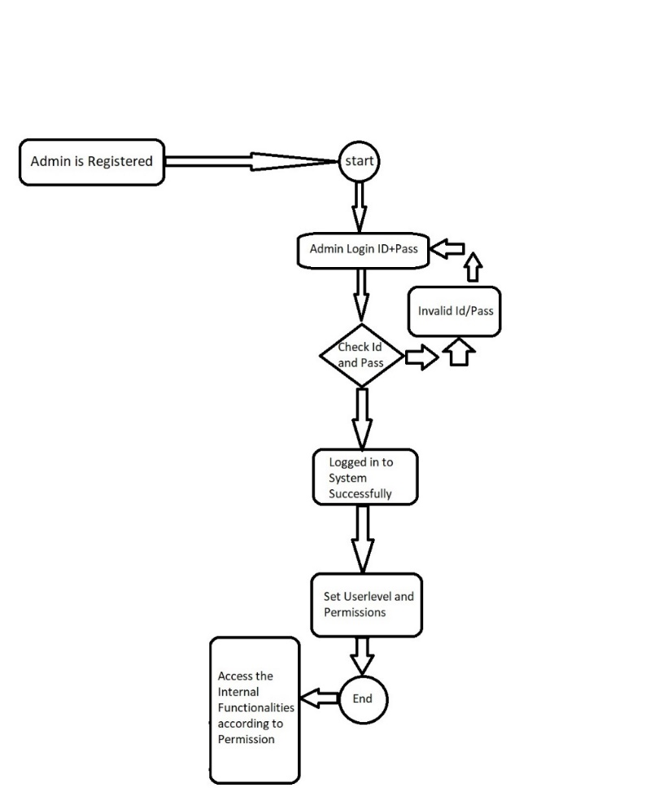
IACSD,PUNE
UML DIAGRAM
Admin

Slide 8
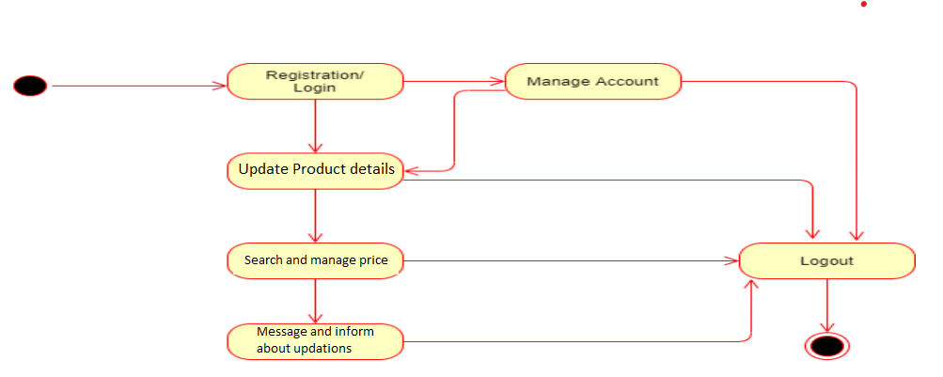
IACSD,PUNE
UML DIAGRAM
Supplier

Slide 9
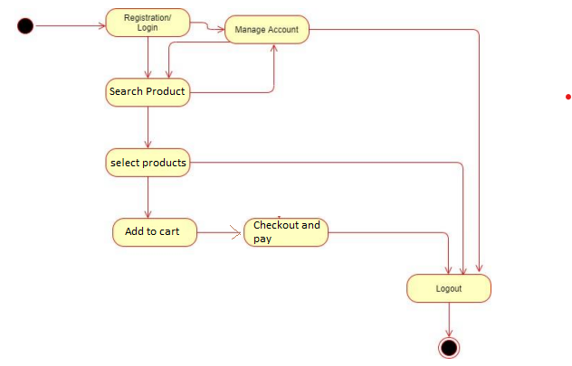
IACSD,PUNE
UML DIAGRAM
Customer

Slide 10
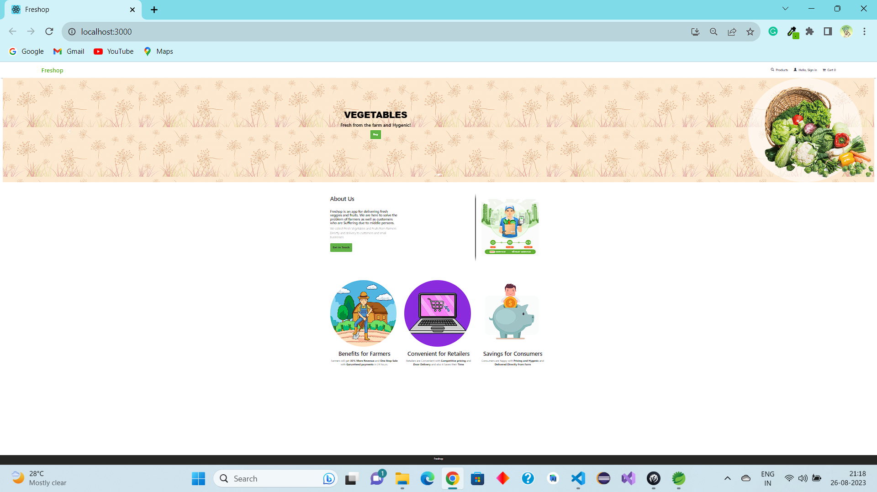
IACSD,PUNE
SCREENSHOTS
Home Page

Slide 11
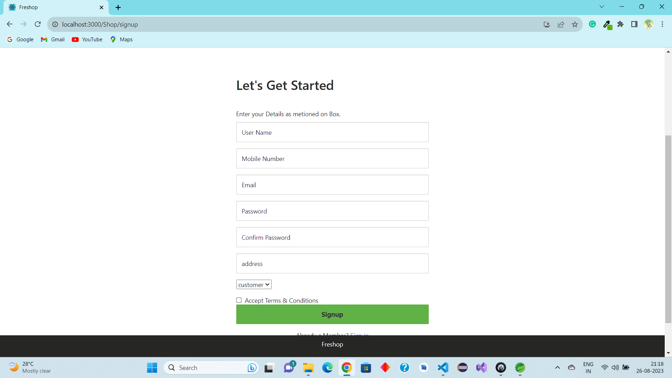
ss
IACSD,PUNE
SCREENSHOTS
Sign Up Page

Slide 12
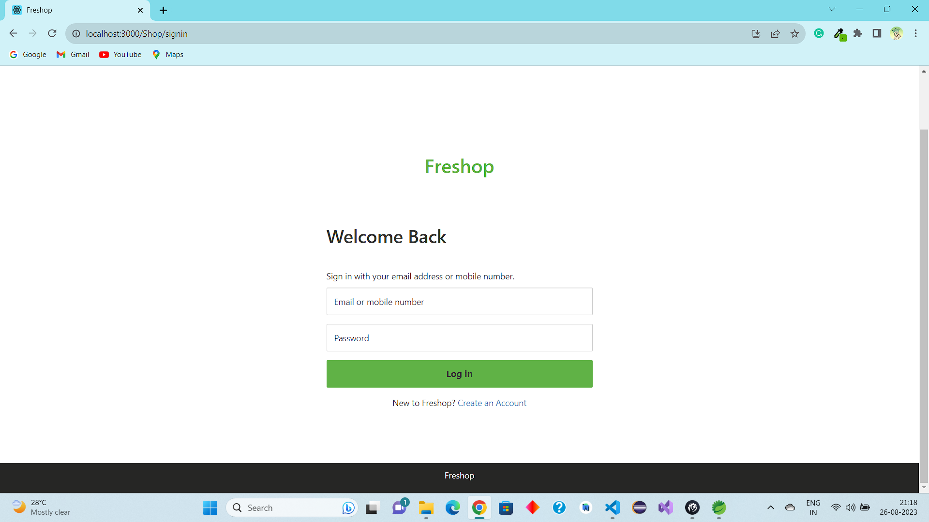
IACSD,PUNE
SCREENSHOTS
Log In Page

Slide 13
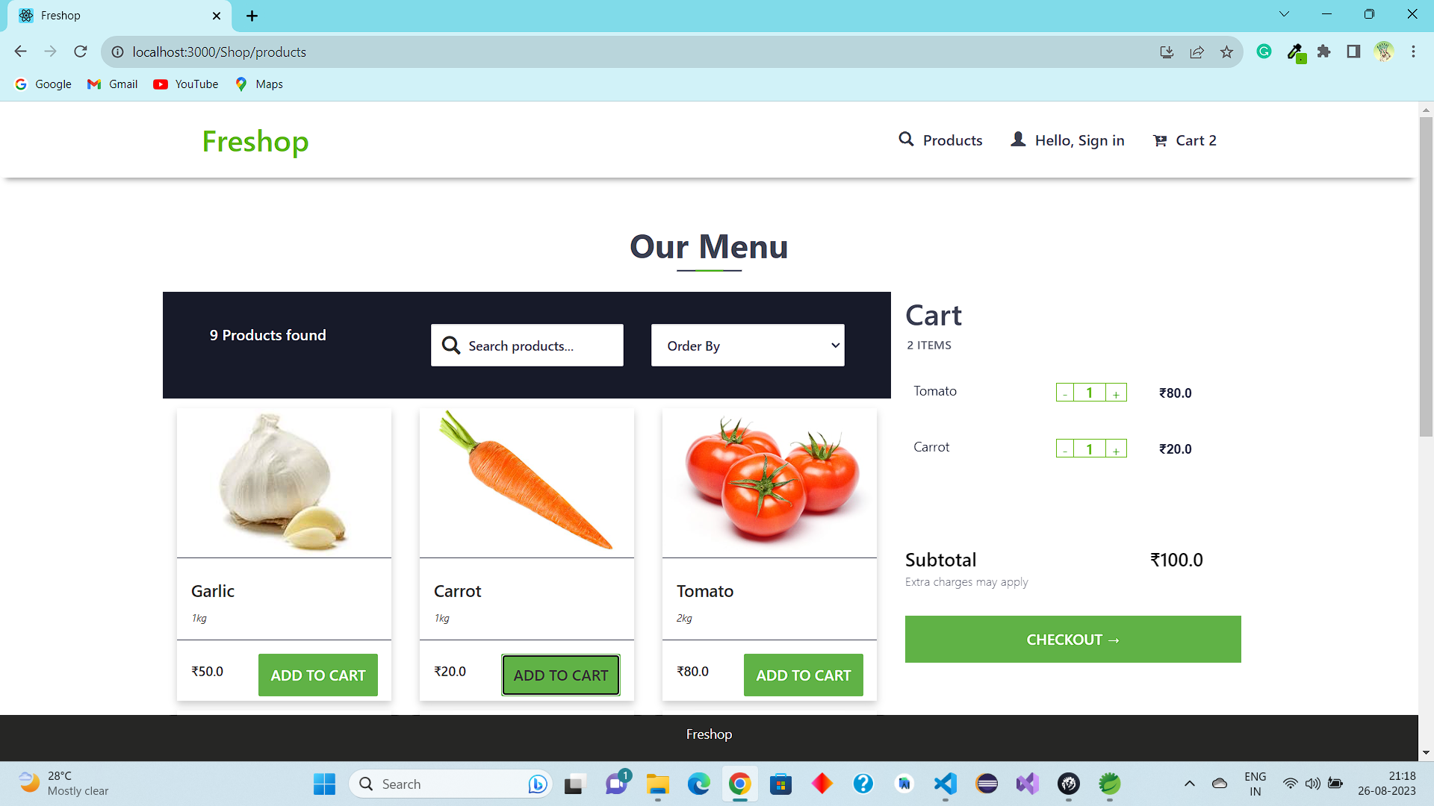
IACSD,PUNE
SCREENSHOTS
Product

Slide 14
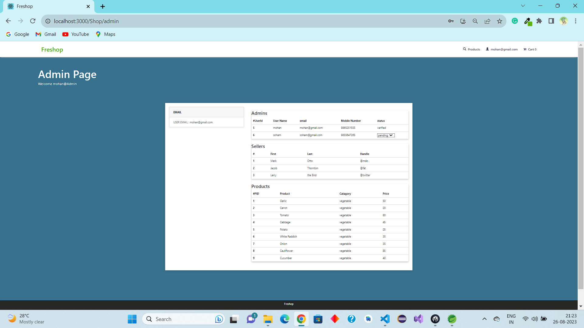
IACSD,PUNE
SCREENSHOTS
Admin Page

Slide 15
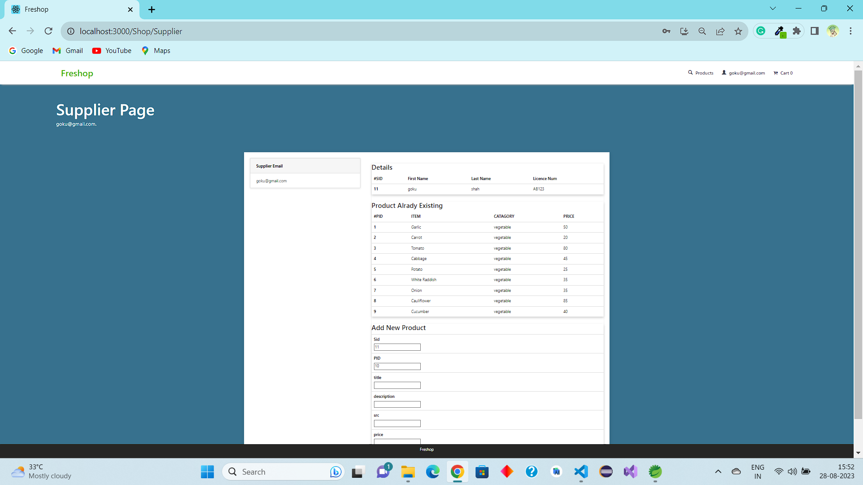
IACSD,PUNE
SCREENSHOTS
Supplier Main

Slide 16
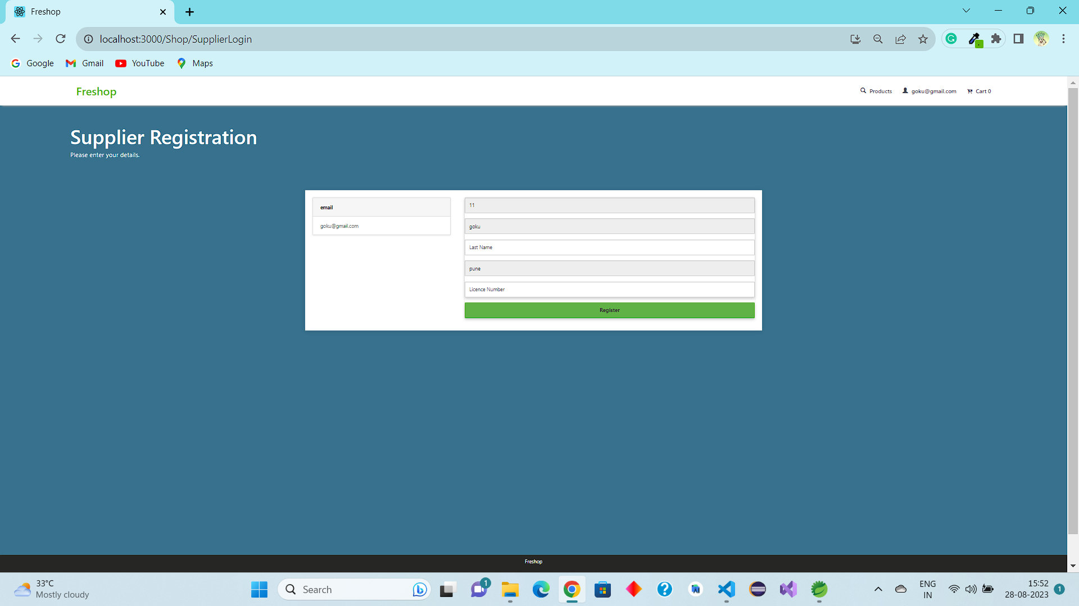
IACSD,PUNE
SCREENSHOTS
User Profile

Slide 17
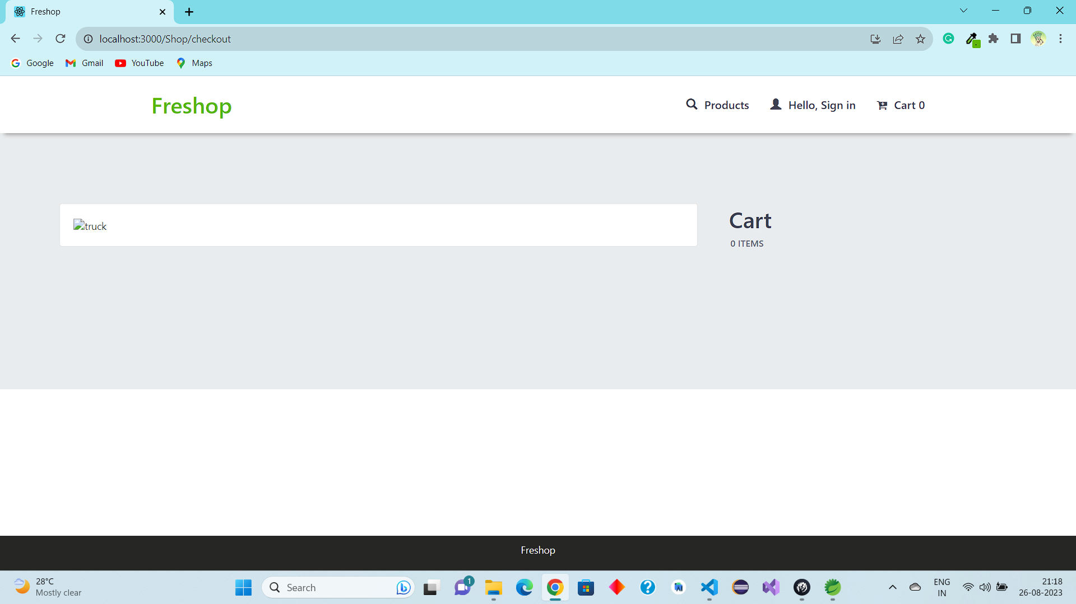
IACSD,PUNE
SCREENSHOTS
Check Out

Slide 18
IACSD,PUNE
S/W AND H/W REQUIREMENTS
SERVER SIDE :-
Processor: Intel® Xeon® processor 3500 series
HDD: Minimum 500GB Disk Space
RAM: Minimum 4GB
OS: Windows 10
Database: MySQL
CLIENT SIDE (minimum requirement) :-
Processor: Intel Dual Core
HDD: Minimum 80GB Disk Space
RAM: Minimum 2GB
OS: Windows 7

Slide 19
IACSD,PUNE
FUTURE SCOPE
This project can be enhanced further by adding some more features. The application is design in such a way that any further enhancements can be done with ease.
The system has the capability for easy integration with other systems.
New modules can be added to the existing system with less effort.
In future a new function or procedure can be easily added in the system through these classes. Or even a new class can be added.
The software is flexible enough to be modified and implemented as per future requirements. We have tried our best to present this free and user–friendly website to Regional Offices.

Slide 20
IACSD,PUNE
CONCLUSION
It has been a great pleasure for us to work on this exciting and challenging project. This project proved good for us as it provided practical knowledge of not only programming in JAVA and JavaScript web based application and no some extent Windows Application and SQL Server, but also about all handling procedure related with Freshop.
It also provides knowledge about the latest technology used in developing web enabled application and client server technology that will be great demand in future. This will provide better opportunities and guidance in future in developing projects independently.

Slide 21
IACSD,PUNE
REFERENCES
React Tutorial (w3schools.com)
Learn Spring Boot | Baeldung
Spring Data JPA - Reference Documentation
React – A JavaScript library for building user interfaces (reactjs.org)
Bootstrap · the most popular HTML, CSS, and JS library in the world. (getbootstrap.com)

Slide 22



IACSD,PUNE
THANK YOU
PG –DAC/DITISS
Center for Development of Advanced Computing

